Slide 1
Incertitude de la borne de Cramér-Rao : conséquences en SRM quantitative
G. Pagès, J.-M. Bonny

Slide 2
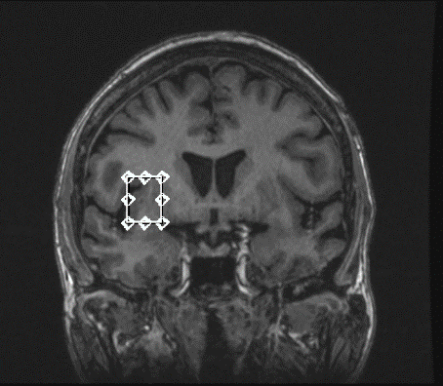
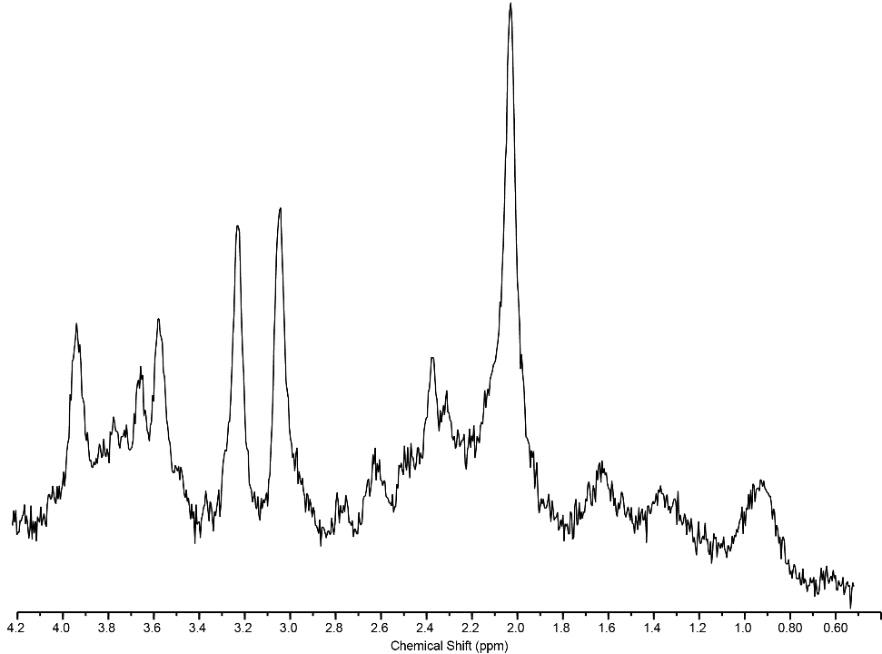
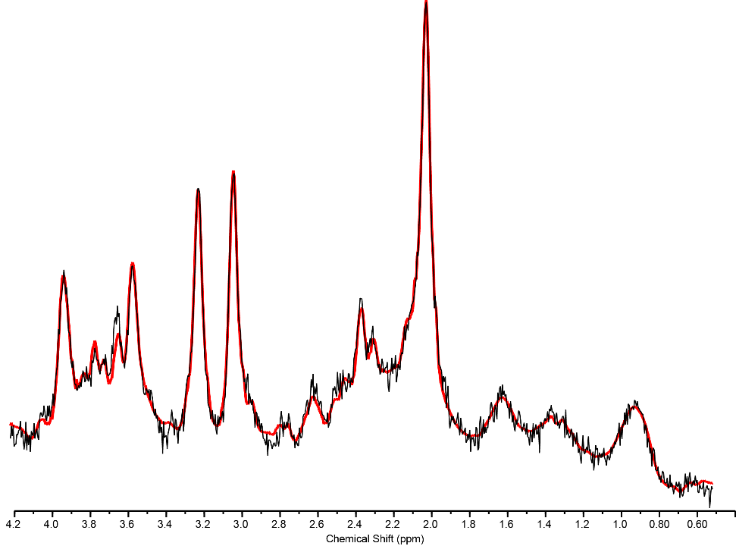
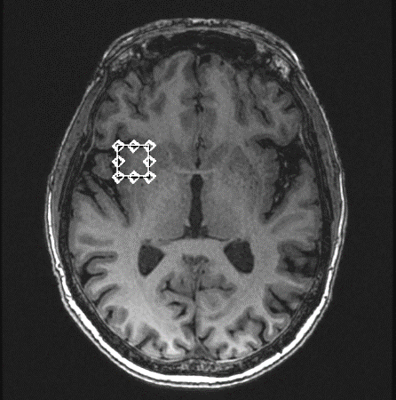
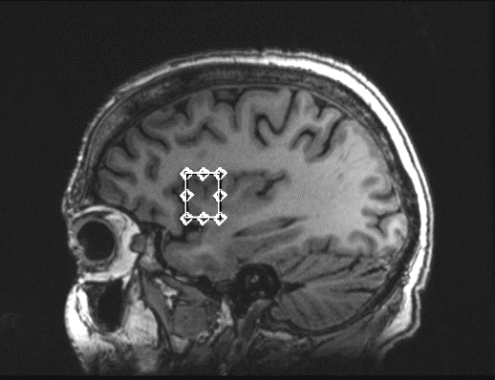
Quantification in MRS
Fitting of a (correct) model on noisy NMR data
Data courtesy of C. Chassain, CHU Clermont-Ferrand
3T
Head coil
PRESS
VOI = 20x15x15 mm³
Tacq = 7 min
Notes:
We need a model to fit data
The parameters of the model being available in database

Slide 3
Quality check
Uncertainties of the fitted parameters
Evaluated by the relative CRB level rCRB
Used as SD of estimation / for rejecting the fit
Raised issues with this indicator
see Tisell et al., Magn. Reson. Med. (2013) 70, 905, Kreis, Magn. Reson. Med. (2016) 75, 15
Notes:
Low concentration metabolites can lead to artefactually boosted rCRB

Slide 4
Background
rCRB = lowest relative uncertainty value which can be reached by estimation
No convergence guaranteed
True values of parameters are needed = replaced by the estimates
rCRB rCRB*
Notes:
Do not knwo any true parameters and we remplace them by estimates leading to a noisy rCRB, whiwh will be called here rCRB*

Slide 5
Aims
To investigate the uncertainties on rCRB*
To prevent the possible confounding effects on quantification

Slide 6
rCRB simulations
Two FIDs containing
1 singlet
2 partially resolved signals (Δ = 10 Hz)
Addition of noise to reach a specified rCRB level
100,000 Monte-Carlo simulations

Slide 7
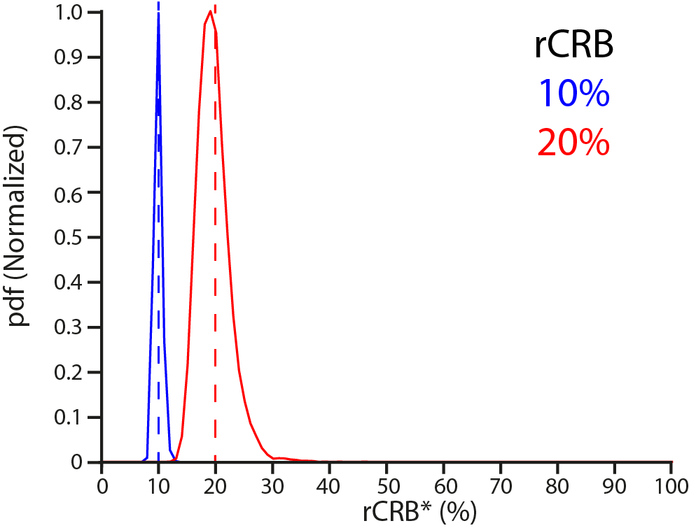
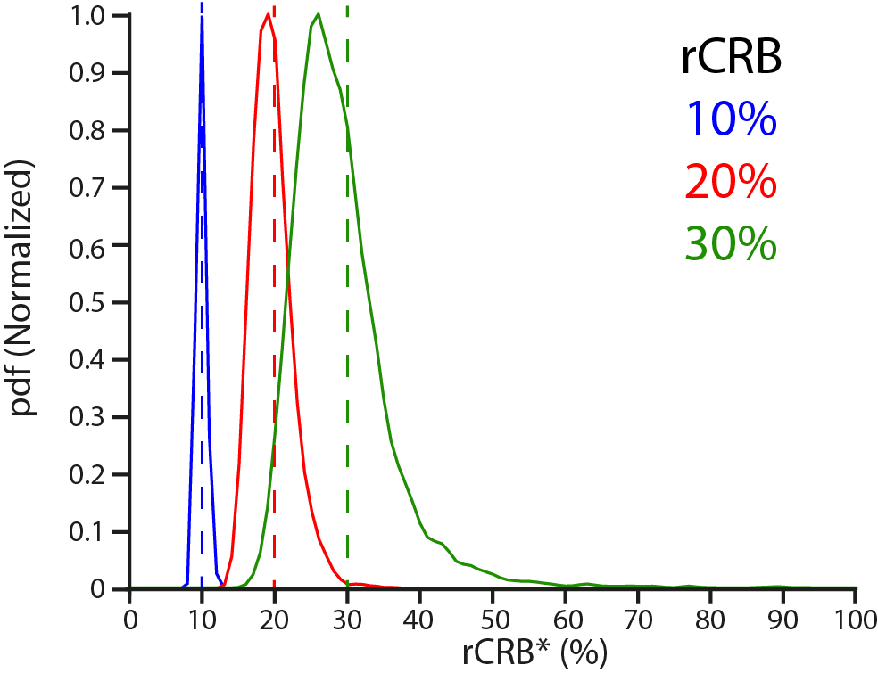
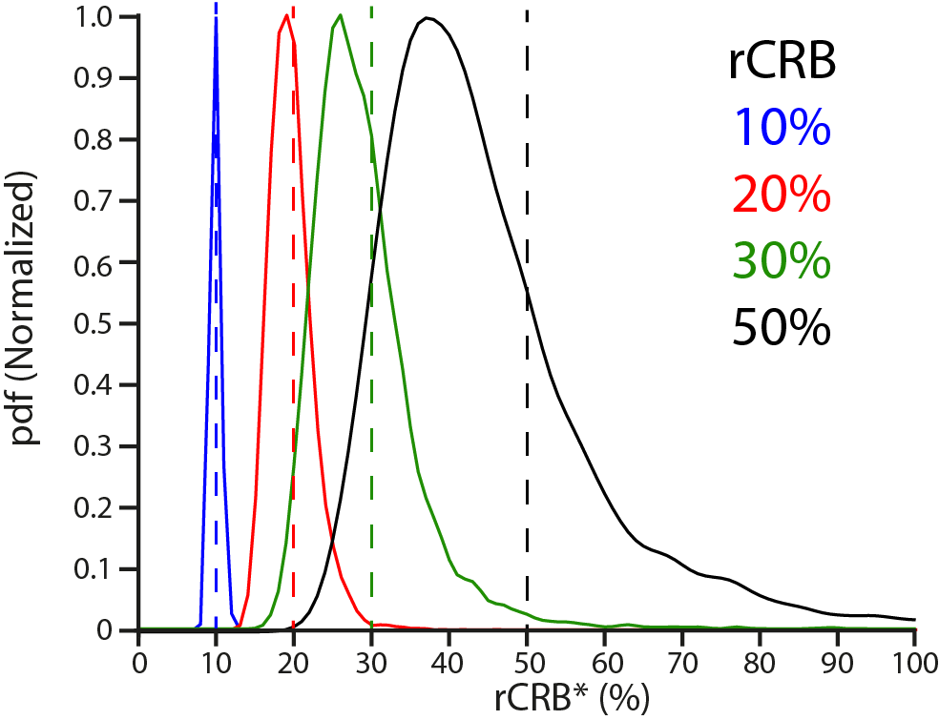
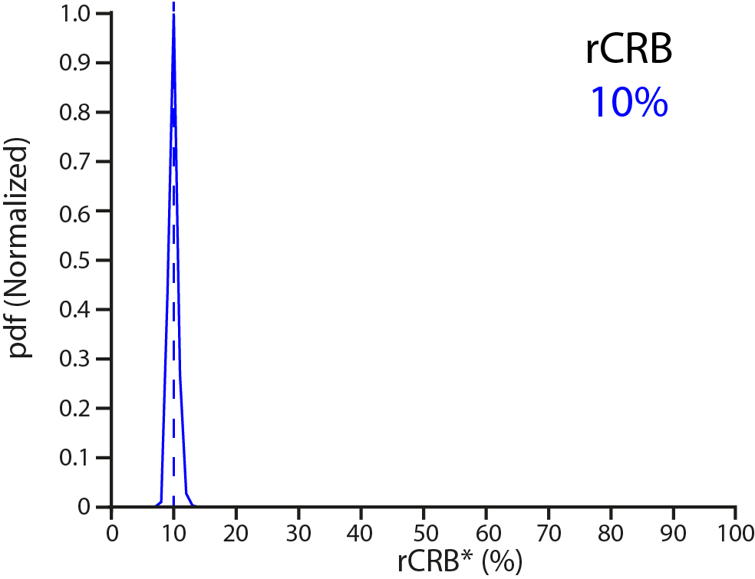
rCRB* distributions
Singlet model
Asymmetric pdf
Asymmetry with rCRB
rCRB* mode < rCRB

Slide 8
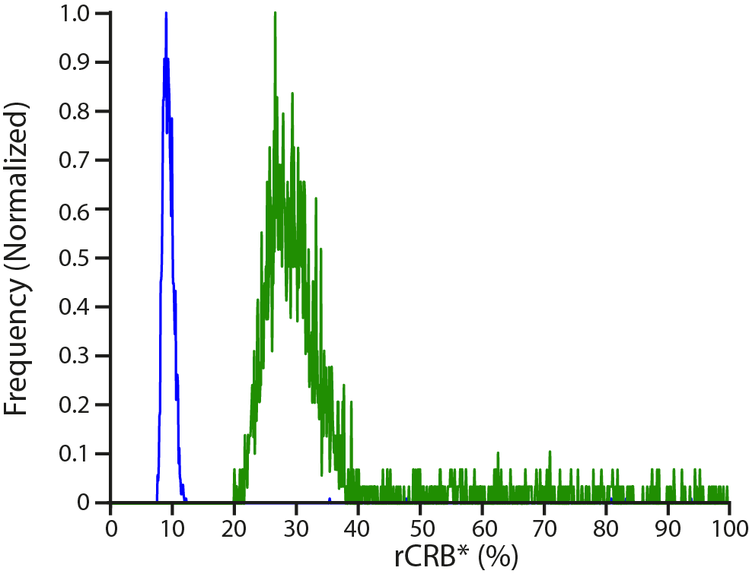
rCRB* distributions for singlet model
Simulation
Experimental

Slide 9
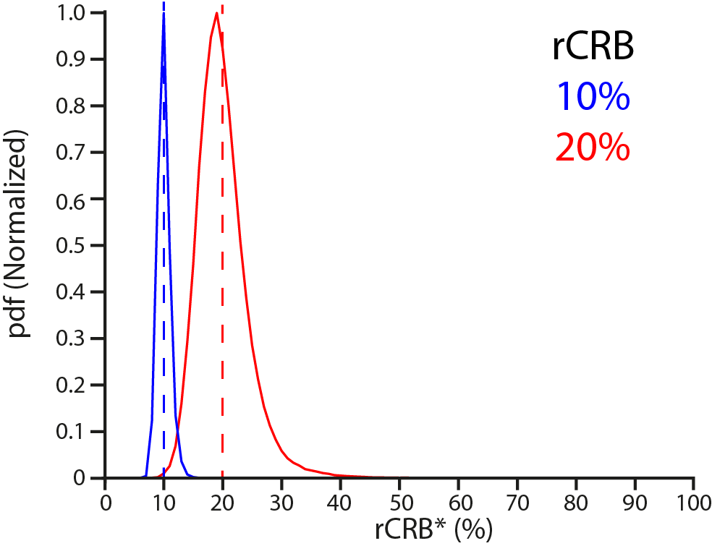
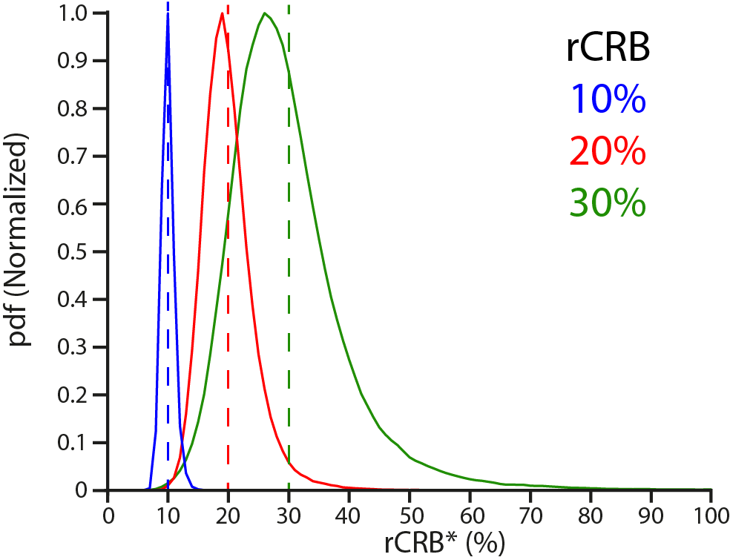
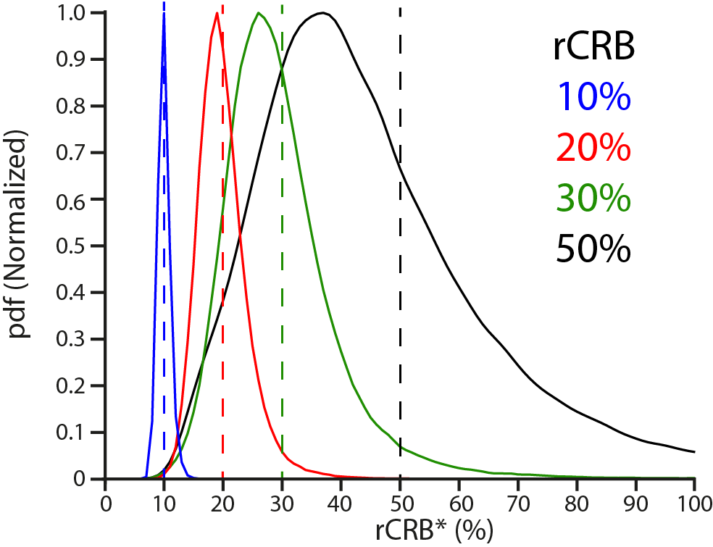
Simulation of rCRB* distributions
Singlet model
2 overlapped singlets

Slide 10
Simulation analysis
(r)CRB* is uncertain
Propagation of noise
Noise introduced twice in rCRB*
(r)CRB is an inaccessible parameter
Estimation ≠ CRB-based experimental design

Slide 11
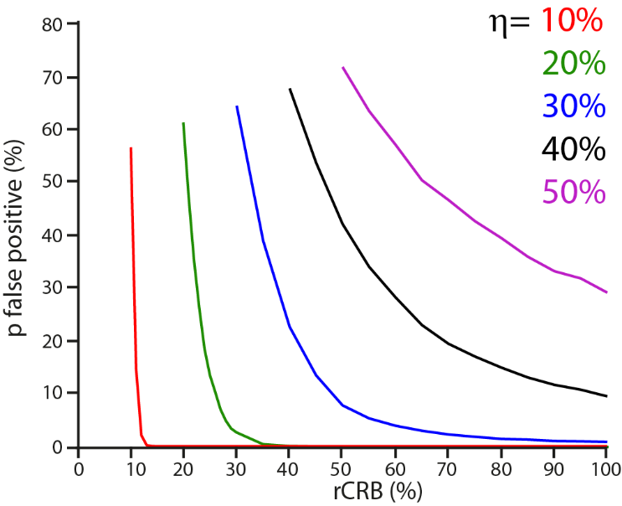
Risk computation (singlet model)
False positive
Steep curve to limit risk
False detection with the threshold η

Slide 12
Take home messages
(r)CRB* from (noisy) data should be used with caution
Optimistic tendency when the noise is dominant
To limit false acceptance = conservative threshold levels <20%

Slide 13
More in
Uncertainties of calculated Cramér-Rao lower bounds: implications for quantitative MRS
J.-M. Bonny, G. Pagès, Magn. Reson. Med. (2019) 81(2) 759-764

Slide 14
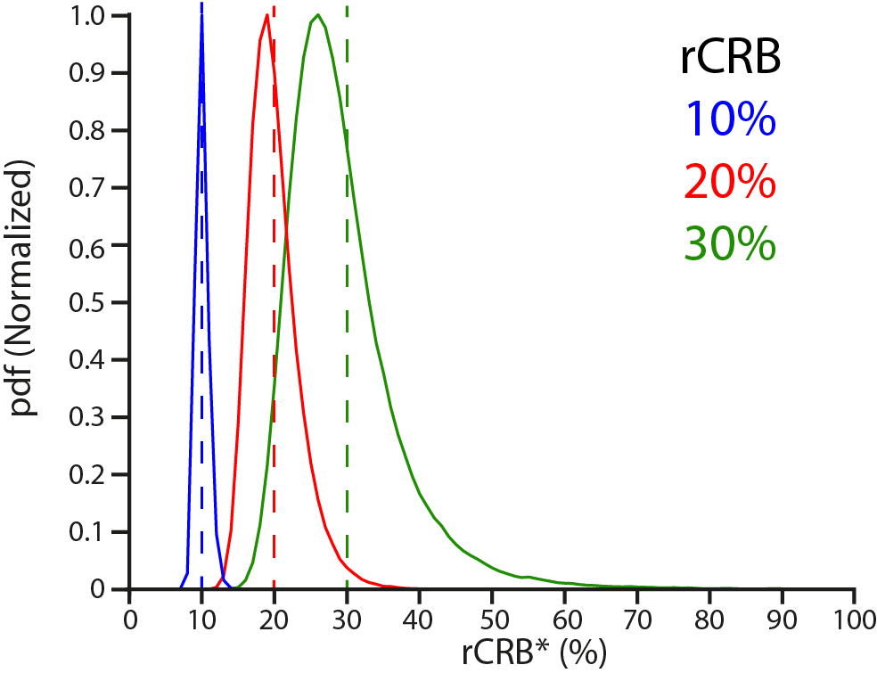
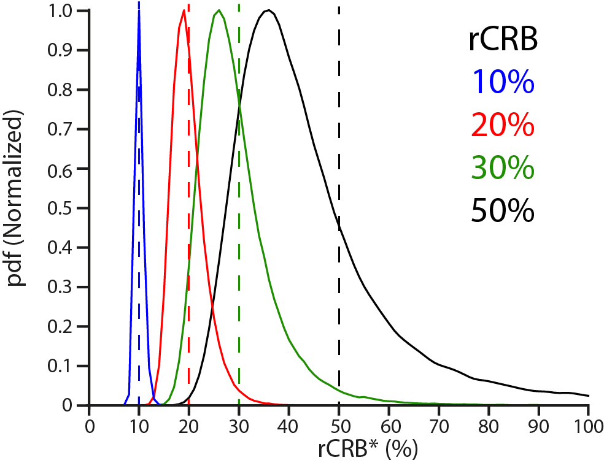
Simulation of rCRB* distributions
Singlet model
Doublet model

