Slide 1





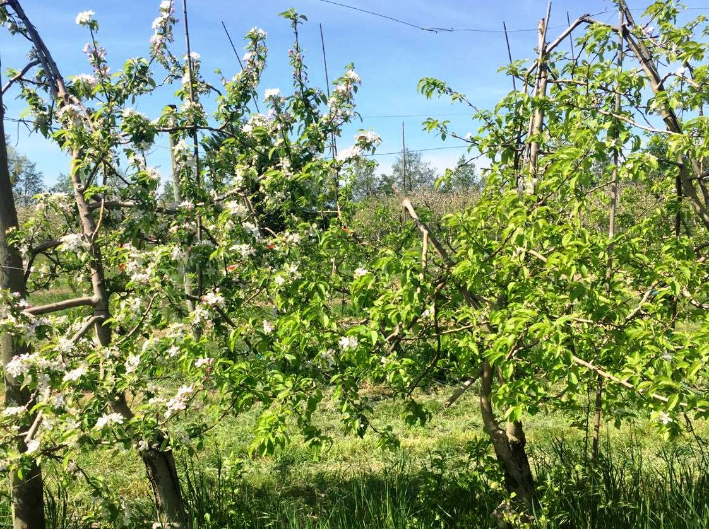
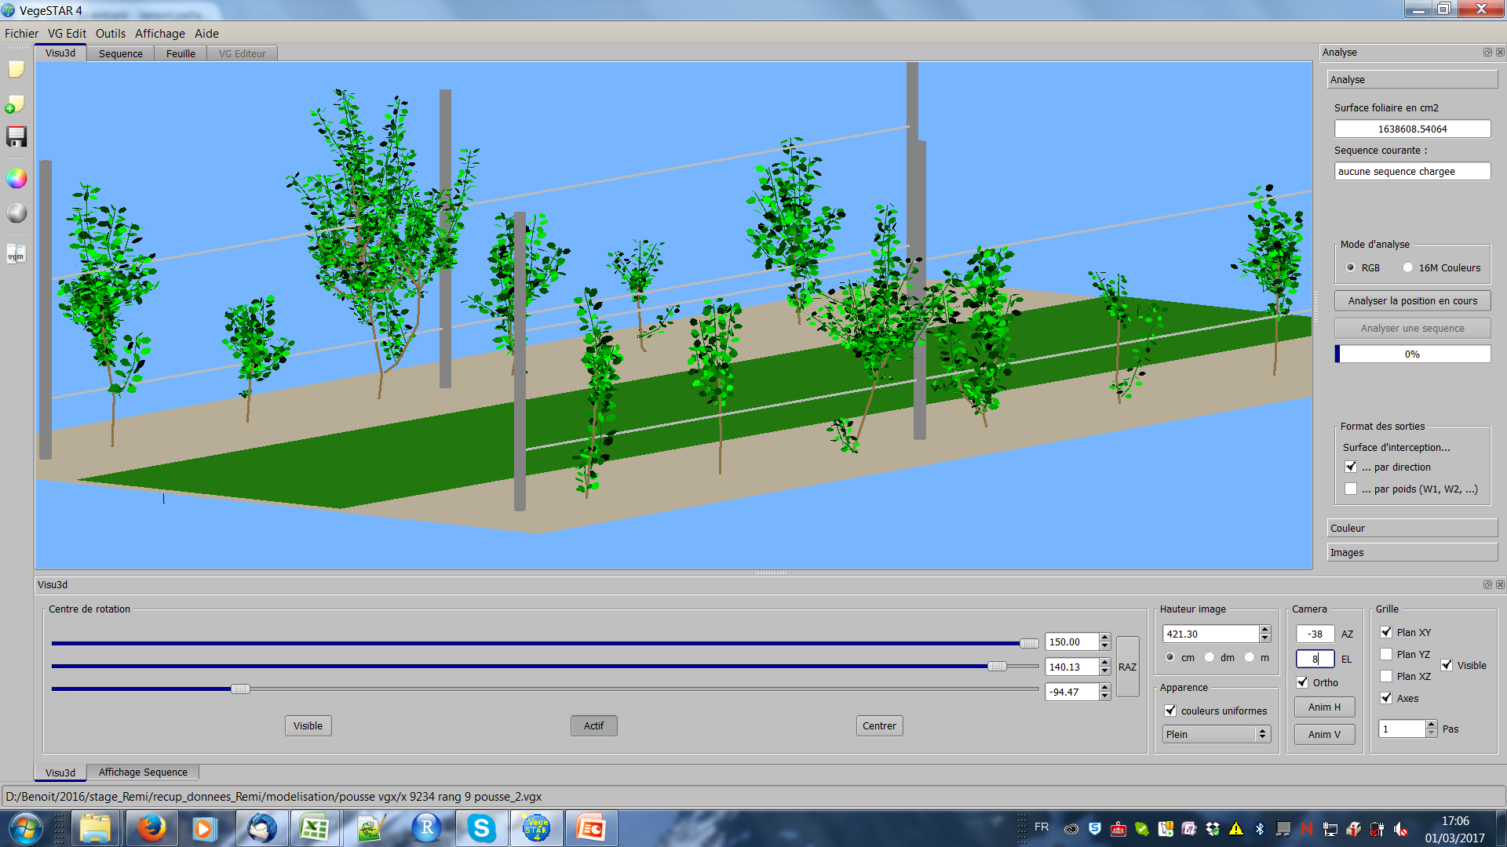
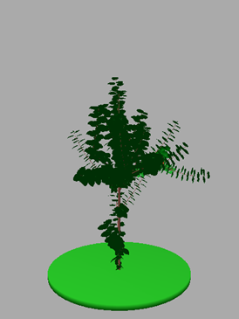
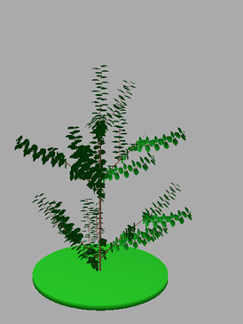
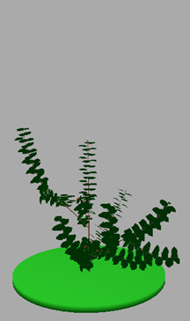
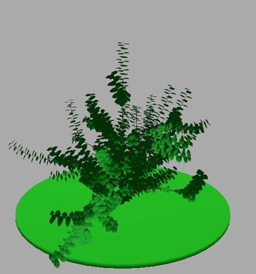
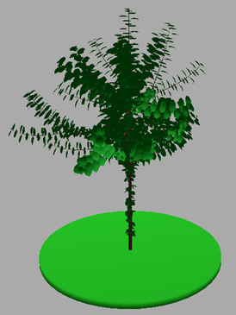
How to understand the alternate production in apple tree ?
A modeling approach of carbon and hormones fluxes
Fares Belhassine ^{1,2}, Benoît Pallas ¹, Damien Fumey ² , Evelyne Costes ¹
^{1,} INRA, UMR AGAP, CIRAD-INRA-SupAgro, AFEF team, Avenue Agropolis, 34398, Montpellier, France.
^{2 ,} ITK, CAP ALPHA Avenue de l’Europe, 34830 Clapiers – France email contact: fares.belhassine@inra.fr
Context
The alternate bearing in apple trees consists in a high fruit production in ON years followed by a low production in OFF years (Fig. 1) and represents a major problem in fruit industry.
Main hypotheses
Floral induction (FI) variability between successive years is caused by:
Competition for carbohydrates between fruits and vegetative organs (Monselise et Goldschmidt, 1982)
Inhibition by gibberellins (GA) coming from the fruits seeds (Neilsen and Dennis, 2000)
Tree architectural variability (Lespinasse et Delort, 1986)
Previous results
Analyzes of transcript differentially expressed in terminal buds of ‘ON’ and ‘OFF’ trees show starvation for carbon and stress hormonal metabolism in ‘ON’ trees (Guitton et al., 2016)
Previous results
Genetic variability in bearing behavior associated with a strong genetic determinism (Guitton et al., 2012)
- Genotypes can be classified for bearing behavior
in three classes (irregular, biennial, regular)
(Durand et al., 2013)
Fig 1: Trees in ON (left) and OFF (right) years.
Objectives
- Understanding the physiological processes controlling FI in apple trees
- Modeling and simulating carbon and hormone fluxes within the trees and their consequences on FI
- Integrating genotypic variability in the modelling approach to account for the variability in bearing patterns
Experimental design
First experiment (2015-2017) :
Leaf and fruit removal at different scales (shoot, branch and Y shape-trees; Fig. 2) to locally modify Carbon source/sink relations and GA content
Second experiment (2017-2018) :
Characterizing the genotypic variability in production patterns and architecture on a subset of genotypes selected in an apple tree core collection(Fig. 3)
Fig 3: 3D representation of a subset of genotypes in the French apple core collection (planted in 2014 )
Fig 2: Experimental design for local leaf and fruit removal on 10 year-old ‘Golden’ trees
Measurements
- Digitizing trees to get 3D representations
- Flowering and fruit production and their within tree distributions
- Non structural carbohydrates and gibberellins concentration before bud break, at FI and fruit maturity
- Photosynthetic activity of leaves at the FI period
Modeling
Calibrate two flux models :
Musca for multi-scale (metamer, shoot, branch) carbon allocation (Reyes et al, 2015)
Model for hormones bi-directional transport (Pallas et al, 2016)
On the trees with modified architecture and on the genotypes of the core collection
Integrate these two sub-models in the MappleT model which simulates plant architectural development (Costes et al, 2008, Fig. 4)
Analyses
- Quantifying the effect of distances on FI and calibration of the flux models
- Analyzing the relationships between architecture, functioning and flower induction on the subset of genotypes of the core collection
Expected final output
Development of a decision support model to help breeders managing fruit thinning and crop load
Fig 4: Different architectures of trees simulated by MappleT model (Costes et al, 2008)
Acknowledgements
The PhD scholarship of Fares Belhassine is funded by INRA, BAP department and ITK company
We thank Sébastien Martinez, Sylvie Bluy-Pierru and other members of AFEF team for their contributions in field experiments and measurements
References
Costes E, Smith C, Renton M, Guédon Y, Prusinkiewicz P, Godin C. 2008. Funct. Plant Biol 35 936 950; Durand J-B, Guitton B, Peyhardi J, Holtz Y, Guédon Y, et al. 2013. J Exp Bot 64: 5099–5113; Guitton G, Kelner J-J, Velasco R, Gardiner SE, Chagné D, et al. 2012. J Exp Bot 63: 131–149; Guitton B, Kelner J. J, Celton J. M, Sabau X, Renou J. P, Chagné D and Costes E. 2016. BMC Plant Biol 16:55; Lespinasse, J.M. and F. Delort. 1986. Acta Hort. 160:120−155; Monselise SP, Goldschmidt EE. 1982. Hortic Rev 4: 128-173; Neilsen JC, Dennis FG. 2000. Acta Hort 527: 137-146; Pallas B, Costes E & Hanan, J. 2016. FSPMA, International Conference on IEEE.p. 150-157. Reyes F, Pallas B, Pradal C, and Costes E. 2015. In International Symposium on Modelling in Fruit Research and Orchard Management.

