Slide 1
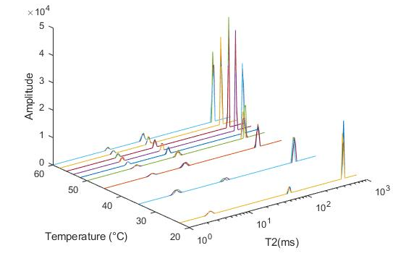
In-situ NMR highlights structural change during apple heating
Sylvie Clerjon, Alexandre Leca*, Catherine Renard*, Jean-Marie Bonny and Amidou Traore
AgroResonance, UR370 QuaPA - INRA, 63122 Saint-Genès-Champanelle, France
*SQPOV, INRA, 84914, Avignon, France
NMR Platform for Agronomy, Food Science and Nutrition
Microstructure and texture evolution of foods during cooking is difficult to characterize, because conventional techniques cannot analyze the internal structure, while preserving the integrity of the product. For apple, one of the most processed fruits, understanding thermal degradations in essential. Such phenomena was thus approached here with quantitative T2 relaxometry during in situ cooking process.
Sampling
Five Golden apples each cut in four
10 mm long and 5 mm diameter cylinders with pore long axis parallel or perpendicular to the cylinder to test anisotropic behavior. Each of the twenty samples was sealed in parafilm.
Heating and Imaging
MRI at 9.4T on a Bruker Ascend 400WB with a Ø 5mm 1H volume coil.
A controlled hot air flow cooked the sample from 22.5 to 60°C, 2°C-step. After 6 min for stabilization at each temperature plateau, T2 measurement were performed with a CPMG pulse sequence (τ=125µs, TR=5s, 256 echoes, acquisition duration=2min30s).
Data analysis
All the echo decay curves were analyzed using non-negative least squares algorithm [1]. An insight to the evolution of the internal structure was gained by studying the resulting T2 distribution.
Results and discussion
T2_{long}
All our 20 samples present a similar and reproducible T2 distribution pattern with 3 water fractions presented at right for a given sample:
the main T2 (called T2_{long}) varies from 700 to 400 ms
a short T2 (called T2_{s2}) varies from 60 to 27 ms
a shorter T2 (called T2_{s1}) varies from 3 to 7 ms
T2_{s2}
1 cm
T2_{s1}
with heating
The main T2_{long} population changes with heating
Because of its amplitude, the T2_{long} population is the main one in our samples, at all temperatures. The study of T2_{long} values and amplitudes with heating leads to 4 main results:
global decrease of T2_{long}
local rebound of T2_{long} at 52°C
smaller inter-individual standard deviation of T2_{long} at 52°C
sharp increase of T2_{long} amplitude at 52°C
In apple, this main pool is often attributed to the vacuolar water, in agreement to the highly vacuolated feature of apple parenchyma [2]. With heating, the observed global T2_{long} decrease may be attributed to the increase of viscosity of vacuolar water related to swelling of macromolecules like sugar [3]. This trend is perturbed at 52°C because of the disruption of plasmalemma, causing a loss of cellular turgor pressure and diffusion of vacuolar water in the whole tissue [4]. This behavior and this critical temperature are consistent through the 20 samples explaining the smaller standard deviation at 52°C.
Evolution of the averaged (20 samples) T2_{long} value with Temperature
9,4 T
z axis
sample
Controlled hot air flow
Evolution of the averaged (20 samples) T2_{long} peaks amplitude with Temperature
Short T2_{s1} and T2_{s2} population changes with heating
T2_{s1} and T2_{s2} values, presumably corresponding to parietal and cytoplasmic water, respectively, also evolve during the heating process even if the parietal (cell wall water fraction) T2_{s1} seems to be thinly sensitive to temperature changes. On the contrary, like T2_{long}, the cytoplasmic T2_{s2} decreases with temperature excepting a significant rebound at 50°C and above all 52°C possibly corresponding to the plasmalemma melting and a temporary more liquid membrane. Looking at the peaks amplitude, these 2 parietal and cytoplasmic populations intersect during heating. This swap in relative amplitude could be explain by the higher sensitivity of plasmalemma (high contain of lipids and phospholipids) than cell wall (high contain of hemicellulose, cellulose and pectins) to thermal changes. Both present a decrease after the critical temperature 52°C which is coherent with the T2_{long} relative amplitude variation at the same temperature: after thermal destructuration, we observe less parietal and cytoplasmic water because of the melting of the plasmalemma and the thermal degradation of the cell wall.
Evolution of the averaged (20 samples) T2_{s1} and T2_{s2} peaks amplitude with Temperature
T2 anisotropy collaps with heating
**
**
Both T2_{long} and T2_{s2} values present an anisotropy on raw (at 22.5 °C and 35°C for T2_{long} only): T2 values depend on the air pore (elongated “hole” in the raw apple parenchyma) direction according to the z axis of the magnet. This phenomena could be attributed to a diffusion in an anisotropic field coming from difference in magnetic susceptibility between air and water. The disappearance of this anisotropy with heating is a supplementary clue of structure change and pore filling during heating.
*
**
*
*
Student p-value<0.03
Student p-value<0.03
This study points out the powerful of multiexponential T2 analysis in resolving subcellular changes during apple in situ cooking at high magnetic field. The T2 distribution pattern allows the follow-up of the evolution of each water fraction with temperature thanks to the short echo time used to limit diffusion exchanges between compartments and pores. This original study, with in-magnet cooking, provides longitudinal information about structure change, probably attributable to the membrane degradation [5] occurring at 52°C, this temperature having been confirmed by mechanical tests (not presented here).
Platform AgroResonance
INRA Center Auvergne-Rhône-Alpes
63122 Saint-Genès-Champanelle, France
https://www6.inra.fr/agroresonance
[1] Istratov, A. A. and O. F. Vyvenko, Rev Sci Instrum (1999).
[2] Hills, B. P. and B. Remigereau, Int J Food Sci Tech (1997).
[3] Fabri, D., et al. Carbohydr Res (2005).
[4] Waldron, K. w., Parker, M. l., & Smith, A. c., Compr Rev Food Sci F (2003). [5] Gonzalez, M. E., et al, J Food Sci (2010).

