Slide 1
A robust and prior knowledge independent method to interpret NNLS T₂ relaxation results
Guilhem Pagès
Amidou Traoré
Jean-Marie Bonny

Slide 2
Why measuring T₂?
Easy to measure
  Low-field NMR
  All type of environments
Highly informative
  Water mobility / interactions
Wide range of applications
  From food products to medical science
How to analyse experimental data?

Slide 3
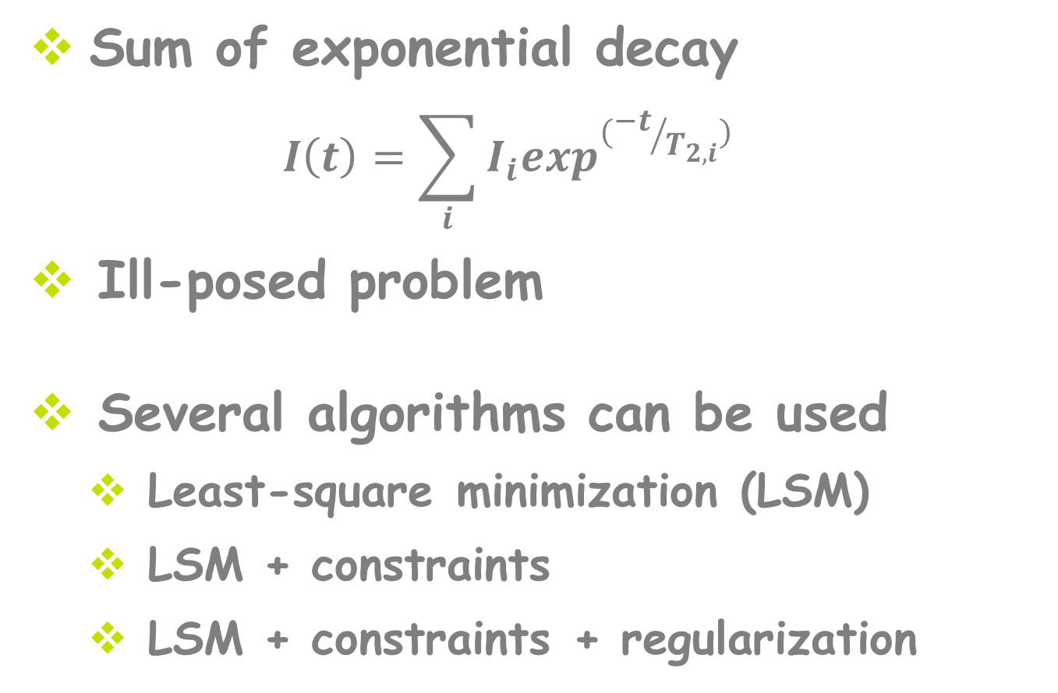
T₂ analysis
Sum of exponential decay
  $$I\left(t\right)=\sum_{i}{I_{i}\exp^{({−t}/{T_{2,i}})}}$$
Ill-posed problem
Several algorithms can be used
  Least-square minimization (LSM)
  LSM + constraints
  LSM + constraints + regularization
Notes:
Expression for discret T2, the sum is remplaced by an integral for continuous T2

Slide 4
NNLS algorithm
A priori known constraints
  T₂ values known (decomposition basis)
  Positive amplitudes
Addition of a regularization parameter: user-dependant

Slide 5
Example of NNLS analysis
L2 regularization
λ =1.015
Notes:
NNLS gives sparse response
Another lambda will gove another response. The question is do we really need to do this regularization

Slide 6
Can we have an user-independent analysis method?
Notes:
In other words, can our analysis be free of any regularization. This point deserves further studies

Slide 7
Monté-Carlo simulations
Pure-FID with known T₂ parameters
  Discrete, continuous or pseudo continuous models
Generation of 10,000 noisy FIDs
NNLS fitting without regularization (decomposition basis logarithmically spaced)
Notes:
We generated three FID. The first one contained three discrete T2, the second a pure continuous T2 distribution while the third one 3 T2 component having a gaussian distribution around the T2 values

Slide 8
Discrete model
T₂: 5, 50, 500 ms
Amplitudes: 0.33
TE: 1 ms
SNR: 10 000
Basis: 1 to 1000 ms
40 points
100 points
200 points

Slide 9
Continuous model
T₂: 5 to 500 ms
Amplitudes: const.
TE: 1 ms
SNR: 10 000
Basis: 1 to 1000 ms
40 points
100 points
200 points

Slide 10
Pseudo-continuous model
T₂: 5, 50, 500 ms
Amplitudes: 1, 4, 8
TE: 1 ms
SNR: 10 000
Basis: 1 to 1000 ms
40 points
100 points
200 points

Slide 11
Conclusions from PDF representations
T₂ amplitudes are biased
T₂ amplitudes are dependent on the NNLS decomposition basis
  Range of T₂s (T_{2,min} & T_{2,max})
  Density of the decomposition basis

Slide 12
Discrete model
Basis: 40 points
100 points
200 points
PDF
CDF
Basis: 40 points
100 points
200 points
Cdf plateaus = True amplitudes

Slide 13
Continuous model
Basis: 40 points
100 points
200 points
Notes:
The NNLS response shape is different because the T2 density is more important at shorter T2s

Slide 14
Pseudo-continuous model
Basis: 40 points
100 points
200 points

Slide 15
Analysis of CDF representations
Amplitude at a plateau = Amplitude of this T₂ component
Unbiased amplitudes for the different models
Insensitive to the decomposition basis

Slide 16
Influence of the SNR
Basis: 100 points
SNR: 100
1,000
10,000

Slide 17
Influence of T_{2,min}
Basis: 100 points
SNR 10,000
T_{2,min}: 1/5 TE (0.2 ms)
1/2 TE (0.5 ms)
TE (1 ms)

Slide 18
Influence of T_{2,min}
Basis: 100 points
SNR 1,000
T_{2,min}: 1/5 TE (0.2 ms)
1/2 TE (0.5 ms)
TE (1 ms)

Slide 19
CDF vs regularization
Basis: 40 points
SNR 100
Processing: CDF
L2, Fixed λ (1.015)
L2, CV λ

Slide 20
Pros and cons of NNLS-CDF
Robust analysis based on undisputable constraints
Few user-dependent parameters set
T₂ amplitudes at the plateaus informative for most of the applications

Slide 21
Thank you for your attention

