Slide 1



Impact
(2013-2017)
Quantitative proteomics provides new insight into chicken eggshell matrix protein functions during pivotal stages of shell mineralization
Joël Gautron, P. Marie (phD)
Brionne, C. Hennequet-Antier, Y. Nys
INRA, « Function and regulation of egg proteins »
UR83 Recherches Avicoles, 37380 Nouzilly, France
Rodriguez-Navarro
University of Granada, CSIC, Spain
V. Labas, G. Harichaux
UMR INRA 85, Proteomics facilities, 37380 Nouzilly France

Slide 2
The chicken eggshell
Eggshell biomineralization in uterus (fast process)
5-6 g of mineral are deposited within a 20 h period
Cuticle
Images:
J.M. Garcia-Ruiz, Granada
Palissadic layer
Mammilary knobs
Eggshell membranes
SEM
Cross-polarized light
95 % calcium carbonate (calcite polymorph)
3.5 % proteins and proteoglycans (organic matrix)
Ultrastructure
Mechanical properties
Interaction

Slide 3
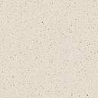

The chicken eggshell formation
Role of amorphous calcium carbonate (ACC) at pivotal stages of shell formation
Rodriguez-Navarro et al., Journal of structural Biology, 2015, 190: 291-303
Friday 18: « 654. Evolution of calcium carbonate mineralogy during rapid avian eggshell calcification » Rodriguez-Navarro et al., presented by Y. Nys
ACC
Calcite crystal units
formation
Preferential crystal orientation
Calcite
Arrest of calcification
ACC transformation into calcite aggregates
ACC deposition
Eggshell
Membranes
Mammillary
Knobs
First events of shell mineralization (initiation 2 h)
Rapid growth phase (12 h)
Terminal phase (2 h)
Role of organic matrix proteins at pivotal events
Stabilization of amorphous calcium carbonate (ACC)
Polymorphs, morphology and size of crystals
Impact
(2013-2017)

Slide 4
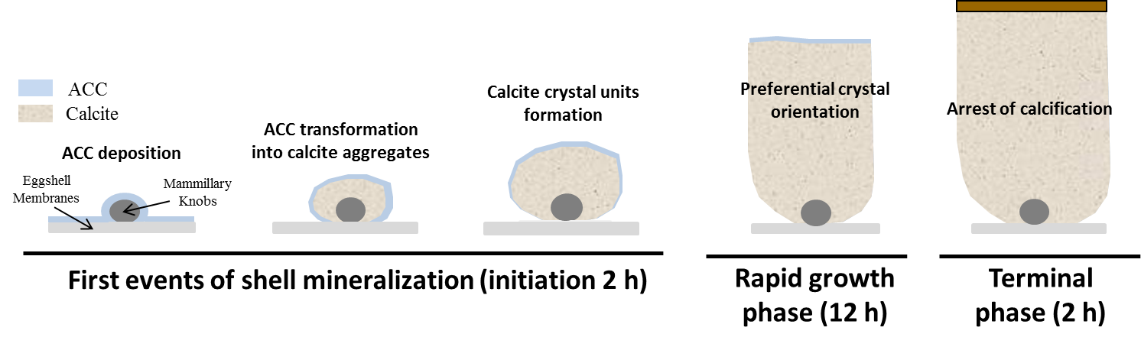
Quantification of matrix proteins at pivotal events
High-throughput quantitative proteomics, statistical and bioinformatic functional analyses of matrix proteins
Marie et al., Journal of Proteomics, 2015, 113: 178-193
Marie et al., Journal of Proteomics, 2015, 126: 140-154
To sort major protein candidates involved in
particular key points of the eggshell mineralization
Impact
(2013-2017)

Slide 5
Quantification of matrix proteins at pivotal events
Distribution and variation of abundance of about 300 matrix proteins
Predicted functional activities of the identified matrix proteins ?
Classification in 3 different groups according to their potential functions
Associated to mineralization process
Involved in the regulation of activity of proteins
Antimicrobial
proteins
Highlight on 22 matrix proteins suspected to have predominant roles in the control of the different stages of shell calcification

Slide 6
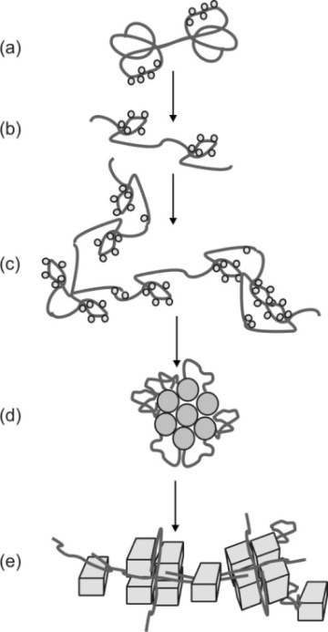
Proteins at pivotal events
Proteins having a direct involvement in eggshell mineralization
Proteins with established role in the biomineralisation
Binds to Calcium
Modification of protein conformation
In vitro study of the role of Ovalbumin on CaCO3 crystallization (Pipitch et al., 2008, Schwahn et al., 2003)
Protein aggregation
ACC Formation
ACC
Calcite
ACC transformation in crystalline shape
OVAL
OVAL
ACC transformation into calcite
Crystal units
formation
Preferential crystal orientation
ACC deposition
Arrest of calcification
First events of shell mineralization (initiation)
Rapid growth phase
Terminal phase

Slide 7
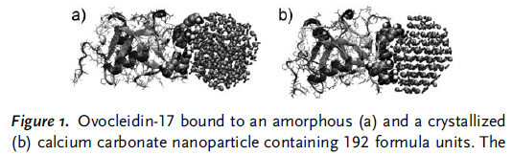
Proteins at pivotal events
Proteins having a direct involvement in eggshell mineralization
Proteins with established role in the biomineralisation
Freeman et al, 2010
OC-17
OC-17
OC-17
OVAL
OC-17
OVAL
ACC transformation into calcite
Crystal units
formation
Preferential crystal orientation
ACC deposition
Arrest of calcification
First events of shell mineralization (initiation)
Rapid growth phase
Terminal phase

Slide 8
Proteins at pivotal events
Proteins having a direct involvement in eggshell mineralization
Proteins with established role in the biomineralisation
Calcium binding proteins (CaBPs) interacting with calcium, favoring crystal nucleation and driving the morphology of crystals
  Proteins with EF-hand and EGF-like calcium binding domains
ALB
OVAL
NUCB2
ALB
GNS
EDIL3
ALB
NUCB2
MFGE8
LYZ
OVOT
LYZ
OVOT
HPX
LYZ
OVOT
OC-17
LYZ
OVOT
OC-17
EDIL3
ALB
OC-17
OVAL
OC-17
OVAL
ACC transformation into calcite aggregates
Calcite crystal units
formation
Preferential crystal orientation
ACC deposition
Arrest of calcification
First events of shell mineralization (initiation)
Rapid growth phase
Terminal phase

Slide 9
Proteins at pivotal events
Proteins having a direct involvement in eggshell mineralization
Proteins with established role in the biomineralisation
Calcium binding proteins (CaBPs) interacting with calcium, favoring crystal nucleation and driving the morphology of crystals
  Proteins with EF-hand and EGF-like calcium binding domains
Proteoglycans and proteoglycan binding proteins
  proteoglycans have a negative charge to attract Ca2+ ions
TSKU
SDCBP
OC-116
GPC4
TSKU
OC-116
ALB
OVAL
NUCB2
ALB
GNS
EDIL3
ALB
NUCB2
MFGE8
LYZ
OVOT
HAPLN3
LYZ
OVOT
HAPLN3
LYZ
OVOT
OC-17
HPX
LYZ
OVOT
OC-17
EDIL3
ALB
OC-17
OVAL
OC-17
OVAL
ACC transformation into calcite aggregates
Calcite crystal units
formation
Preferential crystal orientation
ACC deposition
Arrest of calcification
First events of shell mineralization (initiation)
Rapid growth phase
Terminal phase

Slide 10
Proteins at pivotal events
Proteins involved in the regulation of proteins driving mineralization
Proteins involved in the proper folding of the eggshell matrix to ensure calcium and mineral interactions and to ensure template to the mineralized structure
Proteins inhibiting or activating proteins present in the mineralization milieu (non cellular).
→ Direct interaction with other proteins.
  Molecular chaperone interact with proteins driving mineralization
  Proteases and protease inhibitors (specific and controlled role during calcification process, either by degrading proteins or regulating processing of proteins into their mature forms)
CST3
LOC100859272
OIH
Mineralization depends of the degree of protein phosphorylation
Kinases and Phosphatases
LOC 428451
OCX21
PPIB
CLU
OCX25
CST3
OCX21
OCX-25
OVM
CST3
OCX-32
OCX-25
CST3
OVST
CST3
OVM
CLU
CLU
ACC transformation into calcite aggregates
Calcite crystal units
formation
Preferential crystal orientation
ACC deposition
Arrest of calcification
First events of shell mineralization (initiation)
Rapid growth phase
Terminal phase

Slide 11
Chicken eggshell calcification
Quantitative proteomics to classify and determine a hierarchy of proteins driving the mineralization → Restricted list of 22 pivotal candidate proteins
Direct role in shell mineralization
    Ovocleidin-17 ACC transformation into calcite
    Nucleobindin, MFGE8 calcite crystal units formation and generation and EDIL3 of a preferential crystal orientation
    Regulation of activity of proteins driving the mineralization
    Glypican-4, TSKU Regulation of activity of proteins during the active
    Ovocalyxin-21 growth and terminal phases of shell calcification
    Ovocalyxin-25 Initiation and rapid growth phases of eggshell calcification
Experimental Validation
(Purification, interaction with mineral, Regulation according to physiological stages, polymorphisms related to eggshell quality, Biological markers ….)

Slide 12

THANK YOU FOR YOUR ATTENTION

