Slide 1
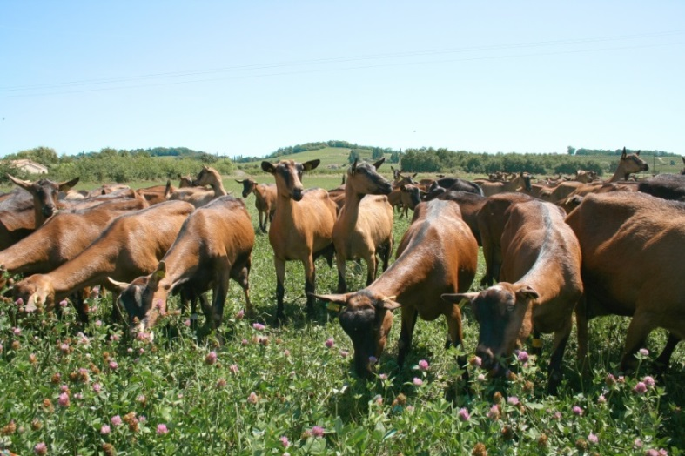
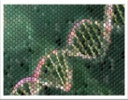
Including αs1 casein gene effect on genomic evaluations of French dairy goats
Céline Carillier
Christèle Robert-Granié,
Hélène Larroque
INRA-GenPhySE, Toulouse, France
66th EAAP meeting, 02 September 2015, Warsaw, Poland
SELGEN

Slide 2
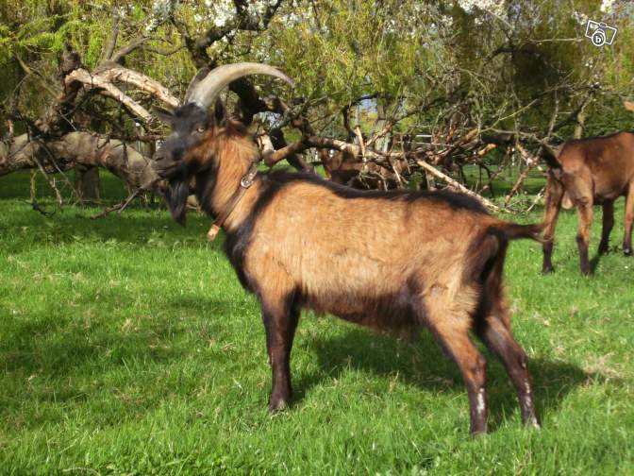
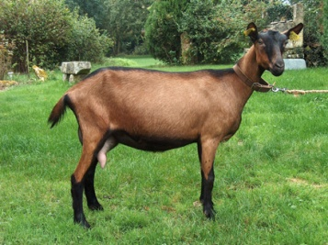
Why adding major gene in genomic evaluations?
αs1 casein major gene in dairy goat
genomic selection : all SNP = equal part of variance
French dairy cattle ¹: Adding QTL in genomic evaluation ➔ accuracy +3% to +12 %
Goats with αs1 casein genotypes:
3 861 bucks
2 949 dams of bucks
823 with 50k genotypes
Alpine
+
Saanen
¹ Boichard et al., 2012, Anim Prod Sci, 52: 115-120

Slide 3
Breed differences in αs1 casein allele frequencies
Alpine : supremacy of allele A
Saanen : supremacy of genotypes AE, CO and EE

Slide 4
αs1 casein: a major gene for dairy goat
Genetic Model used:
with y: DYD, u: polygenic part, w: αs1 casein genotype random effect
Part of genetic variance (%) explained by αs1 casein genotype:
 | Multi-breed | Alpine | Saanen
Milk yield | 9 | 12 | 7
Fat content | 20 | 24 | 17
Protein content | 41 | 43 | 38

Slide 5
Three classes of αs1 casein genotypes (strong, medium and weak effects)
strong effect
medium effect
weak effect

Slide 6
How to integrate αs1 casein genotype in genomic evaluations?
Based on male phenotypes (DYD) and genotypes
fixed ≈ random effect
no significant effect on milk yield and fat content
+53%
+19%
+9%
Correlation(DYD,GEBV)

Slide 7
How to integrate αs1 casein genotype in genomic evaluations?
Based on female phenotypes (genotyped or not)
2.1 Predict genotype for females using peeling iterative method²
Example (biallelic marker):
frequencies in population (%):
D | d
58,5 | 41,5
Probability for genotype of animal 2:
Frequencies in population (%)
Probability for genotype of animal 3 (%):
animal 1
animal 2
DD | Dd | dd
32 | 53 | 15
DD
?
?
animal 3
DD | Dd | dd
58,5 | 41,5 | 0
² Vitezica et al., 2005, Genet Sel Evol, 37: 403-415

Slide 8
How to integrate αs1 casein genotype in genomic evaluations?
2.1 Predict genotype for females using peeling iterative method²
➔probabilities for each 19 possible genotypes
 | AA | AB | AC | AE | AF | AO | BB | BC | BE | … | FF
Female 1 | 0,10 | 0,05 | 0 | 0,05 | 0,25 | 0,05 | 0,15 | 0,10 | 0 |  | 0
…
Female n | 0 | 0,15 | 0 | 0 | 0 | 0,25 | 0 | 0,35 | 0,20
Including probabilities in genomic evaluation:
Random probabilities : each combination of 19 probabilities = level of random effect
3 groups of probabilities : 3 fixed effects (strong, medium and weak effects)
² Vitezica et al., 2005, Genet Sel Evol, 37: 403-415

Slide 9
How to integrate αs1 casein genotype in genomic evaluations?
Based on females phenotypes
2.2 Predict genotype for females using gene content^{3,4} approach:
multiple trait model using simultaneously pedigree, known genotypes and phenotypes
fixed effect
genomic effect
permanent environment
model for genetic evaluation of phenotype
model for gene contents of each allele ( , … , : number of copie of allele (0,1 or 2))
~
polygenic
³ Gengler et al., 2008, J Dairy Sci, 91: 1652-1659
⁴ Legarra and Vitezica, EAAP 2015 session 50

Slide 10
Using gene content approach improved GEBV prediction
Based on females phenotypes
Three models used :
iterative peeling
Random probabilities
3 groups of probabilities
Gene content
+14%
+4%
+8%
without casein
iterative peeling

Slide 11
Include αs1 casein genotype in genomic evaluation improved prediction of breeding values
αs1 casein major gene : 40% of genetic variance of protein content
genomic evaluation
Based on male performances :
fixed effect ≈ random effect
gain Saanen > gain Alpine > gain multi-breed
Based on female performances :
Predict genotypes of non genotyped females
gene content >> peeling iterative
gain : 4 to 14% on protein content
Include αs1 casein effect improved breeding values prediction

Slide 12
Appendix

Slide 13
Design of cross validation
reference population
training set
(425 males born between 1993 and 2005)
DYD in 2008
genotypes
r² ( DYDobs, GEBV)=
prediction reliability
predicting equation
validation set
(252 males born between 2006 and 2009)
DYD in 2013
GEBV
genotypes

