Slide 1




TILLING (Targeting Induced Local Lesions IN Genomes)
Christine Le Signor, Myriam Sanchez, Brigitte Darchy, Grégoire Aubert, Karine Gallardo, Richard Thompson (INRA-UMR Agroécologie, Dijon)
Christine Saffray, Marion Dalmais, Abdelhafid Bendahmane (IPS Paris-Saclay)

Slide 2
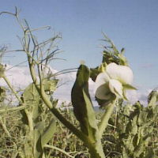
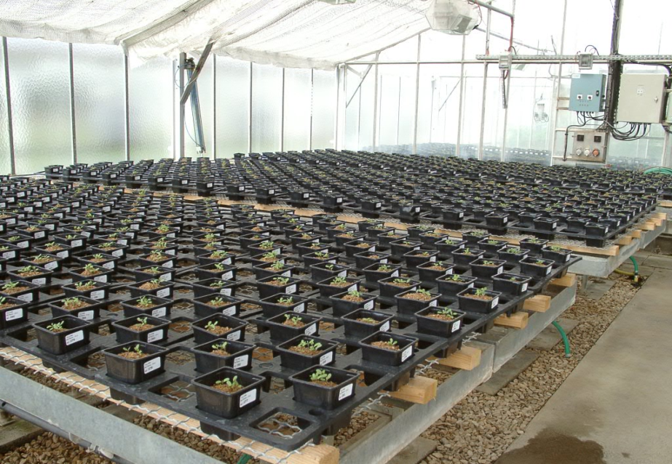
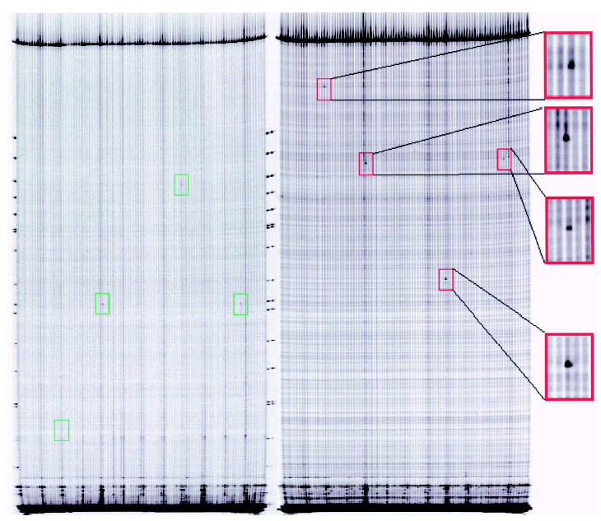
TILLING: A method of producing and identifying mutations in any gene of interest
EMS-generated population of point mutants
Make DNAs from each plant (~4500), arrange in pools
Screen for lines of interest by gene-specific detection
Purify away from other mutations by back-crossing
Photo serre URLEG-INRA Dijon C. Le Signor
Colbert et al (2001)
Plant Physiology 126: 480-484
Notes:
A brief re-cap on the method

Slide 3
TILLING
Targeting Induced Local Lesions in Genomes
Method of producing and identifying mutations in genes of interest
Photo serre URLEG-INRA Dijon C. Le Signor
Colbert et al (2001)
Plant Physiology 126: 480-484
Notes:
A brief re-cap on the method

Slide 4
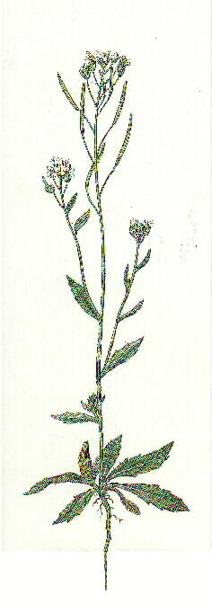
Origin of TILLING
Henikoff’s lab
Basic Sciences Division, Fred Hutchinson Cancer Research Center, Seattle, USA.
Targeted screening for induced mutations.
McCallum et al.
Nat Biotechnol. 2000; 18(4): 455-7
High-throughput TILLING for functional genomics.
Till BJ et al.
Arabidopsis
(génome 125 Mb)
Methods Mol Biol. 2003; 236:205-20.
Notes:
TILLING developed 15 years ago

Slide 5
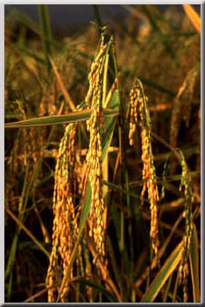

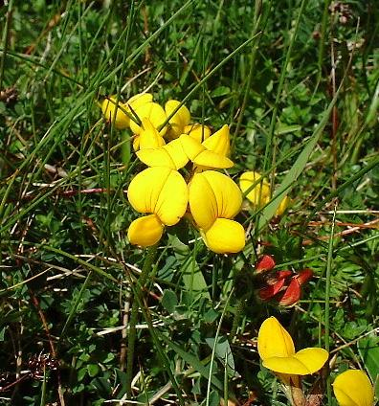
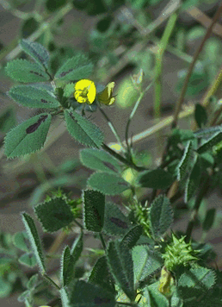
Application of TILLING
Cereals:
Rice
Maize
Génome de 500 Mb
2500 Mb
Henikoff’s lab
Seattle, USA
Crop Pathology and Genetics Research UC- Davis, USA
Legumes:
Lotus
Medicago
Pois
Jemalong A17
470 Mb
520 Mb
4000 Mb
John Innes Centre
Norwich, UK
D. Cook’s lab
UC Davis, USA
INRA Dijon et URGV- INRA Evry France
INRA Dijon
France
Notes:
And now applied to most crop species

Slide 6
Advantages of TILLING:
Applicable to all organisms (small or large genomes)
→ utilises a chemical mutagen which generates an allelic series of point mutations (mutation frequency 1 mutation/300 Kb).
Easily set up:
→ Rapid screening of a collection of mutagenized plants for the identification of point mutations in genes of interest
Notes:
Based on geenration of a mutant pop usually using EMS, and the screening of DNA pools, subsequently deconvoluted to locate mutant individuals

Slide 7
Steps in TILLING procedure
Mutagenesis of genome using Ethyl Methane Sulfonate (EMS)
Production of an M2 population
Screening of the M2 population
Isolation of lines bearing mutations in gene of interest and back-crossing to eliminate unwanted mutations

Slide 8
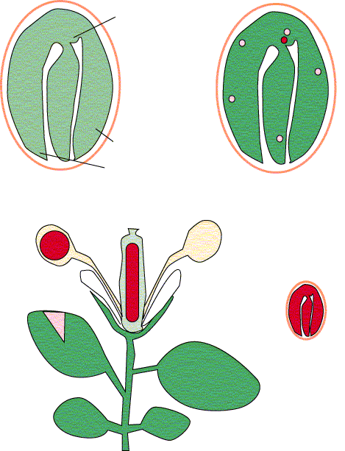
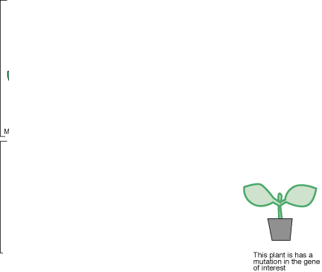
Assessment of mutation efficiency
M1
M2
Mutation efficiency: percentage of embryos aborted in pods of M1 plants ~15 à 20 %
M2 plant carrying one or several mutations in its genome
Chimaera
All the mutations are in the heterozygous state
50% mutations heterozygote
25% mutations homozygote
25% homozygote wild-type
Recessive mutations (99%) - no phenotype associated
For recessive mutations: 25% of plants show phenotype
For dominant mutations: 75% of plants show phenotype
Notes:
The efficiency of EMS treatment is estimated by counting the no. Of aborted embryos in the M1 plants. M1 plants generally without phenotype, occasional chimeric sectors seen

Slide 9
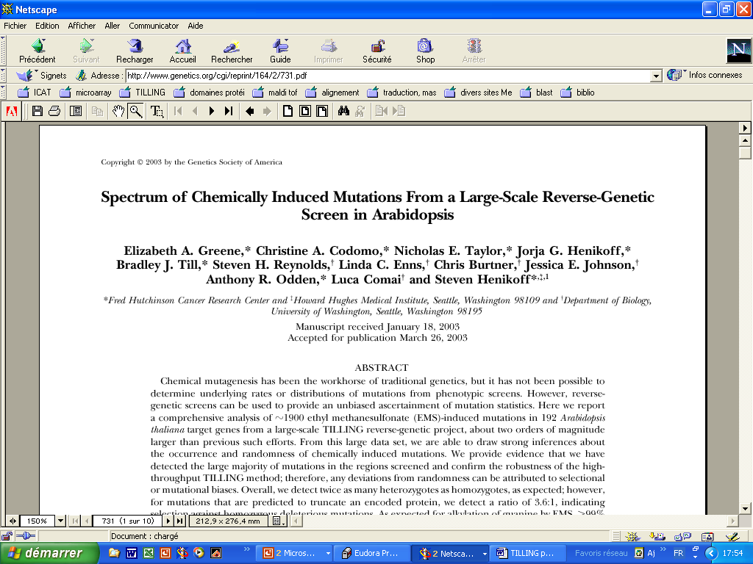
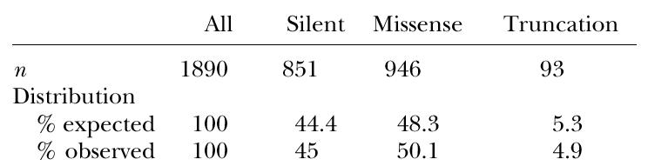
(2003) Genetics 164: 731-740
Mutation frequency: 1 mutation/300 kb (M2)
For a genome size similar to M. truncatula (500 Mb), the frequency would be ~1500 mutations/plant M2)
Therefore backcrosses to WT line needed
Mutation distribution:
Silent mutations : 45%
Missense mutations : 50%
Stop codon Mutations: 4,9%
Therefore need to isolate several mutants for each gene
Notes:
Henikoffs publication on Arabidopsis gives an idea of the mutation frequencies that can be expected, and the type of mutations found.

Slide 10
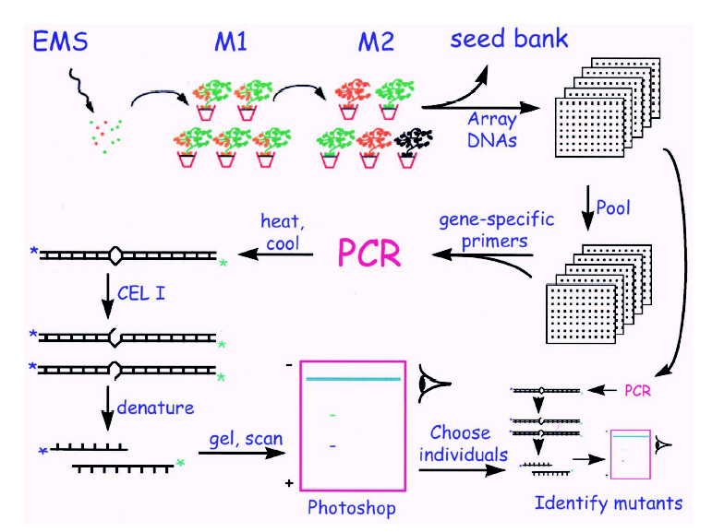
Summary of TILLING method
1
2
3
4
5
6
7
8
9
10
11
12
13
14
15
16
17
18
19
20
21
22
23
24
25
26
27
28
29
30
31
32
33
34
35
36
37
38
39
40
41
42
43
44
45
46
47
48
49
50
51
52
53
54
55
56
57
58
59
60
61
62
Extract DNA
Of individuals
63
64
65
66
67
68
69
70
71
n
heat
DNA pools
From Colbert et al. (2001). Plant Physiology, 126: 480-484.
nt
Screening carried out on DNA pools from 8-12 individuals on microtitre plates and subsequently on individual DNA samples.
Notes:
The original screening method involves detection of DS mismatch sites by the enzyme Cel1, alternatively the heteroduplexes can be fractionated on HPLC. Advantage of Cel1 –can check fragment sizes and locate site of mutation.
To accelerate this process, methods of TILLING by sequencing have been published

Slide 11

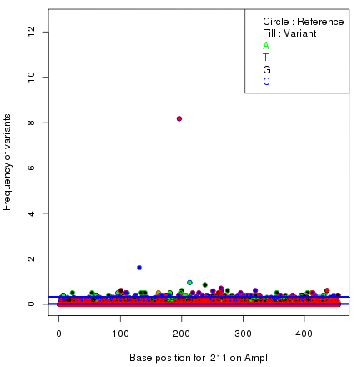
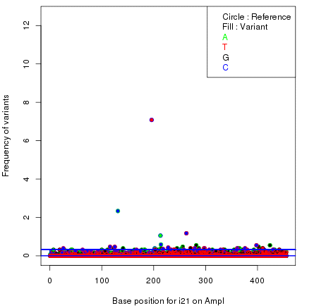
Towards a high throughput screening based on NGS
(URGV Paris-Saclay)
2013 : MiSeq detection system – general workflow
Libraries construction
Library
purification
2D gDNA
pooling
Indexed PCR
Library
Quality control
Library
Quantification
Sequencing
384 PCR
Access Array™
E-Gel ® Invitrogen
Nucleobeads
Agencourt
™
Miseq
™
©
2100
Bioanalyzer
Quant-iT PicoGreen ®
Illumina
Fluidigm
©
Agilent Technologies ©
™
Quality control
CLCbio
NGS data analysis :
Bioinformatic workflow
Output in
1st pooling dimension
Output in
2nd pooling dimension
Alignment, SNP detection
Bowtie II
Filter score
Statistical analysis
Python, R, Unix
Results
Notes:
For each target amplicon, PCR amplification is done in superpools and the products are sequenced. The sequences will be virtually all the same except for mutated sites that allow identification of the line concerned

Slide 12
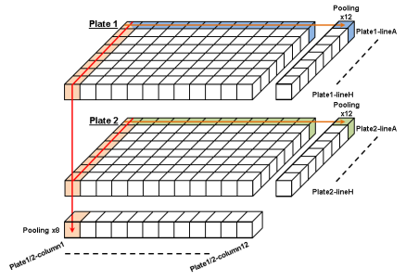
Row pooling :
12 families/well
Column pooling :
16 families/well
1 family = 2 coordinates
384 well-plate gDNA :
First pooling dimension
Second pooling dimension
 | 1 | 2 | 3 | 4 | 5 | 6 | 7 | 8 | 9 | 10 | 11 | 12 | 13 | 14 | 15 | 16 | 17 | 18 | 19 | 20 | 21 | 22 | 23 | 24
A | 1_2-C1 | 1-LA | 1_2-C2 | 2-LA | 1_2-C3 | 3-LA | 1_2-C4 | 4-LA | 1_2-C5 | 5-LA | 1_2-C6 | 6-LA | 1_2-C7 | 7-LA | 1_2-C8 | 8-LA | 1_2-C9 | 9-LA | 1_2-C10 | 10-LA | 1_2-C11 | 11-LA | 1_2-C12 | 12-LA
B | 17_18-C1 | 13-LA | 17_18-C2 | 14-LA | 17_18-C3 | 15-LA | 17_18-C4 | 16-LA | 17_18-C5 | 17-LA | 17_18-C6 | 18-LA | 17_18-C7 | 19-LA | 17_18-C8 | 20-LA | 17_18-C9 | 21-LA | 17_18-C10 | 22-LA | 17_18-C11 | 23-LA | 17_18-C12 | 24-LA
C | 3_4-C1 | 1-LB | 3_4-C2 | 2-LB | 3_4-C3 | 3-LB | 3_4-C4 | 4-LB | 3_4-C5 | 5-LB | 3_4-C6 | 6-LB | 3_4-C7 | 7-LB | 3_4-C8 | 8-LB | 3_4-C9 | 9-LB | 3_4-C10 | 10-LB | 3_4-C11 | 11-LB | 3_4-C12 | 12-LB
D | 19_20-C1 | 13-LB | 19_20-C2 | 14-LB | 19_20-C3 | 15-LB | 19_20-C4 | 16-LB | 19_20-C5 | 17-LB | 19_20-C6 | 18-LB | 19_20-C7 | 19-LB | 19_20-C8 | 20-LB | 19_20-C9 | 21-LB | 19_20-C10 | 22-LB | 19_20-C11 | 23-LB | 19_20-C12 | 24-LB
E | 5_6-C1 | 1-LC | 5_6-C2 | 2-LC | 5_6-C3 | 3-LC | 5_6-C4 | 4-LC | 5_6-C5 | 5-LC | 5_6-C6 | 6-LC | 5_6-C7 | 7-LC | 5_6-C8 | 8-LC | 5_6-C9 | 9-LC | 5_6-C10 | 10-LC | 5_6-C11 | 11-LC | 5_6-C12 | 12-LC
F | 21_22-C1 | 13-LC | 21_22-C2 | 14-LC | 21_22-C3 | 15-LC | 21_22-C4 | 16-LC | 21_22-C5 | 17-LC | 21_22-C6 | 18-LC | 21_22-C7 | 19-LC | 21_22-C8 | 20-LC | 21_22-C9 | 21-LC | 21_22-C10 | 22-LC | 21_22-C11 | 23-LC | 21_22-C12 | 24-LC
G | 7_8-C1 | 1-LD | 7_8-C2 | 2-LD | 7_8-C3 | 3-LD | 7_8-C4 | 4-LD | 7_8-C5 | 5-LD | 7_8-C6 | 6-LD | 7_8-C7 | 7-LD | 7_8-C8 | 8-LD | 7_8-C9 | 9-LD | 7_8-C10 | 10-LD | 7_8-C11 | 11-LD | 7_8-C12 | 12-LE
H | 23_24-C1 | 13-LD | 23_24-C2 | 14-LD | 23_24-C3 | 15-LD | 23_24-C4 | 16-LD | 23_24-C5 | 17-LD | 23_24-C6 | 18-LD | 23_24-C7 | 19-LD | 23_24-C8 | 20-LD | 23_24-C9 | 21-LD | 23_24-C10 | 22-LD | 23_24-C11 | 23-LD | 23_24-C12 | 24-LD
I | 9_10-C1 | 1-LE | 9_10-C2 | 2-LE | 9_10-C3 | 3-LE | 9_10-C4 | 4-LE | 9_10-C5 | 5-LE | 9_10-C6 | 6-LE | 9_10-C7 | 7-LE | 9_10-C8 | 8-LE | 9_10-C9 | 9-LE | 9_10-C10 | 10-LE | 9_10-C11 | 11-LE | 9_10-C12 | 12-LE
J | 25_26-C1 | 13-LE | 25_26-C2 | 14-LE | 25_26-C3 | 15-LE | 25_26-C4 | 16-LE | 25_26-C5 | 17-LE | 25_26-C6 | 18-LE | 25_26-C7 | 19-LE | 25_26-C8 | 20-LE | 25_26-C9 | 21-LE | 25_26-C10 | 22-LE | 25_26-C11 | 23-LE | 25_26-C12 | 24-LE
K | 11_12-C1 | 1-LF | 11_12-C2 | 2-LF | 11_12-C3 | 3-LF | 11_12-C4 | 4-LF | 11_12-C5 | 5-LF | 11_12-C6 | 6-LF | 11_12-C7 | 7-LF | 11_12-C8 | 8-LF | 11_12-C9 | 9-LF | 11_12-C10 | 10-LF | 11_12-C11 | 11-LF | 11_12-C12 | 12-LF
L | 25-LA | 13-LF | 25-LB | 14-LF | 25-LC | 15-LF | 25-LD | 16-LF | 25-LE | 17-LF | 25-LF | 18-LF | 25-LG | 19-LF | 25-LH | 20-LF |  | 21-LF |  | 22-LF |  | 23-LF |  | 24-LF
M | 13_14-C1 | 1-LG | 13_14-C2 | 2-LG | 13_14-C3 | 3-LG | 13_14-C4 | 4-LG | 13_14-C5 | 5-LG | 13_14-C6 | 6-LG | 13_14-C7 | 7-LG | 13_14-C8 | 8-LG | 13_14-C9 | 9-LG | 13_14-C10 | 10-LG | 13_14-C11 | 11-LG | 13_14-C12 | 12-LG
N | 26-LA | 13-LG | 26-LB | 14-LG | 26-LC | 15-LG | 26-LD | 16-LG | 26-LE | 17-LG | 26-LF | 18-LG | 26-LG | 19-LG | 26-LH | 20-LG |  | 21-LG |  | 22-LG |  | 23-LG |  | 24-LG
O | 15_16-C1 | 1-LH | 15_16-C2 | 2-LH | 15_16-C3 | 3-LH | 15_16-C4 | 4-LH | 15_16-C5 | 5-LH | 15_16-C6 | 6-LH | 15_16-C7 | 7-LH | 15_16-C8 | 8-LH | 15_16-C9 | 9-LH | 15_16-C10 | 10-LH | 15_16-C11 | 11-LH | 15_16-C12 | 12-LH
P | WT | 13-LH |  | 14-LH |  | 15-LH |  | 16-LH |  | 17-LH |  | 18-LH |  | 19-LH |  | 20-LH |  | 21-LH |  | 22-LH |  | 23-LH |  | 24-LH
12

Slide 13
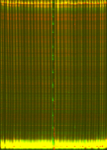

Cel1/Endo1 and NGS TILLING methods compared
(URGV Paris-Saclay)
 | Cel1/Endo 1 | NGS- MiSeq - Illumina
 |  | PCR 384 | Fluidigm
DNA pooling | 1D | 2D (rows + columns pooling)
Amplicon | 1000 bp | 500 bp | 500 bp
Detection system | Endonuclease digestion Detection of labelled DNA fragments on Li-Cor Sanger sequençing | Pair-end sequencing 2 x 250bp → 2 x 300bp Sequence analysis
Amplicon/run | 1 | 25 | 48
Time/ experiment | 1 month | 3 months | 2-3 months
Mutation frequency | 1mutant/200 kb | 1mutant/130 kb | 1mutant/130 kb
Families / screen | 5000 | 384-well plate = 2500 families | 384-well plate = 2500 families
-
-
-
-
-
Notes:
The main advantage of the NGS method is (besides having confirmed the sequence change) being able to screen up to 48 amplicons in parallel

Slide 14

Pea TILLING populations
CAMEOR
spring pea collection
4704 M2 families
60 genes screened (80 targets)
1150 mutants
NGS: 1 mutation /130kb
Dalmais et al., Genome Biology, 2008
http://urgv.evry.inra.fr/UTILLdb)
4200 M2 families
10 genes screened
84 mutants
NGS: 1 mutation / 359kb
Terese rms4
Spring pea collection
Hr Ps336/11 genotype
PEAMUST Winter pea collection
4500 M2 families
2014 : DNA samples for 946
low-seeds M2 families
2015 : DNA samples for 960
high-seeds M2 families
[gDNA] = 52.9 ng/µL
2016-2017 : end of population production
Notes:
Also Medicago TILLING population extensively used
The winter pea pop is being produced because of the demand for a background suitable for screening several characters of importance (disease resistance, cold tolerance) not screenable in Caméor. As we had some difficulty in handling the mutant pop in the g/h, we separated low-yielding and high-yielding seed lots to compare mutation frequencies,

Slide 15
Variation in mutation frequency
within treated seed lot
→ Comparison of mutation frequency in low- and high-yield families
Hr Ps336/11 genotype
PEAMUST Winter pea collection
2014 : DNA samples for 946
low-seeds M2 families (1-7 seeds/plant)
Mutation frequency 1/72 kb
Mutation frequency 1/334 kb
2015 : DNA samples for 960
high-seeds M2 families (20-100 seeds/plant)
Low-yield families had a mutation frequency 4-fold higher, but probability of losing the mutant allele also high → aim for intermediate mutation frequency

Slide 16
Recovery of mutant line for phenotyping
TILLING lines contain 100s-1000 or more induced point mutations, so the mutation of interest should be backcrossed to a non-mutagenized parental line (>2 generations)
Mutant allele is followed using a genotyping method such as dCAPS
If two different mutant alleles available, an allelism test can help associate mutation and an eventual phenotype
Notes:
Use of the TILLING reource boosted recently by the production of a Pea gene expression atlas

Slide 17
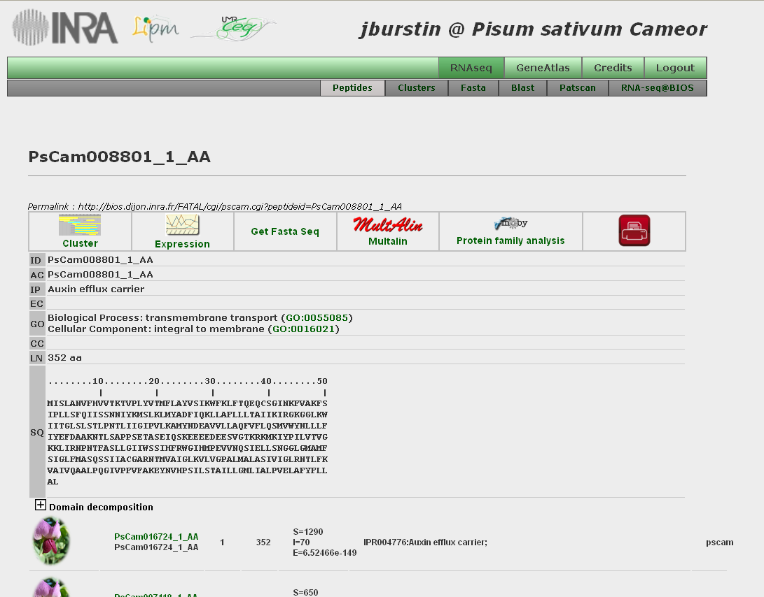
Exploitation of TILLING via new genomics resources in Pea
The Pea Gene Atlas http://bios.dijon.inra.fr/FATAL/cgi/pscam.cgi
Search any gene of interest
(Judith Burstin et al): Alves-Carvalho Plant J. 84:1 (2015)
Notes:
46K expressed sequences evaluated under 20 different conditions –Blast/fasta-searchable

Slide 18
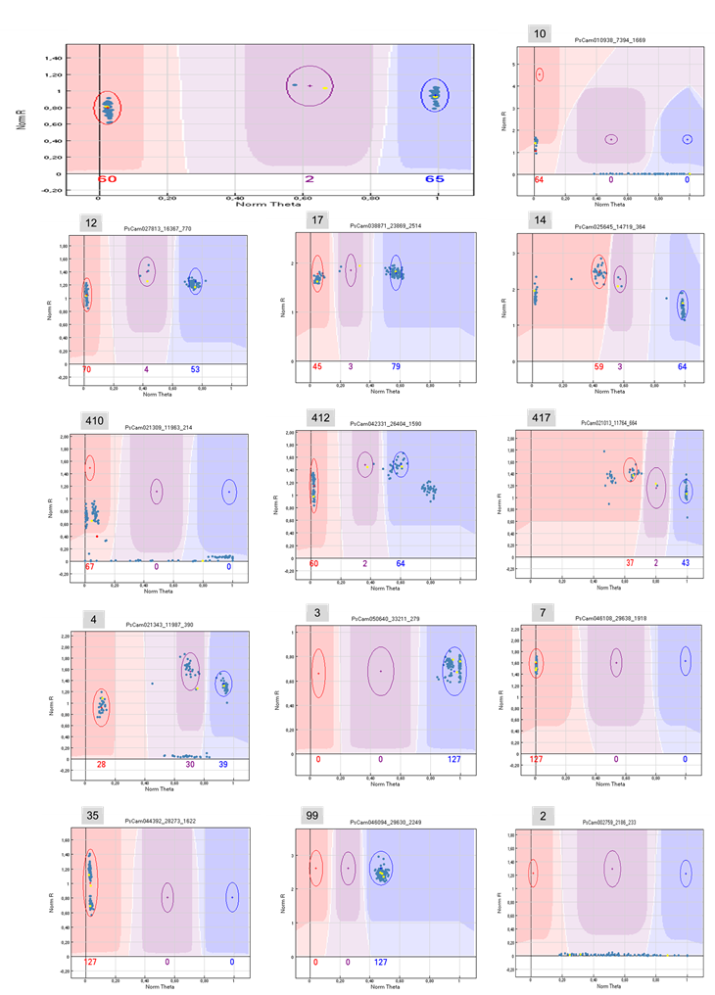

Exploitation of TILLING via new genomics resources in Pea
PsCameor Unigene set
Genomic sequencing of Cameor
Genespace reconstruction
Genomic resequencing 16 genotypes
SNP discovery
GenoPea Infinium® BeadChip
13 204 SNP markers producing results
Genotyping genetic resources
Genotyping mapping populations
GWAS
Mapping
Aluome et al. submitted Tayeh et al. 2015, The Plant J.
(Judith Burstin et al)
Notes:
The sequences also used to prepare an Infinium chip and with resequencing of 8 genotypes and production of a 15K marker map of which 13K are SNPs

Slide 19
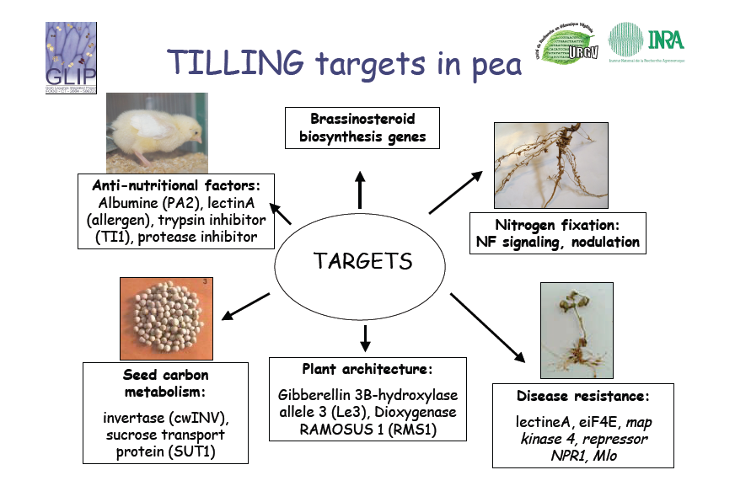
TILLING: Widely used in Pea since 2008
(~100 genes screened, supply on average 6 lines per gene screened)
Notes:
The pea TILLING pop has been used for more than 50 genes since 2008 and we
expect to have an accelerated demand
>60 genes Mtr screened
~100 genes Pea screened
Supply av. 6 alleles per gene

Slide 20





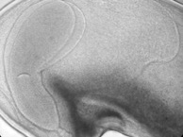

Examples of TILLed genes in our project on seed development and composition
Model
M. truncatula
Crop
P. sativum
1-seed weight
GWAS & Comparative QTL mapping
Candidate genes
Putative pea orthologs
Seed
development
Two genes with an endosperm-specific expression during embryogenesis determine final seed weight through the regulation of embryo cell division :
a Subtilisin-like serine protease
D’Erfurth et al., 2012 New Phytol.
a DNA-binding with One zinc-Finger (DOF)-type transcription factor
Noguero et al., 2013 Plant Sci.
Noguero et al. 2015 Plant J.
Phytosulfokines ?
endosperm
Embryo
Communication & interaction ?
HCERES evaluation, Dijon January 19th-20th, 2016
Notes:
In our group we’ve worked more with medicago TILLING mutants, including two for genes specific to the developing endosperm.

Slide 21
A gene encoding a seed-specific subtilisin colocalizes with a Medicago seed weight QTL and is expressed at the interval embryogenesis-seed filling
Notes:
The MtSBT1.1 gene is one of two specifically expressed in seeds as compared to other plant organs, peaking at start of seed filling. The putative pea ortholog has the same expression profile.

Slide 22
In situ hybridization of MtSBT1.1 to 10 and 12 DAP seeds
sense
antisense
Notes:
In situ hybridization showed a clear signal within endosperm tissue which by 12 DAP was restricted to the outer cells of the endosperm.

Slide 23
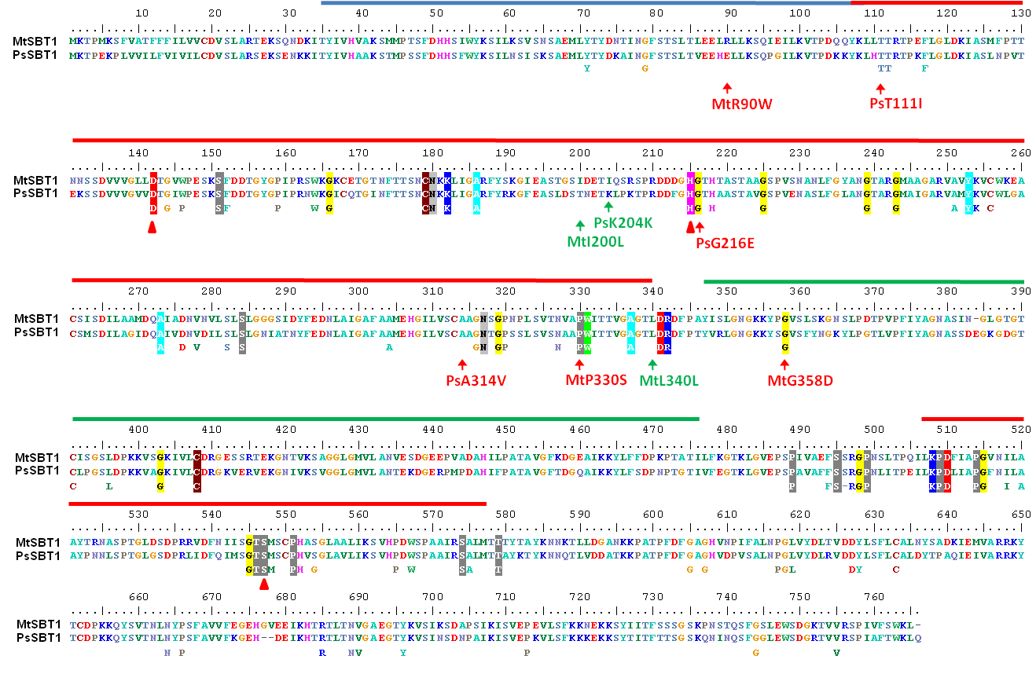
Alignment of MtSBT1.1 AND PsSBT1.1 showing mutants available
Notes:
Of a series of TILLING mutants available for the two genes, we’ve focussed on 2, which generate non-conservative substitutions in highly conserved domains.
If we compare seed weights of WT and mutants;

Slide 24
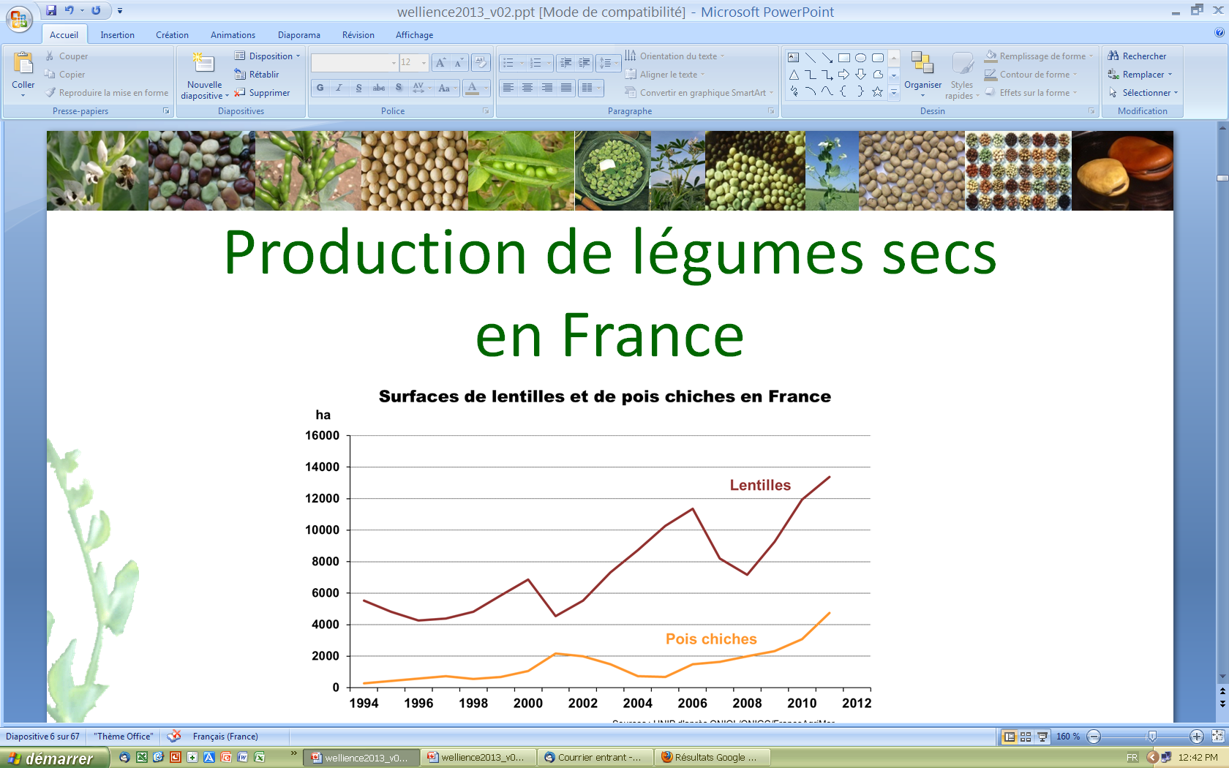
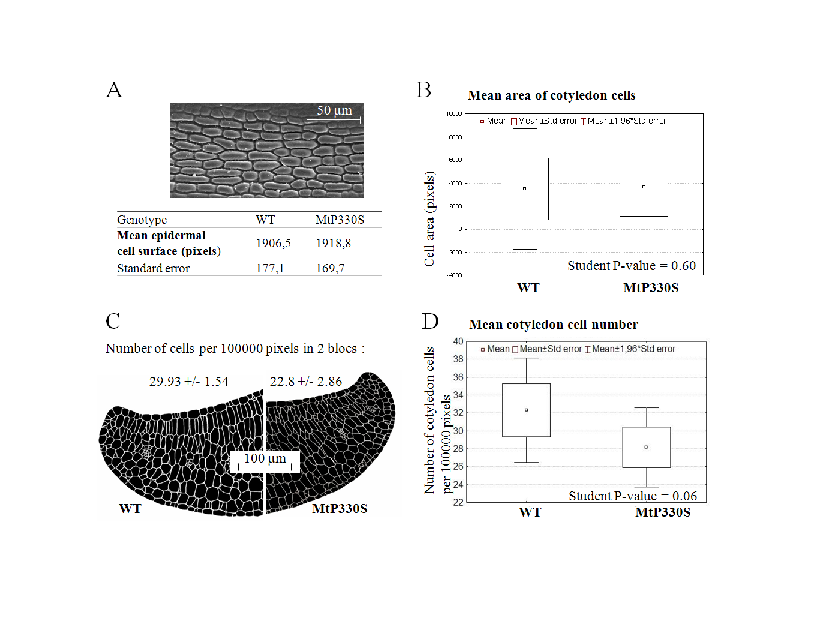
Surface area and number of cotyledon cells in mature seeds of the homozygous MtP330S mutant versus wild-type.
Notes:
Looking at what this reduction in seed weight could be due to, the cell size (area on epidermal cell surface) and cell number were compared for Medicago between WT and mutant.
Observed no difference in mean cell size, but reduced cell number, indicating that the subtilase affects cell number in the seed.

Slide 25
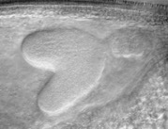
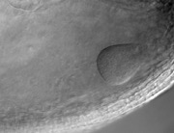
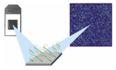


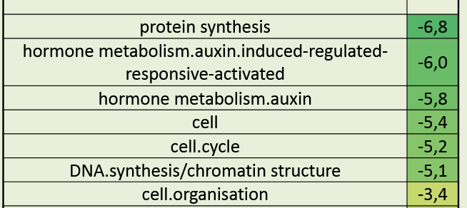

Endosperm-specific genes controlling seed quality
Seed
development
DASH, a DOF TF Acting in Seed embryogenesis and Hormone regulation
10 dap
M. truncatula seeds
WT
Dash mutant
Transcriptome changes in young pods
(8 dap)
Affymetrix
100µm
100µm
Embryo growth arrest (globular stage)
PageMan display of the
functional classes down-regulated in the dof mutant
IAA content (ng/g)
in young pods
WT
dash
8 dap
10 dap
defect in transport or distribution of auxin
Auxin-transport genes
Auxin-responsive genes
Noguero & Le Signor et al. 2015
HCERES evaluation, Dijon January 19th-20th, 2016

Slide 26
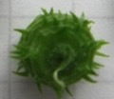

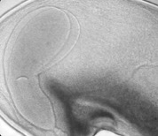

Endosperm-specific genes controlling seed quality
Seed
development
10 dap
M. truncatula seeds
WT
Dash mutant
Transcriptome changes in young pods
(8 dap)
Affymetrix
100µm
100µm
Embryo growth arrest (globular stage)
PageMan display of the
functional classes down-regulated in the dash mutant
Pod wall
Auxin
In vitro auxin treatment promotes
cell division in young
M. truncatula seeds
Atif et al. 2013
Auxin
Dash
division
Auxin-transport genes
Auxin-responsive genes
Compartmentation studies in progress using pea mutants
Noguero & Le Signor et al. 2015
HCERES evaluation, Dijon January 19th-20th, 2016

Slide 27
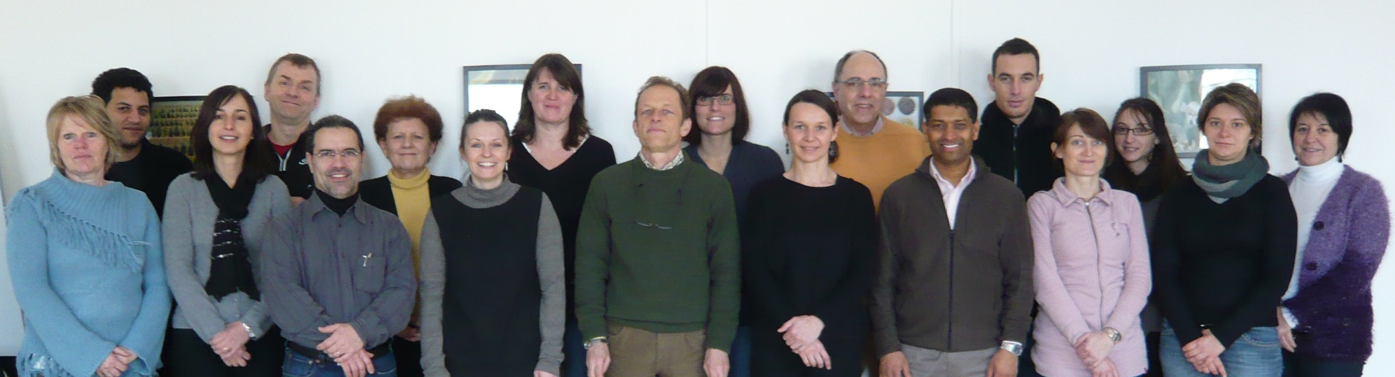








Acknowledgements
Melanie Noguero, Christine Lesignor, Brigitte Darchy, Greg Aubert, Myriam Sanchez, Judith Burstin, Karine Gallardo, (AE, Dijon)
Jérôme Verdier (Shanghai Center for Plant Stress Biology)
C. Saffray, M. Dalmais,
A. Bendahmane (IPS Saclay)
Notes:
J’aimerais finir en remerciant tous ceux/celles qui ont contribué à ce travail, notamment Mélanie Noguero, Christine Lesignor, et Jérôme Verdier.

Slide 29
Pea/Mtr TILLING: Publications arising
Resource development
Triques, K., et al. (2008). "Mutation detection using ENDO1: Application to disease diagnostics in humans and TILLING and Eco-TILLING in plants." BMC Molecular Biology 9.
LeSignor C., (2009) Optimizing TILLING populations for reverse genetics in Medicago truncatula. Plant Biotechnology J. 7 : 430-441
Dalmais, M., UTILLdb, a Pisum sativum in silico forward and reverse genetics tool. Genome Biol. (2008) 9(2): R43.
Examples of Applications
Hofer, J., L. Turner, et al. (2009). "Tendril-less Regulates Tendril Formation in Pea Leaves." Plant Cell 21(2): 420-428.
Laura de Lorenzo, (2009) A Novel Plant Leucine-Rich Repeat Receptor Kinase Regulates the Response of Medicago truncatula Roots to Salt Stress The Plant Cell 21:668-680
Plet et al, (2011) MtCRE1-dependent cytokinin signaling integrates bacterial and plant cues to coordinate symbiotic nodule organogenesis in Medicago truncatula. Plant J. 65: 622-633.
Tivendale, N. D., S. E. Davidson, et al. (2012). "Biosynthesis of the Halogenated Auxin, 4-Chloroindole-3-Acetic Acid." Plant Physiology 159(3): 1055-1063.
D'Erfurth, I., C. Le Signor, et al. (2012). "A role for an endosperm-localized subtilase in the control of seed size in legumes." New Phytologist 196(3): 738-751.
Noguero, M., C. Le Signor, et al. (2015). "DASH transcription factor impacts Medicago truncatula seed size by its action on embryo morphogenesis and auxin homeostasis." Plant Journal 81(3): 453-466.
Vernié, T, Camut S, et al (2016) PUB1 interacts with the receptor kinase DMI2 and negatively regulates rhizobial and arbuscular mycorrhizal symbioses through its ubiquitination activity in
Medicago truncatula. Pl. Physiol. In press.

