Slide 1
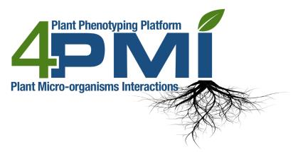
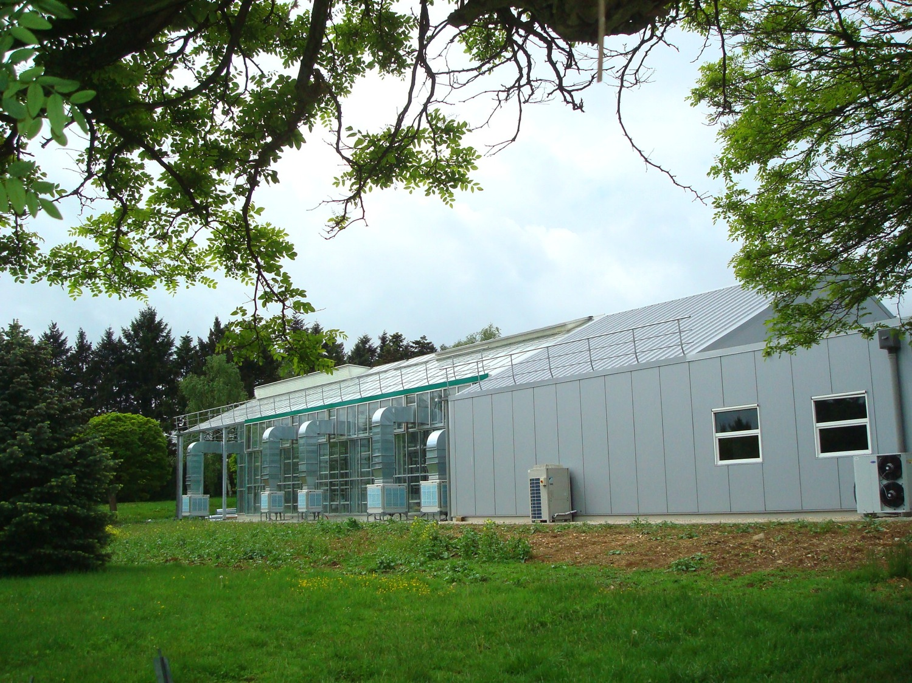
High trougput phenotyping of interactions between plants and microorganisms, associated devices
Phenotyping Platform for Plant and Plant Micro organisms Interactions
(4PMI, INRA Dijon)
Christophe Salon
UMR 1347-AgroSup/INRA/uB, 17 rue Sully - BP 86510 - 21065 Dijon - France

Slide 2
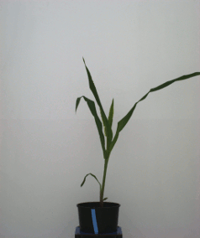
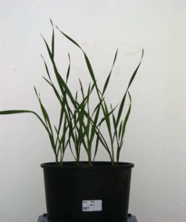
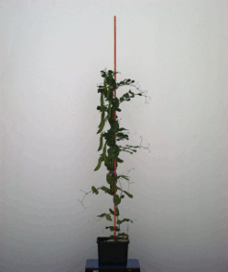
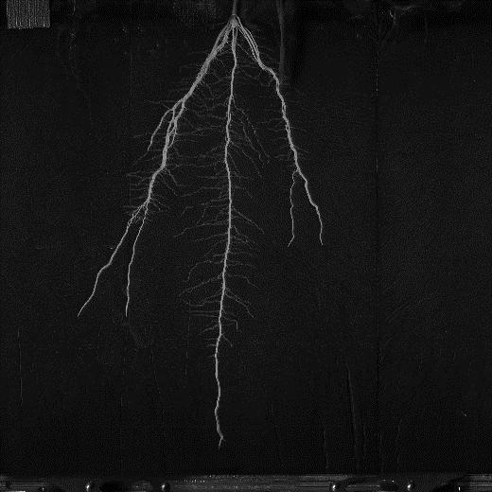
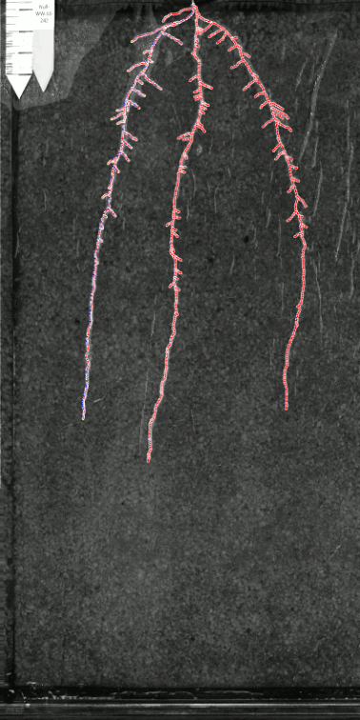
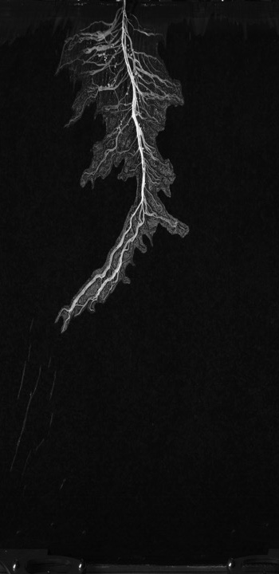
Achievements: Shoot phenotyping
Maize
Wheat
Pea
Notes:
We teste the best model for calibration using either the mean of three lateral viexs, the biggest image taken or a somital view. This was done on a range of data obtained in the platfrom: results show the correlation between the projected images (ie means of 3 images, biggest or somital) on the X axis and the real leaf area manually measured

Slide 3
Achievements: Shoot phenotyping
Calibration, image analysis
“Manual” image
“Manual” weight
4PMI image
Mean of 3 lateral views
Shoot leaf area
Choice of best image acquisition model !
Notes:
We teste the best model for calibration using either the mean of three lateral viexs, the biggest image taken or a somital view. This was done on a range of data obtained in the platfrom: results show the correlation between the projected images (ie means of 3 images, biggest or somital) on the X axis and the real leaf area manually measured

Slide 4
Shoot/root phenotyping: dynamic simulation
Calibration, image analysis
Wheat
4PMI image
EPPN Project, Josh Klein AARO Volcani Israel
Notes:
Here you can see how we get non invasive data for progression of leaf area, shoot fresh and dry weitgth during the experiment with an example showing progression of these traits for the two genotypes

Slide 5
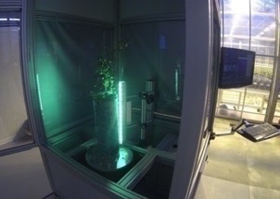
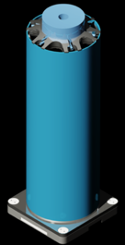
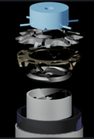
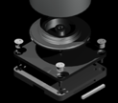
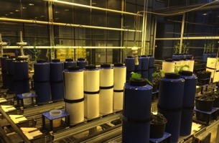
RhizoCab
Prototyping approach: Partnership with SMEs (Inoviaflow and Shakti):
very innovative rhizotrons (European patent) called RhizotubeHD,
associated imaging cabins (Rhizocab and Rhizocab-HT) and software,
irrigating, potting depotting tools.
Standalone: RhizoCab
Conveyors
EU Patent INRA InoviaFlow,
World licence distributions ongoing (INRA-Inoviaflow)

Slide 6
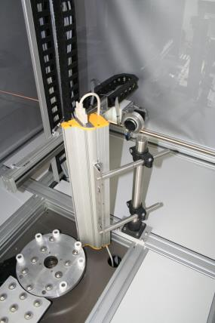
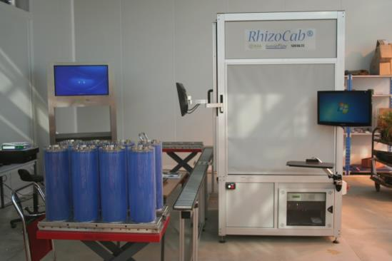
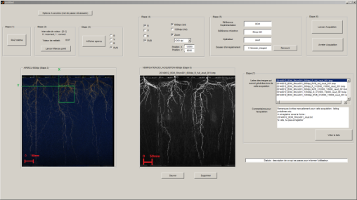
RhizoCab

Slide 7
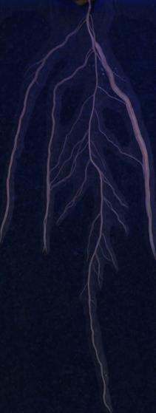
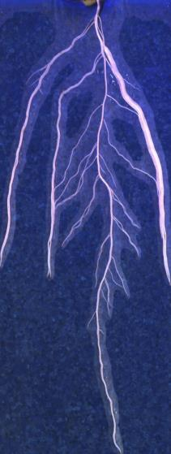
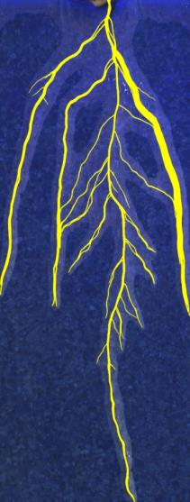
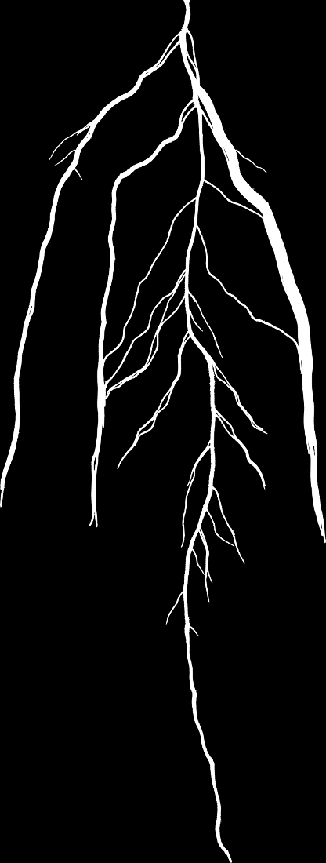
Segmentation software

Slide 8
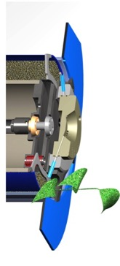
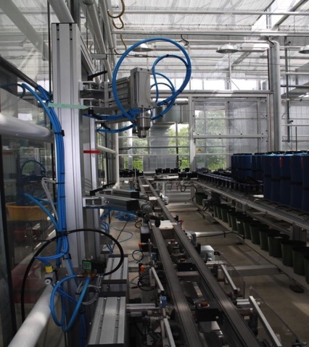
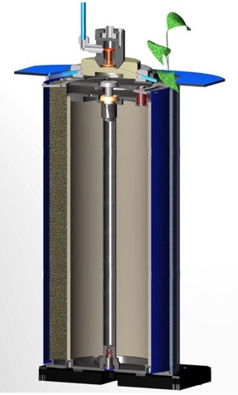
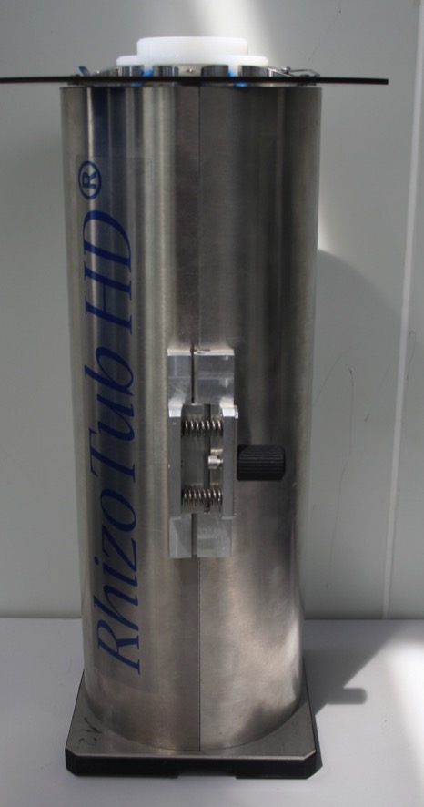
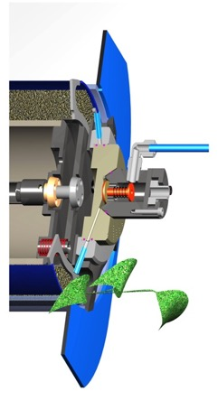
RhizoTubes
Irrigation arm
Shell
Ok for small amount of nutritive solutions
Drainage hole

Slide 9
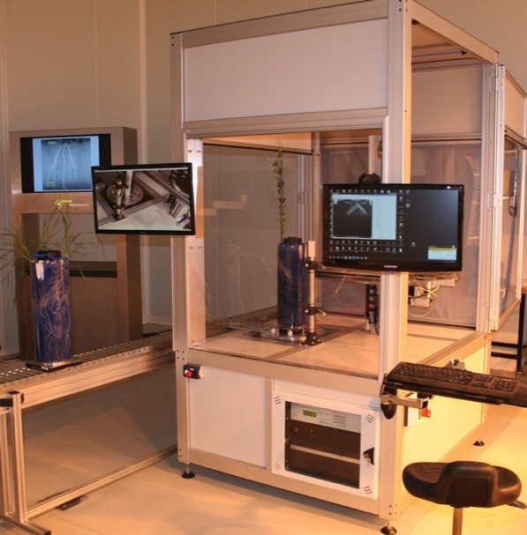
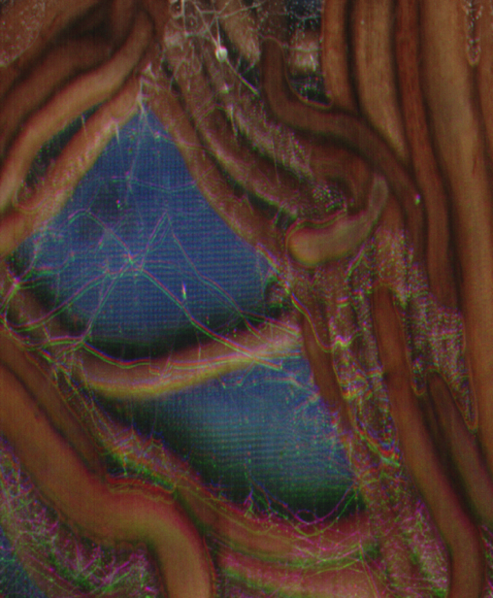
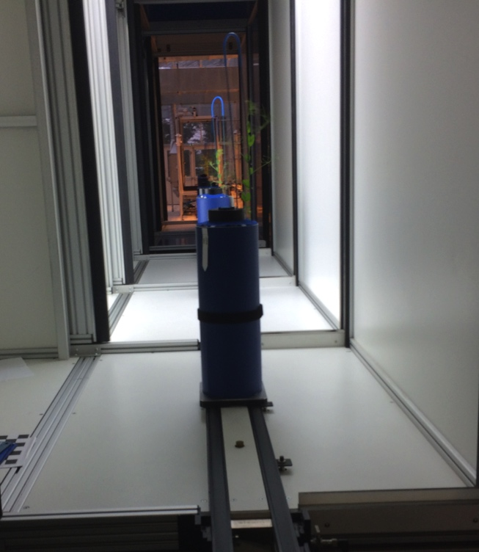
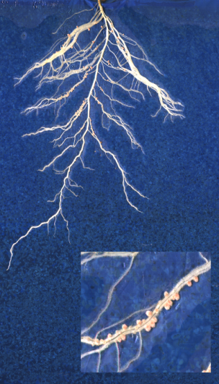
RhizoCab HT development
Low throughput:
50 RT/day, 45s/RT
Very high resolution (7 μm)
High throughput:
100ds/day
15s/RT
Medium resolution (42 μm)

Slide 10
BOM: RhizoTubes vs Pots ?
Similar plant compartments and nodule traits

Slide 11
BOM: RhizoTubes vs Pots ?
*
*
*
*
*
*
*
Pot
RhizoTube
*
*
*
*
*
Same length upper
1st order lateral roots
*
*
*
*
*
*
*
*
… but pot vs RhizoTube depth !
*
*
*
*
*
*
*
*
*
*
Same number and distribution of
roots on 2nd order laterals
2nd order lateral roots
F4
F5

Slide 12
BOM: RhizoTubes vs Pots ?
Pot
RhizoTube
Same nodule profile distribution, shifted
F5

Slide 13
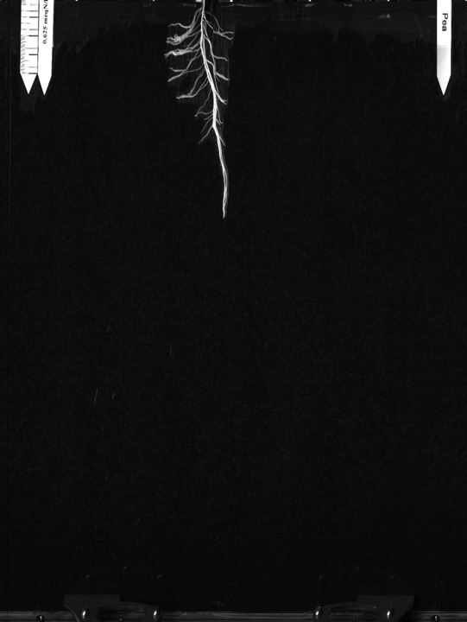
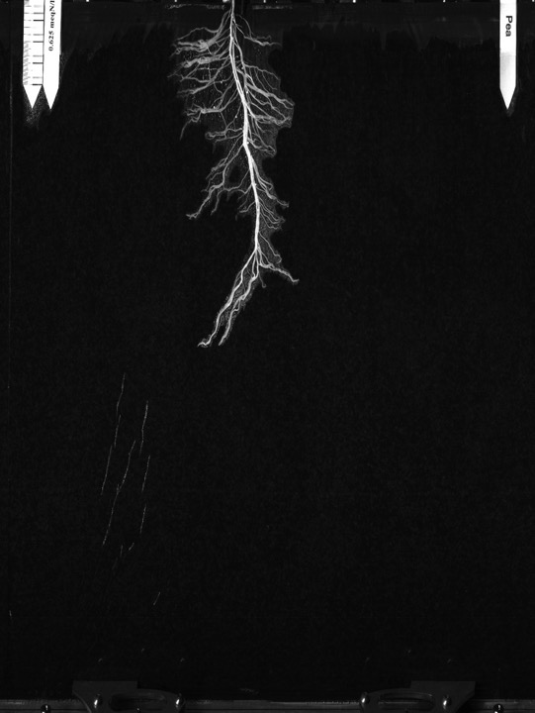
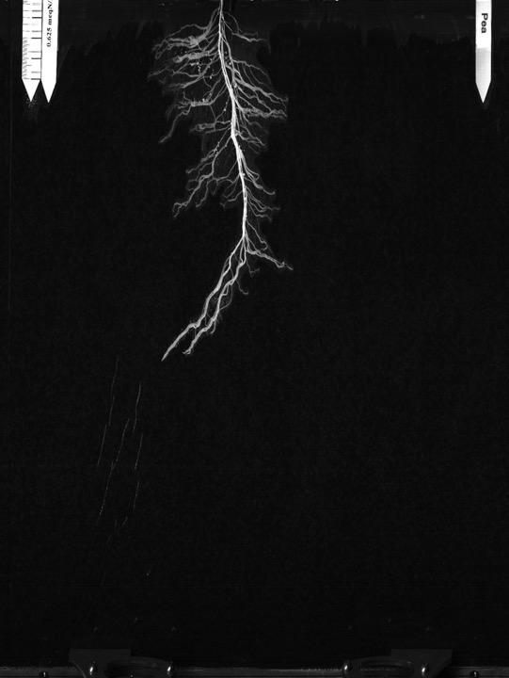
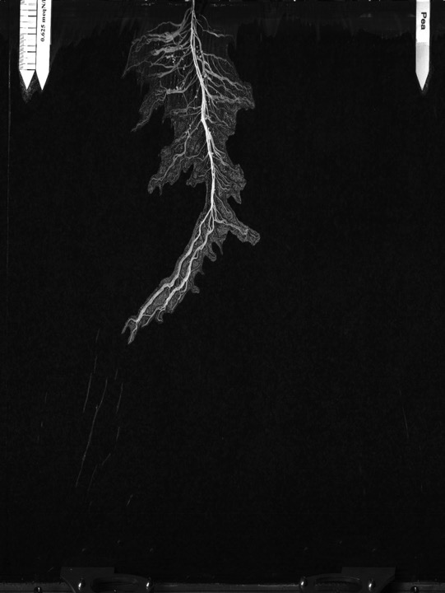
Length main root
Length (cm)
Date
Number of nodule
Number
Date
Number of laterals
Number
Date

Slide 14
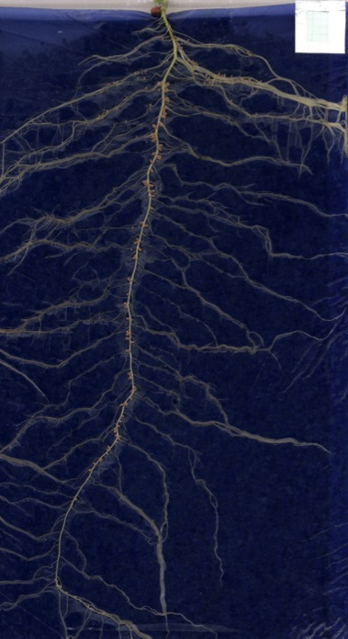
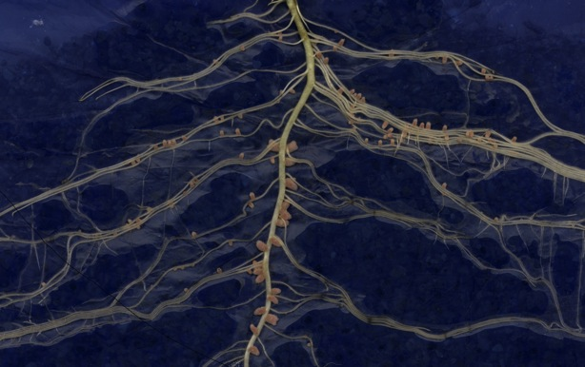
Phenotypic traits: examples
Nodules: Number, projected surface, position, color
Focus on image
PhD Simeng Han (unpublished)

Slide 15
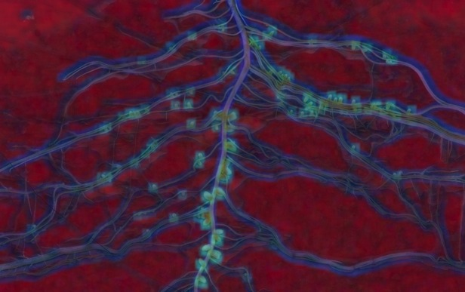
Phenotypic traits: examples
Nodules: Number, projected surface, position, color
Hybrid spaces (color + texture)
(Cointault et al, 2008)
PhD Simeng Han (unpublished)

Slide 16
Phenotypic traits: examples
Nodules: Number, projected surface, position, color
Image with nodules
PhD Simeng Han (unpublished)

Slide 17
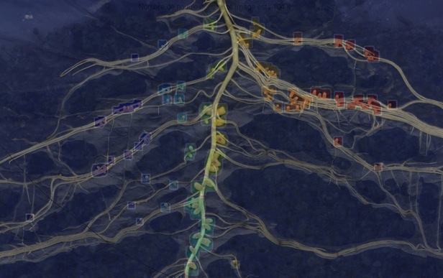
Phenotypic traits: examples
Nodules: Number, projected surface, position, color
Original image + superimposed nodules
PhD Simeng Han (unpublished)

Slide 18
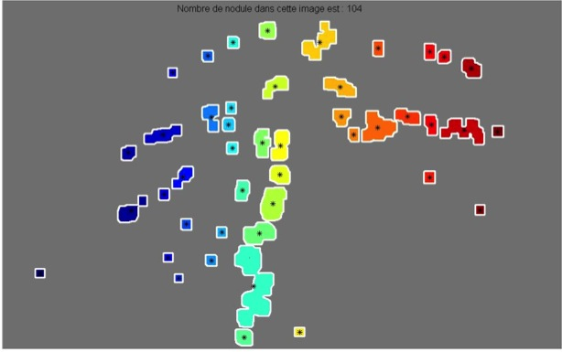
Phenotypic traits: examples
Nodules: Number, projected surface, position, color
Nodules automatically detected
95% detection efficiency
PhD Simeng Han (unpublished)

Slide 19
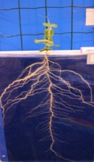
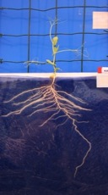
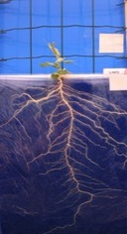
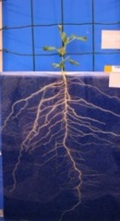
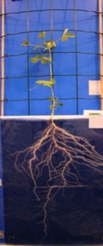
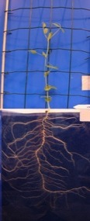
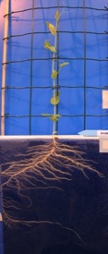
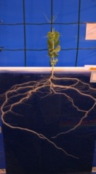
Phenotypic traits: examples
Nodules: Number, projected surface, position, color
Pea core collection
Biomasse (g/plant)
AMINO
KAYANNE
L1073
CAMEOR
Rhizotron
R²=0,95
Hydroponique et substrat
ISARD
CUZCO
LIVIOLETTA
PI186093
PhD Simeng Han (unpublished)

Slide 20
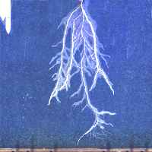
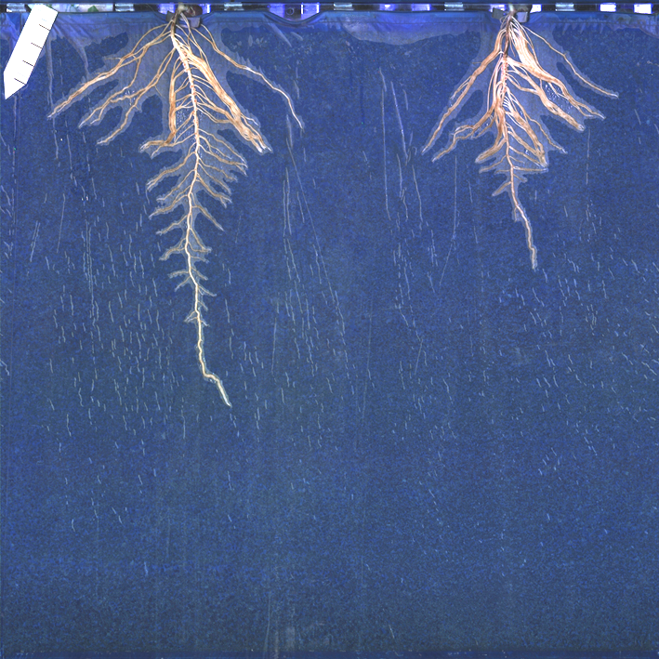
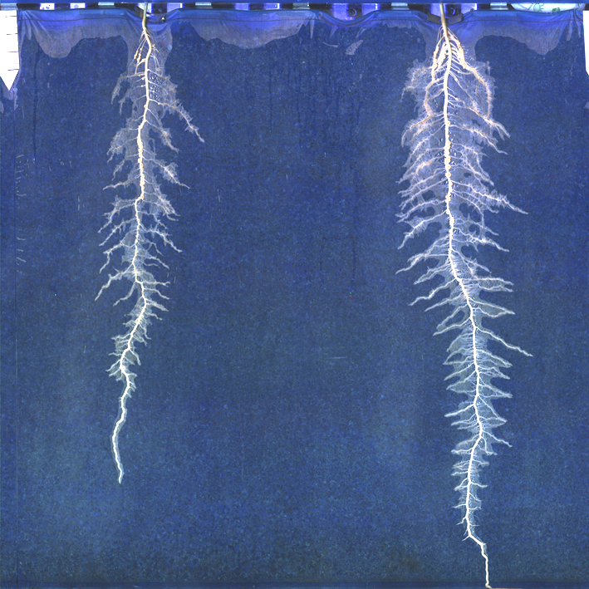
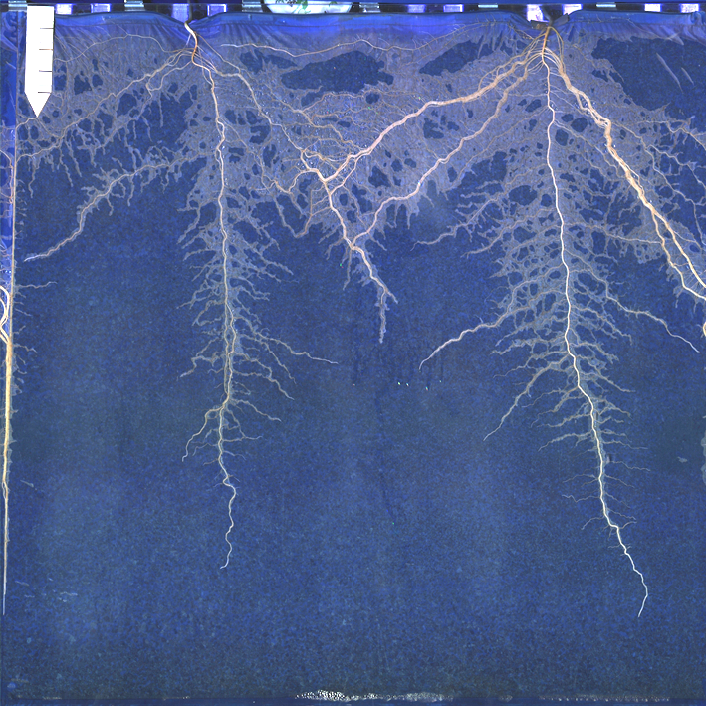
Some root example
Pois
Féverolle
Lupin
Haricot
Vesce Commune
Colza
Vulpie
Maïs

Slide 21
Maïs
17?8
10 cm

Slide 22
Maïs
1 cm

Slide 23
Maïs
100 microns

Slide 24
Maïs
50 microns

Slide 25
Maïs
10 microns

Slide 26
17?8
Maïs
10 cm

Slide 27
Root phenotyping: High resolution
Hyphae
zoom
Root tips
Nodules
Down to 7 microns

Slide 28
Merci pour votre attention!

