Slide 1




Vul’Clim – Climate change vulnerability studies in the region Auvergne (France)
Gianni BELLOCCHI, Raphaël MARTIN
(scientific supervision)
Anastasiya Shtiliyanova, Haythem Ben Touhami
(post-doctorates)
Pascal CARRÈRE
(coordinator)
French National Institute for Agricultural Research, Clermont-Ferrand, France
FACCE MACSUR Mid-Term Scientific Conference
University of Sassari, Italy
01-04 April 2014

Slide 2
Auvergne region of France :
grassland-based (beef and dairy) cattle production territory
Vulnerability assessment of
grasslands to climate changes

Slide 3
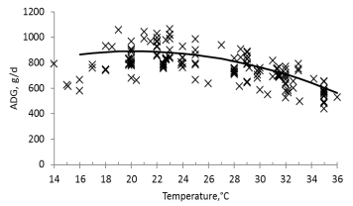
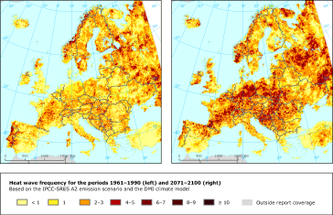
Vulnerability assessment:
what a challenge for research?
Characterisation of the pressure on the agro-ecosystems
Characterisation of evolution scenarios
Estimation of responses
Context: technical, economic, social, etc.
Exposure indicators
Sensitivity indicators
+ / -
+ / -
Coping capacity
+
Potential impacts
+ / -
Vulnerability
-
Adaptation strategies
Evaluation of adaptation measures / social dialogue

Slide 4
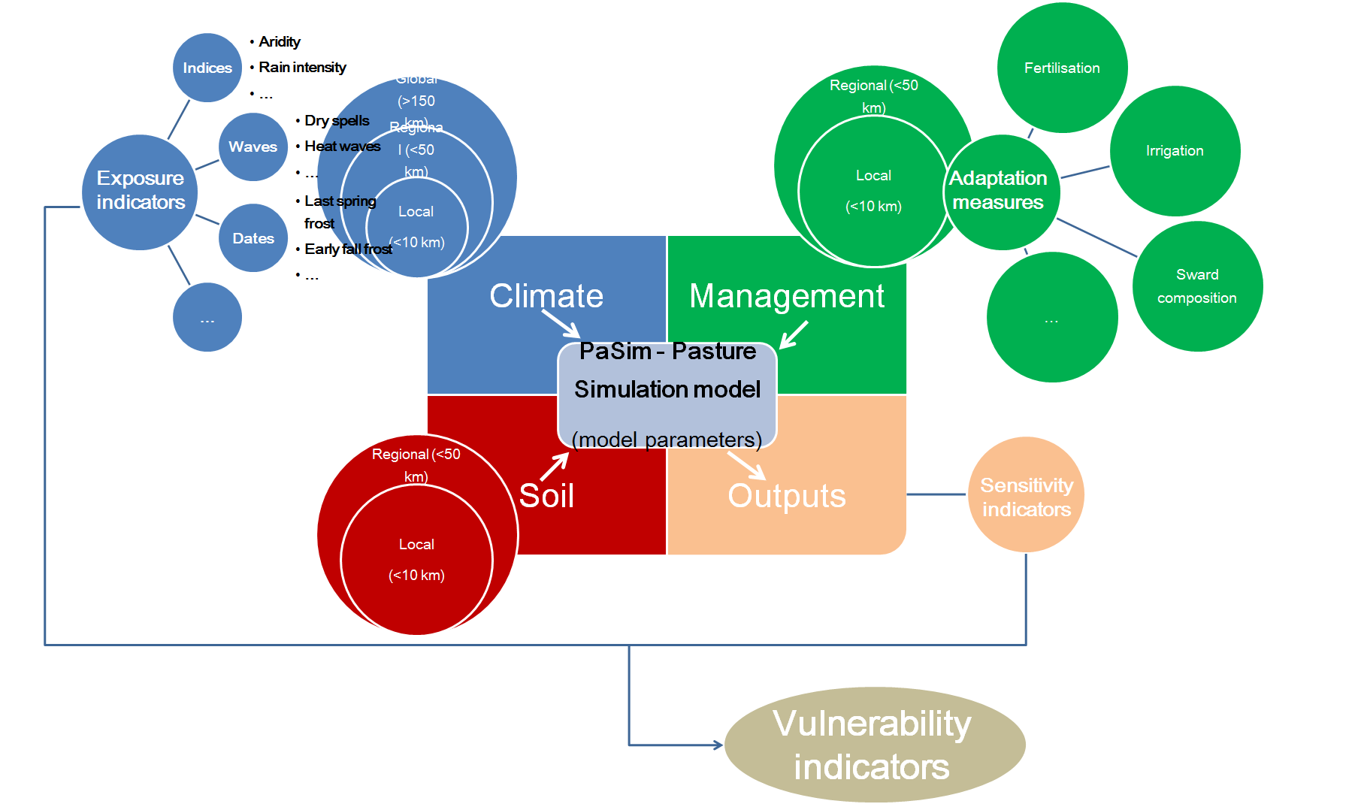
Platform for grassland vulnerability assessment
  Gross primary production
  Harvested dry matter
  …
  Net ecosystem exchanges
  Soil respiration
  …
  N₂O emissions
  Nitrogen leaching
  …
Productivity

Slide 5
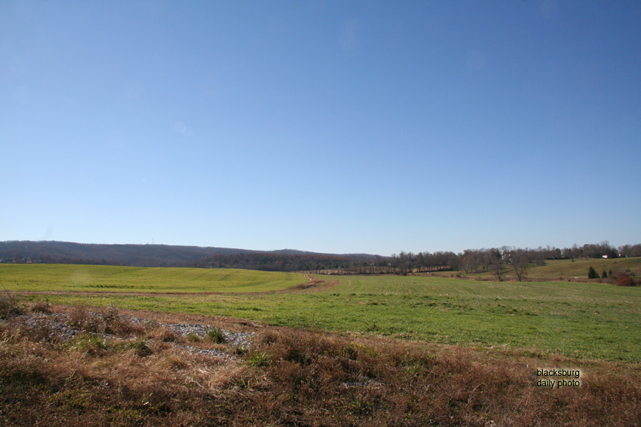
Partners
Downscaling climate
model outputs
Grassland modelling
Vul’Clim
Climate change vulnerability studies
in the region Auvergne (France)
Cost / benefit analysis
Vulnerability assessment
Stakeholder
institution
Thank you for your attention

