Slide 1




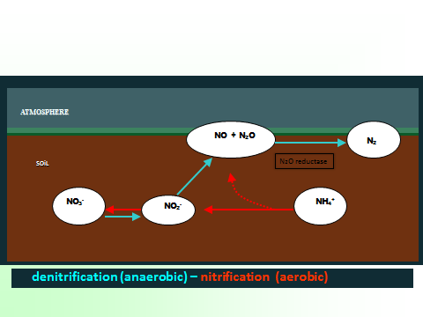
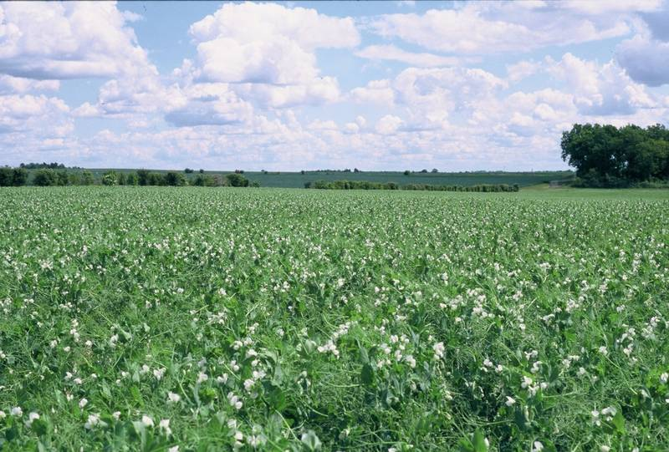
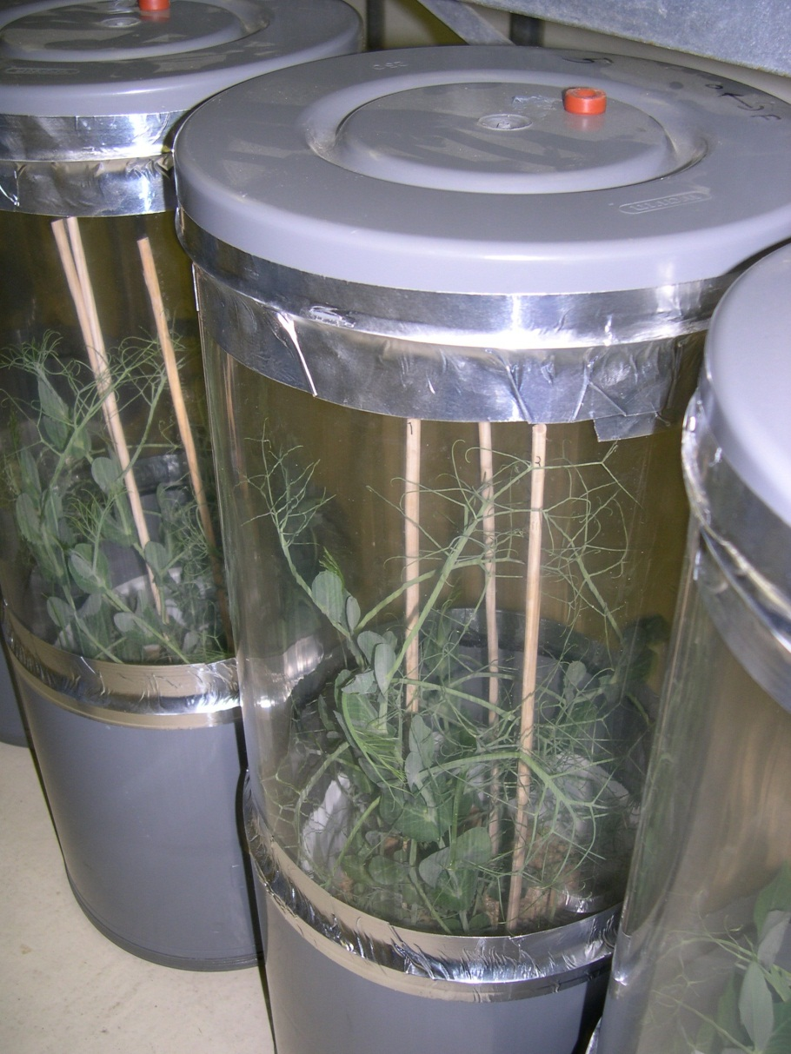
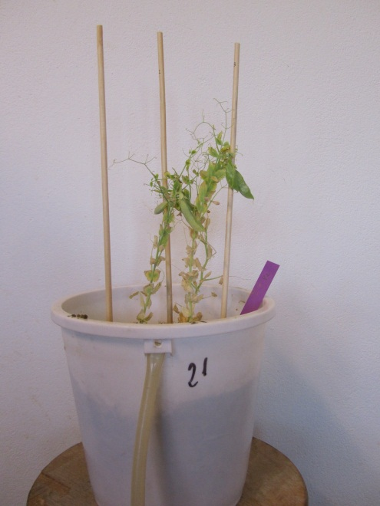
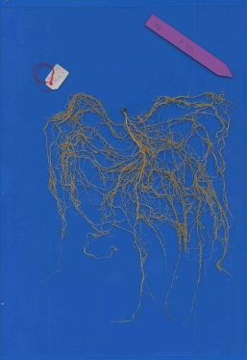
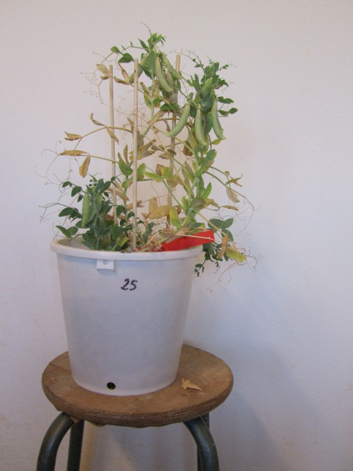
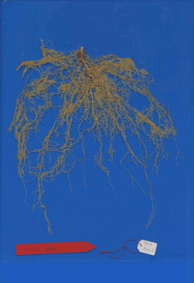
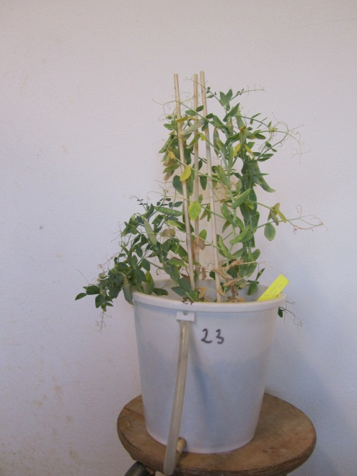
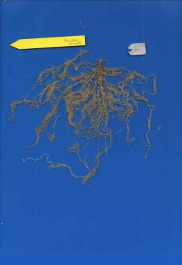
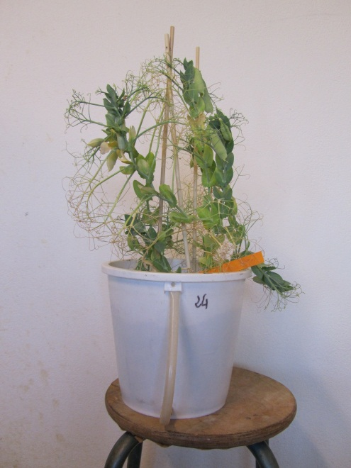
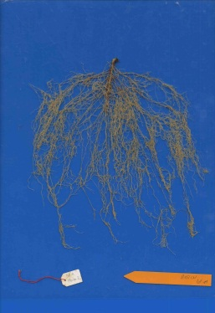
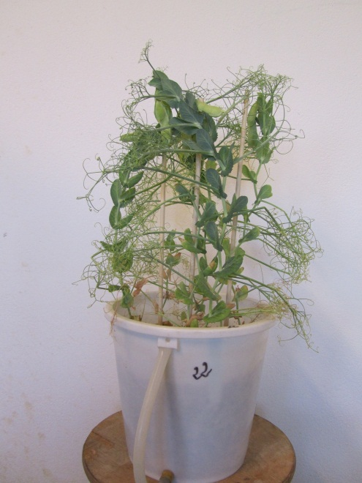
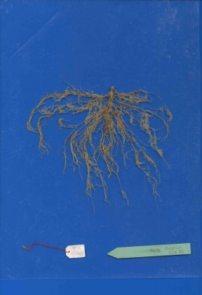



Impact of pea genetic variability on the control of N₂O reduction by soil-microorganisms-plant systems
Key words : greenhouse gas N₂O, pea genetic variability, hypernodulating mutants, Rhizobium leguminosarum biovar viciae
With the financial support of
Bourion V.⁽¹⁾, Revellin C.⁽¹⁾, Bizouard F.⁽¹⁾, De Larambergue H.⁽¹⁾, Aubert V.⁽¹⁾, Duc G.⁽¹⁾, Ferré A.S.⁽²⁾, Hénault C.⁽²⁾
(1) INRA, UMR AgroEcologie, 21000 Dijon France
(2) INRA, UR SOLS, 0272, 45075 Orleans Cedex, France
PUIGES PROJECT
1. Introduction
Agriculture, through soil emissions, is an important anthropogenic source of the greenhouse gas N₂O that has a Global Warming Potential 300 times higher than CO₂ on a molar basis (UNEP, 2013).
In soils, N₂O is mainly produced through the microbial processes of denitrification and nitrification. The last step of the denitrification process is currently the only known pathway for the terrestrial removal of N₂O. N₂O reduction is catalyzed by the N₂O reductase enzyme encoded by the nosZ gene (illustr 1).
Strategies to mitigate N₂O emissions from agricultural soils could be based on the promotion of the N₂O reduction, for example by inoculating crops with microorganisms able to reduce N₂O. Previous studies have demonstrated that soybean roots nodulated by Rhizobia strains carrying the nosZ gene are able to reduce the greenhouse gas N₂O (Sameshima-Saito et al., 2006; Hénault and Revellin, 2011).
Legume crops play a major role in sustainable agricultural systems as their nitrogen demand is mainly satisfied by the root endo-symbiosis they establish with nitrogen-fixing bacteria (Rhizobia) from the soil. Pea is an important legume crop (illustr 2). However, from our knowledge, the nosZ gene has not yet been observed in any isolated strain of Rhizobium leguminosarum biovar viciae.
The aim of this study was to assess the ability of reducing N₂O of different systems involving pea genotypes varying for their nodulation abilities.
Illustr 1 : Mechanisms involved in the N₂O budget in soil
Photo : B. Carrouée (UNIP)
Illustr 2 : A field of pea, at flowering
2. Materials and Methods
Five different pea genotypes were chosen from their varying nodulation abilities. They were (i) the old cultivar Frisson and (ii) the more recent one Austin ; hypernodulating mutants, respectively (iii) Frisson-sym29 (Bourion et al., 2007) and (iv) Austin-sym29, and (v) P2 a non-nodulating mutant of Frisson. All mutants were obtained from ethyl methane sulfonate mutagenesis.
All these five genotypes (illustr 3) plus a control (bare soil) were cultivated in a greenhouse (6 pots per genotypes, 3 plants per pot) on a soil known as unable to reduce N₂O. No inoculations were made. Nodosities were established with soil indigenous strains.
At the beginning of seed filling, pots were incubated for 48 h in airtight chambers. The N₂O concentration in chambers was periodically analyzed using a GC (electron capture detector) to evaluate N₂O production/reduction rates (illustr 4).
Illustr 3 :
Pictures of the different pea genotypes
P2
Frisson
Frisson-sym 29
Austin
Austin-sym 29
Illustr 4 : Incubation of peas during N₂O
consumption measurement
3. Results
Both the number and the mass of nodosities were higher for hypernodulating genotypes.
Variations in N₂O concentration in the airtight chambers after the 48 hours of incubation were observed between the pea genotypes.
No change of the N₂O concentration in chambers was observed on both the bare soil control and the system with Austin.
A low increase of N₂O concentration was observed for the system with the non-nodulating P2 genotype.
Conversely, the hypernodulating Austin-sym29 genotype clearly allowed a N₂O consumption.
The pea Austin-sym29 genotype has probably enhanced the development of strains having the nosZ gene and able to reduce N₂O.
Table 1 : Characteristics of nodosities and Net Flux of N₂O (µg N-N₂O h⁻¹ and per pot) by the soil planted with different genotypes of peas.
Positive values indicate a production of N₂O while negative values indicate N₂O consumption.
4. Conclusions and Perspectives
The use of hypernodulating pea genotypes has allowed to create systems (soil-plant-microorganisms) able to reduce the greenhouse gas N₂O
The next step of this study is to investigate whether if the increase of nodosities for the Austin-sym29 genotype would explain the detected N₂O consumption or if specific strains of Rhizobium leguminosarum biovar viciae with the functional nosZ gene has been preferentially selected by the pea Austin-sym29
Therefore field tests both with pea inoculation with isolated strains or with hypernodulating Austin sym 29 genotype would be necessary to quantify the N₂O reduction by this process at the field scale.
At the end, this study suggests that pea breeding and its interactions with soil microbial activities could contribute to promote the N₂O reduction in soils, as a strategy for mitigating greenhouse gas emission by agriculture.
References
Hénault C., Revellin C. 2011. Inoculants of leguminous crops for mitigating soil emissions of the greenhouse gas nitrous oxide. Plant and Soil. 346:289-296.
Sameshima-Saito R., Chiba K., et al., 2006. Symbiotic Bradyrhizobium japonicum reduces N₂O surrounding the soybean root system via nitrous oxide reductase. Appl. Env. Microb. 72:2526-2532
UNEP (2013) : A UNEP synthesis report. UNEP, Nairobi, Kenya.
Bourion V., Laguerre G. et al., 2007. Genetic variability in nodulation and root growth affects nitrogen fixation and accumulation in pea. Annals of botany. 100:589-598.

