Slide 1
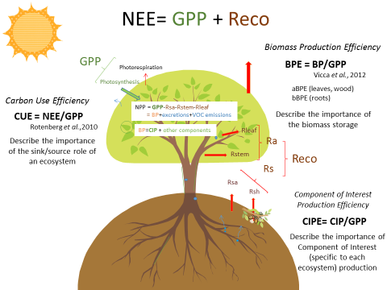
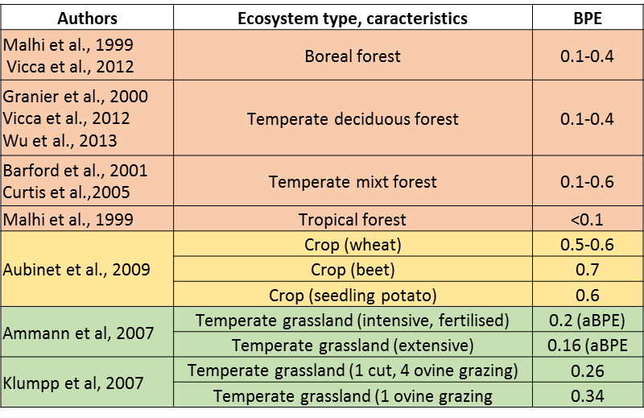
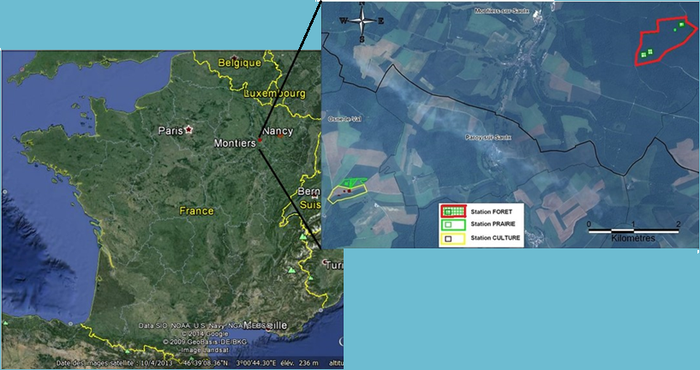
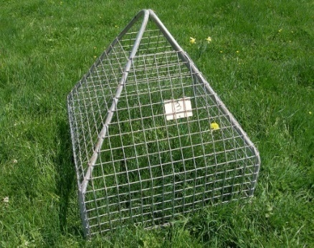
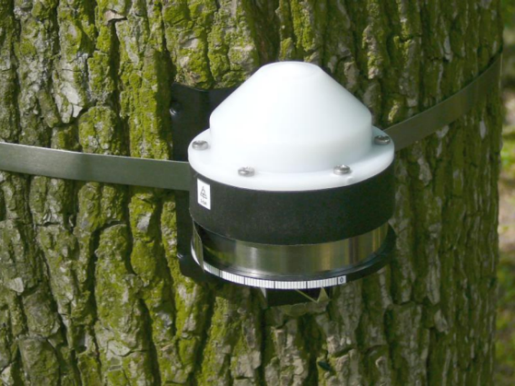
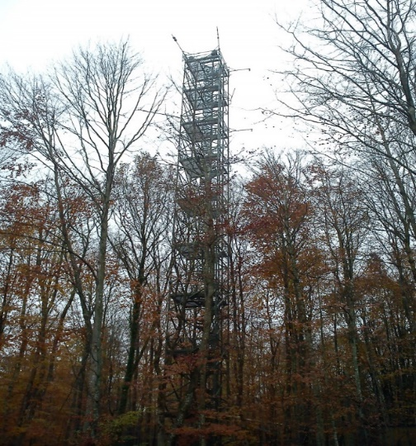
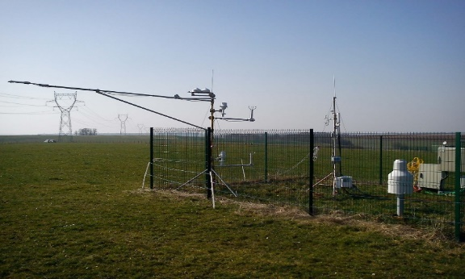
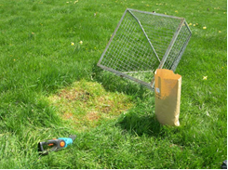
Comparison of the Biomass Production Efficiency (BPE) seasonal evolution for a forest, a crop and a grassland under similar soil and climatic conditions.
HEID Laura^{(1,2)}, CONIL Sébastien⁽²⁾, KlUMPP Katja⁽³⁾, MOUREAUX Christine⁽⁴⁾, GRANIER André⁽¹⁾, LONGDOZ Bernard⁽¹⁾
⁽¹⁾INRA, UMR EEF, UMR 1137, Champenoux, France
⁽²⁾ANDRA, DRD – OS/GES, Centre Meuse-Haute Marne, 55290 Bure, France
⁽³⁾INRA, UR EP, UR 874, Clermont-Ferrand, France
⁽⁴⁾Université de Liège-Gembloux Agro-Bio Tech, Unité de Physique des biosystèmes, Gembloux, Belgium
Context
Biomass Production Efficiency (BPE)
Uncertainties in spatiotemporal variability of C allocation models within ecosystems (Campioli et al., 2013)
Better understanding of C allocation would help to predict the strategies adopted by ecosystems to adapt to climate change
Long term ecosystem C emissions depends indeed of where the C assimilates goes (i.e. deciduous tree leaves having a life span shorter than the woody part,…) (Trumbore, 2006)
Vicca et al., 2012
$$BPE=\frac{BP}{GPP}$$
With: BP the biomass production of the year (aboveground and belowground), and GPP the Gross Primary Production
Introduced to distinguish the BPE from the ratio NPP/GPP (which also includes VOCs and root exudates) as BP is often used as proxy for NPP
Show the part of C assimilated through photosynthesis used by plant for biomass production
Ecosystem Efficiencies
State of the art
Potential determining factors:
Nutrient availability (Vicca et al., 2012, Sheriff et al., 1986)
Age (controversial: De Lucia et al., 2007; Vicca et al., 2012)
Species (Ryan et al., 1997; Aubinet et al., 2009)
Atmospheric CO₂ concentration (Matamala et al., 2003)
Acronyms:
NEE: Net Ecosystem Exchange
GPP: Gross Primary Production
Reco: Ecosystem’s respiration
Ra: aerial Respiration
Rs: soil Respiration
Rsa: soil autotrophic respiration
Rsh: soil heterotrophic respiration
NPP: Net Primary Production
BP: Biomass Production
CIP: Component of Interest Production
VOC: volatile organic compounds
Holocellulose
Lignin
Digestibility
Seed oil content
Experimental Sites
Component of interest (CI) to analyze
Forest:
→ Study zone spread on a 133 ha –toposequence, even-age stand of Beech (88%)
Grassland:
→ 8ha, cut then grazed
Crop:
→ 16ha, Canola (2013-2014)
CI : Component that we thought are interesting for the ecosystem manager
Studied soil type: Calci-brunicol
(AFES, 1998)
General objectives
Method
Obtain BPE for a weekly to monthly scale
Compare the BPE of a forest, a crop and a grassland under almost identical climatic and pedological conditions
Study relationship with climate and management
Analysis of adaptability to climate change (if large climate variability)
Compare the temporal evolution of CIPEs for the 3 ecosystems
Growth follow-up
Flux tower/mast
Photo O. Darsonville
Photo A. Naiken
Wind speed
Wind direction
Radiation
Precipitation
Eddy covariance
CO₂/H₂O profile (forest only)
Biodiversity effects on WUE
NEE
Tree growth increment
Crop, Grassland monthly sampling
Biochemical analysis
EC system: IRGA (LI 7200) coupled with a 3D sonic anemometer (Gill HS)
References
Aubinet, M. et al. (2009) Agricultural and Forest Meteorology 149, 407–418.
Bonan, G.B. (2008) Ecological Climatology: Concepts and Applications, 2nd ed. Cambridge University Press.
Campioli, M. et al. (2013) Ecological Modelling 263, 42-55
DeLucia, E.H. et al. (2007) Global Change Biology 13, 1157–1167.
Falge, E. et al. (2001) Agricultural and Forest Meteorology 107, 71-77
Matamala, R. et al. (2003) Science 302, 1385–1387.
Reichstein, M. et al. (2005) Global Change Biology 11, 1424-1439
Rotenberg, E., Yakir, D. (2010) Science 327, 451–454.
Ryan, M.G. et al. (1997) Journal of Geophysical Research: Atmospheres 102, 28871–28883.
Schädel, C. et al. (2010) Physiologia Plantarum 139, 241-255
Sheriff, D.W. et al. (1986) Tree Physiology 2, 73–88.
Trumbore, S (2006) Global Change Biology 12, 141-153
Vicca, S. et al. (2012) Ecology Letters 15, 520–526.
Waring, R.H., Running, S.W. (2010). Forest Ecosystems: Analysis at Multiple Scales. Elsevier.
Waring, R.H., Schlesinger, W.H., (1985). Forest ecosystems. Concepts and management.
Obtaining GPP
Tree monthly micro-coring, Crop and Grassland monthly sampling
Forest CI: gravimetric determination (Schädel et al., 2010)
Crop, grassland CI: chemical, IR determination (Cesar laboratory, France)
u* filtering (Reichstein et al., 2005)
Gap filling (Reichstein et al., 2005; Falge et al., 2002)
NEE partitioning (Reichstein et al., 2005)
(use of bgc-jena online tool?
Acknowledgments
The UMR1137 is supported by the French National Research Agency through the Laboratory of Excellence ARBRE (ANR-12- LABXARBRE-01)

