Slide 1
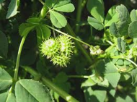




Work Package #1 : Define and establish the experimental conditions for investigating plant response to drought and Fusarium stress
INRA, CSIC, FERA, ARTERA
Christophe Salon, Carmen Bianco, Adrian Charlton, Roberto Defez, Mike Dickinson, Rebecca Iglesias, Christian Jeudy, Tracy Lawson, Jack Mathews, Ulrike Mathesius, Phil Mullineaux, Marion Prudent, Nicolas Raspail, Diego Rubiales.

Slide 2
Objectives
Protocols for investigating resistance mechanisms to drought and Fusarium,
Produce material for the consortium,
Characterize plant/pathogen interactions under drought stress and compare with optimum environmental conditions in a factorial design,
Give guidance to identified plant phenotypic traits for selecting genotypes having enhanced resistance to drought and Fusarium.

Slide 3
Tasks

Slide 4
M. Prudent and C. Salon, INRA + CSIC/ESSEX.
Description of the work
WP1
Task 1:
Defining experimental setup for cross combination of Fusarium/drought stress
Environmental conditions, phenological stages, extent/ sequence of stress)
Early indicators of plants’ responses to stress
Design for sampling
(Task 2)
Molecular analysis (Task 5)
Leaves,nodules sample
Time (months)
6
Notes:
Design the experimental setup for application of Fusarium pathogen and drought stress (environmental conditions, phenological stages and extent/sequence of stress)
Measure early indicators of the plants’ responses to progressive drought conditions (ie photosynthetic performance and gas exchange parameters
Sample leaves for measuring (a) relative leaf water content and (b) nodules and roots (for N fixation capacity and molecular analysis in Task 5).
➔ Final design of sampling experiments (Task 2).

Slide 5

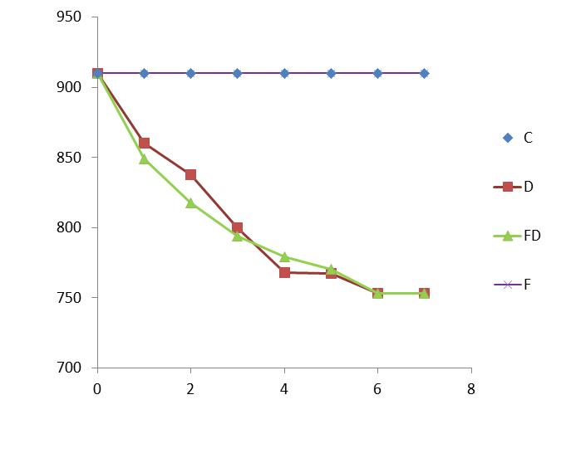
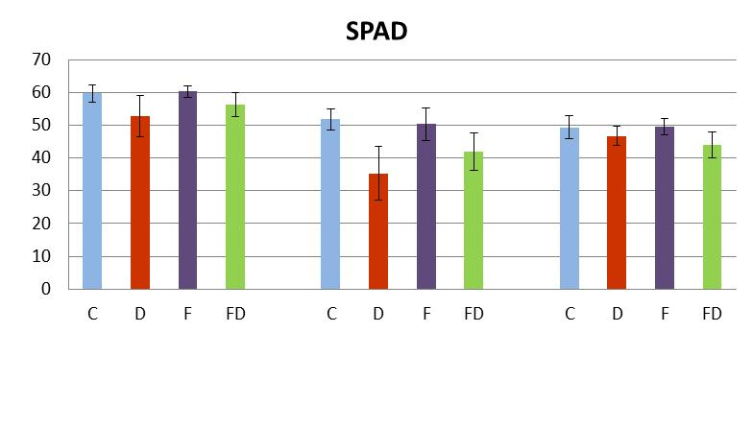
Set up: PEA example
Pilot on Cameor
Sowing
Fusarium inoculation
Water stress imposition
end
8 d
3 d
15 d
~ 2.5 leaves
~ 4 leaves
Loss of water
PILOT Experiment (genotype Caméor)
Sequence chosen
day 3
Pot weight (g)
day 5
day 7
day 3
day 5
day 7
Days after water stress imposition
Leaf 4th
Leaf 5th
+ 3 volumes of Fusarium inoculation tested: 10, 20, 30, 50 mL

Slide 6
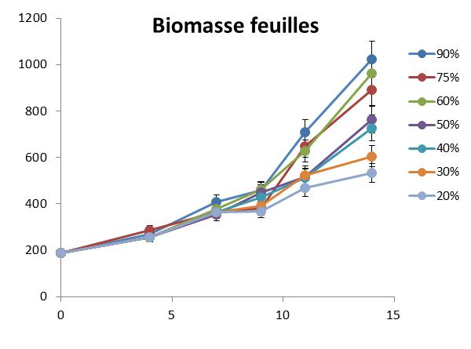
Set up: PEA example
Stress intensity
Comparison of different water stress intensities (2012) :
Stress amplitude fixed
~ 5 leaves
Leaf biomass
Days after water stress imposition
Notes:
Un effet de l’intensité du stress hydrique sur la biomasse foliaire, mais pas d’effet sur biomasse racinaire et nombre de nodules

Slide 7
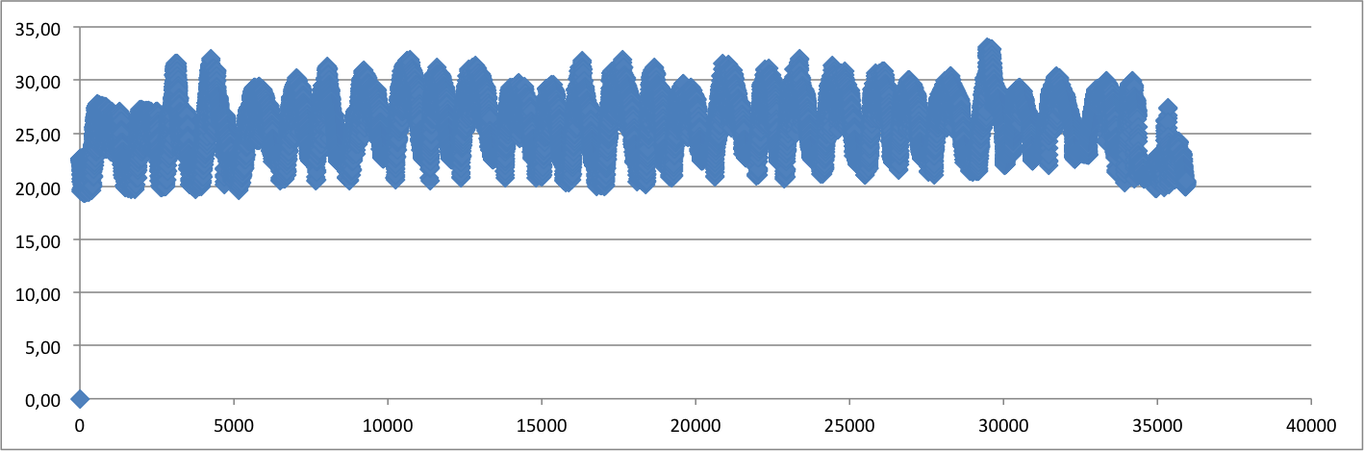


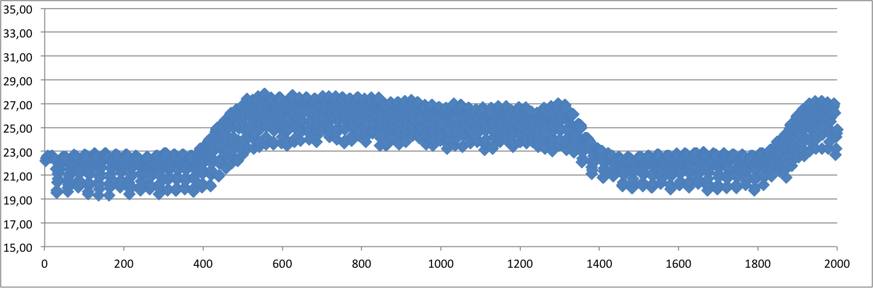
Set up: greenhouse conditions
…and daily

Slide 8
Plant watering verified
BOM
BOP
Automatic

Slide 9
Lessons from the « pilots »
Transferring protocols devised for the infection of plants with Fusarium in highly controlled environments: challenging in the local conditions in Dijon.
Drought conditions, with fluctuations in the internal environment of the platform: challenging conditions in which to undertake controlled experiments.
This added complexity for example the interpretation of physiological data
This ensures that findings are likely to be more relevant to those obtained in field trials than anticipated.
  Relevant transferable protocols for scaling up combined stresses in the large phenotyping platform

Slide 10


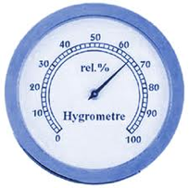
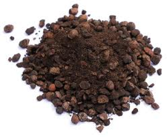


=> Large scaling experiment design
COMPARTMENT
PPHD
25/04
21/05
28/05
02/06
07/06
09/06
20/06
Préparing pots
Fusariose Infection
Sowing
Inoc Fusa
Hydric Stress
70
60
50
40
650 plants, sown
325 infected by fusariose
325 with hydric stress
perlite : biot sand B4, 3 :1
28°C day, 24°C night;
16 hours

Slide 11


Detail
Drought period
1 | 2 | 3 | 4 | 5 | 6 | 7 | 8 | 9 | 10 | 11 | 12 | 13 | 14 | 15
Day of week
Poro et Psycro
DM (Shoots, roots, nod)
Nb nod
Surface foliaire
Phénotypage
Fluxomique
5 plants * 4 treatments+ 29 plants (12/rhizotrons + 15N/marquage)
8 plants* 4 treatments
Gaz exchange
Harvest(shoot et roots)
Freezer storage

Slide 12
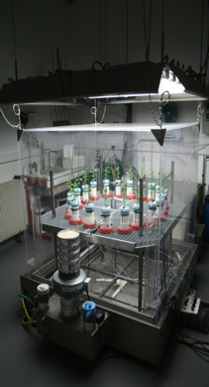
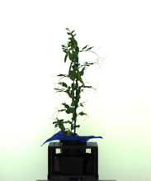

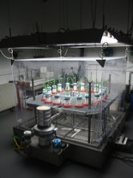
Detail
Drought period
1 | 2 | 3 | 4 | 5 | 6 | 7 | 8 | 9 | 10 | 11 | 12 | 13 | 14 | 15
Day of week
Poro et Psycro
DM (Shoots, roots, nod)
Nb nod
Surface foliaire
Phénotypage
Fluxomique
5 plants * 4 treatments+ 29 plants (12/rhizotrons + 15N/marquage)
Visible cabin
Rhizotron et rhizocab
3 plants * 4 treatments
¹³C et ¹⁵N labeling
3 plants * 4 treatments
3 fois par semaine

Slide 13
Tasks

Slide 14
Description of the work
C. Salon, INRA.
WP1
Task 1:
Defining experimental setup for cross combination of Fusarium/drought stress
Phenotypic, C/N, DW characteristics (PPHD, rhizotrons)
Non invasive measures of plant performance
Experimental design
Struct./funct. descriptors,
signalling compounds
Task 2:
Produce plant material
leaves, root nodules samples
Study of fusarium / drought stress interaction in other WPs
Time (months)
6
12

Slide 15
Tasks

Slide 16

Description of the work
M. Prudent and C. Salon, INRA
WP1
Task 1:
Defining experimental setup for cross combination of Fusarium/drought stress
Task 2:
Produce plant material
Struct./funct/
descriptors
Task 3:
Analyzing data
Study of fusarium/drought stress interaction in other WPs
Study of fusarium/drought stress interaction in other WPs
Key process, involved in structural or functional changes
Time (months)
6
12
18
24
Notes:
Data mining of experiments will be performed for Medicago and pea that describes both the evolution of plant biomass and C and N intakes as a function of environmental conditions.
➔ Identify process modified by the « factorial combination »

Slide 17
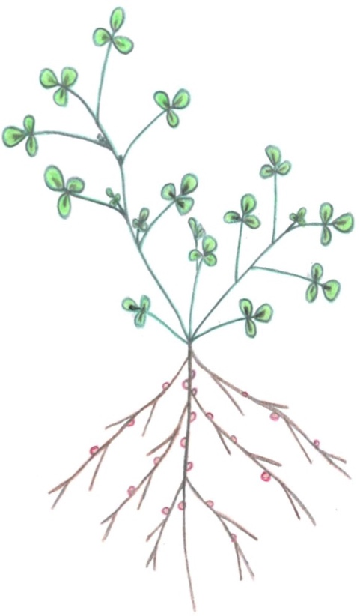
Some results: medicago and pea
How did treatments affect after 12 days:
development,
growth: carbon acquisition, partitioning
Notes:
The second critical phase of reserve mobilization occurs during seed filling which depends upon the external N supply. The exogenous N supply later cannot generally sustain the high N demand of developing seeds, specially under water stress, pH and salinity or phosphorus limitations which greatly reduce symbiotic fixation: as such, root assimilation of soil mineral N becomes the only remaining exogenous supply of N for seed filling. Because of the earlier limitation of root growth (preceding slide), the shallow root system has a poor N assimilation potential.
Hence, seed growth throughout the plant involves N remobilization from the vegetative tissues. The re-export of the protein content of leaves (mostly photosynthetic machinery) to growing seeds leads to foliar senescence, determines the duration of canopy light interception, the end of C accumulation by the seeds and hence seed size.

Slide 18

Physiological data (Pre-pilot)

Slide 19
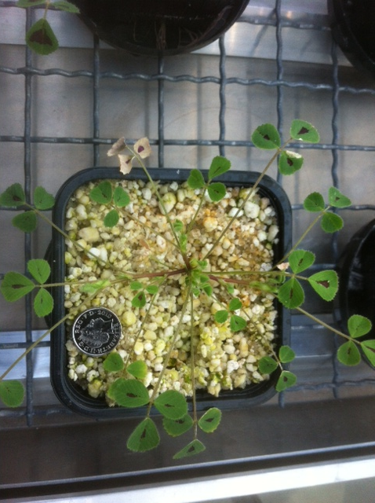
IRGA measurements (Essex)
Instantaneous (snapshot) readings of Assimilation rate (A_{net}) and stomatal conductance (gs) under natural light and saturating light. Two leaves
(youngest fully expanded) per plant and five reps per treatment.
Example from Pre-pilot.
All IRGA measurements were re-calculated to correct for area. All measurement taken between 9 am -12pm

Slide 20
Stomatal resistance
BOP
BOM
July 1st
July 3rd
July 7th
July 8th
July 11th
Drought increases stomatal resistance.
Fusarium:
  amplified the drought stress of plants for both BOM and BOP
  had no effect when plants were well watered for pea and a detrimental effect similar to water stress alone for Medicago plants

Slide 21
Growth: plant, shoots, roots
BOMedicago
C
F
D
FD
C
F
D
FD
C
F
D
FD
Plant DM
Shoot DM
Root DM
Stress reduce plant growth
Shoot biomass mostly impacted.
Shoot over root biomass ratio decreased for water stressed. Already reported in previous report (M18) and for various species.
Fusarium seemed to counteract the drought stress effect (reducing impact on shoots mostly and also roots): explanations ?
Shoot DM/Root DM
C: Control; F: Fusarium infected; D: Drought applied; FD: both stress

Slide 22
Nodules
BOMedicago
C
F
D
FD
C
F
D
FD
C
F
D
FD
Total Nodule DM
=
Nodule number
X
Mean nodule weigth
Stress reduce nodule DM (F effect ?)…
…either nodule number and/or ind. weigth.
Fusarium leads to bigger nodules in absence of water stress and smaller with drought (?).
Nodules represent a lower part of nodulated roots under stress
similar as in M18
Nod DM/Nod root DM
C: Control; F: Fusarium infected; D: Drought applied; FD: both stress

Slide 23
Nitrogen content
BOMedicago
C
F
D
FD
C
F
D
FD
C
F
D
FD
Plant N
Shoot N
Root N
Compartments [N] :
  N status slightly affected, a slight reduction of root N content.
  OK with previous data
Fusarium did not affect N content of plants parts.
C
F
D
FD
Nodule N
C: Control; F: Fusarium infected; D: Drought applied; FD: both stress

Slide 24
Fluxo: N and C specific activities
BOMedicago
C
F
D
FD
C
F
D
FD
A detailed view at the end of drought
Daily C incorporation
Leaf SA = C incorporation/shoot DM
Daily N incorporation
Nodule SA = N incorporation/nodule DM
Stems (photosynthesizing) acquired more carbon than leaves
Water stress affects plant C/N allocation, mostly to shoots, stems and nodules, not to root (constant)
No effect of Fusarium on C and N acquisition
Leaf SA reduced, Nodules SA maintained by drought
C: Control; F: Fusarium infected; D: Drought applied; FD: both stress

Slide 25
Growth: plant, shoots, roots
BOPea
C
F
D
FD
C
F
D
FD
C
F
D
FD
Plant DM
Shoot DM
Root DM
Drought reduces slightly plant growth
  Shoot biomass mostly impacted, roots maintained.
  Shoot over root biomass ratio decreased for water stressed. Already reported in previous report (M18) and for various species.
Fusarium (again) seems to counteract the drought stress effect (reducing impact on shoots mostly and also roots).
Data similar as in M18’s dynamic experiment
Shoot DM/Root DM
C: Control; F: Fusarium infected; D: Drought applied; FD: both stress

Slide 26
Nodules
BOPea
C
F
D
FD
C
F
D
FD
C
F
D
FD
Total Nodule DM
=
Nodule number
X
Mean nodule weigth
Drought
  reduces nodule weigth and number with fusarium.
Fusarium leads to bigger nodules with or without water stress
Nodules = a lower part of nodulated roots under drought stress
Similar as in M18 and for Mt experiment
Nod DM/Nod root DM
C: Control; F: Fusarium infected; D: Drought applied; FD: both stress

Slide 27
Nitrogen content
BOPea
C
F
D
FD
C
F
D
FD
C
F
D
FD
Plant N
Shoot N
Root N
Drought
  Plant N decreased by 20%
  Mostly shoots
  Nodules slightly affected
Fusarium did not affect N content of plants parts.
C
F
D
FD
Nodule N
C: Control; F: Fusarium infected; D: Drought applied; FD: both stress

Slide 28
Fluxo: N and C specific activities
BOPea
C
F
D
FD
C
F
D
FD
Daily C incorporation
Leaf SA = C incorporation/shoot DM
C
F
D
FD
C
F
D
FD
Daily N incorporation
Nodule SA = N incorporation/nodule DM
Pea leaves main sink for new C
Water stress affects plant C and N allocation, mostly to shoots, stems and nodules, not to root (maintained), like Mt
No effect of Fusarium on C and N acquisition
Both leaf SA and Nodules SA reduced by drought, reinforced by total nodule biomass decrease
As the decrease in nodule biomass was rel. less important than that of total N plant incorporation a greater decrease of nodule specific activity is observed/expected.
C: Control; F: Fusarium infected; D: Drought applied; FD: both stress

Slide 29
BOPea and BOM
Pea WW
Pea WS
Mt WW
Mt WS
BOM
BOP
C and N flows tightly linked, plant impacted by water stress have lower C and N incorporations (as seen before)
Slopes indicate the “reactivity” of species: Mt less reactive to drought
Higher efficiency of Mt : smaller nodules and less numerous nodules) ?
  Mt nodules have twice SA than pea nodules

Slide 30
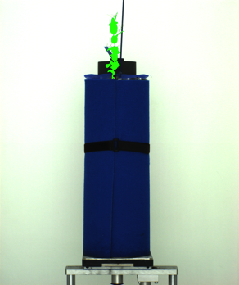






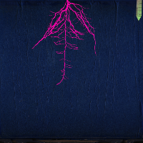
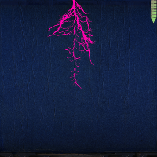
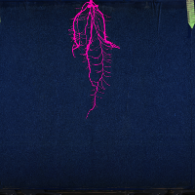



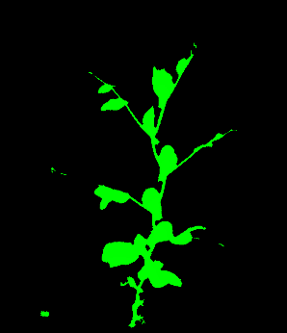
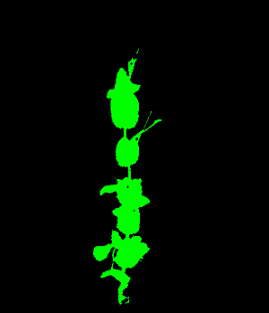
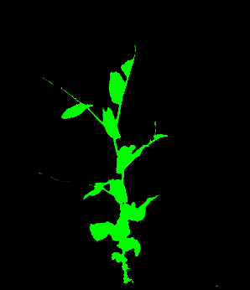

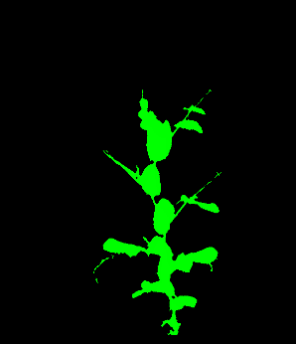

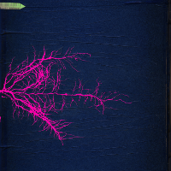
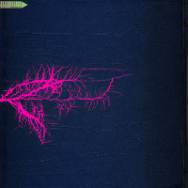
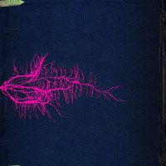
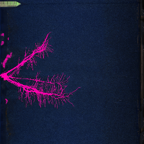
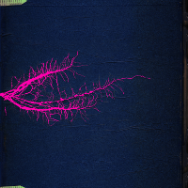
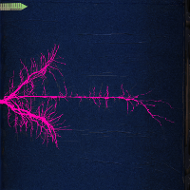
BOP
WW fusa-
WW fusa+
Rhizo 11
Rhizo 13
Rhizo 23
Rhizo 08
Rhizo 07
Rhizo 02
30/06
11/07

Slide 31





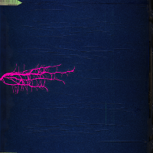

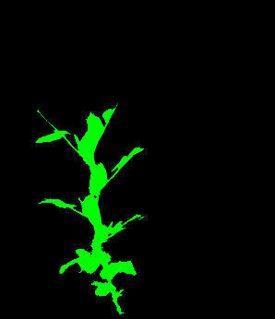


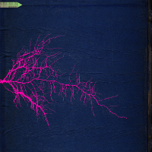
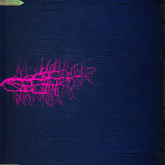
BOP
WW fusa-
WS fusa-
Rhizo 11
Rhizo 13
Rhizo 23
Rhizo 24
Rhizo 17
Rhizo 14
30/06
11/07

Slide 32



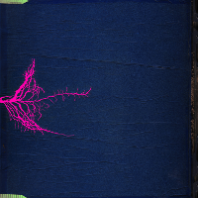

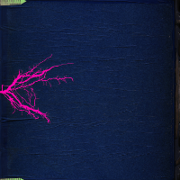






BOP
WS fusa-
WS fusa+
Rhizo 24
Rhizo 17
Rhizo 14
Rhizo 18
Rhizo 20
Rhizo 09
30/06
11/07

Slide 33
BOP
WW fusa-
WS fusa+
Rhizo 11
Rhizo 13
Rhizo 23
Rhizo 18
Rhizo 20
Rhizo 09
30/06
11/07

Slide 34



















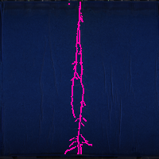



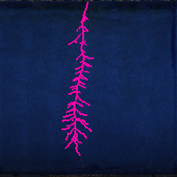
BOM
WW fusa-
WW fusa+
Rhizo 01
Rhizo 19
Rhizo 16
Rhizo 05
Rhizo 15
Rhizo 22
09/06
20/06

Slide 35









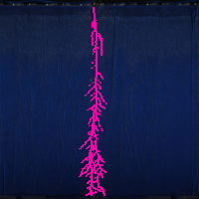


BOM
WW fusa-
WS fusa-
Rhizo 01
Rhizo 19
Rhizo 16
Rhizo 21
Rhizo 10
Rhizo 03
09/06
20/06

Slide 36












BOM
WS fusa-
WS fusa+
Rhizo 21
Rhizo 10
Rhizo 03
Rhizo 12
Rhizo 04
Rhizo 06
09/06
20/06

Slide 37
BOM
WW fusa-
WS fusa+
Rhizo 01
Rhizo 19
Rhizo 16
Rhizo 12
Rhizo 04
Rhizo 06
09/06
20/06

Slide 38
BOM and BOP: Roots RhizoTubes vs Pots ?
Mt
Pea
C
F
D
FD
C
F
D
FD
Root DM
Root DM
Root Projected area
Root Projected area

Slide 39
BOPea and BOM: RhizoTubes vs Pots ?
Publication submited
Same results on another experiment with pots or rhiztrons on pea and medicago: RT are usefull tools

Slide 40
Tasks

Slide 41
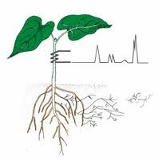
Description of the work
A. Charlton, M. Dickinson, FERA
Task 1:
Defining experimental setup for cross combination of Fusarium/drought stress
Task 2:
Produce plant material
Task 3:
Analyzing data
Struct./funct/
metabolomic
descriptors
Study of fusarium/drought stress interaction in other WPs
Task 4:
Metabolomics
Key process, involved in structural or functional changes
Time (months)
6
12
18
24
Notes:
Molecular phenotypes will be assessed alongside data from high-throughput phenotyping platforms
use molecular traits as predictive biomarkers of resistance to combined biotic and abiotic stressors,
step reduction in breeding cycle.

Slide 42
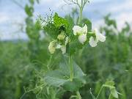
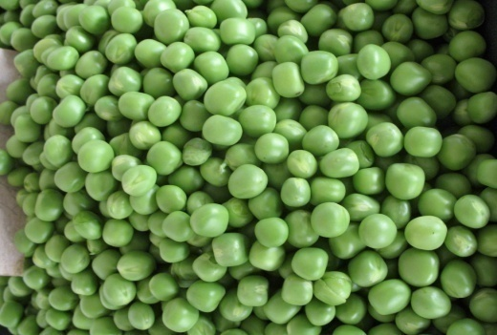
Baseline metabolome data from Medicago /pea

Slide 43
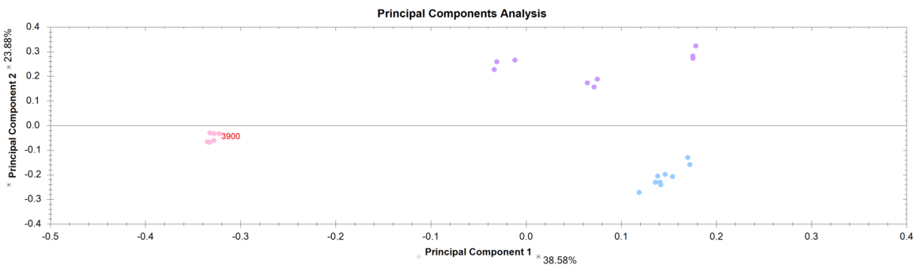
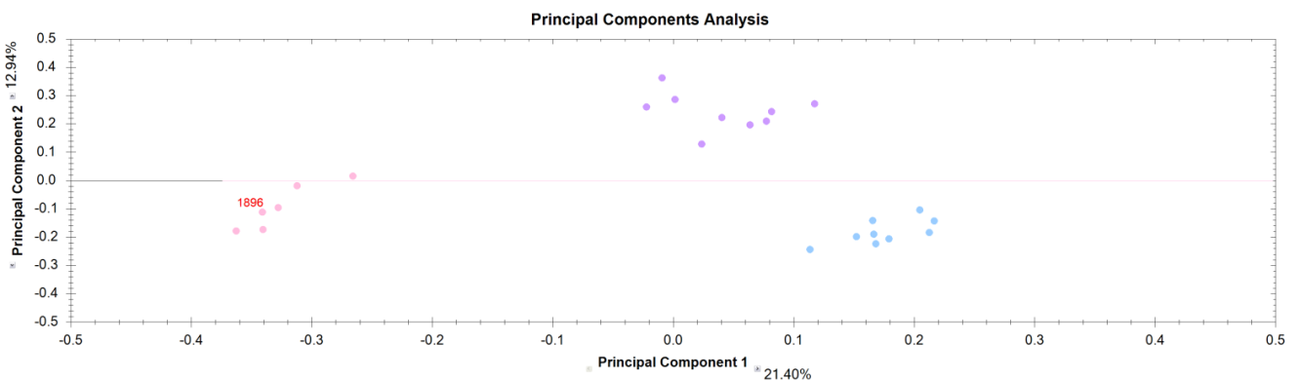
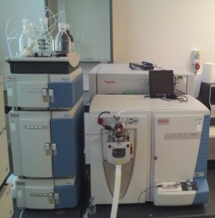
Baseline metabolome data from Medicago pilot – LC-HRMS PCA
Well watered plants
Positive ion mode
Reference material
Drought plants
Negative ion mode
Well watered plants
Reference material
Drought plants

Slide 44
Example compounds signficantly changing in drought stressed Medicago tentatively identified by LC-HRMS
Tentative compound ID | Levels observed (Up / Down) | Ionisation mode | Mean max fold change
putrescine | ↑ | Positive | 68.4
hesperetin (iii) | ↑ | Both | 39.1
dihydrobiochanin A (ii) | ↑ | Positive | 33.7
glutathione | ↓ | Positive | 31.7
pisatin (i) | ↑ | Positive | 31.0
ascorbate | ↓ | Negative | 29.4
ferreirin (iii) | ↑ | Both | 25.3
4-anisic anhydride (ii) | ↑ | Both | 24.9
dehydroascorbate | ↓ | Positive | 16.3
ermanin (i) | ↑ | Positive | 15.0
proline | ↑ | Positive | 12.9
cirsiliol | ↑ | Negative | 8.2
hematoxylin (iii) | ↑ | Negative | 7.8
histidine | ↑ | Positive | 6.8
inositol (iv) | ↓ | Positive | 6.4
abscisic acid | ↑ | Negative | 5.0
raffinose | ↑ | Positive | 4.6
glucose-6-phosphate | ↓ | Positive | 4.4
hexapyranose (iv) | ↑ | Positive | 3.9
oxylipin-3 | ↑ | Positive | 3.5
malic acid | ↓ | Negative | 3.5
asparagine | ↑ | Positive | 3.5
pectolinarigenin (i) | ↑ | Positive | 3.4
gamma-tocopherol | ↑ | Positive | 2.8

Slide 45
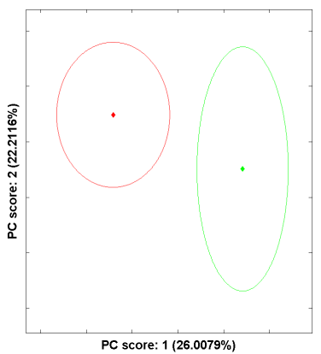
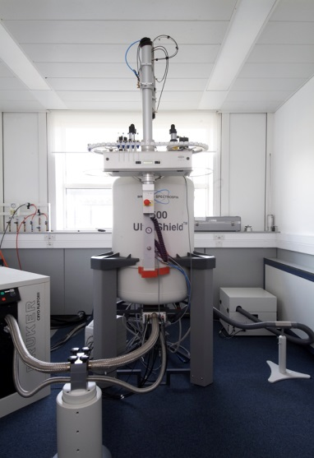
Baseline metabolome data
from Medicago pilot – LC-HRMS PCA
Drought plants
Well watered plants

Slide 46
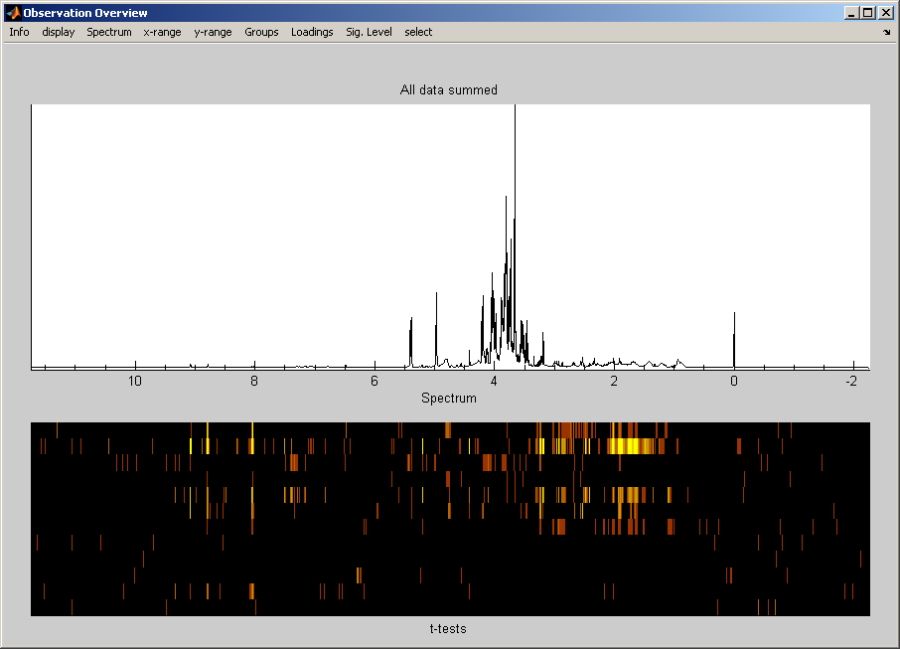
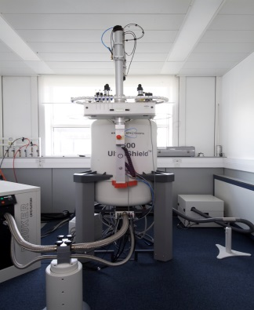
Metabolite variation in drought stressed vs well watered pea study: NMR data
Significant t-test results highlighted by brighter colours
Clearly metabolic changes associated with drought stress have been detected in the seeds

Slide 47
Metabolite variation in drought stressed vs well watered pea study: NMR data
Metabolite | Chemical shift correlations (ppm)
Proline | 4.133-63.87; 3.342-48.72; 3.423-48.68; 2.071-31.55; 2.356-31.61; 2.009-26.41.
Leucine | 1.712-42.34; 0.969-24.77; 0.957-23.68.
Isoleucine | 1.013-17.24; 0.938-13.55.
Valine | 3.615-63.25; 2.289-31.84; 1.049-20.64; 0.999-19.37.
Threonine | 4.259-68.56; 1.336-21.90.
γ-aminobutyrate | 3.012-41.92; 2.311-36.91; 1.904-26.21.
Homoserine (CID:7799) | 3.858-56.13; 3.783-61.40; 2.152-34.82; 2.033-34.78.
Myoinositol (CID:892) | 4.061-74.95; 3.624-75.24; 3.544-73.89; 3.270-77.14.
Trigonelline (CID:5570) | 9.132-148.40; 8.841-147.50; 8.821-148.57; 8.089-130.17; 4.437-50.92.

Slide 48
Tasks

Slide 49
Description of the work
R. Defez and C. Bianco, ARTERA
WP1
Task 1:
Defining experimental setup for cross combination of Fusarium/drought stress
Nodules sample, molecular analysis
Task 2:
Produce plant material
Task 3:
Analyzing data
Task 4:
Metabolomics
Impact of mutated genes on performance of symbiotic N fixation in fusarium/drought stress interaction in WP3
Abundance of rhizobacteria in nodules, number of nodules, impact on N fixation, state of senescence of nodule
Task 5:
Role of symbiotic bacteria
Time (months)
6
12
18
24
30
Notes:
Characterize relations between symbionts under stress conditions :
Performance and abundance of the rhizobacteria in nodules,
Number of nodules on the roots, state of senescence of nodules
Impact on N fixation.
➔ to compare with data from in tasks 1 and 2.

Slide 50
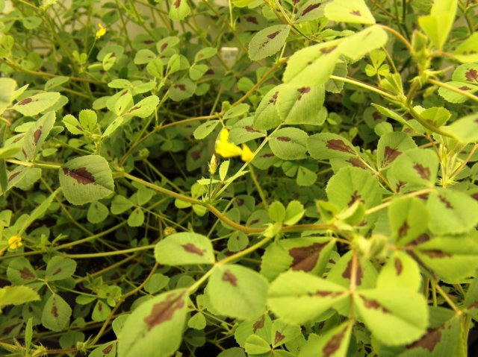
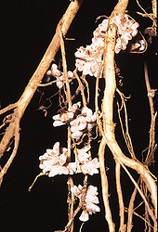
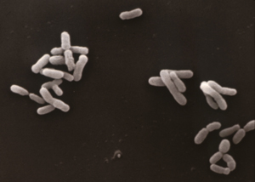
The interaction between legumes and rhizobia leads to the development of a nitrogen-fixing symbiosis
M. truncatula
S. meliloti
Root
nodules
Several environmental factors can adversely affect the performance of symbiotic nitrogen fixation by legumes. These factors may act at the following levels: survival of rhizobia in the soil, the infection process, nodule growth and nodule function. These factors can also indirectly affect N₂ fixing performance through their negative impact on the host plant growth.
wtr – wild type rhizobium
GMr – IAA-overproducing rhizobium

Slide 51
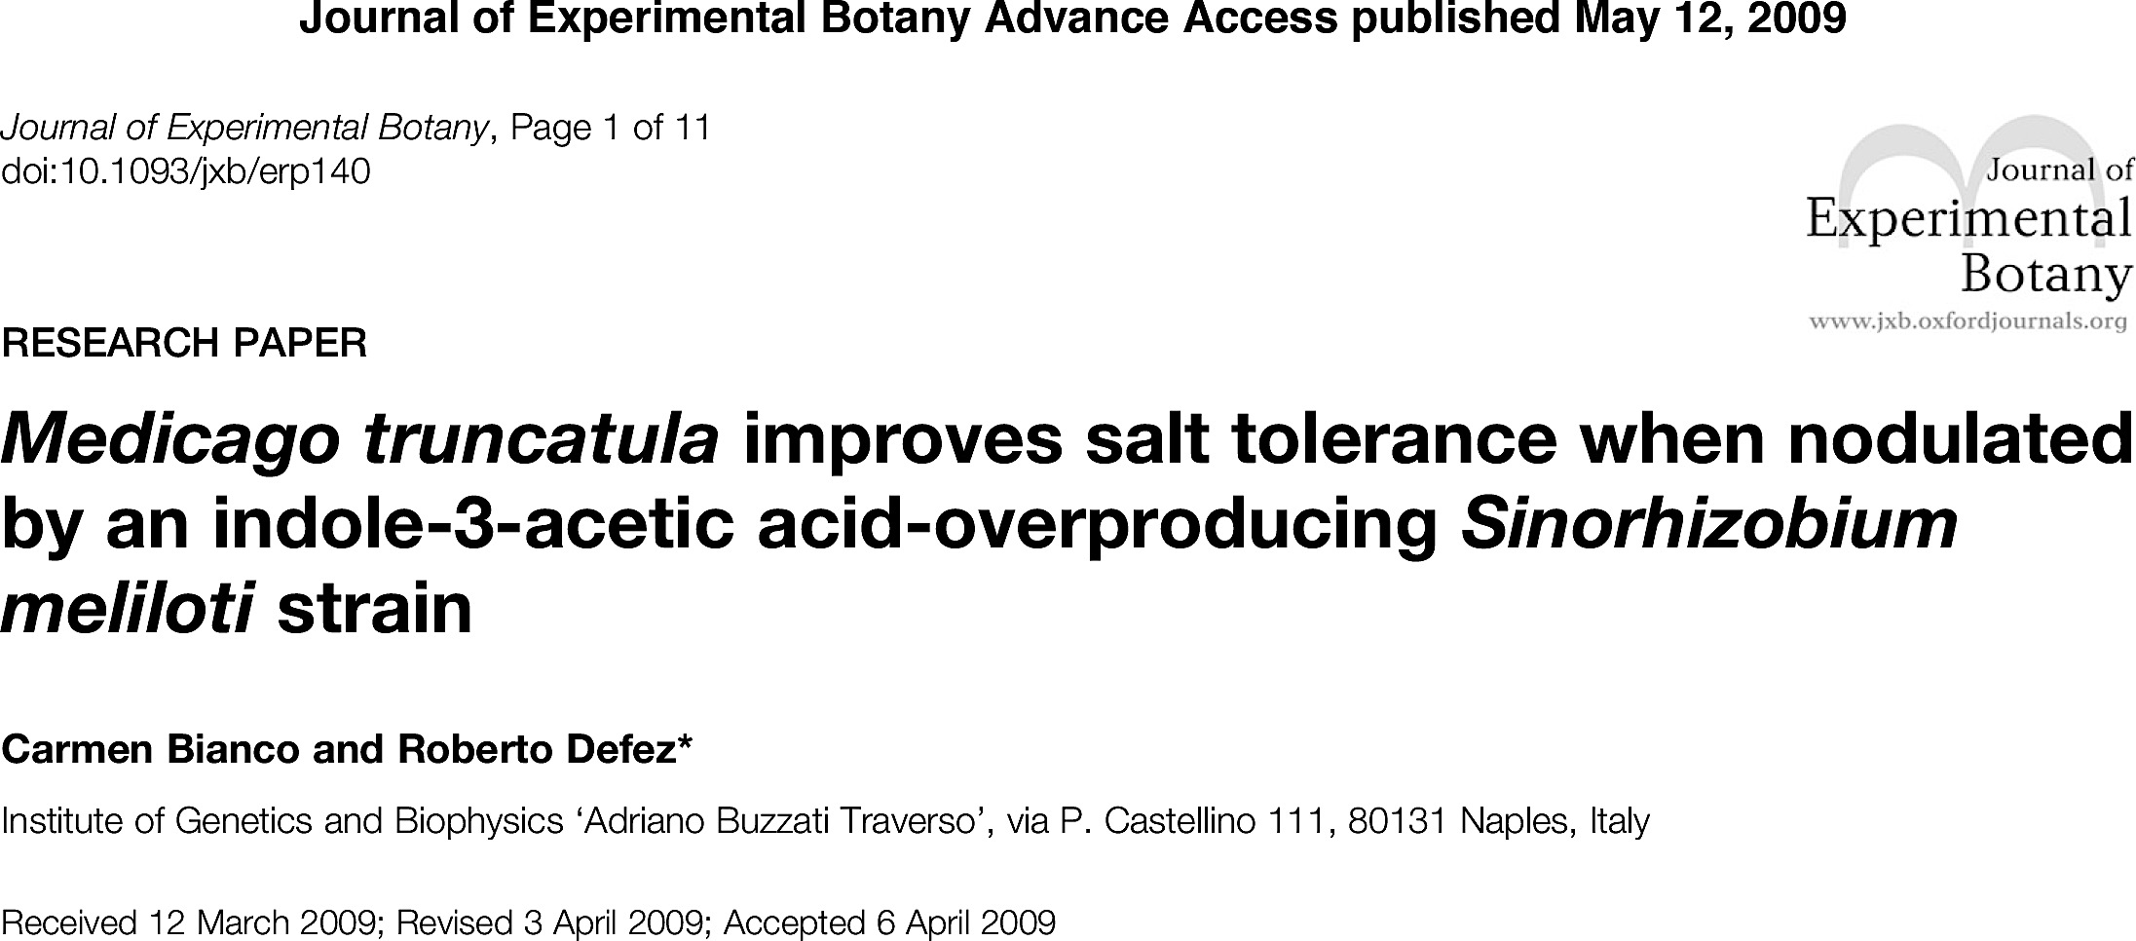



Under salt-stress condition, reduced symptoms of senescence, lower expression of ethylene signalling genes, lower reduction of shoot dry weight, and better nitrogen-fixing capacity have been observed for Medicago plants nodulated by an IAA-overproducing S. meliloti strain.
Mt-1021
Mt-RD64
Control
NaCl-treated

Slide 52



Medicago truncatula plants nodulated by an IAA-overproducing S. meliloti strain and grown under P-deficient conditions showed significant increases in both shoot and root fresh weights when compared to those nodulated by the wild type strain.
P-sufficient
P-limiting
P-sufficient
P-limiting
Mt-1021
Mt-RD64

Slide 53
qPCR analysis of nif and fix genes in M. truncatula root nodules during drought stress and Fusarium attack
The relative expression levels shown in the Figures are >1 for genes more highly expressed in nodules of D (WS F-), F (WW F+) and FD (WS F+) plants as compared to C (WW F-) control plants. The data reported in the Figure are the means ±standard deviation of four biological replicates.
The negative effects related to the stress treatments were visible after six days of treatment. Indeed, at this time, all the three genes tested involved in nitrogen fixation were significantly repressed.

Slide 54
qPCR analysis of nifA and nifH genes in Pea root nodules during drought stress and Fusarium attack
The relative expression levels shown in the Figures are >1 for genes more highly expressed in nodules of D (WS F-), F (WW F+) and FD (WS F+) plants as compared to C (WW F-) control plants. The data reported in the Figure are the means ±standard deviation of four biological replicates.
The data clearly show that the singular stress negatively affect the expression of selected genes and that the down-regulation is even more pronounced when double stress (DF) is applied. The down-regulation of N-fixation genes begins as early as the third day of treatment reaching its maximum after 6 day, after which the damage was retained.

Slide 55

Impact of microbes diversity level
BQR project
level of microbial diversity
Varying:
Drought extent
Genotype
Impact of diversity level
of soil microbial communities
on pea plant response to water stress
Pea (frisson)
Mutant myc-/nod-
A higher diversity level of soil microbial communities
Floral initiation
Drought
Flowering
Maturity
Optimal water conditions
has no impact on pea drought tolerance…
… but provides better pea resilience after stress
Similar response with or without symbioses: non symbiotic communities play a role in this response

Slide 56
Write an ABSTRESS positioning paper on physiological characterization, 1 for pea and 1 for Mt
Thanks for your attention

Slide 57
Conclusions
Both integrative and high resolution experiments : drought greatly decreased carbon incorporation of both Medicago and pea, root biomass less impacted.
Water stress negatively impacted nodule number in Medicago while mean nodule biomass was targeted in pea.
No clear trend concerning pathogen attack.
Labelling experiment shown that N flow was greatly reduced by drought for pea (leaves, stems and nodules), while medicago seemed to be much less impacted for its compartments.
In pea both i) leaf specific activity and ii) nodule biomass and nodule specific activity were severely decreased by water stress, not by fusarium.
In Medicago, only leaf specific activity was reduced by water stress.
A tight carbon/nitrogen relationships was obtained during the labelling experiment:
  Allows estimating the degree of stress sensed by plants, efficiency to react faced to a stress.
Rhizotubes mimics pot growth
Image analysis is a powerful tool to follow dynamically and automatically, non-destructively shoot and root projected area.

