Slide 1
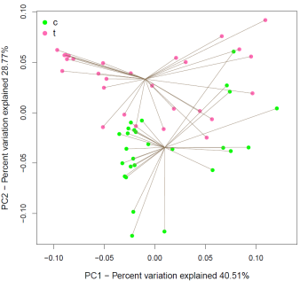
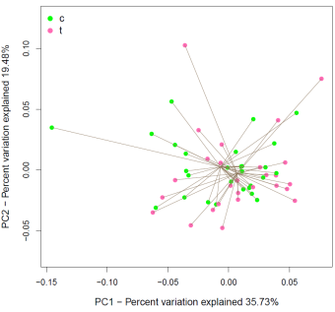
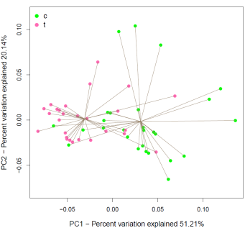
EFFECT OF AN EARLY LIFE ANTIMETHANOGENIC TREATMENT ON METHANE EMISSIONS IN GROWING LAMBS
C. Saro, M. Bernard, D. Graviou, Y. Rochette, C. Martin, M. Doreau, H. Boudra, M. Popova, D.P. Morgavi
INRA, UMR Herbivores, 63122 Saint-Genès Champanelle, France
INRA, UE Herbipôle, 63122 Saint-Genès Champanelle, France
INTRODUCTION
Microbial colonization after birth can affect rumen function and microbiota structure later in life. Rumen development provides an opportunity for manipulation ruminal microbial ecosystem.
The objective of this study was testing whether methane emissions in growing lambs could be modulated by a non toxic antimethanogenic treatment administered in early life.
METHODS
Treatment (T)
-1.6 mL/kg BW/day linseed oil
-3 µL/kg BW/day garlic essential oil
Control (C): sugar-beet molasses
(same volume as treated lambs)
Both administered with a drencher
Experimental design
30 lambs
First period
w/o treatment
Second period
C1
60 lambs
15 lambs
T1
8 wk
10 wk
14 wk
15 lambs
C2
0 wk
16 wk
20 wk
Two treatment periods:
-From birth to week 10: T1
-From week 16 to week 20: T2
30 lambs
15 lambs
T2
-CH₄ (in vitro)
-NGS
15 lambs
birth
-CH₄ (chambers)
-qPCR
-NGS
-CH₄ (chambers)
-qPCR
-NGS
Methane measurements
Archaeal community measurements
-8 weeks
Ex situ measurement (animals too small for chambers) → Ruminal fluid incubated in batch fermentors
-Abundance of mcrA gene at 14 and 20 weeks (qPCR)
-Next generation sequencing (NGS; Illumina) of archaeal amplicons (primers 349F and 806R) at 8, 14 and 20 weeks
-Sequencing data processing → QIIME and mothur
-UniFrac distances were calculated from OTU tables as a measure of dissimilarity between samples and its PCoA was represented into biplots
-14 weeks
Open-circuit respiration chambers (2-3 lambs/chamber) → Emissions per kg of dry matter intake (DMI)
-20 weeks
RESULTS
Methane measurements
µmol CH₄/mL rumen fluid
g CH₄ /kg DMI
*
*
-At 8 weeks in vitro methane production was 24% lower in treated lambs
-At 14 weeks there was no difference between treatments in methane emissions
-At 20 weeks methane emissions were 13.7% lower in treated lambs. No difference was observed within the groups between the lambs treated or not in the first period
qPCR
Principal coordinate analysis of weighted UniFrac distances
log number of copies mcrA gene / mL rumen fluid
8 weeks (T1 vs C1)
14 weeks (T1 vs C1)
20 weeks (T2 vs C2)
*
-Lower abundance of mcrA gene was observed at 14 weeks in treated lambs (T1)
-No difference was observed in week 20 (T2)
Archaeal community structure was particularly affected by treatment at 8 and 20 weeks
The treatment with garlic essential oil and linseed oil, although effective for reducing methane when applied to young lambs, was not able to have a lasting effect on methane emissions.
There was an effect on archaeal community abundance four weeks after the end of the treatment, but it was not reflected in methane emissions.
The research leading to these results has been conducted as part of the FACCE-JPI (NRA) RumenStability project. C. Saro gratefully acknowledges the receipt of a postdoctoral fellowship (Fundación Alfonso Martín Escudero).

