Slide 1
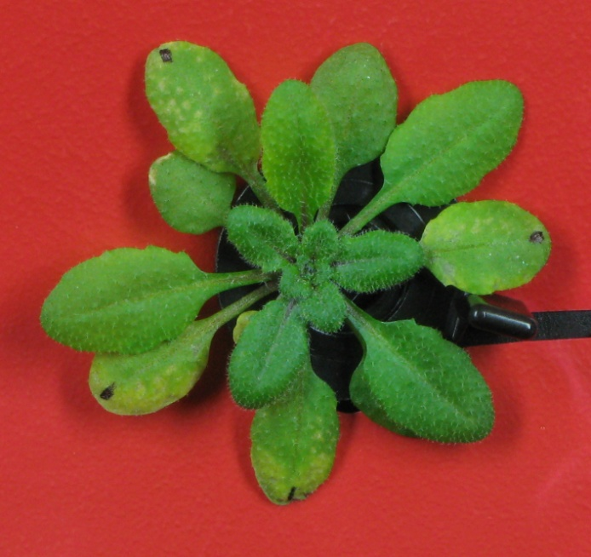
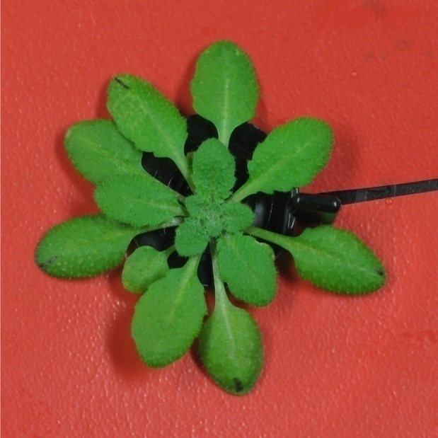
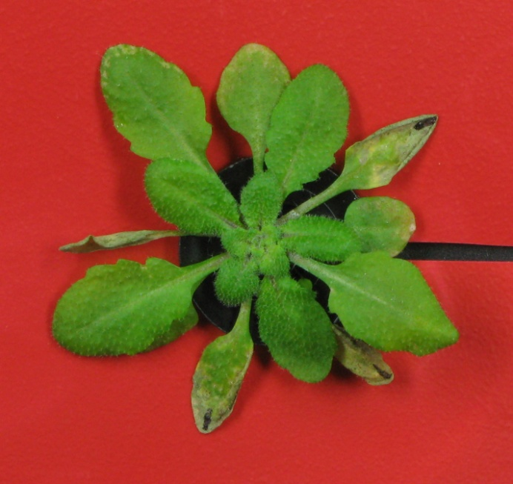
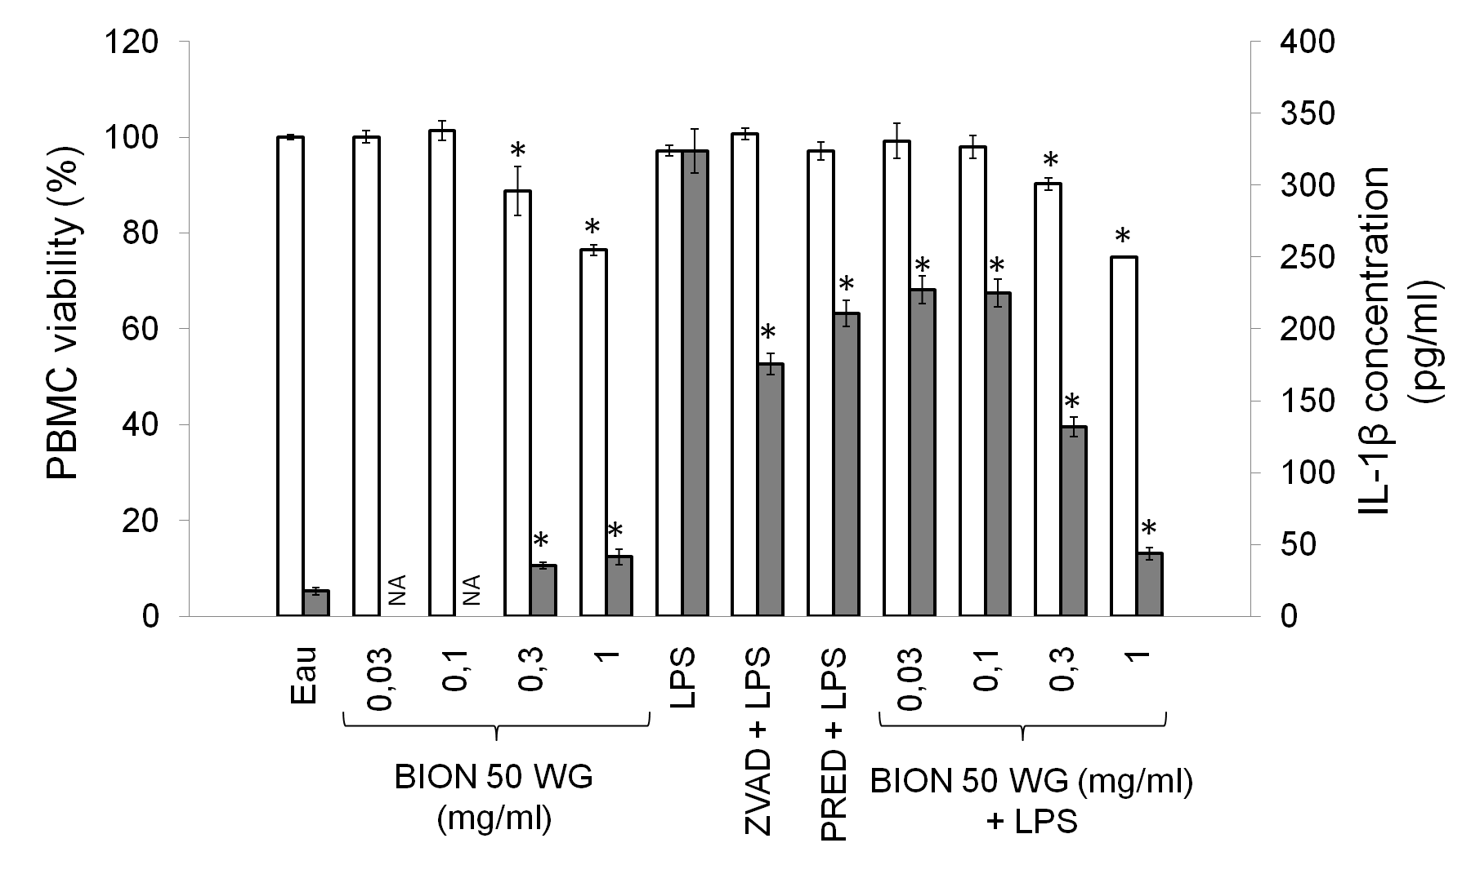
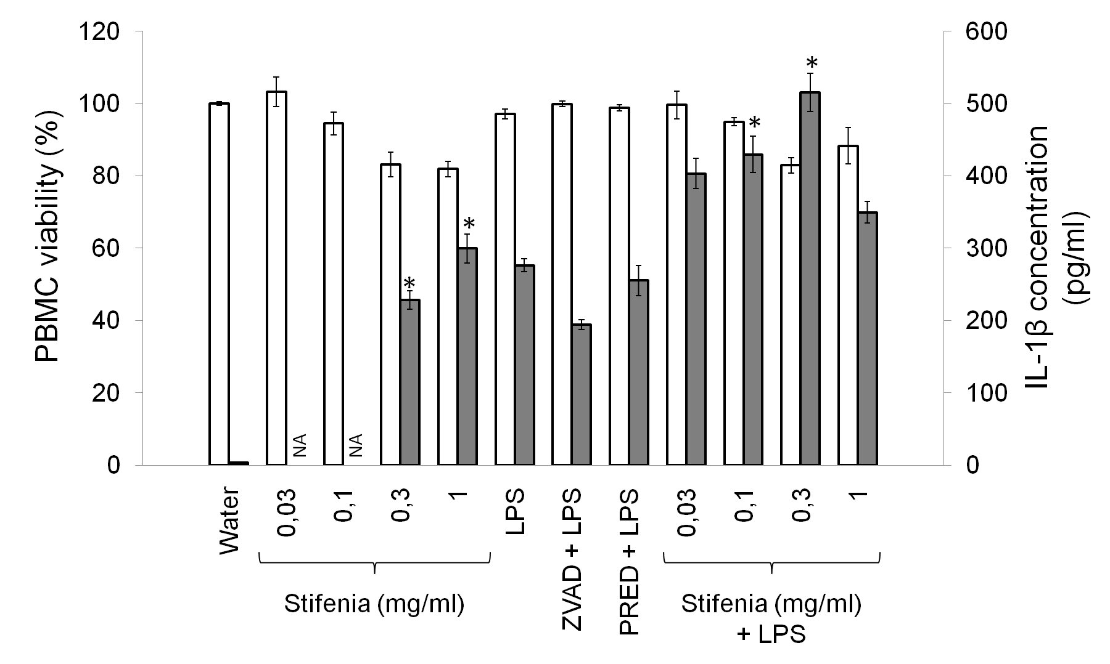
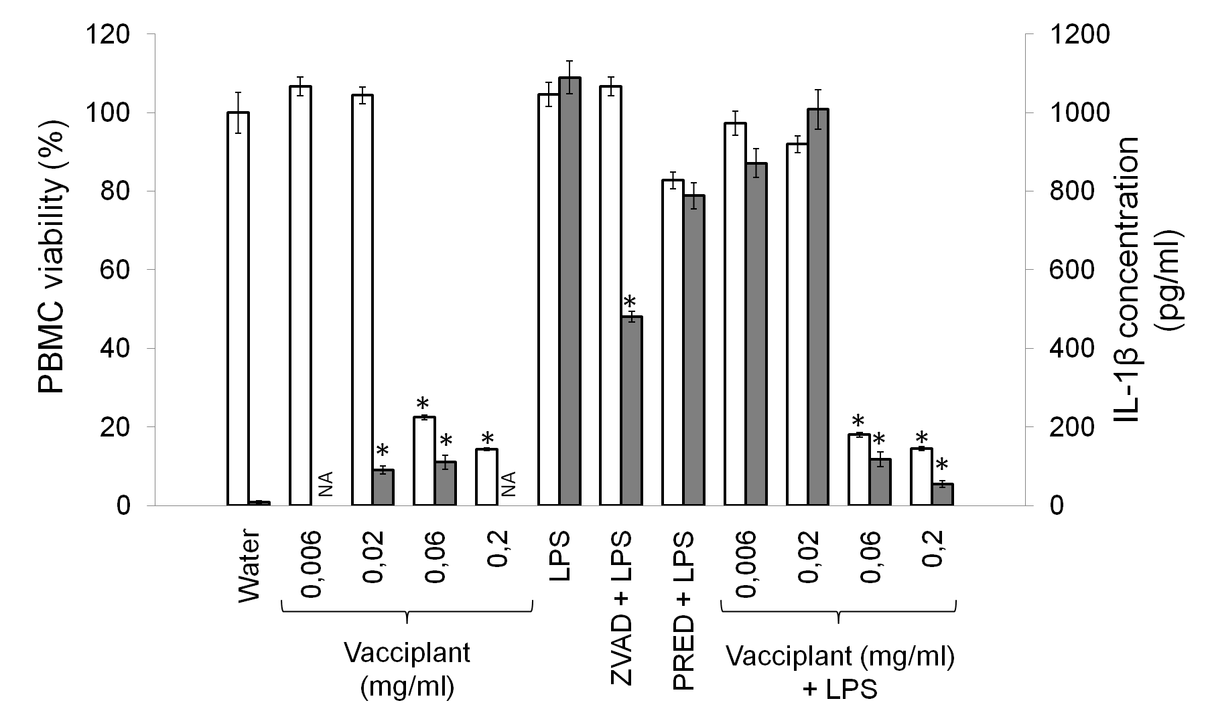
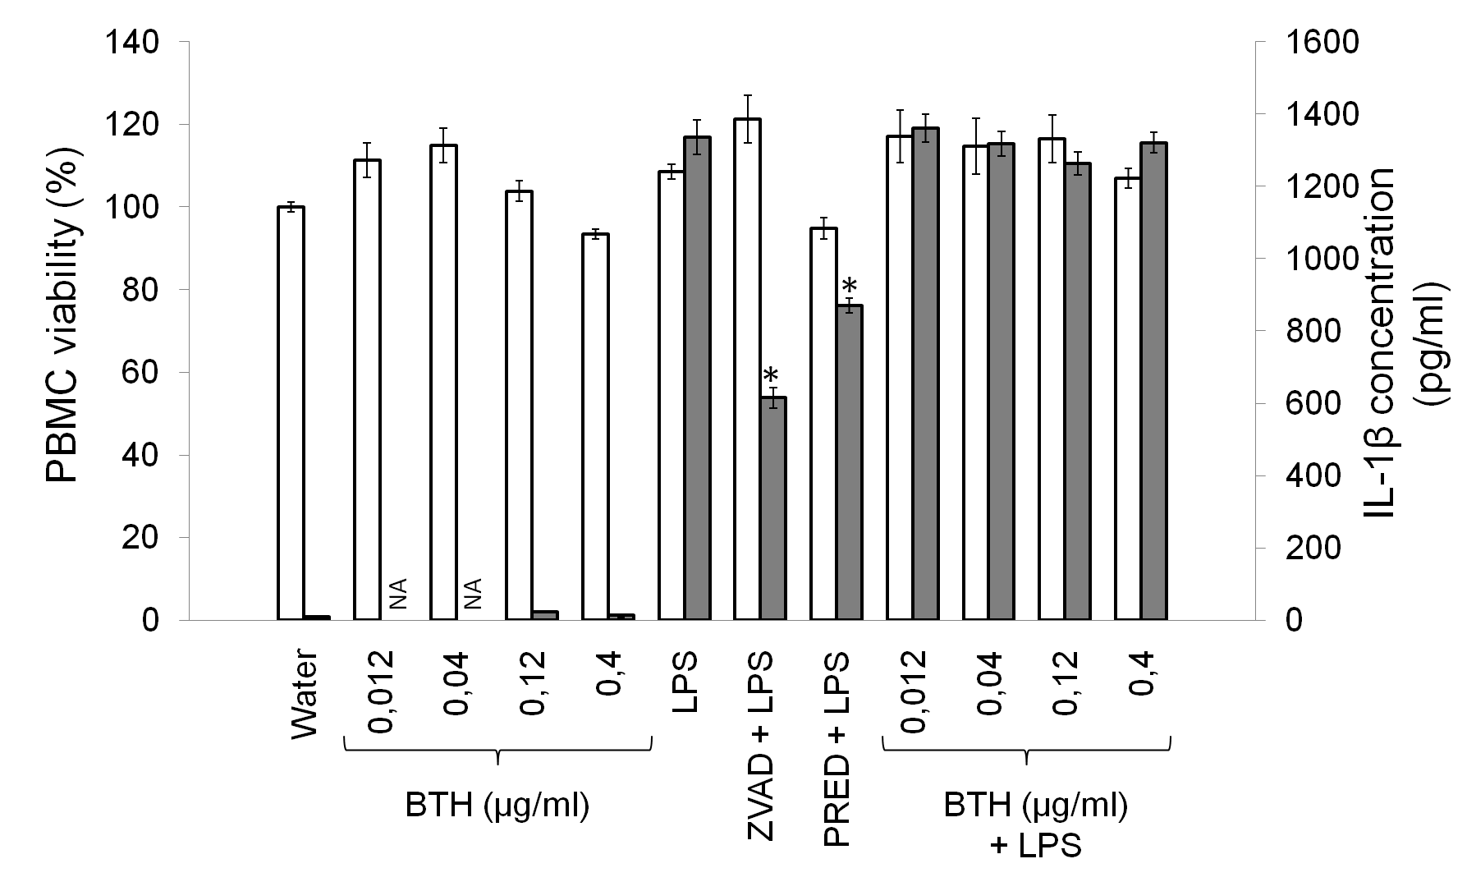
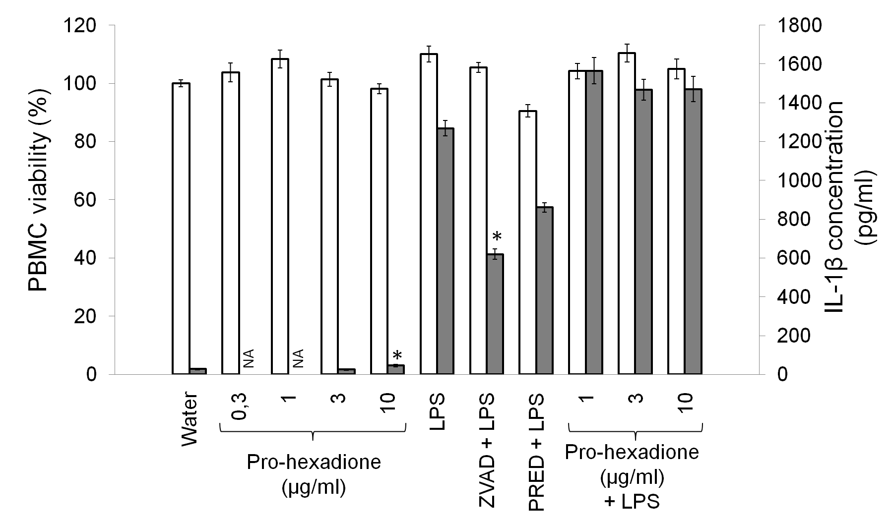
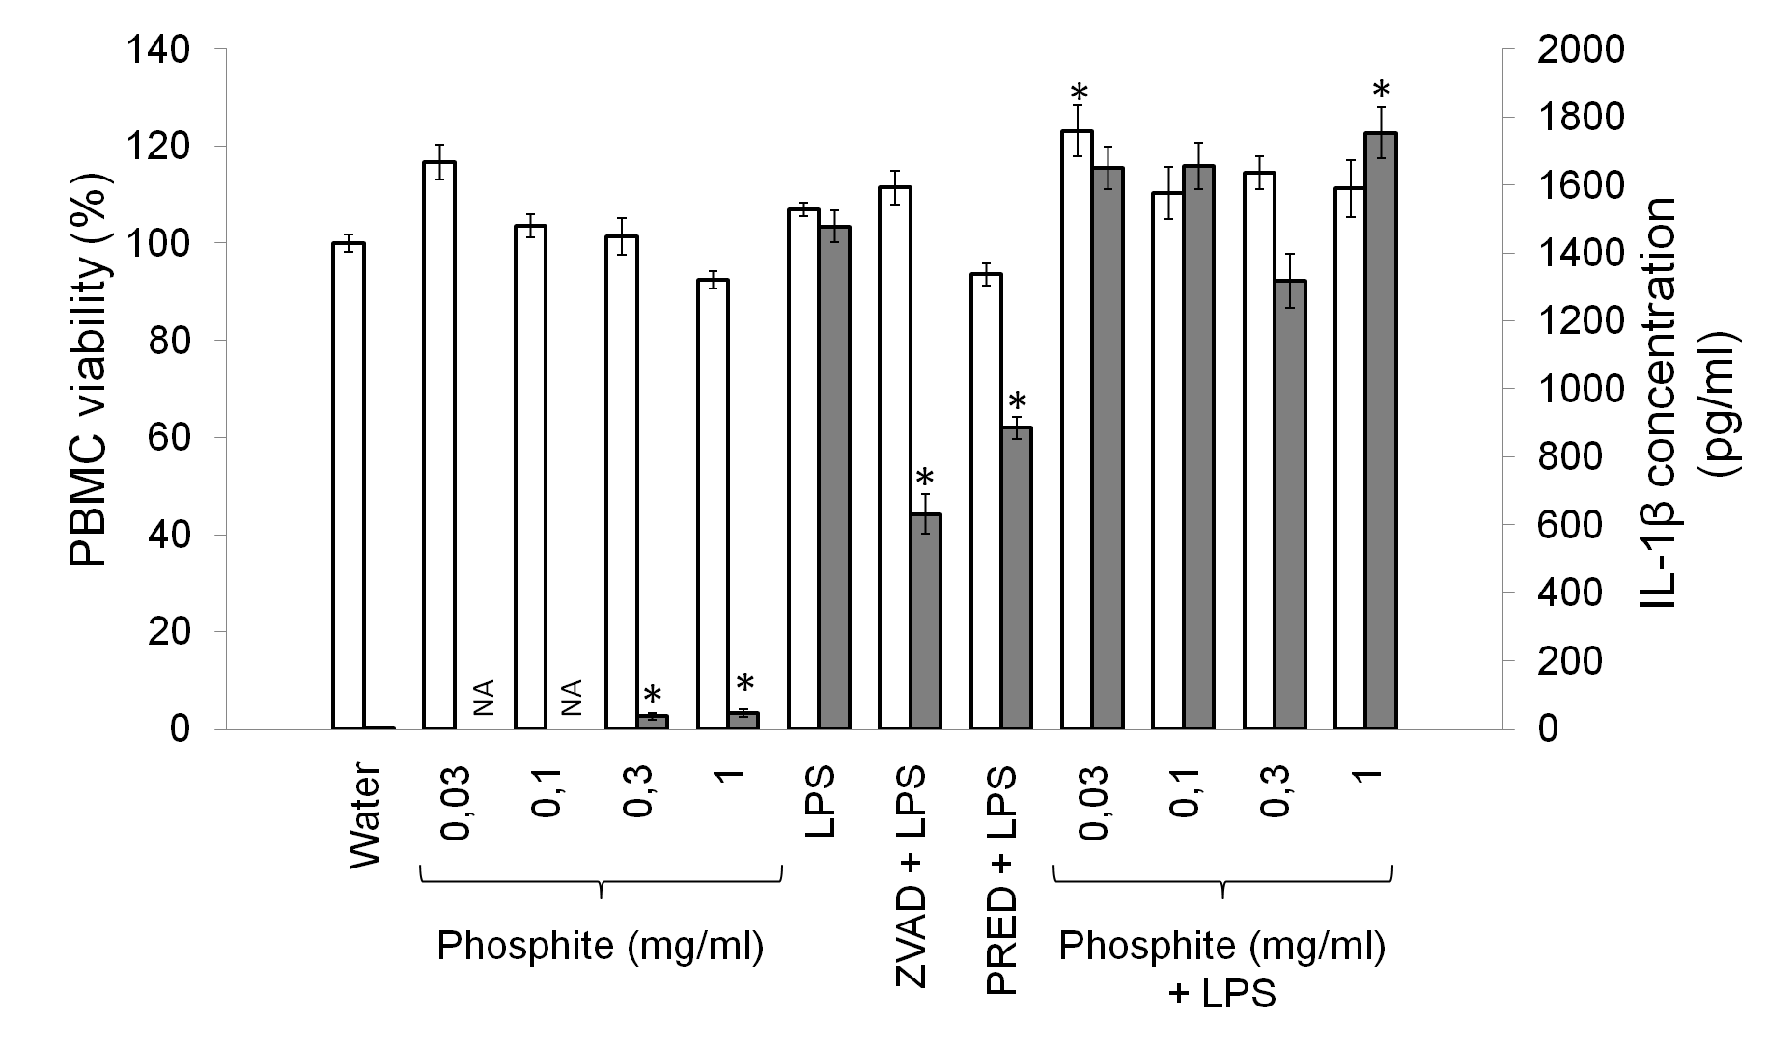
Effect of commercially available PDS
(plant defense stimulators) on human innate immunity
Lény TEYSSIER^{a,c}, Stéphanie DELEMASURE-CHALUMEAU^{b}, Patrick DUTARTRE^{b}, David WENDEHENNE^{c}, Olivier LAMOTTE^{d}, Jean-Louis CONNAT^{a,b}
a: INSERM U866 Lipide Nutrition Cancer, Université de Bourgogne, LPPCM, Facultés de Médecine et Pharmacie, 7 Bd Jeanne d’Arc, 21079 Dijon Cedex, France
b: COHIRO Biotechnology, UFR de Médecine de Dijon, Facultés de Médecine et Pharmacie, 7 Bd Jeanne d’Arc, BP 87900, 21079 Dijon Cedex , France
c. Université de Bourgogne, UMR 1347 Agroécologie, ERL CNRS 6300, 17 Rue Sully, 21000 Dijon, France
d. CNRS, UMR 1347 Agroécologie, ERL CNRS 6300, 17 Rue Sully, 21000 Dijon, France
Introduction
Material and methods
PDS (plant defence stimulators) constitute a recent alternative to pesticides used for crop protection. These compounds, also called elicitors, are of diverse nature, but they all act by stimulating innate immune system of plants. So, plants can better fight pathogens.
We studied the pro/anti-inflammatory effect on human PBMC (peripheral blood mononuclear cells) of PDS (cf. Table1). Only the soluble fraction of PDS was studied.
Table 1: List of the commercially available PDS and there respective active molecule
Pathogen inoculation
active ingredient | IUPAC name for identified active molecule | commercial formulation name
acibenzolar-S-méthyl | S-methyl 1,2,3-benzothiadiazole-7-carbothioate | Bion® 50 WG
seed extract of fenugreek | not applicable | Stifenia®
phosphonates | potassium dihydrogen phosphate | Etonan®
prohexadione | 3,5-dioxo-4-propanoylcyclohexane-1-carboxylic acid | Regalis®
laminarin | not communicated | Vacciplant®
+ elicitor
resistant
- elicitor
susceptible
studied
to be studied
seeding
(10⁵ cells/wells)
Pro-inflammatory test
There are many similarities in pathogen perception systems and cellular signalling in plants and animals. Moreover, it is well established that many elicitors stimulate both human and plant innate immunity (Zipfel and Felix, 2005)¹. Therefore, it is likely that human innate immunity could be modulated by PDS.
+PDS
Cell culture medium
ELISA assay
IL-1β
incubation
(20 hours)
XTT test
Viability
The aim of this study is to evaluate pro/anti‑inflammatory activity of five different commercially available PDS and their respective active molecules on human cell models.
+PDS
+LPS
Anti-inflammatory test
cells
Results
PBMC viability as a percentage of control cells treated with the vehicle (water)
IL-1β concentration in culture medium (pg/mL)
Figure 1: Effect of PDS on PBMC viability and production of IL-1β.
Cells were treated with different concentrations of PDS and stimulated with LPS (10 ng.mL-1) when specified (+ LPS). After treatment, the cells were incubated for 20 hours. The viability values ​​were normalized to 100% with the control treated with the vehicle (water). For each conditions, viability histograms (white) and IL-1β concentration (gray) represent the mean value of 8 technical replications. Error bars represent the standard error of each condition.Statistical analysis of differences between conditions were performed using Dunnett’s test with a significance threshold of 5%. Significant differences are indicated with an asterisk (*). For statistical analysis of the viability test, all the conditions were compared with the water control. Concerning ELISA assay statistical analysis, unstimulated PBMC treated with BION 50 WG were compared to the unstimulated control treated with the vehicle (water) whereas PBMC treated with PDS and stimulated with LPS were compared to untreated PBMC stimulated with LPS (LPS).
NA: not available, BTH: S-methyl 1,2,3-benzothiadiazole-7-carbothioate.
Discussion and perspectives
This study shows that some PDS can have cytotoxic or pro/anti­inflammatory effects on human cells. Vacciplant is cytotoxic at 0.06 and 0.2 mg/ml. Bion 50 WG is slightly cytotoxic at 0.3 and 1 mg/ml and have an anti-inflammatory effect on PBMC stimulated with LPS for the same concentrations. Stifenia is pro-inflammatory at 0.1, 0.3 and 1 mg/ml and the pro-inflammatory effect is additive with those of LPS. To further understand the mode of action of PDS that modulate IL-1β production, a caspase 1 activity assay will be used to determine the role of inflammasomes in the induction of IL-1β production in response to PDS.
Inflammasome activation
Caspase 1 activity
IL-1β production
IL-1β gene regulation
Pro IL-1β
1) Zipfel, C., and Felix, G. (2005). Plants and animals: a different taste for microbes? Curr. Opin. Plant Biol. 8, 353–360.
The 2014 Innate Immunity Summit
Notes:
54*76
PDS was used at equal or lower concentration than those applied in the field. Enlevé

