Slide 1
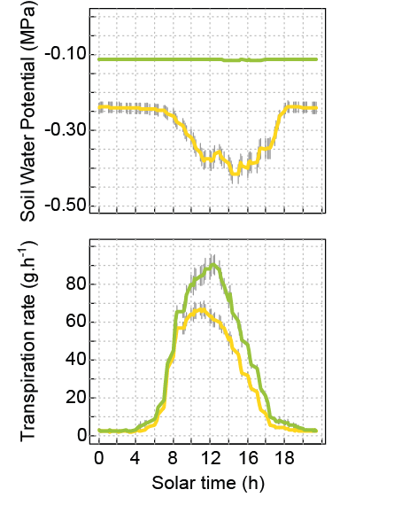
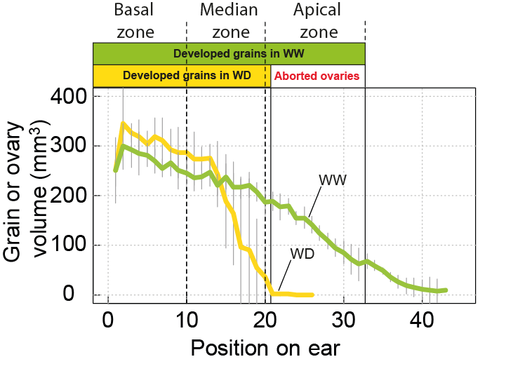
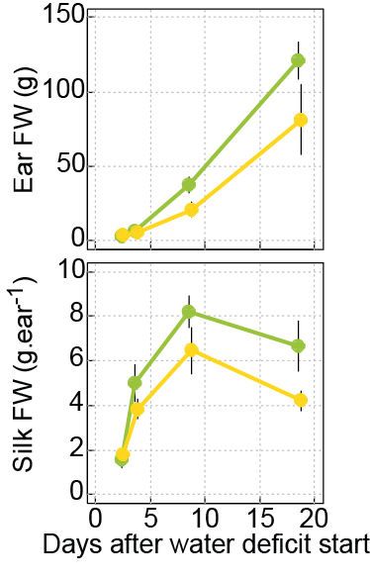
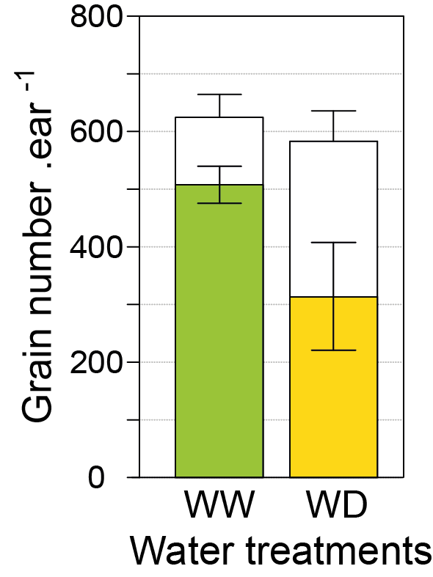
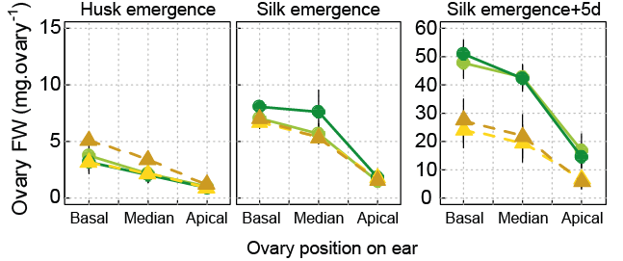
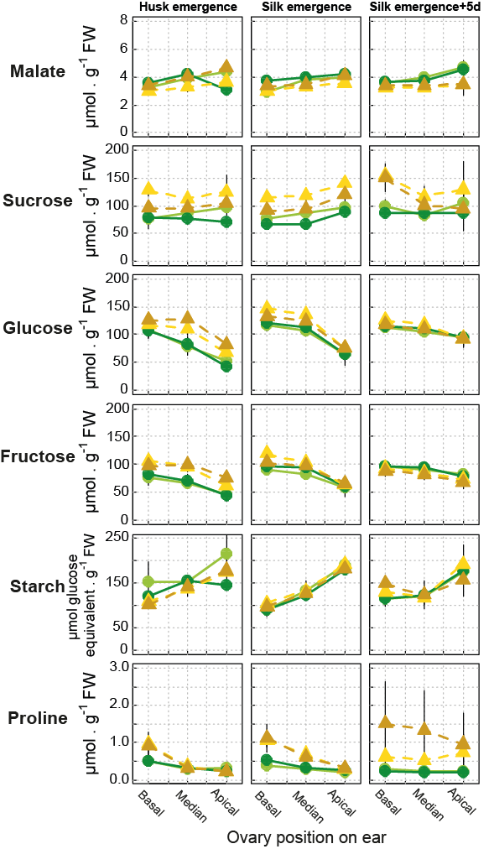
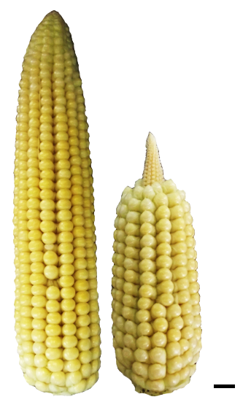
Ovary abortion of maize under water deficit is linked to a developmental process and not to carbon deprivation Vincent Oury¹, Duyên Prodhomme², Yves Gibon², François Tardieu¹ and Olivier Turc¹ ¹INRA, UMR759, Laboratoire d'Ecophysiologie des Plantes sous Stress Environnementaux, F- 34060 Montpellier, France
²INRA, UMR619, UMR Biologie du fruit, F- 33883 Villenave d’Ornon, France
Context
Methods
A moderate water deficit
Water deficit during flowering can lead to abortion of most ovaries along the ear¹. This is generally explained in the literature by carbon deprivation of ovaries as the result of photosynthesis inhibition due to water deficit. However several papers mention sugar accumulation in reproductive organs of water stressed plants², while others report no reduction in grain number with carbon deprivation due to shading³. To investigate the chronology of developmental and physiological events that lead to abortion, we have characterized the development and the metabolic content of ovaries of maize plants subjected to a moderate water deficit, which reduced but did not stop plant growth and photosynthesis.
1- A moderate water deficit around flowering, from tassel emergence to 5 days after silk emergence.
2- Three sampling stages during water deficit: husk emergence, silk emergence, and silk emergence+5d. A final harvest was done 15 d after silk emergence (i.e. 8 d after re-watering) to quantify grain set and ovary abortion.
3- Plants were cultivated in controlled conditions at LEPSE phenotyping platform PHENODYN, allowing control of soil water content and plant transpiration rate for each plant with a 15 mn time step: http://bioweb.supagro.inra.fr/phenodyn
4- Metabolic phenotyping was achieved with robotized high-throughput system of UMR Biologie du fruit:
www.cgfb.u-bordeaux2.fr/en/metabolome/
a
b
Fig.1: Kinetics of (a) soil water potential and (b) transpiration rate per plant on an average day during the period of water deficit (1 d after tassel emergence to 5 d after silk emergence). WW, well-watered plants; WD, plants in water deficit. Bars ,95% confidence intervals.
Results
Abortion affected apical ovaries
Silks were the first organs whose growth was limited by drought
Fig.2: (a) Number of developed grains (colored bars) and aborted ovaries (white bars) per ear; and (b) grain and ovary volume according to their position along the ear 15 d after silk emergence. Basal, median and apical zones correspond to the portions of the ear used in metabolic analyses. WW, well-watered plants; WD, plants in water deficit. Bars, 90% confidence intervals. n≥3.
a
Ears
a
WW
c
d
e
b
WD
WW-ED
Ovaries
b
WW-EN
SE+5d
WD-ED
SE
WD-EN
SE+15d
HE
Silks
Fig.3: Fresh weight of (a) ear, (b) silks, and (c,d,e) ovaries as a function of water status, developmental stage, time of day, and position along the ear. WW, well-watered plants; WD, plants in water deficit. HE, husk emergence; SE, silk emergence. ED, end of day; EN, end of night. Bars, 90% confidence intervals. n≥3.
The C status of ovaries was unaffected
Before
1st fertilizations
After
WW
1- No negative effect on sugar content in ovaries, even a tendency for sucrose to accumulate (Fig 4)
2- No negative effect on ovary and ear fresh weight (Fig 3)
3- But a reduction in silk fresh weight
(Fig 4, 5)
Reduction in the number of emerged silks from apical zone
Reduction in the number of fertilized ovaries in apical zone
Reduction in the grain number in apical zone
WD
Water deficit period
Husk
emergence
Silk
emergence
Silk
emergence
+5d
Silk emergence
+15d
1cm
Tassel
emergence
A central role for silk growth
Conclusion
SE+7d
a
SE
SE+23d
c
Our results show that ovary abortion occurred in water deficit conditions without carbon deprivation in ovaries. Silks were the first organs affected by water deficit, before fertilization, due to the high sensitivity of silk elongation to drought⁴. As a consequence, water deficits reduced the number of emerged silks and therefore the number of potential grains. Hence, our results suggest a central role for hydraulic and developmental processes rather than a sugar signal.
We are currently analyzing the genetic variability of the processes presented here
WW-ED
b
WW-EN
WD-ED
WD-EN
Fig.4: Ovary metabolite content as a function of water status, developmental stage, time of day, and position along the ear. WW, well-watered plants; WD, plants in water deficit. ED, end of day; EN, end of night. Bars, 90% confidence intervals. n≥3.
Fig.5: Effect of water deficit on (a) silk fresh weight per ear, and (b) number of emerged silks per ear, at different developmental stages. SE, silk emergence. Bars, 90% confidence intervals. n≥3. (c) Relationship between number of emerged silks and grain number. 1 point per plant. WW, well-watered plants; WD1 and WD2, plants resp. in moderate and severe water deficits.
¹McLaughlin et al., 2004. Annals of Botany, 94: 675–689.
²Muller et al., 2011. Journal of Experimental Botany, 62(6): 1715-1729.
³Hiyane et al., 2010. Annals of Botany, 106: 395–403.
⁴Fuad-Hassan et al., 2008. Plant, Cell and Environment, 31: 1349–1360.

