Slide 1
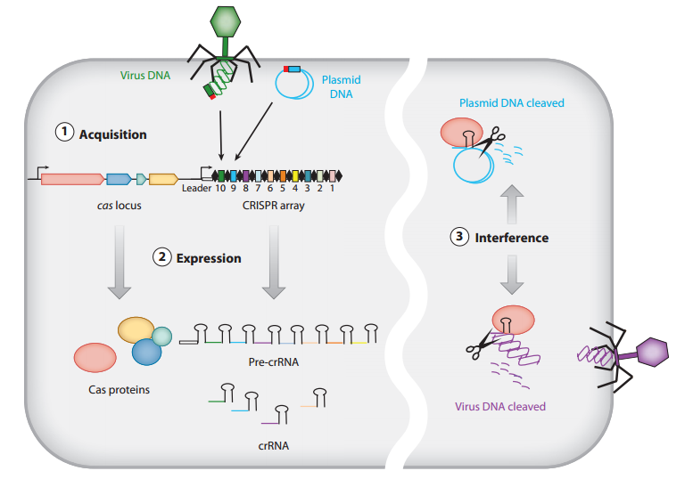
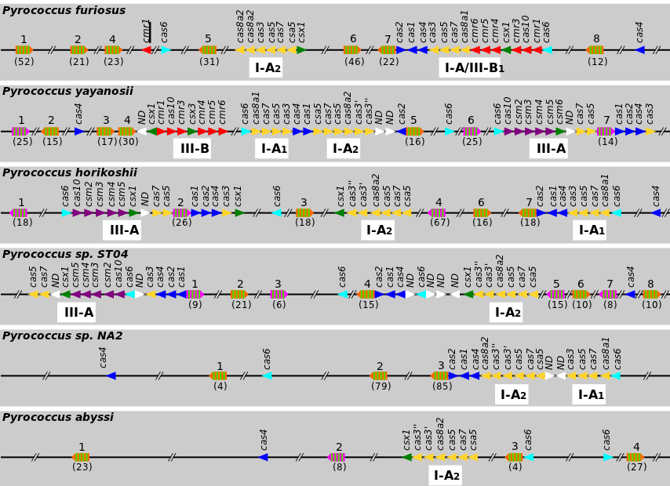
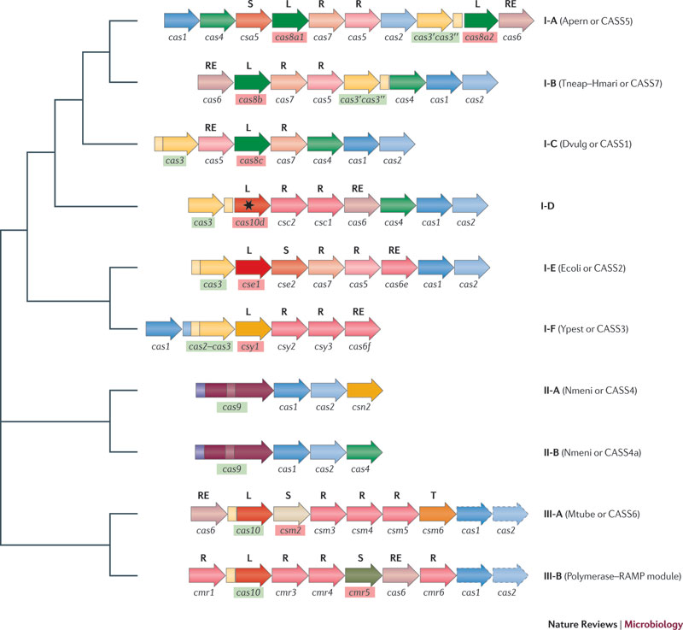
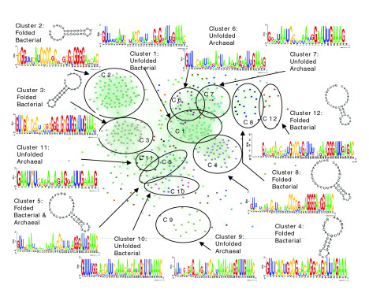
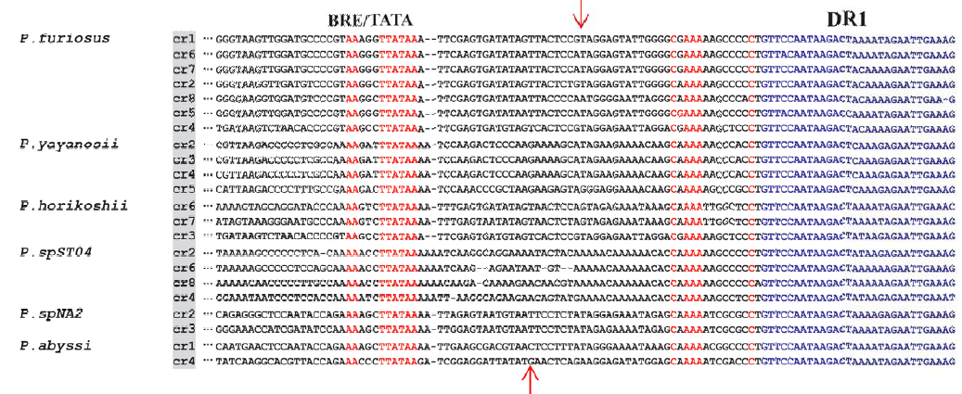
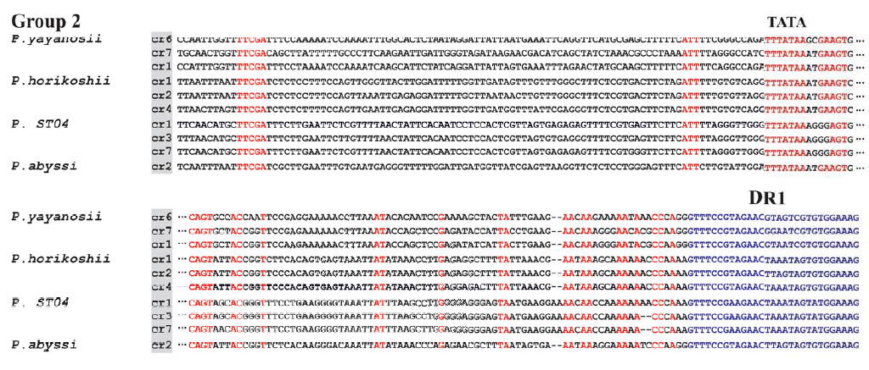
DIVERSITY OF CRISPR SYSTEM In the euryarchaeal pyrococcales [1]
Cédric Norais¹, Annick Moisan², Christine Gaspin², Béatrice Clouet d’orvaL³
¹Laboratoire de biochimie, UMR7654 CNRS, Ecole Polytechnique, Palaiseau, France
²Unité Mathématique et Informatique Appliquées, UR875 INRA, F-31326, Castanet-Tolosan, France.
³Laboratoire de Microbiologie et Génétique Moléculaire, UMR5100, CNRS et Université Toulouse III, 31062, Toulouse, France.
CRISPR-Cas systems: RNA-interference-based immune systems in procaryotes
CRISPR-cas systems are found in approximately 48% of sequenced bacteria and 90% of sequenced archaea. They function as prokaryotic immune systems, in that they confer resistance to exogenous genetic elements.
CRISPRs (Clustered Regularly Interspaced Short Palindromic Repeats) are arrays of direct repeats separated by variable short sequences called spacers or guides that generally derived from invader genetic elements such as plasmids and prophages.
CRISPR-associated (cas) genes are often located adjacent to the CRISPR locus. They code for different proteins involved at each stage of CRISPR mechanism.
Acquisition: new spacers are incorporated into the genome between CRISPR repeats, after exposure to each new foreign element.
Expression: small non-coding CRISPR RNAs (crRNAs) are generated. A long precursor is first produced then processed between repeats and matured into crRNAs.
Interference: crRNAs-Cas protein complexes bind to invading nucleic acid target and cleave it.
*http://noobnim.in.th/crispr-cas-system/crispr-cas-adaptive-immune-system/
Bioinformatic tools for studying the diversity of CRISPR and cas genes in six pyrococcal genomes
Identification of CRISPRs loci
Collect genes in CRISPR neighborhoods
Collect all known cas genes
CRISPRdb[2]
Patscan
CRISPRdb
Litterature
Annotation
CRISPR loci
Clusteringof protein genes
Identification of CRISPRs features
Blast
Promoters
Repeats
Spacers
Groups of homologuous genes
Clustering
Identification of cas genes
Promoters
Repeats
TIGRFam database
COG database
Multalin
Multalin
Comparison to space of CRISPR repeats
Identification of CRISPR/Cas system types
Space of CRISPR repeats[3]
Makarova nomenclature[4]
Group1
Group2
Conclusions
Three different cas genes types were identified within the six pyrococcal genomes (subtypes I-A, III-A and III-B). Subtype I-A is ubiquitously represented. Sequence alignments show strong homologies between CRISPRs and Cas proteins belonging to similar systems.
The diversity of CRISPR system situations in the Pyrococcales illustrates the modularity and instability of CRISPR systems.
There are lot of things that we still do not understand but knowledge in the CRISPR field is added as quickly as guide sequences in an active CRISPR array.
References
[1] Norais C, Moisan A, Gaspin C, Clouet-d'Orval B. Diversity of CRISPR systems in the euryarchaeal Pyrococcales. RNA Biol. 2013 Feb 19;10(5).
[2] Grissa I, Vergnaud G., Pourcel C., The CRISPRdb database and tools to display CRISPRs and generate dictionaries of spacers and repeats. BMC Bioinformatics . 2007; 8:172.
[3] Kunin V.,Sorek R., Hugenholtz P. Evolutionary conservation of sequence and secondary structures in CRISPR repeats. Genome Biology 2007, 8:R61.
[4] Makarova KS, Haft DH, Barrangou R, Brouns S, Charpentier E, Horvath P, Moineau S, Mojica FJ, Yakunin AF, van de Oost J, et al. Evolution and classification of the CRISPR/Cas systems. Nat Rev Microbiol 2011; 9:467-77.
Model of pyrococcal CRISPR mode of action

