Slide 1
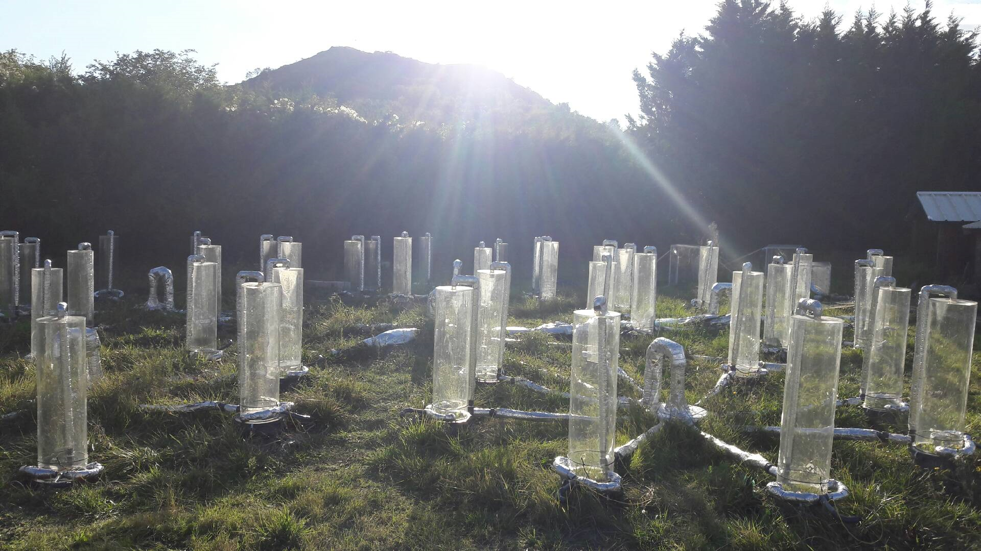
The CO₂-induced acceleration of soil organic carbon mineralization counteracted by legumes
CROS Camille, ALVAREZ Gaël, KEUPER Frida, REVAILLOT Sandrine, FALCIMAGNE Robert, SALCEDO Alexandre, FONTAINE Sébastien

Slide 2
Impacts of human activities
Steffen et al., 2015

Slide 3
Impacts of human activities on CO₂ emissions
IPPC 2016 report

Slide 4
Consequences of human activities climate change
IPPC projections:
IPPC 2016 report

Slide 5
Effect of elevated CO₂ on planted ecosystem
Stimulation of growth primary production → increase plant production
Diaz et al., 1993 ; Zanetti et al., 1996; Cheng 1999; hu 2001; Schneider et al., 2004; Groenigen et al., 2006
From Reddy et al., 2010

Slide 6
What is the consequences of modification of plant functioning due to CO₂ increase on soil processes ?
Fontaine et al., 2011
Perveen et al., 2014
C fluxes
Plant respiration
N fluxes
CO₂
soil
N uptake
N mineral
Root exudation
Immobilization
Mineralization
leaching
FOM
Fresh organic matter
SOM
builders
Humification
SOM
Soil organic matter
SOM decomposers
Rhizosphere Priming Effect
Microbial biomass
Soil
respiration
CO₂

Slide 7
Hypothesis
What is the consequences of modification of plant functioning due to CO₂ increase on soil processes ?
CO₂ +
Photosynthesis stimulation
1
2
3
4
Biomass increasing
(+ root exsudation )
Decrease of mineral N
RPE increasing
Destocking SOM

Slide 8
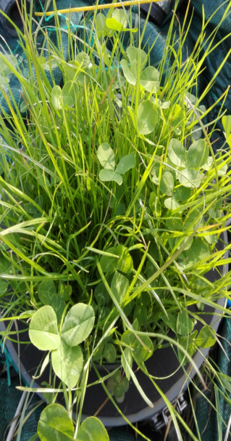
Design
2 species
Sown in September 2016
CO₂ levels ( C ambiant: 400 ppm; C eleveted: 700 ppm)
4 replicates
3 plants destructives harvests
Bare soil
English ryegrass
monocrop
Intercrop with white clover
Ambiant CO₂
Eleveted CO₂
Ambiant CO₂
Eleveted CO₂

Slide 9
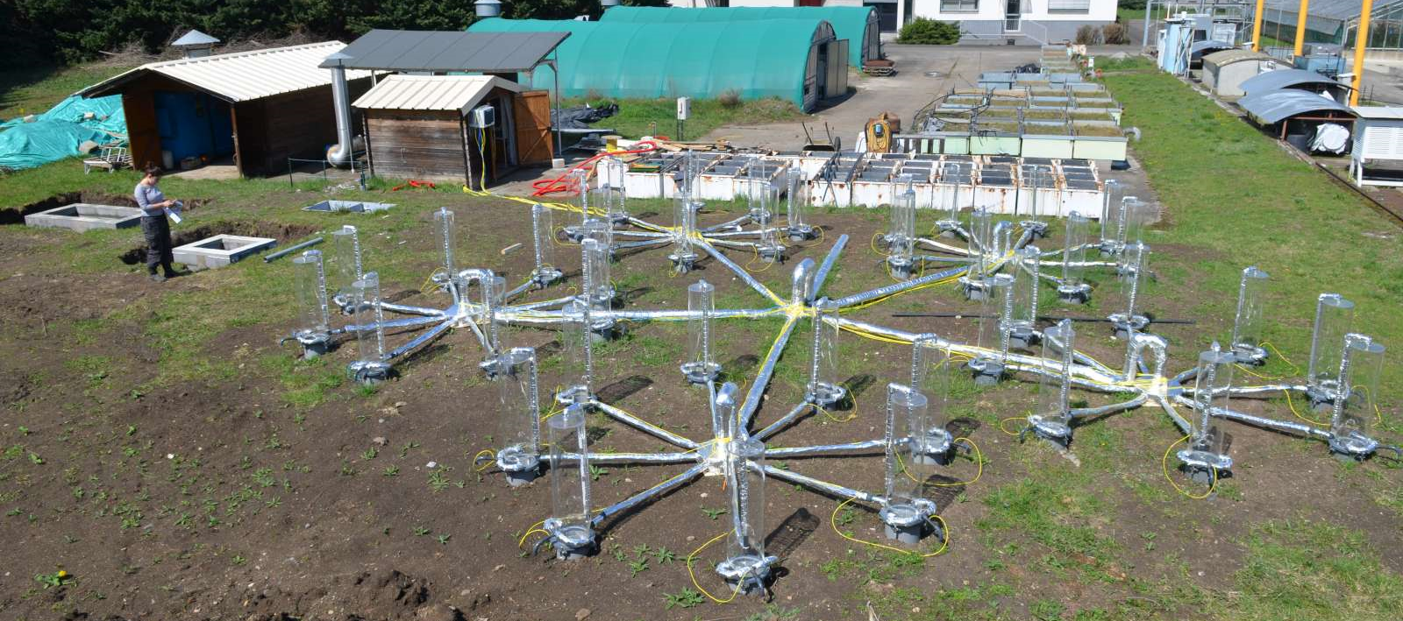
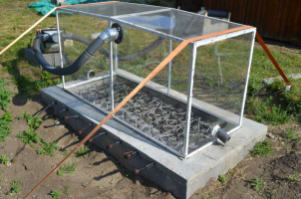
Experimental devices
Two approaches :
1- continuous ¹³C labeling platform
2- continuous CO₂ exchange measurements

Slide 10
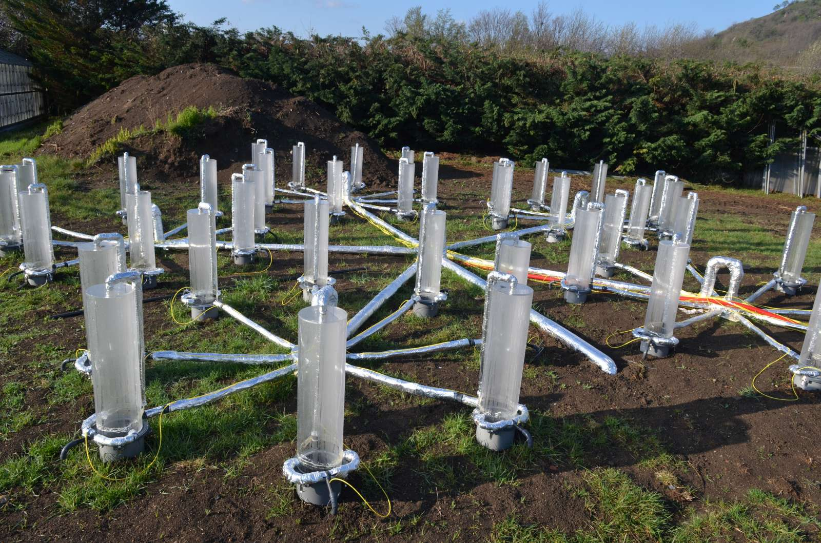
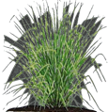
Experimental devices
Labeling platform (¹³CO₂)
Tracing source of respired carbon in presence of living plants
¹³CO₂
¹³C-depleted CO₂ of fossil-fuel origin
Follow humification and Rhizosphere Priming Effect

Slide 11
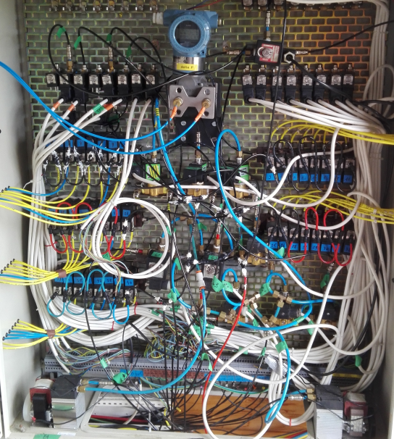
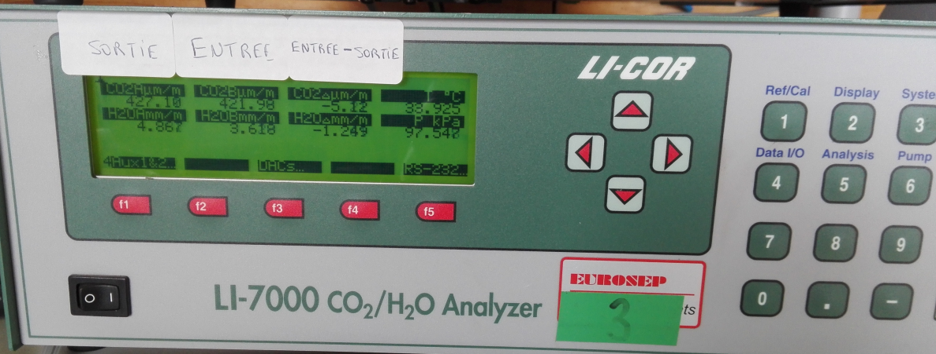
Experimental devices
Gaz exchanges measurements
Measure of differential CO₂ each 30 minutes on each pots
Calculation of net ecosystem exchange
Deduction of ecosystem respiration and photosynthesis
¹³CO₂
air flux

Slide 12
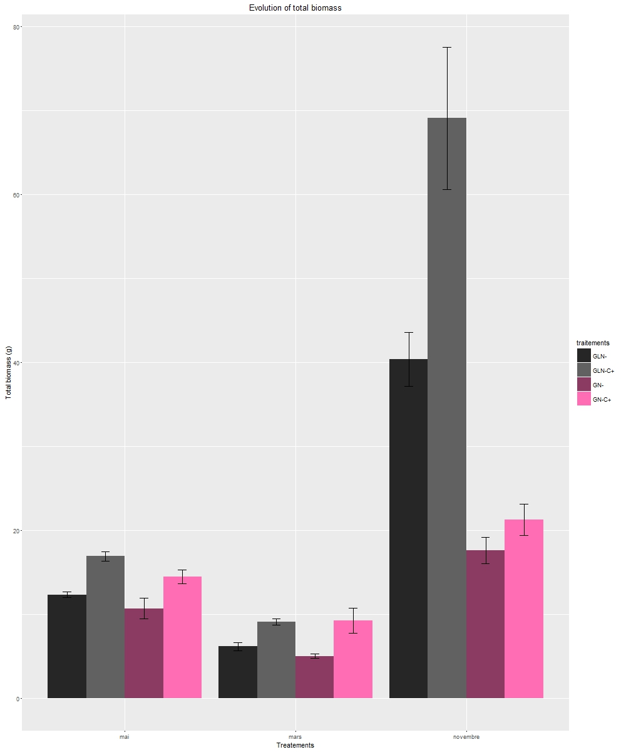
Effect of eleveted CO₂ on total plant production
Shoot + root biomass along the year
a
Globally higher plant production in elevated CO₂ (p-value=0,04)
After summer, no significant difference in monocrop
After one year, higher production in intercrop than monocrop
Intercrop C-
Intercrop C+
Monocrop C-
Monocrop C+
b
Total plant biomass (g)
bc
a
ab
c
a
a
bc
c
ab
b
March
May
November

Slide 13
Effect of eleveted CO₂ on roots production
Root biomass production including the 3 harvests
a
On one year, higher root production in elevated CO₂ (p-value=0,002)
The higher plant production is especially due to higher root investissment
Higher soil exploration in elevated CO₂
b
Root biomass (g)
CO₂ ⁻
CO₂ ⁺

Slide 14
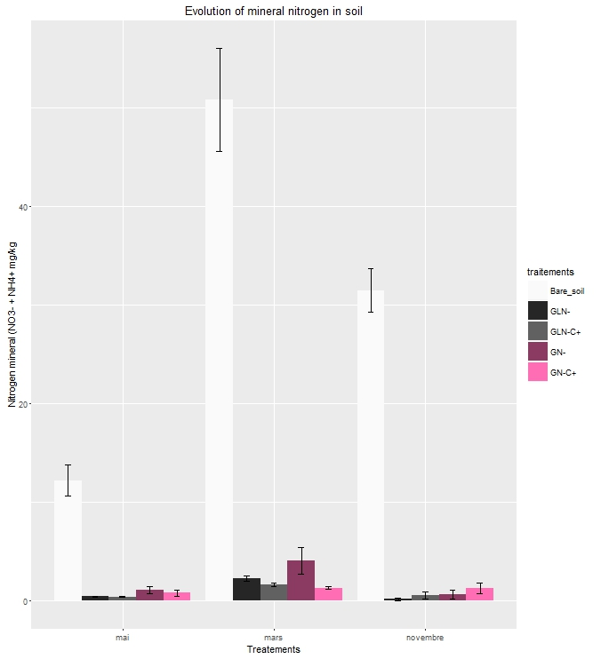
Consequences of root exploration on mineral N in soil
a
Intercrop C-
Intercrop C+
Monocrop C-
Monocrop C+
Planted effect
Fastly mineral N exhaustion in monocrop elevated CO₂
→ In november , absence of biomass difference due to N limitation ?
Bare soil
a
Nitrogen mineral : N0₃⁻ +NH₄ ⁺ (mg/kg)
a
c
c
bc
b
b
b
b
b
b
b
b
b
March
May
November

Slide 15
Consequences of N limitation on RPE
Monocrop C-
Close to alpha= 5%
Monocrop C+
*
*
*
*
*
*
RPE (mg C / chambers)
*
*
Difference between monocrop C+ vs monocrop C-
mowing
Globally higher RPE in monocrop C+ compared to monocrop C-

Slide 16
Consequences of N limitation on RPE
Monocrop C-
Close to alpha= 5%
Monocrop C+
*
*
*
*
*
*
Temperature effect
RPE (mg C / chambers)
*
NA 4,43°C 11,65°C 16,15°C 0,49°C 8,37°C 15,77°C 27,98°C 21,32°C 24,14°C NA 7,23°C
*
Difference between monocrop C+ vs monocrop C-
mowing
Globally higher RPE in monocrop C+ compared to monocrop C-
Sensitivity of extreme temperature higher in monocrop C+ compared to monocrop C-

Slide 17
Consequences of N limitation on RPE
Intercrop C-
Intercrop C+
*
RPE (mg C / chambers)
*
*
Difference between intercrop C+ vs intercrop C-
mowing
Globally no difference of RPE in intercrop

Slide 18
Consequences of N limitation on RPE
Intercrop C-
Intercrop C+
Temperature effect
Monocrop C-
*
*
*
*
*
*
Monocrop C+
*
Close to alpha= 5%
RPE (mg of C / chambers)
*
*
NA 4,43°C 11,65°C 16,15°C 0,49°C 8,37°C 15,77°C 27,98°C 21,32°C 24,14°C NA 7,23°C
*
Difference between intercrop C+ vs intercrop C-
*
Difference between monocrop C+ vs monocrop C-
mowing
→ N limitation in elevated CO₂ induce more RPE in ryegrass monoculture depending on season

Slide 19
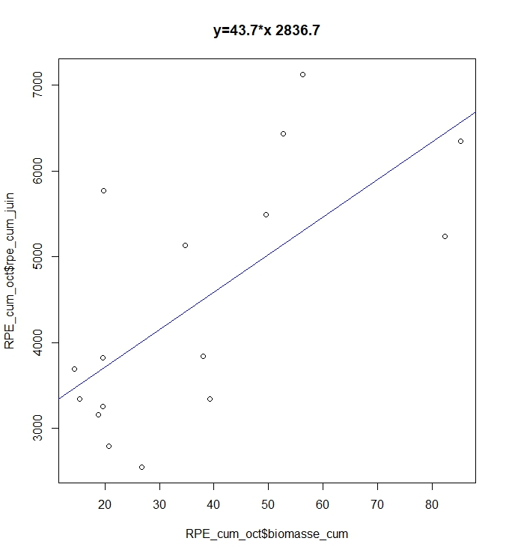
Correlation between photosynthesis proxy and RPE
cumulative RP vs cumulative RPE
cumulative biomass vs cumulative RPE
p – value = 0,0002 Spearman
R² =0,77
p – value = 0,01 Spearman
R² =0,63
cumulative RPE (mg of C / chambers)
cumulative RPE (mg of C / chambers)
cumulative RP (mg of C / chambers)
cumulative biomasse (g)
More biomass = more RPE
→ Destocking in monocrop elevated CO2

Slide 20
Conclusion Our results in front of others papers
Plant biomass
Mineral N
Effect of elevated
CO2 in adequation
In monocrop
In intercop
Adapted from Perveen et al., 2014
Soil C storage
In long term, increase of SOM decomposition → decrease of soil stock
Attenuation with legumes
Hu et al., 2001; Dijsktra et al., 2013; Perveen et al., 2014; Nie et al., 2016; Vestergard et al., 2016;

Slide 21
Thank for your attention ☺

Slide 22
Consequences of N limitation on RPE
Monocrop C-
Close to alpha= 5%
Monocrop C+
*
*
*
*
*
*
RPE (mg of C / chambers)
*
NA 4,43°C 11,65°C 16,15°C 0,49°C 8,37°C 15,77°C 27,98°C 21,32°C 24,14°C NA 7,23°C
*
Difference between monocrop C+ vs monocrop C-
mowing
Globally higher RPE in monocrop C+ compared to monocrop C-
Sensitivity of extreme temperature higher in monocrop C+ compared to monocrop C-

Slide 23
Matching with the model ?
Raygrass en monoculture
Mitigé: sensibilité chaleur
→ Remise en question du choix de l’espèce
Oui au départ puis seulement tendance
→ Suit-on la courbe ? Récolte novembre
Résultats de bilan de C important
MAIS
Décomposition SOM plus élevée en CO2+ hormis été
Perveen et al., 2014

Slide 24
Matching with the model ?
Raygrass associé au trèfle
Biomasse très élevée en CO₂+
Aucune différence
→ Fixation symbiotique du N → atténuation
Résultats de bilan de C important
MAIS
implantation trèfle, décomposition SOM pas différente
+
Biomasse très élevé
→ STOCKAGE ??
Perveen et al., 2014

Slide 25
Effect of eleveted CO2 on roots production
Intercrop C-
Intercrop C+
Monocrop C-
Monocrop C+
Exemple of root biomass in srping
On one year, higher root production in elevated CO₂ (p-value=0,002)
a
a
b
Root biomass (g)
b

