Slide 1

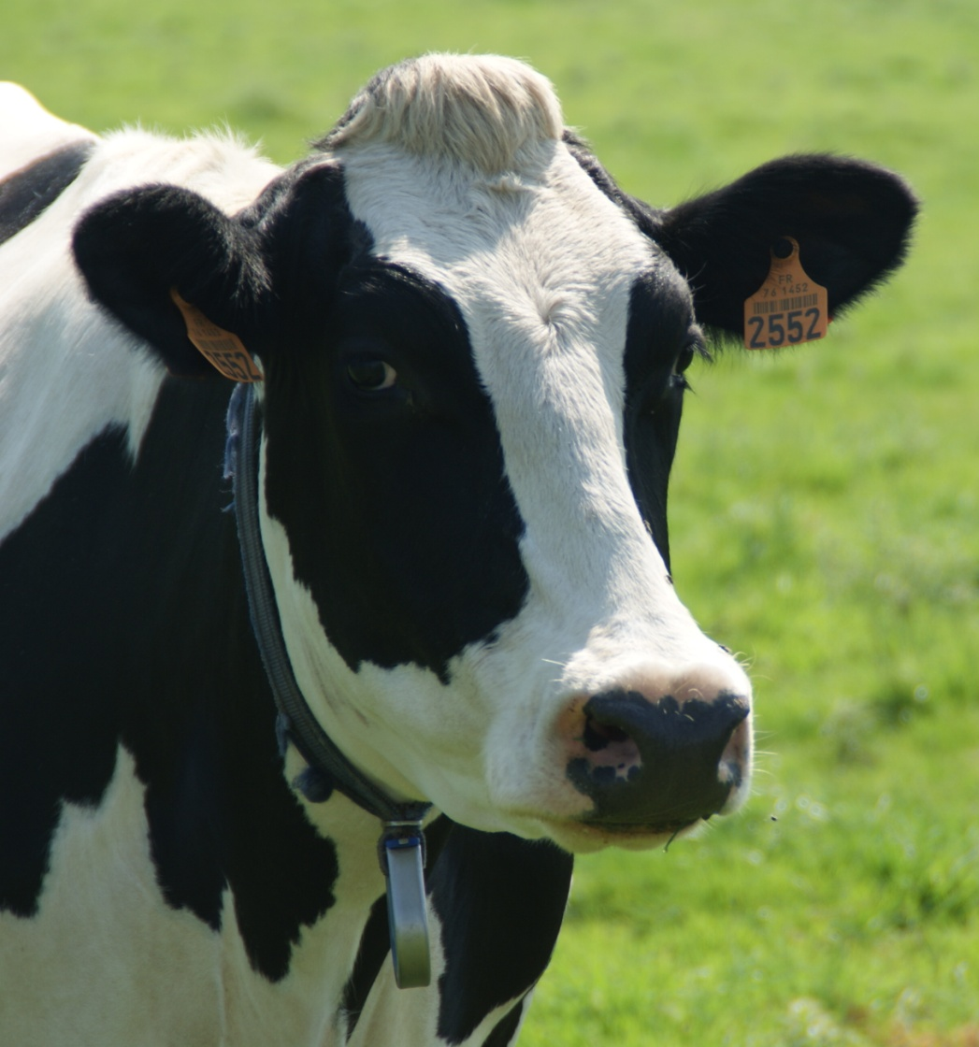


What is a genetic
evaluation ?
Vincent Ducrocq
GABI, Jouy-en-Josas
France

Slide 2
Notion of genetic value
A farmer chooses the animals which are going to produce progeny. These offspring will replace older animals…
This farmer usually wants them to be better, i.e., they should have a phenotype different from the one obtained without selection of the parents.
The difference between the two represents a « genetic gain »
The genetic value or breeding value of an animal is
(twice) what it transmits to its progeny … on average
(twice because only half of its genes are transmitted)
So the « genetic value » is a mathematical notion
it cannot be observed, it cannot be measured …
But it can be predicted / estimated using observations

Slide 3
Genetic values : progeny test
The average « performance » of a large number of progeny gives a precise estimation of its genetic value …
This is how bulls of dairy breeds have been selected during 50 years:
  a representative sample of daughters is created ➔ we « test » each bull via the characteristics of 50-100 daughters
  Then we keep the best bulls using the information on these characteristics but also on other related animals (mother, sisters,…)
  ⬄ these sources of information are combined into an
  estimated genetic value = estimated breeding value (EBV)
  Then the « best » bulls are « used » intensively via AI

Slide 4
“Classical” progeny test
Genetic
evaluation
X
Sire of sons
Dam of sons
Year n
« Test »
Year n+2
Genetic
evaluation
Young male
calf
X
« service »
year n+6
year n+5
Genetic
evaluation
Selection
on an
global index
Daughters with
1 lactation
daughters born
Notes:
4

Slide 5
Genetics and environment
The traits of interest are often complex traits under the influence of genetic effects and environmental effects
The phenotype (= the measure of a trait) is misleading : for example, it depends strongly on the management of the herd.
We want to avoid a confusion between the genetic value and the phenotype influenced by the environment
Example :
cow A produces 3000 kg of milk in a herd with a herd average of 4000 kg
cow B, from the same breed, produces 2500 kg of milk
in a herd with a herd average of 2000 kg
Which one has the highest genetic value for production?

Slide 6
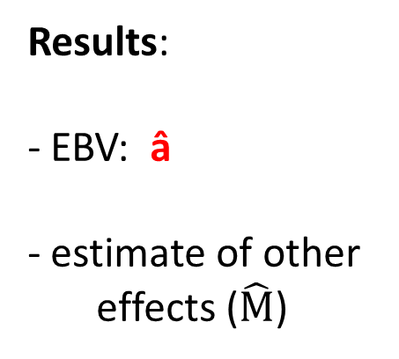
Genetic evaluation
Data :
Phenotypes (mesure of a trait, P)
environment (herd, season, age… )
Pedigree
Models:
Description of the data
P = a + M + e
Genetic model of « transmission » of
genetic value
Results:
EBV: â
estimate of other
effects ($\hat{M}$)

Slide 7
A practical example: 5 recorded cows
cow | sire | dam | Sire of sire | Dam of sire | Sire of dam | Dam of dam | 305d milk yield | Calving date
Bandi | - | - | - | - | - | - | 5000 | 14/10/2010
Honde | - | - | - | - | - | - | 4500 | 23/11/2010
Kapila | Hiren | Bandi | - | - | - | - | 5500 | 6/7/2013
Batali | Akot | Honde | - | - | - | - | 5000 | 15/9/2013
Mangli | Gary | Kapila | Hiren | Bandi | Hiren | Bandi | 6000 | 25/04/2016

Slide 8
practical example : the animal model
5000
4500
Choose a model :
milk yield of cow i =
effect of year j
+ genetic effect of i
+ an unexplained
“residual”
Hiren Bandi
Hiren Bandi
Akot Honde
Gary Kapila
Batali
5500
5000
2016 2013 2010
Mangli
6000
Data file
Pedigree file
Animal | Sire | dam
Hiren | ? | ?
Bandi | ? | ?
Akot | ? | ?
Honde | ? | ?
Gary | Hiren | Bandi
Kapila | Hiren | Bandi
Batali | Akot | Honde
Mangli | Gary | Kapila
Cow (i) | Year (j) | 305d milk yield
Bandi | 2010 | 5000
Honde | 2010 | 4500
Kapila | 2013 | 5500
Batali | 2013 | 5000
Mangli | 2016 | 6000

Slide 9
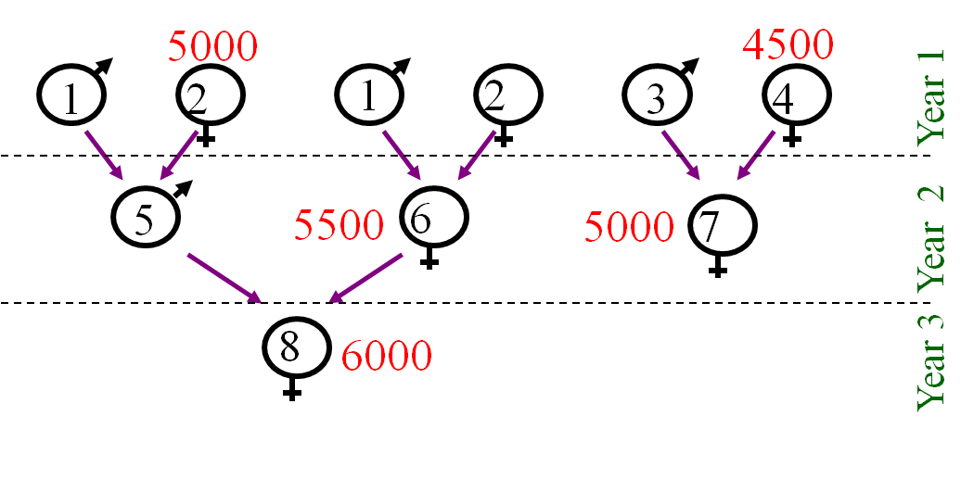
Practical example : after “recoding”
The chosen model :
We would like to estimate:
the year effects (β₁, β₂, β₃)
the genetic values (a₁ to a₈)
Data file: animal n°, year, production
2 1 5000
4 1 4500
6 2 5500
7 2 5000
8 3 6000
Pedigree file : animal n°, sire n°, dam n°
1 0 0
2 0 0
3 0 0
4 0 0
5 1 2
6 1 2
7 3 4
8 5 6

Slide 10
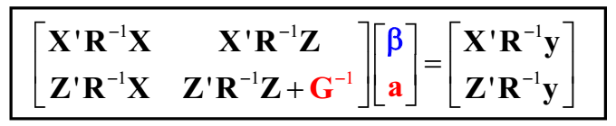
Genetic evaluation in practice
“BLUP” theory ➔ a system of equations, in matrix form :
« mixed model equations »
=
in red : contribution of pedigree
in black: contribution for records
: genetic value

Slide 11
Mixed Model Equations: interpretation
=
characteristics: a lot of 0’s, simple numbers easy to interpret and easy to “construct” just by reading two files (data + pedigree)
the elements in red representing the links between related animals are easy to construct from a pedigree file
α = a simple function of the heritability h² of the trait
Also, the equations can be interpreted intuitively ....

Slide 12
The Mixed Model Equations: interpretation
developing the system of equations:

Slide 13
The Mixed Model Equations: interpretation
We obtain this:
equations to estimate
the “year” effects β
equations to estimate
the genetic values a_{i}

Slide 14
The Mixed Model Equations: interpretation
= average of
performances
corrected for the
genetic effect

Slide 15
The Mixed Model Equations: interpretation
= weighted average
of performances corrected for the effect
and accounting for the
average genetic values
of parents and of progeny
information
from parents
corrected own
performance
information
on progeny

Slide 16
The Mixed Model Equations: interpretation
=
Sum for
«base animals »
=0
average = 18.6
average = 70
Genetic trend
/ generation
y₈= 6000 = 5930 + 70 ➔ connexion through pedigree

Slide 17
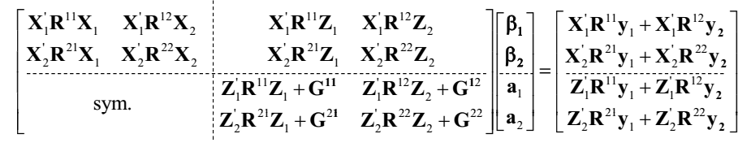
The need for a mathematical tool: Matrix Algebra
(BLUP) Mixed Model Equations : univariate case
(BLUP) Mixed Model Equations : multivariate case

Slide 18
First step: modeling
P = G + E
P: Phenotype
  may be standardized, corrected, combined …
G: Genetic component
  depends on the objective of the analysis
  may be incomplete (e.g., just « sire » or « additive » component )
genetic value gamete of gamete of
= +
of i sire s of i dam d of i
Mean effect
of a gamete
of s
Deviation with respect
to mean effect of
a gamete of s
Mean effect
of a gamete
of d
Deviation with respect
to mean effect of
a gamete of s
+
+
+
ϕ_{i} = mendelian sampling

Slide 19
First step: modeling
P = G + E
P: Phenotype
  may be standardized, corrected, combined …
G: Genotype
  depends on the objective of the analysis
  may be incomplete (e.g., just « sire » or « additive » component )
E: Environment
  « = P – E »
  may contain a genetic component (which was ignored in G)
  includes what is not explained (residual)

Slide 20
Environment
E: « = P – G »
  may contain a genetic component
  includes what is not explained (residual)
E = an overall mean
  + effects that are identified and recorded
  + effects that are identified and not recorded
  + effects that are not identified
  + inaccuracies, errors
By definition: residual = e = y – E(y)
residual

Slide 21
How to represent an environmental effect ?
Covariables: example: age, stage of lactation
  define a relation between the observation (y_{i}) and age (x_{i})
  parametric: linear (A) , quadratic (B) polynomial
  non parametric: define classes (C)
  semi-parametric: splines (linear (D), quadratic (E), cubic)
y_{i}
y_{i}
y_{i}
(A)
(B)
x_{i}
x_{i}
x_{i}
y_{i}
y_{i}
y_{i}
(C)
(D)
(E)
knots
x_{i}
x_{i}
x_{i}

Slide 22
How to represent an environmental effect ? (2)
Factors:
example: herd, year
  use a 0/1 covariable
  y_{i} = … + 0* h₁ + 0* h₂ + … + 1* h_{i} + … 0* h_{n} + …
  y_{i} = … + h_{i} + … n levels

Slide 23
If we ignore important effects …
Biased estimation (eg, season effect)
herd
mean
A B
A B
Accuracy overestimated

Slide 24
If we include useless effects …
example: season effect
  semester
  trimester
  month
  week
  day …
no bias
less precise estimation
risk of disconnection
?

Slide 25
Disconnection …
= absence of information for a fair estimation
Interactions
  example: herd x year x season x lactation number
  balance between risk of bias, disconnection, loss of accuracy …
herd 1 herd 2
herd 1 herd 2
2000
 | 3000
2000 | 3500
 | 3000
bull A
bull B
bull A
bull B
disconnected
connected

Slide 26
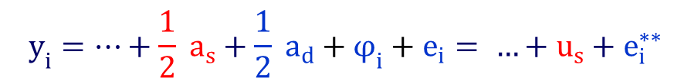
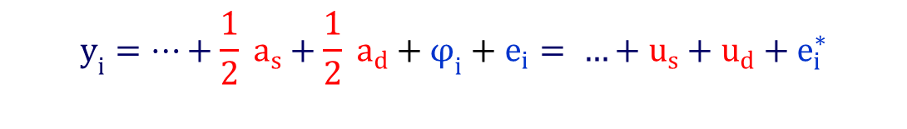
Description of the genetic part
(individual) animal model
many effects to estimate (often more animals than observations)
$$y_{i}=…+\frac{1}{2} a_{s}+\frac{1}{2} a_{d}+φ_{i}+e_{i}= …+u_{s}+u_{d}+e_{i}^{∗}$$
= sire-dam model
$$y_{i}=…+\frac{1}{2} a_{s}+\frac{1}{2} a_{d}+φ_{i}+e_{i}= …+u_{s}+e_{i}^{∗∗}$$
= sire model
interest: fewer parameters to estimate (e.g., only BV of males)
but stricter assumptions !!! (eg: E(u_{d}) = 0 )

Slide 27
If G x E interaction…
1 trait per environment (1 G for each E group
e.g., production in each state = 1 trait)
➔ multivariate approach
Included in the model
(scale factors, heterogeneous variances, random regression models
« reaction norms »)

Slide 28
Random regression
Milk Yield varies with DIM
kg of
milk
2 kg
0 kg
0 50 100 150 200 250 300
-2 kg
Days in
Milk (DIM)
Mean
production
Persistency : explain 96.5-99.6% of total genetic variance

Slide 29
Fixed and random effects
Assumption: Polygenic model:
many (infinite?) genes, each one with a small effect
sum of effects = a_{i} = additive genetic effect
Law of large numbers ➔
a_{i} is a random effect
Similarly, residual = sum of many small effects = random effect
but « Year » or « age at calving » ? No distribution ➔ fixed effects
Quite arbitrary distinction (eg, herd effect?)
… unless you are a Bayesian…

Slide 30
Bayesian perspective (cf D. Gianola)
Bayes (1763), Laplace (1774)
Likelihood function:
Information coming
from the sample
Marginal density of the data:
No information about θ
Posterior density:
a summary of sample
and non sample information
about θ
Prior distribution : what we know
about θ before looking
at the sample
(remark: the formulas are complex but only the « philosophy » is important here: see next example)

Slide 31
an example
1
observation
A and B have
very different
priors but
closer posteriors

Slide 32
an example
100
observations
Data
« dominate »
priors

Slide 33
« Bayesian » fixed and random effects
What we are trying to do in a Bayesian analysis is to describe
our « knowledge » through a distribution (posterior density)
➔ For a Bayesian, all effects are random
In many instances, there exists a Bayesian «point estimate» similar
with what we get with a frequentist approach (e.g., BLUP)
To mimic the frequentist estimate of a fixed effect: assume no prior
My practical definition of fixed and random effects:
fixed effect: no prior information (or we don’t use it)
random effect: we use prior information

Slide 34
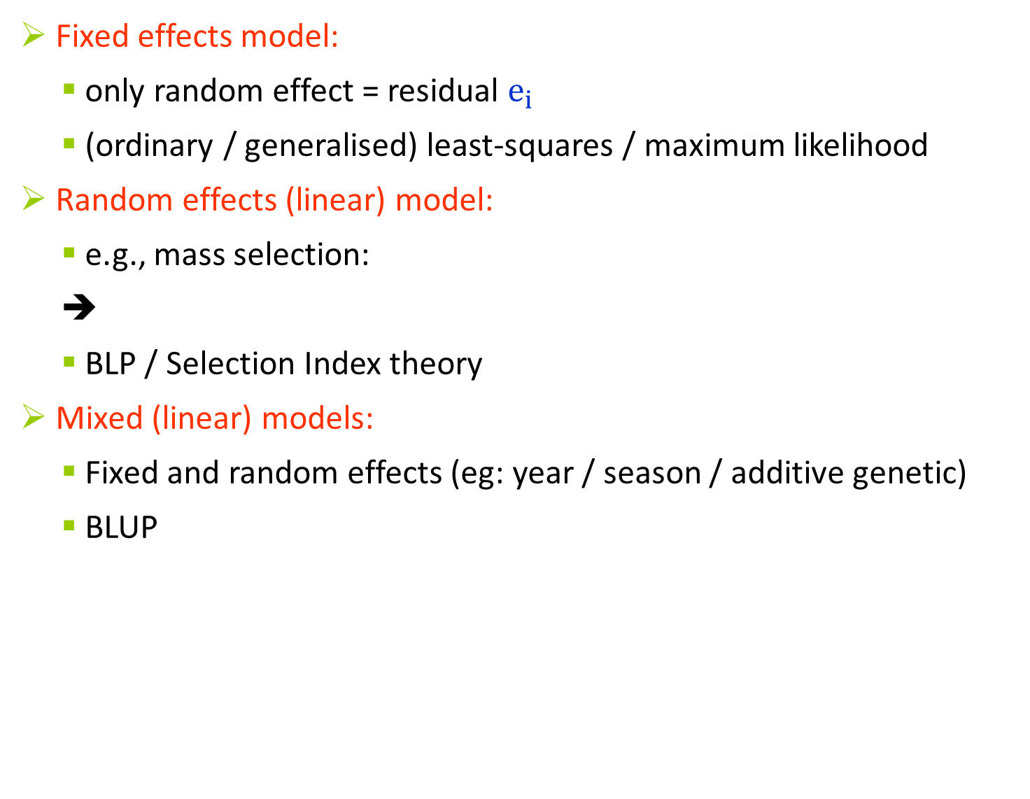


Estimation
Fixed effects model:
  only random effect = residual $e_{i}$
  (ordinary / generalised) least-squares / maximum likelihood
Random effects (linear) model:
  e.g., mass selection:
  ➔
  BLP / Selection Index theory
Mixed (linear) models:
  Fixed and random effects (eg: year / season / additive genetic)
  BLUP
$$y_{i}=μ+b_{j}+c_{k}+ .. +e_{i}$$
$y_{i}=μ+a_{i}+e_{i}$ with μ assumed well known
${(y}_{i}−μ)=a_{i}+e_{i}$ with $a_{i}and{ e}_{i }random$
$$y_{i}=μ+b_{j}+c_{k}+a_{i} +e_{i}$$

