Slide 1





Research unit GenPhySE,
INRA division : Animal physiol.
& farming systems
Food Agriculture Environment
Team:
sustainable farming systems
Rabbit Nutrition in Tropic
Thierry Gidenne, INRA France
thierry.gidenne@inra.fr
INTERNATIONAL CONFERENCE ON RABBIT PRODUCTION IN TROPICAL CLIMATE 2019
Selangor, Malaysia, 4-6 august

Slide 2
INDEX
1. Context & definitions
2. History & basics of digestive system
3. Metabolic regulations for rabbit under tropical climate
4. Nutrition & feeding – which recommendations for which breeding system
5. Practical feeding
6. Conclusions & perspectives

Slide 3
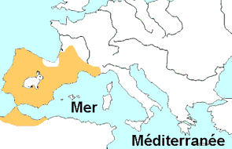

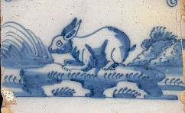
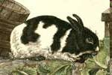
Rabbit history
Oryctolagus cuniculus = the only domestic mammal whose origin is south west of Europe
(-6 mill. années: Andalousia)
Rabbit = the bulk of the meat diet of men living in Provence 7000 to 8000 years before. J.C.
Neolithic (-2500 years): Iberian Peninsula + south France + western part of North Africa
Antique ceramics
First "rabbit breeding": 1st C. BC => leporaria = rabbit kept in enclosures
Domestic rabbit
Buffon (1754)
6th C.: First domestication (hutches) in monasteries
middle 15th C.: backyard rabbit farming expansion
Rabbit production is developping in Europe from 18th & 19th century + new breeds
Rabbit introduction in Asia & Malaysia = end 18th + 19th c.
Rabbit breeding and feeding = very recent history

Slide 4
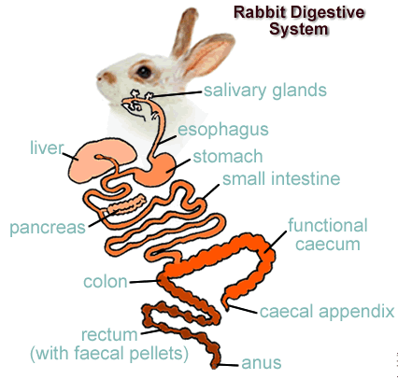
Basics of:

Slide 5

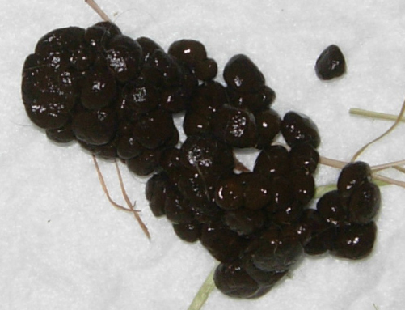
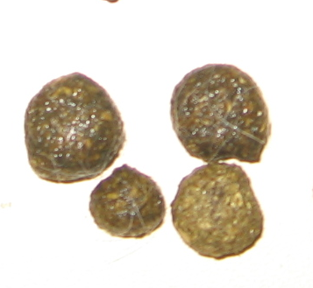
General digestion
Stomach
Intake = pelleted feed (130 g/d)
+ soft faeces or caecotrophes
Small intestine
The Rabbit =herbivorous & monogastric
Enzymatic + bacterial digestion
Caecum
Caecotrophy
2 types of faeces
exclusive and total ingestion of caecotrophes
(rabbits, hares, etc.)
Caecotrophes
± 25 g DM/d
Proximal colon
Faeces =
rejection
± 40g DM/d
Notes:
5

Slide 6
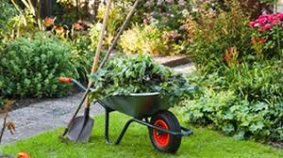
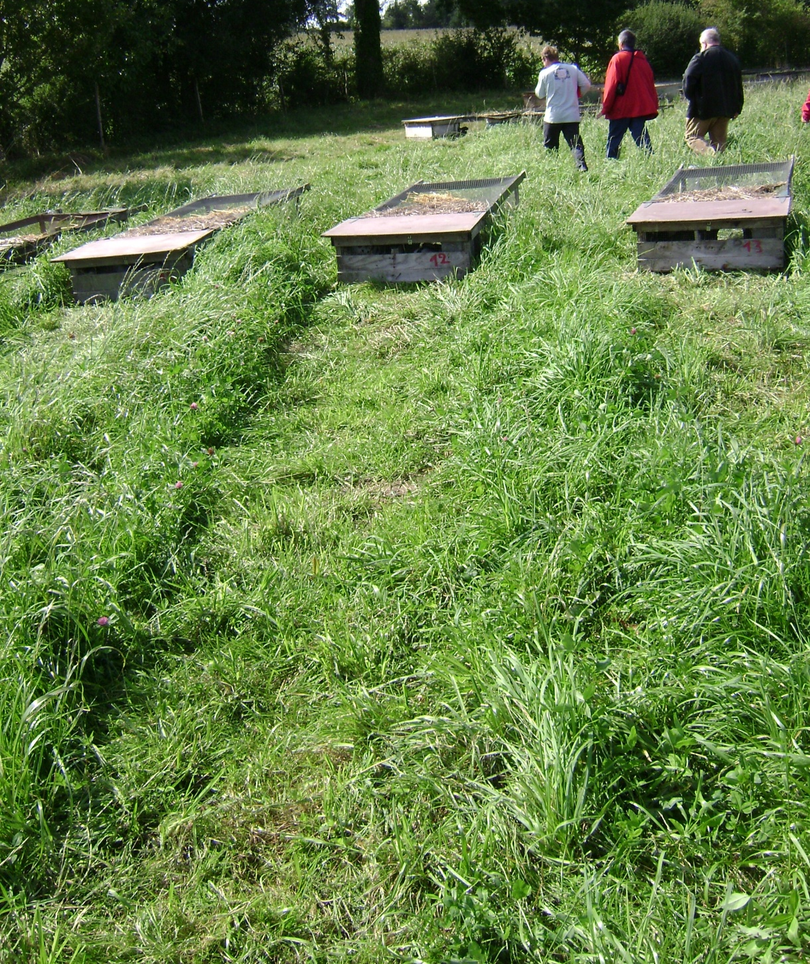
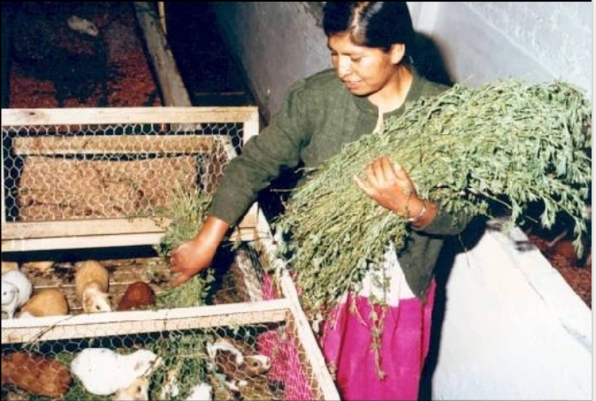
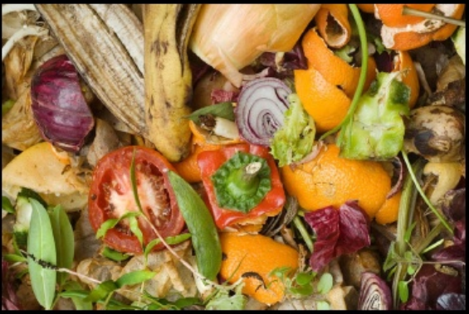
Basics of
Rabbit Feeding as an herbivorous
Advantage of rabbit production (in tropical countries too) :
rabbits can be fed with many plants, forages or agricultural byproducts (not suitable for human consumption).
Rabbit production can use fibrous by-products that are useful neither for poultry nor swine, and of forages that may be available in insufficient quantities for ruminants.
When these feeds make up the bulk of the diet for rabbits, the use of a small quantity of concentrate feed to improve performance can be justified

Slide 7
3. Metabolic regulations for rabbit under tropical climate
The tropical climate = two seasons (wet and dry). The average monthly temperature does not drop below 18°C throughout the year, and is commonly around 30°C, and can reach 35-38°C. But with high humidity level (>80%).
For animals several adaptations, but the most important is for thermic stress
Some basics about thermoregulation and animals
Thermoregulation is the function physiological that helps maintain the internal temperature within limits
physiological narrow (homeothermic).
This function controls the balance between heat production and losses heat.
Heat production of an animal is a by-product of its metabolism.
Heat losses through : radiation, conduction & convection,
or evaporation at cutaneous level (perspiration) or respiratory level (perspiration

Slide 8
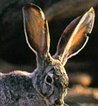
3. Metabolic regulations for rabbit under hot climate
Smaller animals : generally less sensitive to heat
because a better relationship body surface/volume,
and better heat losses by radiation, conduction & convection (sensitive way)
Slow growth animals generally less sensitive to heat stress,
because lower production of metabolic heat
Morphologic adaptation to heat => enlarging surface exchange, such larger ears for the hares, rabbits, etc…
EAR heat exchange coefficient is 9.1 W/m²/°C,
about four times the coefficient for the whole animal
No transpiration for the rabbit =>
heat evacuation by respiration & at 95% by the nose!
Consequences of heat stress on the rabbit performances
- Decrease feed intake and increase the water intake
- Decrease fertility and reduce reproductive efficiency. Hot climate is one of the main causes for abnormal maternal and sexual behaviour.
Decrease the live weight & maturity of the female rabbit. The breeding doe decrease the feed intake=> litter weight, the litter size reduced
The mortality of suckling rabbits could increase due to high temperature.

Slide 9
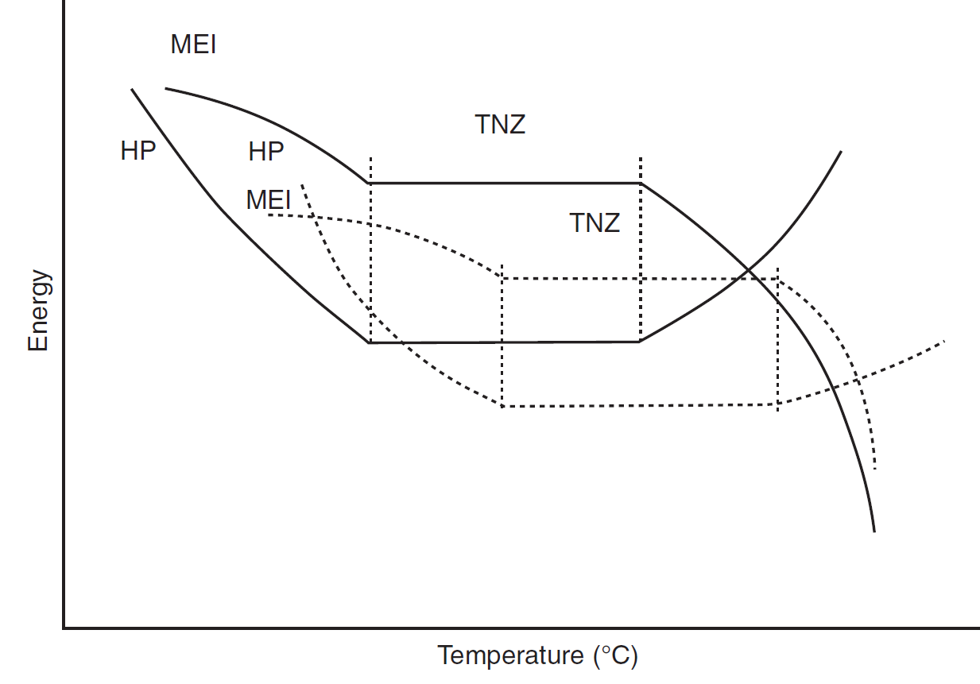
Schematic representation of heat production and energy intake.
Heat production for non acclimatized animal
TNZ
Heat production for acclimatized animal
TNZ, thermal neutral zone.
— Non-acclimatized animals; … heat-acclimatized animals.
HP, heat production; MEI, metabolizable energy intake;
In a hot environment rabbits have to dissipate metabolic heat:
First, through skin vasodilation (least expensive heat loss procedure),
then through a decrease in feed intake, which decreases Heat Increment,
and through evaporation of water from the respiratory tract

Slide 10
Other adaptation to hot environment:
Behavioural adapation : lower activity, laying down… activity during "fresh periods"….
Digestive adaptation : lower intake => better feed efficiency
Heat production from digestion: protein accretion produce more metabolic heat than lipid
Since energetic efficiency for protein body deposit = 70% vs 83% for lipids
Nutritional recommandation: increase the lipid content of the feeds
Two Key points in rabbit nutrition:
Breeding doe : management of the body energetic reserve along the carrier in accordance to its productive level
Fattening rabbit : good balance fibre intake / energetic intake for optimal growth

Slide 11
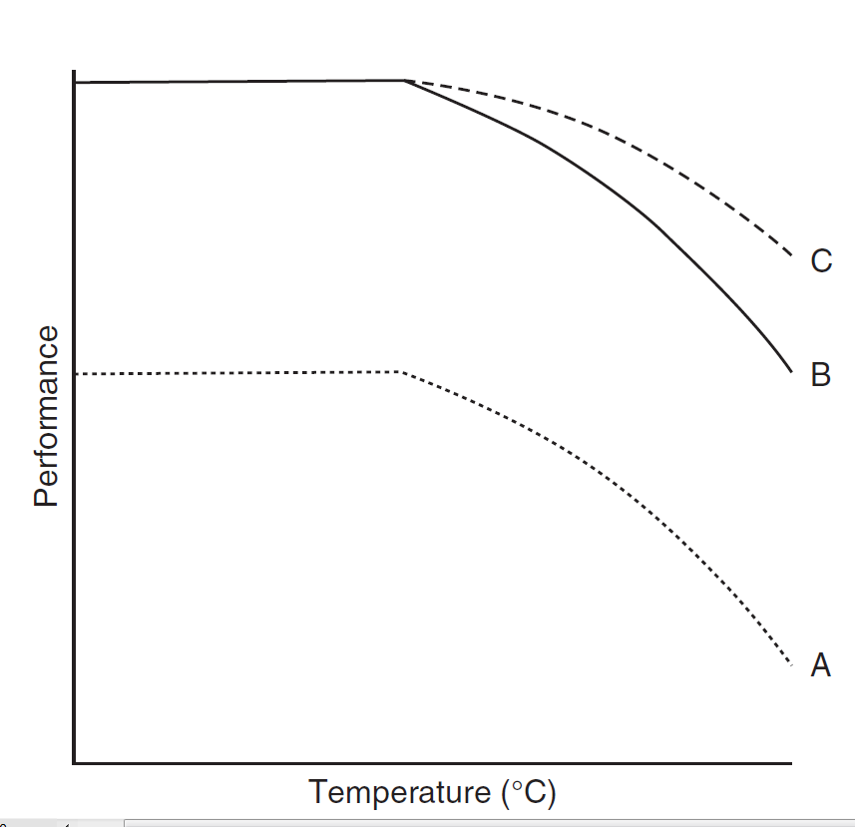
Relationship between performance and diets according to temperature
Response to diet B is always higher A:
Meaning a difference in formulation: déficiency? (energy, amino acids, vitamins,….)
response to diet C is only higher than diet B
under extreme conditions
Meaning a better formulation adapted to "high temperature"

Slide 12
Ingestion et température ambiante
Responses to heat exposure: depressed feed intake & higher water intake
Depends of the physiological state of the rabbit (adult, doe, fattening, …)
If dry feed (pelleted, or flour) , NO water means
=> feed intake STOP within 24h
Standard regulation of intake and excretion
for adult rabbit, according to ambiant temperatures
Temperatures
Ratios 20°C 26°C 32°C
Water/ feed intake 1.7 3.5 8.3
urine/feed 1.0 1.6 4.0
water/faeces 1.9 5.5 11.2
urine/faeces 1.1 2.5 5.3
(Finzi et al., 1992)

Slide 13
Intake regulation and production
according to ambiant temperatures
%
For the breeding doe
Fed pelleted feeds (89%DM)
% respect to control group at 23°C
intake: pellets water milk prod.
g/d
(Szendrö et al., 1998)

Slide 14

Intake regulation and production
according to ambiant temperatures
For the breeding doe
Fed pelleted feeds (89%DM)
Temperature
18°C
30°C
Pellet intake, g/d
380
280
Water intake, g/d
750
600
No water => no solid feed intake (pellets or flour)
Importance of water quality

Slide 15
Intake regulation and production
according to ambiant temperatures
For the fattening rabbit
Temperature
5°C
18°C
30°C
Pellet intake, g/d
182
158
123
Water intake, g/d
328
271
386
Ratio water / pellets
1.80
1.71
3.14
Weight gain, g/d
35.1
37.4
25.4
Eberhart (1980)

Slide 16
INDEX
1. Context & definitions
2. History & basics of digestive system
3. Metabolic regulations for rabbit under tropical climate
4. Nutrition & feeding – which recommendations for which breeding system
5. Practical feeding
6. Conclusions & perspectives

Slide 17
very diversified systems
Examples of rabbit breeding systems
Non intensive
Does
Gestation 1
Lactation 1
Gestation 2
Lactation 2
Fattening
Fattening
-31 0 30 40 70 110 150
Parturition
Weaning
Slaughter
Reproduction : 4 to 5 litters of 6 weaned rabbit per year
Growth ≈ 25 g/d to reach 2.3 kg at 100d
Reduced income costs (feeds, prohylaxy, renewal of livestock)
feeding system : with forages, grazing, byproducts =>
Notes:
A bit of system analysis to give an idea on what I am working on

Slide 18
Intensive
Gestation 3
Lactation 3
Does
Gestation 1
Lactation 1
Gestation 2
Lactation 2
-31d 0 35 42 72 110 150d
Weaning
Slaughter
Parturition
Fattening 1
Fattening 2
6 weeks between two parturitions =>
6 to 7 litters of 7 weaned rabbit per year
Growth ≈ 40-45 g/d to reach 2.3 kg at 70d
Higher income costs (feeds, prohylaxy, renewal of livestock)
Feeding system : with balanced pelleted feeds
Notes:
A bit of system analysis to give an idea on what I am working on

Slide 19
Requirements are dependent of the performances
For a defined system & expected performance=>
Respond to several classes of needs
Maintenance
Gestation
Period (gestation, lactation)
Parity
Litter size
Temperature
Housing system
Feed presentation
Lactation
Growth
Thermoregulation
Physical activity
Three basic nutrients : energy, protein, fibre
+ vitamins + minerals

Slide 20
Definition of nutritional needs
Response curve
Optimal
range
performance
carency
toxicity
Nutrient intake (feed supply: amino acids, energy, vitamins, etc.
Response curves with various shape according
to the nutrients or chemical components

Slide 21
Requirements, recommendations and safety margins in animal feeding
Performance
(growth, milk, ...)
Recommendation
include safety margin
Requirement
Potential
Animal response curve
Nutrient, vitamins, etc ...
maintenance
Safety margin
Limiting factor

Slide 22
Rabbit milk production + comparaison with cow and sow
Feeding the breeding doe
=> the most important <=>"engine" of your rabbitry
Rabbit milk production
g milk/kg LW/d
Prod. /d : 0.32kg 47.5kg 8.9 kg
Semi-intensive rythm - 6 weeks DI (delivery intervall)

Slide 23
Comparative export of proteins and lipids via milk for rabbit doe and comparison with cow and sow
Semi-intensive rythm - 6 wks DI Delivery Intervall
Production at lactation peak
g lipids/kg LW/d
g protein /kg LW/d
Greater exports => higher requirements
Lactating doe=> carefull feeding!!

Slide 24
Requirements along time for the breeding doe
Total requirements
Semi-intensive
rythm (6 wks DI)
lactation
Gestation
Maintenance
0
7
14
21
28
35
42
Parturition
AI
weaning
Parturition, n+1

Slide 25
Energy balance along time for the breeding doe
Total requirement
Semi-intensive
rythm (6 wks DI)
Negative balance
Deficit
Excess
Intake)
Besoins d’entretien
0
7
14
21
28
35
42
Parturition
AI
weaning
Parturition, n+1

Slide 26
Energy balance along time for the breeding doe under hot climate with lower intake
Total requirement
Semi-intensive
rythm (6 wks DI)
Deficit
Larger negative balance
Low fertility
Shorter carreer
Higher culling rate
Higher mortality rate
Intake)
Besoins d’entretien
0
7
14
21
28
35
42
Parturition
AI
weaning
Parturition, n+1

Slide 27
Energy balance along time for the breeding doe
under hot climate with lower intake
Total DE requirement
Solutions :
1. extending the DI to 9 wks
2. Reduced performance level= lower litter size
3. Increase the dietary DE concentration
4. Air conditioning (refreshing with water air-pads)
Little negative balance
Deficit
DE Intake
Besoins d’entretien
0
7
14
21
28
35
42
Parturition
AI
weaning
Parturition, n+1

Slide 28
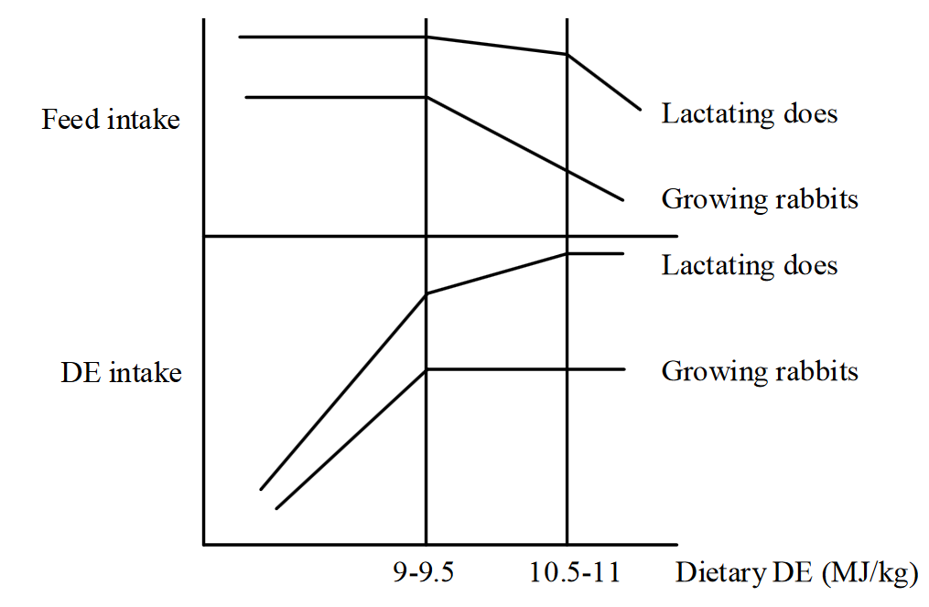
Regulation of feed intake and of energy intake
Within 15-26°C – correct regulation of DE intake, either for fattening rabbits or doe
Over 30° C : feed intake reduction
=> DE intake maintained for doe if higher DE concenctration , with lipids incorporation
=>lower DE intake for fattening, not easy to compensate with higher DE concentration

Slide 29
Prediction of growth for a 1.5kg rabbits at
18°C 30°C
Feed intake (g DM/kg MW) 80 60
Energy intake (kJ DE) 1188 891
Maintenance requirement(kJ DE)* 745 633
Growth requirement (kJ DE) 443 258
Growth (g/day) 37 21
Pelleted diet with 11 MJ DE/ kg DM.
* 552 kJ DE /kg MW with 15% lower requirements at 30°C.
Approximately 12 kg DE / g LW gain.
Several studies: 10% increasing dieary DE or increasing protein and lysine=> no improvement in DWG of rabbits kept at 30°C.
Neither increasing protein from 130 to 200 g kg−1 nor increasing total digestible nutrients from 57% to 62% improved the DWG of "slow" growing rabbits
in tropical conditions (Deshmukh and Pathak, 1991)
No "optimal" diet adapted to tropics to increase the carcass fat content in rabbits

Slide 30
Energy and protein requirements for the breeding doe
Feed intake regulation according to DE level of the diet
Feed intake
10 essential aminoacids (on 21)
Lactating doe
Lower intake=> lower protein intake
Readjusting the dietary protein level
reasoning = ratio DE/DP
Relative supply in DE and DP
Fattening
rabbit
Recommandations in Europe for does:
Energy : DE = 9.8 to 10.2 MJ ED/kg
Protein: DP =12.5 to 13.5 g/kg
with Lysine (>0.8%) and SAA (>0.6%)
DP/DE range: 9.8 -11.3 g DP/MJ DE
11.5–12.5 g DP / MJ DE for lactating doe with 6 wks DI
Dietary DE, MJ/kg
9.0 9.5 10.0 10.5 11.0 11.5
Recommandations in Europe for fatteners:
Energy : DE = 9.4 to 9,8 to 10.2 MJ ED/kg
Protein : DP =11.0 to 12.0 g/kg
with Lysine (>0.6%) and SAA (>0.5%)
DP/DE range: 11.6 -12.2 g DP/MJ DE
9.8–11.3 g DP / MJ DE for end fattening
Carency in protein : lower milk production and litter weight + lower fertility
Excess in protein : lower litter survival and prolificacy

Slide 31
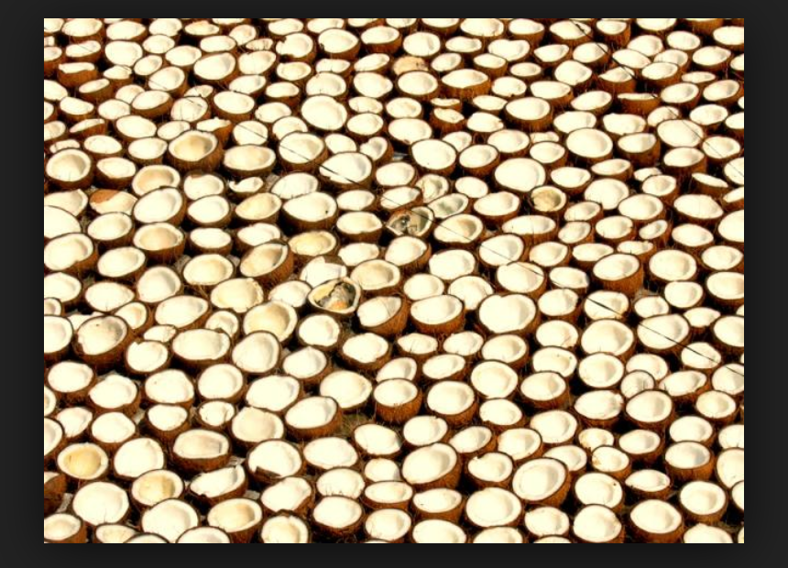
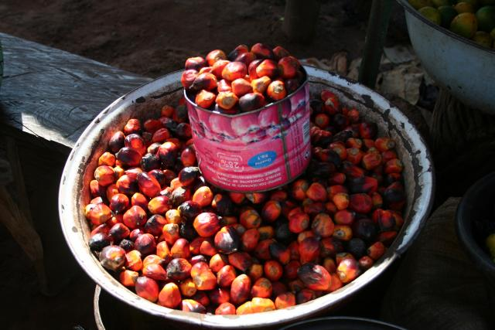
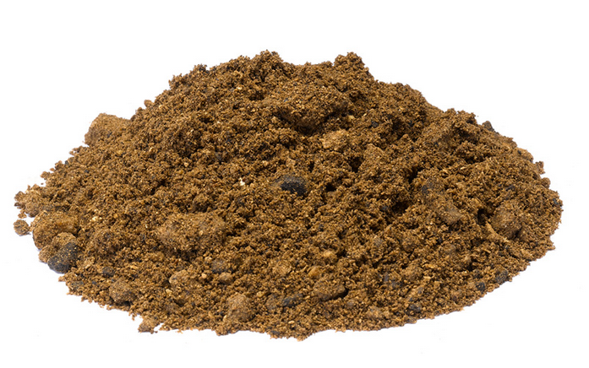
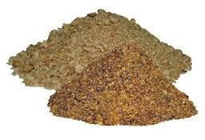
Lipids recommandations : 2.5 to 3% lipids
Covered "naturally" by the ingredients of the diet
Not necessary to add fat to fattening rabbit feed (because intake regulation)
May be necessary for breeding doe except to enrich the DE content , for instance under hot environment
Ingredients: rice brans (3 to 16% whether de-oiled or not) or meal obtained by simple pressure : 8 to 9% lipids in coconut or palm kernel meal (cake)
Palm kernel meal
Coprah meal

Slide 32
Fibre recommandations
For the breeding doe : ADF > 15%
Carency : higher risk of digestive troubles
Excess => lower DE content in feed => lower performances
For the fatteners :
ADF > 18% after weaning
+ >5% Lignins
Carency : higher risk of digestive troubles
Excess => lower DE content in feed => lower performances
Engraissement excessif
Infertilité
Meta-analysis from 7 studies and 22 diets
For moderate or low production level with forage based feeding
=> fibre needs largely covered

Slide 33
Effects of lignins* on growing rabbit digestive health ?
6 studies, 19 diets
without antibiotics
Requirement : minimum 5% ADL .
*Beware : sometimes ADL* is not true lignin …
overestimation in some cases: feedstuffs rich in tannins or phenols -> grape marc, grape seeds meal,

Slide 34
Minerals & vitamins
Lactation phase : high requirements in :
calcium 11 to 13 g/kg, phosphorus 6 to 7g/kg of the diet
Vitamins found in various ingredients : green fodder, cereals, cakes, agro-food by-products, leftovers and compound feeds.
Fat-soluble vitamins (A, D, E and K) must be provided by the diet=> beware of excess , hypervitaminosis DA (< 3,500 IU) and A (100,000 IU).
Water-soluble vitamins : C and those of group B provided by the caecotrophy (caecal microbiota)
 | /kg diet | Breeding doe | Growing rabbit
Vit. A | UI | 10000 | 6000
Vit. D | UI | 900 | 900
Vit. E | UI | 50 | 15
Vit. K₃ | mg | 2 | 1
Biotine | mg |  | 0.2
Folic acid | mg |  | 5
 | /kg diet | Breeding doe | Growing rabbit
Calcium | g | 11.5 | 6.0
Phosphore | g | 6.0 | 4.0
Iron | mg | 50 | 30
Copper | mg | 10 | 6
Zinc | mg | 60 | 35
PREMIX with standards established for environmental conditions in Europe, may contains coccidiostatics or drugs
BEWARE: do not use premix sell for poultry or ruminants !

Slide 35
Nutrient requirements for rabbits under "intensive" production systems
Composition per kg as fed (for a feed with 90% DM) | Unit | Breeding does | Fattening rabbits |  | Mixed feed
 |  |  | Post-weaning | finishing
Digestible energy | MJ/kg | 10.5 to 10.9 | 9.4 to 9.8 | 9.8 à 10.2 | 9.6 à 10.2
Crude fibre | g/kg | >130 | >150 | >150 | >140
NDF | g/kg | >270 | >310 | >310 | >290
ADF | g/kg | >150 | >180 | >180 | >170
ADL | g/kg | >40 | >50 | >50 | >45
Hemicelluloses NDF-ADF | g/kg |  | 130 | 130
ratio FD/ADF |  |  | <1.3 | <1.3
Crude Protein | g/kg | 165 to 185 | 150 to 170 | 150 to 170 | 155 to 180
Digestible protein | g/kg | 125 to 140 | 100 to 120 | 100 to 120 | 110 to 125
Amino-acids
Lysine | g/kg | >7.0 | >7.3 | >7.3 | >7.1
Sulphur AA | g/kg | 5.2 to 5.5 | >6.0 | >6.0 | 5.6 to 5.9
Threonine | g/kg | 6.2 to 6.4 | 5.8 to 6.2 | 5.8 to 6.2 | 5.9 to 6.3

Slide 36
Hot climate limits the duration of the breeding season of rabbits.
A breeding doe able to produce 7 litters a year in thermoneutral zone , gives only 4-5 litters in hot climate
Growth performance range from 15 to 25 g/day under tropics (vs 40-50 g/d in intensive European systems)
Production level => nutritional need
High production level wanted? High and balanced recommendations
Which breed (line) / thermoneutral zone = climatic regulation / air conditioned => elevated costs + optimal pelleted feeds ///
in brief "copy and paste" the European conditions
Medium production level wanted? Pelleted feed (or flour) + forages or plants => limited costs according to the production expected
Moderate production level wanted? Only plants of forages, byproducts, household wastes, etc.
=> Low feeding costs according to the production expected

Slide 37
INDEX
1. Context & definitions
2. History & basics of digestive system
3. Metabolic regulations for rabbit under tropical climate
4. Nutrition & feeding – which recommendations for which breeding system
5. Practical feeding : ingredients, feed formulation
6. Conclusions & perspectives

Slide 38
High production level
Pelleted commercial feeds with adequate premix, balanced formulations according to type of rabbits (doe, fattening)
in brief "copy and paste" the "standard" recommendations
Special attention to intake behaviour : high DE content, with added fat?
Special attention to drinking behaviour and water quality
Medium to moderate production level
* Pelleted feed (or flour) at farm with local ingredients (with some minerals) ⬄ "home" feed formulation => limited feeding cost in accordance with the expected production
* Flour or mash , mixed forages & grains & by products => low feeding cost
Moderate to low production level
Feeding = only plants of forages, byproducts, household wastes, etc.
=> Low feeding costs

Slide 39
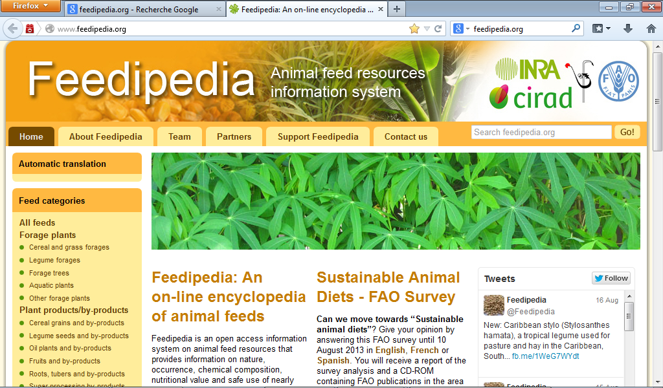
Nutritional value of tropical forages and byproducts for the rabbit
Several compilation of nutritional data of ingredients usable for rabbit feeds
Raharjo, 1987; Ayoade et al., 1985; Lebas, 2004; Safwat et al., 2014, …..
+ Feedipedia
Many tropical feeds contain toxicants and some tropical legumes contain toxic amino acids or alkaloids.
e.g. Leucaena: contains mimosine, while cassava contains cyanogens.
leucaena can be utilized as component of a forage mixtures till 10% , or even to 25% for low-mimosine cultivars.
Farmers teaching programms to use plants and forages having good nutritional value.
Few informations about feeding systems and programmes adapted to tropics.
e.g.: recommand some mixture of forages according to seasons, to reduce the concentration of specific toxins to non-hazardous levels

Slide 40
Selecting the right ingredients ….
The tropical legume forages, in general, have a high content of digestible energy and protein, while the tropical grasses are characterized by a low digestibility.
e.g. little success with the use of Setaria spp "golden millet forage", since very poorly digested by the rabbit
Under hot climate conditions, digestion of highly lignified fibrous feeds increases the heat output and heat load at a time the animal is already under considerable heat stress.
Thus, arranging feeding with minimum lignified and / or containing ingredients with low fibre-high energy content will that produce less metabolic heat, may be beneficial… particularly for lactating doe feeding

Slide 41
Agricultural and industrial by-products.
Only a few need special mention.
First come the various tropical oilcakes such as groundnut , palm nut and coconut.
Cottonseed cake should be used very cautiously, as rabbits are at least as sensitive
as pigs to gossypol, more sensitive than ruminants.
However, cottonseed cakes containing up to 700 ppm of free gossypol have been fed to growing rabbits with no problems.
In many countries where cottonseed feedcake is available, i.t is preferable to use it and to accept a drop in performance of 10 to 15 percent compared with a gossypol-free ration rather than attempt
to introduce livestock-based meal as a protein source which may be expensive or of poor bacteriological quality.
Then there are maize and rice by-products. Brewer's draff and citrus pulp are possible feed sources where the processing plants are not too far from the rabbitry.
Rabbits can also be fed waste products from pineapple canneries (Ivory coast), but pineapples are poor in protein.

Slide 42
http://www.fao.org/
% DM Forage species |  | Crude protein |  | Acid detergent fibre
Woody legumes
Albizia falcata |  | 16.3 |  | 26.9
Calliandra calothyrsus |  | 21.8 |  | 29.1
Leucaena leucocephala |  | 21.9 |  | 21.8
Sesbania formosa |  | 19.9 |  | 20.8
Non-woody legumes
Cassia rotundifolia |  | 15.0 |  | 47.0
Desmodium heterophyllum |  | 13.4 |  | 37.1
Pueraria phaseoloides "kudzu" |  | 15.6 |  | 39.9
Stylosanthes guianensis |  | 14.8 |  | 33.1
Grasses
Panicum maximum¹ |  |  | 5.8 | 48.7
Pennisetum purpureum |  |  | 12.0 | 38.2
Setaria splendida |  |  | 6.9 | 39.7
Agricultural by-products
Manihot esculenta (tops) |  | 16.8 |  | 28.2
And also, domestic wastes, crop residues and gardening cuts …
Diet may be not perfectly balanced, but very low cost.

Slide 43

and also ….Grazing/pastured rabbit….
Mobile cages or pens in a natural meadow (without fertilizer) can produce ⬄ 1.2 tonnes of carcasses = 240 kg of protein / ha / year.
High forage utilization by rabbits, but need of protein supply
legumes plots = growth rate (20 -25 g/d)
grass plots = only 15-20g/d
Direct grazing
problems of fencing
Protection from predators

Slide 44
Sous consommation
quantité et qualité de l'eau
Présentation de l'aliment: dureté (lapereau) ,
granulés friables, poussières, pâtées, farine
Concentration en ED élevée (trop peu de fibres?)
Protéines : qualité ? (excès de méthionine), quantité ?
Qualité des granulés : moisissures

Slide 45
How to formulate simply a complete feed for the rabbit
1- make your list of ingredients available for you
2- look at the chemical composition and nutritive value (DE, DP),
of your ingredients, in EGRAN tables or in Feedipedia website
3- look at the nutrient requirements for the rabbits you have
4- use a software for formulation
Free software in WRSA website= WUFFDA,
based on a simple excel sheet

Slide 46
Free ingredients table at : http://www.feedipedia.org/

Slide 47
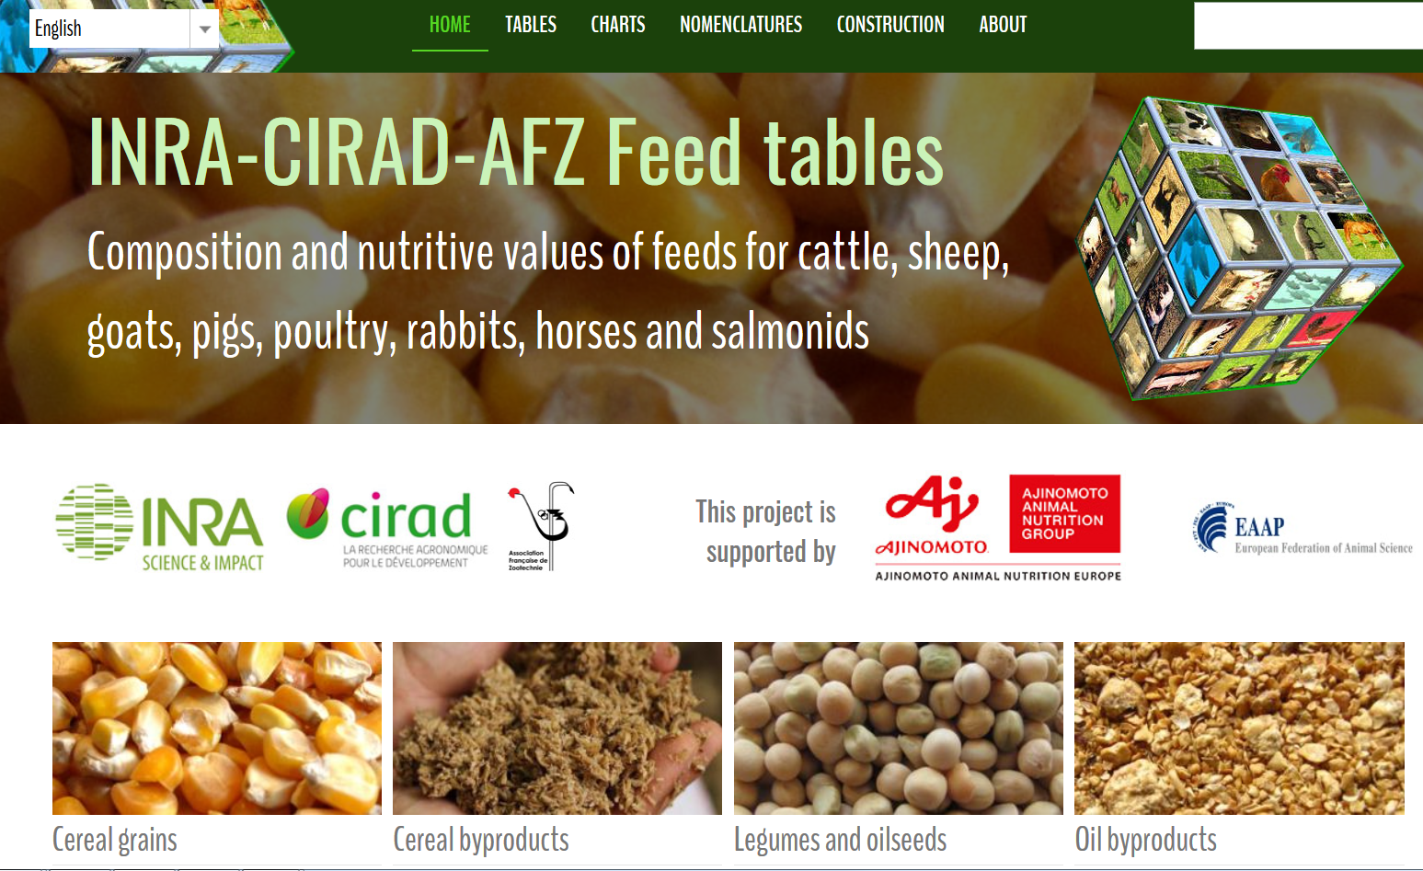
Feed tables with free access
https://www.feedtables.com/

Slide 48
* Feeding during the coolest periods of the day: early morning, end of day
OK for Rabbit = nocturnal feeding behaviour

Slide 49
Figure 2. Rabbit pellets are a combination of several
different ingredients blended to provide the daily nutrient
requirements of a rabbit
Figure 1. Rabbit feed is a combination of ingredients in
pelleted form to provide for a rabbits daily needs

Slide 50
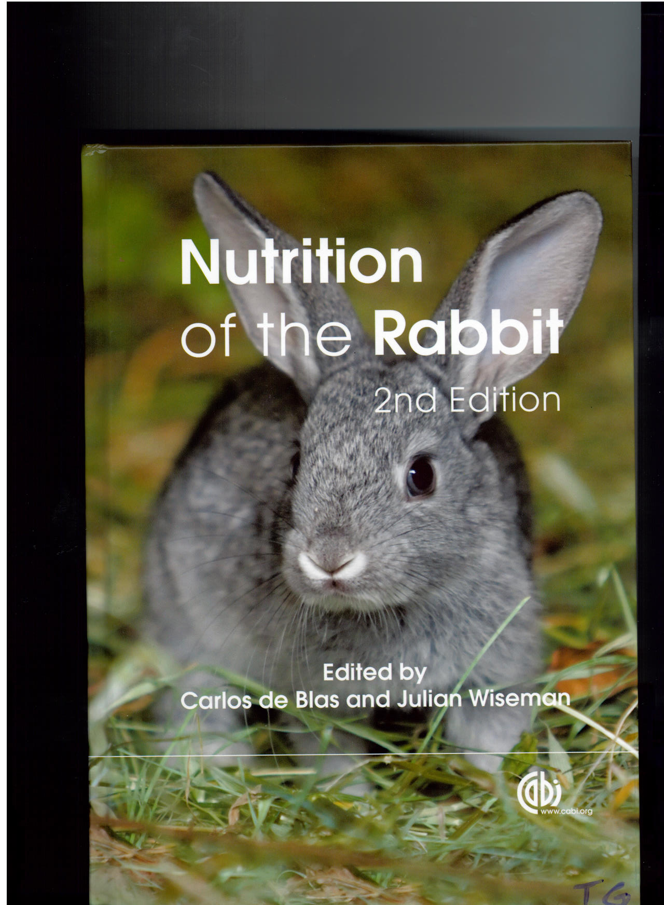

Free European tables of Feeds composition and nutritive value for the rabbit
World Rabbit Science, Maertens et al., 2002
Free book to download in WRSA website
FAO free book download at :
Rabbit breeding and pathology
http://www.fao.org/3/x5082e/X5082E00.htm

Slide 51
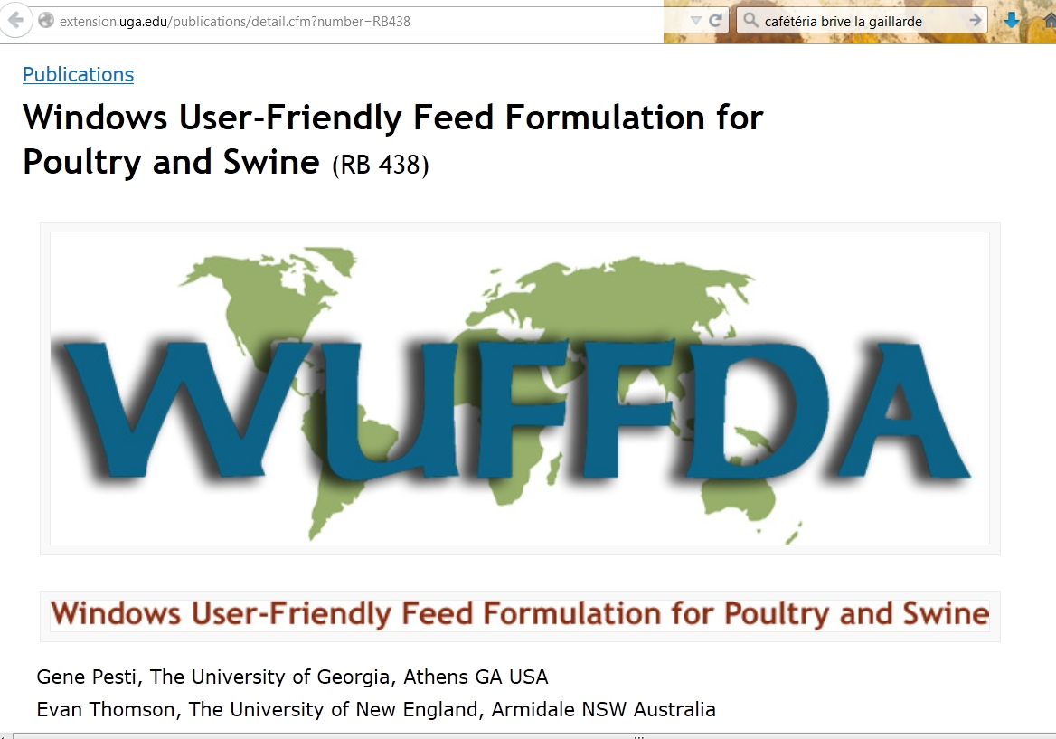
http://www.caes.uga.edu/publications/pubDetail.cfm?pk_id=7886
FREE EXCEL Sheet
For FEEDS FORMULATION

Slide 52
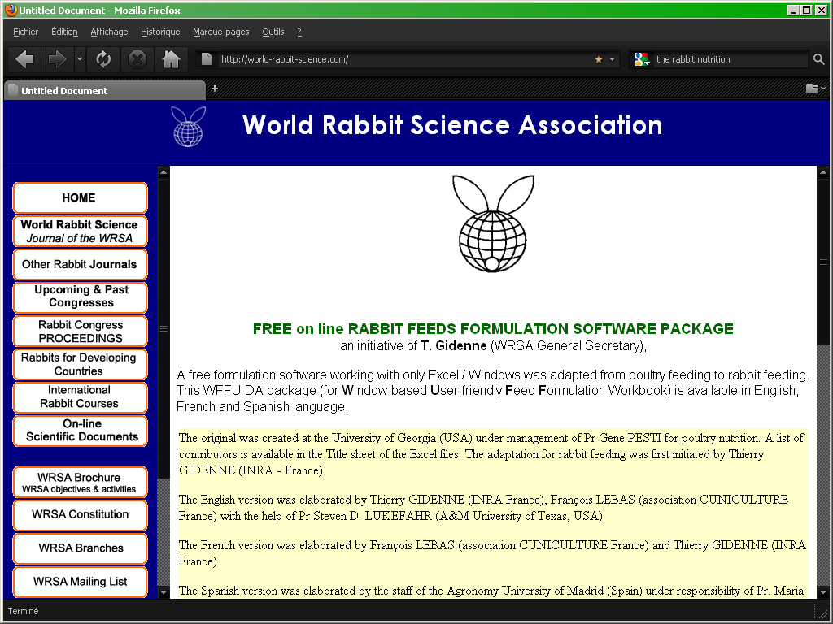
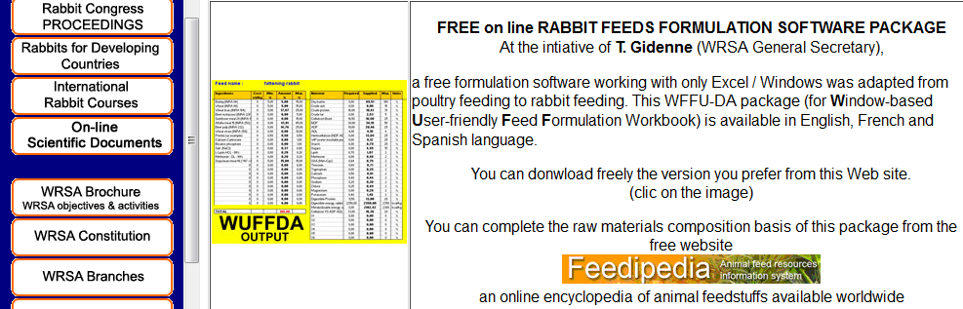
FREE EXCEL Sheet
For RABBIT FEEDS FORMULATION
download at:

Slide 53
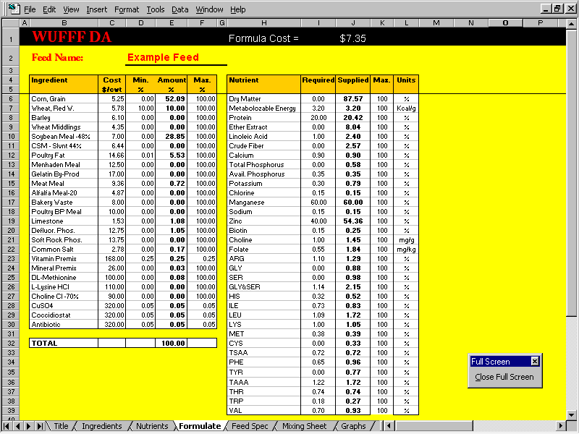
The Amount of Each Ingredient in the Formula and the Nutrients the Diet Supplies Will Be Displayed.

Slide 54
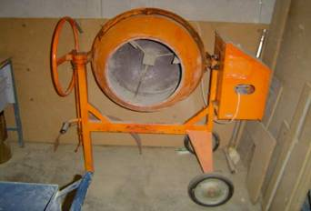
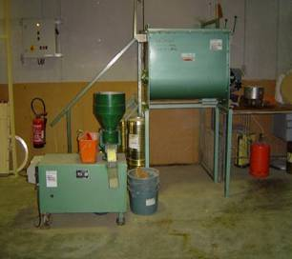
Pelleting : advantage on performances
Intake DWG FCR
Pellet =100 =100 =100
Meal (flour) 83 87 106 (Lebas, 1973)
Meal 75 60 123 (Candau, 1986)
Meal 98 80 123 (Machin, 1980)
Mash 75 84 89 (Machin, 1980)
(40% water)
Small mixing and pelleting machines
Wastes reduction
Less dust compare to flour
Balance complete feed
Easy storage and manipulation
BUT, need : grinder, mixing machine, pelleting machine
Dried and safe ingredients

Slide 55
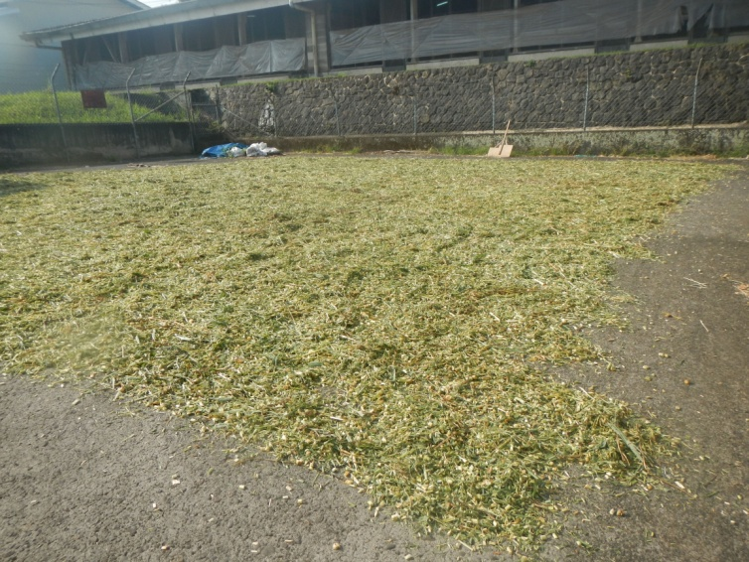
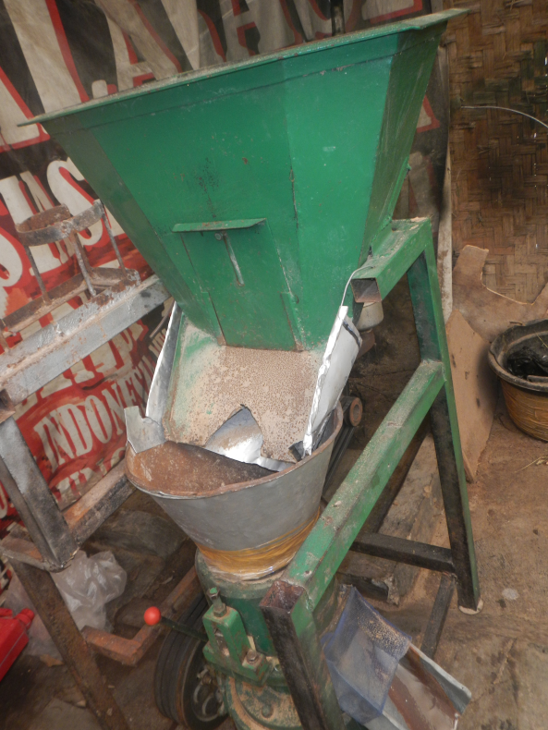
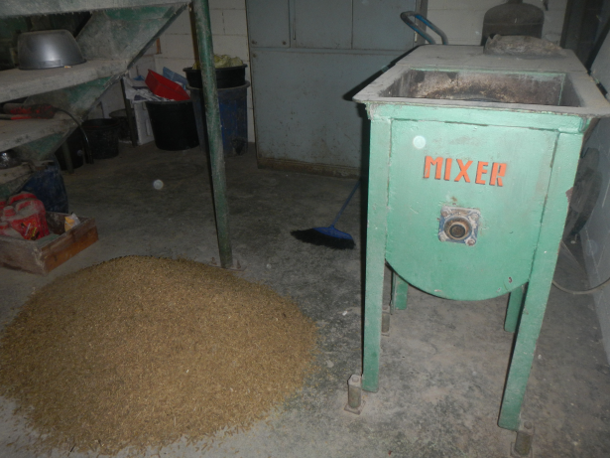
Pelleting at farm (or for a group of farmers):
(cf. Benin, China, Indonésia, …)
With local fodders, byproducts….
Pelleting machine
Sun drying of fodder
Grinder

Slide 56
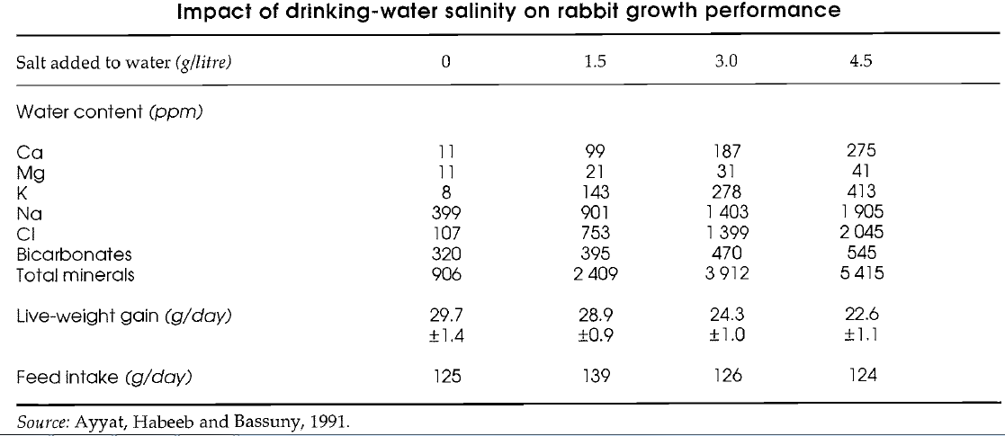
If pelleted feed => look at the quality of the water
Ex. Excess of water salinity can depress the performance

Slide 57
INDEX
1. Context & definitions
2. History & basics of digestive system
3. Metabolic regulations for rabbit under tropical climate
4. Nutrition & feeding – which recommendations for which breeding system
5. Practical feeding : ingredients, feed formulation
6. Conclusions & perspectives

Slide 58
Conclusions & perspectives
Further research : nutritional value of tropical forages and by-products for rabbits.
Technical assistance to rabbit breeders to develop their skills in feed management
For high to medium size rabbitry : teaching feeding, selecting ingredients, and pelleting
Extension programs to stimulate the rabbit farming (including backyard rabbitry)

Slide 59
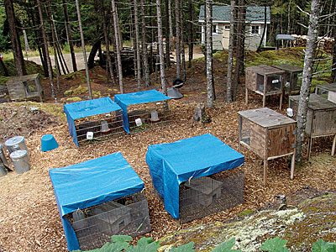
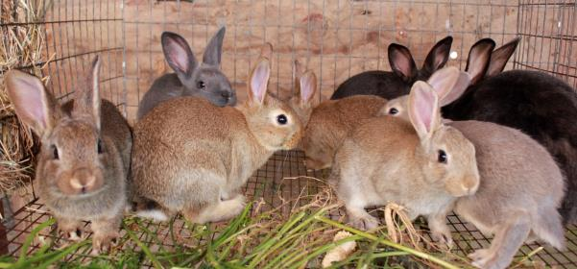
Other farms with outdoor rabbitry, forage base feeding
Raising Rabbits Organically at Rabbit Hill Farm, USA Maine
Ghana and Kenya

Slide 60
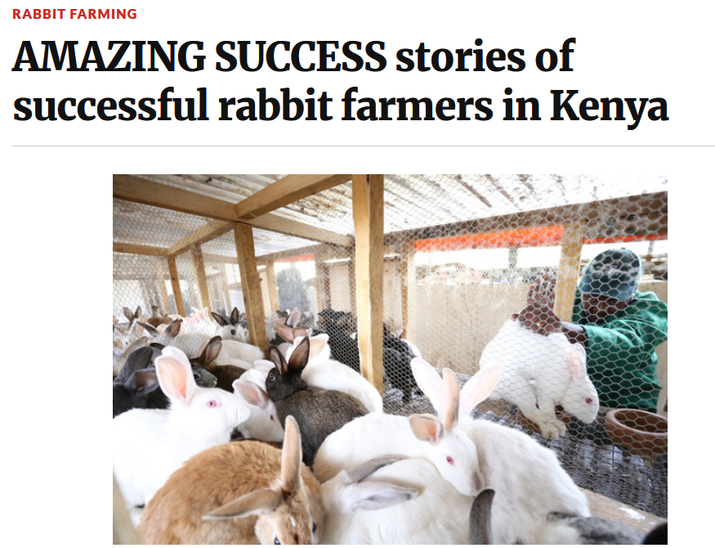
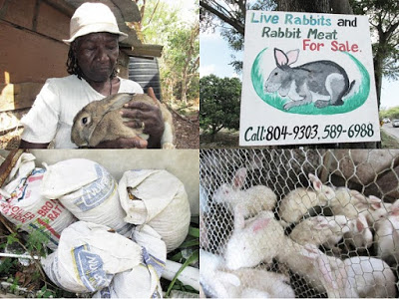
2014

Slide 62
Housing recommanded in tropics, with 25 doe cages (or more)

Slide 63
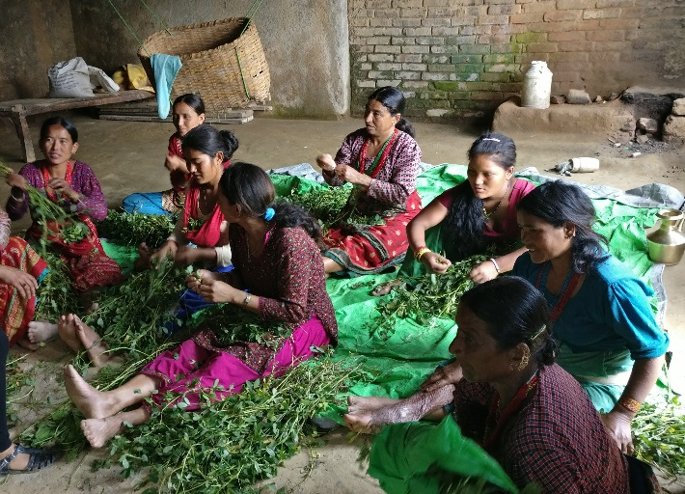
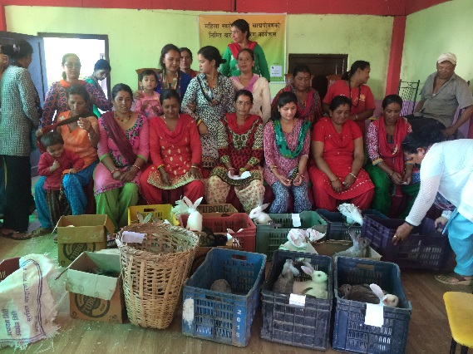
Rabbit Farming for Poverty Alleviation
In NEPAL: http://www.himalayanrabbitfarm.com/
Forage distribution
And in many other countries: indonesia, congo, ivory coast, haiti, etc.

Slide 64
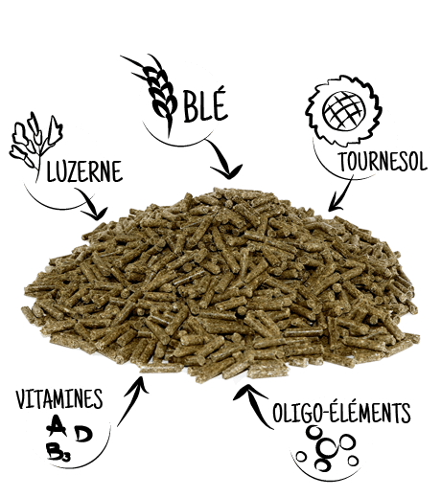
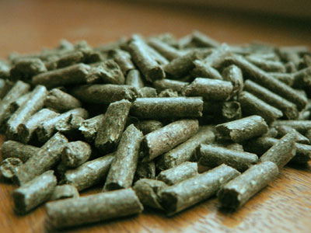
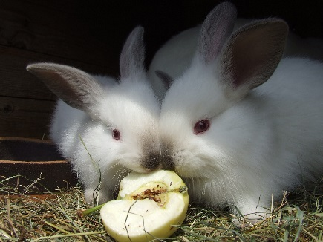
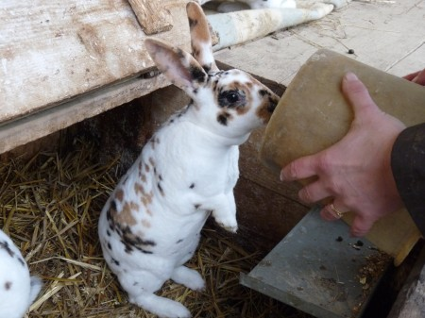
wheat
alfalfa
sunflower
Food Agriculture Environment
vitamins
Oligo-elem
Thank you for your attention
Rabbit Nutrition in Tropic
Thierry Gidenne, INRA France
thierry.gidenne@inra.fr
INTERNATIONAL CONFERENCE ON RABBIT PRODUCTION IN TROPICAL CLIMATE 2019
Selangor, Malaysia, 4-6 august

Slide 65





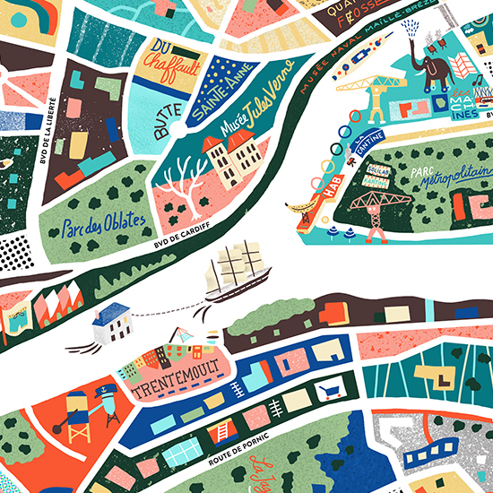

World
Rabbit
Science
Association
Next year 1-3 july
WELCOME
IN NANTES!
Website open !
https://colloque.inra.fr/wrc2020
You can already pre-submit a scientific communication (title + synopsis)

