Slide 1



Inactivation of enzymes challenges
the current view of temperature response of enzymatic reactions
Sébastien FONTAINE & Gaël ALVAREZ
INRA Clermont-Ferrand
sebastien.fontaine@inra.fr

Slide 2
Extreme environments
What does it mean extreme environments?
A concept a bit anthropocentric .
Extreme environments
Extreme environments
Water availability
« Human life »
Temperature
  Extreme environments are not exceptions but their understanding requires a fine knowledge of the response of biological processes to environmental factors (T°C…)

Slide 3
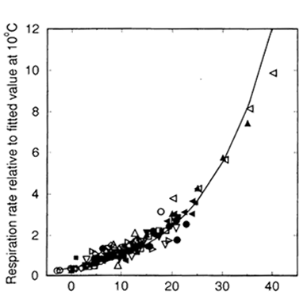
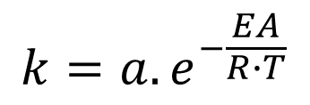

Impact of temperature on microbial degradation: current theory
$$\frac{dC}{dt}=−k.C$$
Describes decomposition
as a substrate-limited process
Thermo-dependence is
embedded in the rate constant k
Lloyd and Taylor, 1994
$${k=a.e}^{−\frac{EA}{R∙T}}$$
(Arrhenius equation)
  In the short-term (hours to days) warming accelerates C decomposition
Temperature (°C)
1

Slide 4
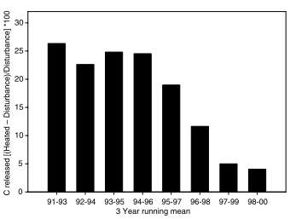
Attenuation of warming effect with time
Harvard Forest, soil warming +5°C (10 years)
+ 28%
Melillo et al., 2002
  Stimulation
  of soil respiration is transitory
  (6-7 years)
% of control
Warming-induced C released
Discrepancy short vs. long term response
2

Slide 5
Re-analysis of thermo-dependence of enzymatic reactions

Slide 6
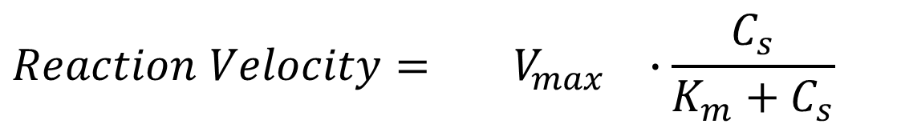
Velocity of enzyme reactions is co-limited by substrate concentration and enzyme pool
Michaelis-Menten equation
$$Reaction Velocity={ V}_{max} ∙\frac{C_{s}}{K_{m}+C_{s}}$$
Substrate
limitation
Maximum velocity at saturating substrate
3

Slide 7


Let us to consider the case of excess of substrate
$$V_{max}$$
$$Reaction Velocity=k_{cat}∙E_{act}∙$$
Enzyme
catalytic activity
Active Enzymes
(thermo-dependence?)
$${k_{cat}=a_{c}.e}^{−\frac{EA_{cat}}{R}∙\left(\frac{1}{T}\right)}$$
3

Slide 8



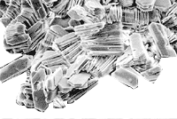
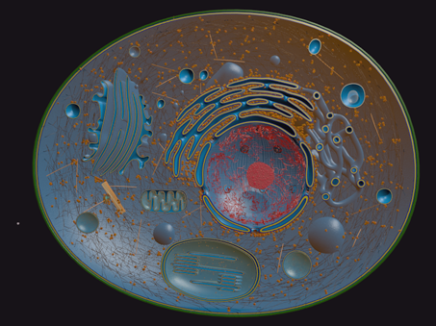



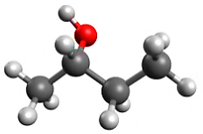
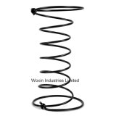
Active enzyme pool controlled by microbial production and enzyme inactivation
Enzyme Production (T)
Enzyme Inactivation (T)
  Minerals
  Cell
  Toxics
  Thermal inactivation
3

Slide 9
Thermal inactivation of enzymes
  A well-known process by enzymologists
  Induced by the Brownian movement and collisions between molecules
=> loss of protein conformational structure and active sites
  Continuous process acting at all temperature (+/- process of ageing)
  Intensifying with temperature

Slide 10

Objective
  Describing the temperature response of enzymatic activity
  by accounting for the thermo-dependence of enzyme pool
$$Vmax=k_{cat}∙E_{act}$$
Enzyme
catalytic activity
Active Enzymes
limitation
Temperature

Slide 11
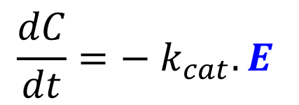
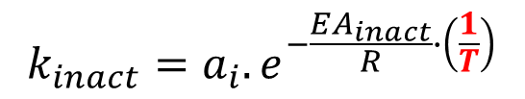
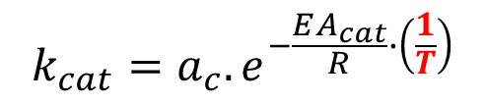
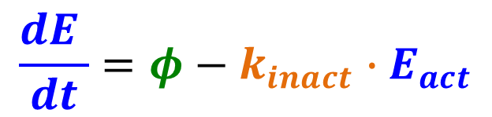
Modelling the enzymatic system
$$\frac{dC}{dt}=− k_{cat}.E$$
$${k_{cat}=a_{c}.e}^{−\frac{EA_{cat}}{R}∙\left(\frac{1}{T}\right)}$$
Substrate degradation
Enzyme pool
dynamics
$$\frac{dE }{dt}=φ−k_{inact}∙E_{act}$$
  Constant flux of enzyme
  (might depend on T)
  continuous enzyme inactivation
$${k_{inact}=a_{i}.e}^{−\frac{EA_{inact}}{R}∙\left(\frac{1}{T}\right)}$$
4

Slide 12



Analysis of the theory
1. Batch reactor (𝝓 = 0) : effect of a pool of enzyme
2. Enzyme flow reactor : with enzyme production
$${− k}_{inact}∙E$$
E₀
inactivation
$$φ$$
$${− k}_{inact}∙E$$
E
Enzyme production
inactivation

Slide 13
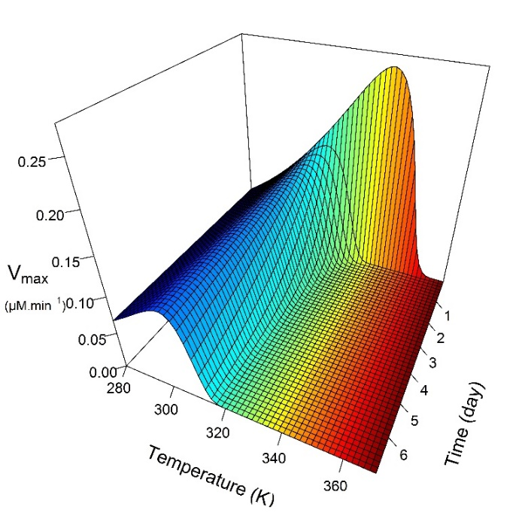
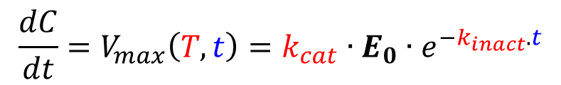
Batch reactor – V_{max}
The reaction velocity (V_{max}) mediated by a pool of enzyme is given by:
Optimum
$${{\frac{dC}{dt}=V}_{max}\left(T,t\right)=k}_{cat}∙E_{0}∙e^{−k_{inact}.t}$$
Cat. activity resp.
dominates
Inact. resp.
dominates
Time 0
For a given time, V_{max}
shows an optimum
5

Slide 14
Batch reactor – V_{max}
T optimums shift with time
towards lower values
due to slower enzyme inactivation
at cold T
5

Slide 15
Batch reactor – V_{max}
=> Temperature response of V_{max} changes with time and can be opposite.
Positive
resp.
Negative
resp.
+10°C.
5

Slide 16
Batch reactor – V_{max}
Temperature optimum is not a relevant trait
- depends on assay duration
- does not inform on the long-term effect of temperature
Positive
resp.
Negative
resp.
+10°C.
5

Slide 17
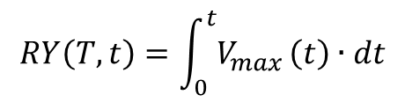
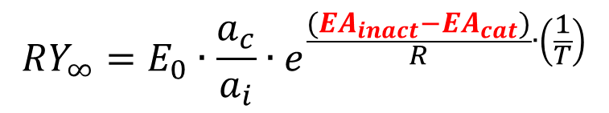
Batch reactor – Reaction yield
To capture the long-term temperature response of enzymatic activities we need to consider the cumulative enzyme activity:
$$RY\left(T,t\right)=\int_{0}^{t}{V_{max}}\left(t\right)∙dt$$
  Reaction Yield
  Total amount of substrates degraded by the enzyme pool until its complete inactivation (Integration of RY with t → +∞)
E_{power}
catalytic power of enzyme
RY∞ per unit of E₀
$$RY_{∞}=E_{0}∙\frac{a_{c}}{a_{i}}∙e^{\frac{{(EA}_{inact}−{EA}_{cat})}{R}∙\left(\frac{1}{T}\right)}$$
5

Slide 18
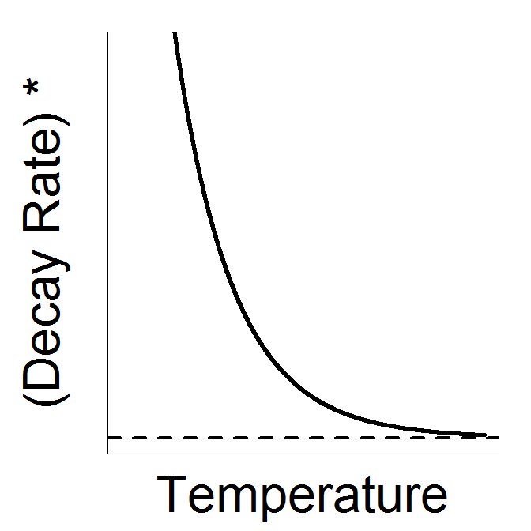
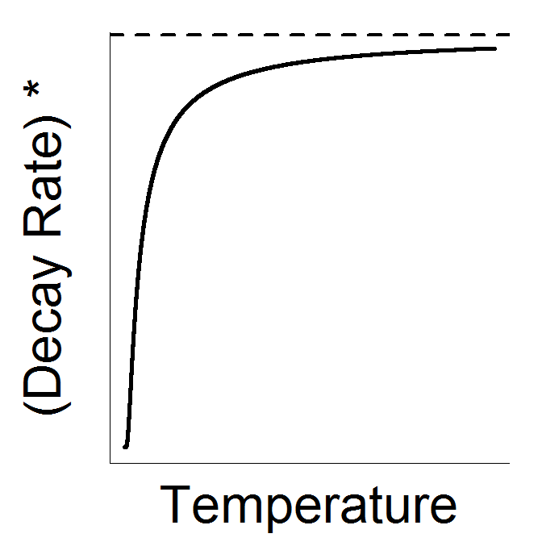
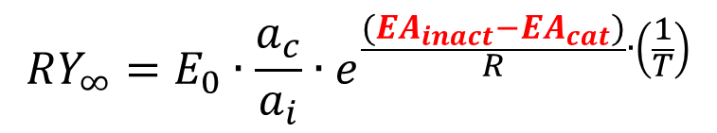
Batch reactor – Reaction yield
E_{power}
catalytic power of enzyme
RY∞ per unit of E₀
$$RY_{∞}=E_{0}∙\frac{a_{c}}{a_{i}}∙e^{\frac{{(EA}_{inact}−{EA}_{cat})}{R}∙\left(\frac{1}{T}\right)}$$
Temperature response of E_{power}
EA_{inact} > EA_{cat}
EA_{inact} < EA_{cat}
negative
response
positive
response
E_{power}
E_{power}
5

Slide 19
Meta-analysis of EAs for catalysis and thermal inactivation
Enzyme | Catalysis EA_{cat} (kJ.mol-1) | Inact. EA_{inact} (kJ.mol-1) | References
Dihydrofolate reductase | 67 | 93 | Daniel et al., 2008
Alkaline phosphatase | 55 | 90 | Daniel et al., 2008
Acid Phosphatase | 79 | 95 | Daniel et al., 2008
β-Glucosidase | 63 | 95 | Daniel et al., 2008
3-isopropylmalate dehydrogenase | 72 | 100 | Daniel et al., 2008
Ammonia-Lyases | 80 | 97 | Daniel et al., 2008
ATPase | 74 | 92 | Daniel et al., 2008
α-Glucosidase | 71 | 0 | Daniel et al., 2008
3-isopropylmalate dehydrogenase | 73 | 94 | Daniel et al., 2008
Dihydrofolate reductase | 66 | 90 | Daniel et al., 2008
Glutamate dehydrogenase | 57 | 94 | Daniel et al., 2008
Malate dehydrogenase | 53 | 85 | Daniel et al., 2008
Alkaline phosphatase | 57 | 97 | Daniel et al., 2008
Fumarase | 60 | 92 | Daniel et al., 2008
γ-Glutamyl transferase | 63 | 98 | Daniel et al., 2008
Glutamate dehydrogenase | 63 | 93 | Daniel and Danson, 2013
Malate dehydrogenase | 55 | 96 | Daniel et al., 2008
α-Glucosidase | 64 | 96 | Daniel et al., 2008
Dihydrofolate reductase | 67 | 97 | Daniel et al., 2008
α-Glucosidase | 88 | 103 | Daniel et al., 2008
3-isopropylmalate dehydrogenase | 76 | 101 | Daniel et al., 2008
β-Glucosidase | 81 | 98 | Daniel et al., 2008
Citrate synthetase | 88 | 103 | Daniel and Danson, 2013
Alkaline phosphatase | 72 | 99 | Daniel et al., 2008
Catalase | 18 | 230 | Sizer, 1944
Tannase | 17 | 85 | Nie et al., 2012
Tannase | 23 | 69 | Yu and Li, 2006
Xylanase | 32 | 311 | Cobos and Estrada, 2003
5-lipoxygenase | 28 | 110 | Lagutina et al., 1990
Lipase | 13 | 79 | Bhatti and Amin, 2013
1:1 line
  Universal pattern of enzyme
  thermodynamic properties
  EA_{inact} > EA_{cat}
Enzyme inactivation is more sensitive to T than enzyme activity
6

Slide 20
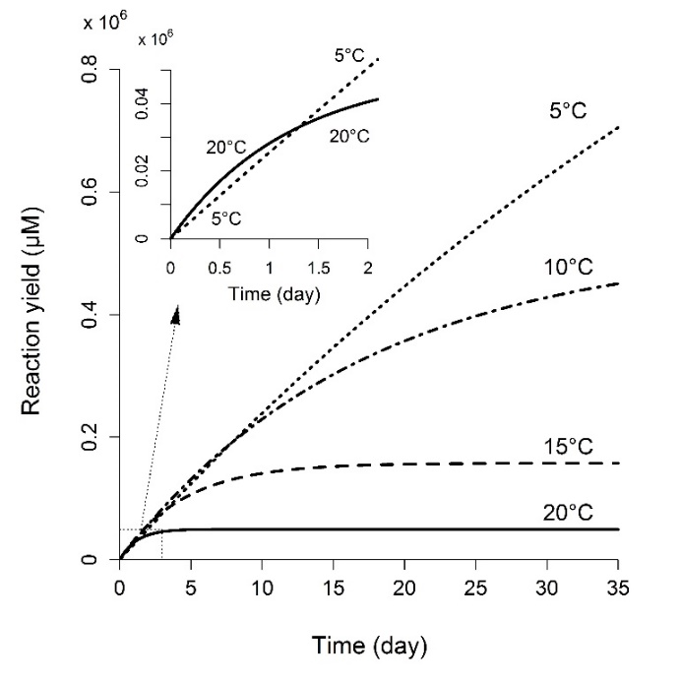
The cumulated amount of degraded substrate decreases with temperature
E_{power}
Over the long-term, T has negative effect on enzymatic activities
6

Slide 21


Enzyme flow reactor - Steady-state analysis
Consider a pool of enzymes replenished by an enzyme production
$$φ(T)$$
$${− k}_{inact}∙E$$
E
Enzyme production
inactivation
5

Slide 22

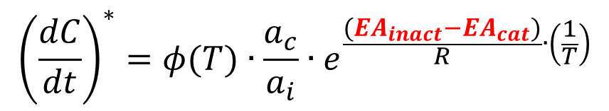
Enzyme flow reactor - Steady-state analysis
Consider a pool of enzymes replenished by an enzyme production
$$φ(T)$$
$${− k}_{inact}∙E$$
E
Enzyme production
inactivation
When enzyme production compensates for enzyme inactivation,
the pool of active enzymes is at steady-state
$$\frac{dE_{act}}{dt}=0$$
Reaction velocity
at steady-state
$${\left(\frac{dC}{dt}\right)}^{∗}=φ(T)∙\frac{a_{c}}{a_{i}}∙e^{\frac{(EA_{inact}−EA_{cat})}{R}∙\left(\frac{1}{T}\right)}$$
5

Slide 23
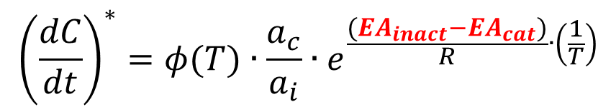
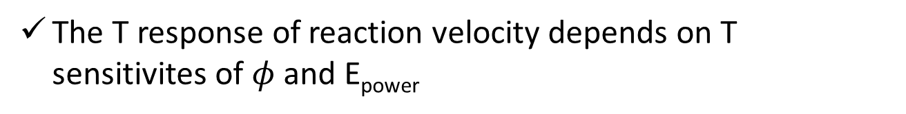
Enzyme flow reactor - Steady-state analysis
Reaction velocity
at steady-state
$${\left(\frac{dC}{dt}\right)}^{∗}=φ(T)∙\frac{a_{c}}{a_{i}}∙e^{\frac{(EA_{inact}−EA_{cat})}{R}∙\left(\frac{1}{T}\right)}$$
Similar to batch reactor,
E_{power} decreases with T
E_{power}
The T response of reaction velocity depends on T sensitivites of $φ$ and E_{power}
5

Slide 24
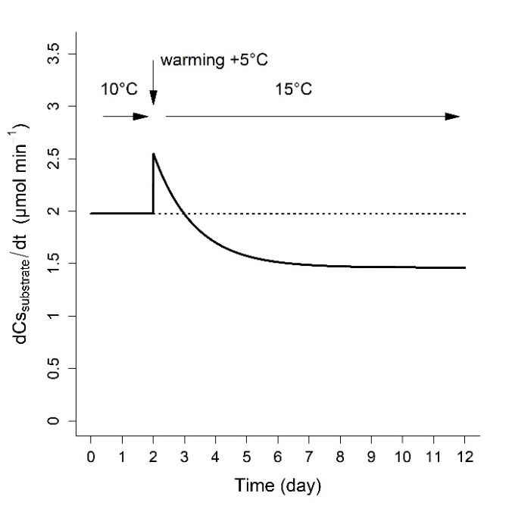
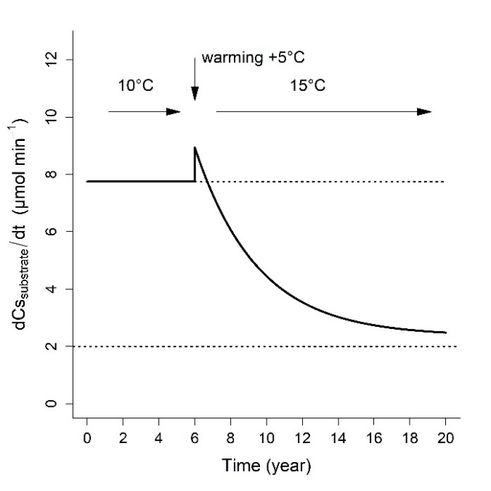
Dynamic response of reaction velocity - 5°C warming
  If enzyme production remains constant …
constant 𝝓
  1. Instantaneous positive response of k_{cat}
  after warming
  2. Thermal inactivation
  decreases V_{max} with time
Chitinase
Peroxidase
5

Slide 25
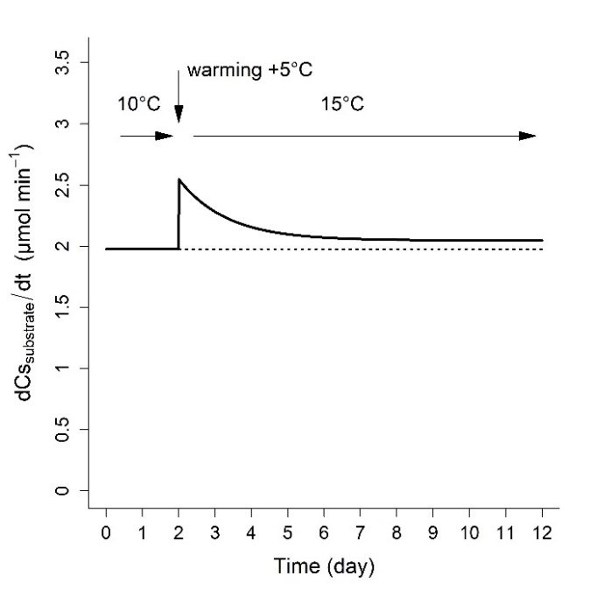
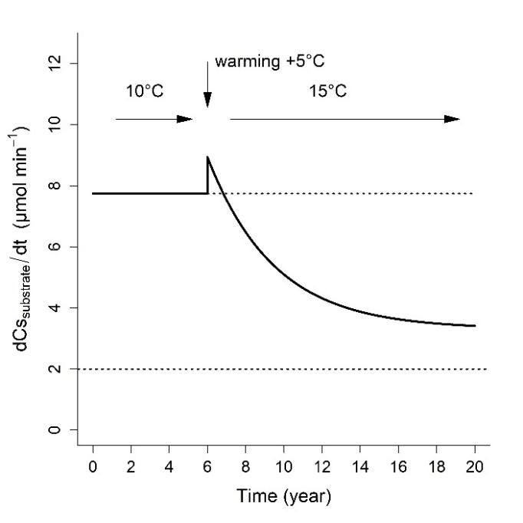
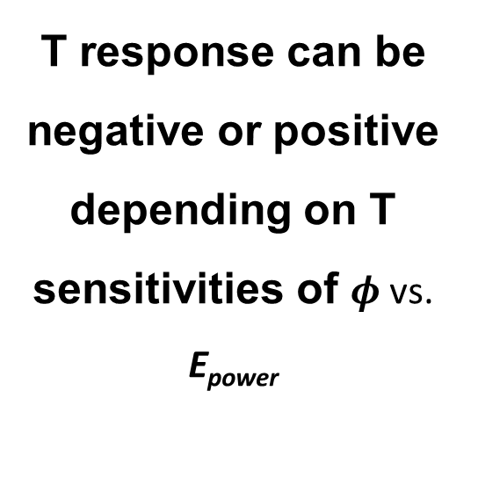
Dynamic response of decay rate (5°C warming)
  40% increase of enzyme production with warming …
constant 𝝓
40% increased 𝝓
  T response can be
  negative or positive depending on T sensitivities of $φ$ vs. E_{power}
Chitinase
Peroxidase
5

Slide 26
Conclusions & Implications
Enzymes do not have optimum temperature.
E_{power} is a relevant enzyme trait to characterize T effect on enzyme activities
Cold temperature can promote enzyme activities
The enzyme inactivation may explain the temporal change in T response of microbial degradation of soil C
+ 28%
Melillo et al., 2002
Enzyme inactivation?
% of control
Warming-induced C released

Slide 27
Conclusions & implications
The universal pattern EA_{inact} > EA_{cat} indicates that the E_{power} systematically decrease with T
  What evolutionary process can explain this pattern?
  What are the consequences for cell physiology and flux of matter?
  How can microorganisms adapt to the lower E_{power} of their enzymes in warm environment ?
These questions could be assessed in NEXER of Franciso Matus :
Characterisation of soil enzymes activities & their thermodynamics properties
Extraction of microorganisms & characterisation of their physiological and enzymes traits
Latitudinal gradient of T
10

Slide 28
Thank you for your attention

