Slide 1





Conflict of interests: is a free expertise possible?
GMO and NBT as a case study
Yves Bertheau
Inra – MNHN
March, 29 2018
Ethics, Research & Society Workshop
University of Liège

Slide 2
A rapid progression of techniques
1970s: appearance of the molecular biology of prokaryotes, with some persistent dogmas over-simplified and overused...
Horizontal transfers, phylogenetic analyzes, sequencing,
1980s: transformation of eukaryotes (Agrobacterium, micro-injection ...)
1990s: GMOs, OdMs and meganucleases
2000s: Genome editing (ZFN, interfering RNA, OdM) and epigenetics take off ...
2010: TALEN, Crispr-endonucleases, epitranscriptomics, the importance of 3D or even 4D organization of nuclei / chromosomes ...
Notes:
Exemples de dogmes des années 70 et toujours employés :
Un gène une protéine, mais plus tard épissage alternatif, nombreux organismes comme l’homme env. 20 000 gènes et plusieurs centaines de milliers de protéines, la notion de « junk » DNA qui devient de la « dark matter » quand on se rend compte petit à petit de son importance pour la conformation des chromosomes et l’accessibilité / régulation des parties codantes...
Une régulation simple, avec une partie codante dont l’expression dépendrait d’un promoteur et d’un terminateur, pouvant fonctionner sous forme d’opéron chez les bactéries, mais dont le modèle s’est complexifié avec divers effecteurs, enhancers, dont certains semblent aussi importants que les promoteurs, bien que situés quelquefois à plusieurs dizaines de milliers de bp, voire sur d’autres chromosomes, la notion de nucléosome, l’importance de la chromatine, de son état et de l’accessibilité conférée aux séquences...
Code génétique ARNm - ARNt - ARN ribosomique initial, qui se complexifie ultérieurement avec divers autres ARN (circulaire, microARN non-codant...)
ADN et ARN pensées cellulaires mais en fait circulant dans le sang, au travers du placenta, dans le phloème du porte-greffe au greffon, et même passant la barrière intestinale et pouvant influencer la régulation de gènes de l’animal se nourrissant, certains de ces acides nucléiques (ARN circulant...) étant utilisables en diagnostic de maladies / désordres
Code génétique à l’origine de tout, mais évidences que le monde vivant serait passé par une phase ARN? Ce qui souligne la complexité des interactions ADN-ARN,
L’épigénétique (attention aux différentes définitions), suite à l’amélioration des techniques de séquençage, et de capture des protéines modifiées de la chromatine, puis l’épitranscriptomique (ou épigénétique de l’ARN) semble prendre le pas pour l’adaptation, voire même pour certains phénomènes mal compris comme l’héterosis (vigueur hybride) utilisée en agriculture (ex: maïs) selon un des schémas de sélection variétale privilégié par les firmes...

Slide 3
The life complexity

Slide 4
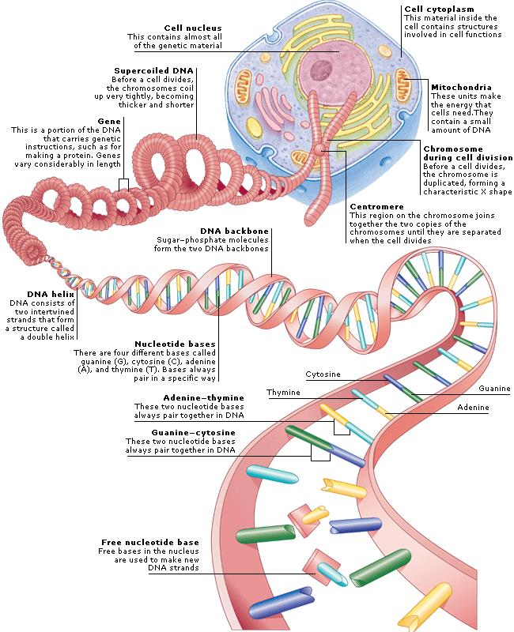
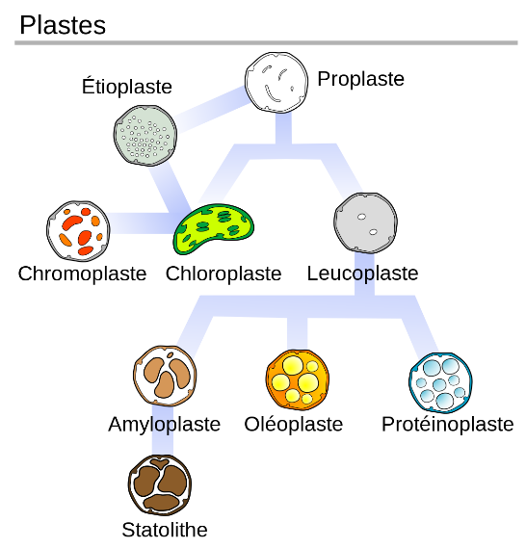
From the nucleotide to the cell then tissues
The majority of considerations
will focus on the eukaryotes’
nuclei, not on the
Organelles’ genomes
(mitochondria, chloroplasts)

Slide 5
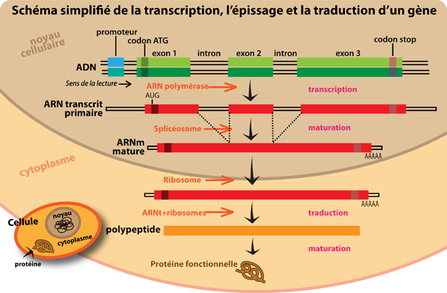
Simplified diagram of a protein’s synthesis
Traduction

Slide 6
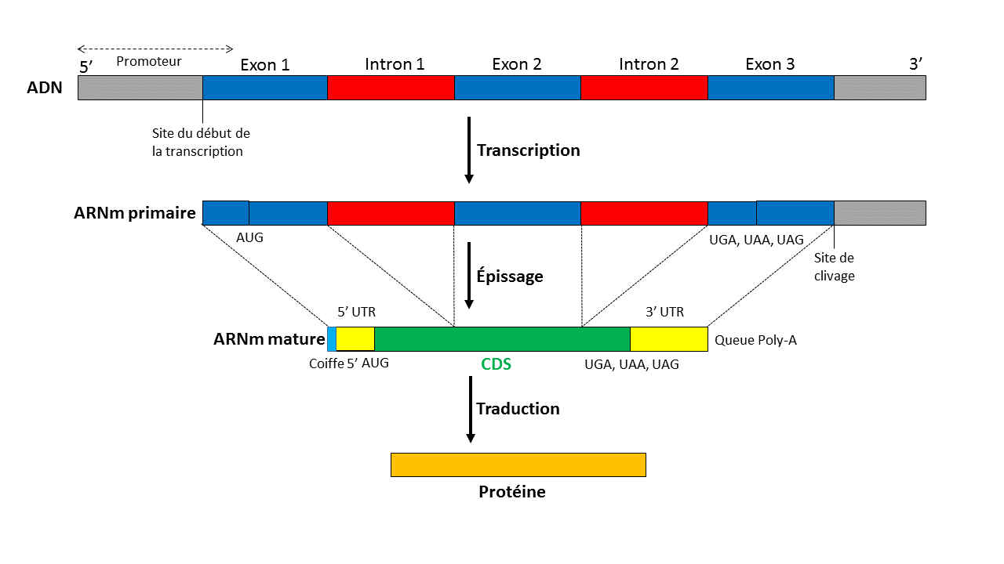
Central dogma of genes’ splicing in eukaryotes ...
ADN
transcription
ARN
traduction
Protéine

Slide 7
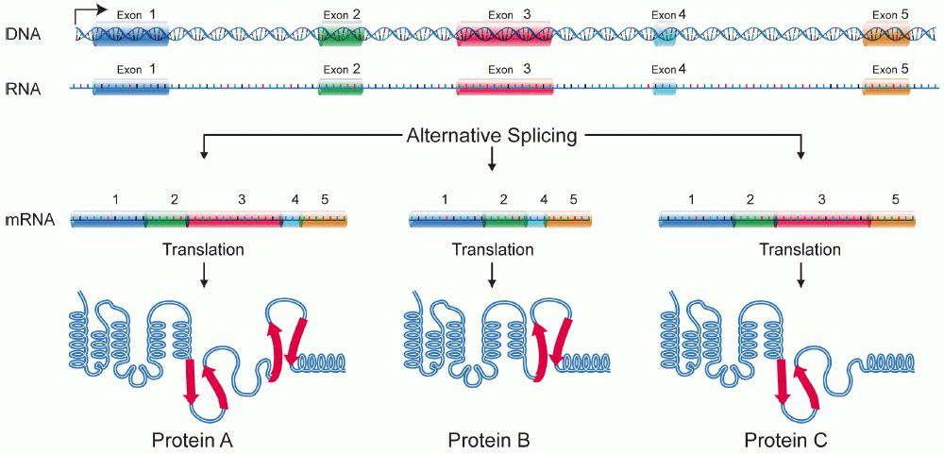
"Central dogma of biology": but in fact ...
The RNA transcripts as well as their abundance are representative of a cell at time T ...
But in fact :
Alternative splicing produces many isoforms, some of which are pathological (e.g. exon skipping of the Duchenne muscular dystrophy).
Hence, different abundances for various transcripts, variable according to the tissues
The transcriptome is a mixture of transcripts of all genes varying according to tissues, age and environmental conditions.
The human transcriptome consists of tens of thousands of transcripts of 20-25,000 genes (95-98% of non-coding DNA) for more than 100,000 proteins per cell
Proteins "moonlighting" with a changing function (ex: enzyme) one time then another (ex: structural) ...

Slide 8
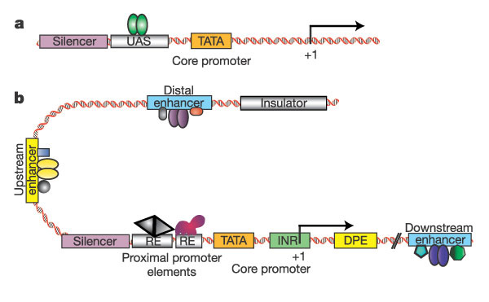
Eukaryotic transcriptional unit: the spatio-temporal organization matters
Levine et Tjian Nature, 2003

Slide 9
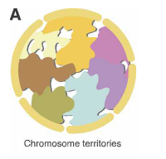
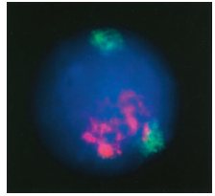
Spatio-temporal organization
Genes poor chromosomes
Gens rich chromosomes
Schneider et al. 2007
Spector et al. 2003

Slide 10
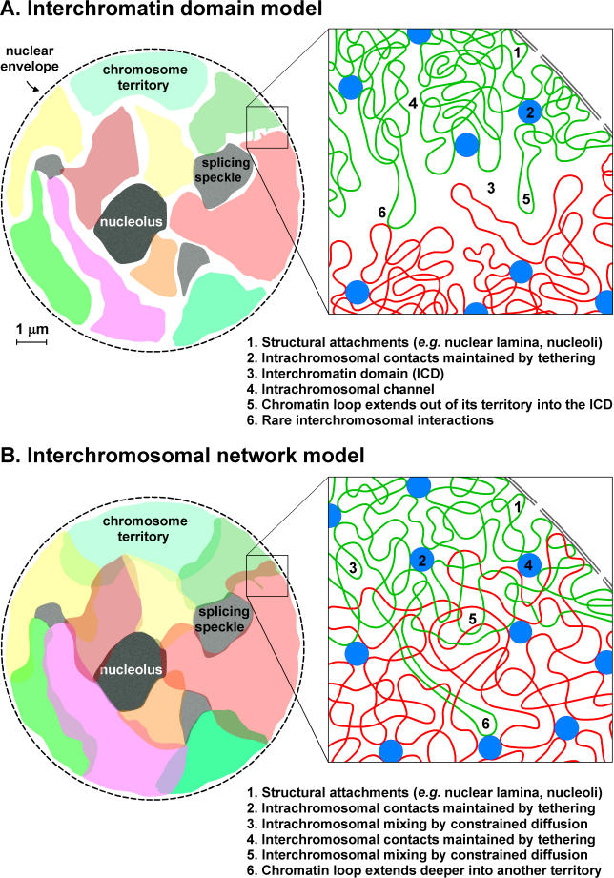
Spatio-temporal organization

Slide 11
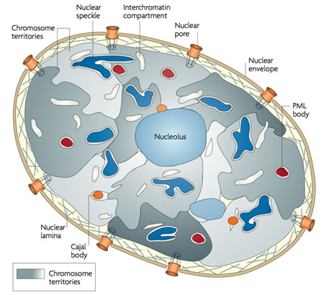
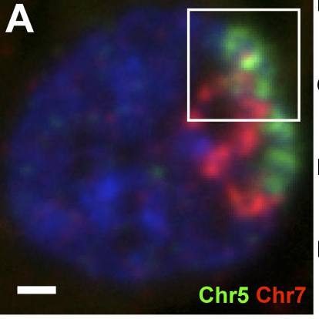
Spatio-temporal organization: inter-chromosomal domains (TAD)
Interactions inter-chromosomiques
Schneider et al, 2007
Branco et Pombo, 2006
Gene synchronization? Co-regulation?
Notes:
Branco Pombo 2006 http://www.sciencedirect.com/science/article/pii/S0962892406003588

Slide 12
Spatio-temporal organization: inter-chromosomal domains (TAD)

Slide 13
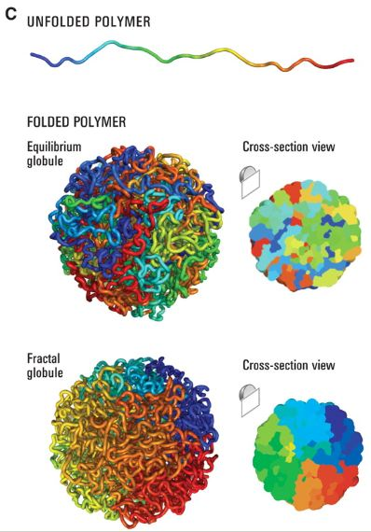
Recall on genomes and epigenomes
Very large shares of non-coding DNA, ex: man 95-98%, previously thought as "DNA junk" now known as involved in the gene expression regulation
The "Black matter" (the essential "missing" genes in some organism)
The poor functional correlation between linear and spatial genomic and epigenomic regions.
We are very far from the mechanistic molecular biology of the 70s-80s
Epigenomes (DNA, Proteins and RNA): we start to know where start (see the conclusions of the EFSA Symposium held in June 2016)
Message to take home: except neutral mutations and those improving the fitness in the current environment, all living organisms do everything to preserve their genomes from mutations (e.g. ‘Napoléon’s oak’)…
Notes:
Spatial genome organization see Ramani et al. Genomics Proteomics Bioinformatics 2016
Les plantes comme les animaux (au niveau des cellules germinales isolées au début du développement, à taux de reproduction faible...) se protègent des mutations, en particulier au niveau des cellules souches des méristèmes apicaux et axillaires, ce qui explique la longévité des arbres et le faible taux de mutations transmis à leur descendances même par de vieilles plantes ou des parties âgées de plantes (Burian et al., 2016; Ledford, 2017; Sarkar et al., 2017; Watson et al., 2016). Exemple du chêne Napoléon du campus de l’université de Lausanne repris dans « Pour la Science » août 2017 page 16 et « Le Temps » (Kuhlemeier, 2017; Schmid-Siegert et al., 2017).
https://www.letemps.ch/sciences/2017/12/04/lausanne-chene-napoleon-devoile-secrets-adn

Slide 14
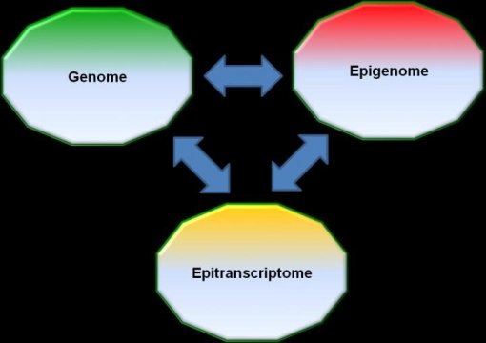
Interactions between "domains" still very poorly understood

Slide 15
Interactions between "domains" still very poorly known
DNA and RNA circulate in the blood, placenta and plant vessels: sources of information and expression of genes in distal parts (including graft-scions),
Nucleic acid exchanges with parasitic plants, sources of adaptation and coevolution,
Food RNA could regulate the genes of the animal consuming it,
C. elegans: transport of small RNAs inside the cells,
Epimutations that are transmitted are taken into account in varietal breeding programs, as they may explain heterosis,
Plant micro-RNAs present in royal jelly induce caste changes in the haemolymph (creation of bee queens),
SiRNAs of modified plants induce their resistance to insects ...
Message to take home: even a single nucleotide change (SNP) may have important effects on either neighboring or distal genetic, epigenetic or epitrancriptomic items, changes which might be visible only in some agro-environmental circumstances…
Notes:
Plant microRNAs in larval food regulate honeybee caste development Kegan Zhu , Minghui Liu , Zheng Fu , Zhen Zhou, Yan Kong, Hongwei Liang, Zheguang Lin, Jun Luo, Huoqing Zheng, Ping Wan, Junfeng Zhang, Ke Zen, Jiong Chen , [ ... ], Xi Chen [ view all ] Published: August 31, 2017 https://doi.org/10.1371/journal.pgen.1006946
The major environmental determinants of honeybee caste development come from larval nutrients: royal jelly stimulates the differentiation of larvae into queens, whereas beebread leads to worker bee fate. However, these determinants are not fully characterized. Here we report that plant RNAs, particularly miRNAs, which are more enriched in beebread than in royal jelly, delay development and decrease body and ovary size in honeybees, thereby preventing larval differentiation into queens and inducing development into worker bees. Mechanistic studies reveal that amTOR, a stimulatory gene in caste differentiation, is the direct target of miR162a. Interestingly, the same effect also exists in non-social Drosophila. When such plant RNAs and miRNAs are fed to Drosophila larvae, they cause extended developmental times and reductions in body weight and length, ovary size and fecundity. This study identifies an uncharacterized function of plant miRNAs that fine-tunes honeybee caste development, offering hints for understanding cross-kingdom interaction and co-evolution.
Plant genetics: Gene transfer from parasitic to host plants Jeffrey P. Mower, Saša Stefanović , Gregory J. Young & Jeffrey D. Palmer Nature 432, 165–166 (11 November 2004) doi:10.1038/432165b
Plant mitochondrial genes are transmitted horizontally across mating barriers with surprising frequency, but the mechanism of transfer is unclear^{1,2}. Here we describe two new cases of horizontal gene transfer, from parasitic flowering plants to their host flowering plants, and present phylogenetic and biogeographic evidence that this occurred as a result of direct physical contact between the two. Our findings complement the discovery that genes can be transferred in the opposite direction, from host to parasite plant³
PNAS Plus - Biological Sciences - Evolution: Zhenzhen Yang, Yeting Zhang, Eric K. Wafula, Loren A. Honaas, Paula E. Ralph, Sam Jones, Christopher R. Clarke, Siming Liu, Chun Su, Huiting Zhang, Naomi S. Altman, Stephan C. Schuster, Michael P. Timko, John I. Yoder, James H. Westwood, and Claude W. dePamphilis Horizontal gene transfer is more frequent with increased heterotrophy and contributes to parasite adaptation PNAS 2016 113 (45) E7010-E7019; published ahead of print October 24, 2016, doi:10.1073/pnas.1608765113
Horizontal gene transfer (HGT) is the nonsexual transfer and genomic integration of genetic materials between organisms. In eukaryotes, HGT appears rare, but parasitic plants may be exceptions, as haustorial feeding connections between parasites and their hosts provide intimate cellular contacts that could facilitate DNA transfer between unrelated species. Through analysis of genome-scale data, we identified >50 expressed and likely functional HGT events in one family of parasitic plants. HGT reflected parasite preferences for different host plants and was much more frequent in plants with increasing parasitic dependency. HGT was strongly biased toward expression and protein types likely to contribute to haustorial function, suggesting that functional HGT of host genes may play an important role in adaptive evolution of parasites.
Des ARN non codant (ncRNA), il y a peu encore considérés comme des déchets, jouent en fait un rôle important dans la régulation des gènes.
Petits ARN non codants (sncRNA) transmettent à la descendance chez la souris le traumatisme de séparation d’avec la mère (Gapp et al., 2014).

Slide 16
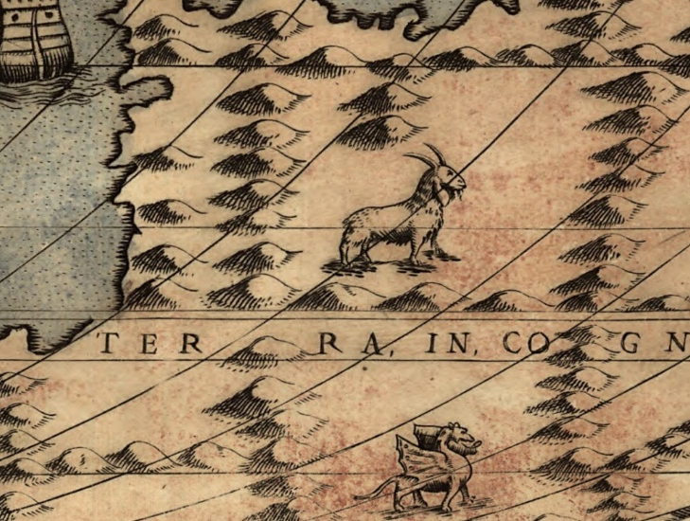
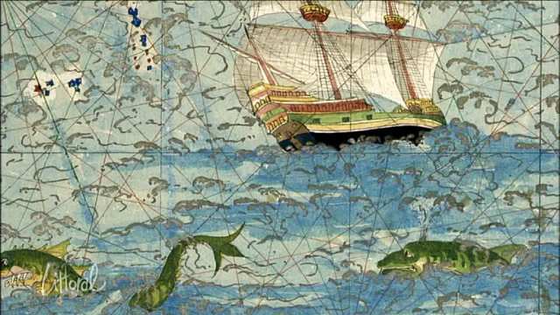
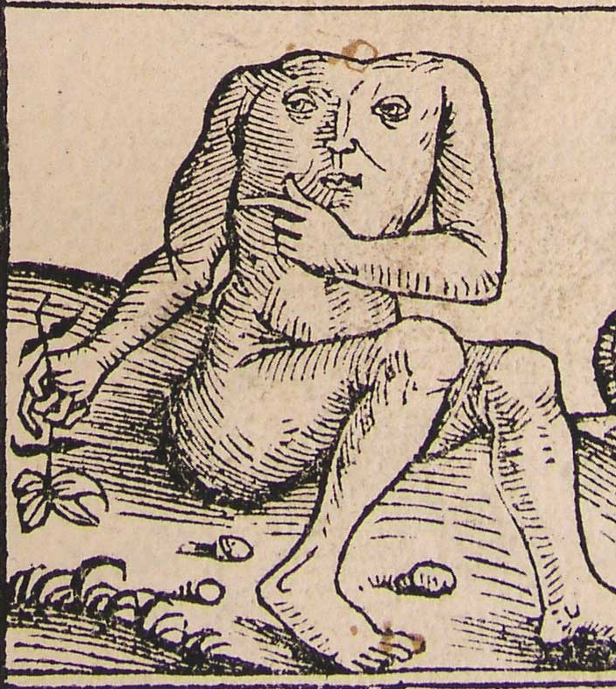
Conclusion:
Terra incognita

Slide 17
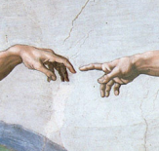
But how do these fabulous changes come about?

Slide 18
Related techniques

Slide 19
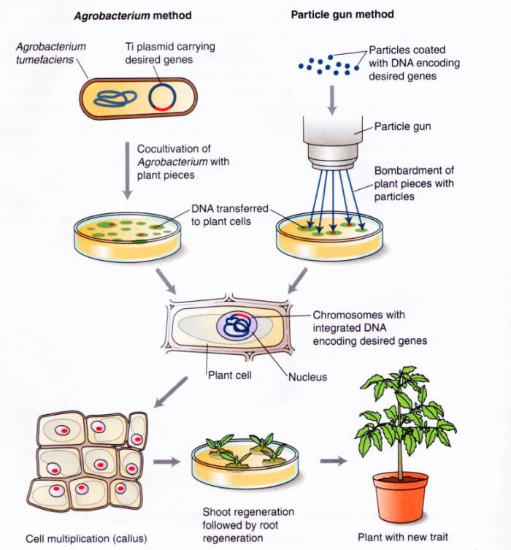
Agrobacterium: phytopathogenic
bacteria with many aborted infections as observed in Plants (e.g. sweet potato) ...
A regeneration of
plants limited to a few
species: little hope
to enlarge the circle of elected
given the costs of
development, returns
on late investments and
from the few considerations
for publications ...
A specific international meeting held in London (Oct. 2016)

Slide 20
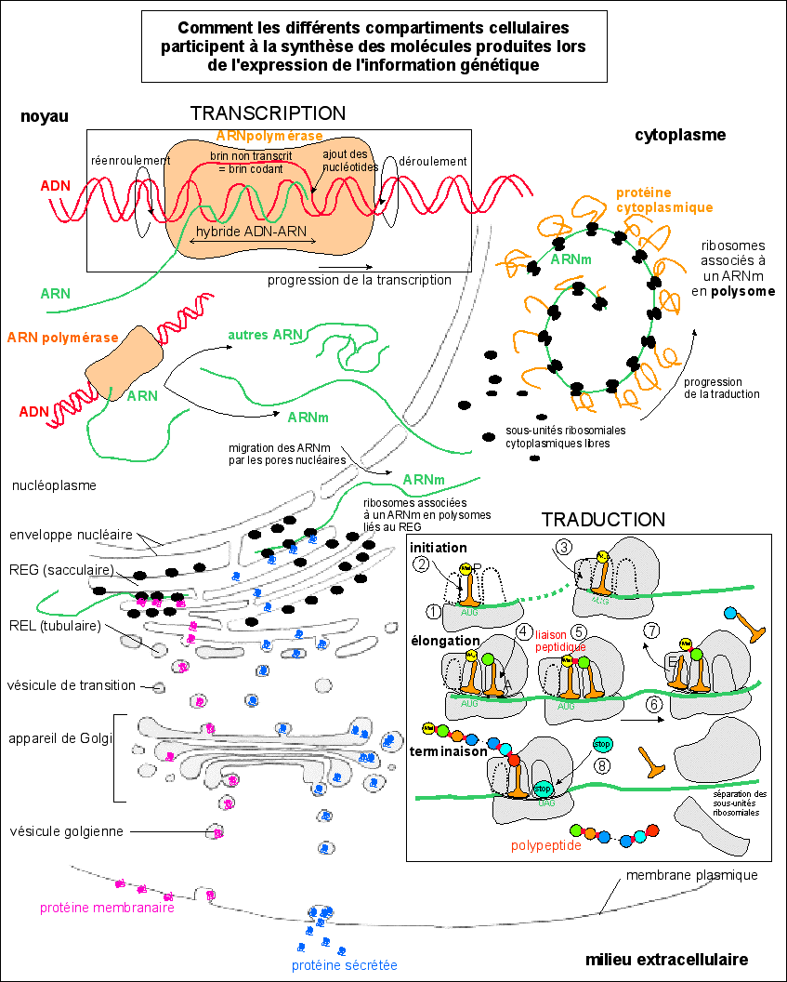
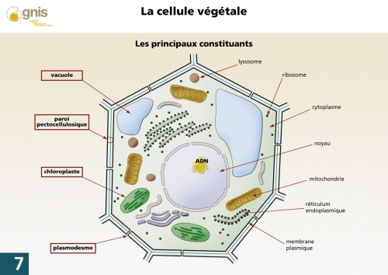
Les différents compartiments cellulaires affectés par les techniques connexes : membranes…

Slide 21
Related techniques
NBTs require the use of "old techniques" used for the transgenesis of already marketed GMOs:
protoplastisation, vectorization (very large proteins, remains of genome and Agrobacterium plasmid ...), cell cultures, modified cell selection systems, regeneration of non-recalcitrant plants (hence a still limited spectrum of species),
All stressful techniques inducing mutations and epimutations (up to 35% for cell cultures, somaclonal mutants):
  poorly identifiable (reliable software and reference genomes missing) because often point or indelible mutations, especially in repeated or non-coding regions, problems of translocations and inversions ...
  Difficult to eliminate (backcrossing by insufficient firms, co-segregations according to characteristics, regions with non-Mendelian inheritance…) leaving millions of pb not "cleared" and poorly controllable (see the software and reference genomes issues)
International meeting held in London in October 2016: laboratories are desperately looking for good, well-trained chefs and regret the lack of schools to train future "chefs" ...
Notes:
Voir les articles de Inf’OGM:
https://www.infogm.org/5975-ogm-modifier-plante-pas-anodin
https://www.infogm.org/5982-ogm-modifier-plante-pas-anodin-suite
On old cooking recipes (past decades) see for instance Ledford 2016 Nature 539 (7627): 16-17 about the Conference held in October 2016 o those ‘related technics’.
NBT labs are looking for trained chiefs but training are missing and thus experienced chiefs also…
In most – if not all - of the description of NBT, the related technics such as protoplast preparation or cell culture are omitted while their use in the genome editing technics, rdDM, OdM are all causes of unexpected effects.
We have to recall that most of theses related technics are also used for transgenesis and are the sources of some of the unintended genome changes also observed for the GMO obtained by transgenesis.
Protoplates’ preparation, cell culture and plant regeneration, somaclonal variation are all inducing by stresses mutations and epimutations, chromosomes’ rearrangements…
Anjanasree K. Neelakandan and Kan Wang 2012 Plant Cell Rep 31:597–620
Wilson, A.K., Latham, J.R., Steinbrecher, R.A. (2006) Transformation-induced mutations in transgenic plants: analysis and biosafety implications. Biotechnol Genet Eng Rev, 23(1), 209-238.
Florentin, A., Damri, M., Grafi, G. (2013) Stress induces plant somatic cells to acquire some features of stem cells accompanied by selective chromatin reorganization. Developmental Dynamics, 242(10), 1121-1133.
Skirycz, A., De Bodt, S., Obata, T., De Clercq, I., Claeys, H., De Rycke, R., Andriankaja, M., Van Aken, O., Van Breusegem, F., Fernie, A.R., Inzé, D. (2010) Developmental stage specificity and the role of mitochondrial metabolism in the response of Arabidopsis leaves to prolonged mild osmotic stress. Plant Physiology, 152(1), 226-244.
Yoo, S.-D., Cho, Y.-H., Sheen, J. (2007) Arabidopsis mesophyll protoplasts: a versatile cell system for transient gene expression analysis. Nat. Protocols, 2(7), 1565-1572.
Marx, V. (2016) Cell biology: delivering tough cargo into cells. Nat Meth, 13(1), 37-40
Lusser, M., Parisi, C., Plan, D., Rodríguez-Cerezo, E. (2011) New plant breeding techniques. State-of-the-art and prospects for commercial development. EUR 24760 EN. In JRC scientific and technical reports (European Commission. DG JRC/IPTS, ed: pp 220.
Yau, Y.Y. and Stewart, C.N. (2013) Less is more: strategies to remove marker genes from transgenic plants. Bmc Biotechnology, 13.
Breyer, D., Kopertekh, L., Reheul, D. (2014) Alternatives to antibiotic resistance marker genes for in vitro selection of genetically modified plants – Scientific developments, current use, operational access and biosafety considerations. Critical Reviews in Plant Sciences, 33(4), 286-330.
Manimaran, P., Ramkumar, G., Sakthivel, K., Sundaram, R.M., Madhav, M.S., Balachandran, S.M. (2011) Suitability of non-lethal marker and marker-free systems for development of transgenic crop plants: present status and future prospects. Biotechnology Advances, 29(6), 703-714
Krizova, K., Fojtova, M., Depicker, A., Kovarik, A. (2009) Cell culture-induced gradual and frequent epigenetic reprogramming of invertedly repeated tobacco transgene epialleles. Plant Physiology, 149(3), 1493-1504
Machczyńska, J., Orłowska, R., Zimny, J., Bednarek, P.T. (2014) Extended metAFLP approach in studies of tissue culture induced variation (TCIV) in triticale. Molecular Breeding, 34(3), 845-854.
Rhee, Y., Sekhon, R.S., Chopra, S., Kaeppler, S. (2010) Tissue culture-induced novel epialleles of a Myb transcription factor encoded by pericarp color1 in maize. Genetics, 186(3), 843-855.
Kawakatsu, T., Kawahara, Y., Itoh, T., and Takaiwa, F. (2013). A whole-genome analysis of a transgenic rice seed-based edible vaccine against cedar pollen allergy. DNA Research 20, 623-631.
Montero, M., Coll, A., Nadal, A., Messeguer, J., Pla, M. (2011) Only half the transcriptomic differences between resistant genetically modified and conventional rice are associated with the transgene. Plant Biotechnology Journal, 9(6), 693-702.
Meins, F. and Thomas, M. (2003) Meiotic transmission of epigenetic changes in the cell-division factor requirement of plant cells. Development, 130(25), 6201-6208.

Slide 22
NBT techniques with only 2 case studies

Slide 23
Initial European work
Zinc finger nuclease technology (ZFN1-ZFN3) + TALEN+ meganucleases (then Crispr-endonuclease added)
Oligonucleotide directed mutagenesis (ODM)
Cisgenesis/ Intragenesis vs. Transgenesis
RNA-dependent DNA Methylation (RdDM),
Negative segregants
Grafting (GM rootstock / non-GM scion)
Agro-infiltration (Agro-infiltration “sensu stricto”, Agro-infection, Floral-dip i.e. plant transformation)
Reverse breeding
Synthetic biology (later on abandoned as being taken on board by CBD protocol despite SB remains still undefined)
A 2007-2012 Euopean working group
Report not publicly available
But largely commented for its "positive" aspects (ex: JKI)
Notes:
A very large set of diverse unrelated different techniques used or not in combinations with several mechanisms but possible final characteristics.
The first version of the NBT set did not include some technics, such as CRISPR-Cas9, published in 2012,
A contrario agro-infiltration is thought by some Countries only as sensu-stricto and in confined areas, while some other ones are also considering agroinoculation and floral dip, and as disseminated organisms
Meganucleases: 1990s
Oligonucleotide-directed mutagenesis: late 1990s
Zinc finger nucleases (ZFNs): mid 2000s
Transcription activator like effector nucleases (TALENs): early 2010s
Clustered regularly spaced short palindromic repeats (CRISPR): 2012 but several previous papers of Bayer
A discourse targeting only plants as the technics do not appear to be ready for animals, to avoid fears about Human transformation, while plants will be used for “proof of concept”.
A 2007 first memo from COGEM (Dutch advisory board on GMOs)
Lusser et al. 2011 New plant breeding techniques State-of-the-art and prospects for commercial development EUR 24760 EN
The importance of semantics and semiology…
Have a look to the wording “breeding technique” and the “New” adjective… more or restriction to plants, idea of improvement (techniques presented as the offspring of old and secure techniques)
The faith in backcrosses for “rapidly” coming back from GM organisms to non-GM plants ( but 4 to 14 generations needed according to the location of and distance between off-target / unintended mutation and the targeted trait, not segregation
To decrease the duration of successive backcrosses: special greenhouses (see for instance Florimond Desprez investments: 5 M€ for reducing the 3 first generations to 14 months) with further impact on seeds’ prices…
▪ Zinc finger nucleases are chimeric proteins “Zinc finger” domain (recognising specific DNA sequence) & nuclease cutting double-stranded DNA
▪ ZFN-1 technology:
- delivery of genes encoding ZFNs (without repair template)
- site-specific double-strand break (DSB)
- natural repair process (through non-homologous end-joining NHEJ)
mutation in one or a few bp, short deletions or insertions (site-specific but random change)
▪ ZFN-2 technology:
- delivery of genes encoding ZFNs & repair template (DNA stretch of a few kbp)
- site-specific double-strand break (DSB)
- natural repair process (through homomologous recombination HR)
- mutation in one or a few bp, short deletions or insertions (site-specific and specific change)
▪ ZFN-1 and -2
- ZFN gene expression transient
- or in the case of gene insertion, progeny carrying the transgene is segregated out
▪ ZFN-1
- mutation in one or a few bp, short deletions or insertions (site-specific but random change)
mutation frequency varies, but usually rather low
ZFN-3 technology Leads to site-specific insertion of the target gene
Oligonucleotide directed mutagenesis (ODM)
▪ Oligonucleotides
- share homology with target sequence with the exception of the nucleotides to be modified
- chimeric oligonucleotides (mixed DNA and RNA bases)
- or single-stranded DNA oigonucleotides
- 20 to 100 pb long
▪ Oligonucleotides “target” the homologous sequence in the genome
▪ Create one or more mismatch base pairs corresponding to the non-complementary nucleotides
▪ Meganucleases
- Natural proteins acting as “DNA-scissors”
- Recognise specific DNA sequence (12-30 bp)
- Cause site-specific DNA break
▪ Possible applications as for ZFN technology
▪ Transcription activator–like effector (TALE) proteins
- Proteins that bind to DNA in a sequence-specific way
- Converted into “DNA-scissors” by binding to a nuclease
(catalytic domain of FokI)
- Can be modified for targeting a given sequence
▪ Possible applications as for ZFN technology
Cisgenesis/Intragenesis
▪ Stable integration of cisgene
▪ In the case of Agrobacterium-mediated transformation, presence of
T-DNA border sequences
▪ Possible unintended effects:
- Interruption of open reading frames (ORFs)
- Creation of new ORFs
- Deletion of host DNA
Gene transfer can lead to modified levels of gene expression
In the case of gene stacking, multiple recombination sites may cause chromosomal rearrangements
In the case of use of selectable markers, they have to be recombined out and leave behind a recombination site
Intragenesis (additional effects)
Possible unintended effects:
New combinations of genes and regulatory sequences – more extensive modification of gene expression to be expected (compared to cisgenesis)
In the case RNAi is used for gene silencing, effects on other genes and metabolic pathways possible
AGROINFILTRATION "SENSU STRICTO”
• Infiltration with suspension of Agrobacterium sp. containing the gene of interest
• Local, transient gene expression at high levels
Infiltration with construct containing the foreign gene in a full-length virus or Agrobacterium vector
Question: what is the status / classification of the progeny?
AGRO-INFECTION
• Infiltration with suspension of Agrobacterium sp. containing the gene of interest inserted into a full-length virus vector
• Facilitates the spreading and expression of the target gene in the plant
FLORAL DIP
• Germline tissue (typically flowers) is immersed into a suspension of Agrobacterium sp. containing a T-DNA construct to transform female gametocyte
• GM seeds are obtained
Agro-infiltration and Agro-infection
▪ Temporary expression of specific coding sequences
▪ No DNA integration in the plant genome
▪ Possible unintended changes:
Agro-infiltration:
- Integration of T-DNA cannot be excluded
Agro-infection:
- RNA viruses cause spreading of the gene construct
- Since spread via RNA molecules, no integration in plant genome
Grafting on GM rootstock
▪ Changes in the genome are targeted to root tissue
▪ Intended manipulation of gene expression (new trait) in the scion can be achieved through movement of specific proteins and/or RNA from roots to scion, e.g. RdDM
▪ Possible unintended changes:
- genetic exchange restricted to graft site
- unintended manipulation of gene expression through movement of specific proteins and/or RNA from roots to scion
NPBT are mainly applied for pest resistance and herbicide tolerance.
Some techniques (like cisgenesis) have been already tested in many crop plants, while others (like ZFN) have been tested mainly in model plants, commercial plants are available

Slide 24
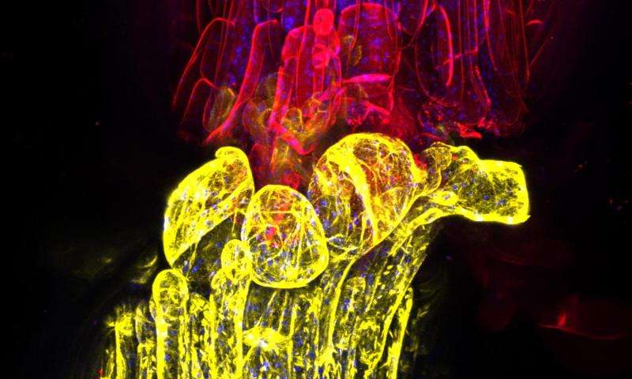
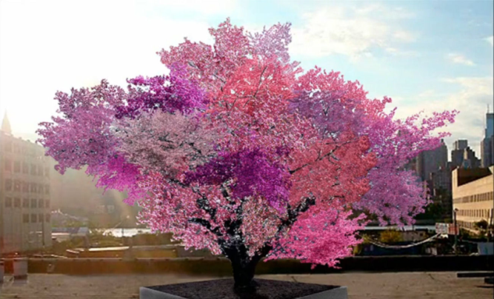
Grafts: interactions between scions and rootstocks
pathogens, proteins (eg Cry1Ac), DNA, RNA, hormones... circulate,
Expression regulation (silencing ...), protein synthesis in scions due to rootstock,
Genomes communicate with each other with epialleles http://phys.org/news/2016-01-grafted-genomes.html#jCp
Products of the non-GM scion (e.g. fruit) cannot be considered as not influenced by the GM rootstock
Credit: Charles Melnyk/University of Cambridge
Sam van Aken, Syracuse University, New York.
Notes:
http://phys.org/news/2016-01-grafted-genomes.html#jCp and Lewsey et al. 2016 PNAS. 113(6): E801-E810
…/… "Grafting is something done often in the commercial world, and yet, we really don't completely understand the consequences for the two plants," says Joseph Ecker, one of the senior authors of the paper and director of Salk's Genomic Analysis Laboratory. "Our study showed genetic information is actually flowing from one plant to the other. That's the surprise to me.“
…/…
Goldschmidt 2014. Frontiers in plant science. 5: 727
…/… The graft hybrid concept, which was developed and demonstrated by the Soviet horticulturist Michurin (1949), appeared to be in contrast with Mendelian genetics and was rejected (and almost forgotten) by Western scientists who opposed and dis- trusted the Soviet biology led by Lysenko. Several published studies (and most probably many unpublished) could not confirm the appearance of graft hybrids (Stubbe,1954; Bohme,1957; Topoleski and Janick, 1963; Menda et al., 2006). Yet, reports supporting the occurrence of graft transformations appeared from time to time (Frankel, 1956), and increasingly so in recent years (Li et al., 2013; Tsaballa et al., 2013; Wu et al., 2013; Zhou et al., 2013). Proponents of the graft hybrid concept reviewed the supporting evidence and called for reassessment of the graft transformation hypothesis that has been neglected for several decades (Liu, 2006; Liu et al., 2010).
Growth and development in multi-cellular organisms is co-ordinated by local and long-distance communication between cells and tissues. In plants, signaling molecules, including RNAs, are transported locally between cells, and long-distance in the phloem to provide developmental and defence information (Lough & Lucas, 2006; Sparks, Wachsman & Benfey, 2013). Small RNAs are critical regulators of plant development and defense, and
can be mobile. For example, the endogenous miRNAs miR165/6, tasiRNA (tasiR-ARF), and miR394 serve as morphogen-like signals, forming gradients to determine cell fate during leaf and root development (Chitwood et al., 2009; Carlsbecker et al., 2010; Skopelitis, Husbands & Timmermans, 2012; Knauer et al., 2013). Plant virus-induced small interfering RNAs (siRNAs) can also move throughout the plant from the original site of infection to prime the defence mechanism against further virus invasion (Nelson & Citovsky, 2005; Voinnet, 2005).
Small interfering RNAs derived from transgenic hairpin RNAs also spread both locally and over long distances (Palauqui et al., 1997; Voinnet & Baulcombe, 1997; Himber et al., 2003; Brosnan et al., 2007; Liang, White & Waterhouse, 2012). Experiments in Arabidopsis thaliana showed that these siRNAs will move from rootstocks expressing a hairpin RNA targeting a green fluorescent protein (GFP) sequence across graft junctions to silence GFP expression in grafted shoot tissue (Brosnan et al., 2007). Although the hairpin-derived silencing signals generated in roots have been shown to move gradually from cell to cell into the shoot, rather than moving through the phloem (Liang, White & Waterhouse, 2012), the factors controlling silencing mobility in plants are unknown.
In the nematode Coenorhabditis elegans, the movement of silencing signals is facilitated by the dsRNA-channels SID-1 and SID-2 (Winston, Molodowitch & Hunter, 2002; Feinberg & Hunter, 2003), but there is no clear homologue in Arabidopsis. Instead, the spread of silencing in plants is thought to be regulated, in part, by transport through plasmodesmata (PD), the channels that link the cytoplasm of adjacent plant cells, although direct genetic evidence is lacking (Melnyk, Molnar & Baulcombe, 2011).
Graft-transmission of RNA silencing could become of practical importance in horticulture, especially for fruit crops (e.g., apple, pear, grape, and sweet cherry), which are propagated vegetatively by grafting scions of superior clones/cultivars onto clonally propagated rootstocks [14]. The idea to graft non-transgenic scions onto silencing transmitter rootstocks that affect traits within non-transgenic parts of the tree like fruits, seems promising. Beside the advantage of being a straightforward approach to improve individual traits of well-established cultivars such as self-fertility, resistance, flavor, or sugar content, the use of graft-transmissible gene silencing would avoid the possibility of spreading transgenes by outcrossing through pollen and/or seeds. The graft-transmissible manipulation of specific traits provoked by sRNAs has not been demonstrated in apple until now, but it was several times reported in other horticultural plants. For example, wild-type potatoes grafted as stocks with scions overexpressing miR172 showed induced tuberization [15]. For apple, Flachowsky et al. (2012) showed that RNA are transmitted in vitro but not in greenhouses.
In the case of grapevine more than 3,000 genes are exchanging mRNA at a more or less high frequency, depending on the genotype, the combinations and the growth environment (Yang et al. 2015).
Kumari et al. (2015) study on Arabidopsis thaliana : The controlling effect of rootstock over scion is possibly due to altered root-to-shoot and/or shoot-to-root chemical signaling [3]. Several studies on long-distance signaling via graft-union provide evidences for multiple types of mobile signals, such as hormones [4,5,6,7], proteins [8,9], ribonucleoprotein [10], RNAs [11], small RNAs [12,13,14,15,16], minerals [17,18 ] etc, conferring a wide range of effects on scion development. Despite the wide use of grafting in agriculture, very little is known about the molecular mechanism of rootstock-regulation of scion’s phenotypes. Gene expression studies are useful approaches in understanding the genes involved in the effect of the rootstock. Transcriptional profiling in the scions of Prunus cerasus [19] and Malus domestica [20] revealed differences in the expression level of 99 and 116 transcripts, respectively, which could contribute to rootstock-regulation of biomass in scion. Recently, effect of heterografting has been examined on gene expression in scion [21] and graft interface [22] in Vitis vinifera. In the shoot apex of scion, grafted onto vigorous rootstock, the differentially expressed genes related to growth, stress, hormone signaling and hybrid vigour possibly confers vigour effects [21]. Up-regulation of stress response was notified at graft interface of heterografts, as compared to the homografts, suggesting that the tissues involved in graft-union could recognize and behaved differently in case of self or non-self grafting partner [22].
Zhao et Song (2014) Plant Biotechnol J. 12(9):1319-28. Virus resistance transferred from GM rootstock to scion.
Thieme et al. 2015. Nature Plante 1: 15025. Numerous mRNA are moving from a part to another one, with translation in distant tissues.

Slide 25

Crispr-Cas9 et al…

Slide 26

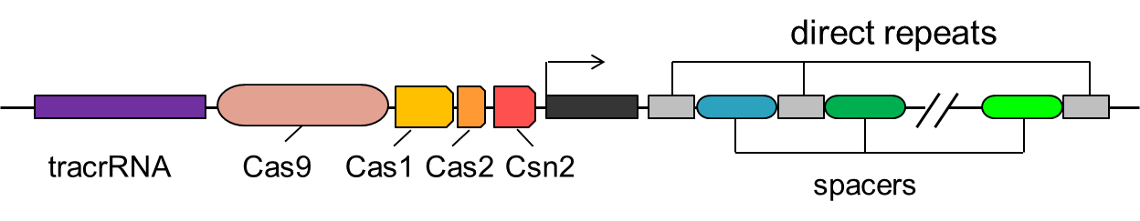
CRISPR
(6 classes, 19 subclasses with little or fully unknown functions)
Clustered Regularly Interspaced Short Palindromic Repeats
"Adaptive acquired immunity" of bacteria against phages
described since 1987, adapted for genome editing in 2012, and eukaryotes
in 2013,
Evolutionary convergences in animals and plants with genome stabilizing systems
ex: mRNAs and transposable elements, small RNAs and DICER ...
Fundamental objective: to fight invasive DNA
Notes:
This technique is currently the leader among genome edition technics, first results were obtained and patented by e.g. Bayer… Currently several agreements between companies on patents (Crispr, but also TALEN and ZFN) to constitute a portfolio to preparer the negotiation phase as one cannot predict which techniques will be effectively used for what (see. For instance the claims about low off-targets effects of TALEN vs. Crispr).
No all plant species or genome location are « targetable » (e.g. need for PAM sequences near the target to be modified).
Several Cas proteins (and thus PAM sequences) for extedning the size of modifiable genome.
C2c2 able to modify RNA instead of DNA.
Sans doute bientôt utilisation dans le même but d’une dizaine d’autres systèmes de protection de l’ADN bactérien (d’immunité acquise) Doron et al. 2018 Systematic discovery of antiphage defense systems in the microbial pangenome. Science http://science.sciencemag.org/content/early/2018/01/29/science.aar4120.long

Slide 27
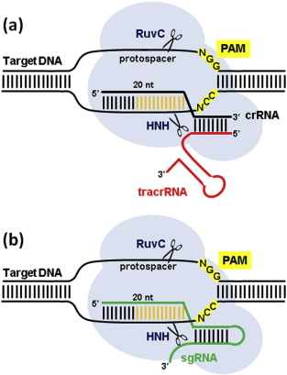
Crispr-Cas9/endonucleases: genomes and épigenomes modifications
Limitations of action in genomes by
PAM sequences inducing a search for
other nucleases with other PAM (AT / GC rich) ex: Cas9, C2c1, Cpf1 (1 single RNA); bringing his own PAM...
Limitations of insertion size from where
problems for e.g. human modifications,
Unintended effects:
Off targets because SDN = sequence directed mutagenesis (homologies of sequences) and several thermodynamic considerations...
Exon skipping (generally not screened)
Chromosomes’ translocations (undetectable by ‘low cost’ off-targets sequencing)…
Attempts to reduce off-targets by
changes -> nickase activity,
reduction of reagent quantities, activity duration, RNP (but with contaminating DNA),
C2C2 (Cas13a) and RCas9 for RNA modifications…
Numerous cooking recipes of different labs applied without any quality assurance frame…
natural
artificial
RNA-guided DNA cleavage by Cas9. (a) In the native system, the Cas9 protein (light blue) is guided by a structure formed by a CRISPR RNA (crRNA, in black), which contains a 20-nt segment determining target specificity, and a trans-activating CRISPR RNA... Luisa Bortesi, Rainer Fischer. Biotechnology Advances, Vol. 33, Issue 1, 2015, 41–52
Notes:
Comparison of the native system and the one proposed in 2012 by Doudna and Charpentier.
The sgRNA is more easy to change than TALEN enzymes…
But the changes in creating sgRNA (by linking the crRNA and the TracrRNA) drastically impacts specificity and efficiency by its conformation and energy issues, number of mismatches allowed to reduce off-targets…

Slide 28
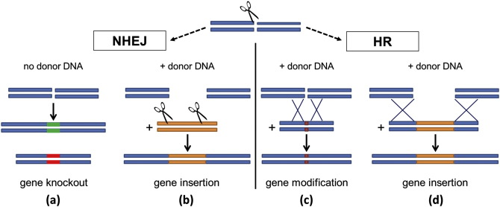
NBT such as Crispr-endonuclease are using double strand DNA reparation system
High frequency
Canonical and alternatives (MMEJ)
Low frequency
The challenge: favoring the less efficient HR DNA reparation system
Message to take home: very rapid and numerous dsDNA breaks followed by very rapid
fragments sticking without any control of the former vicinity of the sticked fragments nor of
the absence of changes at the cutting point…
Notes:
NBT as for “spontaneous” mutations & mutagenesis through ionizing radiation or chemical mutagens
▪ Consequences can be
- chromosome breakage, translocation and elimination
chromosome (segment) doubling
prevalent with irradiation
In plants, DSBs are mostly and typically repaired by the imprecise non-homologous end joining (NHEJ) DNA repair pathway, resulting in random deletions and insertions (indels) at the site of repair (Schröpfer et al., 2014). By leveraging the error-prone nature of NHEJ, many groups have reported using engineered nucleases to generate loss of function alleles in a target-specific manner (Carlson et al., 2012; Lor et al., 2014; Shan et al., 2015; Zhang et al., 2015).
NHEJ random DNA repair, the most frequent mechanism used by cells, means you cannot predict what would happen. You thus have to transform numerous cell before having a chance to get the expected result on the target. It is thus still a “trial and error” system which explains whay Addgene is so important for supporting scientits as providing proofs it works in some instances.
“Precision genome editing”, on the other hand, relies on template-directed repair of DSBs using exogenously supplied double stranded DNA or ssODN and as such is more precise than NHEJ (Voytas, 2013). While groups have reported using oligonucleotides in combination with engineered nucleases to increase gene editing frequencies in fish, mammals and flies, in plants the challenge of making and tracking targeted genome edits from individual cells through to whole plants in a non-selectable manner remains a barrier.
chromosome - single base-pair changes (substitution, insertion and deletion)
prevalent with chemical mutagens
▪ Further propagation or backcrossing and selection necessary
Cf. Van de Wiel, C. et al., “Traditional plant breeding techniques”, Wageningen UR Plant Breeding, Report 338 (2010)
Susan W.P. Wijnhoven and Harry van Steeg 2003 Toxicology 193 171–187
At least five main, partly overlapping damage DNA repair pathways operate in mammals: nucleotide excision repair (NER), base excision repair (BER), homologous recombination (HR), end joining (EJ) and mismatch repair (MMR) (reviewed in Hoeijmakers 2001)
NHEJ (Non Homologous End Joining) DNA repair system of DSB (double stranded DNA) is also involved in transgenesis. See e.g. Jun Dai et al. 2010 Int J Biol Sci 6(7):756-768.

Slide 29
Principle of the matrix Approche
(gathering a converging proof network) http://www.inra.fr/Entreprises-Monde-agricole/Resultats-innovation-transfert/Toutes-les-actualites/Detecter-les-OGM-inconnus
Identification of the initially used NBT techniques and derived products

Slide 30
Classic premises of identification
Principle:
  Observe / distinguish characters, traits ... eg shape of flowers, animals, hair or feathers ...
  Inventory the elements: locomotion devices, bone, disposition, ontogenesis ...
  Classify the elements: phenotypic, genotypic, epigenotypic, epitranscriptomic ...
  Analyze nucleic acid sequences; proteins, compare DNA / proteins (exon jumps, alternative splicing) ...
  Combine the elements if necessary according to the desired degree of precision,
  Correlate, for example in trees (evolutionary tree ...)
Users: Aristotle, Linnaeus, Jussieu, Darwin ... breeders of seed companies ...
The identification of NBT techniques and products is only an application of the methods and targets used in taxonomy, phylogeny / cladistics / phenetics / statistics, varietal identification, marker-assisted selection, detection of GMOs ... assisted or not by various statistical tools, databases, decision support systems (DSS) ...

Slide 31
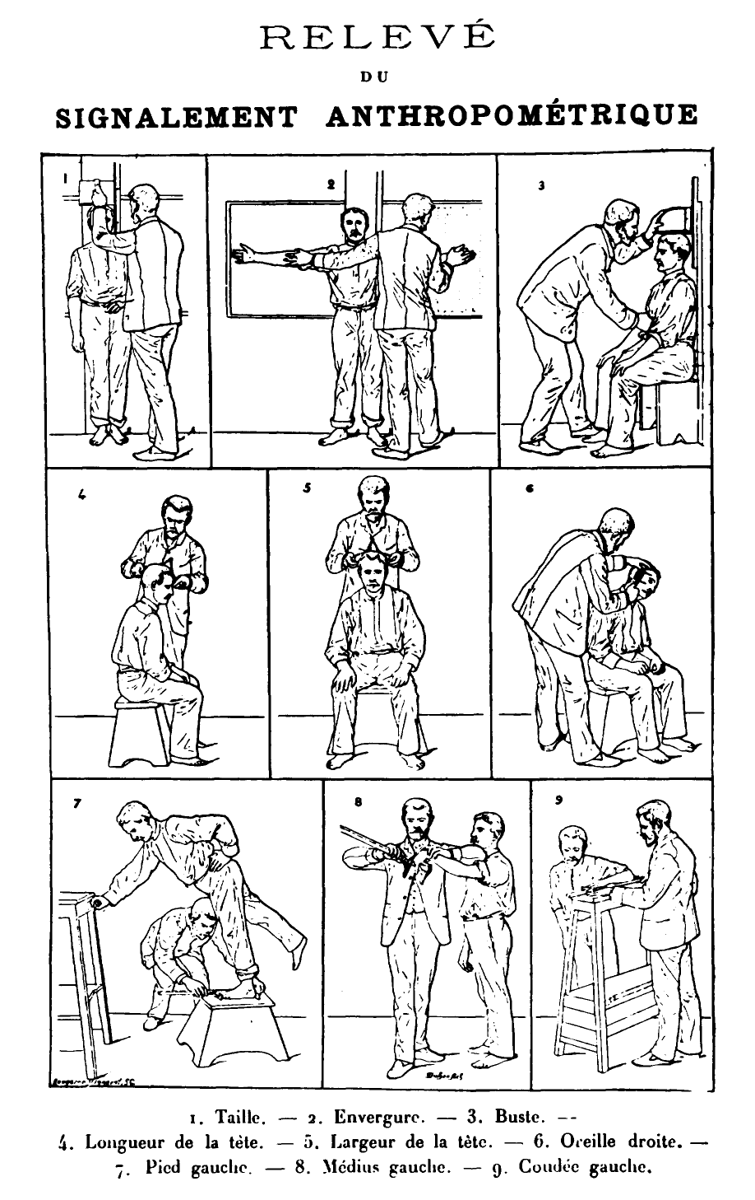
Other examples
Of the matrix approach
Basic principles of scientific identification as synthesized by Alphonse Bertillon in judicial anthropometry

Slide 32
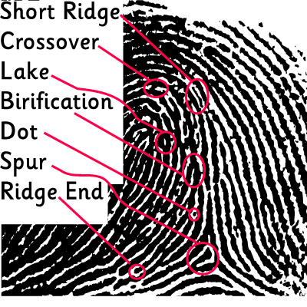
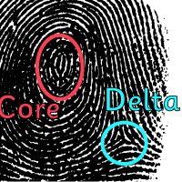
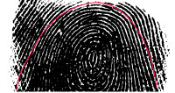
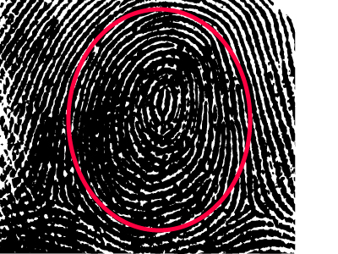

Another example of the matrix approach
Some characters / traits of
differentiation in dactyloscopy

Slide 33
Another
example of
the matrix
approach
Multipoints
facial recognition

Slide 34
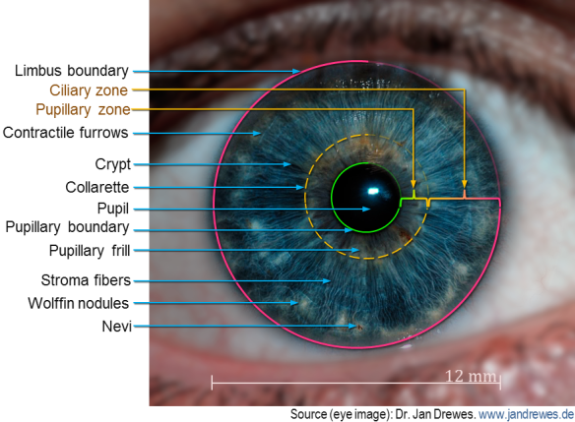
Another example of the
matrix approach
Iris recognition

Slide 35
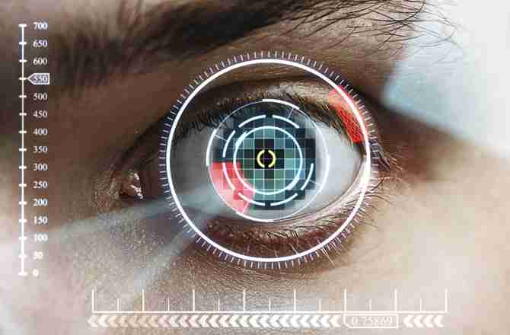

Slide 36
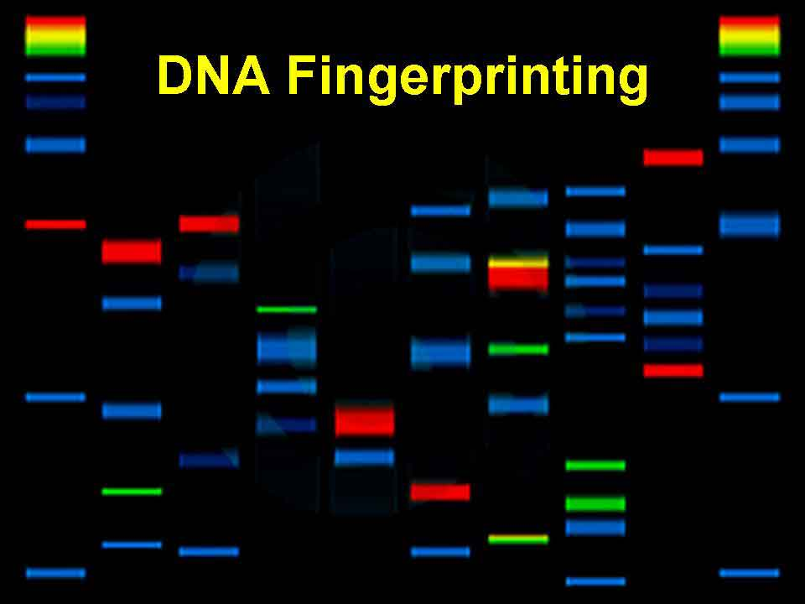
Genetic polymorphism
How to become one of the experts of the technical and scientific police,
or - more prosaically – how to identify varieties
to do marker-assisted plant selection ...
"In addition, the plant genome is extremely diverse," says Jeffrey Sander, scientist at the
Pioneer Molecular Engineering (Johnston, Iowa),
“Between two varieties of corn, there is almost the same genetic distance
as between man and monkey. "

Slide 37
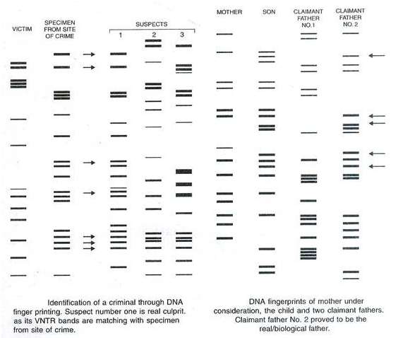
Another example of
the matrix approach
Depending on the context, the "weight of evidence" (here the number of identification bands differentiating individuals in these forensic studies) may differ ...

Slide 38

Another example of the matrix approach
Another approach to facial recognition in noisy contexts: similarities of approach between sequencing of genomes and / or epigenomes and scanning recognition methods (eg Viola-Jones method)

Slide 39
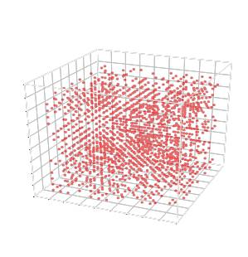
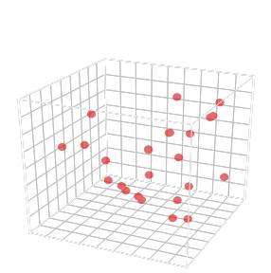
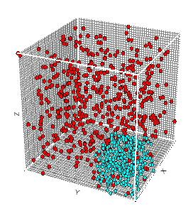
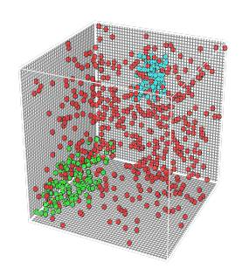
The matrix approach to identify the NBT techniques initially used and the derived products is based on the assemblies of markers of different types, for example in genomes and epigenomes
Markers in all
genome and
epigenomes (ex: used
for a MAS, PAM,
off-targets, translocation,
transversion ...
frequency, cartography ...)
Choice of identification
markers
of the species
Choice of markers
differentiating
products from
in vitro techniques
Choice of markers
differentiating one (of)
technique(s), ex.
Crispr-endonuclease (s)
natural mutation (s)
Choice of a combination for unambiguous legal identifications
Choice of one (or some) relevant marker (eg PCR on targeted mutation-PAM) for routine detections (aspects of cost, speed ...)

Slide 40

Conclusion
Do not be fooled by the tree that hides the forest:
An element, alone, isolated, might not be an unambiguous signature (but a border fragment or a rearrangement internal to an insert is sufficient for GMOs of transgenesis ...), this is what you are generally asked to consider for NBT (to make you admit that the modification is natural), not all...
Various elements collected (see above for NBT and mutagenesis in vitro vs. in vivo) make it possible to determine the technique employed and then to trace the product by using only a part of the elements (cost aspect, speed... according to the needs of the analysts)
These matrix approach practices are already in use (detection of known and unknown GMOs, to reduce costs, simplify complex samples detection ...) and made more user-friendly using the labs’ databases and DSS ...

Slide 41
Detection Methods

Slide 42
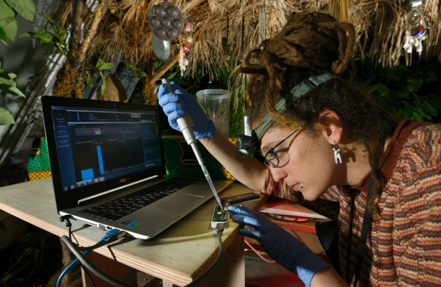
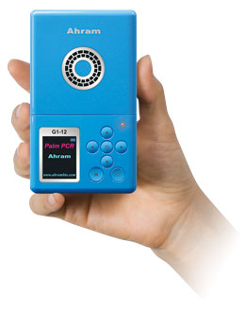
Available methods
Phenotypic (ex: tolerance to a herbicide, immunology ...)
Omics (metabolomic modification, proteomics ...)
Molecular: genomes and epigenomes / epitranscriptomes (DNA, proteins, RNA):
  DNA, RNA and modified or unmodified proteins
  Simplex (PCR, LCR, OLA ...) multiplex (SNPLex, DNA chips ...),
  From the nucleotide (LCR, OLA ...) to the large chromosomal rearrangement (border fragment ...),
  Isothermal or not (LAMP, NASBA ...)
  Combined or not (eg SNPLex = LCR + PCR + DNA chip)
  Sequencing (Sanger, NGS, ChiSeq, RNASeq ...) with or without reference genome,
  On isolated tissues or cells, nucleus or organelles,
  In the laboratory or in the field (PCR, LAMP, sequencing ...)
Using scars and signatures
  Univocal (s) or multiple (databases and DSS, see ENGL network works and FP6 Co-Extra program)
  Analyzes with various software (assemblies, comparisons, phylogeny, statisitics, cartographies)
  Combinable and modular according to the needs: legal identification vs. routine detection

Slide 43
Identification / detection targets

Slide 44
In vitro versus in vivo
It is not forbidden to consider in the modifications of the genomes of the organelles (mitochondria ...) in addition to the nucleus (cf post-traumatic stress war of the Golf ...)
A fundamental:
  genomes and epigenomes are stable (in equilibrium as a result of evolution), cf. work on the stability of animal and plant genomes such as "Napoleon Oak", tomato ...
  only the neutral or pressurized modifications that are transmittable remain.
Random mutagenesis methods: chemical, physical
  Types of induced modifications, eg transversion, micro-deletions according to mutagen (EMS, ENU, neutron flux, γ-rays ...)
  Characterizations (principle and software of tilling / ecotilling, NGS ...): frequencies / statistics, cartographies, hotspots ...
Related techniques: "scars" (including somaclonal variations following electroporations, cell cultures, regeneration of calls / plants ...), ...)
  Mutations and random epimutations of DNA, proteins and RNA (the change of a nucleotide can induce mutations and epimutations, positioning in TAD and gene expression ...)
  Modification of polymorphisms: genetic maps, SNPs, STR repeat sequences, microsat ...
  Transposable element motions, hotspot studies and recombination coldspots,
  Traces of elimination of modified cell selection sequences (eg Cre-Lox),

Slide 45
General signatures
Comparison of « cell lineage », e.g.https://www.pourlascience.fr/sd/genetique/suivre-le-devenir-de-chaque-cellule-du-corps-9810.php) considering nuclear and mitochondrial genomes and epigenomes
Notes:
McKenna et al. (Duarte, 2016; Kupferschmidt, 2016; McKenna et al., 2016; Nawy, 2016) selon lesquels les modifications de génome induites par Crispr-cas9 seraient « enregistrées » dans le génome et aboutiraient à une sorte de barcode au travers d’une succession de mutations induites dans Crispr. Les modifications effectuées, et probablement n’importe quel évènement biologique, dont des signaux environnementaux (Borkowski et al., 2016; Roquet et al., 2016), devenant donc traçables comme semblent le montrer chez l’homme les résultats de (Perli et al., 2016) et chez les bactéries, de manière ordonnée, ceux de (Barrangou and Doudna, 2016; Shipman et al., 2016; Wang and Qi, 2016). Des signatures univoques seraient alors possibles et les signatures de ces systèmes d’enregistrements biologiques des modifications pourraient éventuellement être imposés aux laboratoires et sociétés, comme dans le cas des OGM de transgenèse actuels. AJOUTER (Sheth et al., 2017) système d’enregistrement effaçable avec Crispr des différents stress (Ledford, 2018; Tang and Liu, 2018)
(Sullivan et al., 2015) selon lesquels toute insertion de séquence (endogène ou exogène) dans le génome s’accompagnerait d’une signature épigénétique. Ce marquage épigénétique pourrait contribuer au faisceau convergent de preuves voire constituer des signatures univoques. Les auteurs considèrent que leur article apporte une preuve de concept en détection d’OGM inconnus, y compris donc pour de la cisgénèse, par des techniques d’épigénétique. Rappelons que de même qu’Agrobacterium pour les plantes et le génome, les modifications de l’épigénome font partie de l’arsenal pathogène de bactéries comme Shigella, Listeria et Legionella.
Les indels générés, par exemple par Crispr-Cas9, et donc celles issues des techniques connexes sont traçables dans les cellules filles, avec même certains « patterns » spécifiques comme le laissent penser des fréquences d’occurrence différentes (Junker et al., 2016), ce qui rejoint les histoires / généalogies de cellules (« cell lineage », cf l’article de Callaway repris / traduit dans « Pour la science » de septembre 2017) (Callaway, 2017; Sulston et al., 1983). Signature génomique de l’origine et de l’histoire des cellules / cell lineage (Callaway, 2017; Frumkin et al., 2005; Junker et al., 2016; Kalhor et al., 2017; Sulston et al., 1983; Woodworth et al., 2017) avec création d’un barcode unique (Williams, 2016). (Nawy, 2018)
Barrangou, R., and Doudna, J.A. (2016). Applications of CRISPR technologies in research and beyond. Nature Biotechnology 34, 933-941.
Borkowski, O., Gilbert, C., and Ellis, T. (2016). On the record with E. coli DNA. Science 353, 444-445.
Callaway, E. (2017). The trickiest family tree in biology. Nature 547, 20-22.
Duarte, J.H. (2016). Tracing cell lineages with mutable barcodes. Nat Biotech 34, 725-725.
Frumkin, D., Wasserstrom, A., Kaplan, S., Feige, U., and Shapiro, E. (2005). Genomic variability within an organism exposes its cell lineage tree. PLOS Computational Biology 1, e50.
Junker, J.P., Spanjaard, B., Peterson-Maduro, J., Alemany, A., Hu, B., Florescu, M., and van Oudenaarden, A. (2016). Massively parallel whole-organism lineage tracing using CRISPR/Cas9 induced genetic scars. bioRxiv.
Kalhor, R., Mali, P., and Church, G.M. (2017). Rapidly evolving homing CRISPR barcodes. Nat Meth 14, 195-200.
Kupferschmidt, K. (2016). CRISPR views of embryos and cells. Science 352, 1156-1157.
Ledford, H. (2018). CRISPR hack transforms cells into data recorders. Nature 554, 414-415.
McKenna, A., Findlay, G.M., Gagnon, J.A., Horwitz, M.S., Schier, A.F., and Shendure, J. (2016). Whole organism lineage tracing by combinatorial and cumulative genome editing. Science 353, 462-U480.
Nawy, T. (2016). Genomics: Cas9, the cellular genealogist. Nat Meth 13, 609-609.
Nawy, T. (2018). Tracing cellular descent. Nature methods 15, 32.
Perli, S.D., Cui, C.H., and Lu, T.K. (2016). Continuous genetic recording with self-targeting CRISPR-Cas in human cells. Science 353.
Roquet, N., Soleimany, A.P., Ferris, A.C., Aaronson, S., and Lu, T.K. (2016). Synthetic recombinase-based state machines in living cells. Science 353.
Sheth, R.U., Yim, S.S., Wu, F.L., and Wang, H.H. (2017). Multiplex recording of cellular events over time on CRISPR biological tape. Science 358, 1457-1461.
Shipman, S.L., Nivala, J., Macklis, J.D., and Church, G.M. (2016). Molecular recordings by directed CRISPR spacer acquisition. Science 353, 463-.
Sullivan, C.J., Pendleton, E.D., Abrams, R.E., Valente, D.L., Alvarez, M.L., Griffey, R.H., and Dresios, J. (2015). Chromatin structure analysis enables detection of DNA insertions into the mammalian nuclear genome. Biochemistry and Biophysics Reports 2, 143-152.
Sulston, J.E., Schierenberg, E., White, J.G., and Thomson, J.N. (1983). The embryonic cell lineage of the nematode Caenorhabditis elegans. Dev Biol 100, 64-119.
Tang, W., and Liu, D.R. (2018). Rewritable multi-event analog recording in bacterial and mammalian cells. Science.
Wang, F.Y., and Qi, L.S. (2016). Applications of CRISPR genome engineering in cell biology. Trends in Cell Biology 26, 875-888.
Williams, R. (2016). Self-editing genetic barcodes. The Scientist.
Woodworth, M.B., Girskis, K.M., and Walsh, C.A. (2017). Building a lineage from single cells: genetic techniques for cell lineage tracking. Nat Rev Genet advance online publication.
Ce qui ne serait pas étonnant, les système Crispr étant à l’origine un système d’ “immunité adaptative” bactérien insérant des séquences nouvelles de phages agresseurs dans le génome bactérien…

Slide 46
NBT signatures
PAM proximity (sometimes several) and targeted mutation (s) / epimutation (s), eg Crispr-endonuclease,
Off-targets near PAM, off-targets of RNAi, ZFN and TALEN...
Insertions of vector residues (eg Agrobacterium genome and plasmid) for SDN, RNAi ...
Contaminating DNA for RNP systems (see results of DNA insertion in the human genome ...), chromatin modifications,
Natural or Crispr-based "barcode" for recording changes in genomes and epigenomes and environmental cues ...
DNA, RNA (including mRNA) and proteins circulating between rootstock and scion,

Slide 47
Conclusion
The identification of the methods used (in vitro vs in vivo, NBT ...) is possible using the matrix approach already in use for known and unknown GMOs, as in other areas of identification / detection ...
The techniques and targets used are of the same type as those used by seed companies for varietal identification, SAM ...
One, or part, of these targets can suffice in routine, so at the least cost as for the current GMOs
The proof of concept will be accessible
  As soon as the research programs proposed by ENGL to the European Commission in 2013 are launched,
  The reference materials will be provided by the companies as for the GMOs of transgenesis (regulations 1829/03 and 1830/03)
The premises have not been fulfilled in the HCB, Scientific Advice Mechanism European... Reports despite the available time (5 years for the HCB...) and considerable resources (40 experts for the HCB), in absence of elicitation of experts (ex: Q method) and public consultation demonstrate a political choice (see speech JY Le Déaut at OPECST in 2016, comment European Commissioner January 2018 ...) allowed by the use of circular reasoning (a classic of scientific bias)
Notes:
Raisonnement circulaire utilisé : prendre l’hypothèse initiale que la mutation engendrée par la technique NBT est indistinguable d’une mutation naturelle, ne pas chercher d’autres éléments de distinction / différenciation, et conclure qu’en conséquence on ne peut différencier la technique NBT d’un phénomène naturel de mutagénèse…
Tous les éléments de distinction des techniques NBT et produits sont bien connus des firmes semcnières..

Slide 48
France as a case study:
NBT at the HCB and the Conseil d’Etat
Working Group 2008-2015
December 2015: "discussion on a summary note" of the WG
  No gvt referral nor self-referral, thus without precise request of work to be performed,
  "Written in a weekend or so",
  provided to the Scientific Committee 3 working days before the HCB SC meeting,
  with less than a third of the final document (remainder to be provided later on),
  with regulatory and economic considerations of the CEES but not of the CS,
  provided to CEES the same day (contrary to the procedures’ scheme),
  which will be announced the days after as to be provided as a notice to the government,
  request for dissent refused
Communication “double talk" to justify a misuse of procedures,
Resignation of the CS: an expert intuitu personae vs. organizations of the highest quality,
Status of the document regressed several times on the HCB website but was always presented by the gvt as a “advice" of HCB,
Request to the gvt to urgently provide the HCB with an official referral on NBT,
New SC WG on NBT started for writing a new CS document… delivered November 2017 despite a new dissent,
Ad-hoc working group (‘coach’, chairs and staff) i.e. a judge and party WG on HCB governance. Conclusions after several months: the rules of procedures have to be applied, the documents have to be provided in due time, procedures have to be transparent, minority opinions have to be taken into account as stated by the procedures...
HCB (High Council for Biotechnologies): “business as usual”
Application to the Conseil d’Etat by organizations against Prime minister decisions of “VrTH” (“hidden GMO”) approval,
NBT were included during an exceptional investigation at the helm (‘enquête à la barre’)
The Conseil d’Etat then sent several preliminary questions to the European Court of Justice (ECJ)
Follow-up of the ECJ general advocate comments delivered on February 2018

Slide 49
Some general questions
A series of agricultural technical evolutions, often described as revolutions (middle-age, green...),
A technical evolution of molecular biology: GMOs, then NBT, synthetic biology,
Related techniques: cooking recipes that have been used for several decades generating mutations and epimutations (see the October 2016 seminar)
Techniques used without evaluation guidelines on certain impacts (e.g. epigenome, see EFSA symposium, June 2016) nor an appropriate quality assurance scheme,
Societal issues that led to the refusal by citizens of certain techniques and leading to regulatory questions (what is mutagenesis, GMO or not, exempted or not?) being processed at the level of the ECJ,
A society where technical progress and innovation are asserted as a source of happiness and wellbeing by both private and public actors (ministries in charge of the environment and agriculture, CTPS vs. Evaluation agency ...)
What can be learned from the current NBT controversy (ZFN, TALEN, Crispr-nuclease) and other techniques (negative segregants, RdDM, RNAi, OdM, grafting ...), copy / paste errors, positions of experts and authorities they control, business lobbies and policies?

Slide 50
NBT : rhetoric and omerta
Confusing copy-paste, without any updating or critical thinking, ex:
  the story of the definition of recombinant DNA and the nucleotides
  Traceability / detection / identification, from the industry arguments to the European SAM report,
From flooding of promises reminiscent of GMOs and cloning promises 30 and 20 years before, with many omissions: breeding acceleration, feeding the world… to a fabulous world 2.0 without genetic diseases nor harmful organisms, around precision medicine
An abuse of undefined wording such as 'natural’ (e.g. use of natural mechanisms such as NHEJ, but current GMOs also use natural DNA reparation mechanisms), a semantics of fight ('new' synonymous with breakage for patents, and ‘plant breeding / selection' for falling asleep citizens), 'editing' rather than modification, this despite the many errors, 'precision' despite several unintended effects such as off-target ...
A focus on 'targeted mutagenesis' not mentioning the unexpected effects of old techniques (protoplastisation, regeneration of plants...) used to generate mutations and new techniques of genome modifications,
A mechanistic presentation of the 70s-80s of the genome and molecular biology instead of the current one of dynamic networks constantly interacting between genomes of a cell, between cells, between tissues,
A biased choice of mechanisms and of their relative importance e.g. RdDM (a way of obliterating the problem of gene regulation, pleiotropy):
  Methylation of DNA as a natural process,
  Unmodified DNA sequence,
A mix of confusing situations: old reassuring techniques such as grafting but with GM rootstock without consideration of the remote effects on the scion and its products ...
Confusion maintained for example by the different definition between countries about e.g. agro-infiltration (agro-infection itself and floral-dip included or not),
Gibberish confusion with ‘concepts’ (e.g. cis-, intra- and trans-geneses using the same techniques) presented at the same level as techniques.
A semantic battle and biased rhetoric to mask the regulatory and financial aims

Slide 51
After the GMO, the NBT: biased semantic and rhetoric battles to mask the regulatory and financial ones

Slide 52
Who’s expert in which context?
As a kid, you can be the expert for the bicycle of your sister,
Administrations’ delegates: OECD, EC’s committees… with several instructions,
As a “connoisseur”, such as a scientist or as stakeholders’ representative…
But
Experts are themselves “politicians” (as they are as scientists in their labs) with different opinions and strategies, hidden agendas…
Experts may be rare, difficult to mobilize, particularly in controversial areas, possible biases in their choice by e.g. the nominated chairs…
Experts are generally questioned about unstable situations, with large uncertainty margins, affecting different possible scenarios, sometimes with guidelines and norms (e.g. toxicology) not taking into account recent research data…
Expertise can be also mostly based on stakeholders documents (expertise privatization?) without power of initiating additional research, in very short expertise timing,
The quality of expert’s work is generally not assessed (some are just making summaries instead of applying critical mind or checking the application of legal directives)
Generally highly depending on the secretariat competence, a staff whose members can publish to express their viewpoints (see e.g. EFSA’s staff) and thus influence the experts.

Slide 53
The experts / politicians relatiosnhips
The enlightened prince, a kind of epistocracy,
The empire of standards: the legitimacy of “science based” and the full epistocracy. Which expert to choose and who is nominating them?
The technical democracy: the power of experts decreases, citizens are involved (consensus conference, HCB CEES…). But who is representing? Several limits (see the debate about nanotechnologies in France).

Slide 54
Direct interferences during the expertise
Social pressures of an economy of promises:
  Colleagues’ interventions about e.g. socio-economic impacts (feeding vs. nurturing the world, children's nutritional deficiencies, supposed huge costs of approval dossiers…),
  Nationalist arguments: agricultural exportations and trade balance, improving competitiveness, Shangai’s ranking of our research,
  Authority arguments during colleagues’ interventions about what “everybody knows”, tribunes of renowned scientists of other domaines,
  The usual and intentional confusion between science and their applications,
  Number of “successful publications” (forgetting the fashion effect, the funding needs with claims for disruptive technics, the publication biases…)
  No compliance to scheme rules (e.g. CS HCB meeting on dec. 16, 2015 and following steps) and their control (internal WG’s conclusions: to respect the rules of procedure, be transparent, provide documents in time…), independent structure without ethical committee at the difference of Anses (recent dissensus issue)
  In conclusion: the red Queen race of Alice in Wonderland

Slide 55
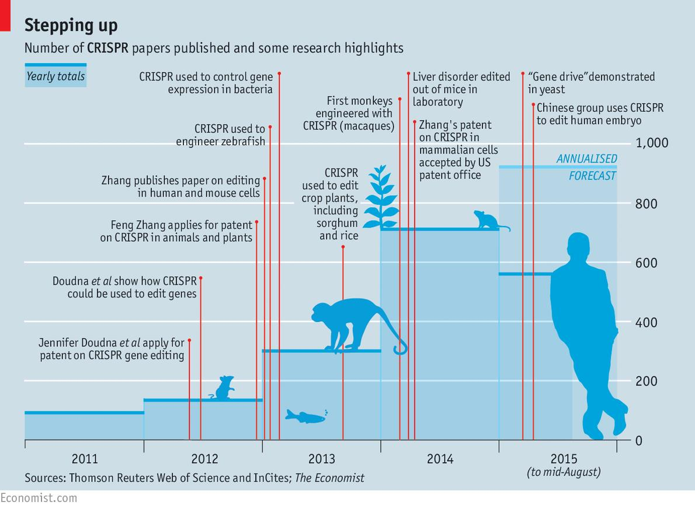
Crispr-endonucleases: fashion and new opportunity of funding...
And the bias of publications (as for cloning 20 years ago…)

Slide 56
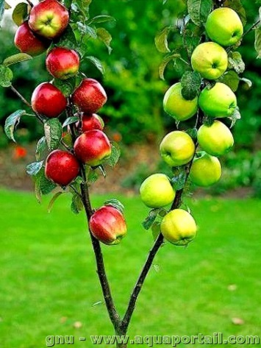
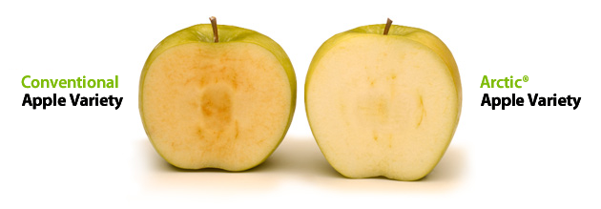
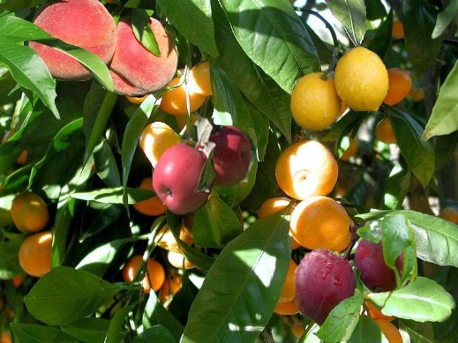
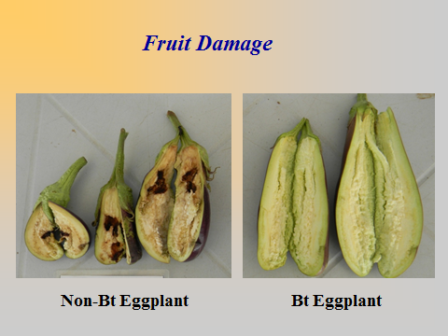
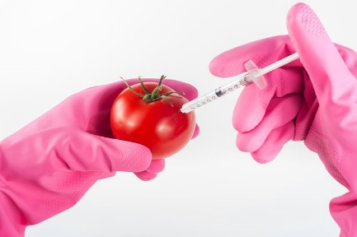
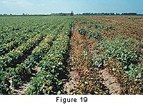
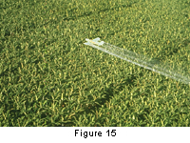
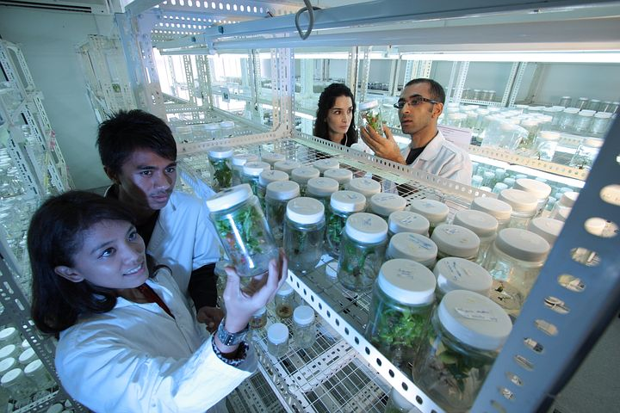
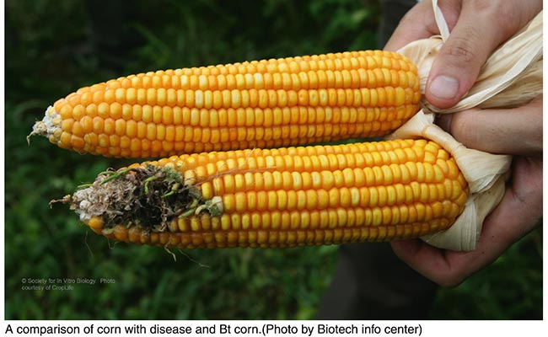





Are consumers, but also supply chains, really wishing such changes?

Slide 57













An economy of promises and a race of lies
Crispr body-builded dogs
Dolly
Notes:
Société Genta: 1 milliard US$ d’essais cliniques avant la faillite à cause du produit Genasense (mauvaise interprétation initiale des premiers résultats)

Slide 58
Authority’s arguments
Usual sentences during sessions: ‘everybody knows’,
Appeals to authority such as chair taking the time instead of favoring the expression of diverse opinions,
Subordinate relationship, funding or positions backlash in future e.g. call for tenders…
Standardized risk assessment (e.g. toxicology) vs. research issued assessment (e.g. epigenetics without guidelines, effects of fed miRNA on host’s genes regulation…),
Using several cognitive biases.

Slide 59
Experts’ integrity
Direct links of interests and earnings (merchants of doubt…)
Cherry picking of publications
Biased information / communication (see the lack of HCB CS to CEES communication on related techniques)
Circular reasoning (e.g. identification of NBT techniques and derived products, effetcs of genes modification vs. verifications....)

Slide 60
How language matters
The direct impact of using words and expressions on the reasoning and acceptance of both scientists and laypersons (e.g. new breeding techniques),
Outrageously simplified language and metaphors (e.g. genome editing),
Notes:
Affective level, metaphors engage more in depth motivation, emotion, and memory ssytems.
By using often them, it changes the mind...

Slide 61


What are precision, unintended modifications and publication’s bias?
First training…
Then start ... for
missing a lot ...
Many total or partial homologies in the rest of the genome,
Thermodynamic considerations,
Many recipes attempting to reduce the number of off-targets (of a 1,500 factor...)
As a result: occasional insertions / deletions or not, chromosomal rearrangements (inversions,
translocations...), exon skipping effects, epimutations… difficult to predict and detect...
Additionnally: false positive not checked, circular reasoning accepted…
Finally, only presumed successful data are published: the usual bias of publication

Slide 62










Some misleading metaphores
(which influence your perception and then your ways of thinking and finally acting )
But a series of cuttings
(with numerous
breaks to rapidly and accurately stick)
SDN: do not foresee an unique
and precise cutting
Editing the genome ... Waiting
for amending electronic
and known languages?
What you have effectively
to “edit”: untranslated
handwritten languages…
The promised precise modification?
plus
On a destructed
landscape due to
related techniques:
everything to rebuild
Several 'off targets' obtained
due to rebound effects
from homologous
Sequences
It’s rather Staline’s organ shots
Targeted mutagenesis: were you
thinking about a ‘one shot’?
Notes:
And not forget the border between our 2 jobs: scientist and expert. A lot of them forget it.
As (almost) said by Pierre Gilles de Gennes (Nobel Prize): experts are almost similar to militaries, they know very well the pas wars, but cannot anticipate the new ones.
Keep ‘critical mind’ (officially a part of the training of scientists) in front of any assertion of a lack of hazards. Beyond the usual financial conflicts of interest, there are numerous other links of interest: institutional, politics, economics…
Numerous scientists are unaware of professional ethics…
As already by sociologists: the scientist does not leave its opinions at the door of the lab or the expertise room.
Be careful with metaphors: they are often useful for some initial explanations but when repeatedly used it will drastically change your perception, your way of thinking and then of acting.
Look at the wording/ semantic used.
First example:
gene or genome editing.
You think rapidly about this image as with a “copy and paste” or “cut and paste” in your favorite computer located word processor?
But why did you imagine
That you are using a computer with word processing system?
1.1 In fact you may be using hand written text, which means you will cross-out text…
1.2. It might also bee a type written text. With such old type writer you can inly cut paper, around sentences, you will then use scotch tape and work on in order to hidden the changes at the photocopier. You can also have to completely reformat pages and thus make mistakes I the successive pages…
2. That you know well the language used in this text?
Suppose it is a foreign language you do not know. How accurate and understandable could be your cut and paste?
Suppose you are reading hieroglyphs before Champollion used the Rosetta stone.
What would make your “cut and paste” between eyes or birds differently located? No changes in the text’s meaning? Or in the poesy? The subtilities?
Second example.
Nuclease as molecular scissors
You are often facing the metaphor of endonuclease as a molecular scissor?
You thus spontaneously think to the scissors you have in your sewing box.
Forget it, you are using a multi-blades scissor, as the one you may be using for cutting herbs for cooking.
As you can see, never accept directly the metaphors and images somebody else is providing you… Look at what can be beyond the simple image, easily coming to your mind

Slide 63
Links of interest
Direct:
  e.g. scientist paid by a stakeholder, published results are generally more favorable to the funding companies…
  Your company or public research institute and its policies, hierarchy and carrier…
Indirect: lab. funding and temporary positions of team’s personnel (e.g. backlash from colleagues in position to influence the results of your research proposals),
Message to take home: you cannot expect a scientist selling all the week a technique, such as NBT, for funding his team to change his/her state of mind and being critical when entering into an expertise’s room…

Slide 64
Bioethics
Enhanced gene drive: organisms’ eradication (despite it is already known it is unsustainable) means a privatization of public health policies (see. WHO director’s statements at the appearance of Zika, Chikungunya… viruses in Brazil…)
Plants as a proof of concept, to test the accuracy of the methods,
Huge demand of perfect children, particularly in some countries…
As for GMOs, large differences observed in polls in western countries about changes of human somatic vs. germinal lines, as well as for pharmaceuticals issued from modified organisms (different ‘cost-benefits’ analyses).

Slide 65
Recurrent politician interferences
The abuse of metaphors and other rhetoric effects, oversimplified statements, the confusion between science and applications / innovations,
Choice of experts and of the committees’ chairs, creation of appropriate new structures when political decisions have not been endorsed by the current expertise areas (e.g. European SAM with “high level” experts),
Requests of changes in e.g. the coexistence issues of GM and non-GM fields production: isolation distances with negotiations between farmers vs. territory management, measurement units to be changed (ENGL advice requested…),
French OPECST’s chair, telling we have to avoid with NBT the current situation of GMOs’ refusal,
European commissioner saying it would prefer NBT product being not traceable (ENGL proposed in 2013 to work on…)…

Slide 66
How to deal with expertise’s biases such as links of interest?
Better recognition of the involvement: emoluments, careers’ evaluation…
Experts’ elicitation: Delphi, Q methods (see the current FRB’s call for expertise on synthetic biology and environment), involvement of young experts without backlash…
Improving the weight of evidence? Scientific collective expertise according to recognized quality standards and rules (see e.g. Inra’s EsCo), systematic lliterature reviews, metaanalyses… But how could the democratic debate be maintained?
Message to take home: links of interest cannot be fully discarded, we have to find combined ways to ‘manage’ them and control the success of the procedures.

Slide 67

Thank you for your attention
After decades of expertise, such as for the HCB, i like to remind this sentence of
Pierre Gilles de Gennes (Nobel laureate) :
« You know, experts are often like the military.
They are experts of the last war but not of the next… »

