Slide 1
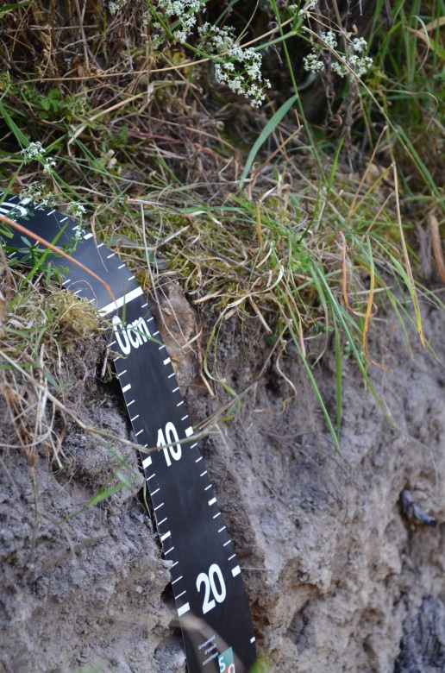
Controlling factors explaining soil carbon within large, heterogeneous environments
V.L. (Titia) Mulder – INRA Unité Infosol, Orléans, France
Contributors: M. Martin, M. Lacoste, N. Saby, A. Richer de Forges & D. Arrouays
Project: GlobalSoilMap
6th Global Workshop on Digital Soil Mapping
11-14 November, 2014, Nanjing, China

Slide 2
01
Introduction
Background, Conceptional framework and Objectives

Slide 3
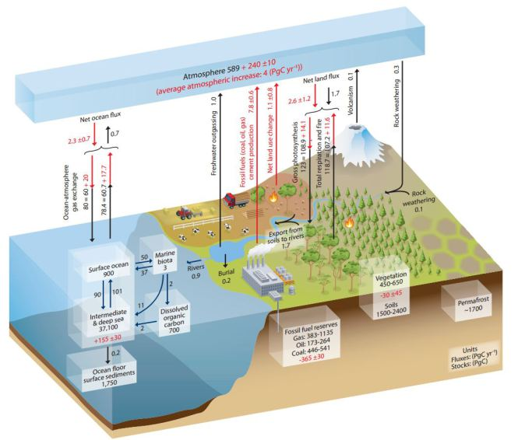
INTRODUCTION (I/II)
GLOBAL CARBON CYCLE & SOIL CARBON
Soils are not an unlimited resource
Importance of soil carbon
Carbon pool – mitigation and adaptation to climate change
Food security
Topsoil well modelled (only 30% of the global soil carbon stock)
Methods: Kriging, Regression tree modelling
Subsoil modelling
Decrease in model performance
Lack of understanding on controlling factors of SOC within large areas
Data availability
This work aims to:
Improve the understanding of SOC controls
Determine which data is specifically needed to improve subsoil SOC models

Slide 4
INTRODUCTION (II/II)
CONCEPTIONAL FRAMEWORK
HYPOTHESIS:
“Variability in SOC may be better explained by modelling SOC within different soil-landscape systems (SLSs). These may be defined by broad-scale data of climate, land use, parent material, relief and soil type, as supported by the Soil-Landscape paradigm described by Jenny [1941]”

Slide 5
OVERVIEW RESEARCH
Input data
Soil sample data (source: French Soil Monitoring network & Soil Inventory programmes)
Exhaustive covariates capturing biotic and abiotic conditions (Soil type and properties, parent material, relief, climate and vegetation)
Analysis
Modelling Soil-Landscape Systems (SLS)
MB clustering – undirected datamining
Explanatory SOC models within SLSs, for each soil layer
Multiple linear regression

Slide 6
03
RESULTS & MAIN FINDINGS

Slide 7
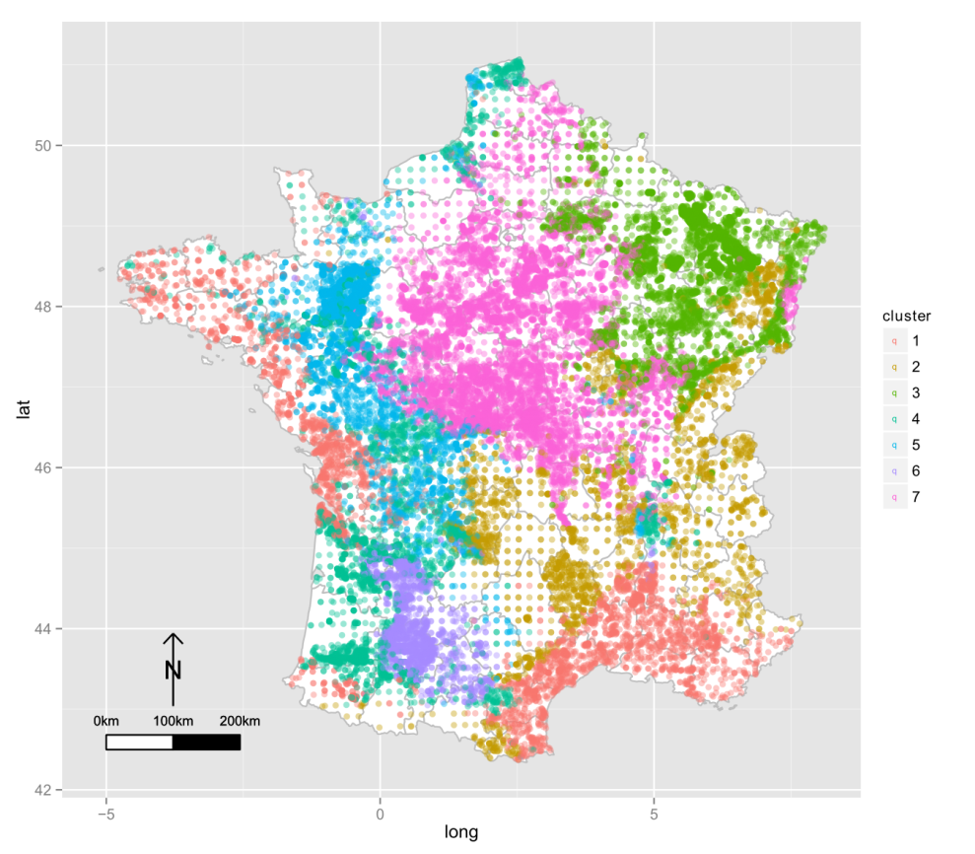
RESULTS (I/V)
1) Dry climate
SOIL LANDSCAPE SYSTEMS
2) Mountain areas
3) Undulating areas +
agriculture
4, 5, 6) Similar climate but different parent material and land use
7) Well-developed loamy calcaric soils, agriculture
Model accuracy: BIC 882785, NEC 0.027
Notes:
These clusters were having young soils of sandy (cluster 4), crystalline rocks (cluster 5) or detritial (cluster 6) materials. Also, their SOC contents were lower compared to the other clusters.

Slide 8
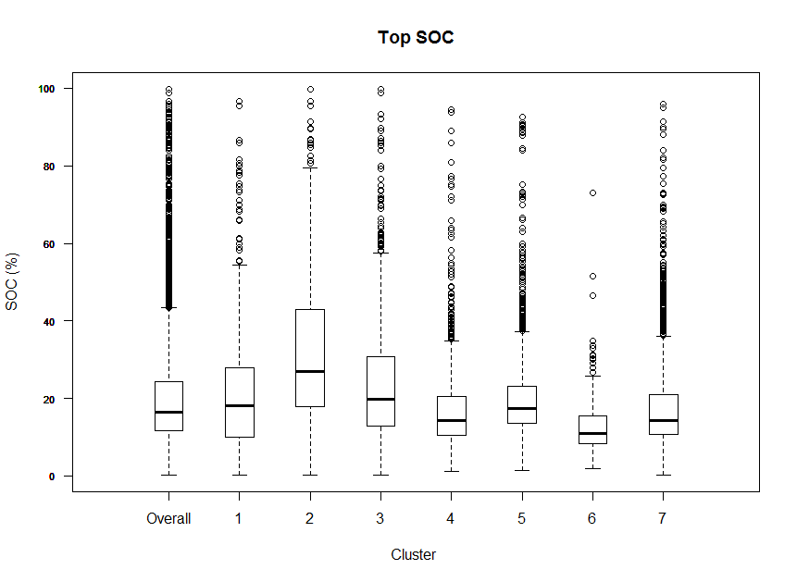
RESULTS (II/V)
SOC content within Soil Landscape Systems

Slide 9
RESULTS* (V)
Land management
Vegetation
Climate
Soil
Topography& geomorphology
* Presented variables: regression weight > 0,1

Slide 10
RESULTS* (V)
Land management
Vegetation
Climate
Soil
Topography& geomorphology
* Presented variables: regression weight > 0,1

Slide 11
Current state and on going research
Major findings
Shift in controlling factors both in space and depth
Carbon controlled by Soil-Landscape characteristics
Human influence on Soil-Landscape relations
Climate – precipitation/water availability
Subsoil data availability needs to be improved, current data relates poorly to subsoil SOC
Ongoing research
Improvement of data on controlling factors
Geostatistical modelling for large datasets (Kriging)
Soil depth and soil texture
Development of up-to-date database with remote sensing data and products

Slide 12
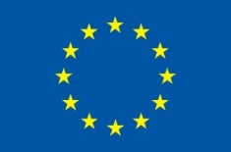
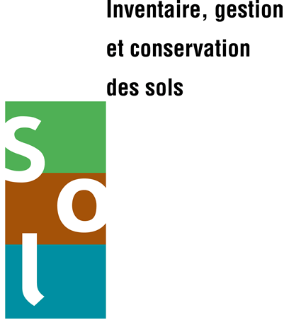
THANK YOU ALL!
Essentially, all life depends upon the soil.
There can be no life without soil and no soil without life;
they have evolved together.
American naturalist Charles Kellogg, 1938.
REFERENCE:
Mulder et al., (under review). Understanding large-scale soil organic carbon controls in relation to soil depth and soil-landscape systems. Global Biogeochemical Cycles.
FINANCIAL SUPPORT:

