Slide 1

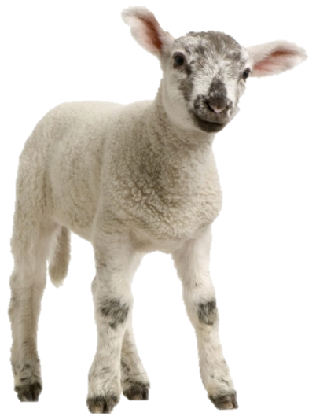

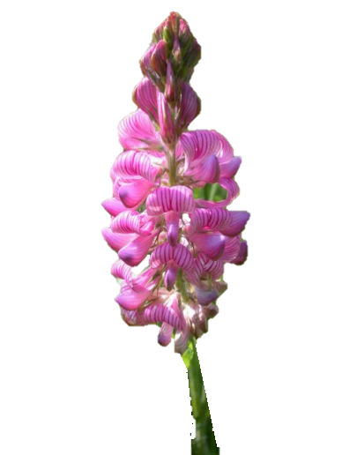

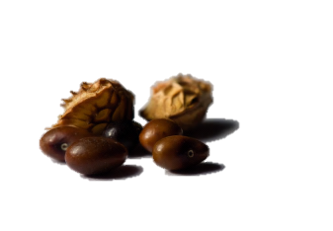

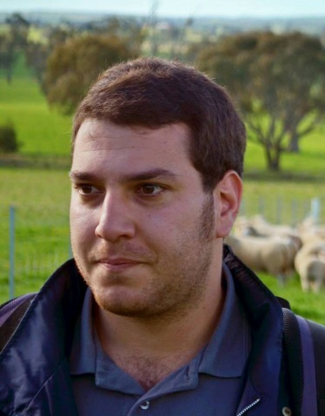


How mixing bioactive legumes with grass impacts animal productivity ?
INRA, UMR1213 Herbivores
V. NIDERKORN
(Thesis G. COPANI)
PITN-GA-2011–289377, ‘LegumePlus’ Project
NIAB event, 21 October 2015

Slide 2

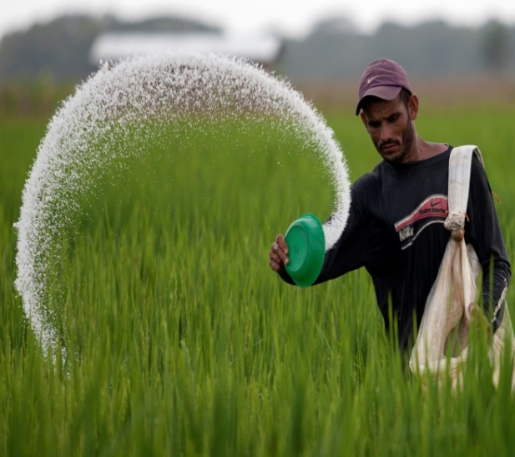
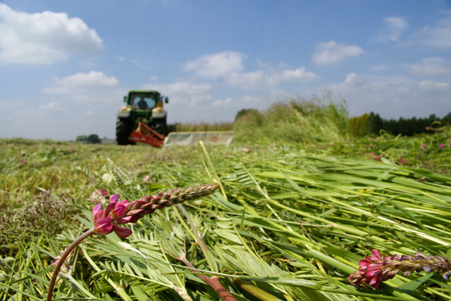
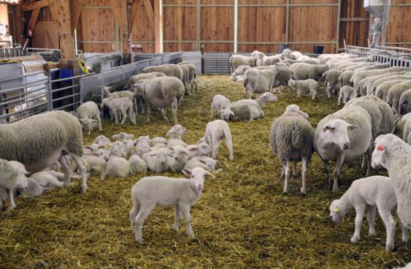
Benefits of legumes
Agronomy
Environment
High N content
Sustainable protein source
Fix atmospheric N
 Chemical fertilizers
Farm
 N self-sufficiency
Notes:
Among the forage resources, legumes is a locally available protein rich source for ruminant, representing an alternative for example to imported soya
They heve the advantage to fix atmosferic N from the atmosfere limiting the use of chemical fertilizer
At the animal level, their inclusion in diet have been observed to increase voluntary intake and animal performances

Slide 3
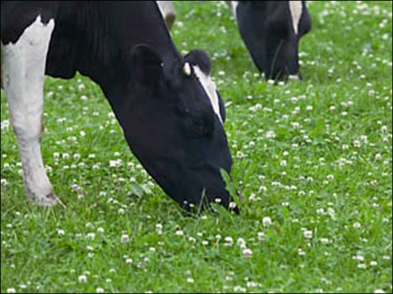
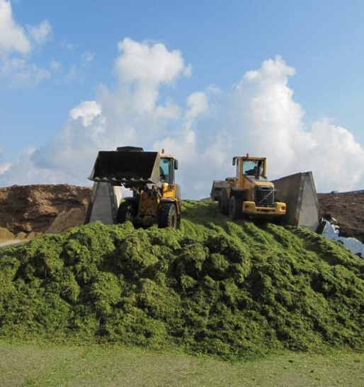
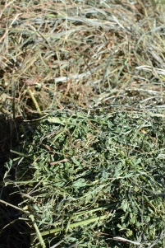



Utilization of fodder legumes
Grazing
Conservation
Hay preparation
Silage
Leaves losses
 Leaves losses
Animal nutrition
Unbalanced  N &  Energy
Grass – legume mixtures
10 / 09 / 2015
Notes:
However, one major weakness of fodder legumes for ruminant nutrition is their unbalanced contents in N and energy with an excess in N, leading to excessive protein degradation in the rumen and losses on the environment via the urine and faeces
Mixing grass and legumes then appears to be a good solution to rebalance energy and protein. In addition, previous studies have shown that forage mixtures can stimulate animal voluntary intake
Another issue concerns harvest and conservation. Compared to grass species, the hay making process of legumes is associated with important losses of leaves. Then a more adequate mode of legume conservation is silage, on which I have focused during my thesis work

Slide 4
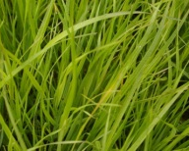
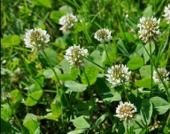
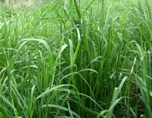
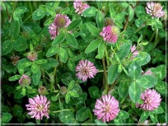
Benefits of grass-legume mixtures for animal
Daily intake of the digestible fraction (indicator of performances)
Ryegrass / white clover (fresh)
Cocksfoot / red clover (silage)
a
ab
ab
a
a
ab
b
ab
+10 %
b
c
Linear effect (P<0.001)
Quadratic effect (P < 0.001)
Niderkorn et al., 2014
Notes:
Mixing grass and legumes then appears to be a good solution to rebalance energy and protein. In addition, previous studies have shown that forage mixtures can stimulate animal voluntary intake
Another issue concerns harvest and conservation. Compared to grass species, the hay making process of legumes is associated with important losses of leaves. Then a more adequate mode of legume conservation is silage, on which I have focused during my thesis work

Slide 5
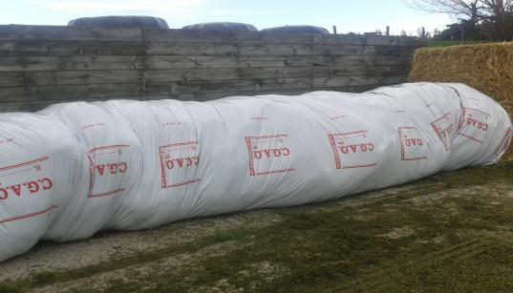






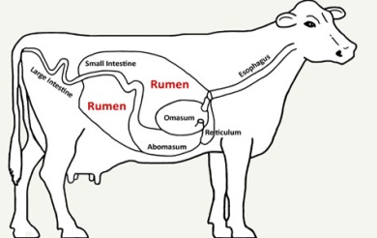
Protein degradation during fermentation in silage and rumen
Plant Proteases
Proteolytic micro organisms
Peptides
Proteins
Amino Acids
Bioactive

Legumes
Free
Amino Acids
Ammonia

Condensed tannins
Polyphenol oxydase
Notes:
To optimize the silage quality and conservation, it is crucial to ensure a intense lactic fermentation and a low protein degradation to ensure a better nutritive value and prevent N losses.
Protein degradation in silage is due to the action of plant protease and proteolytic microorganisms that solubilize the protein into free amino acids and ammonia .
Some legumes contain secondary compounds able to bind protein, thereby preserving their degradation in the silos and thus decreasing the concentrations of aminoacids and ammonia in the silage
On current knowledge, the most active secondary compounds in legumes to bind protein are condensed tannins and polyphenol oxydase. The thesis will focus on these 2 compounds.

Slide 6

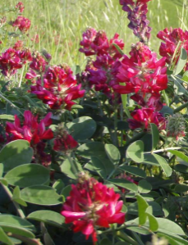
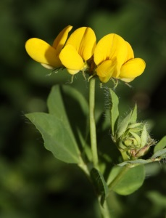
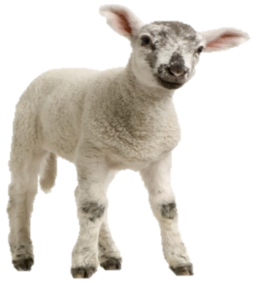
Condensed tannins (CT)
CT-Protein complex
Active in the silo and the rumen
 Urinary N
 CH₄
+
Anthelmintic effect
Theodoridou et al. 2010, 2011, 2012; Hoste et al., 2012;
Min et al., 2003; Paolini et al., 2003
Notes:
Condensed tannins are phenolic compounds forming complexes with protein by hydrogen bonding in a pH depending manner. Protein complexes are formed at near neutral pH and can dissociate at very low or very high pH
Thus they are expected to be active during ensiling process and in the rumen environment. Subsequently in the animal, the literature suggest that the complexes would be dissociated in the abomasum due to the very low pH leading to a better N utilization in the intestine and lower urinary N excretion (> mettre sur diapo)
Additionally, condensed tannins have been shown to have anthelmintic proprierties, especially against gastrointestinal nematods in small ruminants. They are also suspected to be reduce methane emissions but the mode of action is not well understood yet
Condensed tannins are present in several legume species such as Sainfoin, Lotus and sulla. In this thesis, we have chosen sainfoin as it grows in temperate conditions and are well consumed by herbivores
(réorganiser la diapo surr la base du texte)

Slide 7
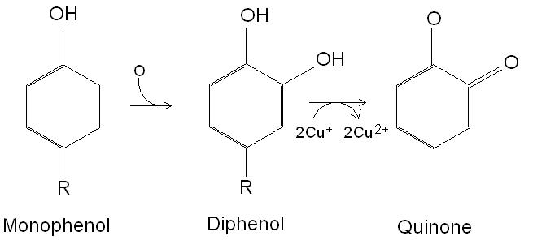
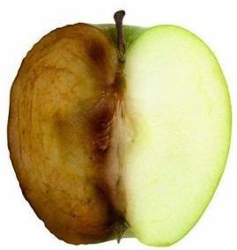

Polyphenol oxydase (PPO)
Phenols
Quinone
Quinones are highly reactive to bind protein
The enzyme works in presence of O₂
Silage has the right requirements
Red clover
Lee et al., 2009, 2012
 Proteolysis
 N use efficiency
Notes:
An other bioactive compounds of interest is PPO
PPO present is an enzyme that catalyse the oxidation of forage phenols into quinones (visible as brown colour when we cut an apple) that are , as condensed tannins, able to bind protein preserve their proteolysis in the silo and rumen and increase N use efficiency.
PPO is present in plant cloroplasts and its action necesitates its release, the contact with phenols present in plant vacuoles and the presence of oxygen. This especially occurs during ensiling process when plants are chopped in small length pieces causing cellular damage and before completion of anaerobiosis in the silo
Among the forage legumes, PPO is especially present in red clover which will be the second legume species used in this work

Slide 8
Main results obtained in LegumePlus

Slide 9
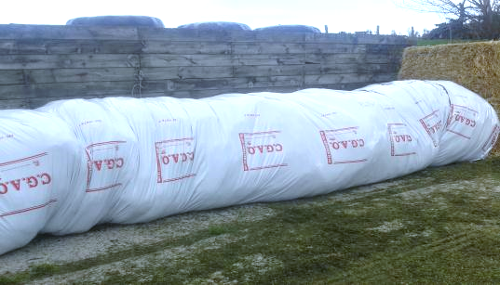
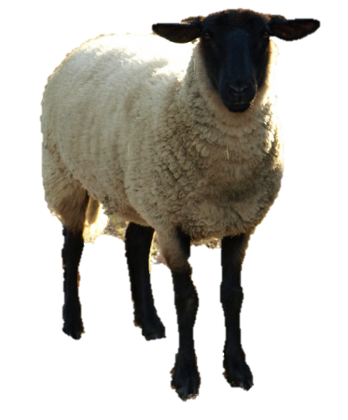
Thesis objective
To evaluate and understand the benefits of mixing bioactive legumes with grass as silages for sheep nutrition and the environment
 Silage fermentation
 Protein degradation
Hypotheses
 N use efficiency
 Animal performance
 Pollutant emissions
Notes:
My thesis objective is To evaluate and understand the benefits of mixing bioactive legumes (SF and or RC) with grass as silages for sheep nutrition and the environment
My main hypothesis are that including bioactive legumes in silage will at the silage level, increase lactic fermentation and decrease protein degradation, and at the animal level increase N use efficiency, animal performances and reduce polluant emission

Slide 10
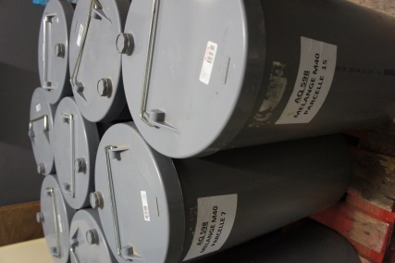
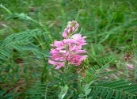
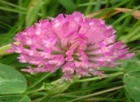
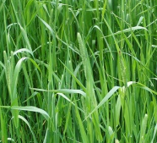
Plant material and treatments
In vitro
18 small scale silos
SF – Sainfoin
Onobrychis viciifolia
Ensiled at the same targeted DM ~ 30%
Early flowering stage
Treatments | T (%) | SF (%) | RC (%)
T | 100
SF |  | 100
RC |  |  | 100
T-SF | 50 | 50
T-RC | 50 |  | 50
T-SF-RC | 50 | 25 | 25
RC – Red Clover
Trifolium pratense
Early flowering stage
Silage quality
Fermentation
Protein degradation
T – Timothy
Phleum pratense
End of ear emergence
Notes:
(expliquer pourquoi choix fléole: bonne companion grass for SF)
Plant material used in my work are
SAINFOIN latin name witch contain CT
RED CLOVER …PPO
All legumes were harvest at …
T … as control harvest at …
From now and during all the presentation i’ll use the same colour code and abbreviation for the differents species
All the plant were ensiled at around 30% (suggested as good values of DM for good silage)
The table show all the treatment used during the differents trial….

Slide 11
Silage quality - Acidification
pH values
Lactic acid content (g/kg DM)
a
a
ab
ab
b
b
ab
ab
Bioactive Legumes
b
b
bc
c
Better acidification
Copani et al., 2014
pH
All silages including SF or RC: pH around 4.5
as requested for good silage quality
Better lactic fermentation when SF or RC in silage
 Lactic acid
T: Timothy; SF: Sainfoin; RC: Red clover
Notes:
All silages were made without addition of any kind of inoculants or preservatives. In the pure grass silage, this resulted in a poorer fermentation as demonstrated by higher values of pH, and by lower lactic acid concentration compared with silos containing SF or RC, that have low ph values and high lactic acid content.
pH around 4.5 is requested in silages to reduce proteolytic activity and other undesirable reactions
Lactic acid stabilizes the silage and can be used as an energy source by rumen bacteria and the ruminant animal (Counotte and Prins, 1981).
(anticiper une question sur ce que sont les résultats avec une légumineuse non bioactive = ref ensilage luzerne à chercher)

Slide 12

Silage quality - Protein degradation
Soluble N (% total N)
NH₃ (% total N)
a
a
Low quality
Bioactive Legumes
bc
b
ab
c
bc
bc
b
ab
b
b
+
RC: better protein protection
High quality
Copani et al., 2014
T: Timothy; SF: Sainfoin; RC: Red clover
1.1 Silage quality
Notes:
Soluble N content in the silo is an indicator of proteolysis and is low for good quality silage. In this study, soluble N content was higher in T than in all other experimental silages involving SF or RC
Additionally, the fact that NH3 content did not exceed 10% in all the silos containing RC, indicates that RC facilitated the preservation of proteins from degradation in the silo compare to grass silage
RC appears be more effective than SF to preserve silage from protein degradation
These results suggest that PPO might be more efficient than CT (inclure discussion sur luzerne pour renforcer le role potentiel des composés)

Slide 13
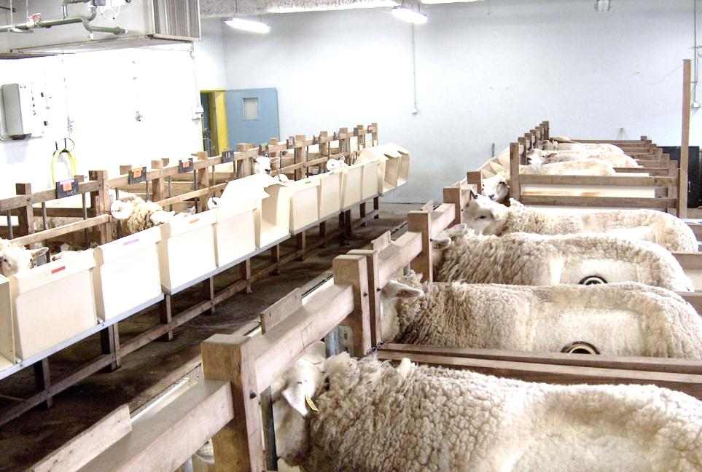
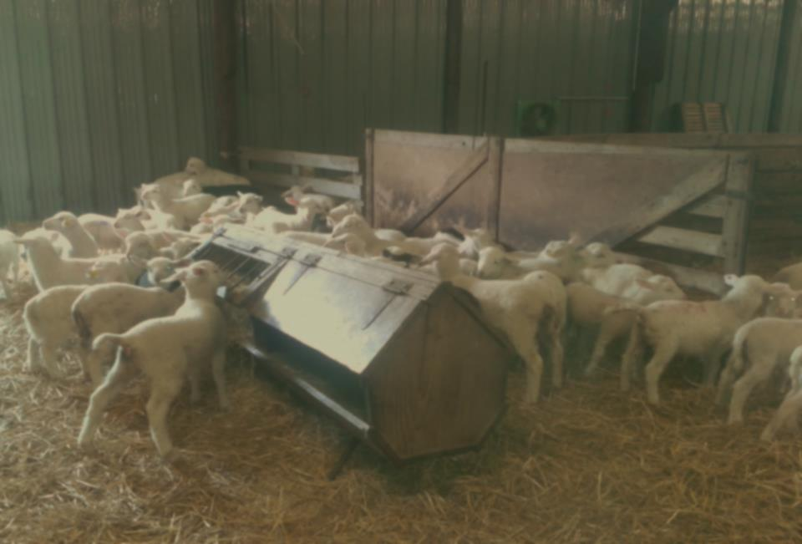
In vivo trials
Treatments | T (%) | SF (%) | RC (%)
T | 100
T-SF | 50 | 50
T-RC | 50 |  | 50
T-SF-RC | 50 | 25 | 25
SF-RC |  | 50 | 50
5 large scale silos
Digestion
Performances
10 young sheep
Repeated latin square design
10 weeks
8 growing lambs/ treatment
10 weeks
Individual intake
Body weight
Carcass weight
Digestibility and N balance
CH₄ emission (SF6 technique)

Slide 14
Organic matter digestibility
a
ab
bc
bc
c
T: Timothy; SF: Sainfoin; RC: Red clover
Inclusion of SF reduces OM and fibre digestibility compared to pure T
2.1 Digestion
Notes:
C’est bien mais bien animer cette diapo en réduisant les graphes après les avoir présenté pour ne pas surcharger
Mixtures containing both SF and RC were more ingested than pure T
Inclusion of SF reduces OM and fibre digestibility compare to pure T, in a dose dependent manner especially on NDF and ADF digestibility.
Confirmation de la moindre dégradabilité du SF observée in vitro
Pour expliquer le fait que l’ingestion ne suit pas la digestibilité > autres facteurs qui interviennent (facteurs sensoriels: on retrouve les résultats biblio (meilleur ingestion quand mélange par rapport à Graminée pure, ici + xxx%), notamment lorsque les 2 légumineuses sont présentes
(2 diapos pout tout ca ?)

Slide 15
N balance
N faeces and urine, g/g N intake
T-SF:
Pattern of N excretion directed towards faeces
a
ab
ab
b
b
Indicates that the CT-protein complexes are not totally dissociated post ruminally
(Theodoridou et al., 2012)
T: Timothy; SF: Sainfoin; RC: Red clover
2.1 Digestion
Notes:
Griser T-SF-RC et SF-RC sur le graphe des profils urine/feces
Réduire taille figure de droite
Indicate that complexe CT-protein not totally dissociated post ruminally (Ref Theodoridou)

Slide 16
CH₄ emission
 | T |  |  | T-SF |  |  | T-SF-RC |  |  | T-RC |  |  | SF-RC
CH₄, g/kg DM intake | 35.7 | a |  | 29.7 | b |  | 29.3 | b |  | 30.5 | ab |  | 27.2 | b
All the mixtures including SF led to the lowest CH₄ emission than pure T
The slight difference is probably due to CT-complexation with proteins in the silos (less available in the rumen)
2.1 Digestion
Notes:
Although differences in CH4 yield were close between T-SF and T-RC, it can be noticed that all the mixyures including SF were those led to the lowest CH4 emission which were significantly lower than pure T
Meme sens que tendance obseve in vitro mais a nouveau avec une amplitude modérée des différences qui pourrait être du à la concetration modérée de CT ou à leur complexation avec les protéines dans le silo (à mettre sur la diapo)

Slide 17
Animal performances
Silage intake (g/DM)
b
b
b
a
All silages containing RC were better ingested
a
T: Timothy; SF: Sainfoin; RC: Red clover
Fibre content and lower digestibility of SF may have impaired animal intake
2.2 Performances
Notes:
A la réflexion, mettre un graph avec barres sur moy ingestion (p81 l.3) car + facile à comparer avec autres graphs
Harmoniser les unités avec des ‘/’ dans tout le diaporama (au lieu de .⁻¹)
When we look at daily intakes, it appears that all T-RC containing silage induced greater intakes, notably when compared to T-SF, the gret diff between T-Sf and T-RC can be partly due to differences in silages chemical composition: T-Sf lower CP and higher NDF and ADF contents than T-RC, but also to difference in digestibility (especially of N and fibers, lower in T-SF)
These differences in digestibility could explain the differences in intake we observed between the 2 in vivo trials: in the digestion trial, sheep ingested similarly T-SF and T-RC but the length of the feeding periods were far shorter (2 wks) than those in the performance trial (10 weeks)
This would mean than despite its recognized high palatability, the low digestibility of SF may impair animal intake then peformance on the long term,

Slide 18

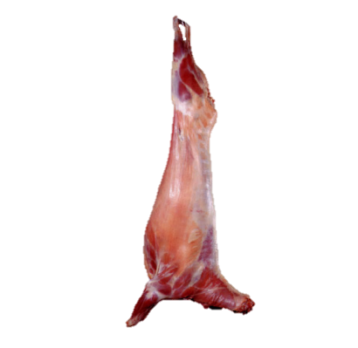
Animal performances
All RC-including silages:
better growth than T-SF and T
Live weight (kg)
Standard error of the model
Extreme average daily gains observed for T-RC (235 g/d) and T-SF (145 g/d) (P=0.001)
These differences were reflected in carcass weights (T-RC: 20,5 vs T-SF: 17,2 kg) (P=0.001)
Diet P=0.0025
Diet*Weeks P<=0.0001
Weeks
Copani et al., 2015b
T: Timothy; SF: Sainfoin; RC: Red clover
2.2 Performances
Notes:
Mettre la légende de chaque courbe à la fin et en couleur
How these differences in growth rate can be explained ?

Slide 19
Take home messages
Bioactive Legumes
 Protein degradation
=
Good Silage
+
 Silage Fermentation
RC appears to be more effective than SF
Notes:
compared to T Bioactive legumes allow improvement of silage fermentation, reduction of protein degradation in the silo and tend to produce the same effect in the rumen environment
RC better than SF
SF less degraded …

Slide 20

Take home messages
Inclusion of SF reduces OM and fibre digestibility compared to pure T
T-SF vs T and T-RC
Pattern of N excretion directed towards faeces
CH₄ emission
SF-containing silages led to the lowest CH₄ emission, significantly lower than pure T
Performances
All RC-including silages: better intake and better growth than T-SF and T
Notes:
On a rajouté une diapo « take home message » pour faire comme dans l’in vitro
On a rassemblé les principaux résultats: on te laisse faire la mise en forme et le texte

Slide 21
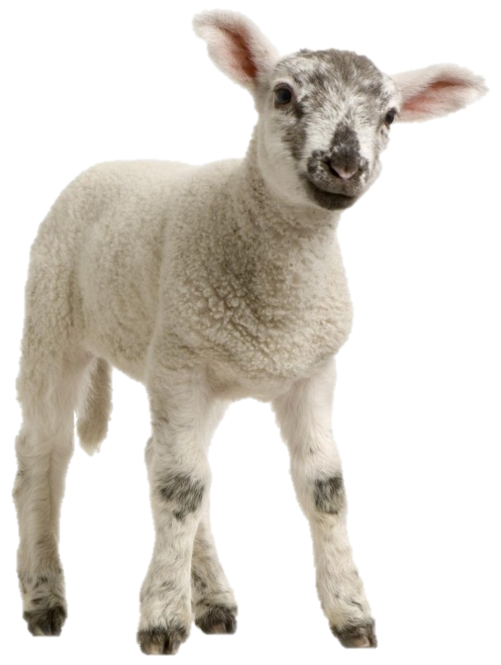
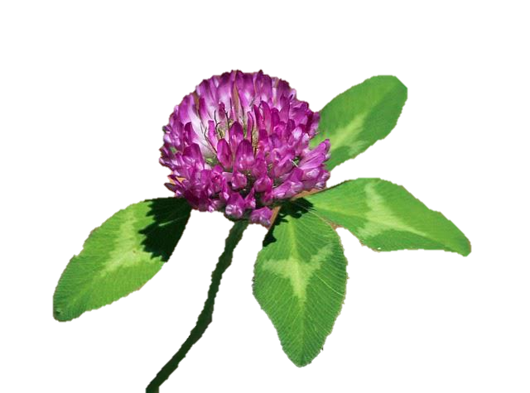
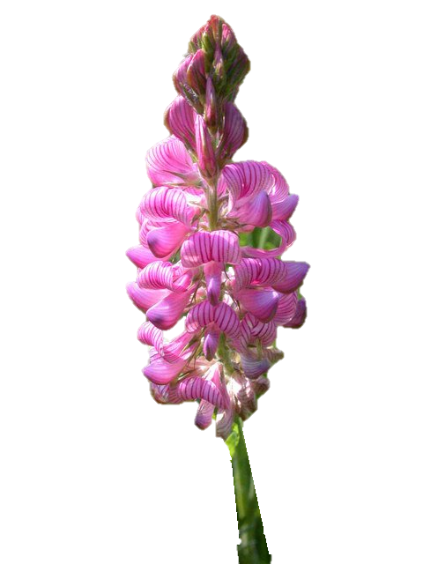
Thank you for your attention

