Slide 1
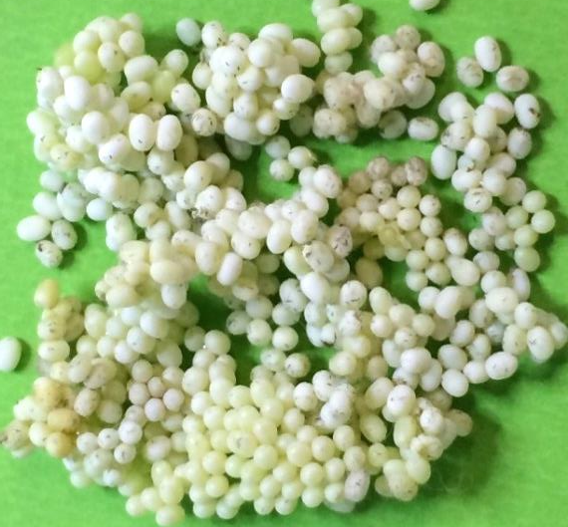
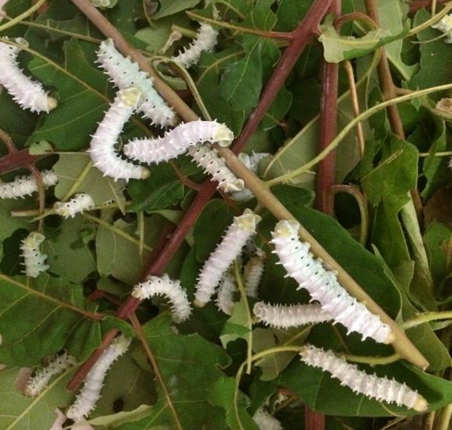
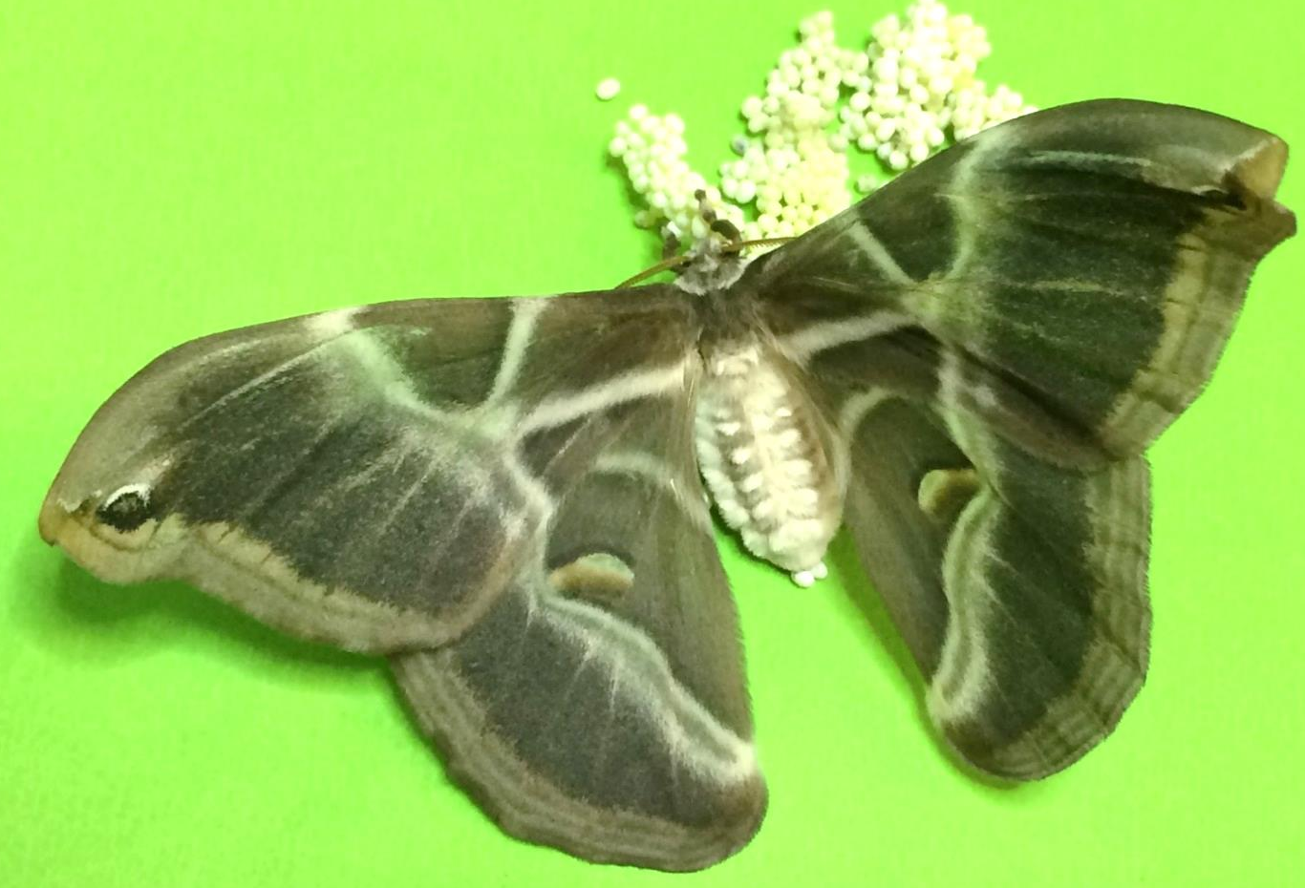
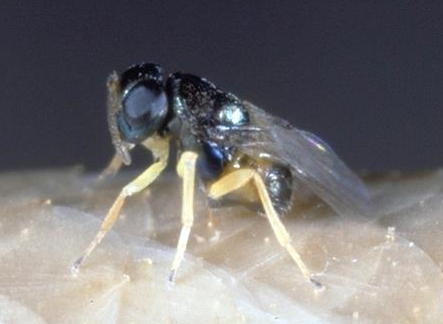
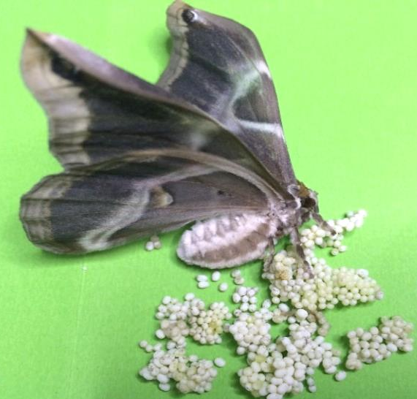
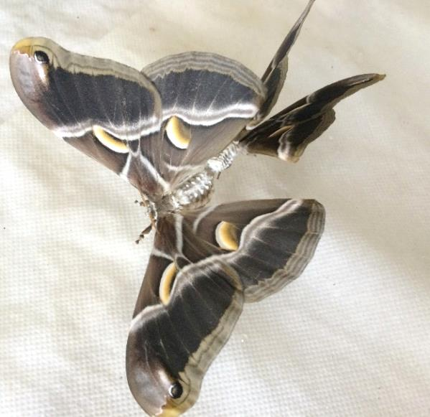
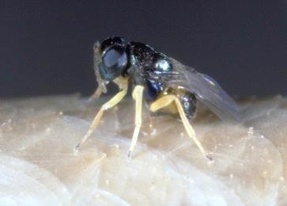
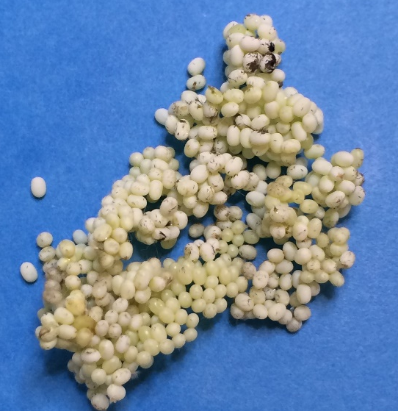
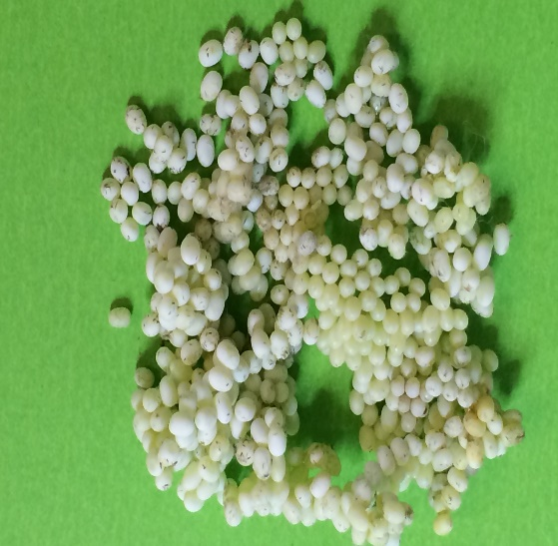
XVIII. International Plant Protection Congress
Performances study of Ooencyrtus pityocampae (Mercet) (Hymenoptera: Encyrtidae) on the new factitious host Philosamia ricini (Danovan) (Lepidoptera: Saturniidae) to optimize its rearing
Hilal Tunca¹, Etty-Ambre Colombel², Maurane Buradino²
Fiona Gaglio², Elisabeth Tabone²
¹Ankara University, Agriculture Faculty, Department of Plant Protection ,06110, Dışkapı, Ankara, Turkey e-mail: htunca@ankara.edu.tr
²INRA-UEFM Site Villa Thuret, Laboratoire BioControle, 90 Chemin Raymond, 06160, Antibes, France
Introduction: Pine processionary is the most damaging pest of pine trees in the Mediterranean region. Ooencyrtus pityocampae is an egg parasitoid of the pine processionary. Studies were conducted to assess the biological parameters of this parasitoid on the new factitious host Philosamia ricini under laboratory conditions (25°C ±1, R H 65±5% and with a L:D 16:8 h photoperiod).
Material and Methods:
a) The host Philosamia ricini b) The parasitoid Ooencyrtus pityocampae
c) Experimental procedure
✔ Emergence rate
✔ Development time
Parasitoid age
(1, 3, 5 days)
Parasitoid number
(1 or 2 females)
Host age
(1-2 or 3-4 days)
Host number
(50, 60, 80, 100 eggs)
✔ Longevity
Results:
✔ Effective-economic rearing of parasitoid
1-2 days
3-4 days
✔ Emergence rate
✔ Development time
%84.10
%60.20
23 days
✔ Longevity
46 days
Conclusion: Mass rearing of parasitoids is an essential step for biological control programs. Based on the results of this study, Philosamia ricini is an appropriate host species for the mass rearing of Ooencyrtus pityocampae.

