Slide 1

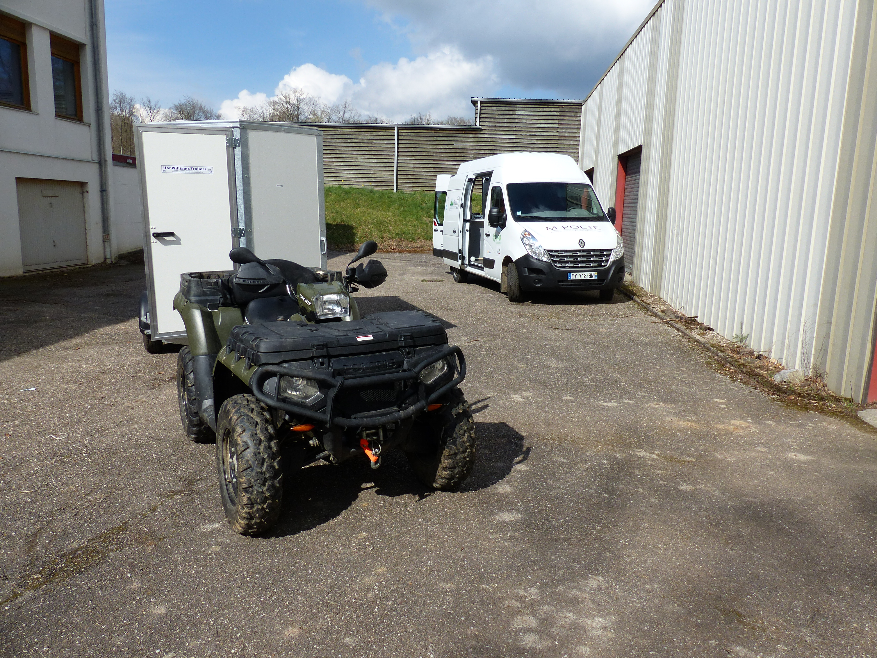
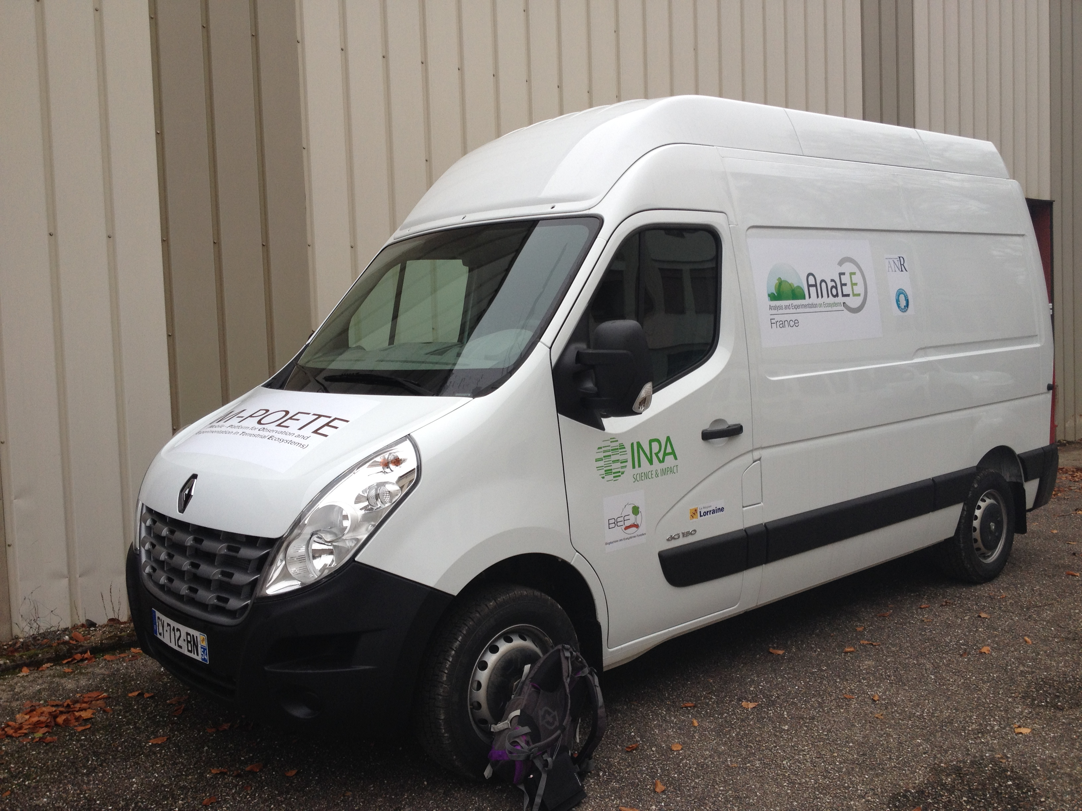









M-POETE, A Mobile-Platform for the Observation and the Experimentation in Terrestrial Ecosystems
Zeller B., Saint-André L.., Bienaimé S., Murat C., Constant T., Bonne F., Longdoz B., Klump K.

Slide 2

Context and Challenges
Why such a platform?
Generalize observed findings (example nitrification) from a well equipped site using a network of sites (network approach, variation of soil parameters, climate…..)
Need for new networks or combination of networks (territory approach) with respect to specific scientific questions or to respond to a demand of society, decision maker or end users.
60
2
88
25
26
30
RENECOFOR (102 permanent plots, here shown the beech plots)

Slide 3
Context and Challenges
Challenges
Field site or network
Basic measurements
Lab mobile (specific campaigns, “hotspots”, “hot – moments”
Improvement of knowledge and multi-disciplinary approach

Slide 4
Missions
Mobile Laboratory Units Missions:
Characterize terrestrial ecosystems (vegetation, soils, climate)
Provide a backbone for measurement campaigns (short –term fluxes, special events, access to non stable molecules……)
Research and development of in situ techniques and high frequent and/or non destructive measures (instant fluxes, fragile non stable samples, preservation of samples)
Mobile Laboratory Units Dutys:
Mobile laboratory provides basic equipment for field based measurements in numerous terrestrial ecosystems.
Modularity for targeted campaigns
Can host specific equipments provided by the applying research teams

Slide 5
Equipment details
Characterize terrestrial ecosystems
Mobile lab provides adaptable infrastructure (lab mobile, Polaris, trailer) to set up well designed field based measurements.
The whole is highly mobile and needs few time to move from site to site.
Use of the “Polaris” optimize transport time between sampling sites and analysis base, improve the transport of equipment.
Basic equipment:
    Common toolbox: high precision GPS, meteorological devices
    Soil toolbox: Soil corers, humidity probes, sieves, soil physics toolbox,.. Vegetation toolbox: tree height, diameter, LAI, T-LIDAR,…
    Microbial toolbox: sample preparation tools (sampling, isolation, grinding)

Slide 6
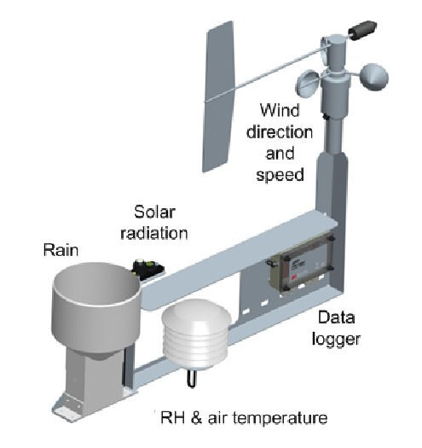
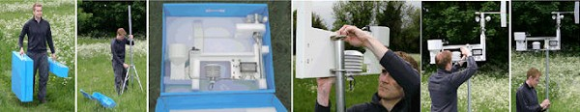
Equipment details
Provide a backbone for measurement campaigns (short –term fluxes, special events, access to non stable molecules……)
Lab mobile and trailer(s) equipped with on board analyzers (NIRS – MIRS, PICARRO….) or sample preservers (lyophilisation, liquid N2) to support multi-disciplinary research.
Improves the temporal and spatial resolution of field based measurements, further used to evaluate the effects of short term events (hot moments & hot spots).

Slide 7
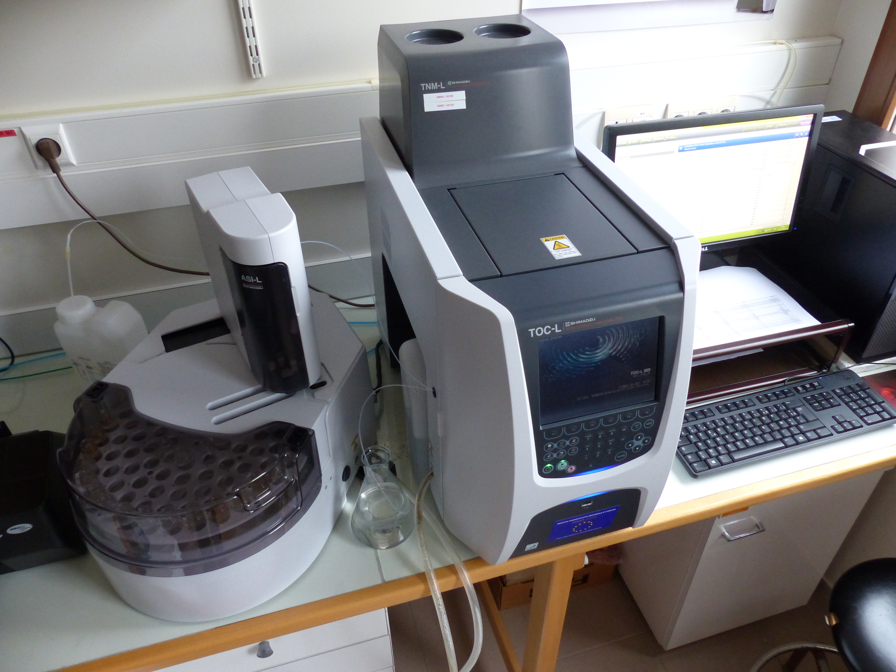
Equipment details
Research and development of in situ techniques and high frequent and/or non destructive measures (instant fluxes, fragile non stable samples, preservation of samples)
Characterization of solid and liquid samples (NIRS – MIRS, 18O and 2H analyzer)
Characterization of the vegetation DRONE (Lidar, Muti-channel cameras, Infrared camera,..)
Microbiology = preservation of samples or in situ treatments of samples (extraction of DNA, qPCR)

Slide 8
Access
Open platform from the national infrastructure ANAEE-Fr
Applications soon available on the ANAEE-Fr website
You are very welcome !!!!!

