Slide 1
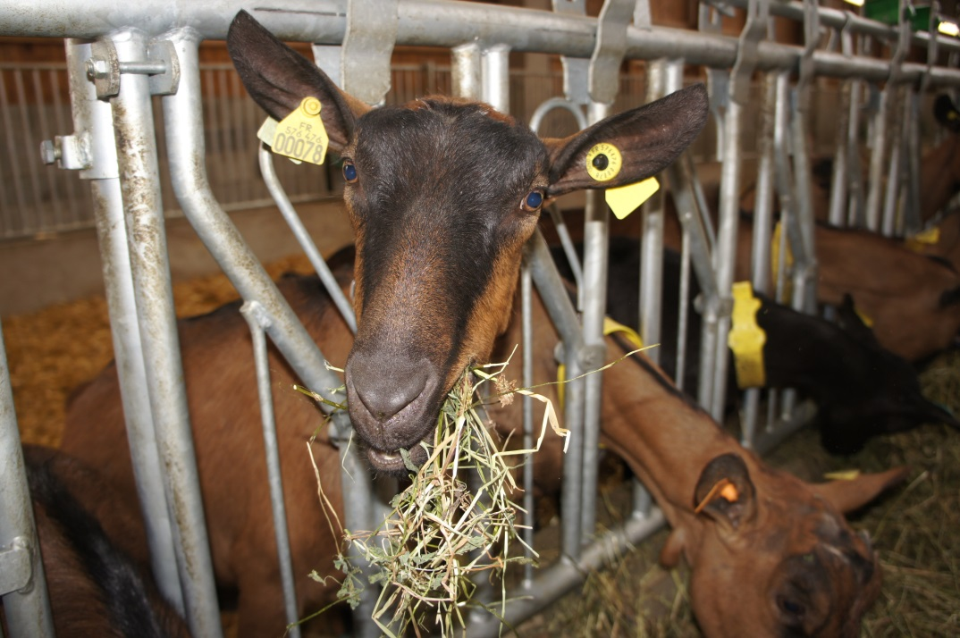
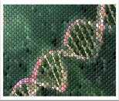
Toward genomic selection in French dairy goats
Céline Carillier
Christèle Robert-Granié.
Hélène Larroque
INRA-GenPhySE. Toulouse. France
PAG XXIII. IGGC. January 12th 2015. San Diego. USA
SELGEN

Slide 2
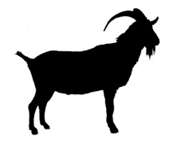
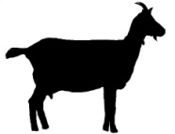
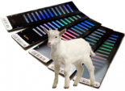
Classical breeding scheme in French Saanen and Alpine
5.5 years
40 Alpine
30 Saanens
100 daughters with performances
bucks progeny tested/year
170 young bucks in AI center
Parent average accuracy= 0.38
40 AI bucks
1000 matings
20% AI
commercial flocks
2011

Slide 3
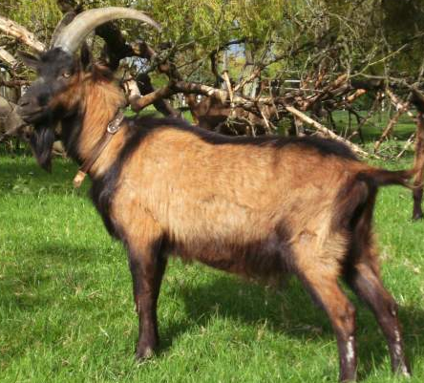
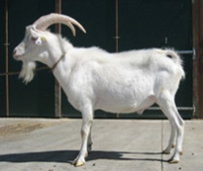
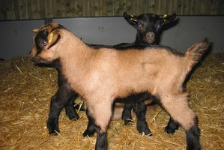
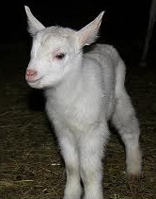
The French dairy goat population: small size, 2 breeds
46 959 SNP after quality control
1993
2009
reference population
677
all progeny tested since 1993
training set
425
232 Alpines
193 Saanens
2005
validation set
252
152 Alpines
100 Saanens
candidates
148
not progeny tested yet
2010
2011
87 Alpines
61 Saanens

Slide 4
Genotype population structure
Notes:
La population: les pop génotypées dep du schéma précision jeunes mâles d’IA avec bcp de filles
La st : apparentemnt consanguinité. DL

Slide 5
Low average linkage disequilibrium between SNP in dairy goats
0.23
0.17
(825)
0.14
(470)
(355)
0.08
0.03
- 0.02

Slide 6
Good genetic diversity in Alpine and Saanen breeds
 |  | Alpine | Saanen | Multi-breed
inbreeding | reference population | 1.8 | 2.3 | 2.1
kinship | between reference and candidates | 1.1 | 2.4 | 0.7
high genetic diversity compare to dairy cattle or Lacaune dairy sheep
Low LD between 2 SNP
Low relationship between candidate and reference populations for Alpine
➔ Difficulties for genomic prediction

Slide 7
Alpine and Saanen two different breeds according to persistence of LD
0.8
Blond faced Manech – black faced Manech
Blond faced Manech - Lacaune
Alpine - Saanen
0.4
0.2
0.08
600

Slide 8
Alpine genomic structure different from Saanen one
Allele frequency correlation between Saanen and Alpine breeds:
Males: | 0.69
Females: | 0.85
Low persistence of LD between Alpine and Saanen
Low correlation between allele frequencies
➔ Alpine and Saanen = two different breeds
PCA on genotypes, factor = breed
Axis 1 and 2

Slide 9
Genomic selection
Notes:
La population: les pop génotypées dep du schéma précision jeunes mâles d’IA avec bcp de filles
La st : apparentemnt consanguinité. DL

Slide 10
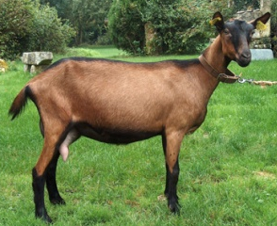
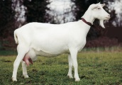
Per-breed vs multi-breed genomic selection
Multi-breed
Per-breed
Alpine
pedigree
+
1.5 million animals
+
+
pedigree
+
3 million animals
384
GBLUP
4 million performances
677
7.4 million performances
GEBV
GBLUP
Saanen
pedigree
+
1.5 million animals
+
GEBV
293
GBLUP
3 million performances
GEBV
GEBV= genomic estimated breeding value

Slide 11
Evaluation of prediction quality of genomic selection
In 2008
In 2013
677 genotypes
a
384 Alpine 293 Saanen
1993 to 2009
performances
performances
pedigree
pedigree
BLUP
GBLUP
GEBV
252 without daughter
2006 to 2009
DYD
2006 to 2009
correlation ( DYD, GEBV) =
Prediction accuracy
252
100 Saanen and 152 Alpine
GEBV= genomic estimated breeding value
DYD=daughter yield deviation
Notes:
Y= 1st where females of the yougest males from training population were born

Slide 12
Similar prediction accuracies whatever the model used
Lacaune dairy sheep and Montbéliarde dairy cattle: 0.47 on milk yield

Slide 13
A way to estimate feasibility of genomic selection
Female performances in 2013
reference population (677 bucks: 1993 to 2009)
genotypes
GBLUP
candidates
(148 young males: 2010 to 2011)
GEBV
PEV
genotypes
if genomic accuracy > parent average accuracy
➔ genomic selection feasible
GEBV= genomic estimated breeding value
PEV=prediction error variance
Notes:
Y= 1st where females of the yougest males from training population were born

Slide 14
Genomic accuracy of candidates exceeds parent average one

Slide 15
Genomic selection with single-step is feasible in goats
population
677 genotyped and phenotyped
2 different breeds
high genetic diversity, low LD
Genomic evaluation*
prediction quality : - no difference between models
- not bad results with per-breed model
genomic accuracy > ascendance accuracy
genomic selection feasible
Prospects
- Evaluation of efficiency and cost of “genomic” breeding schemes (with breeding organism)
- Including major gene (casein, DGAT1) in genomic selection model
- Using other genomic tools: Low density bead chip (females)
High density bead chip (multi-breed)
Sequence data
* Carillier et al. 2014. Genetic Selection Evolution. 46:67.

