Slide 1



Designing soil monitoring schemes for large areas based on digital soil mapping products
Alex McBratney, Nicolas Saby,
Jaap de Gruijter, Budiman Minasny

Slide 2
DSM & Soil Monitoring
Digital soil maps have been produced at continental, country and regional extents.
These maps of soil properties along with their uncertainty can be used to establish strata for soil monitoring.

Slide 3
HOW?

Slide 4
Map of prediction of target variable

Slide 5

How to stratify?
Map of prediction of target variable
compact geographical stratification
K-means, minimise the mean of the shortest distance

Slide 6
How to stratify?
Map of prediction of target variable
compact geographical stratification
K-means, minimise the mean of the shortest distance
Minimise sampling variance
Cum √f method
(Dalenius and Hodges, 1959)

Slide 7
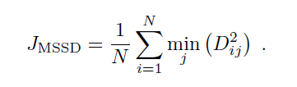
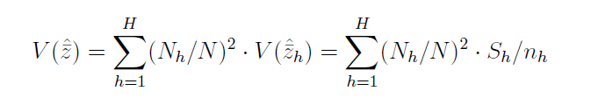
The two extremes
1. No prior information at all? (Brus et al. 2003)
2. No spatial context, assume implicitly that the predictions have only negligible errors,

Slide 8

Optimal stratification (Ospats)
Map of prediction of target variable & uncertainty
compact geographical stratification
OSPATS
Minimise sampling variance

Slide 9
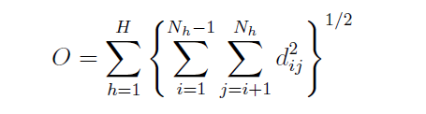



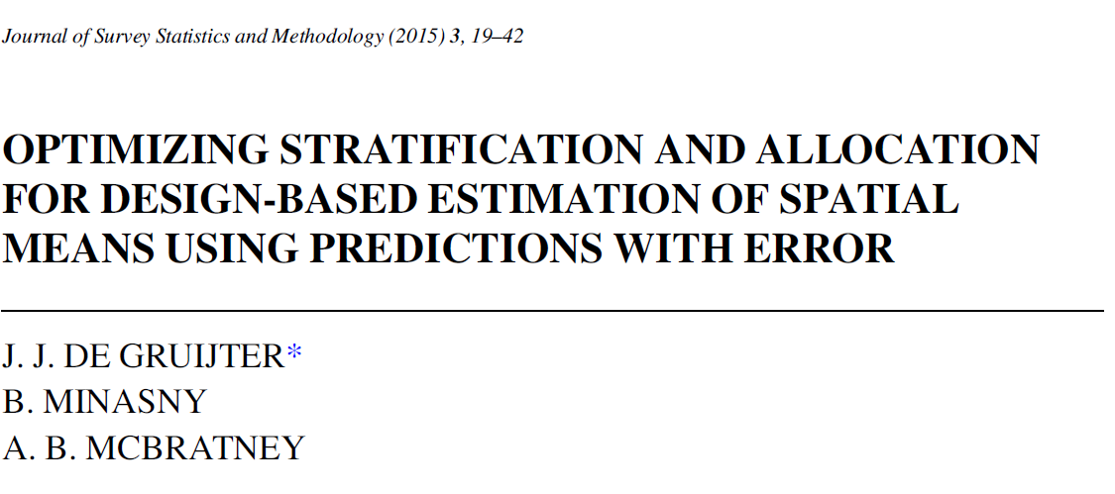
Optimal stratification (OSPATS) de Gruijter et al. 2015
Predictor

Slide 10
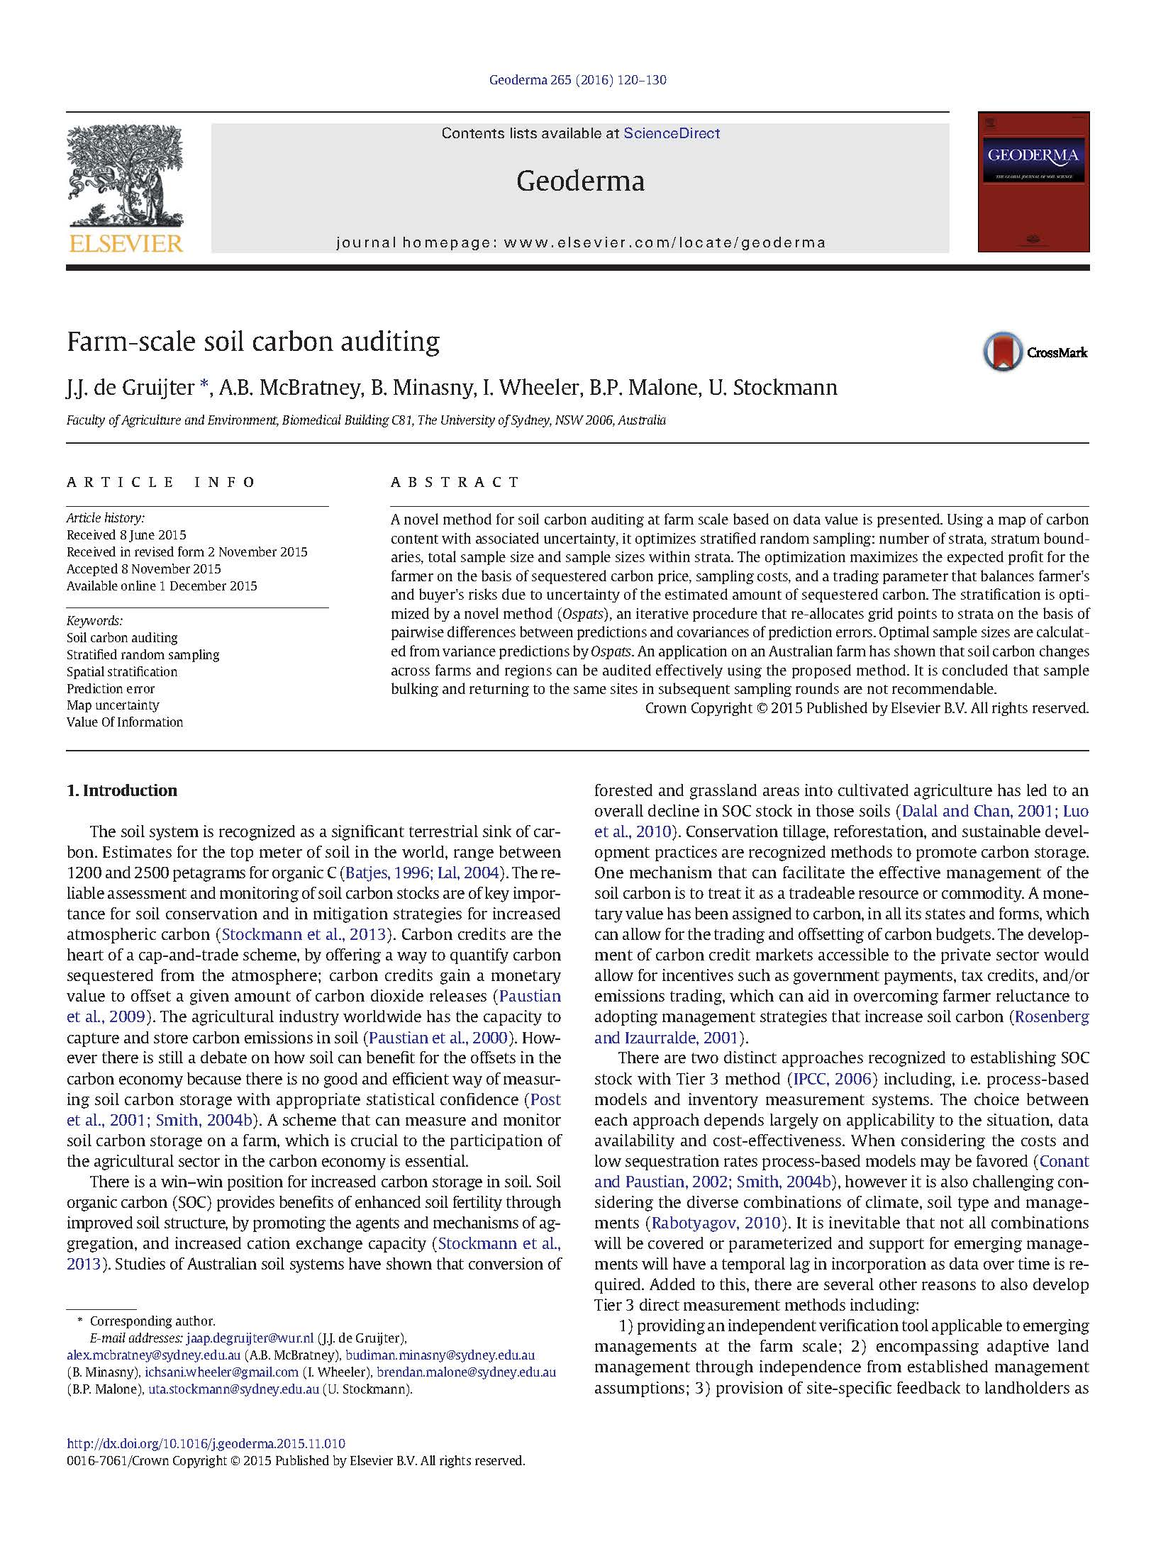
Designed for small extents
See talk by
Hedley et al.
for an example from
New Zealand

Slide 11
Applying it to a very large extent
Computationally expensive/challenging

Slide 12
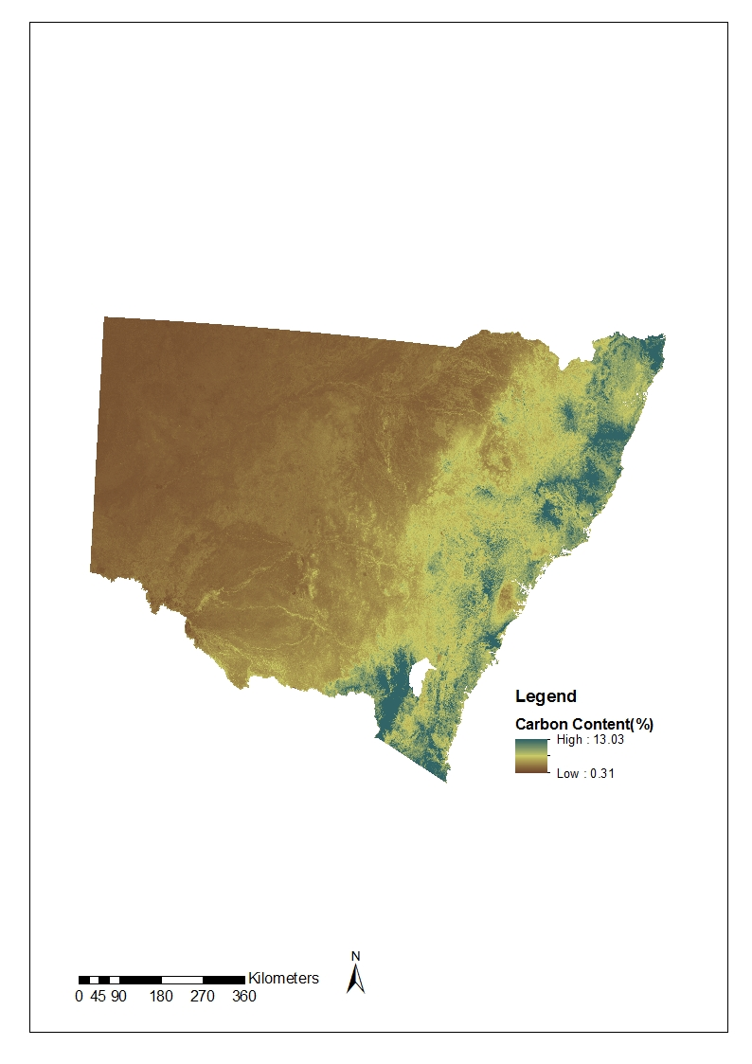
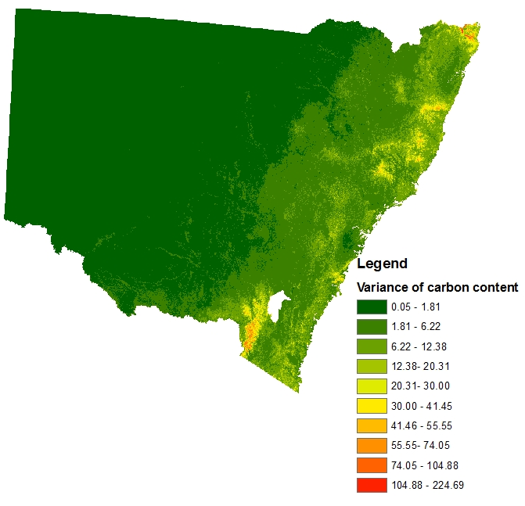
NSW, Australia
809,000 km²

Slide 13
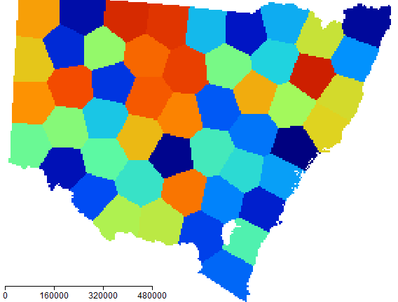
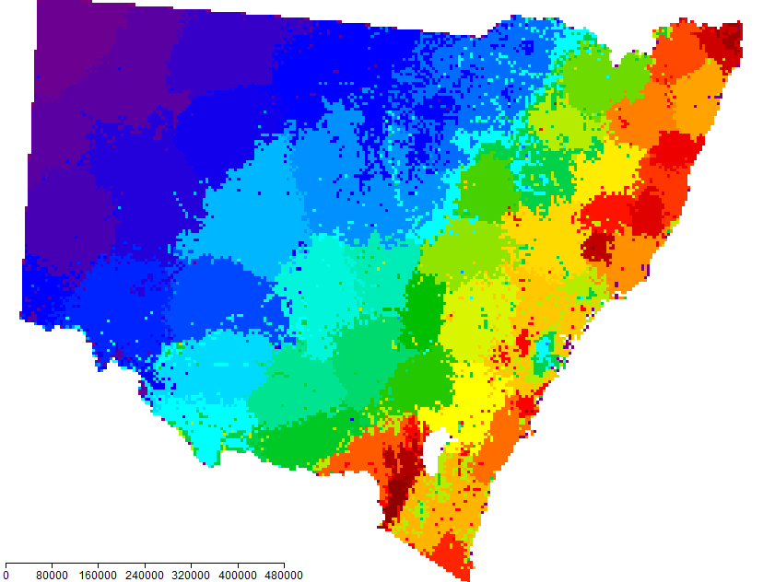
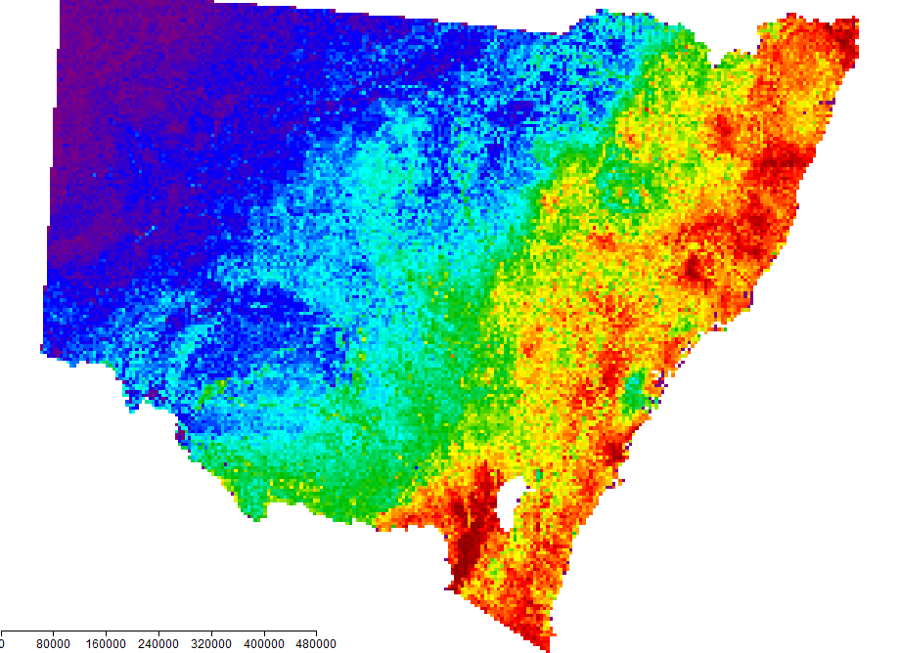
OSPATS
kmeans
OSPATS 50 strata
Cum_sqrt_f

Slide 14
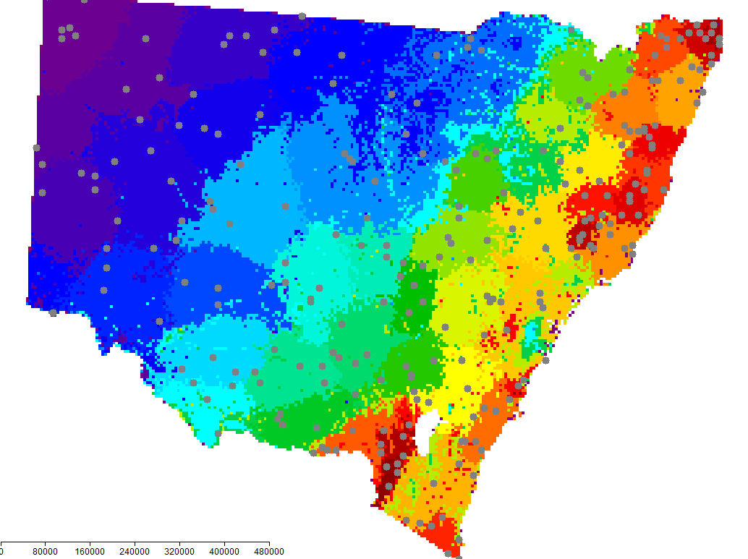
Sampling location

Slide 15
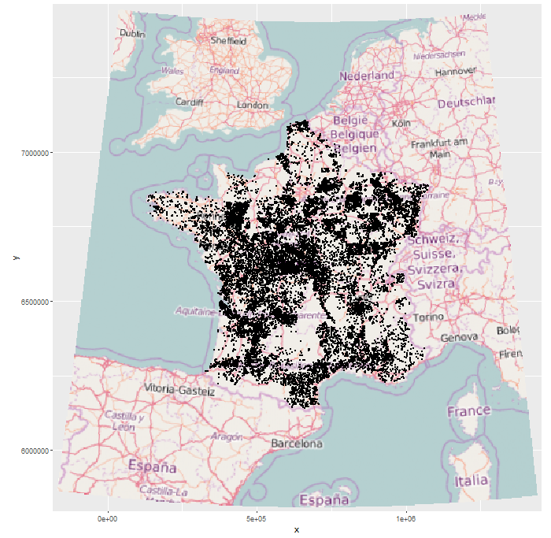
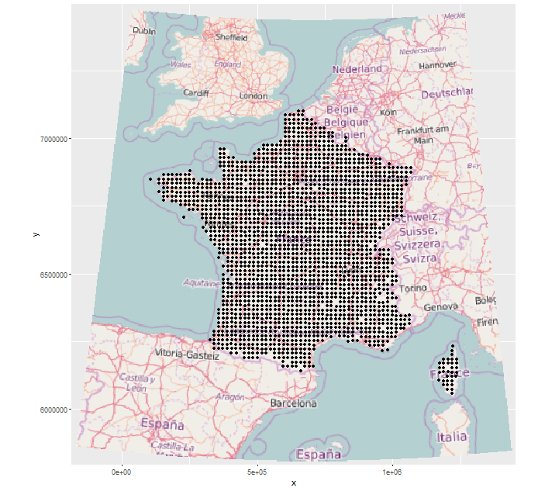
France
550,000 km²
Calibration data:
Legacy soil data
Validation data:
Soil Monitoring Network

Slide 16
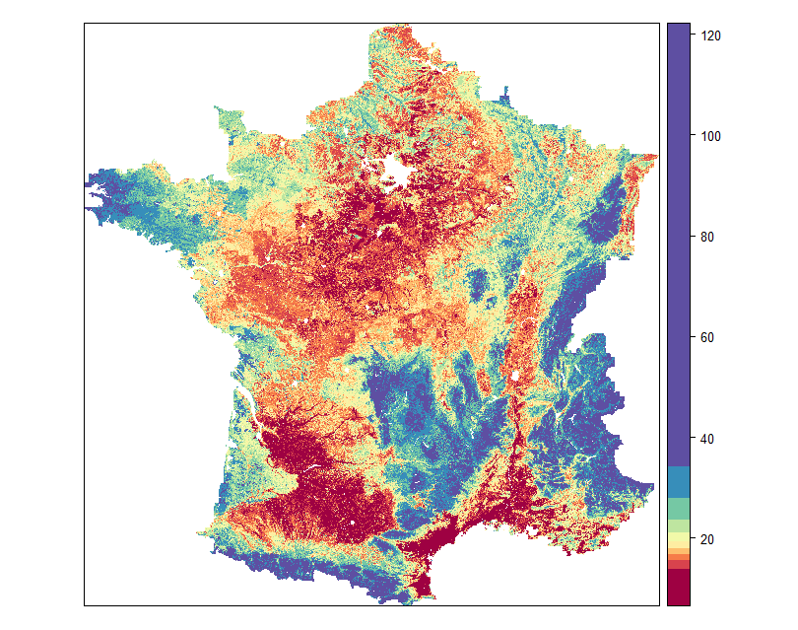
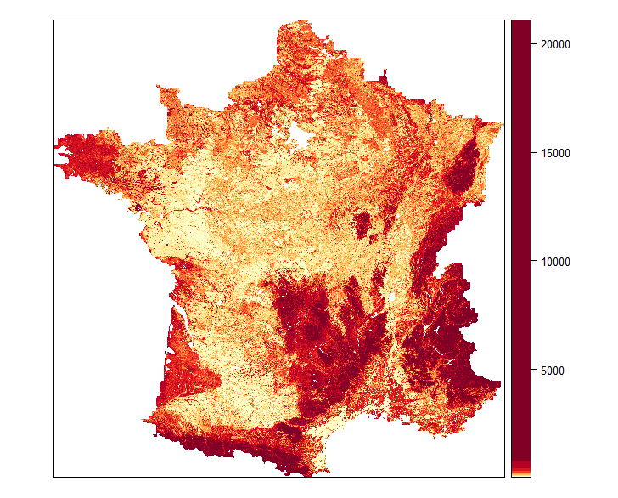
Map of topsoil (0-30 cm) C content
Prediction mean (using Quantile Random Forest)
Prediction variance
Independent Validation
R² = 0.32 RMSE = 17.52 g/kg

Slide 17
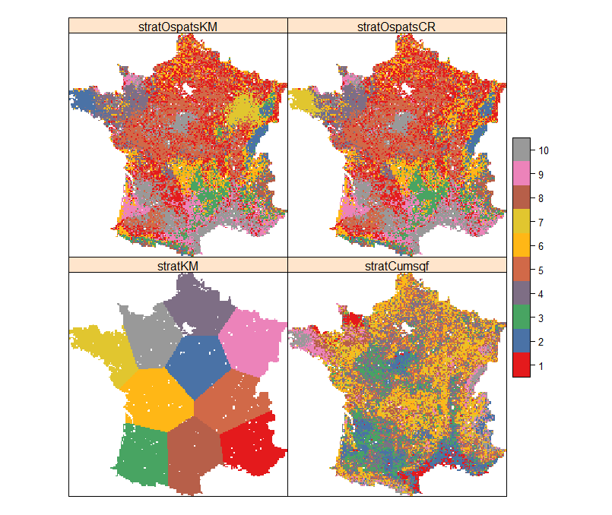
Stratifications
5km grid
10 strata
Needs annealing schedule
Sologne
Jura
Massif Central

Slide 18
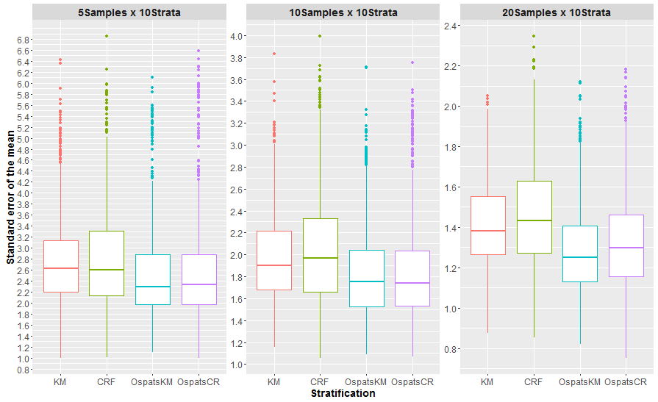
Standard error of the mean of C content in g/kg

Slide 19
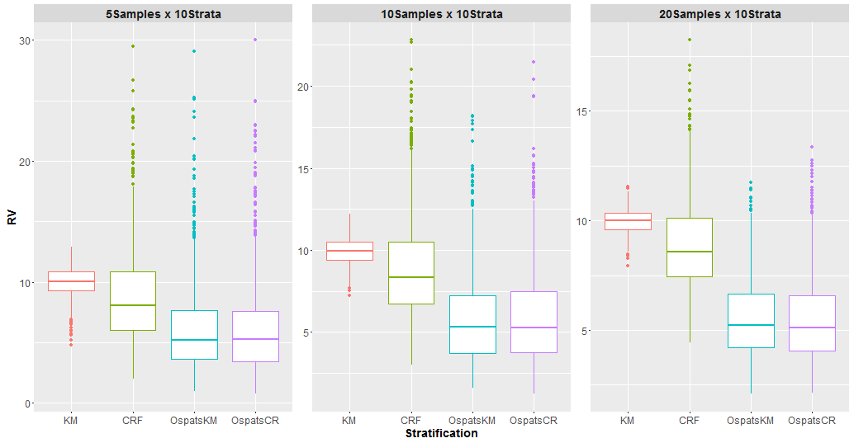
Percentage RV_{p}
Calculated using the SMN observations

Slide 20

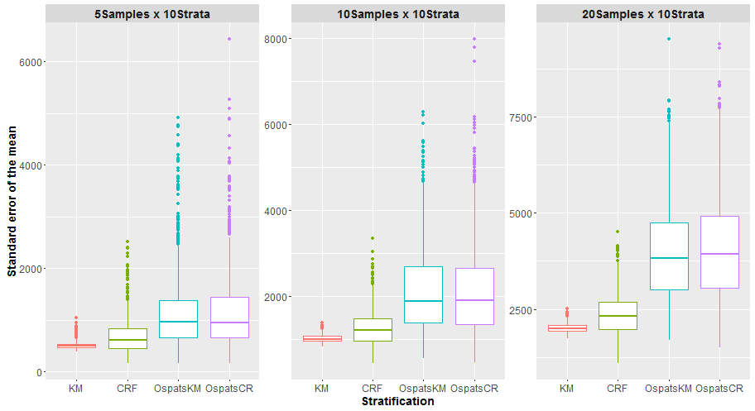
the ‘equivalent sample size’, which would yield the same precision if Simple Random Sampling were used

Slide 21
Conclusions
Use of national or global DSM (e.g., GlobalSoilMap) products can be used for designing regional or national soil monitoring schemes to detect regional or national mean change.
Conversely these monitoring schemes can be used to remove bias and/or update national or global DSM products (e.g., GlobalSoilMap).

