Slide 1


Project: ANAEE-S(puis ANAEE-F)
Titre du projet en français : Infrastructure nationale “Analyse et d’expérimentation sur les écosystèmes – Service”
Project title in English Analysis and Experimentation on Ecosystems – Service
Scientific area
Ecology, agronomy, ecosystem biology, evolutionary biology, complex system analysis
Coordination
Jean CLOBERT , CNRS, Station d’Ecologie Expérimentale de Moulis
Co-coordination
André CHANZY, INRA, EMMAH, UMR 1114
Requested funding:
Phase 1 (2012-2015) 9,753,607 €
Phase 2 (2015-2020) 4,427,734€

Slide 2
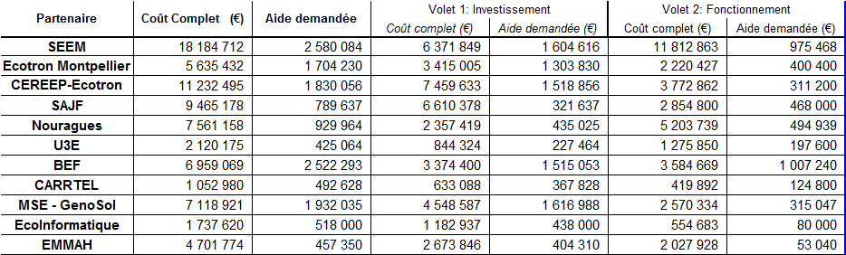
Project: ANAEE-S(puis ANAEE-F)
Participants :
EFPA
+ UREP [EFPA], EEF [EFPA], EGC [EA] (via BEF - Instrumentation)
+ SOERE F-ORE-T (via BEF – sites ateliers)

Slide 3
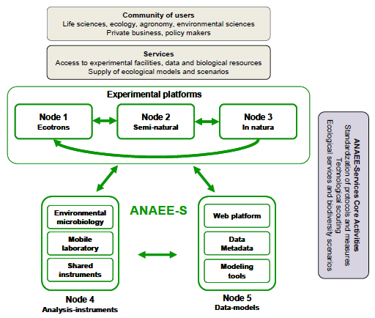
Project: ANAEE-S(puis ANAEE-F)
3SEMI-NATURAL experimental platforms CEREEP-PLANAQUA (CNRS), SEEM-Métatron (CNRS) and the U3E-Aquatic Platform (INRA).
SOERE F-ORE-T (14), ACBB(4), PRO (3), GLAPCE (1)
Ecotrons de Montpellier et
Ile de France
Overall project structure
BEF, UREP, EEF [EFPA]
GENOSOL, PESSAC [EA]
ECO-INFORMATIQUE INRA (Capsis, Record, Sol Virtuel) + CMTB (CNRS)

Slide 4
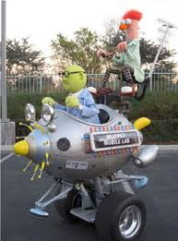
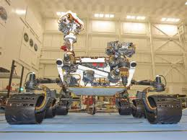
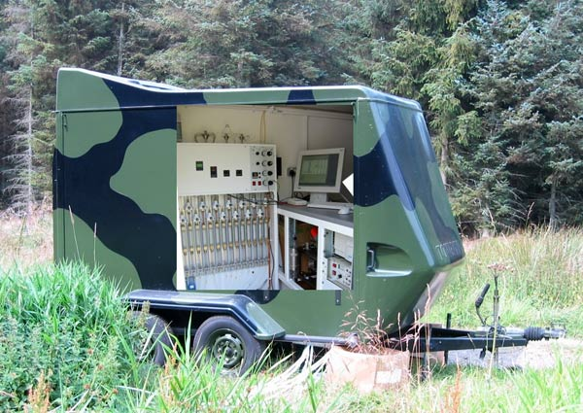
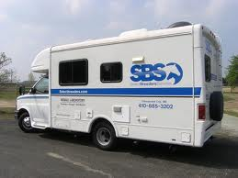
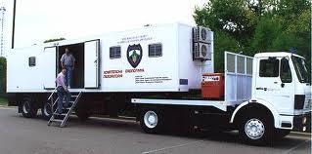

Mobile - Plateform for the Observation and the Experimentation in Terrestrial Ecosystems
Node 4
DEMARCHE:
- pragmatisme avec création d’un comité d’utilisateurs potentiels, étude des solutions techniques d’instrumentation embarquées (modularité, réactivité et souplesse d’utilisation, etc…)
- Instruments prévus (végétation, sol, flux, biochimie, microbiologie)
- effet levier sur d’autres financements (INRA, Region, Europe) – pour l’instrumentation, la mise au point de nouveaux outils et le fonctionnement
York Environmental Sustainability Institute
Muppet mobileLab
SBS Mobile Freezing Labs
National Air and Radiation Environmental Laboratory
U.S. space agency NASA
Camionette Renault Master |  |  |  |  | 25000
Freeze dryer (sample conservation) |  |  |  |  | 10000
fast gaz isotopic analyser (18O, 2H) |  |  |  |  | 94200
Dataloggers and connectors |  |  |  |  | 23985
NIRS, MIRS Chemical and biochemical characterization, root identification |  |  |  |  | 37111
sample preparation (extractions centrifuge balance |  |  |  |  | 15000
Cryosystem 4000 (tree ans soil sampling and preservation need storage in N2) |  |  |  |  | 9000
Portable laser for vegetation structure characterization |  |  |  |  | 53000

Slide 5
Mobile - Plateform for the Observation and the Experimentation in Terrestrial Ecosystems
Node 4
Field site (network)
Basic measurements
Lab mobile (specific campaigns, hotspots, hot moments)
Improvement of knowledge and multi-disciplinary approach

Slide 6
Mobile - Plateform for the Observation and the Experimentation in Terrestrial Ecosystems
Node 4
Mission(s)
Provide a backbone for measurement campaigns at Noeud 3 sites or others (short –term fluxes, special events, access to non stable molecules……)
Mobile lab provides adaptable infrastructure (lab mobile, Polaris, trailer) to set up well designed field based measurements.
The whole is highly mobile and needs few time to move from site to site.
Use of the “Polaris” optimize transport time between sampling sites and analysis base, improve the transport of equipment.

Slide 7
Mobile - Plateform for the Observation and the Experimentation in Terrestrial Ecosystems
Node 4
Available now:
Mobile lab (Renault Master) with fix basic equipment
+ mobile equipment (power supply, GPS, tools, tool boxes)
+ kits (soil sampling, meteorology, soil humidity, biomass sample preparation and handling)
+ Polaris + small trailer
+ big trailer as mobile “dirty laboratory” useful for sample preparation, like sieving of soils or transport of big equipment

Slide 8
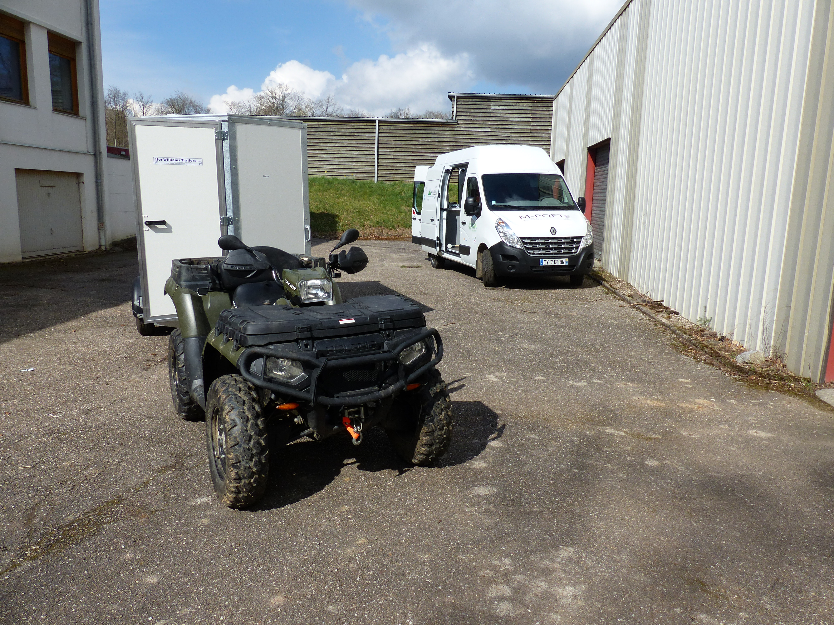

Slide 9
Mobile - Plateform for the Observation and the Experimentation in Terrestrial Ecosystems
Node 4
Facilities
Characterize terrestrial ecosystems (vegetation, soils, climate)
Basic equipment = toolboxes for each task + some common tools like high precision GPS, meteorological devices, NIRS analyzer
Example soil toolbox: soil corers, humidity probes, sieves, soil physics toolbox……..
Example vegetation toolbox: tree height, diameter, spatial repartition of trees, LAI….

Slide 10
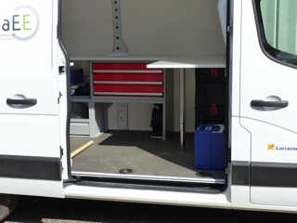
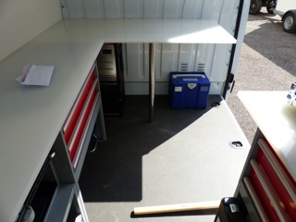
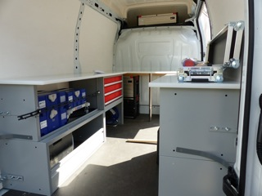
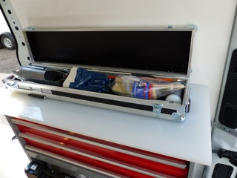

Slide 11
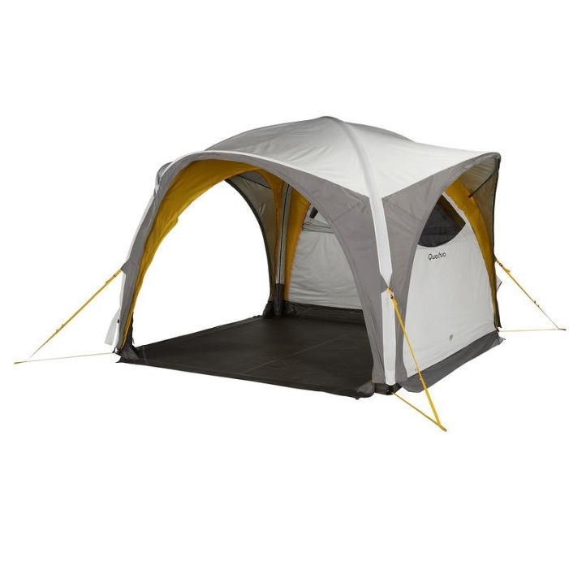
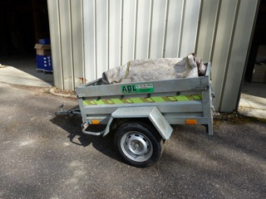
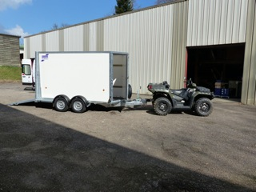
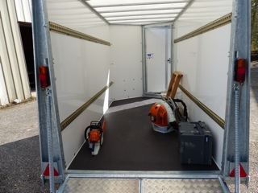

Slide 12
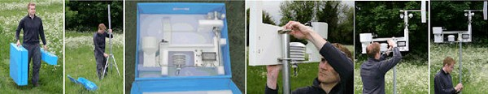
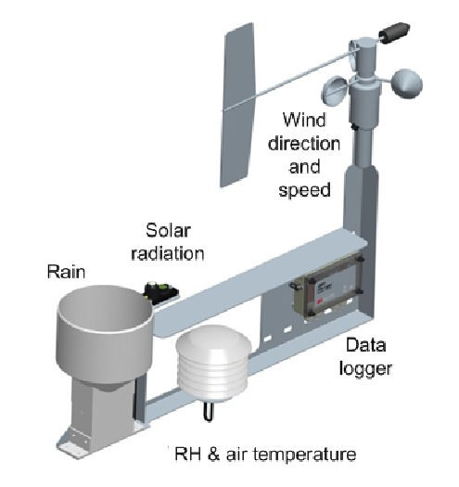
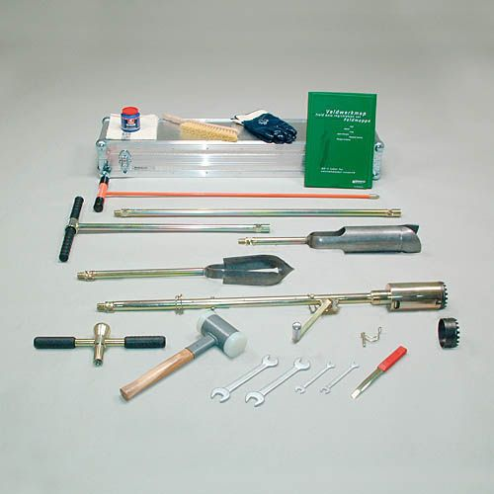
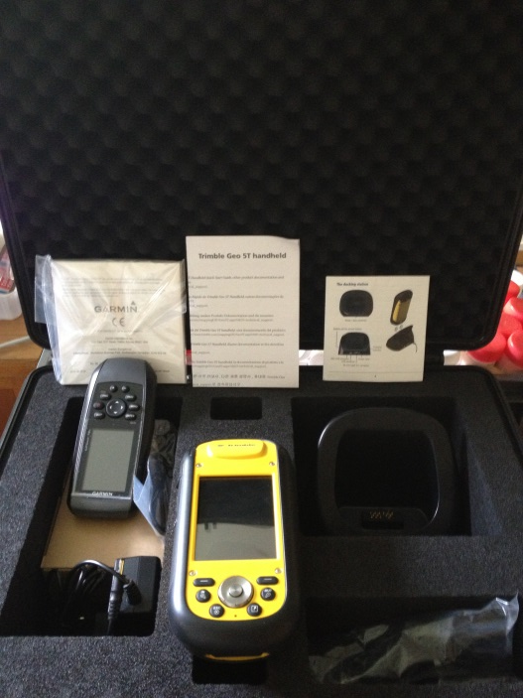
Station météo démontable
multifonctionnelle WS-GP1 Compact Automatic Weather Station
Kit prélèvement pédologique et racines fines
Kit dendrométrie, GPS

Slide 13
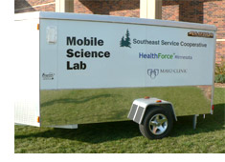
Node 4: Shared instrument facilities - CRDS
Projet UMR UREP
Example
Network of measure devices (4) able to measure continuously (1Hz)¹³C, CO₂, H₂O and CH₄ concentration using gradient chambers technique, or others (atmosphere), at 8 sample points to determine soil efflux, canopy gas exchange, ect to determine C transfer plant-soil systems.
 |  | unit |  | total
CRDS analyser, Picarro |  | 55000 | 55000 | 220000
Closed trailer |  | 1500
Data acquisition computer |  | 1500
2 Pompes |  | 1500
MassFlowControllers |  | 3000
CR3000, 8 electronic valves, SDM |  | 3000
tubing +conncections |  | 1000
Isolation+ventilation |  | 500
 |  |  | 12000 | 48000
 |  |  |  | 268000
12m technicien+ 24m ingeneer

Slide 14
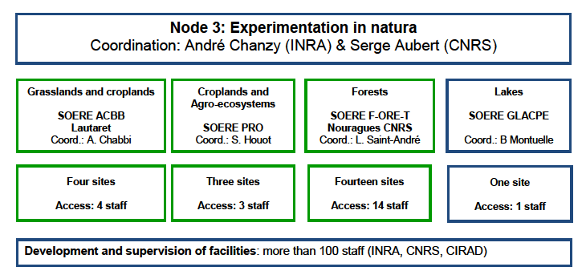
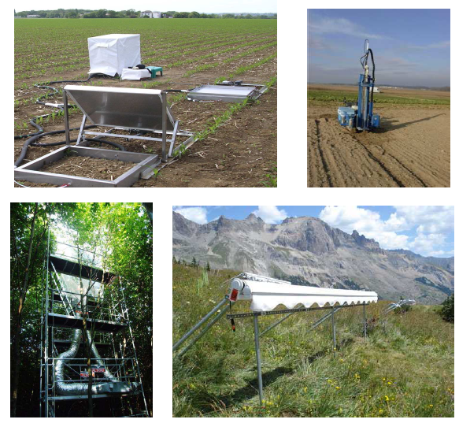
  Noeud 3

Slide 15
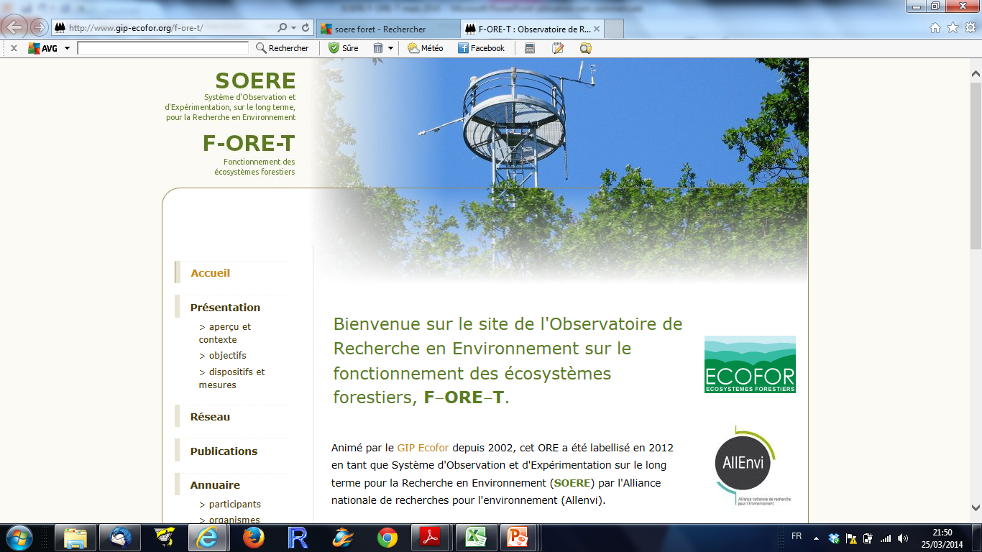
ANNAE-F, Nœud 3
SOERE F-ORE-T

Slide 16
SOERE F-ORE-T Insertion dans le paysage des dispositifs en forêt
  Noeud 3
SOERE
F-ORE-T
GIS-Coop
Amendement
MOS, Litières 15N etc..
Réseau 16x16
Plantacomp
RENECOFOR
GUYAFOR
Inventaire forestier national
Instrumentation in situ
Couverture
des situations écologiques
Sites ateliers
Expérimentation
Avec une caractéristique essentielle quand il s’agit de forêt:
le LONG TERME (>>20 ans)
Des dispositifs d’observation (monitoring), et d’expérimentation (manipulation des écosystèmes) en forêts très variés

Slide 17
SOERE F-ORE-T Insertion dans les grands projets nationaux et internationaux
  Noeud 3

Slide 18
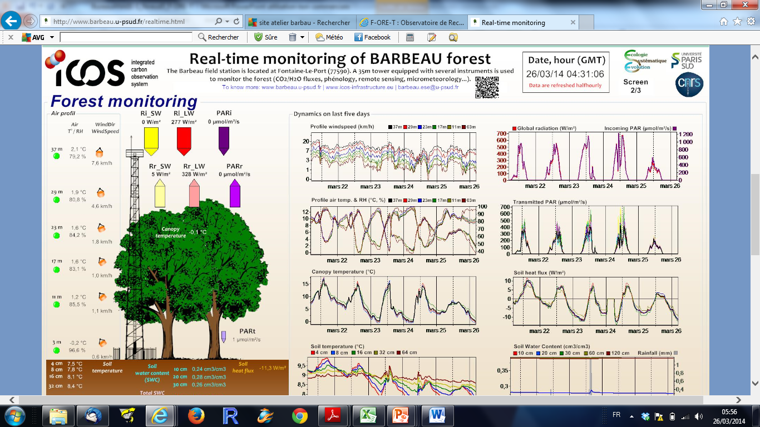
SOERE F-ORE-T Faits marquants 2013
  Noeud 3
Rayonnement, attractivité du dispositif
Autre
Europe
France
73 utilisateurs sur l’ensemble du dispositif F-ORE-T
Pour plus de 8300 jours de manip
Barbeau: visualisation en direct des mesures (voir site web)
(http://www.barbeau.u-psud.fr/realtime.html)

Slide 19
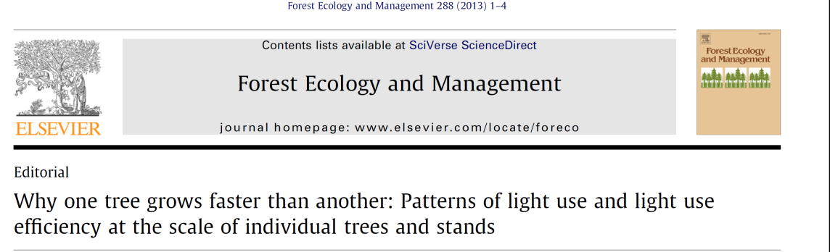
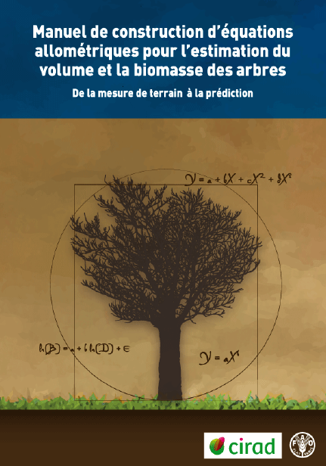
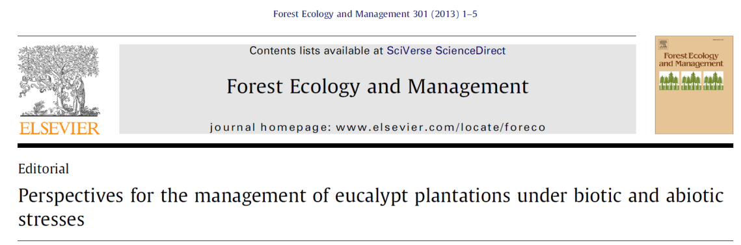
SOERE F-ORE-T Faits marquants 2013
  Noeud 3
Publications
53 en 2013
Editoriaux de numéros spéciaux, ouvrages de référence, animation de sessions dans conférences internationales:
Binkley, Laclau et al. 2013
Laclau et al. 2013
AGU Fall meeting en Décembre 2013 à San Francisco: session B012 “Carbon and water cycling in managed forests” (A. Noormets & Y. Nouvellon)

