Slide 1
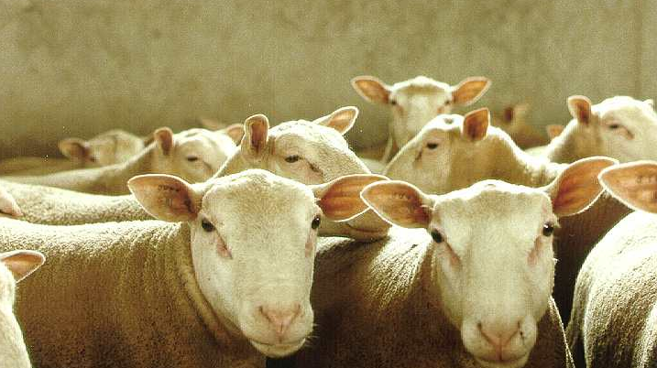
High density genome scan for selection signatures in French sheep CM Rochus, C Moreno, F Tortereau, G Tosser-Klopp, B Servin
france-genetique-elevage.org
Notes:
I would like to begin today by thanking my collaborators...

