Slide 1
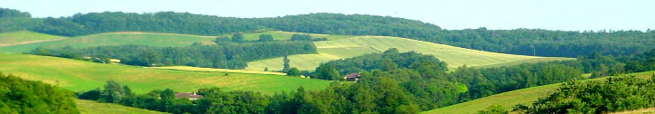
A socio-ecological framework for the analysis of forest edges dynamics and their consequences on ecosystems services in temperate landscapes.
Marc Deconchat, Audrey Alignier, Annie Ouin, Emilie Andrieu, Antoine Brin, Luc Barbaro, Hervé Jactel

Slide 2
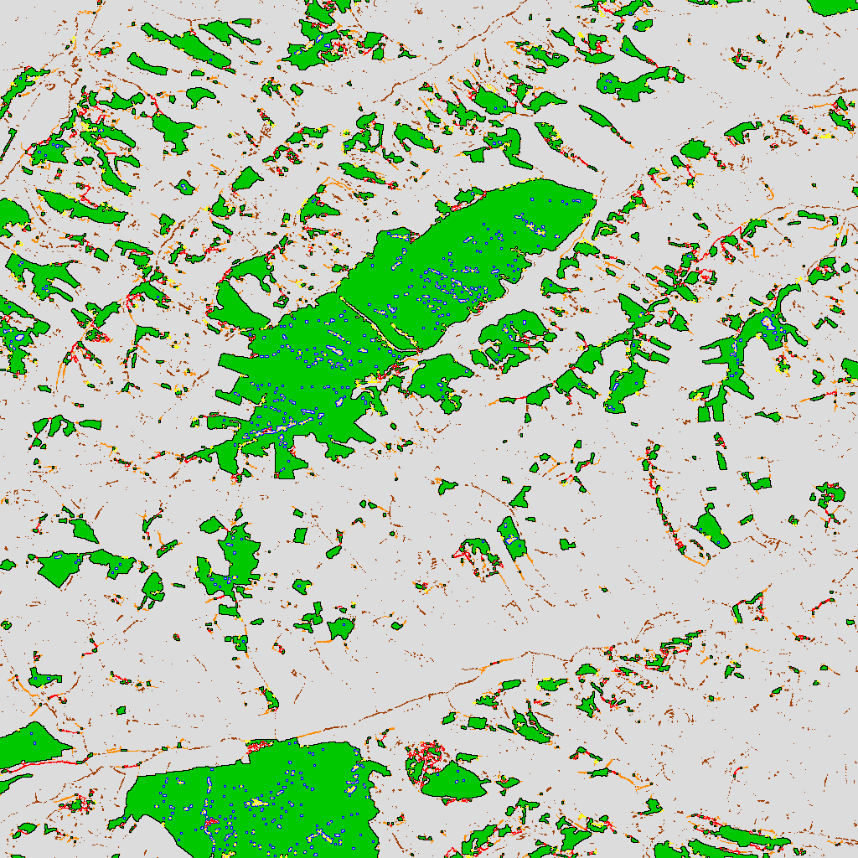
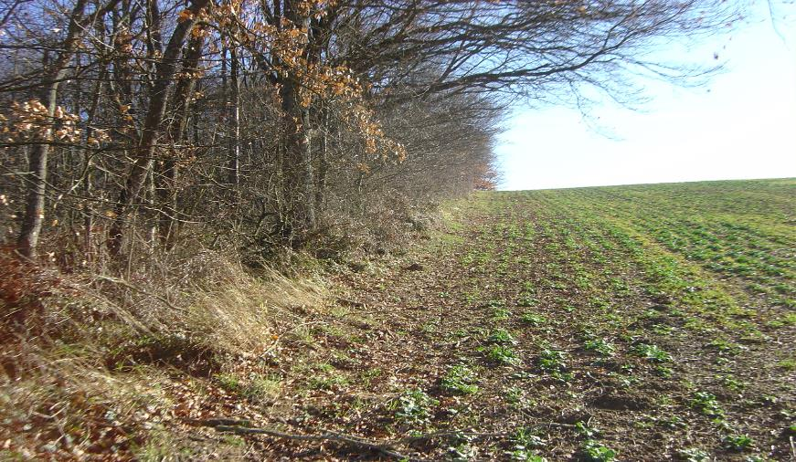
Forest edges: many facets of a very common landscape component
Forest edges are very common in many temperate landscapes
Ecological « edge effect »: what does it mean?
Forester/farmer: place of interaction?
A socio-ecological system (or component of a SES).
« Dissection » to analyze the anatomy and functioning of forest edges

Slide 3
Forest edges: 2 adjacent vegetation structures
Forest / non-forest discontinuity
Different types of forests
Many possible non-forest habitats
  Water bodies
  Human infrastuctures
  « No thing » (cliffs)
  Pastures
  Crops

Slide 4
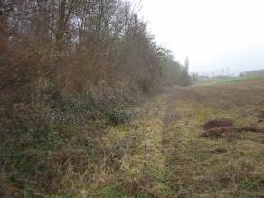

Forest edges: Dynamics
Natural dynamic of forest is expansion
Older edges can disappear into the forest behind new edge
Or, new edge can appear by clearing part of the forest
Edges have an age

Slide 5
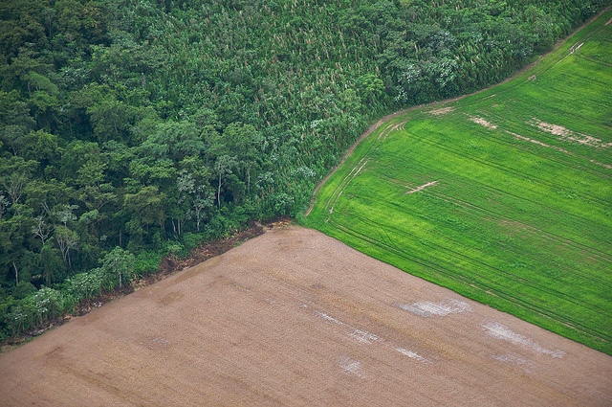
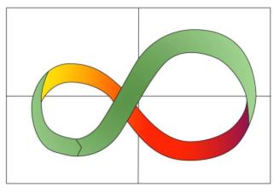

Forest edges: 2 rates of disturbance
Forest edges has to be reset regularly
Disturbance of vegetation limits tree expansion
Higher rate of disturbance in non-forest habitat than in forest
Slow disturbance regime
(~50 years)
Fast disturbance regime
(~ once and more per year)

Slide 6

Forest edges: 2 managers
Forester / farmer
Their own objectives
Edges are a consequence of their practices
Farming is the main origin of forest edges in temperate landscapes
Private ownership of land induces stability of edges

Slide 7
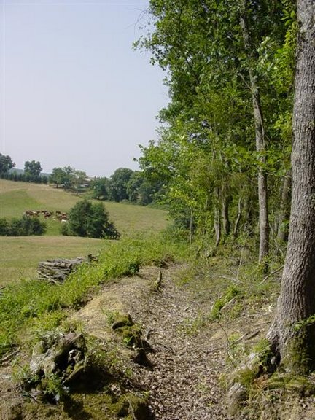
Forest edges: objects of a management
Edges are consequence of management
But they are also managed themselves
  To control tree dynamics
  To exploit their resources
Generally managed by/for farmers
Importance of secondary features associated to forest edges: ditches, paths, stone walls, fences

Slide 8
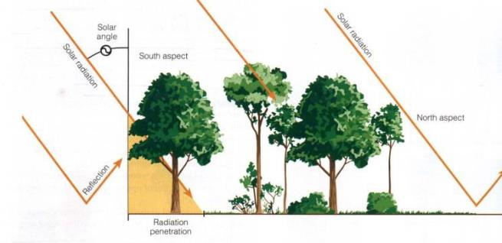

Forest edges: physical gradients
Discontinuity of vegetation structure → heterogeneity
Gradients of physical parameters

Slide 9
Forest edges: biological gradient
Field
Forest edge
Forest interior
Species influenced by physical conditions
Re-distribution of individuals
Secondary edge effect
Biological gradient/heterogeneity
Biological gradient → vegetation structure→physical gradient → biol gradient : feedback loop
Convergence toward a stable state?
Variable value
Distance from border

Slide 10
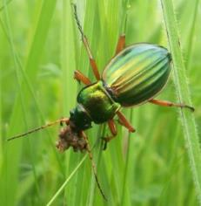
Forest edges: interfaces between habitats
Edges influence fluxes of matter, energie, information
Edges as filters
Consequences for the adjacent habitats
Number of individuals/trap/week
Distance (m) from the border

Slide 11
Forest edges: are very diverse
Many factors influence edge characteristics
Which one are the most important for edges effects?
Which one can we modify?

Slide 12


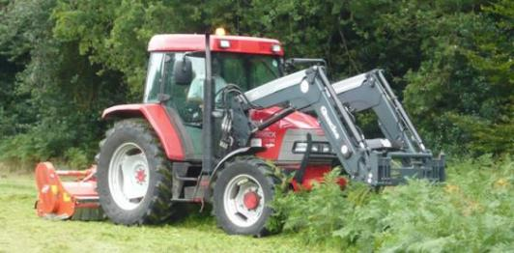
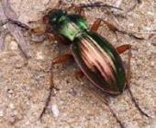
Forest edges: key role in ecosystem services
Some fluxes support ecosystem services (or dys-services)
Modifications of edges may enhance ecosystem services
Density of overwintering carabids (m⁻²)

Slide 13
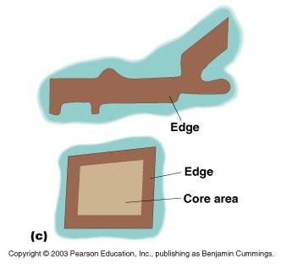
Forest edges: limits between inside and outside
At larger scales, edges are limits of forest fragments
Core area/edge area
Edge effects at fragment scale are not the same as local edge effect

Slide 14
Forest edges: a spatialy-defined socio-ecological system

