Slide 1
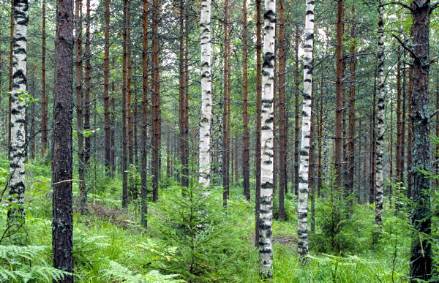









Effects of tree species diversity
on resistance to natural disturbances
in planted forests
http://www.waldwissen.net
Hervé Jactel, Johanna Boberg , Damien Bonal, Bastien Castagneyrol, Barry Gardiner, José-Ramon Gonzalez, Julia Koricheva, Nicolas Meurisse, Eckehard Brockerhoff

Slide 2


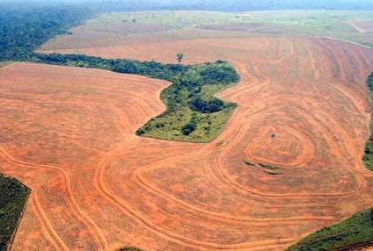
An urgent need for new, planted forests
1. to meet the social demand for wood products
including energy wood
2. to contribute to climate change mitigation
through carbon sequestration
3. to alleviate the logging pressure
on natural forests and preserve biodiversity

Slide 3
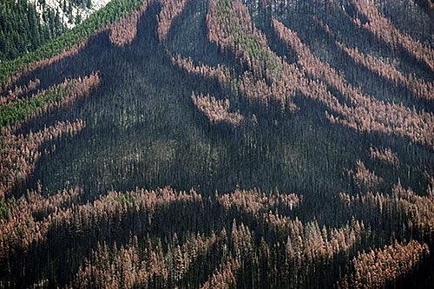

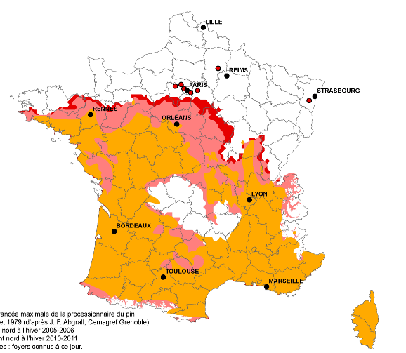
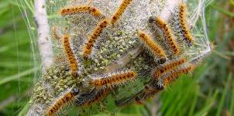
Rising threats due to global change
Climate change
  ↗ temperatures trigger pest outbreaks and range expansion
Mountain pine beetle
2011
2006
1979
Pine processionary moth

Slide 4


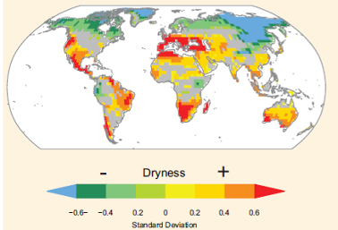

Rising threats due to global change
Climate change
  ↗ droughts increase the risk of forest fires
  ↗ droughts increase tree susceptibility to infection

Slide 5
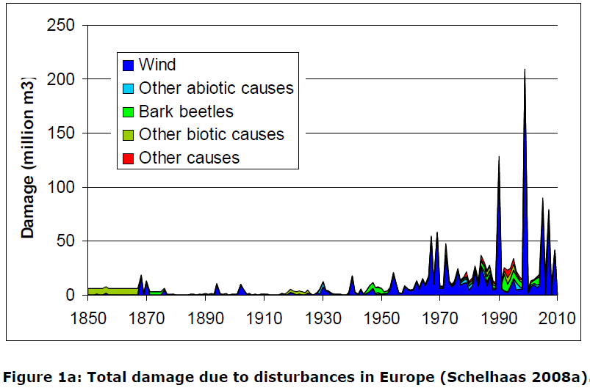
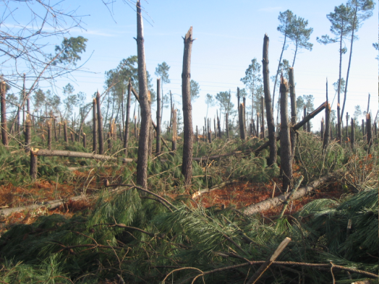
Rising threats due to global change
Climate change
  ↗ wind damage

Slide 6
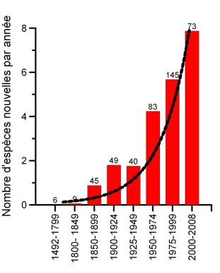
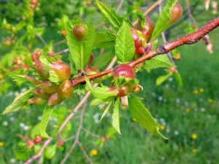
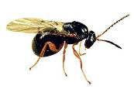
Rising threats due to global change
World trade
  ↗ globalization results in more biological invasions
Number new species / year
Exotic arthropods
Dryocosmus kuriphilus
Origine: China

Slide 7
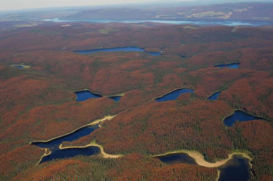
Challenge: design new planted forests
less vulnerable on the long term
Trees are being planted for decades or centuries
Forests will experience disturbances never met before

Slide 8

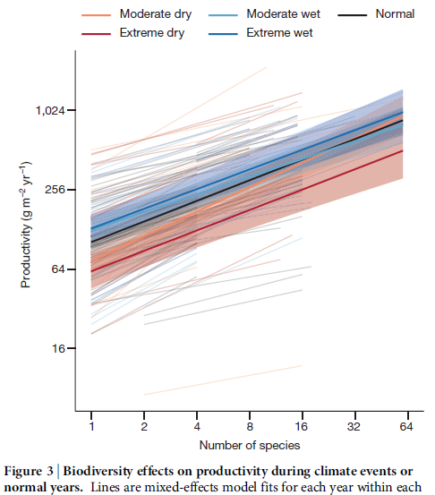
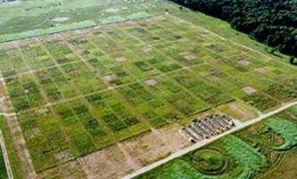
Is mixing tree species in planted forest an option?
Diversity – resistance relationships in grasslands

Slide 9
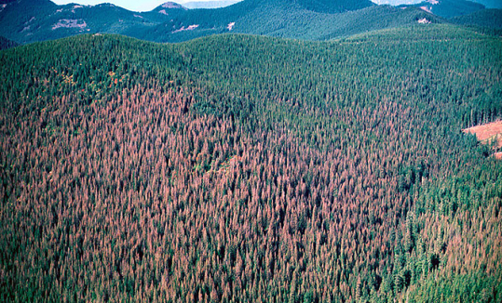
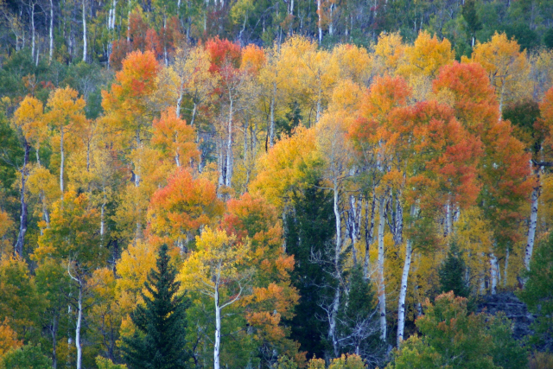
Resistance of mixed forests to 7 natural disturbances
Drought
Fire
Windstorm
Mammal herbivores
Pest insects
Fungal pathogens
Invasive species
William M. Ciesla, Forest Health Management International, Bugwood.org
Patterns of response to tree diversity
Underlying ecological mechanisms
http://www.redbubble.com/people/bberwyn

Slide 10

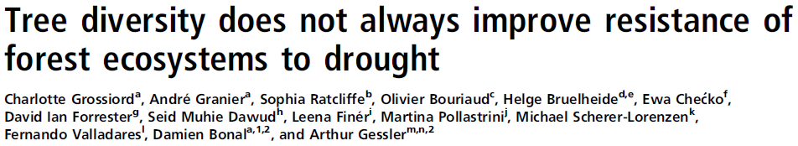
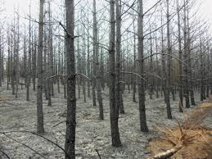
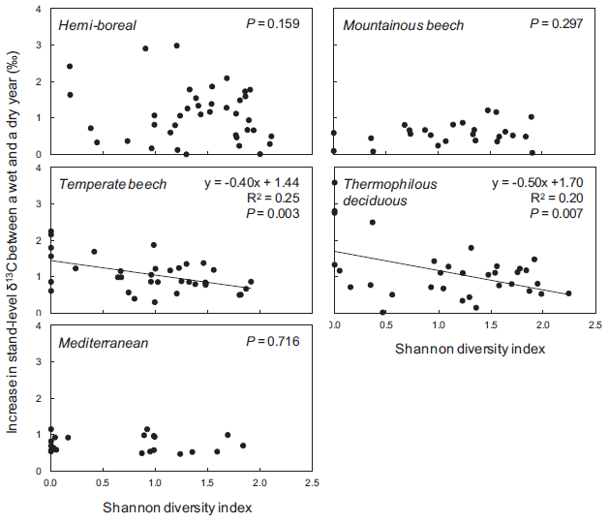
1. Resistance of mixed forests to drought
http://dnr.wi.gov/
Water Use Efficiency = Productivity / Transpiration

Slide 11
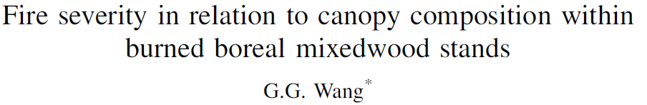
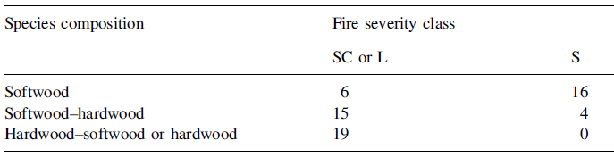

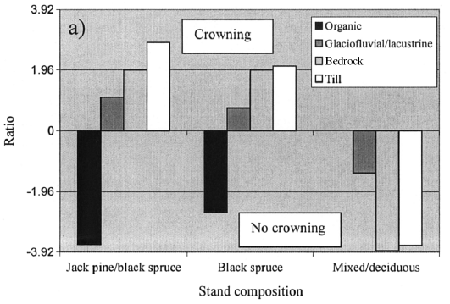
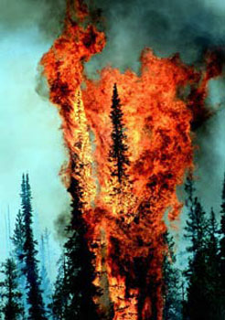
2. Resistance of mixed forests to fires
Light
Severe
http://www.sierraforestlegacy.org

Slide 12
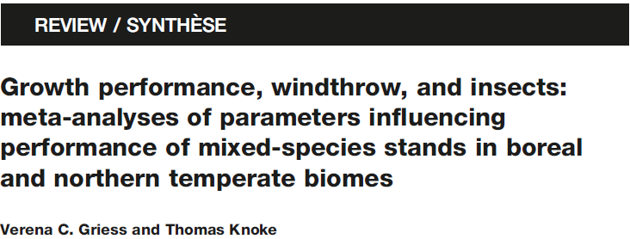
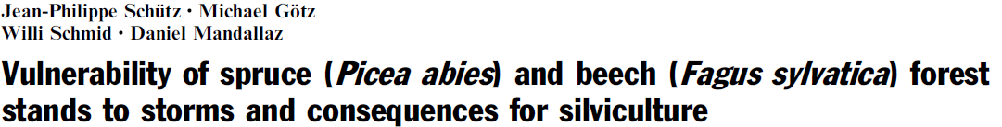
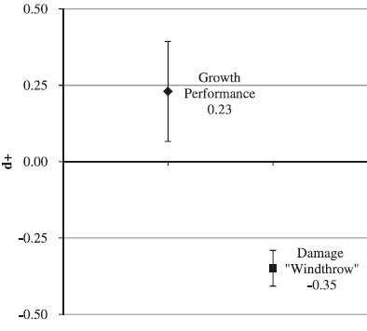
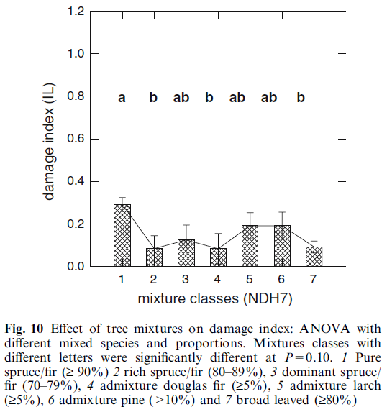
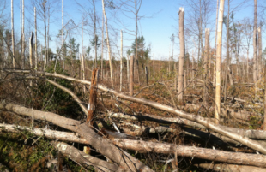
3. Resistance of mixed forests to windstorms
http://iireporter.com

Slide 13
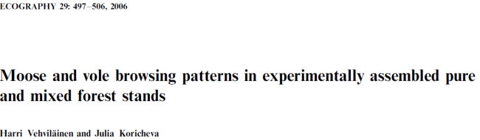


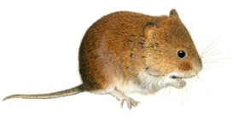
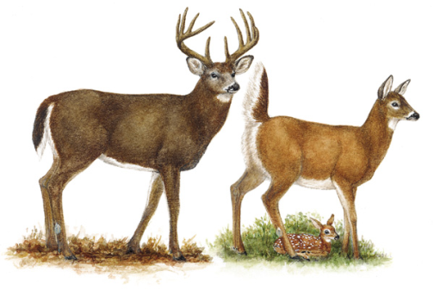
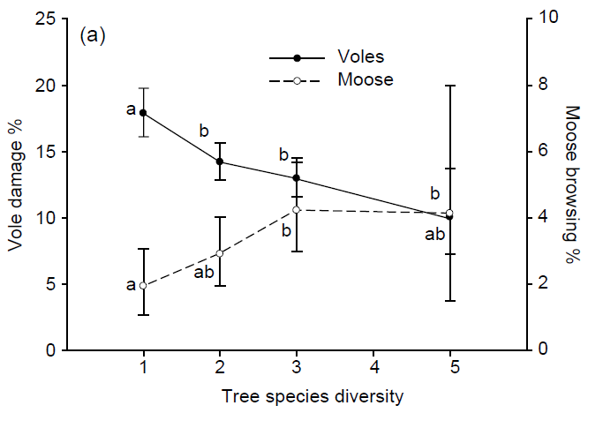
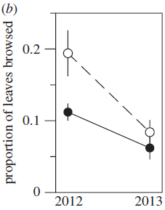

4. Resistance of mixed forest to mammal herbivores
Contrasting effects on mammal herbivores

Slide 14
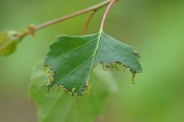


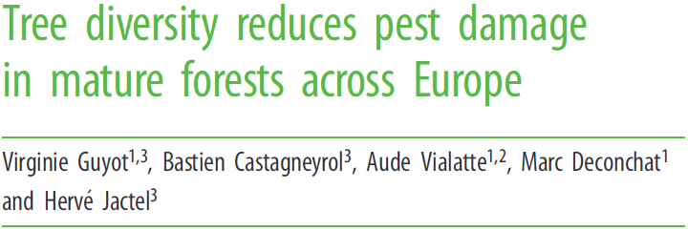
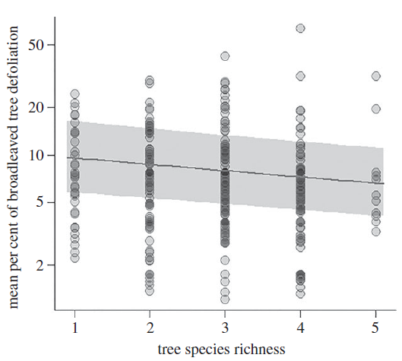
5. Resistance of mixed forest to pest insects
119 case studies, 33 tree species
36 % less damage
in mixed forests
(80% cases)
-31%

Slide 15
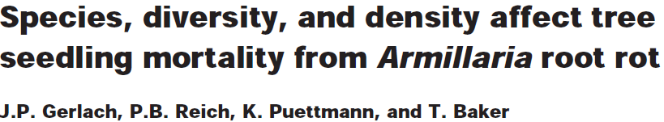
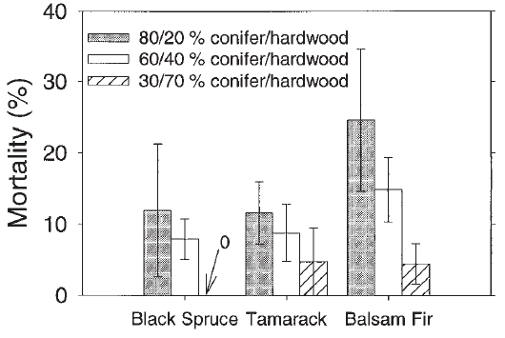
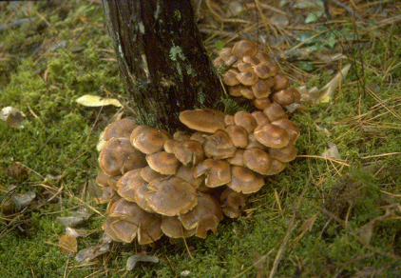

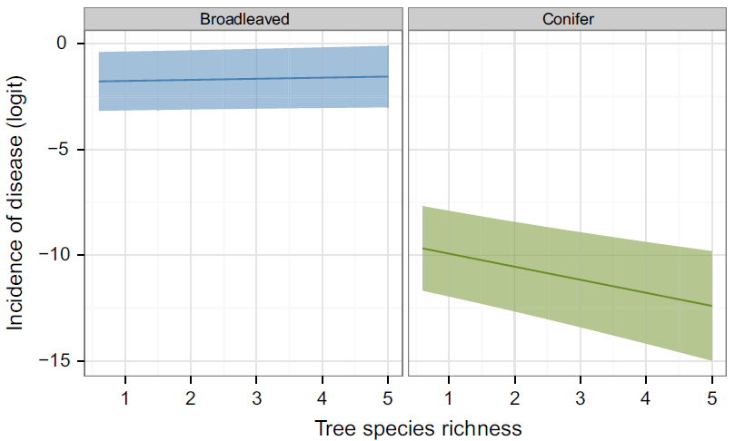
6. Resistance of mixed forest to fungal pathogens
Overall better resistance of mixed forests to root rot fungi
Resistance or neutral effects for foliar pathogens

Slide 16
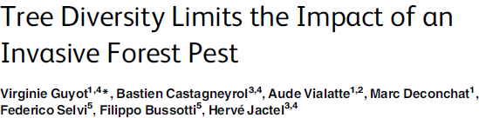
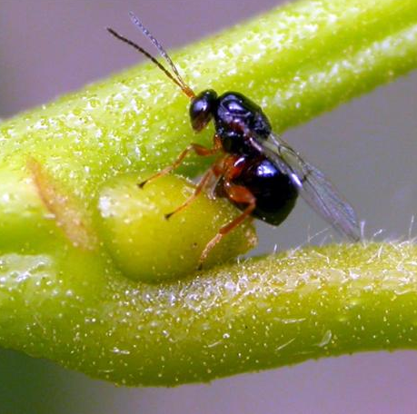
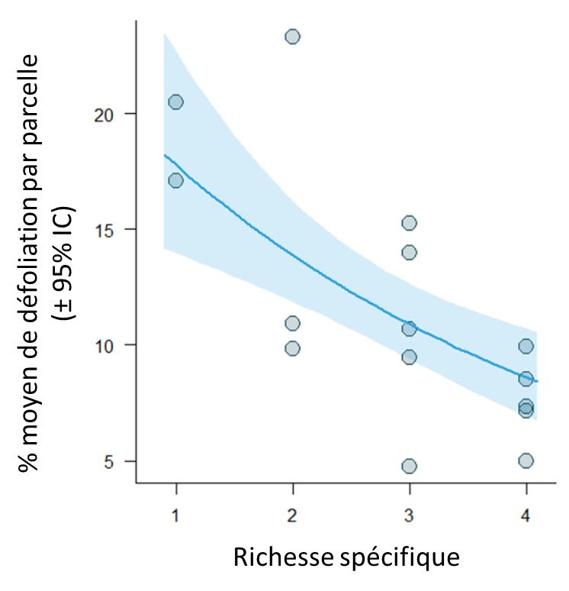
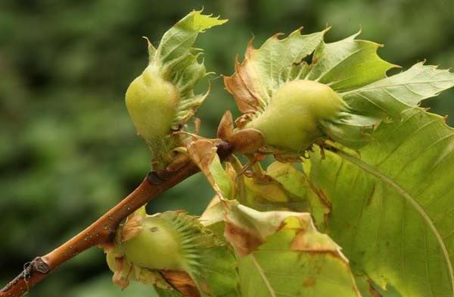
7. Resistance of mixed forests to invasive species
Mean % defoliation per plot
Tree species richness

Slide 17
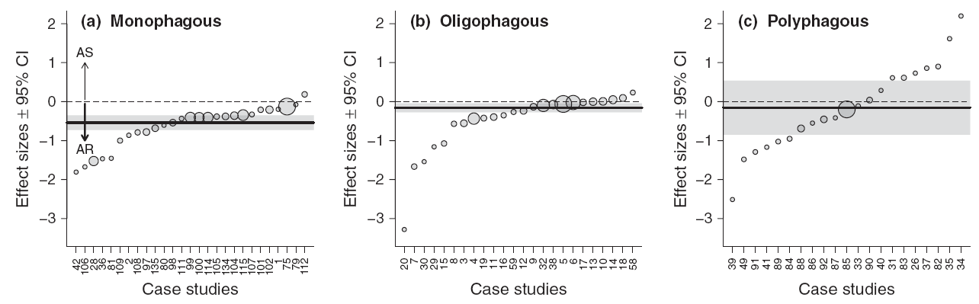
Resistance of mixed forests: common features
Direction and magnitude of effects depend on pest specialization
- 42%
- 15%
0%
Castagneyrol et al. 2014
Spill over
Mixing diet

Slide 18
Resistance of mixed forests: common features
Forest composition more important than tree species richness
conifer
conifer
broadl.
broadl.
broadl.
conifer
conifer
broadl.
– 27%
– 45%
% damage reduction

Slide 19
Resistance of mixed forests: common features
“Associational resistance” operate at several, nested spatial scales
Landscape scale
Stand scale
Heterogeneity
Tree scale
Species
composition
Neighbors
identity

Slide 20
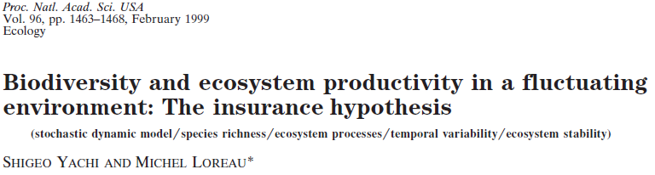
Mechanisms underlying
diversity – resistance relationships
0. The insurance hypothesis
Being composed of several species with different functional traits,
mixed forests have a higher likelihood of containing resistant trees,
thus providing more opportunities to maintain a forest cover
and sustain basic ecosystem functions on the long term

Slide 21
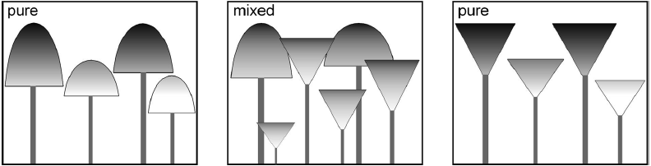
Mechanisms underlying
diversity – resistance relationships
Traits complementarity
Root depth / drought
Bark anatomy / fire
Crown architecture / wind
Leaf quality / herbivores
Niche occupancy / invasive species

Slide 22
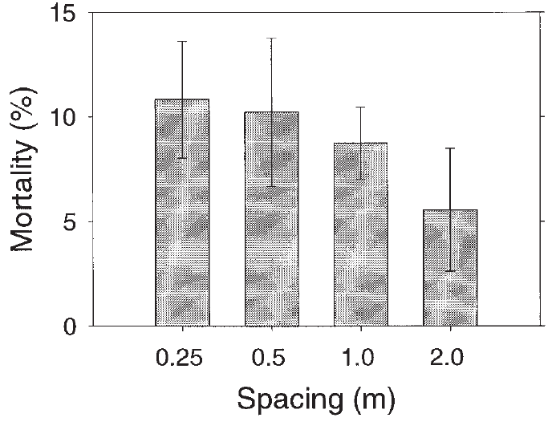
Mechanisms underlying
diversity – resistance relationships
Reduced density (amount) of susceptible trees
herbivores less likely to enter the plot
lower amount of resources/fuel
longer distance between host trees
Gerlach et al. 1997
Tree mortality due to A. ostoyae
in mixed stands

Slide 23
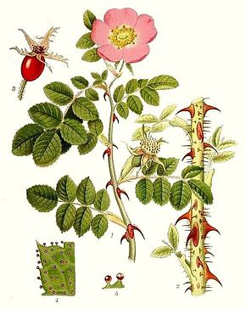
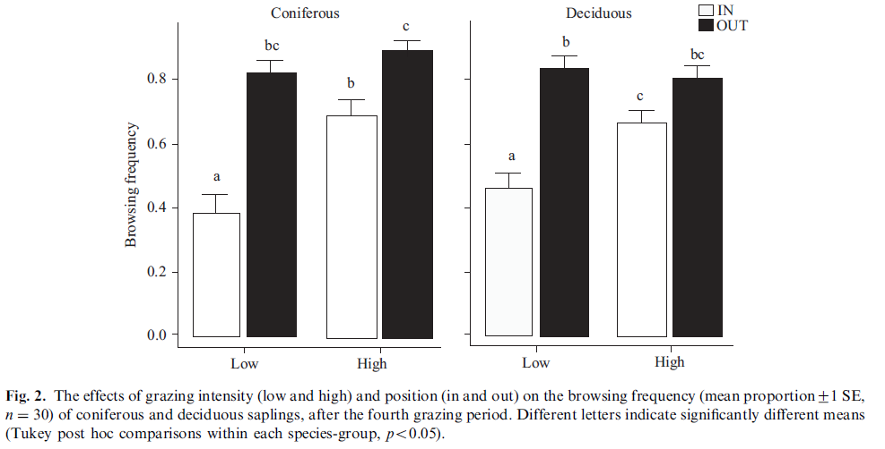

Mechanisms underlying
diversity – resistance relationships
Reduced probability of susceptible trees being hit
physical protection by neighbors
diversion (decoy) processes
Spruce - Fir
Beech - Maple
Saplings planted under Eglantine
Browsing frequency

Slide 24



Mechanisms underlying
diversity – resistance relationships
Reinforced multitrophic interactions
decomposers and mycorrhiza
natural enemies
100% Scots pine
50% Scots pine – 50% Birch
Neodiprion sertifer

Slide 25
Conclusions
Mixed forests : associational resistance > susceptibility
Tree composition > species richness
Several scales, many processes involved
Tradeoffs for resistance to different disturbances?
Recommendations to forest managers:
  2 species mixtures might be enough
  beyond the conifer – broadleaved mixtures

Slide 26

Thank you for your attention
http://mixedwoodecozone.weebly.com/natural-vegetation.html

