Slide 1




Articulation and Consistency of the Processes driving Soil Organic Matter dynamics at different scales
Laurent SAINT-ANDRE, Delphine DERRIEN, Bernd ZELLER
With special thank to Rémi d’Annunzio, Pierre-Joseph Hatton, Jades Saleles, Julien Sainte-Marie, Emila Akroume, Polina Nikitich …..
And Matthieu Barrandon, Antoine Henrot, Laurent Remusat, Makus Kleber, Munuel Nicolas, Jacques Ranger, Etienne Dambrine….

Slide 2
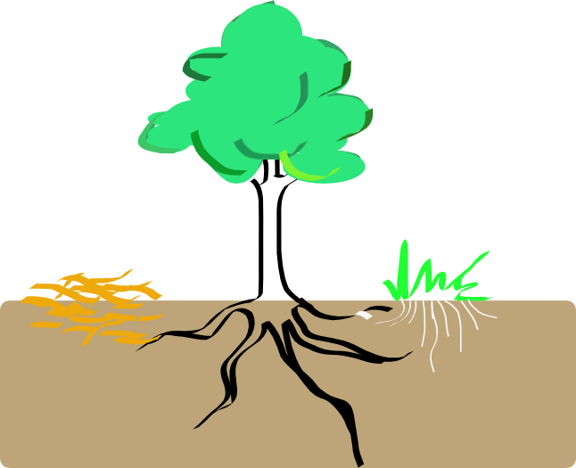
Carbon and Nitrogen cycle in a Forest Ecosystem ?
CARBON
NITROGEN
Net Ecosystem Exchange : NEE = GPP – Reco
Carbon Uptake or Release
Atmospheric deposits
Respiration
Photosynthesis
GPP = Gross Primary Production
R_{eco} = Ecosystem Respiration
LitterFalls
Nox emission
N atmospheric fixation
NPP = GPP – Ra
= Net primary production
Rs = Soil Respiration
Ra = Autotrophic Respiration
L= Litterfall
N Mineralisation
Rh = Litter decomposition
Litter N
Decomposer
Biomass
AR= (root turnover and exudates)
NO₃⁻
NH₄⁺
BC = L+AR-Rh - Drainage
= Soil Carbon Balance
Soil Organic N
N Release
Drainage
N Recycling
-Strong similarities between the two cycles but some big differences (photosynthesis – C cycle, N uptake by the trees – N cycle)
-Intimely linked in the organic matter (aboveground – vegetation, and belowgroound – the soil organic matter)

Slide 3
Soil Organic Matter…….. Does it matter ?
Stocks
Fluxes
Tropics = 300 kgN/ha
Temperate = 200kgN/ha
Boreal = 89 kgN/ha
NPP
Tropical : 1500 g C/ m2/yr
Temperate : 700 g C/ m2/yr
Deposition + BNF
5-30 kgN/ha/yr
Tropics = 65-150 tC/ha
Temperate = 80 tC/ha
Boreal = 95 tC/ha
Litterfall
Tropical : 500 g C/ m2/yr
Temperate : 200 g C/ m2/yr
Boreal : 100 g C/ m2/yy
Immobilization
20-40 kgN/ha/yr.
Harvest
5-10 kgN/ha/yr.
Volatilization +
Denitrification
5-10 kgN/ha/yr.
Tropics = 2 – 5 tN/ha
Temperate = 2 – 12 tN/ha
Boreal = 2 – 5 tN/ha
Mineralization +
Nitrification
50-150 kgN/ha/yr.
Tropics = 104 tC/ha
Temperate = 118 tC/ha
Boreal = 149 tC/ha
CO2 emission from the SOC
Tropical : 1 250 g C/ m2/yr
Temperate : 450 g C/ m2/yr
Boreal : 200 g C/ m2/yr
Leaching
2-50 kgN/ha/yr.
For Nitrogen : highest stocks and fluxes take place in the soil
For Carbon : highest stocks in the soil (in average), and of the same magnitude of NPP (third flux after GPP and Reco)
From Schlessinger 1997

Slide 4
Soil Organic Matter…….. Variable ? Sensible ? Vulnerable ?
Climate
Long term changes (CO₂, temperature, rainfall)
Short term events (drought periods, storms)
Soil fertility
Notion of VARIABILITY,
of SENSIBILITY,
and of VULNERABILITY
of the C and N budget to these factors
Carbon and Nitrogen Budgets in Forest Ecosystems
Genetic
(species efficiency)
Human intervention
(Thinning, rotation length, soil preparation,
Slash management, fertilization, land-use change)

Slide 5
Soil Organic Matter…….. Variable ? Sensible ? Vulnerable ?
Hypothesis 1
Hypothesis 2
  Increase of CO2 and atmospheric deposits
  Increased tree productivity
  Increased litter inputs
  Increased soil C and N stocks ?
  Increase of temperature during winter
  Increased micro-meso-macro fauna activities
  Increased mineralization
  Decreased soil C and N stocks ?
?
From processes to the budget…….. A long way down our understanding of ecosystem functionning

Slide 6
Soil Organic Matter Processes…….. Opening the blackbox !
SOERE
F-ORE-T
GIS-Coop,
Liming network,
MOS network,
PlantaComp,…
15N labelled litter network
Douglas network
Monitoring networks
Eg. level II- 16x16
RENECOFOR
GUYAFOR
National Forest Inventories
Instrumentation in situ
Intensive study sites
Range of ecological situations
Experimentation
Take advantage of the high (but structured) diversity
of monitoring and experimental networks in forest ecosystems
Let’s open the black box !!

Slide 7
Soil Organic Matter Processes…….. Organo-mineral interactions plays a role in C and N sequestration
Micro aggreagtes
Clay minerals
Aggregated quartz and clay minerals
Isolated coarse minerals
Oxides and quartz
=>The processes involved need to be studied at the micron scale.
Hatton et al. RCM 2012

Slide 8
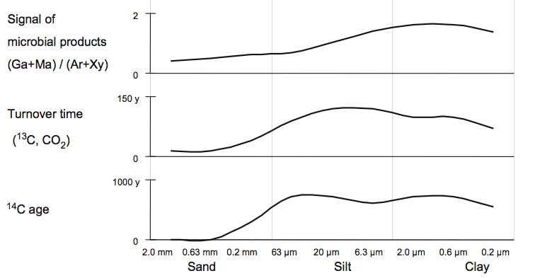
Soil Organic Matter Processes…….. Organo-mineral interactions plays a role in C and N sequestration
When organo-mineral associations become finer, denser,
they exhibit a stronger microbial signature
their carbon is older
(see reviews from von Lutzow et al., 2007; Sollins et al., 2009)
von Lutzow et al., 2007
Working hypothesis
Microbial transformation of litter residues would facilitate their preservation on the long term within organo-mineral associations

Slide 9
Soil Organic Matter Processes…….. Organo-mineral interactions plays a role in C and N sequestration
Research questions
What is the nature of OM stabilised (present to several years) on soil particle ?
Experiment 1: Fate of N using 15N labelled leaves (after an application 12 years ago)
What are the factors that control the spatial distribution of the microbial metabolites?
Experiment 2: Fate of C and N using 13C/15N labelled glycine (after short term soil incubation)

Slide 10
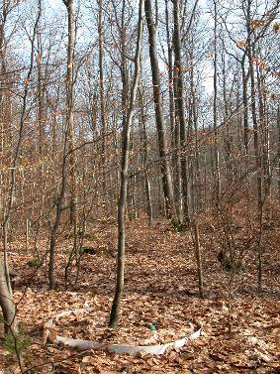
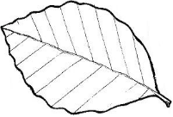
Experiment 1
Soil Organic Matter Processes…….. Organo-mineral interactions plays a role in C and N sequestration
1. Study site & soil sampling
German Beech forest with moder humus-type.
Acidic dystic Cambisol (Zeller et al., 2001).
2. ¹⁵N labeling
Beech leaves enriched in ¹⁵N (2.5 At% or δ¹⁵N=5700‰ )
Sampling after 12 years .
About 20% of the tracer is still in the top 2.5 cm soil layer

Slide 11
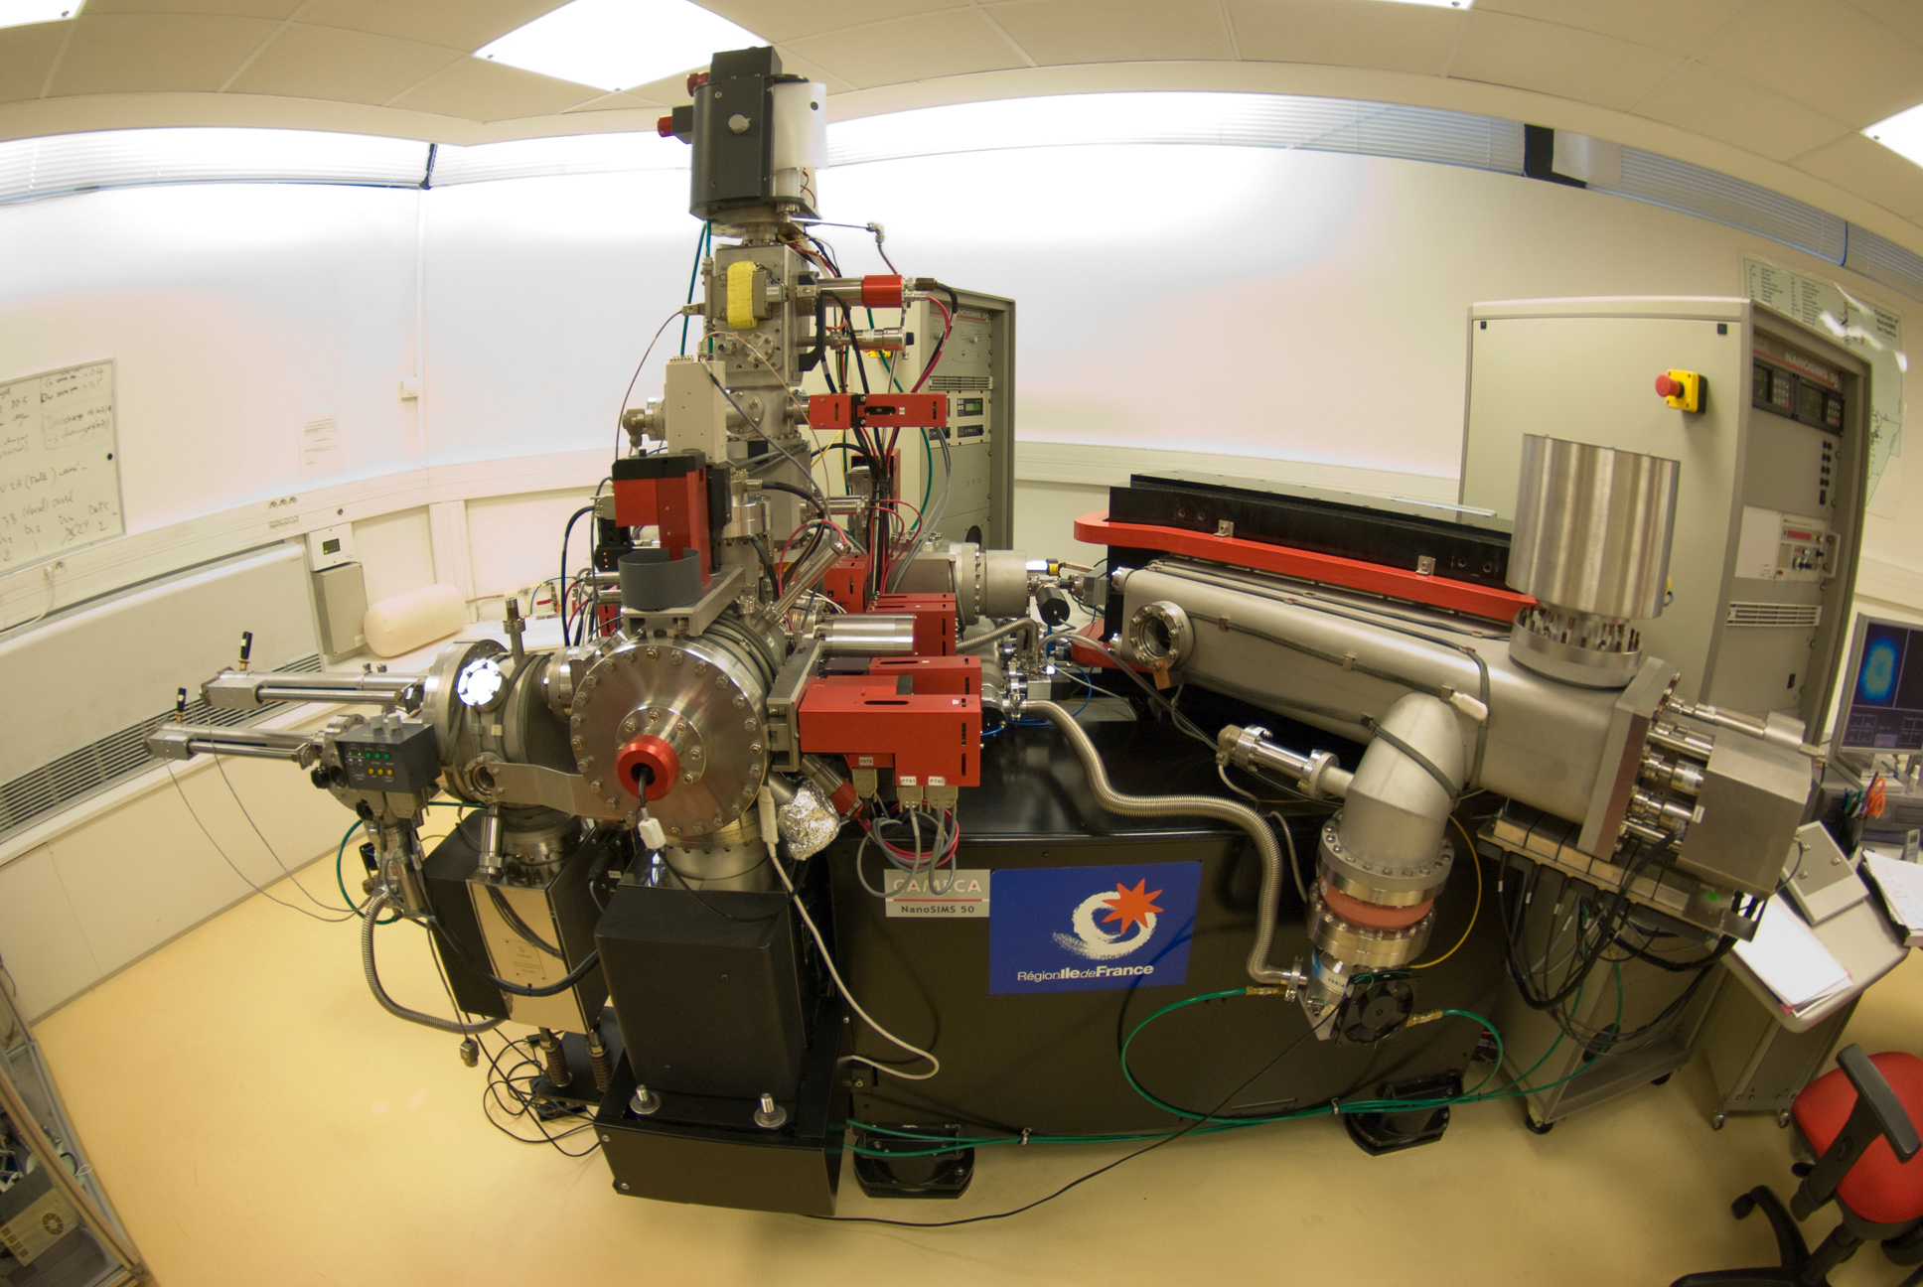
Instrumentation
Soil Organic Matter Processes…….. Organo-mineral interactions plays a role in C and N sequestration
NanoSIMS is the only instrument able to produce isotopes maps, with a 100 nm spatial resolution.
It combines high spatial resolution with high mass resolution: we can study N or O isotopic compositions.
Coll. MHN, ……

Slide 12
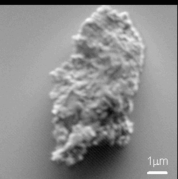
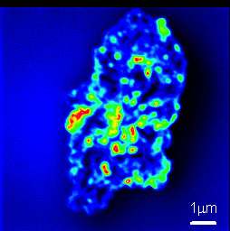
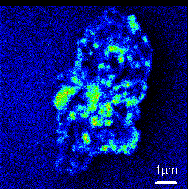
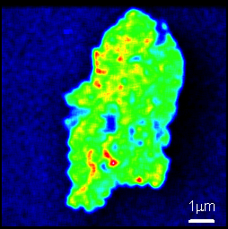
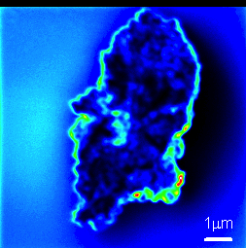
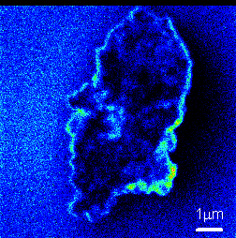
NanoSIMS principles
Soil Organic Matter Processes…….. Organo-mineral interactions plays a role in C and N sequestration
Primary source (Cs⁺)
High-resolution isotopic analysis
The incident beam is perpendicular to the surface
Magnetic Sector Mass Analyzer
with Multicollection
Primary ions
m/z
Secondary ions
Atomic collisions
& ejection ions
Mass 12
Sample
Mass 13
Mass 18
Mass 26
Mass 27
Secondary electrons
¹²C⁻
¹³C⁻
¹⁸O⁻
²⁶CN⁻
²⁷CN⁻

Slide 13
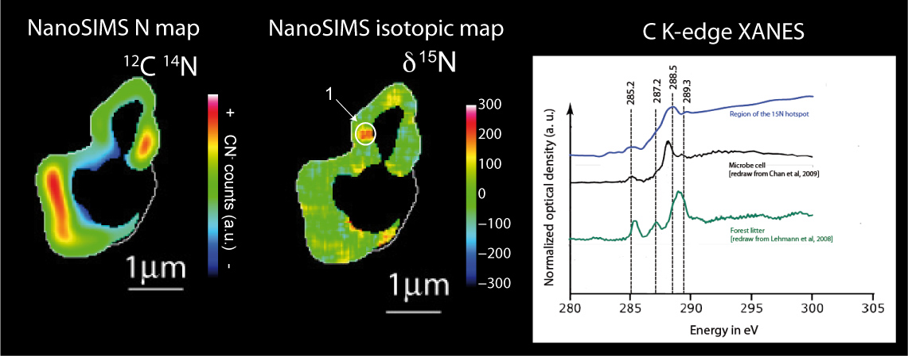
An attempt to determine the nature of the OM bearing the label
Soil Organic Matter Processes…….. Organo-mineral interactions plays a role in C and N sequestration
Remusat et al. ES&T 2012
Combination of NanoSIMS with STXM-NEXAFS (molecular imaging).

Slide 14
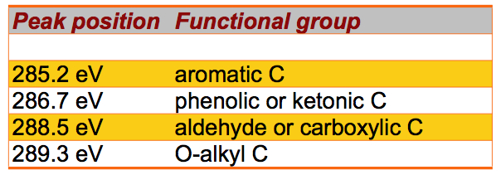
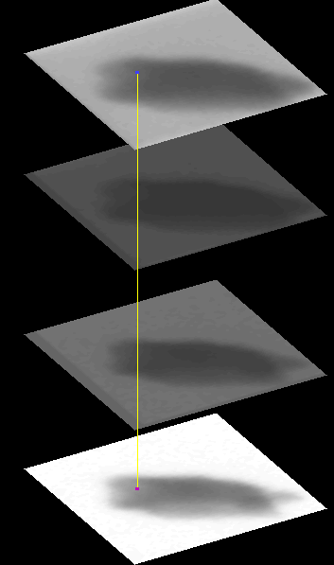
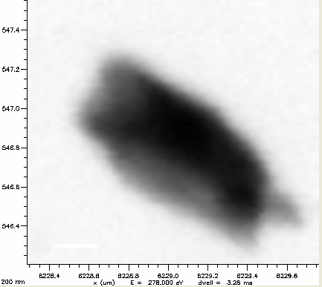
STXM-NEXAFS principle
Soil Organic Matter Processes…….. Organo-mineral interactions plays a role in C and N sequestration
STXM is a transmission technique that maps C, N, and, through acquisition of NEXAFS spectra, can determine the type of C and N functional groups
Image 280 eV
Single Image @ 280 eV
Image 300 eV

Slide 15
An attempt to determine the nature of the OM bearing the label
Soil Organic Matter Processes…….. Organo-mineral interactions plays a role in C and N sequestration
Acquired at ALS Berkeley
Remusat et al. ES&T 2012
The label seems related to microbial OM.

Slide 16
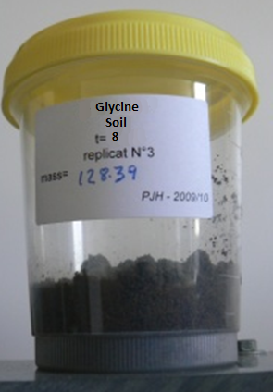
Experiment 2
Soil Organic Matter Processes…….. Organo-mineral interactions plays a role in C and N sequestration
1. Study site & soil sampling
German Beech forest with moder humus-type.
Acidic dystic Cambisol (Zeller et al., 2001).
2. Incubation of ¹³C/¹⁵N-labeled glycine (glycine is metabolised within a couple of hours)
=> Tracing of glycine residues at the surface of different types of organo-mineral association by NanoSIMS imaging

Slide 17
Biotic fixation of ¹³C and ¹⁵N derived from glycine after 8 hours of incubation
Soil Organic Matter Processes…….. Organo-mineral interactions plays a role in C and N sequestration
 | Soil Carbon | Soil Nitrogen | ¹³C | ¹⁵N
 | mg g⁻¹ soil | mg g⁻¹ soil | % applied | % applied
 | 8 hour incubation in non-sterile treatment
Bulk | 28.7 ± 0.3 | 1.85 ± 0.04 | 86.2 ± 6.3 | 98.0 ± 8.2
Attached to soil particules | 21.53 ± 0.36 | 1.25 ± 0.05 | 7.0 ± 0.5 | 7.17 ± 0.11
 | 8 hour incubation in sterile treatment
Bulk | 28.7 ± 0.5 | 1.85 ± 0.03 | 97.8 ± 3.1 | 92.3 ± 6.2
Attached to soil particules | 21.8 ± 0.29 | 1.28 ± 0.05 | 0.70 ± 0.09 | 1.11 ± 0.04

Slide 18
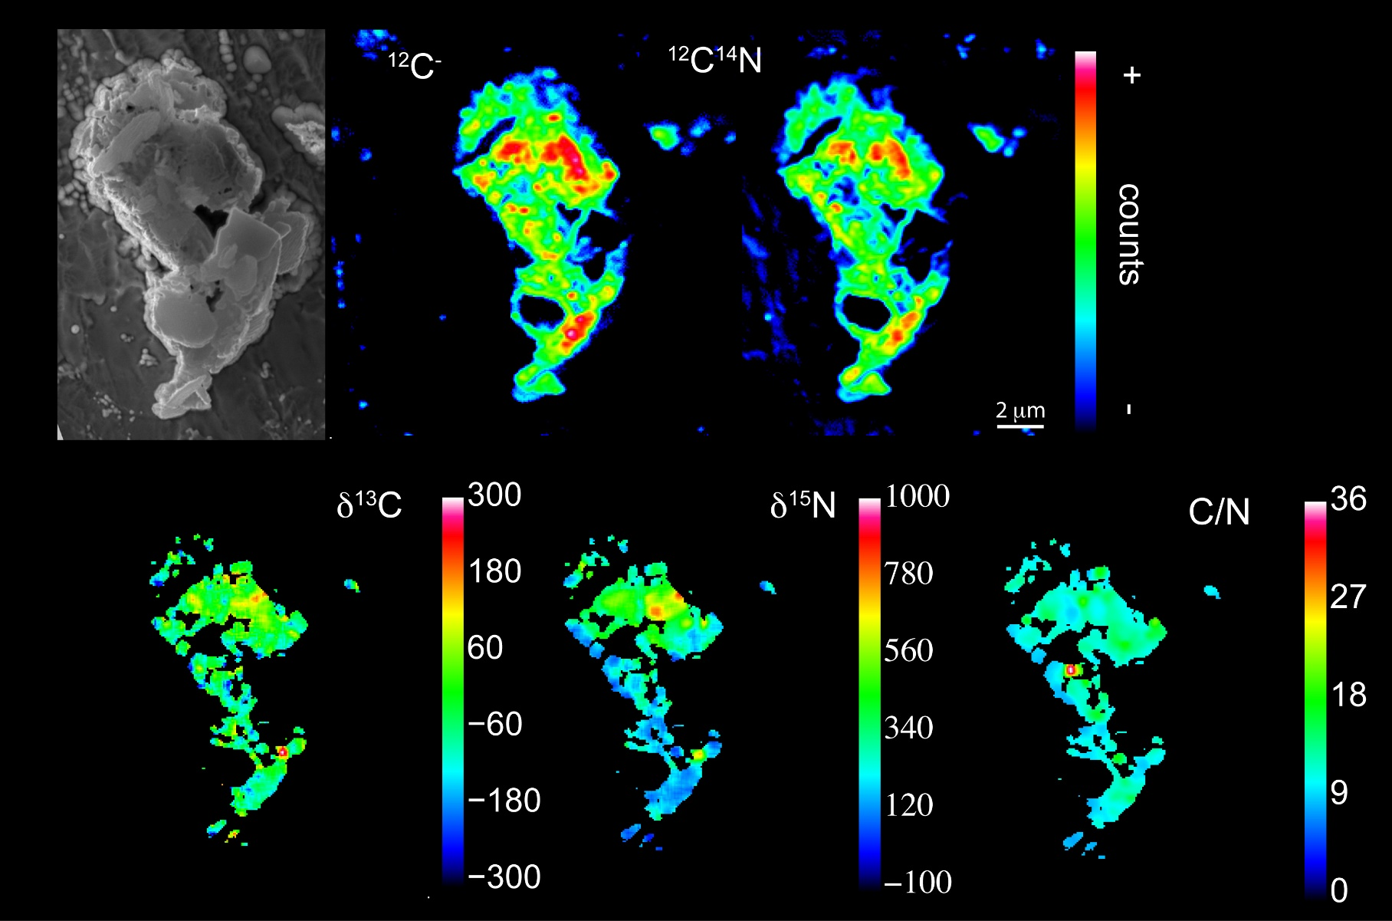
NanoSIMS images
Soil Organic Matter Processes…….. Organo-mineral interactions plays a role in C and N sequestration
25 particles were imaged (3800 μm²)
Hatton et al. in prep
Micro aggregate from the fraction 1.85 -2.0 g.cm⁻³

Slide 19
¹³C and ¹⁵N derived from glycine
Soil Organic Matter Processes…….. Organo-mineral interactions plays a role in C and N sequestration
In some cases, ¹³C and ¹⁵N labels are spatially correlated
88 ±10 ‰
560 ±20 ‰
235 ±50 ‰
540 ±50 ‰
Hatton et al. in prep
Micro aggregate from the fraction 1.85 -2.0 g.cm⁻³

Slide 20
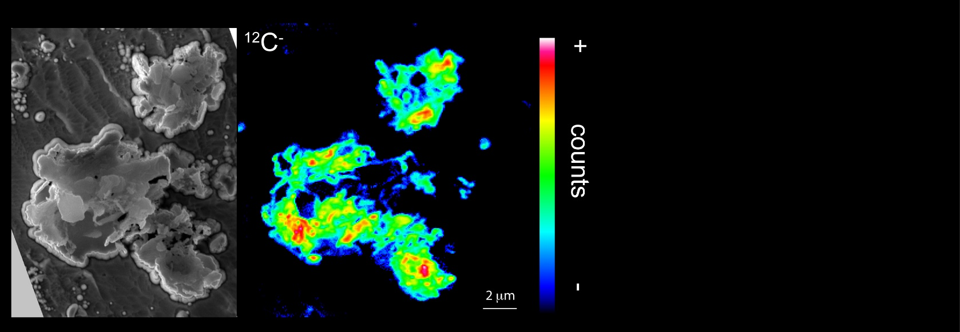
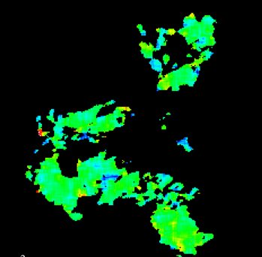
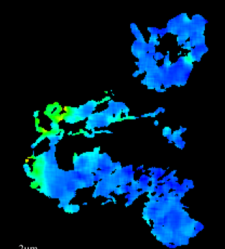
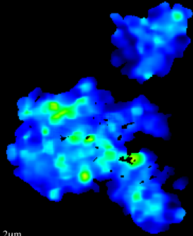
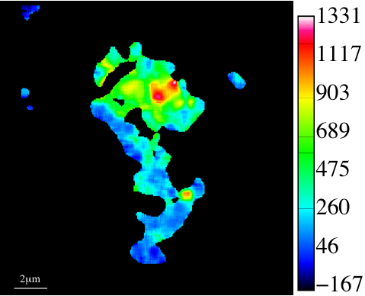
Soil Organic Matter Processes…….. Organo-mineral interactions plays a role in C and N sequestration
¹³C and ¹⁵N derived from glycine
But in many cases, ¹³C and ¹⁵N labels are decoupled
C/N
δ¹³C (‰)
δ¹⁵N (‰)
36
130
1400
9.9±0.1
823±100‰
1050
27
90
18
50
700
9
10
350
0
47±28‰
-30
1054
±133‰
0
11.3±0.1
Hatton et al. in prep
Micro aggregate from the fraction 1.85 -2.0 g.cm⁻³

Slide 21
Soil Organic Matter Processes…….. Organo-mineral interactions plays a role in C and N sequestration
Conclusions (experiment 1)
NanoSIMS is a powerful tool to study the fate of OM onto small soil structures, at the scale of stabilisation processes
Its elemental maps are a valuable tool to demonstrate
the discontinuity of the OM cover (definitly not a single layer cover !)
the spatially variable OM nature;
In combination with isotopic labelling, NanoSIMS generates unique information about the mechanisms controlling the attachment to soil
  After 12 years of decomposition in situ we observed N derived from litter likely as microbial matter, in some aggregates where decomposition activity is hampered and cycling slows down.
  Microorganisms operate stabilization (i) directly via the immobilization within microbial cells and (ii) indirectly through an abundant production of extracellular microbial products

Slide 22
Soil Organic Matter Processes…….. Organo-mineral interactions plays a role in C and N sequestration
Conclusions (experiment 2)
Over the 3700 μm² we imaged : 5 spot of ¹³C and 28 spots of ¹⁵N
Glycine-derived C is concentrated in few locates, likely in the vicinity of microbial cells (We do not observe any bacteria - consistent with a rather small surface sampled)
Glycine-derived N is widely spread in soil, presumably as NH₄⁺ or exoenzymes and preferentially attached to mineral-attached OM rich in N

Slide 23
Soil Organic Matter Processes…….. importance of microbe activity into the control of SOM dynamics
mortality*C_{dec}
A simple mecanistic model
SOC
Cdecomposer
Allowing investigating the functional diversity of the decomposers using the differences in isotopic signature between the SOC and the fresh OC
CO₂
CO₂
activity*C_{dec}
respiration*C_{dec}
Φ
Research question
Do microbes destabilise old soil organic matter
after fresh substrate addition?
Fresh OC
Modified from Fontaine et al., 2005

Slide 24
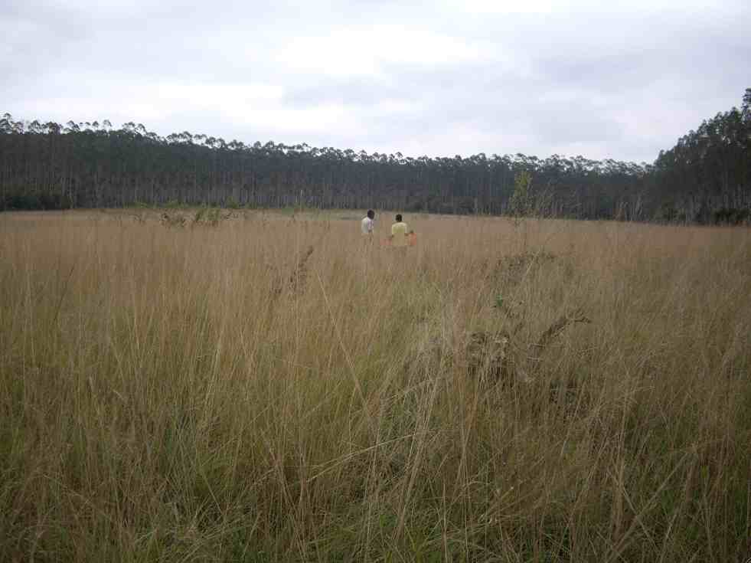
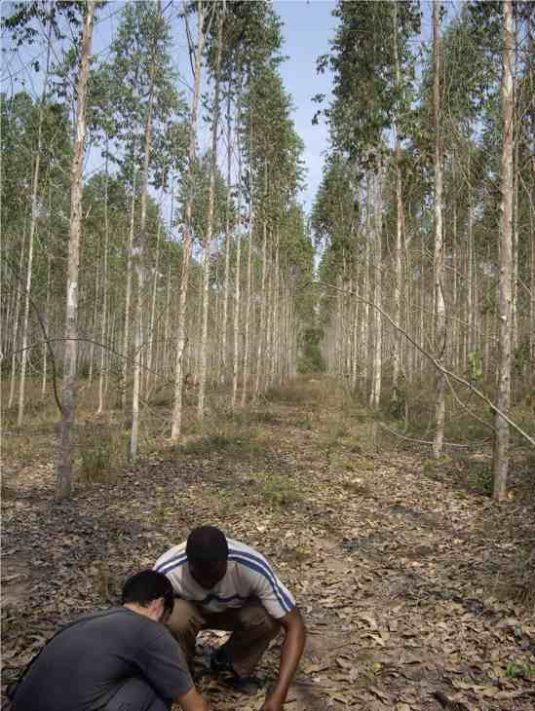
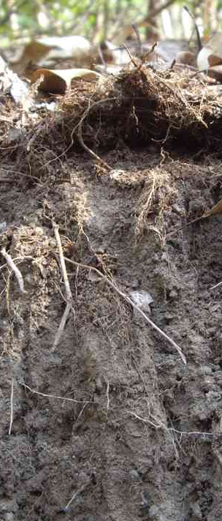
Soil Organic Matter Processes…….. importance of microbe activity into the control of SOM dynamics
Experimental Approach
Topsoils from Congolese Eucalyptus plantations established for 17yrs on a former savannah
- C4 labelling of SOC older than 17yrs
- C3 labelling of SOC younger than 17yrs
steady state:
δ¹³C CO₂:
-26.3‰
Expected changes in CO₂ - δ¹³C
C4 Carbon
derived from the old savannah
δ¹³C = -14.8‰
C3 Carbon
derived from the young eucalyptus
δ¹³C = -31.2‰
Increase in the CO₂ - δ¹³C
➔ Increase in the mineralisation of old C4-C derived from the savannah
Addition of glucose
(200μg/g to induce microbe growth)
Glc-δ¹³C ~ CO₂-δ¹³C _{steady state} (-24,7‰)
Decrease in the CO₂ - δ¹³C
➔ Increase in the mineralisation of young C3-C derived from eucalyptus
Incubation at 25°C for one week
Continuous monitoring of CO₂ and CO₂ - δ¹³C
Derrien et al. 2014

Slide 25
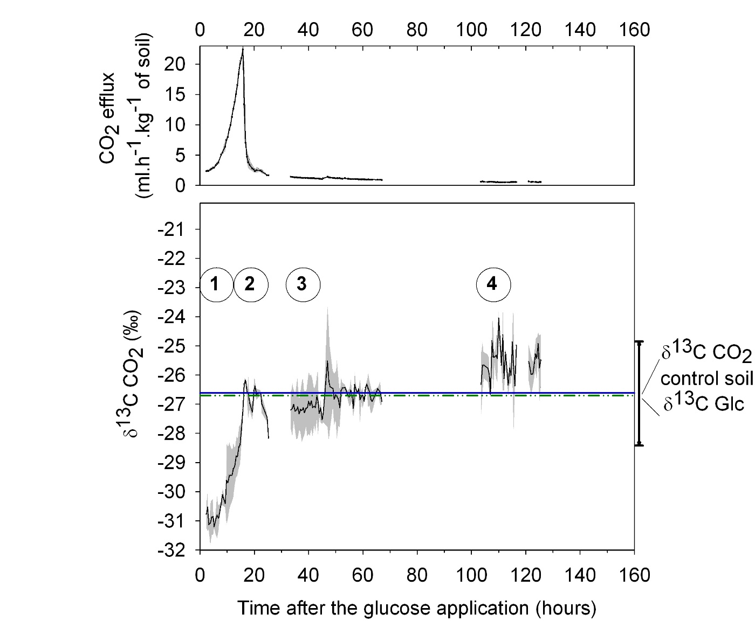
Functional diversity of microbial populations
Soil Organic Matter Processes…….. importance of microbe activity into the control of SOM dynamics
C4 OM
derived from the old savannah
δ¹³C ~ -14.8‰
steady state:
δ¹³C CO₂:
-24.7‰
C3 OM
derived from the young eucalyptus
δ¹³C ~ -31.2‰
Increase in the mineralisation of OM derived from the old savannah ?
Increase in the mineralisation of OM derived from fresh eucalyptus inputs ?
Derrien et al. 2014

Slide 26
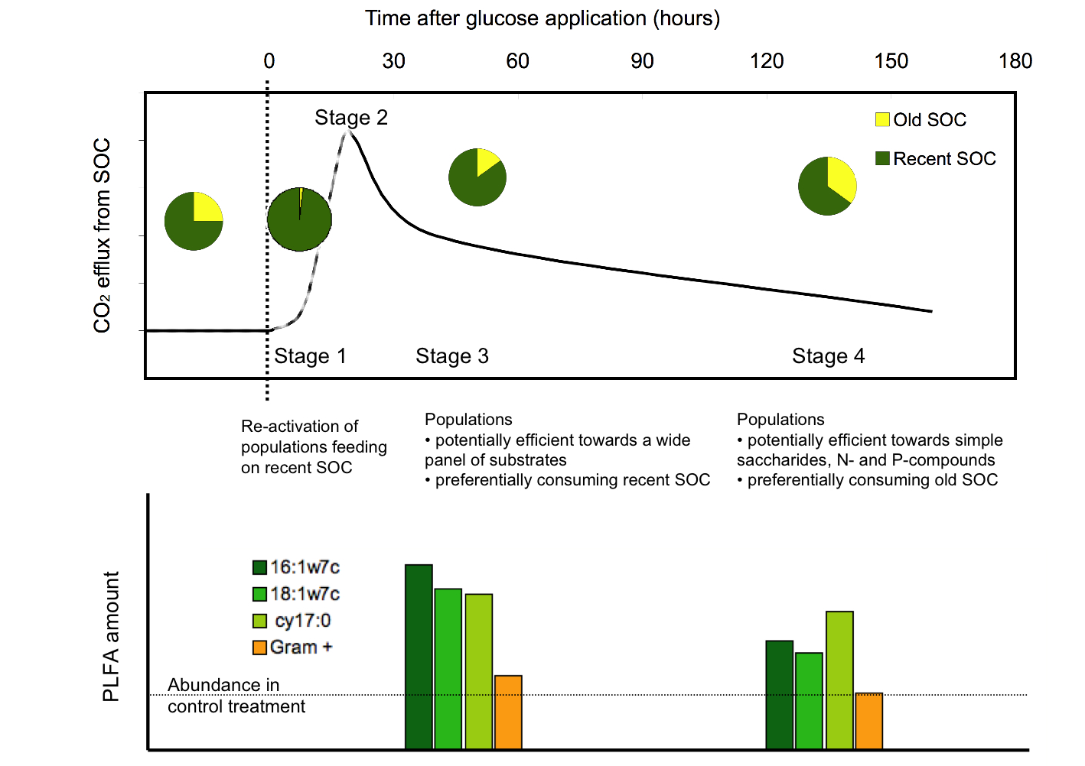
Functional diversity of microbial populations
Soil Organic Matter Processes…….. importance of microbe activity into the control of SOM dynamics
Derrien et al. 2014

Slide 27
Functional diversity of microbial populations, conclusions and perspectives
Soil Organic Matter Processes…….. importance of microbe activity into the control of SOM dynamics
In the N-poor Congolese soil, the pulse input of glucose induced major changes in microbial community structure and SOC utilisation patterns;
Inducing first a preferential use of recent SOC and then a destabilisation of old SOC, likely to meet needs in N;
Nitrogen availability would be a key factor controlling microbial activity.
Derrien et al. 2014

Slide 28
Soil Organic Matter Processes…….. importance of the site fertility on the control of SOM dynamics
Sources of nitrogen for the decomposers ?
A model
(1-p)
Lost N
Nutrition
Volatilization
Nitrification
Litter
Mineralization
Residual N
+
Microbial N
(from the litter)
+
Exogenous N
Depolymerization
Recycled N
(p)
+ 15N labelled
litter experiments
N_{decomposeurs}
x N_{decomposers}
Assimilation
(1-x).N_{decomposers}
D’Annunzio et al. 2008, modified from :
Agren and Bosatta, 1998; Schimel and Bennett 2004
Exogenous N
Sol, Solution, Dissous

Slide 29
Soil Organic Matter Processes…….. importance of the site fertility on the control of SOM dynamics
N végétal dérivé+résiduel
Model fitted in Beech stands in Europe
(the 15N labelling network)
Carbone
R²=0.86, n=367
Soro
Fougères (3)
Leinefelde (4)
Hesse
Ebrach
Breuil
Aubure
N exogène
R²=0.92, n=392
R²=0.65, n=367
Derrien et al. In prep

Slide 30
Soil Organic Matter Processes…….. importance of the site fertility on the control of SOM dynamics
The poorer is the soil in nitrogen, the more the decomposers recycle the litter
Derrien et al. In prep

Slide 31

Soil Organic Matter Processes…….. Integration at ecosystem scale
Research questions
Atmospheric deposits
When the mineralized N is available for the trees ?
How much of this N is uptaken by the trees after 10 years of monitoring?
LitterFalls
Nox emission
N atmospheric fixation
N Mineralisation
Litter N
Decomposer
Biomass
N and other nutrient bio-availability for the trees
NO₃⁻
NH₄⁺
Soil Organic N
N Release
N Recycling
Stabilisation/Destabilisation processes of the SOM

Slide 32
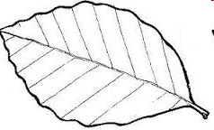
The extraordinary adventure of the ¹⁵N in the ecosystem…
Soil Organic Matter Processes…….. Integration at ecosystem scale
¹⁵N
1
¹⁵N labelled litters spread on the soil
2
¹⁵N Incorporation in the soil layers
3
¹⁵N uptake by the trees

Slide 33
The 15N labelling network
Soil Organic Matter Processes…….. Integration at ecosystem scale
1 species:
  Beech (Fagus sylvatica)
10 sites:
  7 in France, 3 in Europe
2 networks:
  RENECOFOR – NIPHYS/CANIF
2 (Renecofor) ou 3 (NIPHYS) trees labelled per site
A 10 year monitoring period:
  1994 – 2013
3 compartiments of the ecosystem measured:
  Leaves, Litter, Soil

Slide 34
A soil-plant model to follow the 15N
Soil Organic Matter Processes…….. Integration at ecosystem scale
N in leaf biomass
φ
N Litter
Tree
N in woody biomass
1-φ
Needs in N
1-θ
N in big roots
N allocation
(internal recycling)
Combining Fagacée
[improved for biomass and nutrient content
Genet et al. (2011), Wernsdörfer et al. (2013)]
N in fine roots
1-φ
N Litter
0 – 10 cm
hyp: source N = Litter (solely)
N Sol total
φ
k_{litière} . N_{litière}
α
1-α
N Debris
k_{débris} . N_{débris}
Soil
h
1-h
N Soil 1
k_{sol 1} . N_{sol 1}
N uptake
x
N available
1-tr
tr
And a soil module specifically built for the study
1-x
N Soil 2
1-tr
k_{sol 2} . N_{sol 2}

Slide 35
Mean residence time of 15N in the litter
Soil Organic Matter Processes…….. Integration at ecosystem scale
k_{litière}
¹⁵N
1
Mean residence time of 15N in the litter

Slide 36
Fit on litter data sets
Soil Organic Matter Processes…….. Integration at ecosystem scale
Mull
Moder
N_{Litière} = N_{o} . exp(- k_{Litière} . t)

Slide 37
Mean N residence time
Soil Organic Matter Processes…….. Integration at ecosystem scale
MRT = 1 / k
With k – ¹⁵N, the cinetic parameter of N litter decomposition
 | Aubure | Ebrach | Collelongo | Het 02 | Het 25 | Het 26 | Het 30 | Het 55 | Het 60 | Het 88
k – ¹⁵N (an⁻¹) | 0.34 | 0.43 | 0.23 | 0.71 | 0.67 | 0.36 | 0.35 | 0.50 | 0.71 | 0.31
MRT ¹⁵N (ans) | 2.9 | 2.3 | 4.4 | 1.4 | 1.5 | 2.8 | 2.9 | 2.0 | 1.4 | 3.2
Mull
Moder
– High altitude, high rainfall
MRT contrôlé par les conditions climatiques

Slide 38
Soil Organic Matter Processes…….. Integration at ecosystem scale
15N incorporation into soil layers
k_{litière}
¹⁵N
2
¹⁵N incorporation into soil layers

Slide 39
Soil Organic Matter Processes…….. Integration at ecosystem scale
Fit on soil datasets (0 – 10 cm) – R² from 0.70 to 0.98
Mull
Moder
N Sol = N Sol 1 + N Sol 2

Slide 40
Sequestration of ¹⁵N in woody debries.
Soil Organic Matter Processes…….. Integration at ecosystem scale
MRT Débris
1-h
The higher ¹⁵N MRT in woody debries is, the higher is N bio-availability for trees in the same laps time

Slide 41
Sequestration of ¹⁵N in woody debries.
Soil Organic Matter Processes…….. Integration at ecosystem scale
MRT Débris
1-h
High N Stock (≥ 2.5 t.ha⁻¹)
Low transfert between woody debries and N available for the trees (≤ 35%)
Low N stocks (≤ 1.8 t.ha⁻¹)
High transfert between woody debries and N available for the trees (≥ 40%)
Consistent with X-ratio study (High recycling of litter inputs) – both decomposers and trees uptake N from the litter when other sources are low
Het 25
Het 26
Het 60
Het 02
Het 30

Slide 42
15N incorporation and site fertility
Soil Organic Matter Processes…….. Integration at ecosystem scale
1-tr
Again, consistent with X-ratio study – trees uptake N from the soil when this resource is available
Transfert between N soil and site fertility index (dominant height at 100years)

Slide 43
Soil Organic Matter Processes…….. Integration at ecosystem scale
¹⁵N budget from the model outputs
Mull
Moder
MULL: Impact of macro-fauna (hearthworm), formation of agregates, SOM sequestration
Stabilisation and conservation of ¹⁵N into the soil layers

Slide 44
Soil Organic Matter Processes…….. Integration at ecosystem scale
¹⁵N budget from the model outputs
Mull
Moder
Are the trees N sinks of the available N in the soil (for both MULL and MODER)

Slide 45
Soil Organic Matter Processes…….. Integration at ecosystem scale
x
¹⁵N
3
¹⁵N uptake by the trees

Slide 46
Soil Organic Matter Processes…….. Integration at ecosystem scale
¹⁵N incorporation in the leaves
Mull
Moder
2 incorporation phases:
Increase of the biodisponibility of ¹⁵N for the trees
Decrease of this biodisponibility (stabilisation / immobilisation)
slow use of N from the litters
(long phase 1)
rapid use of N from the litters
(short phase 1)

Slide 47
Soil Organic Matter Processes…….. Integration at ecosystem scale
Conclusion
Favourable climate conditions
Long period for tree physiological activity and growth
Fast litter degradation
Unfavourable climate conditions Snowy, cloudy
Short period for tree physiological activity and growth
Slow litter degradation
Moder
Mull
Moder
Amount of ¹⁵N accumulated after 10 years (% of ¹⁵N applied) :
Ebrach (19.4)
Het 02 (11.4)
Het 55 (7.3)
Aubure (3.0)
Het 30 (14.8)
Het 26 (4.5)
Het 88 (9.5)
Het 25 (11.3)
Het 60 (14.3)

Slide 48
Soil Organic Matter Processes…….. Integration at ecosystem scale
Net Ecosystem Exchange : NEE = GPP – Reco
Soil productivity, storms events and climate variations
Carbon Uptake or Release
Respiration
Photosynthesis
GPP = Gross Primary Production
R_{eco} = Ecosystem Respiration
Impact on litter inputs and SOM mineralisation
NPP = GPP – Ra
= Net primary production
Rs = Soil Respiration
Ra = Autotrophic Respiration
L= Litterfall
Rh = Litter decomposition
Research question
AR= (root turnover and exudates)
BC = L+AR-Rh - Drainage
= Soil Carbon Balance
Drainage
Is there a Stabilisation or a Destabilisation of the SOC after 15 years monitoring in forest soils?

Slide 49
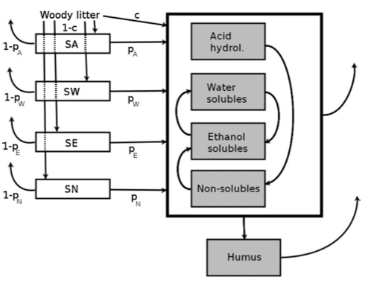
Soil Organic Matter Processes…….. Integration at ecosystem scale
Specifically designed for forest growth and yield models
Based on the biochemical composition of the litter inputs (for both above and belowground)
Takes climate into account
Makes the hypothesis that soil fertility and its impact on SOC dynamics is fully transmitted by the amount of litter input
The Yasso7 model (from Masera et al, 2003; Liski et al, 2005; Tuomi et al 2011)

Slide 50
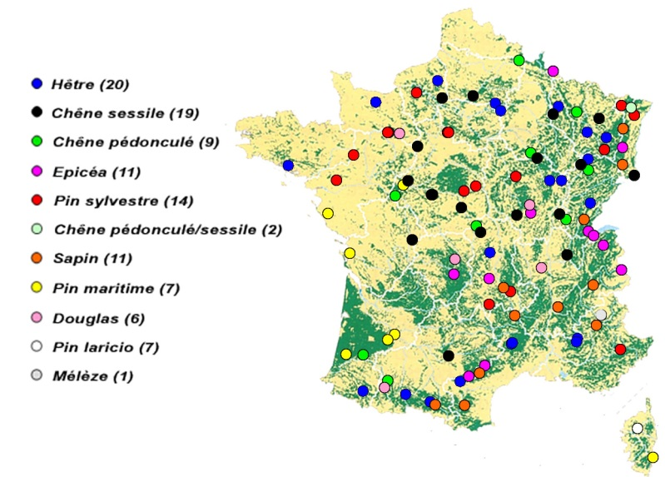
Soil Organic Matter Processes…….. Integration at ecosystem scale
An unique dataset in forest ecosystems
Cover the main tree species in France
Aboveground litterfalls measured between1994-2008 (leaves, branches, fruits et miscellaneous).
Regular forest inventories combined with biomass models (above- and below-ground biomass) allowed to estimate the inputs after each thinning and each storm
Soil carbon stocks have been measured in 93-95 and in 07-12.
Climatic datasets are coming from RENECOFOR own recording and Meteo France.
102 plot of the RENECOFOR Network

Slide 51
Soil Organic Matter Processes…….. Integration at ecosystem scale
Good results in average
1999 storm, plot HET 54b
Spinup procedure with average climate and litter inputs
Thinning
 | Observed (tC/ha) | Yasso07-6rdRun (tC/ha)
Mean | 80.9 | 81.6
SD | 29.9 | 22.8
CV | 37% | 28%
 | Observed (tC/ha/period) | Yasso07-6rdRun (tC/ha/period)
Mean | 5.6 | 6.1
SD | 9.5 | 7.2
CV | 170% | 118%
Actual climate and litter inputs (evaluation of the stock changes)

Slide 52
Soil Organic Matter Processes…….. Integration at ecosystem scale
BUT, not at the stand / species level…….
Taking species specific biochemistry of the litters
Without considering species biochemistry of the litters
Same results for both stocks and stock changes……..

Slide 53
Soil Organic Matter Processes…….. Integration at ecosystem scale
Error tracking…….
Error well correlated to the initial stock
Past history ? But also wrong estimate of the partitionning of SOM into the biochemical components
Species effect (on the intercept and interaction with the stand productivity)
  Biogeochemistry of the litter not well taken into account
  Too much emphisize on the amount of the litter
Fertility effect (slight)
The litter inputs do eliminate most of the impact of soil fertility on
SOC dynamics, but not all. It remains a slight effect of soil properties

Slide 54
Soil Organic Matter Processes…….. Integration at ecosystem scale
Conclusion on the Yasso model
The architecture of Yasso based on a biochemical partitioning of SOC is particularly relevant to tackle the challenge of assessing assess fluxes at decades to centuries time scale
But it need to be reparametrized for French application with more contrasted values for the Acid, Ethanol and Non soluble pools (like in Tuomi et al., 2011a Ecological Modelling; 2011b, Environmental Modeling and Software)
And also may be an improvement to take, at least, humus type into consideration (cf work of J. Salleles)

Slide 55
Soil Organic Matter Processes…….. Conclusion
General conclusion
Context, socio economic issues
SOM as support of soil fertility
Technological
Innovation
Comprehensive sites – Highly instrumented
Hypotheses on ecosystem functioning
Extrapolation
Nanosims-STXM
Stabilisation/Destabilisation of SOM
Dedicated models
Service-related Indicators
Knowledge on the processes
Soil-Plant model
Identify bottle-necks and important processes
Interpret, understand
Yasso07 on Renecofor
Permanent plots, experimental networks
Input/output budgets
Put things into perspective
N cycling
Synthesis, this presentation
Conceptualization of forest ecosystems functioning
New hypotheses and research questions
Soil-plant models; recommendations to forest managers

Slide 56
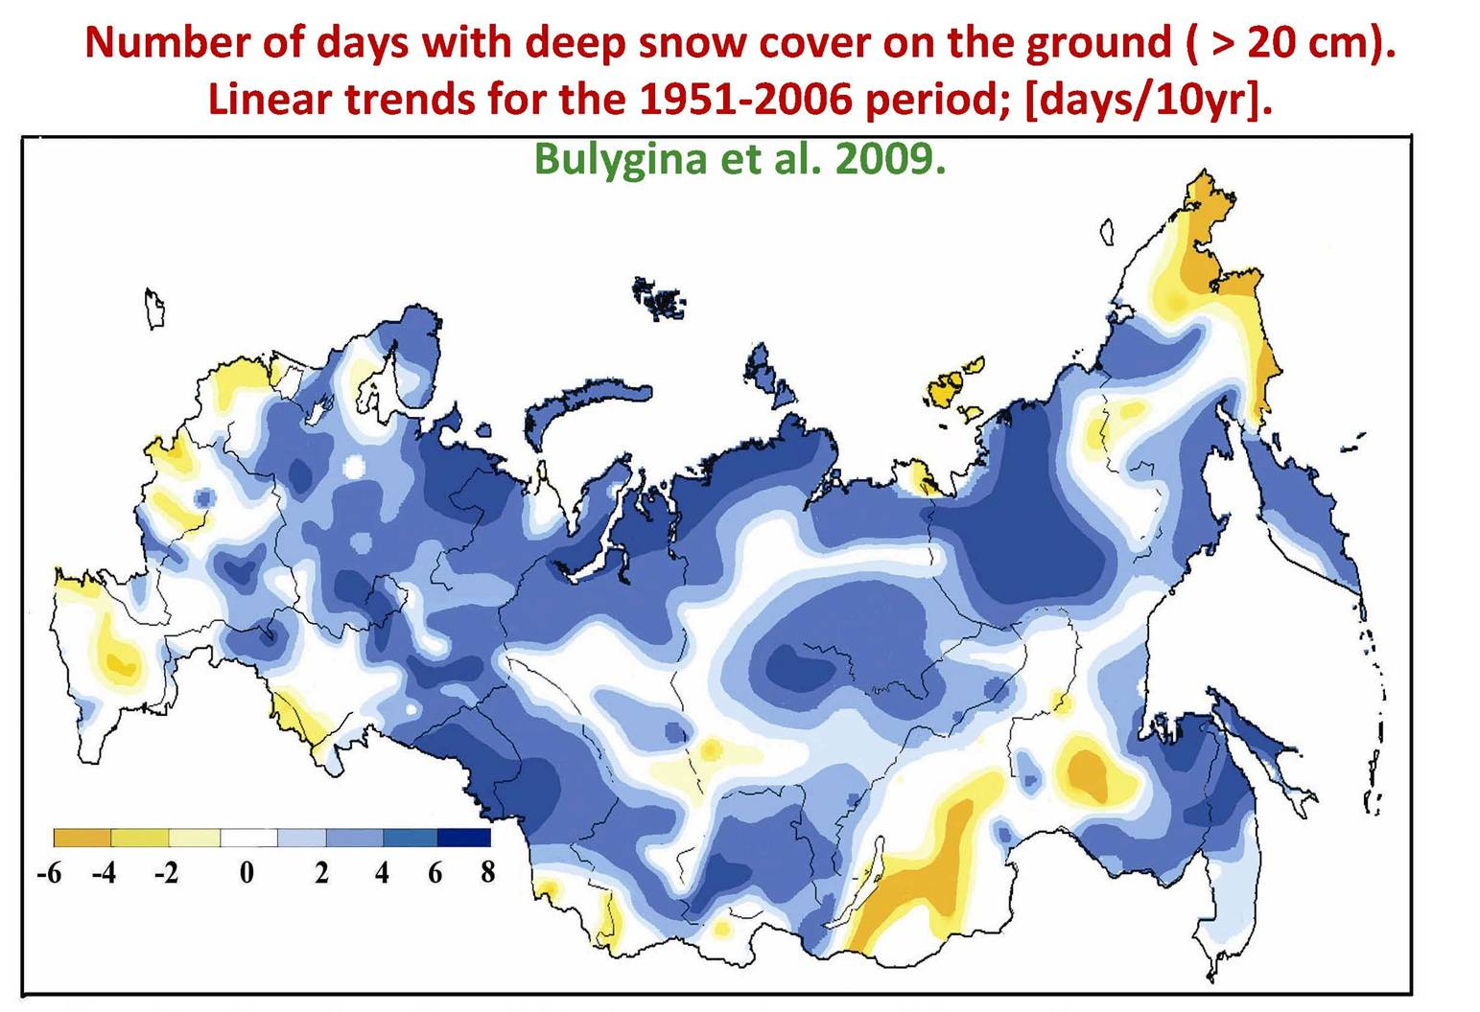
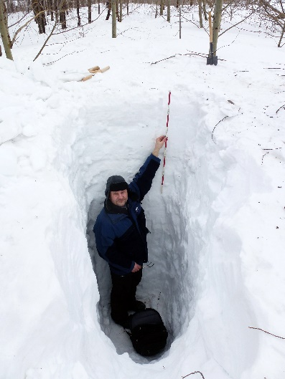
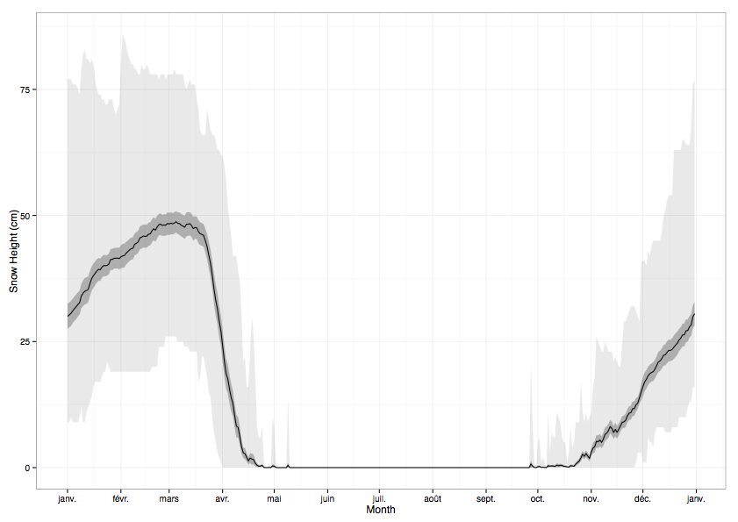
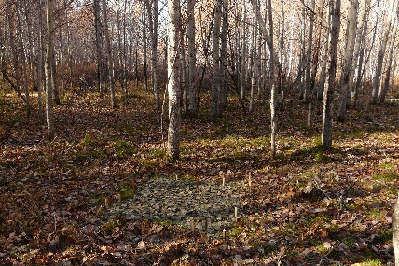
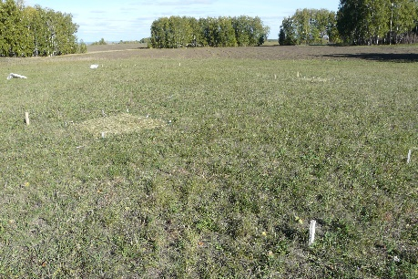
Soil Organic Matter Processes…….. Perspective
Perspectives
Climate change and soil fertility – Western Siberian
Context
Current projections for climate change indicate that the huge territory of the western Siberian plains will become suitable for agriculture. However, the projections do not consider the soil fertility, whereas it is a relevant issue. The intention is to test whether the predicted increase in snow precipitations will change the soil water fluxes but also the patterns of soil organic matter decomposition and the rate of nutrient release through reduced soil freezing.
Hypotheses
  the predicted increase in snow precipitations will
  reduce soil freezing
  Modify the soil water fluxes
  And as a result, change
  the patterns of soil organic matter decomposition
  the rate of nutrient release.
Methods :
snow manipulation, experimental sites on a snow gradient
T°C, moisture record
15N litter decomposition
Enzyme measurement
phD Polina Nikitich

Slide 57
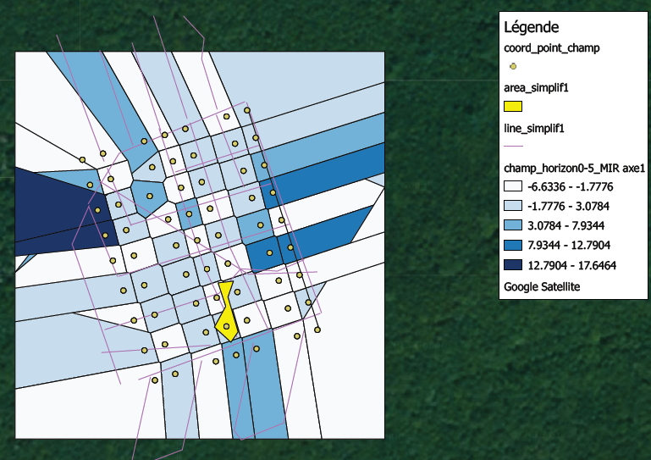
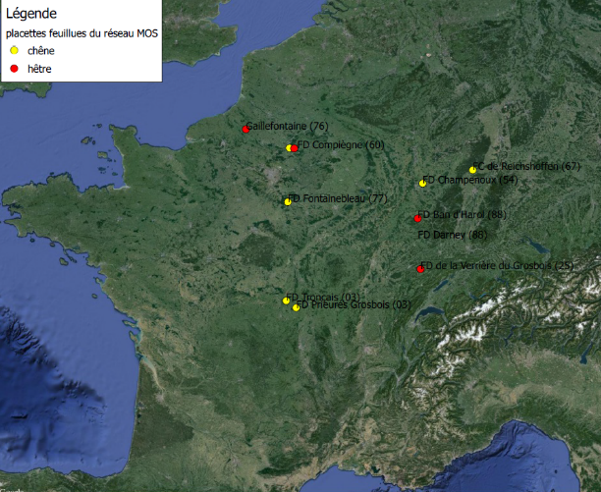
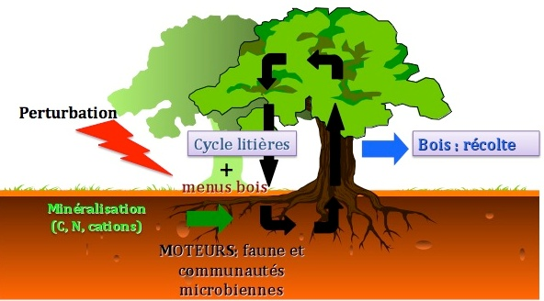
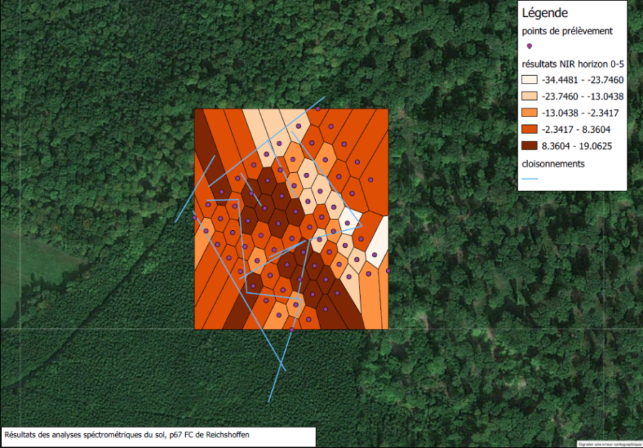
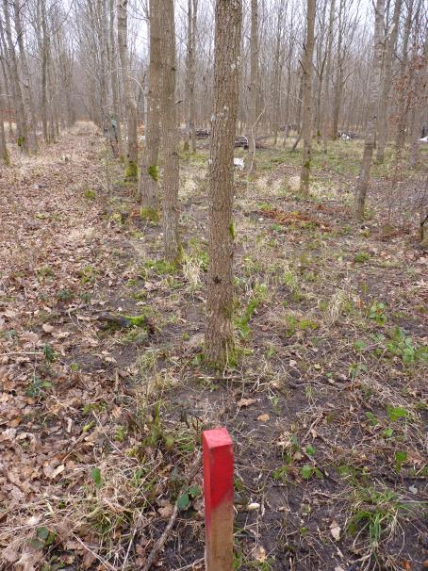
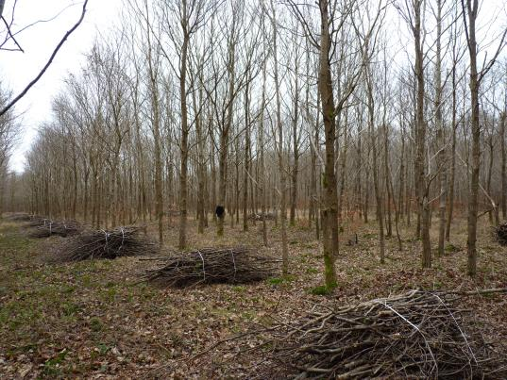
Soil Organic Matter Processes…….. Perspective
Perspectives
Impact of Slash management on soil fertility and soil biodiversity (structure and function)
phD Emila Akroume

