Slide 1
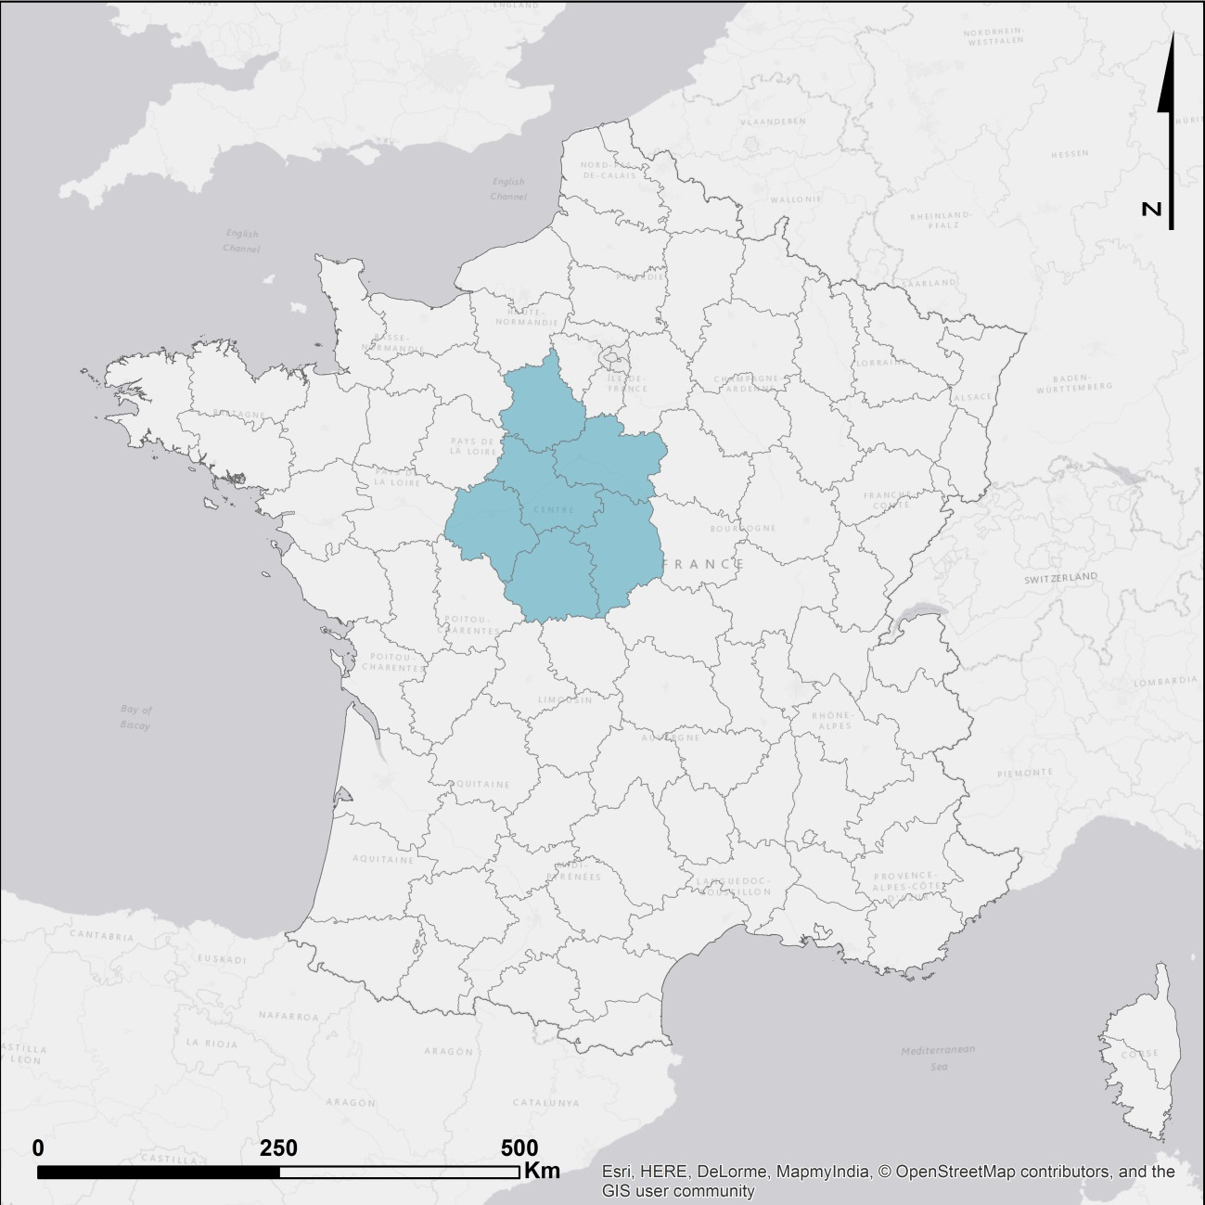
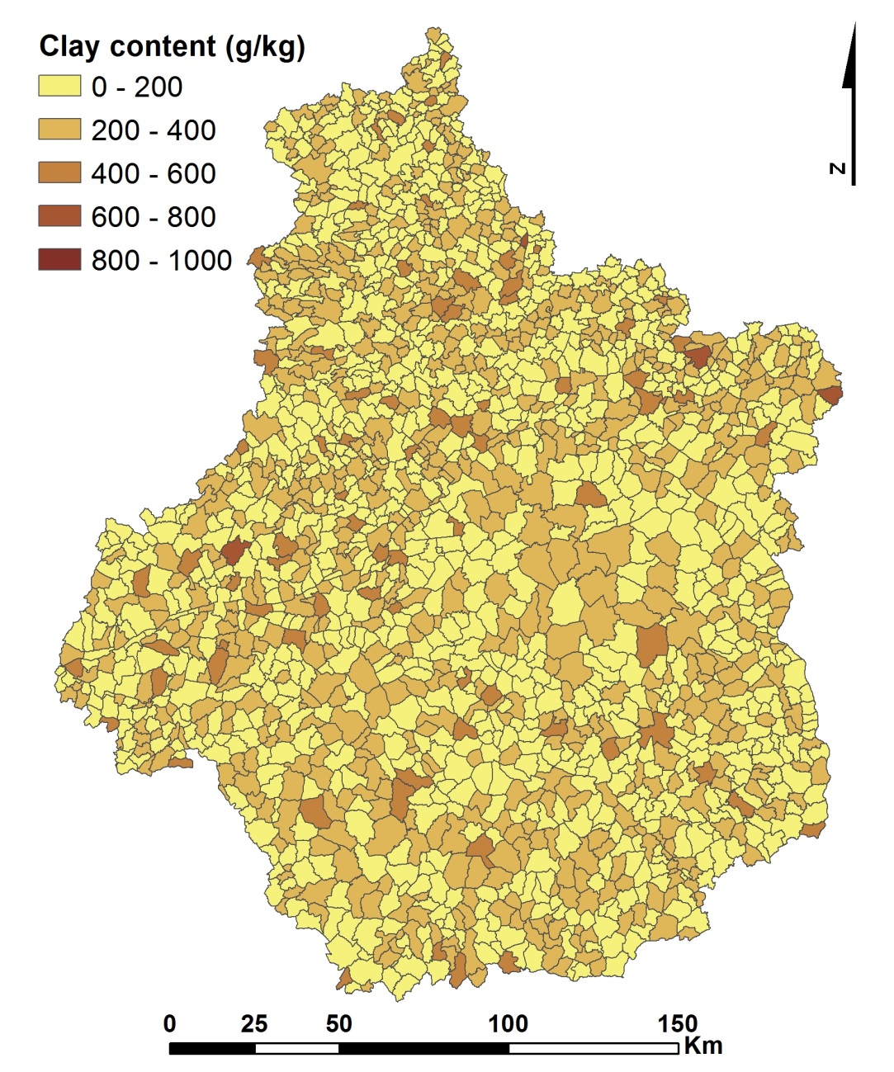
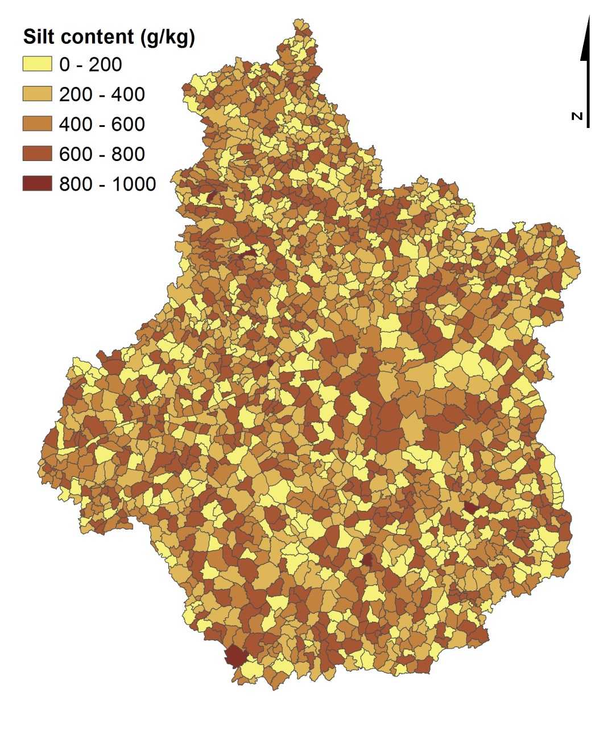
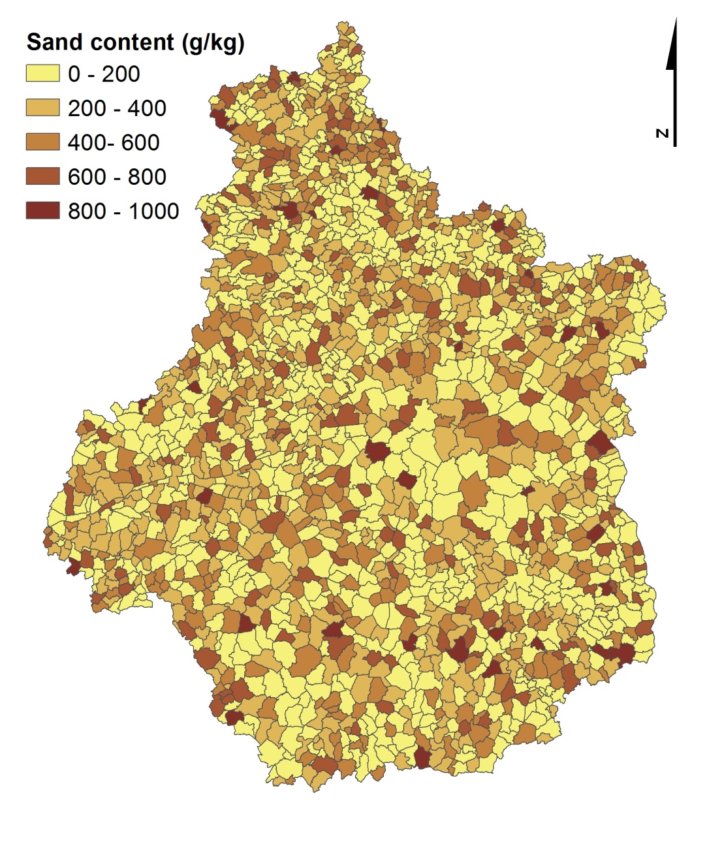
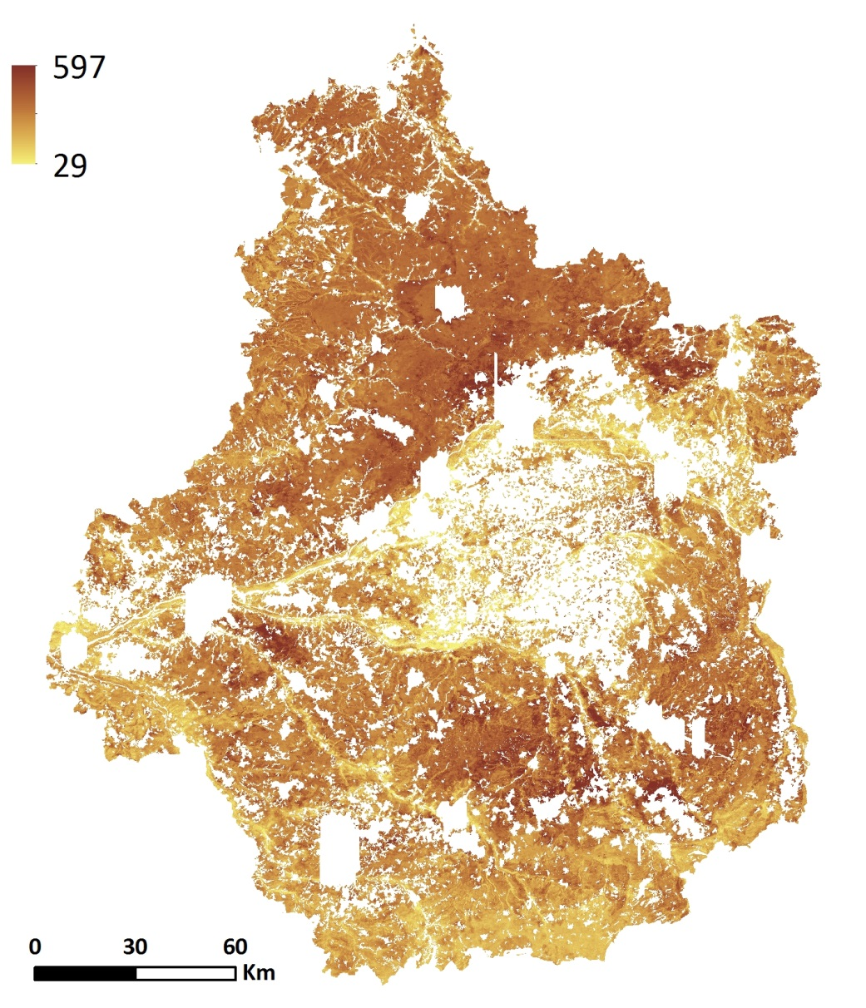
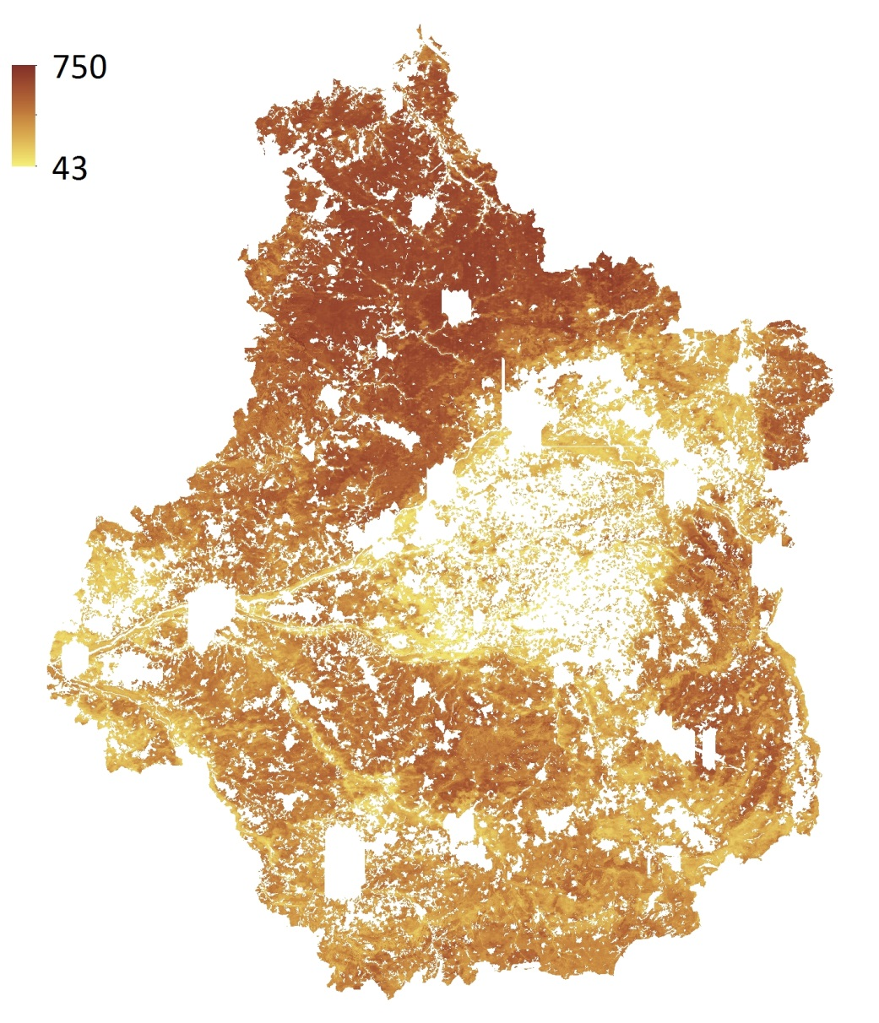
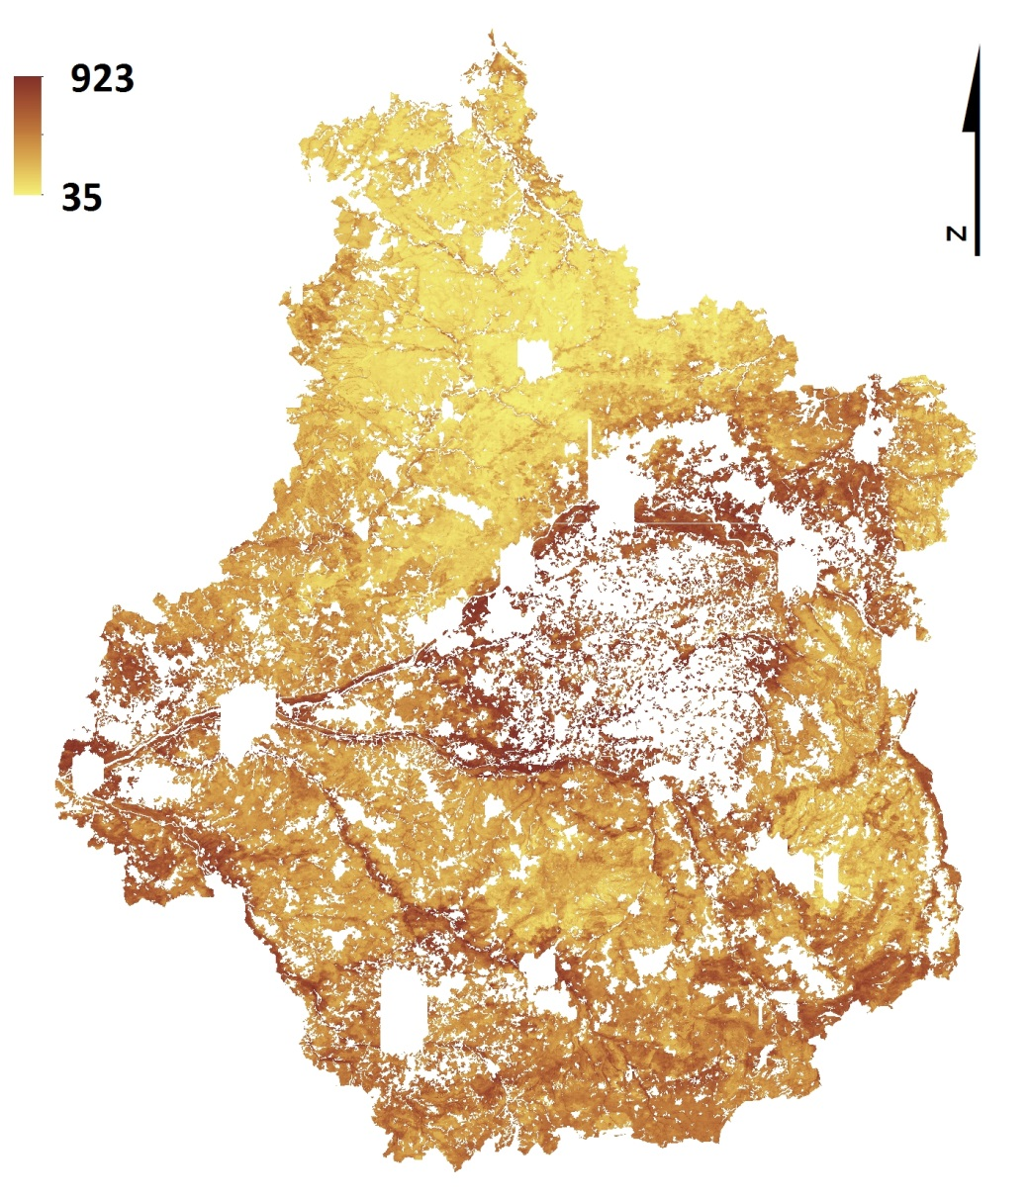
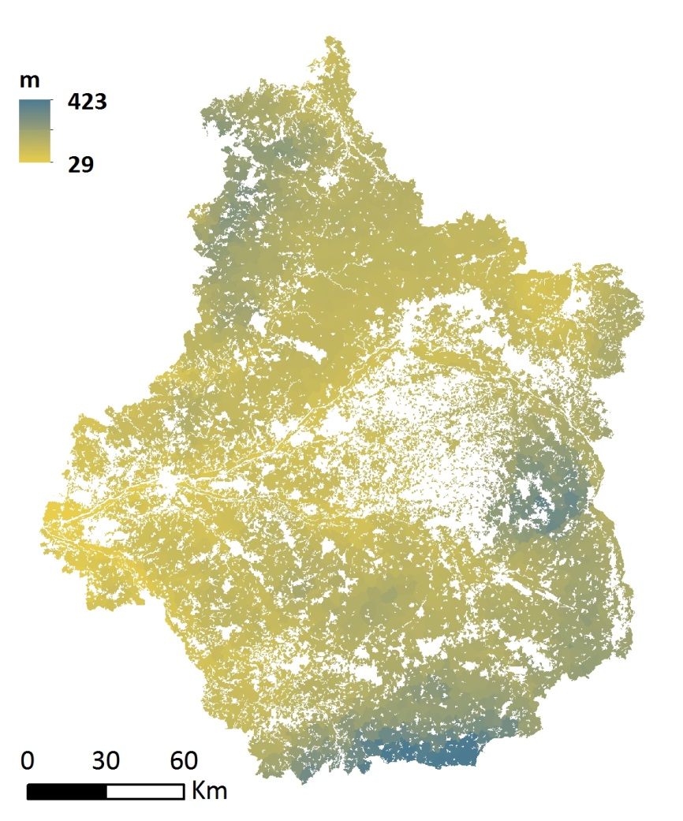
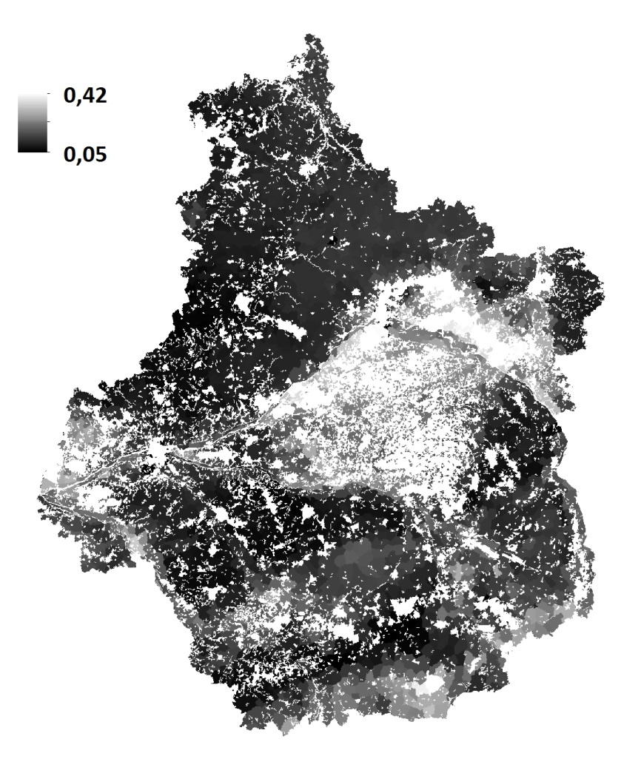
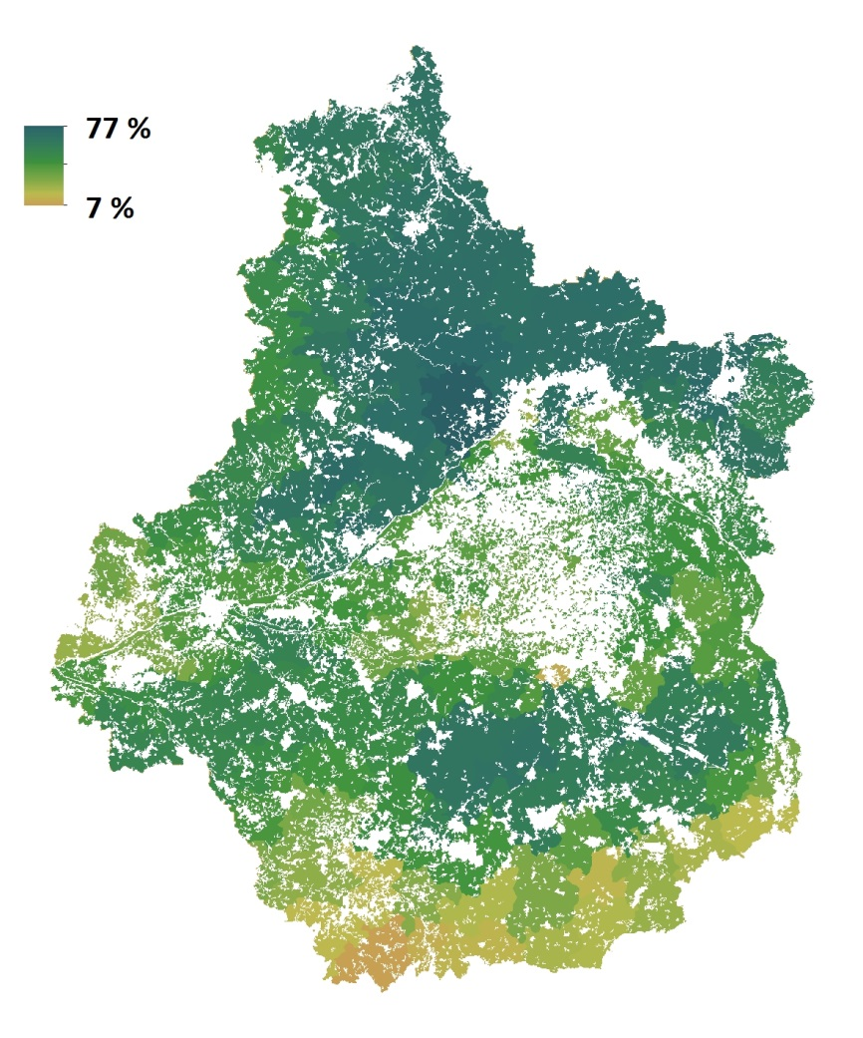
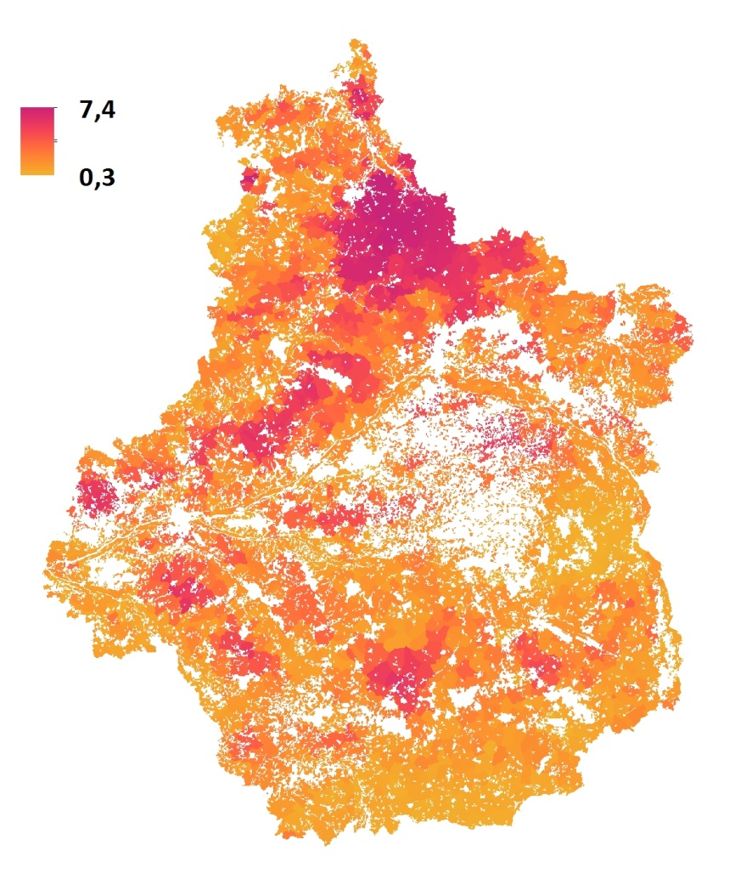
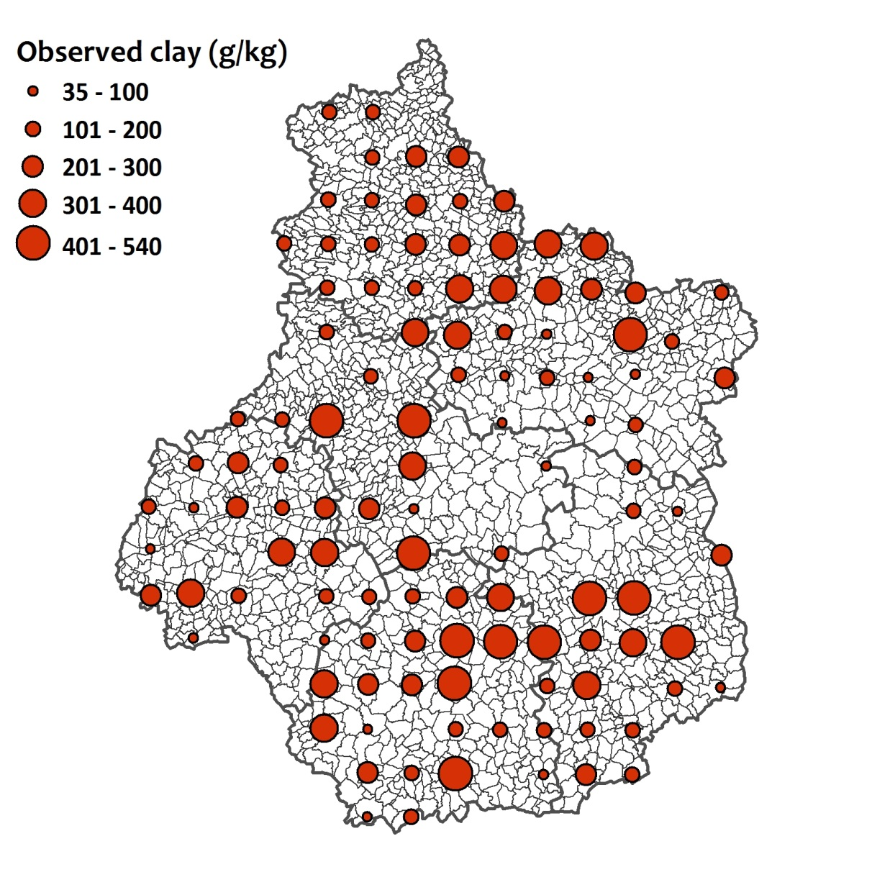
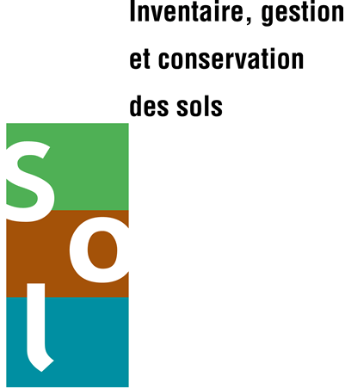
Spatial prediction of soil texture in Region Centre (France) from summary data
Mercedes Román Dobarco¹, Nicolas Saby¹, Tom G. Orton², and Jean-Baptiste Paroissien¹
1. Institute National de la Recherche Agronomique, US InfoSol, France. 2. Faculty of Agriculture and Environment, University of Sydney, Australia
Introduction and Objective
Preliminary Results
Soil texture is a key controlling factor of important soil functions like water and nutrient holding capacity, retention of pollutants, drainage, soil biodiversity, and C cycling. High resolution soil texture maps enhance our understanding of the spatial distribution of soil properties and provide valuable information for crop management and environmental protection.
Only BRT models provided better predictions than average BDAT data by municipality.
Model | Particle size fraction | RMSE | R² | Bias
BDAT reference | Clay | 96.93 | 0.32 | -8.57
BDAT reference | Sand | 153.73 | 0.59 | -2.72
BDAT reference | Silt | 123.02 | 0.64 | 10.45
MLR | Clay | 88.98 | 0.40 | -4.92
MLR | Sand | 168.73 | 0.51 | -38.3
MLR | Silt | 132.81 | 0.59 | 43.21
Cubist | Clay | 100.97 | 0.23 | -11.33
Cubist | Sand | 167.1 | 0.52 | -19.06
Cubist | Silt | 126.06 | 0.63 | 30.39
BRT | Clay | 81.58 | 0.50 | -20.02
BRT | Sand | 125.19 | 0.73 | -4.65
BRT | Silt | 99.96 | 0.77 | 24.67
The French soil-test database (BDAT) is populated with soil analysis requested by farmers interested in improving soil properties.
Unknown location of farms.
Soil texture data are available aggregated by municipality (but valuable information!).
The objective is to predict soil texture of agricultural topsoils in the Region Centre (France) in point support from areal data combining regression models and area-to-point kriging.
Region Centre
Variable influence for clay-alr BRT model and sand-alr model
Geological map 1:50,000
Geological map 1:1,000,000
Uranium
Elevation (SRTM 90 m)
Potassium-thorium ratio
MRRTF
Parent material 1:1,000,000
MRVBF
Percentage of oleaginous
Slope
Percentage of cereal
Potassium-thorium ratio
Uranium
Geological map 1:50,000
Percentage of fallow land
Elevation (SRTM 90 m)
Geological map 1:1,000,000
Potassium
Slope height
Thorium
Methods
Predicted clay content (g/kg)
Predicted silt content (g/kg)
Predicted sand content (g/kg)
25 environmental covariates calculated within the agricultural land by municipality: continuous variables (mean value), categorical variables (dominant class).
Mean elevation (SRTM 90 m)
Mean potassium-thorium ratio (gamma-ray)
Percentage of cereal in agricultural land (2000)
Mean Multi-resolution Ridge Top Flatness index
Future work
Soil texture model predictions will be used as auxiliary variables for area-to-point kriging following the method developed by Orton et al. (2012).
Area-to-point kriging considers the average value, the number of observations, and the sample variance by municipality, assessing the uncertainty areal means.
Predictions are mass-preserving (average of the point predictions within a municipality equals the average measured value).
Point predictions are calculated with a linear mixed model, in which BRT predictions are included as a fixed effect, including indirectly the relationships among covariates and soil texture.
Prediction for sand-alr and clay-alr will be calculated by cokriging using a linear model of coregionalization.
Covariance parameters are estimated with residual maximum likelihood, and spatial predictions by empirical best linear unbiased predictor.
The results will inform on whether the later and statistically more-challenging approach improves significantly texture predictions.
Additive-log-ratio transformation of soil texture data (alr-transform).
Individual texture observations (n=25548) and average covariate values were used to fit multiple linear regression models (MLR), cubist models, and boosted regression trees models (BRT) for sand-alr and clay-alr.
Independent validation of back-transformed predictions with data from 104 sites from the systematic soil quality monitoring network
References
Orton, T.G., Saby, N.P.A., Arrouays, D., Walter, C., Lemercier, B., Schvartz, C., Lark, R.M., 2012. Spatial prediction of soil organic carbon from data on large and variable spatial supports. I. Inventory and mapping. Environmetrics 23(2), 129-147.
Orton, T.G., Saby, N.P.A., Arrouays, D., Walter, C., Lemercier, B., Schvartz, C., Lark, R.M., 2012. Spatial prediction of soil organic carbon from data on large and variable spatial supports. II. Mapping temporal change. Environmetrics 23(2), 148-161.
INRA Centre de recherche d'Orléans
2163 Avenue de la Pomme de Pin
45075 Orleans CEDEX 2
France
http://www.val-de-loire.inra.fr/

