Slide 1


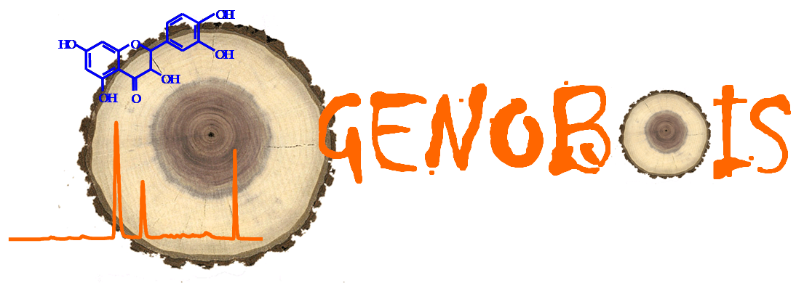


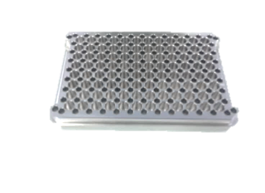
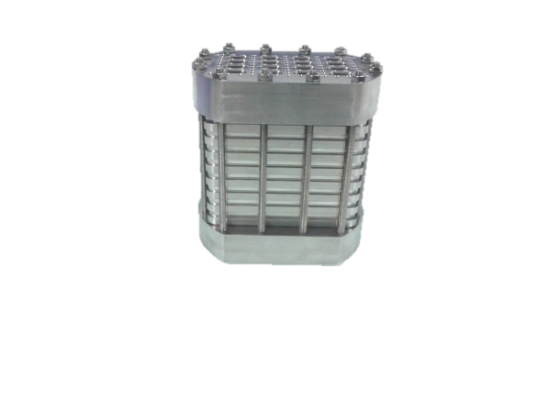
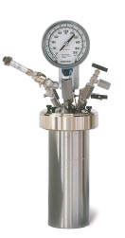
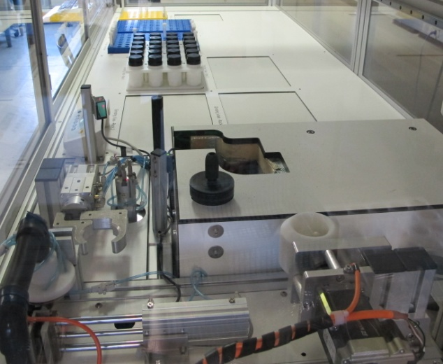
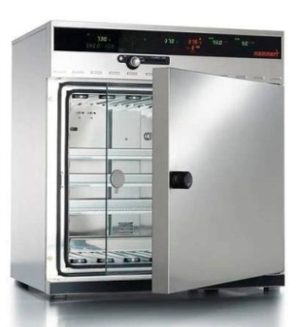
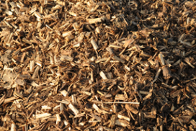

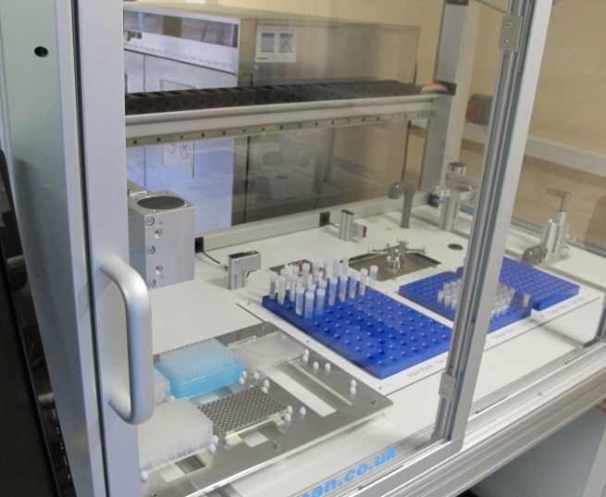
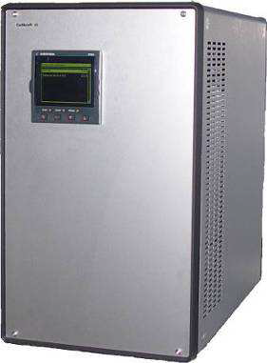
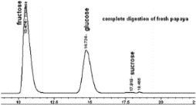
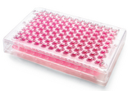





Transfer of a miniaturized method for
high-throughput screening of biomass
pretreatment and saccharification and application
on poplar and miscanthus clones
Nassim Belmokhtar^{a,b}, Vincent Seguraª, Brigitte Chabbert^{c}, Nathalie Boizot^{a,b}, Kévin Ader^{a,b}, Stéphanie Arnoult^{d}, Maryse Brancourt-Hulmel^{e}, Jean-Charles Bastienª, Catherine Bastienª, Jean Paul Charpentier^{a,b}
ª INRA, Centre Val de Loire, UR 0588 AGPF, 45075 Orléans Cedex 2 , France
^{b}INRA, Centre Val de Loire, Plateforme Régionale GénoBois, 45075 Orléans Cedex 2, France
^{c}INRA, Centre Nord Picardie Champagne, UMR 0614 FARE, 51100 Reims, France
^{d}INRA, Centre Nord Picardie Champagne, UE GCIE, Estrée-Mons, 80203 Péronne, France
^{e}INRA, Centre Nord Picardie Champagne, UR AgroImpact, Estrée-Mons, 80203 Péronne, France
Introduction
In order to meet increasing demand for second-generation biofuels, exploring large sets of lignocellulosic biomasses appears to be one of the key levers to improve bio refinery yields.
Poplar and miscanthus breeding programs have provided large sets of varietal outputs, whose saccharification potential assessment could lead to identify the best biofuel-oriented varieties.
Assessment of saccharification potential
2nd generation bioethanol production
2
1
3
Plant breeding programs
High saccharification yielded varieties
Objectives of this study:
1- Transfer into breeding programs and adaptation of a high-throughput screening method developed at NREL (USA)¹
2- Demonstration, on poplar and miscanthus biomass, of the importance of pretreatment step in screening process
Experiments
Biomass preparation
Pretreatment
Enzymatic hydrolysis
Enzymatic hydrolysis without pretreatment
A
Lignocellulosic biomass from short rotation coppice (SRC) and very short rotation coppice (vSRC) poplars and miscanthus clones
Steam (180° C)
Hastelloy 96-well microplate (SBS-type):
Thermal and corrosion resistance
4 steam ports surrounding each well
Stackable in Hastelloy holder
5 mg of biomass per well (1,67 % w/v)
Reaction volume: 340 µL per well
(NREL, Denver, USA)
Enzymatic hydrolysis
(50° C, 70 mg.g⁻¹ Dry Matter of Cellic Ctec-2)
B
Stainless pretreatment reactor
PARR Instrument®
Glucose quantification
Fully automated station for biomass grinding (A) and precise dispensing (B)
(Xyloforest project)
Steam generator
Cellkraft®
Results
HPLC
GOPOD assay (Megazyme®)
1- Impact of pretreatment on the variability of glucose release percentage
2- High-throughput screening of 10 SRC and 10 vSRC poplar varieties
Poplar (20 samples)
Miscanthus (15 samples)
Untreated
Pretreated
Untreated
Pretreated
A
B
Hot water pretreatment in 96-well microplates increases significantly saccharification yield for both plants
More variability in glucose release is observed after hot water pretreatment mainly for poplar clones
vSRC poplars release higher glucose amounts than SRC ones when saccharified without pretreatment (A)
SRC and vSRC poplars show similar enzymatic glucose yield after hot water pretreatment (B)
More variability in glucose release is observed for SRC poplar without pretreatment (A) in contrast to vSRC ones which express more variability after hot pretreatment (B)
Conclusions
Based on the comparison of the sugar release of poplar and miscanthus biomasses, our approach allowed us to stress the importance of a pretreatment step before enzymatic hydrolysis to magnify the expression of the genetic variability. Furthermore, this approach revealed different responses to saccharification of SRC and vSRC poplar biomasses without or after a pretreatment.
Our developed high-throughput method is well adapted to screen, with high accuracy, a large set of samples from different lignocellulosic biomasses to evaluate their potential for saccharification.
Reference:
[1] M.J. Selig, M.P. Tucker, R.W. Sykes, K.L. Reichel, R. Brunecky, M.E. Himmel, M.F. Davis and S. R. Decker. Lignocellulose recalcitrance screening by integrated high-throughput hydrothermal pretreatment and enzymatic saccharification. Industrial Biotechnology 6 (2010), 104-111.
Acknowledgments:
This work was funded by BPIFrance in the R&D project Futurol
Innovative equipments was funded by Xyloforest, an Equipex Project (ANR) (INRA Aquitaine)
E-mail contacts :
Nassim.Belmokhtar@orleans.inra.fr
Jean-Paul.Charpentier@orleans.inra.fr

