Slide 1
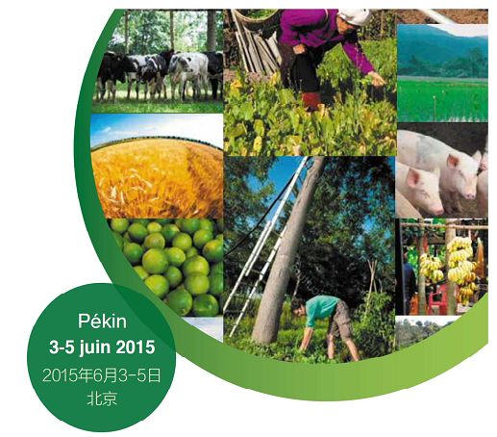





Harvesting slash residues in forests: a sustainable opportunity for the bioenergy sector?
Saint-André L, Achat D., Bilot N., Augusto L., Legout A., Wernsdörfer H., Laclau J-P., Deleuze C., Ranger J.
Session on Biomass for Energy

Slide 2
Context and main issues
Energy policies
Current energy policies are characterized by two complimentary objectives:
to reduce fossil energy consumption
to develop renewable energies market, particularly woodfuel sector
European energy policies target a proportion of 20% renewable energies in total energy consumption of whole EU for 2020 (2009/28/CE) - France: 23%
Sto very short rotation cropping systems dedicated to wood production (see Marron et al. this session)
Impact on soil and forest sustainability?
Increase forest management intensity
Increased harvesting in existing forest ecosystems (this presentation)

Slide 3
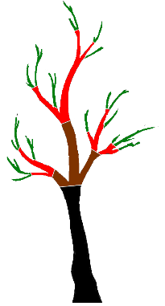
Context and main issues
Scientific challenges
Soil fertility in forest ecosystems ?
Restitution by litter falls
and root turn-over
Soil chemical fertility is based on a small amount of nutrient circulating rapidly in the ecosystem
Uptake from the trees
Soil organic matter
BIOCHEMICAL Sub-Cycle
- translocations
Mineralization = current restoration
BIOLOGICAL Sub-Cycle
- Canopy Exchanges
- Nutrient uptake
- Immobilization
- Litter falls
- Mineralization of organic matters
Soil mineral
The partitionning between these sub-cycles is ecosystem-dependant
Weathering = current restoration
GEOCHEMICAL Sub-Cycle
- Atmospheric deposits
- Weathering
- Drainage
- Run-off
Exch. + available reserves = current
Total reserves = long term
Hanson et al. 2015

Slide 4
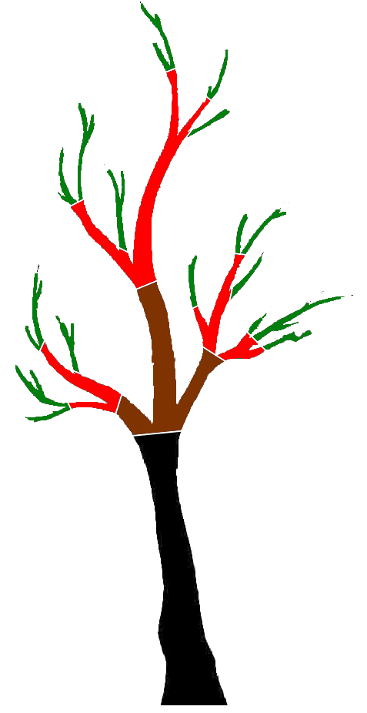
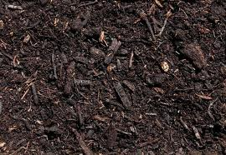
Context and main issues
Scientific challenges
Harvesting slash residues = modification of the biological cycle
Beech, 80 years, Fougères, France
3
74
65
Eucalyptus, 6 years, Pointe-Noire, Congo
205
2
6.5
5
56
192
22.5
275
80
20
Organic matter mineralisation (C, N, Cations)
113
Douglas fir, 60 years, Vauxrenard, France
16
50
225
45
121
Contribute to the maintenance of soil chemical properties and soil biodiversity (macro-, meso-, micro- fauna)
352
154
195
From, Laclau, 2001; Nys 2007; Ranger 2004

Slide 5
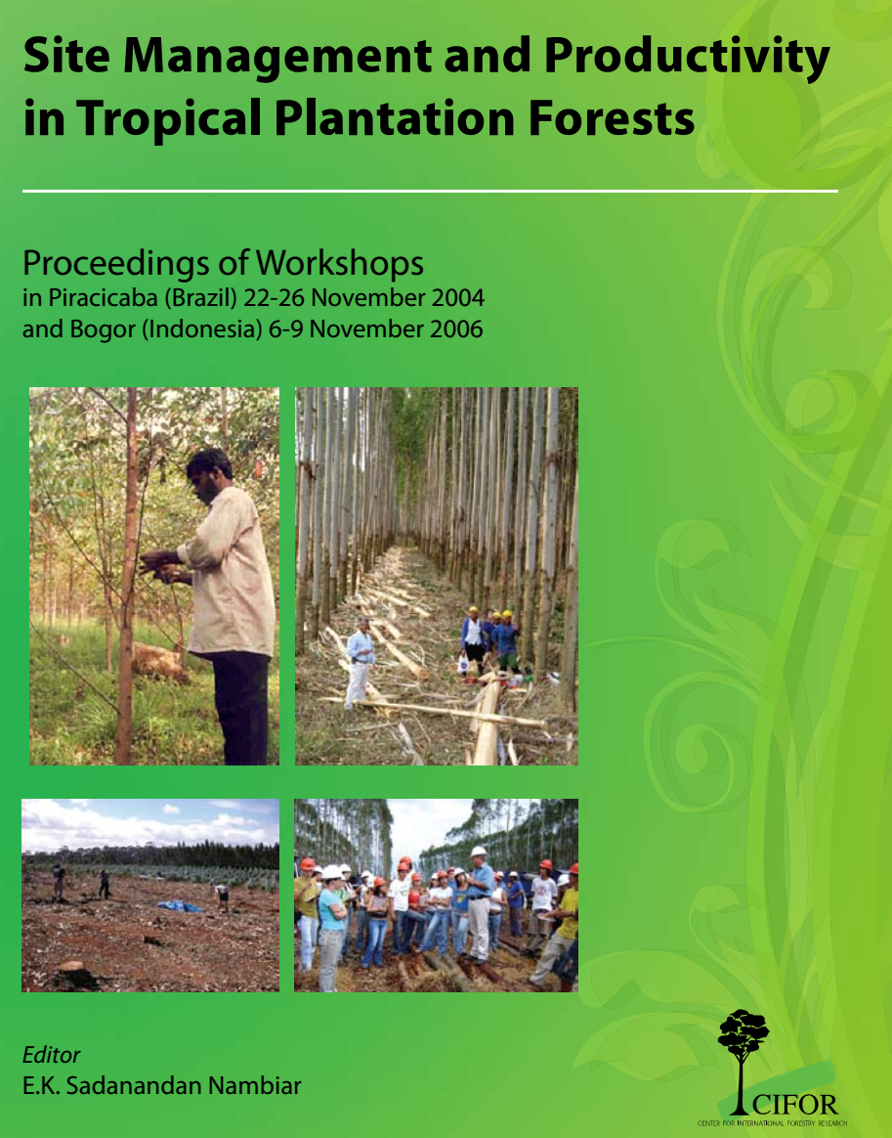
A concrete example, the CIFOR network
Assessing the Impact of Slash Management on the Eucalyptus Productivity
6 countries, 10 sites
Eucalyptus plantations
Same treatments applied in each country (bare soil to double slash)
Unique modelling framework to assess the impact of slash management on the site index (SI), the ability of trees to produce biomass at a given SI, the between tree competition and the height/diameter growth partitioning
Nambiar et al. 2008

Slide 6
A concrete example, the CIFOR network
Assessing the Impact of Slash Management on the Eucalyptus Productivity
Dominant height as a function of age
Site Index
- Unchanged
- Temporary changed
- Changed
Saint-André et al. 2008

Slide 7
A concrete example, the CIFOR network
Assessing the Impact of Slash Management on the Eucalyptus Productivity
- Changed but non significantly
- Significantly Changed
- Unchanged
Stand Basal Area Growth as function of dominant height growth
Capacity of trees to produce biomass at a given Site Index
Saint-André et al. 2008

Slide 8
A concrete example, the CIFOR network
Assessing the Impact of Slash Management on the Eucalyptus Productivity
As a result the impact reached up to 30% for height growth, 20% for the circumference and 70% for the stand basal area after one rotation
Impact correlated to a loading index (N in residues/ [N] in soil)
Saint-André et al. 2008

Slide 9
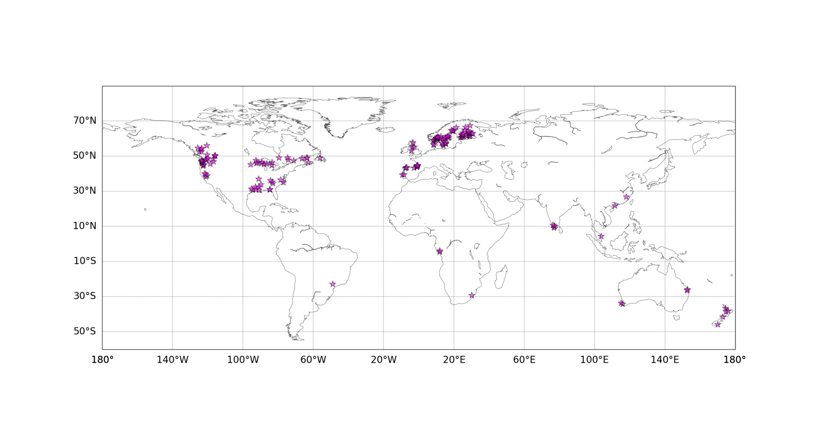
Generalisation, meta-analysis from different networks in the world
43% in North America (29% in USA, 14% in Canada)
45% in Europe (35% from Scandinavia)
Mainly:
- ‘‘North American long-term soil productivity’’ study (LTSP network)
- Experiment network in Scandinavia
- ‘‘Site Management and Productivity in Tropical Plantation Forests’’ network (CIFOR project)
Consequences on nutrient outputs (data compilation from 230 articles, 749 case studies)
Consequences on soil properties and tree growth (data compilation from 140 articles, 168 case studies)
Achat et al. 2015

Slide 10
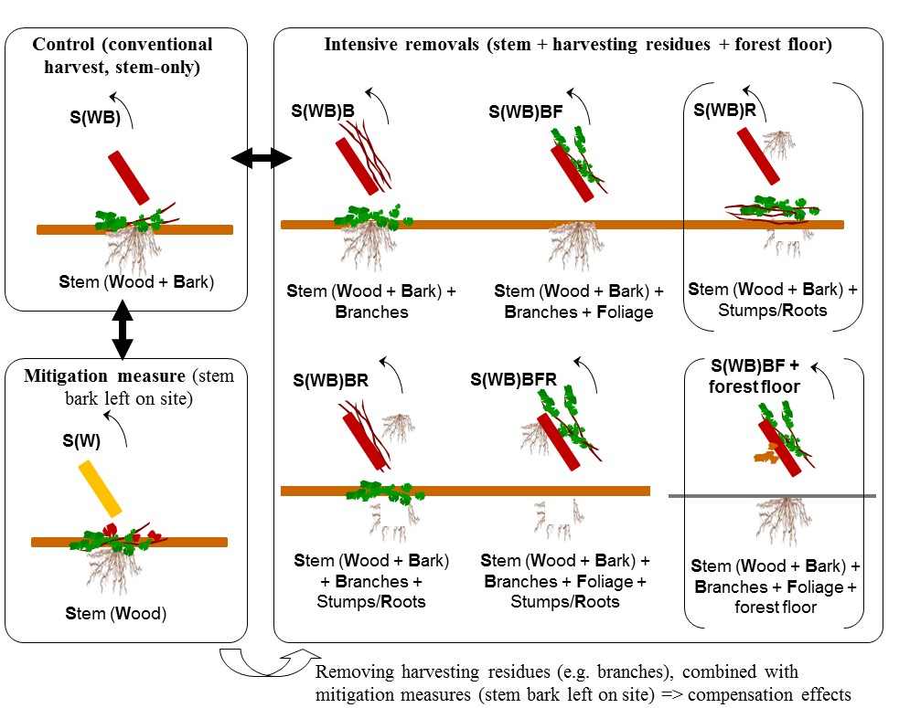
Generalisation, meta-analysis from different networks in the world
Main harvest treatments considered in the meta-analysis.
Conventional stem-only harvest (S(WB), control) compared to different types of intensive removals or to stem wood harvest (S(W), stem bark left on site; mitigation measure).
Achat et al. 2015

Slide 11
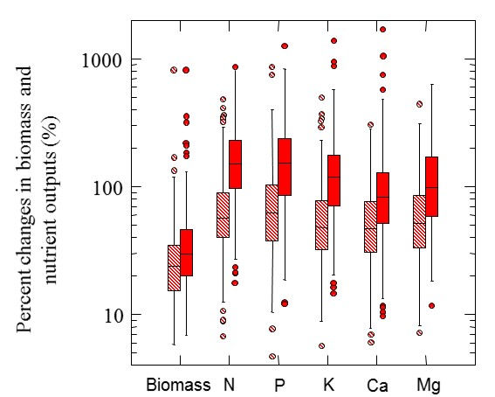
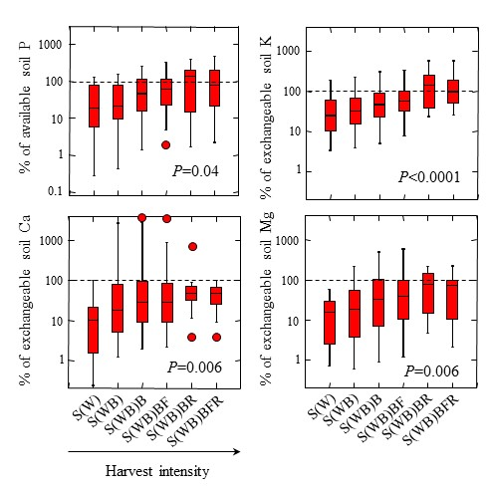
Generalisation, meta-analysis from different networks in the world
Increases in nutrient exportation (% changes)
Nutrient exportation as % of nutrient socks in soils (0-80 cm)
Examples for: Treatment S(WB)B vs S(WB): hatched boxplots
Treatment S(WB)BF vs S(WB): solid boxplots
Achat et al. 2015

Slide 12
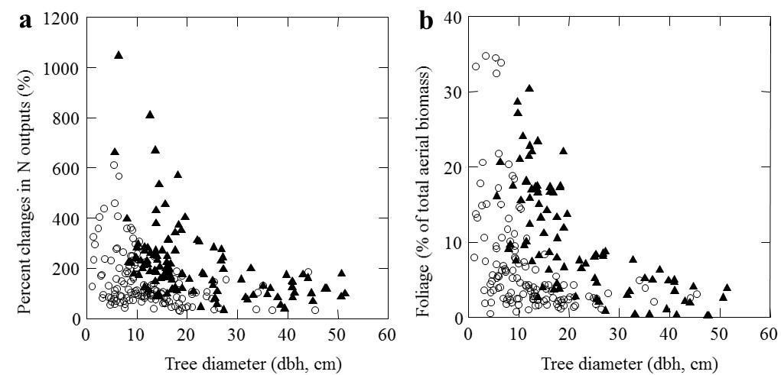
Generalisation, meta-analysis from different networks in the world
Increases in nutrient exportation (% changes): relationships with stand age
S(WB)BF
S(WB)
Open circle, broadleaf trees; grey square, sparse canopy coniferous (mainly Pinus, also Larix or Agathis); black triangle, dense canopy coniferous (Picea, Abies and Pseudotsuga).
Achat et al. 2015

Slide 13
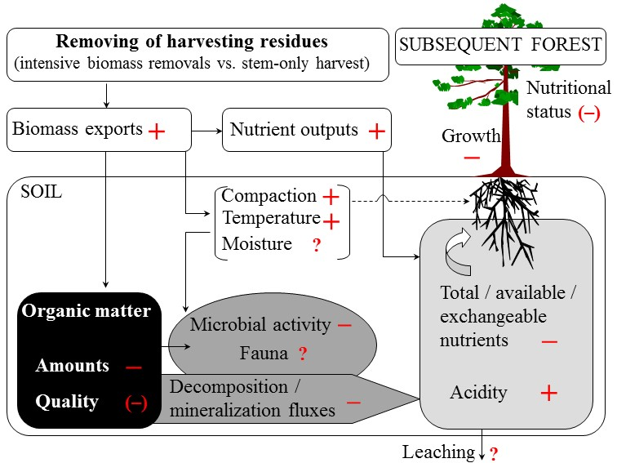
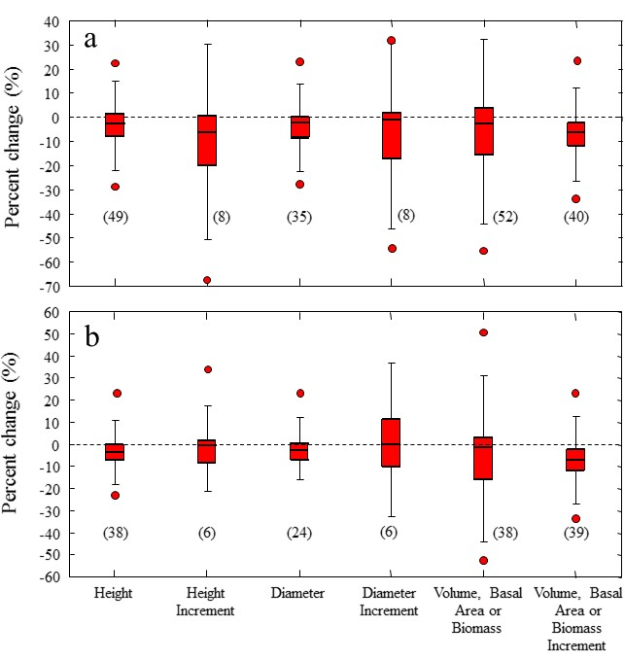
Generalisation, meta-analysis from different networks in the world
-6 to -12% in total N, P, Ca;
-8 to -17% available soil P and CEC, S/T
-3 to -7% in tree growth
-40 % in wood debris, -10% in forest floor and deep soils
-27% in net N mineralization fluxes
-8% in microbial activity; -23 to -37% in enzymatic activity
-0.2% in soil pH
mean changes for S(WB)BF vs S(WB
Achat et al. 2015

Slide 14

Toward an optimized chain for the sustainable use of forest biomass for energy
Energetic issue
Sustainability
Energy used to harvest trees
Nutrient Exportations
Energy produced
Soil fertility, soil biodiversity
Bilot 2015

Slide 15

Toward an optimized chain for the sustainable use of forest biomass for energy
Tree and stand growth
Critical point 1 : Site effect on nutrient concentration in the tree compartments
CAPSIS
Impact on soil fertility, soil biodiversity
Biomass, nutrient content in the different compartments
ForEnerChips
Critical point 4 : Indicators on the impact, responses curves
Harvesting decisions (management- and/or demand- driven)
Machine used – Men/month – Fuel – etc…
Remediation by ashes
Critical point 5 : Non desirable elements in ashes, impact on ecosystem functionning
Energy used during the harvest
Exported Biomass and Nutrient content; Humidity
Energetic caracterisation of the exported material
Critical point 2 : Knowledge on the energy used in a given harvesting operation
HHV
Ash content
Critical point 3 : Conversion matrix to assess PCI and Ash content
Energy used during the process
Energy produced
(ex by pellets)
Nutrient exportation
Ashes production
Modified from Bilot 2015

Slide 16
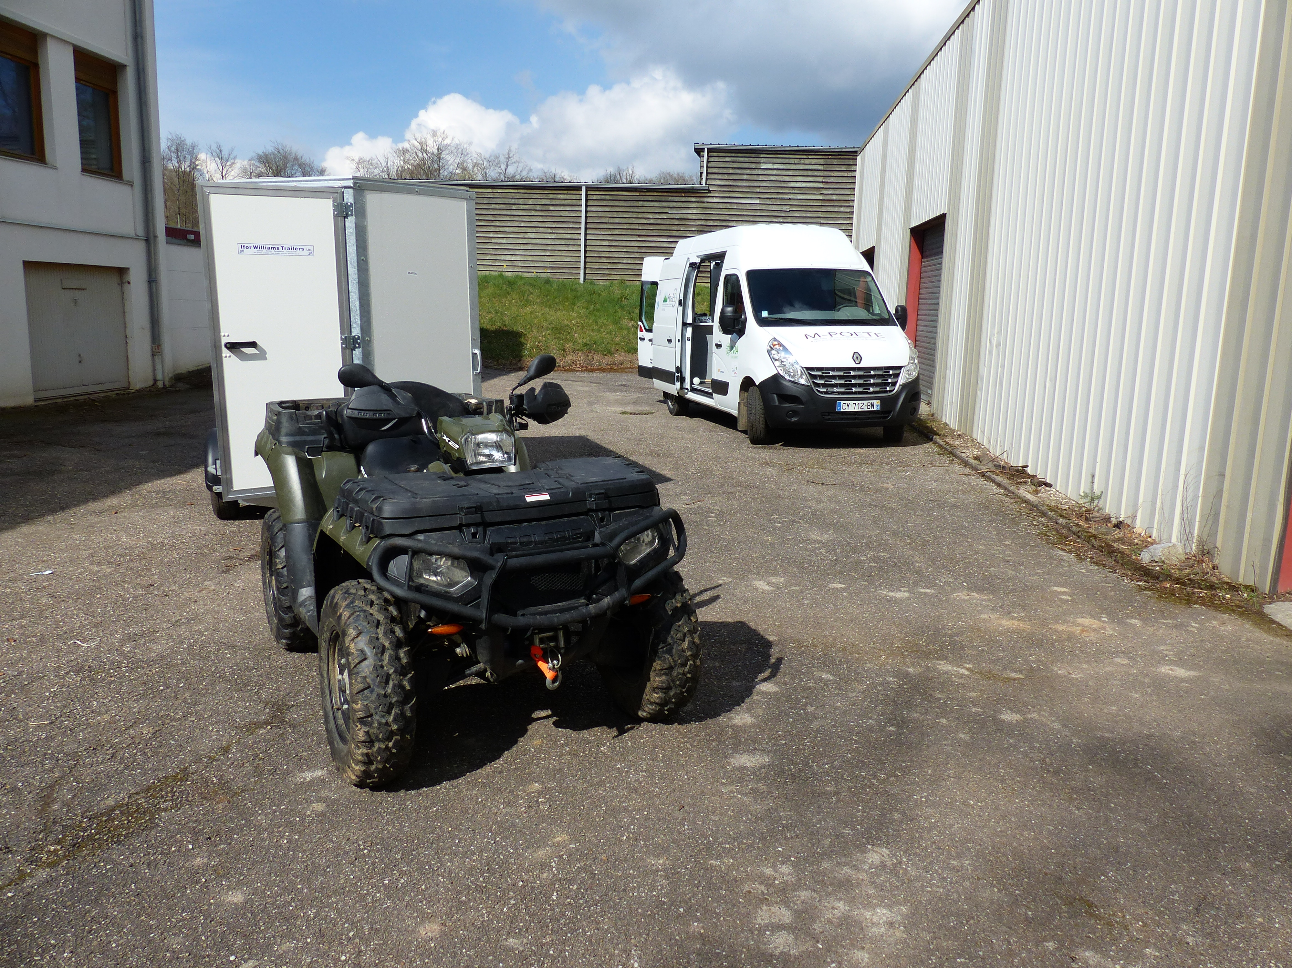



Toward an optimized chain for the sustainable use of forest biomass for energy
Critical point 1 : Site effect on nutrient concentration in the tree compartments
Conc. Tot
(Wood + Bark)
Conc. Bark
M-POETE, A Mobile-Platform for the Observation and the Experimentation in Terrestrial Ecosystems (Zeller et al)
Conc. Wood
Infra-red spectrometry in situ
Translation of the curves (site effect) by making few measurements on the field
Size of the compartment
Site effect on the curve – not directly related to soil concentrations
Wernsdörfer et al. 2014

Slide 17

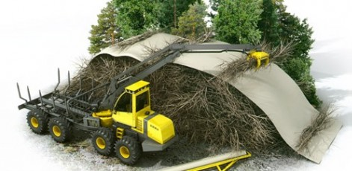
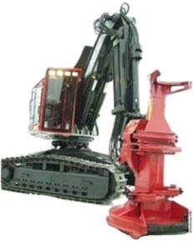

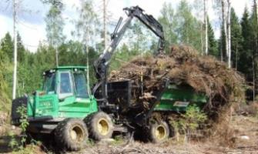
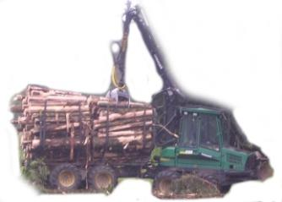

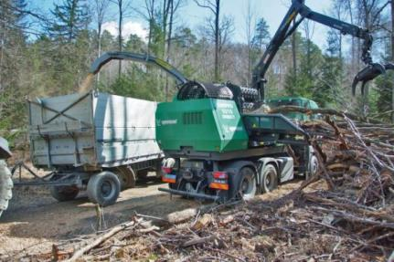
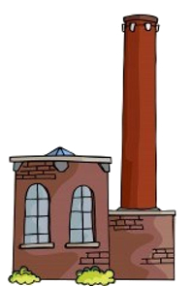
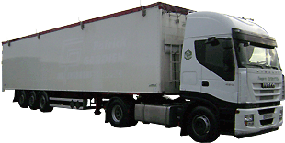
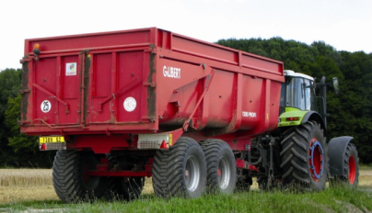
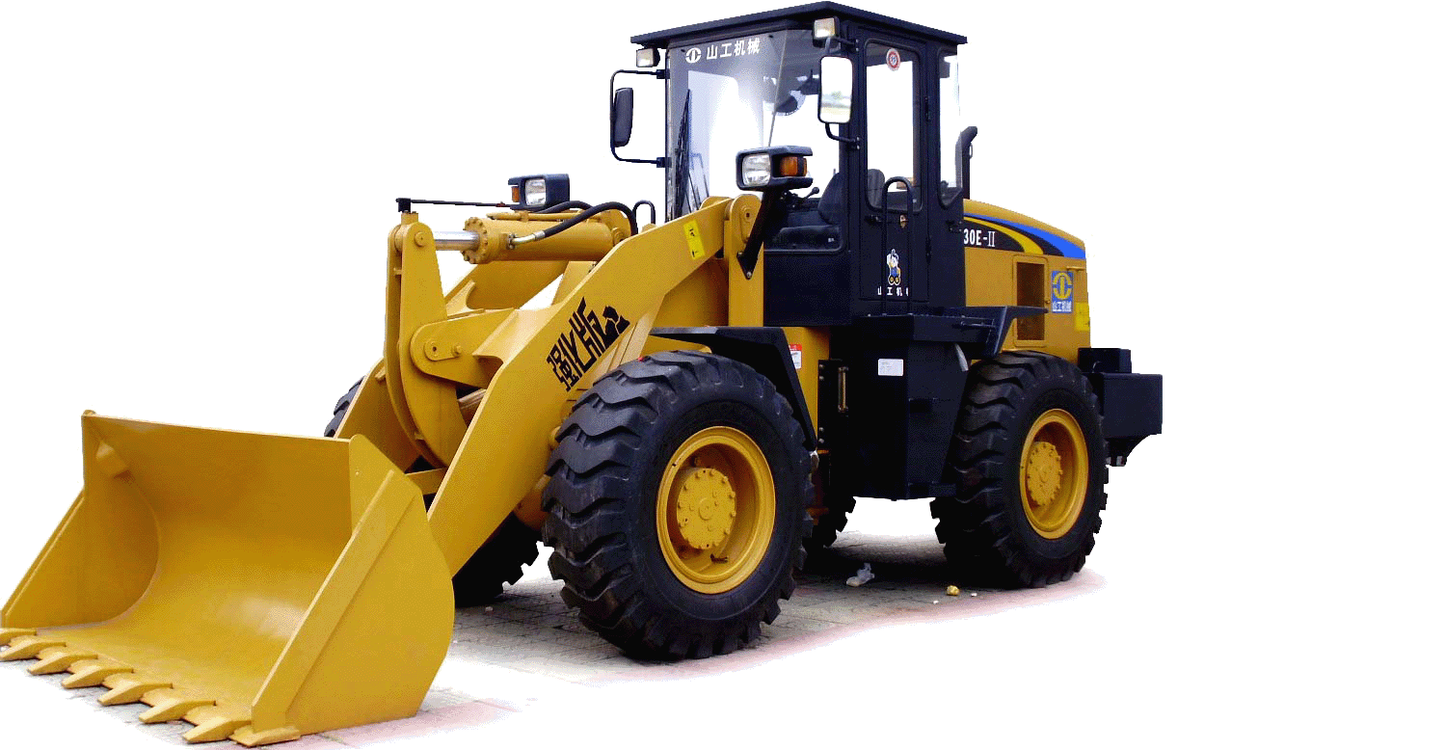
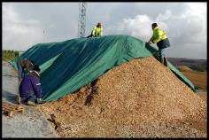
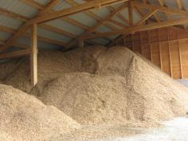
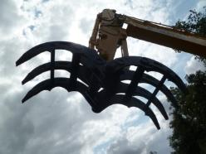
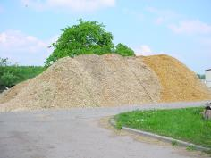
Toward an optimized chain for the sustainable use of forest biomass for energy
Critical point 2 : Knowledge on the energy used in a given harvesting operation
Simulation of different scenarios at each step from the forest to the mill
Bilot 2015

Slide 18
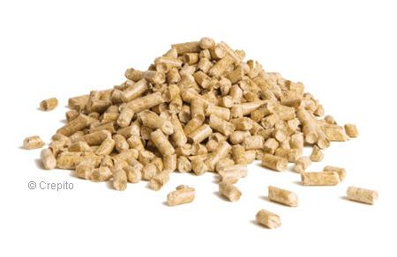
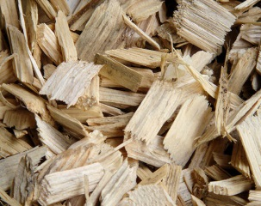
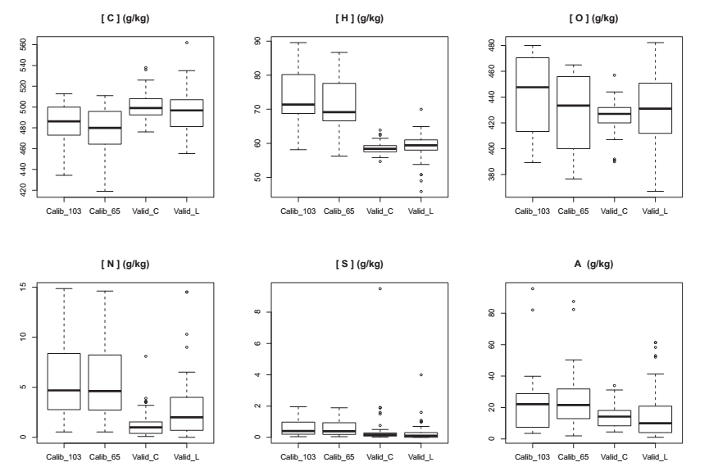

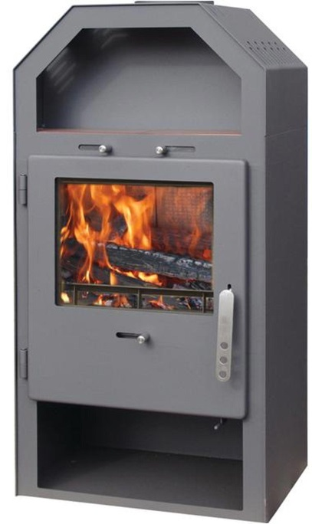
Toward an optimized chain for the sustainable use of forest biomass for energy
Critical point 3 : Conversion matrix to assess HHV and Ash content
Ecology, Biogeochemistry
Energy
Bilot et al.
Wood energy
production chain
"Dry material": 103°C
C, H, O, N
"Dry material": 65°C
C
N
S
P
K
Ca
Mg
Mn
Na
Al
Heating value, Ashes
Bilot et al. 2015

Slide 19

Toward an optimized chain for the sustainable use of forest biomass for energy
Critical point 4 : Indicators on the impact of increased harvest on tree growth, responses curves
Critical point 5 : Non desirable elements (such as heavy metals) in ashes, impact on ecosystem functioning
Two projects have started in 2014, funded by the French environmental and energy management agency (ADEME)
INSENSE: Ecosystems sensitivity indicators to increased biomass removal in forests
RESPIRE: Slash management in forests: potentialities, environmental impact and compensation by wood ashes.
Starting points for a future collaboration ?

