Slide 1
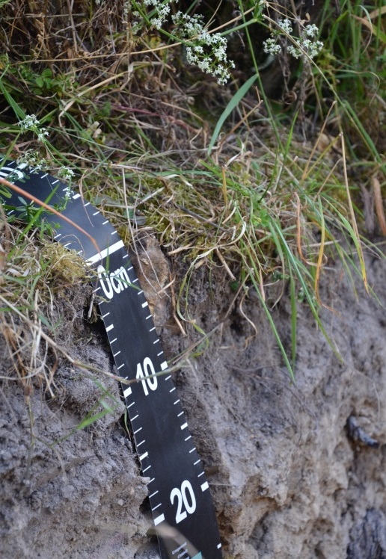
High-resolution spatial modelling of total soil depth for France
Marine Lacoste – INRA UR 0272 Science du Sol, Orléans, France
Titia Mulder – INRA US Infosol, Orléans, France
Contributors: M. Martin, N. Saby, A. Richer de Forges & D. Arrouays
Project: GlobalSoilMap
6th Global Workshop on Digital Soil Mapping
11-14 November, 2014, Nanjing, China

Slide 2
INTRODUCTION
Soil depth (SDt):
Key soil property for water availability and carbon stocks
Exhaustive mapping of total soil depth = requirement of the GlobalSoilMap project
Difficulties of SDt mapping due to:
Soil properties: high spatial variability
Soil observation tools: estimation of soil depth for deep soils (> 1.5 m)
Discordance about SDt definition
Evaluate two different modelling approaches to produce a high-resolution soil depth map of France
In a regional or global context + high resolution
Large data sets
Spatial heterogeneity
Local, large and nested-scale processes
Robust and reproducible
Spatial explicit uncertainties

Slide 3
RESEARCH OVERVIEW
Input data
Soil sample data (source: French Soil Monitoring network)
Exhaustive covariates capturing biotic and abiotic conditions
Soil type and properties
Parent material
Relief (SRTM-DEM)
Climate
Land use
Analysis
1) Data mining
+ Bias correction
+ Ordinary kriging of the residuals
Resolution: 90 m
R packages: caret, gbm, qmap, gstat
2) Multi-resolution kriging for large datasets
Fixed trend model + kriging Resolution: 500 m
R packages: LatticeKrig
Evaluation criteria
Map accuracy
Internal validation
Cross-validation
External validation: concordance with previous soil map
Prediction and confidence intervals by conditional simulation of kriging model

Slide 4
RESULTS (I/V)
Data mining
-
Multi-resolution Kriging
Validation Type (90% prediction interval) | Data mining | Multi-resolution Kriging
Internal | 91 % | 32 %
External | 72 % | 30 %
 | Min | Q1 | Mean | Median | Q3 | Max | sd
Data Mining | 0 | 66 | 99 | 97 | 125 | 288 | 45
MR Kriging | 4 | 78 | 95 | 96 | 112 | 193 | 25
Difference | -154 | -18 | 4 | 1 | 24 | 186 | 33
 | Min | Q1 | Mean | Median | Q3 | Max | sd
Data Mining | 0 | 97 | 111 | 113 | 127 |  | 197
MR Kriging | 13 | 35 | 38 | 38 | 42 | 72 | 6
As discussed: the validation is incorrect for MR Kriging

Slide 5
Discussion
Data mining
Prediction of extremes values
Large (high uncertainties)
“Consistent” with observed values
Multisteps/multitools approach
No direct estimation of uncertainties
Flexible for large datasets, high resolution
Promising prediction of soil depth class instead
Multi-resolution Kriging
No extremes values
Narrow (low uncertainties)
“Not consistent” with observed values
Straight forward modelling approach
Flexible in delivering spatial explicit uncertainty measures
Potential for modelling beyond the country level, at high resolution as demonstrated in other global environmental models
Predictive map of soil depth
Consistent spatial pattern
Good prediction of the mean values
Ongoing: increasing the resolution/levels
90% Confidence interval
Ongoing: test lower confidence intervals
Implementation
Outlook

Slide 6
THANK YOU ALL!
Essentially, all life depends upon the soil.
There can be no life without soil and no soil without life;
they have evolved together.
American naturalist Charles Kellogg, 1938.
FINANCIAL SUPPORT:

Slide 7
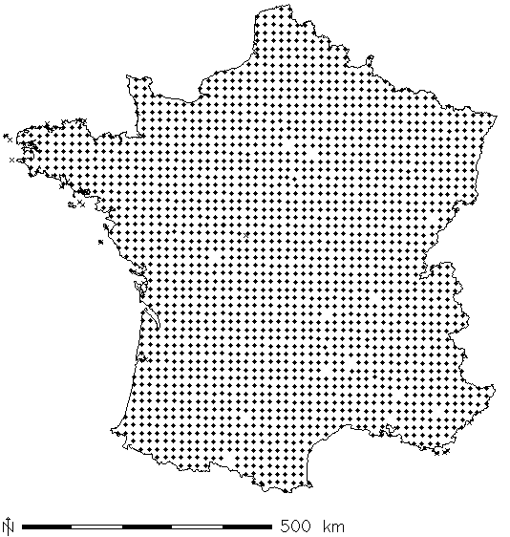
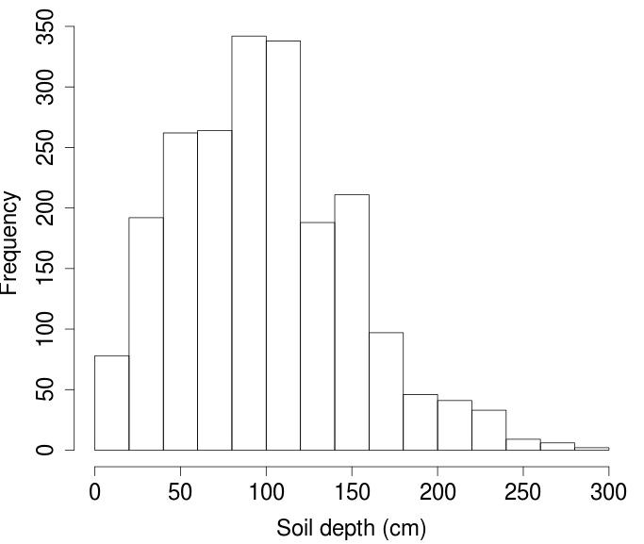
STUDY AREA : France (~ 540K km²)
16km x 16km grid
SD_{t} determined for 2116 sites
French Soil Monitoring network (RMQS)
Mean value: 102 cm
Work with $\sqrt{\text{SDt} }$ to obtain Gaussian distribution

Slide 8
STUDY AREA : France (~ 540K km²)
Existing soil depth maps
Scale: 1/1 000 000
Scale: 1/250 000
Lower limit
Upper limit
Lower limit
Upper limit
Lower limit
Upper limit
Soil depth (cm)
Note: these are classes. The spatial distribution of these classes is the same
As the soil type classes used for the data mining model: this introduces bias
In the following validation results – I have my questions about that approach…

Slide 9
METHODS
Continue soil depth prediction
Data mining
Multi-resolution Kriging
Robust and flexible
Driven by target variable
R package caret and GBM
Resolution: 90 m
+ Bias correction (R package qmap)
+ Ordinary kriging of the residuals
→ 90% prediction interval
Upper limit: ($\hat{SDt}$ + $\hat{e}$+ 1.64 * sd)²
Lower limit: $\hat{\text{(}SDt}$ + $\hat{e}$- 1.64 * sd)²
Estimation of covariance matrix using multi-resolution radial basis functions
Covariance model can approximate the Matern covariance family
Developed for handling large datasets
R package LatticeKrig
Resolution: 500m – for me it doesn’t make sense to go to 90m because it is not supported by the data we use….also, the model cannot be calibrated because there is no variability below this level
Fixed linear trend model: elevation, slope, precipitation, gravimetry, bed rock resistance and NPP
Kriging error obtained by conditional Gaussian simulation (1000 times) – this is really a pro!

Slide 10
RESULTS
Importance of the covariates
Data mining
Multi-resolution Kriging
Variable | Importance (%)
SRTM (elevation) | 14
Maximal annual temperature (mean) | 9
Parent material | 8
Aspect | 7
Mean annual precipitation | 7
Climate type | 7
Roughness | 7
Land use for forest areas | 6
Wetness index | 6
Soil type | 6
Drainage network | 6
Slope position | 6
Slope | 6
Bare rock areas | 5
Fixed linear trend model: elevation, slope, precipitation, gravimetry, bed rock resistance and NPP – what are the coefficients?

Slide 11
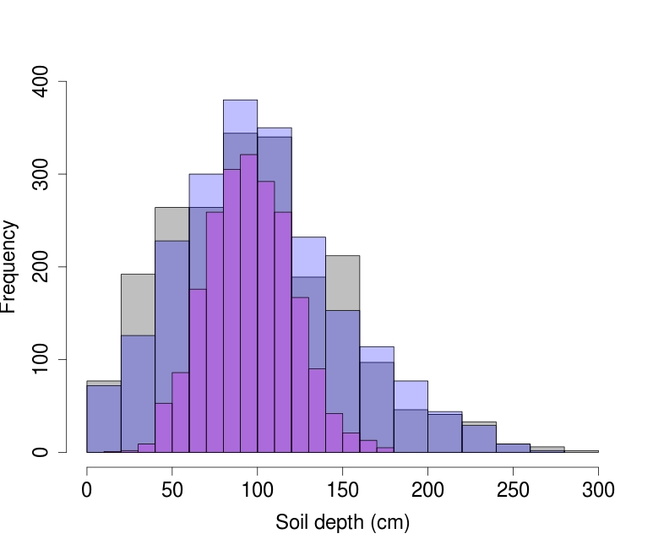
RESULTS
Models accuracy
Interesting to see the multi-resolution kriging improves with a higher resolution soil class map. The good validation results for data mining relate to the previous mentioned bias. The classes have been very important for the data mining – this data does not have the spatial variability compared to eg SRTM. Matching the soil depth class with modelled soil depth thus shows high agreement + The variogram of the residuals did not show high spatial variability. Concluding – a soil class map is not the best type of validation here. BTW the internal validation of the MR kriging is cross validation – so not too bad compared to the cross-validation of the data mining technique.
The histograms should be changed to relative frequency due to the different resolution – or make 2 separate histograms (difference in resolution = different total). The kriging, as expected, shows a smoothing of values (no extremes). What about the validation with the independent IGCS soil depth data? Still impossible because of the inaccuracy of that dataset? Maybe Anne knows how to select the most accurate samples – perhaps a specific year, institute or sampling programm which was consistent over the years?
 | Data mining | Multi-resolution Kriging
Internal validation | R²=0.58 RMSE=1.87 | R²=0.35 RMSE=2.25
Cross-validation | R²=0.26 RMSE=2.45 | R²= RMSE=
External validation (concordance with previous soil map) | 1/1 000 000 75% 1/250 000 → 85% | 1/1 000 000 → 17% 1/250 000 → 20%
Observed data
Data mining
Kriging

