Slide 1
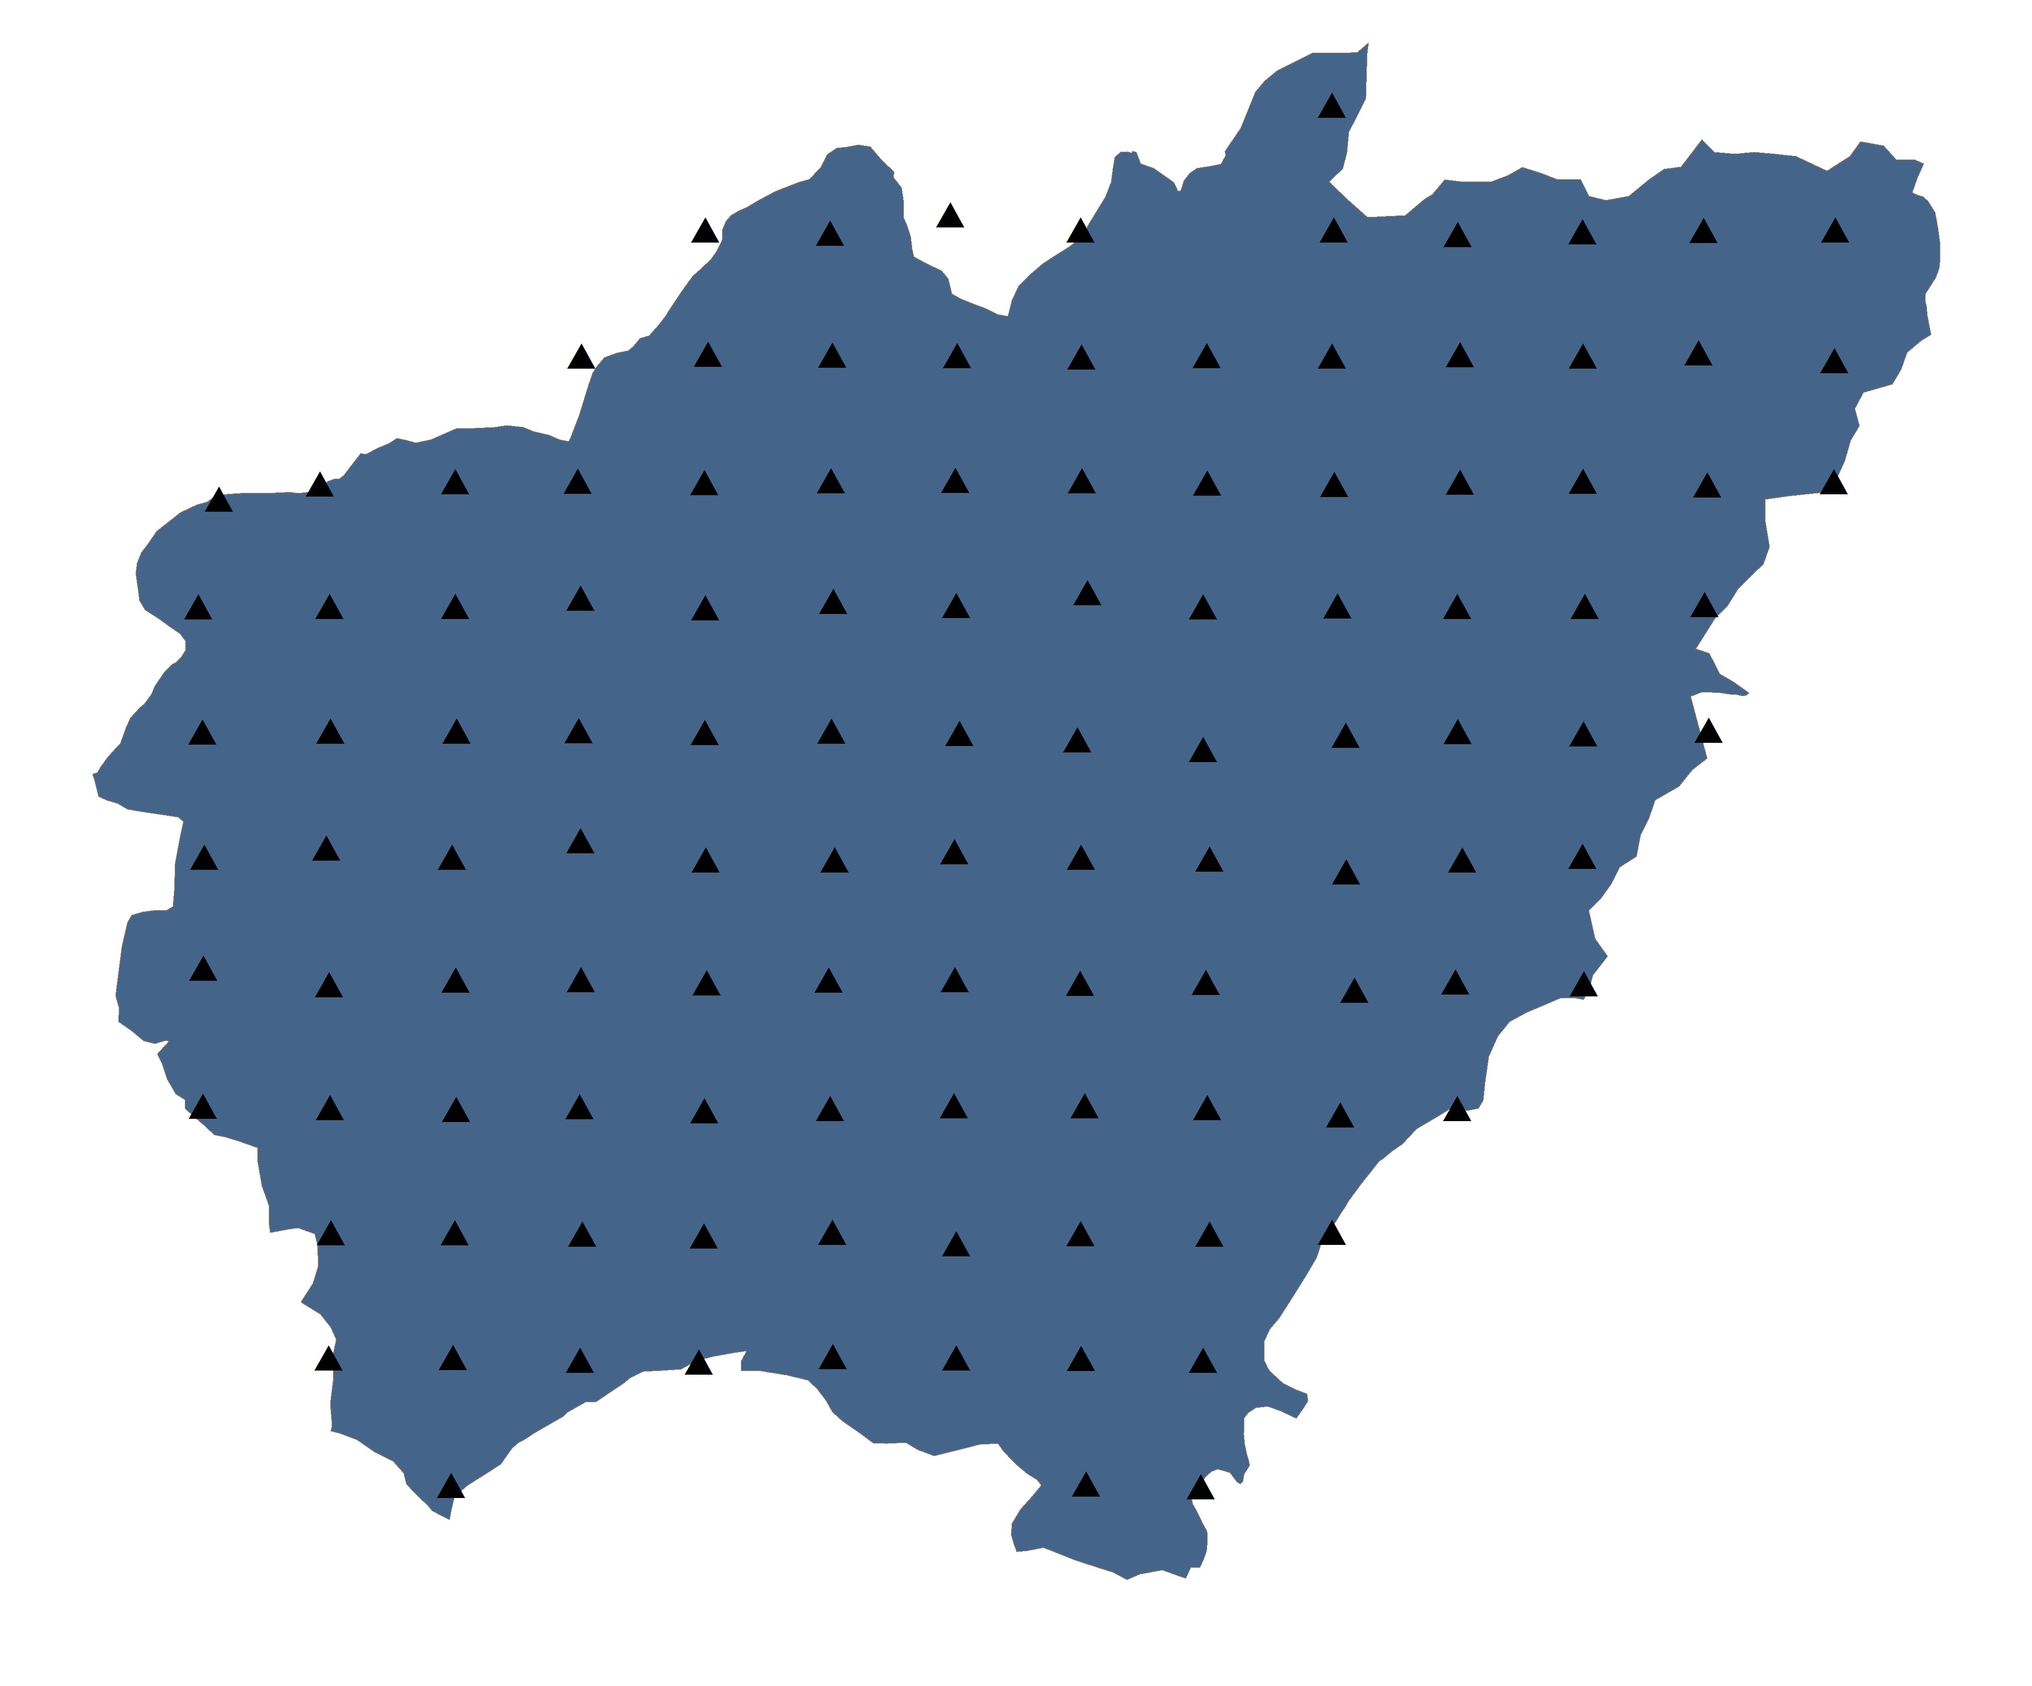
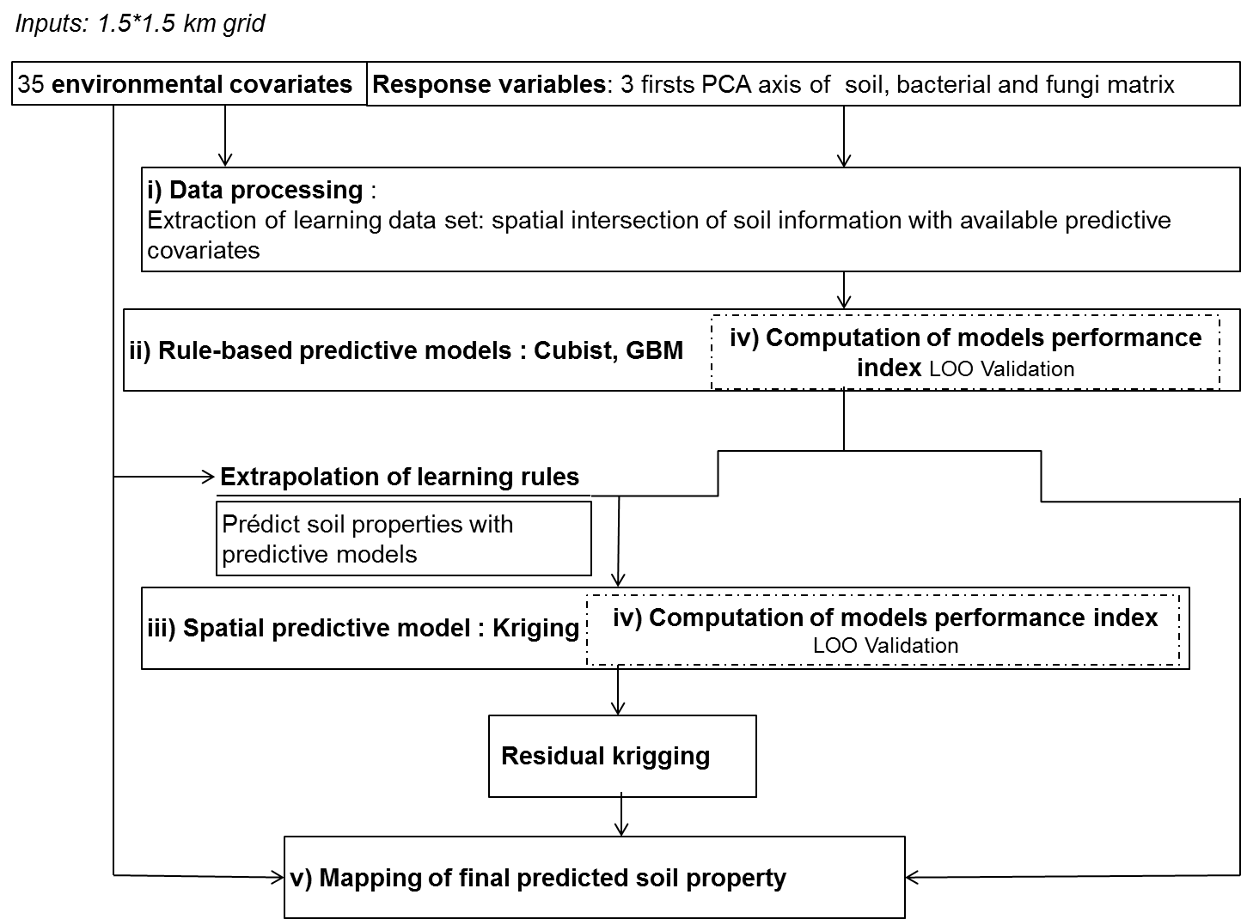
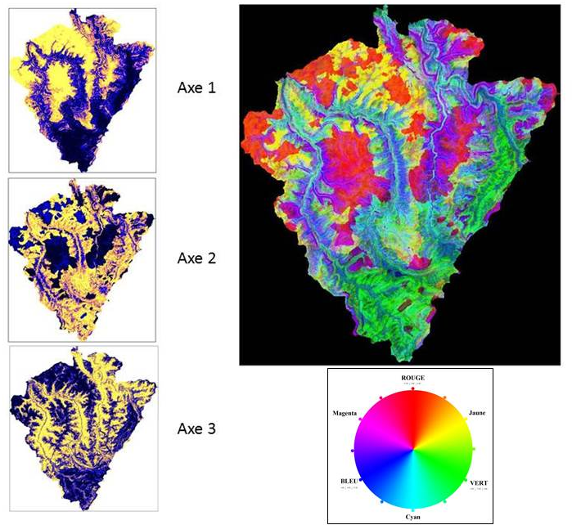
Analysis of soil and micro-organisms diversity at landscape scale : approach by digital mapping of the upper horizon
Swiderski C.¹, SABY N.P.A. ¹, ARROUAYS D¹, RATIE C. ¹, JOLIVET C. ¹, DEQUIEDT S. ², REDON P.O³.
INTRODUCTION
In 2007, the Perennial Observatory of the Environment (OPE) was established to support research on environment long term evolution. As part of its overall objective, a soil monitoring and observation network was set within a 240 km² area in northern France.
This network is based on systematic sampling with 117 sites located at regular spatial intervals, following a 1.5 km-square grid. The aim of this study was to find the factors controlling the spatial distribution of chemical and physical soil properties and microbial communities at landscape scale using digital soil mapping.
OPE
Study
area
systematic sampling on 1.5 km-square grid
MATERIAL & METHODES
OPE : 240 km²
Soil parent material : limestone, marls and clay
Land use : field crop (50%), grassland (17%), forest (32%), urban (1%)
Regular grid 1.5km x 1.5km
117 samples
Covariates:
Morphometric : data extracted from Digital Elevation Model (25m) : elevation, slopes, curves, Beven index, distance from the nearest river system, Landform,…
Soil : geology and pedology(1/50 000)
Land use : Corine Land Cover, graphic parcel register
We used a 3 steps approach combining a multivariate analysis, a boosting regression tree (BRT) models and universal kriging. The first three principal components resulting from a spatially constrained PCA (R package multispati) of pedological properties, fungal and bacterial communities matrix were first modelled using cubist and gbm function. The predictions of the BRT models were then used as the fixed effect in a geostatistical linear mixed model. The entire process was tested by “leave-one-out” cross validation.
RESULTS
 | Regression |  |  | Regression kriging
Target variables | model | R² | RMSE SD | R² | RMSE mean | RMSE median
Bacterial communities axis 1 | GBM | 0,18 | 2,9 | 0,52 | 1,107 | 0,402
Bacterial communities axis 2 | GBM | 0,17 | 0,79
Bacterial communities axis 3 | Cubist | 0,14 | 0,799
Fungal communities axis1 | GBM | 0,23 | 0,601 | 0,88 | 1,138 | 0,326
Fungal communities axis 2 | GBM | 0,30 | 0,451 | 0,82 | 1,044 | 0,484
Fungal communities axis 3 | GBM | 0,08 | 0,481
Pedological properties axis 1 | Cubist | 0,48 | 2,22 | 0,94 | 0,955 | 0,149
Pedological properties axis 2 | GBM | 0,58 | 1,09 | 0,94 | 1,048 | 0,2787
Pedological properties axe 3 | rpart | 0.45 | 1,26
Pedological properties were a combination of soil texture, cation exchange capacity, pH, carbon to nitrogen ratio, organic carbon content, limestone content, total nitrogen, available phosphorus, total and exchangeable cations.
The first PCA’s axis represented a global mineral richness of the soil upper horizon. The second axis reflected the anthropogenic effects of land use, allowing the distinction between forest soils and arable soils. The third axis sorted soils by their saturation of cation exchange capacity. The three axes were combined to create this colour composition map on the right (RGB ratio).
Spatial distribution of pedological properties
Models with the best accuracy were found for pedological properties. Ordinary kriging led to improuve R². The most important predictor variables for soil properties were related to heigth and distance of the nearest hydrographic system, pedology (axis1); land use (axis 2) and geology, curvature and direction slope (axis 3).
Interpretation of microbial PCA’s axis had no meaning because variables represented a relative number of individuals. Interpretation was limited to a genetic similarity of individuals sharing the same scores. Fungal and bacterial communities seemed to be related to watershed and topographical conditions, but the link between these variables and spatial distribution of microbial properties was not strong (R²<30%). Microbial processes have to be studied at finer scales and interlinked scales from landscape to soil micro-aggregates.
Spatial distribution of bacterial and fungal communities
CONCLUSION
By using different statistical methods, we showed that identifying influencing factors and predicting spatial distribution of chemical, physical and biological soil properties is possible at landscape scale.
Predicting spatially constrained principal components is a useful technique for homogeneous areas, or when modelling individual soil properties results in poor prediction quality indicators.
References
Arrouays D. et al., Large trend in French topsoil characteristics are revealed by spatially constrained multivariate analysis. Geoderma 161. 2011. 107-114.
Odeh, I.O.A et al, Futher results on prediction of soil properties from terrain attributes : heterotopic cokriging and regression-kriging. Geoderma. 1995. 251-226.
De Souza E. et al., Comparing spatial prediction methods for soil property mapping in Brazil : A case study for the Rio Doce Bassin. GlobalSoilMap. 2014. 267 –271.
Software
R: A language and environment for statistical computing. R Foundation for Statistical Computing, Vienna, Austria. ISBN 3-900051-07-0, URL http://www.R-project.org.
1 : INRA, US 1106 Infosol, F-45075 Orléans , France.
2 : INRA, UMR 1347 Agroécologie – plateforme GenoSol, F-1065 Dijon, France.
3 : Andra, (Agence nationale pour la gestion des déchets radioactifs), direction Recherche et Développement, Centre de Meuse Haute Marne, Route départementale 960, F-54280 Bure.

