Slide 1
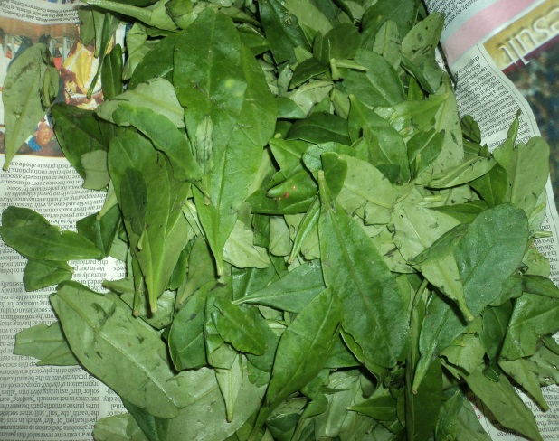
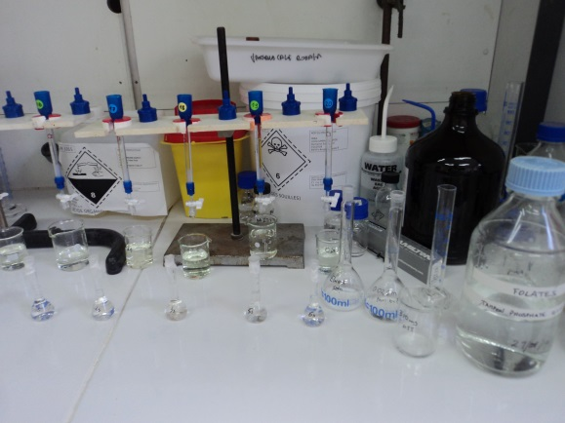
Folate content of cultivated and wild traditional leafy vegetables found in Nigeria
Shirley Isibhakhomen EJOH^{1, 2}, Faustina DUFIE WIREKO-MANU^{1, 3}, David PAGE¹, Catherine M.G.C. RENARD¹
1. UMR408 SQPOV « Sécurité et Qualité des Produits d'Origine Végétale », INRA, Avignon Université, F-84000 Avignon, France; 2. Department of Human Nutrition, Faculty of Public Health, College of Medicine, University of Ibadan, Nigeria; 3. Department of Food Science and Technology, Kwame Nkrumah University of Science and Technology, Kumasi, Ghana.
BACKGROUND
MATERIALS AND METHODS
10g vegetable sample
Folates ( Vit. B9) is an important B-vitamin associated with reduced neural tube defects in pregnancies and cardiovascular diseases due to high homocysteine levels.
Fresh samples from Oyo state Nigeria
30ml 0.1M phosphate buffer with 1% ascorbic acid
boiled in water bath
100°C – 10 min
Cooled – 15 min
Packaged and transported in cold chain to lab – SQPOV, INRA Avignon, France
centrifuged for 10 min at 5000g.
There is great diversity of cultivated and uncultivated traditional green leafy vegetables (TGLVs) in Nigeria, that form a major component of several local dishes.
Folate extraction
Green leafy vegetables are rich sources of folates in the diet (1).
Raw (fresh)
boiled for 5mins in water approx. 1g/4ml
1ml of chicken pancreas conjugase to extract & incubated at 37⁰C
2h.
Deconjugation
However there is a dearth on information on their folate content. Establishing accurate and reliable folate content of foods that could contribute significantly to dietary intake is important as it would enrich our local food composition table; facilitate better estimate of dietary intake of the vitamin from TGLVs among different age groups; and useful for educating the public about folate rich foods.
PURPOSE OF STUDY: To quantify the folate content of selected raw and cooked TGLVs.
Drained and cooled
Chemical transformation of folates to 5-methyltetrahydrofolic acid (THF-5CH₃) monosodium glutamate and / or diglutamate.
Ground in liquid nitrogen with cutting mill (A11 analytical mill, IKA, Staufen, Germany)
stored at -80°C until analysis
Folate Binding Protein
eluent solution - 0.02M DL-dithiothreitol (DTT) and 0.02M trifluoroacetic acid (TFA)
Table 1: Cultivated and uncultivated TGLVs studied
RESULTS
Purification of folates by afﬁnity chromatography
Scientific name (family) | English/ Local name | Status
Amaranthus hybridus L. (Amaranthaceae) | Pig weed/Efo tete/ green | Cultivated
Abelmoscus esculentus fruit (Malvaceae) | Okro/ ila | Cultivated
Abelmoscus manihot (L.) Medikus (leaves and tender shoots) – (Malvaceae) | Okro leaves/ ilasa | Cultivated
Adansonia digitata (Malvaceae) | Baobab leaves/ Luru / kuka | Uncultivated
Corchorus olitorius L. (Malvaceae) | Jute mallow/ ewedu | Cultivated
Crassocephalum crepidioides (Benth.) S. Moore (Asteraceae) | Ebolo | Uncultivated
Launaea taraxacifolia (Willd.) Amin, ex C. Jeffrey (Asteraceae) | African lettuce/ wild lettuce/ Yanrin | Uncultivated
Solanum macrocarpon L. (Solanaceae) | Efo igbagba | Cultivated/ wild
0
0.5
Folate concentration (mg/kg f.w.)
Water + 1 ml/l formic acid: acetonitrile
1
1.5
2
2.5
Abelmoscus
esculentum
Fruit
fresh
RP-HPLC
leaves
boiled
CONCLUSIONS
TGLVs are good sources of folate. But boiling caused a considerable decrease in the folate content: 47% to 88%. TGLVs are consumed in their cooked form in Nigeria, preparation methods that would allow for optimal retention of folate are necessary. For example limited contact with water or steam cooking (2).
100g of the boiled leafy vegetables could contribute 2 – 12% of RDA for women of reproductive age in Nigeria.
Adansonia
digitata
leaves
Amaranthus
hybridus
leaves
Corchorus
olitorius
leaves
Crassocephalum
crepidioides
leaves
Launaea
taraxacifolia
leaves
Solanum
macrocarpon
leaves
FIG 1: Folate monoglutamate content of fresh and boiled vegetables
REFERENCES
Ogle et. al. (2001). Asia Pacific J Clin Nutr. 10(3): 216–221
Delchier et. al. (2013). Food Chemistry 139 : 815–824

