Slide 1


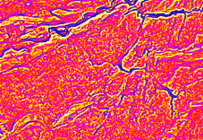
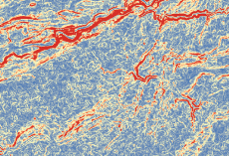
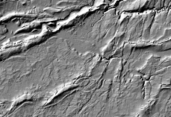
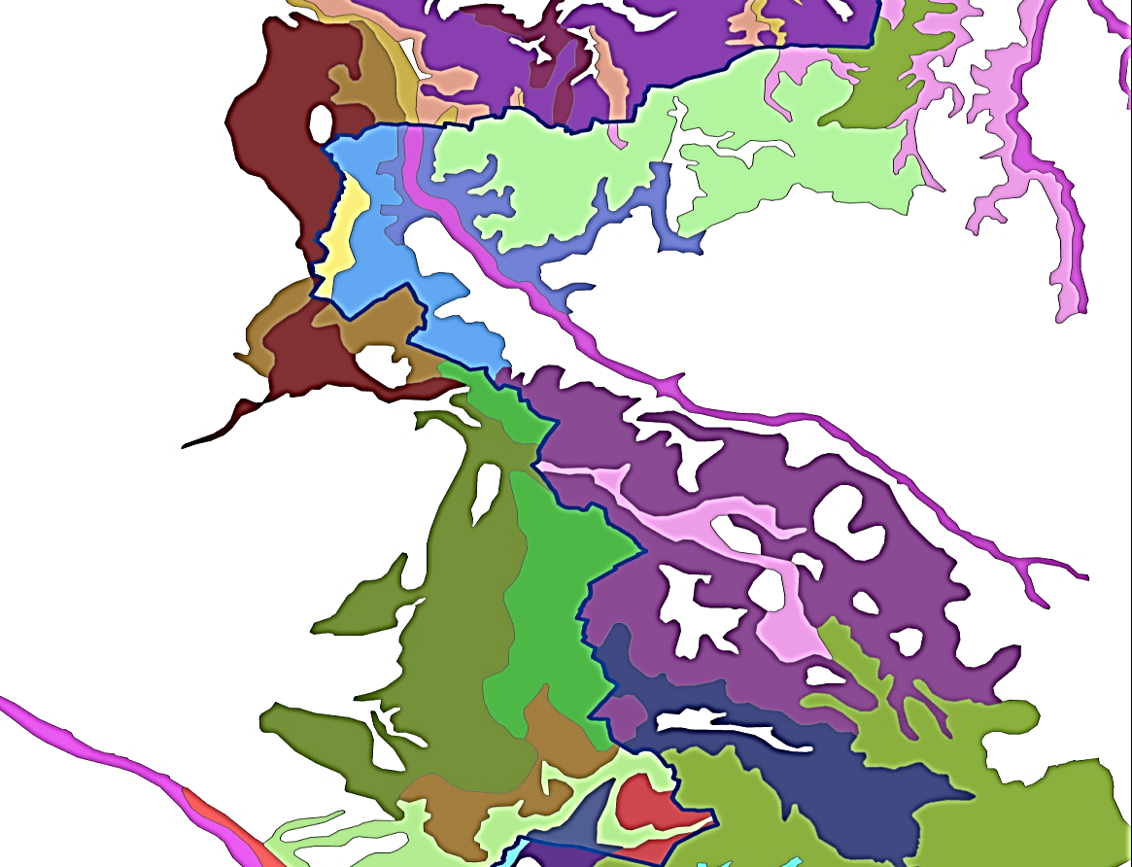
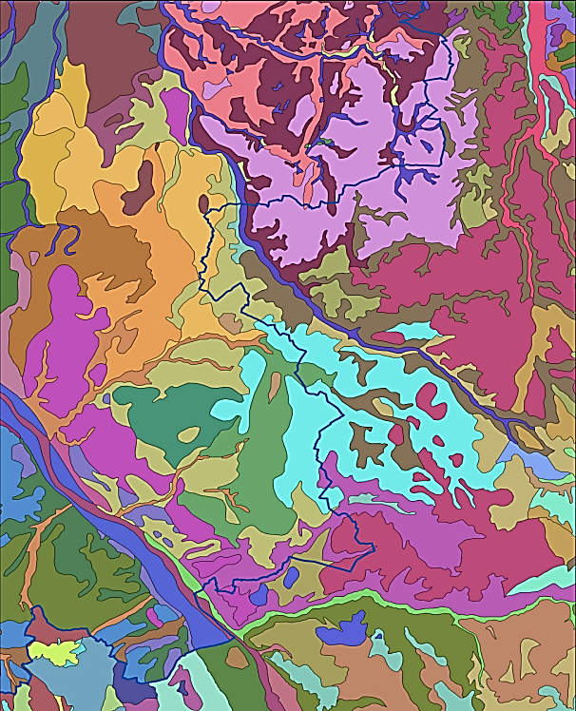

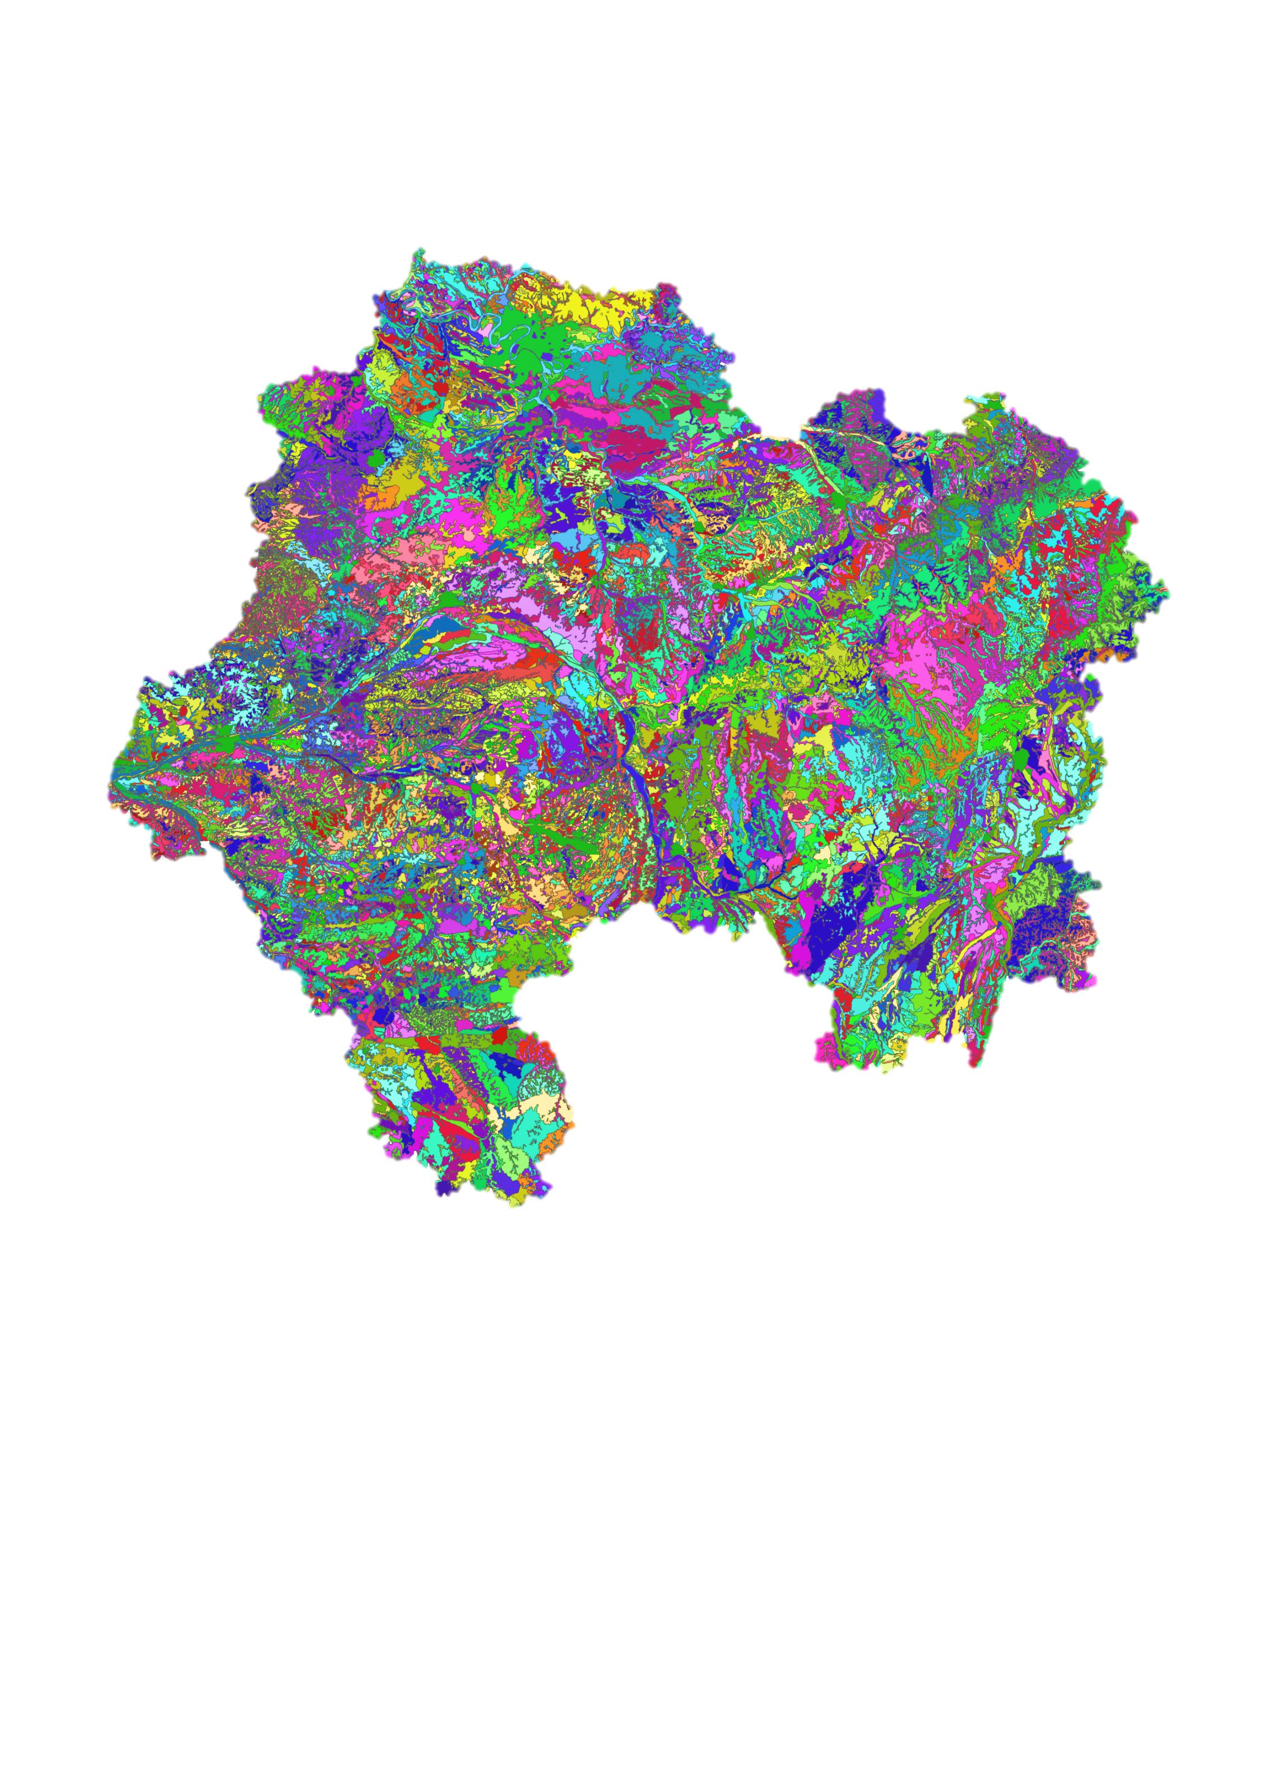



Towards a methodology for the harmonization of soil maps assisted by digital mapping
DRUFIN S.¹, LAROCHE B.¹², FOURVEL G.¹, RICHER DE FORGES A.C.¹, GIROT G.³
¹ : INRA US1106, InfoSol, F-45075 Orléans, France, ² Réseau Mixte Technologique « Sols et Territoires », ³ Unité Science du sol, INRA, CS 40001 Ardon, Orléans cedex 2, France Bertrand.laroche@orleans.inra.fr
Background & objectives
Soils are central to several global challenges such as ecosystem services delivery, food security, climate change mitigation or biodiversity protection. Though soils are threatened by many human activities such as intensive agriculture or urbanization. So it is indispensable to protect soil and manage this resource as well as possible.
To manage soil resource on an area, it is firstly necessary to gather spatial information about soil types and soil properties. Today, the only exhaustive soil map available for France is the 1/ 1.000.000 soil map published in 1998 and available on this website : http://www.gissol.fr/donnees/cartes/les-sols-dominants-de-france-metropolitaine-1491
In 1991, to respond to the needs of planners and managers of Departments and Regions, France launched a 1/250.000 soil mapping program. To develop this national program, each department was responsible for the production of a soil map on its own area. In 2001, a new program was launch to establish common rules and a shared database for mapping. Despite of these specifications, there are consistently several inconstancies between adjacent department soil maps. These inconstancies can be graphic problems or semantic problems or both. So our objective is to harmonize these maps to create a coherent 1/250.000 soil map on the whole country.
To use a reproducible method which can be applied to maps of the entire country. The harmonization method has also to be objective to erase the inconstancies between the adjacent maps due to the interpretations of each soil surveyor during the mapping process and the drawing of the Soil Map Units (SMUs). As testing area, INRA started with 3 central regions in France which are Région Centre (where INRA is located), Ile de France (Paris…) and Région Bourgogne. It was easier to start with these department since map author where geographically close.
Material & Methods
1
2
3
4
5
Identify similar environment area to work on SMUs modifications
Select SMU from either side in contact with the boundaries
Apply SCORPAN prediction model Gradient Boosting Model function (GBM)
Graphic and semantic harmonization of SMUs and their attributes using authors decision and digital mapping predictions
A
SCORPAN*
MAP 2
MAP 1
PREDICTION 1
SMUs prediction resulting from MAP 1 to MAP 2 prediction
MAP 2
MAP 2
Collect relevant covariates to predict SMU e.g. DEM, derived DEM, geology, …
B
MAP 1
MAP 1
MAP 2
Map’s author meeting to set SMUs modifications and validation with help from prediction models delivered
MAP 1
SMUs of 2 MAPS that are located in the same environment and that are discontinuous when placed facing each other
Selection only of SMUs in contact with boundary to minimize modifications due to harmonization. Moreover, a mask is applied on every non-soil unit e.g. river, city
Running GBM by learning MAP 1 SMUs to predicting them into MAP 2
Final harmonized map with no more SMU discontinuity at the boundaries
C
MAP 2
MAP 1
Running GBM by learning MAP 2 SMUs to predicting them into MAP 1
PREDICTION2
SMUs prediction resulting from MAP 2 to MAP 2 prediction
Results
Harmonization steps | Time spent *
Data preparation | 1 day
Running prediction model | 2 days
Preparation and holding of mapping expert meeting | 2 days
Digitalization and modification of graphic units | 1 week
*Without taking account of time spent for R script programming
Soil units | Count
Number of SMUs in initial maps | 32 979
Number of SMUs in harmonized map | 32 232
Total deleted or merged SMUs | 747
This project is under the framework of the network « RMT Sols et Territoires » http://www.sols-et-territoires.org
Harmonization is achieved on 22% of the metropolitan French territory. Methods works well and will now be applied to the rest of the country. A way to improve prediction models could be to gather additional covariates if available, and to run new validation fields sampling.
SCORPAN * McBratney, A.B.; M.L. Mendonça Santos, B. Minasny (1 November 2003). "On digital soil mapping". Geoderma (Elsevier B.V., Amsterdam) 117 (1–2): 3–52 / Acknowledgment : Special thanks to map authors J. Moulin, N. Duigou and J-P Party
Harmonized map containing 21 departments
INRA - InfoSol
Centre de recherche d'Orléans
2163 Avenue de la Pomme de Pin
CS 40001 ARDON
45075 ORLEANS Cedex 2
www.val-de-loire.inra.fr/
Notes:
Methods :
The harmonization method includes many steps. First, the DSM model prediction area had to be defined. To minimize the modifications of the initial department maps, it has been chosen to modify only the area of the SMUs actually in contact with the border of the maps. This area is also the learning area of the DSM model. Then it is necessary to collect relevant covariables for the region. Next is the step of the establishment of the model of classification using Gradient Boosted Modelling (GBM) model or Classification and Regression Tree (CART) model.
In parallel, similar work is done to the base of semantic data to gather similar SMU of both sides of neighboring maps, thanks to soils descriptions put in the semantic bases.. All these phases are in interaction with the author of the map (pedologist) to set and refine the model at different stages. It remains the only decision maker in the choices made Harmonized map. Modelling from GBM is only used to enhance authors choices about SMU gathering.
For now, our first modeling is calibrated on a specific area in France which is located in “Région Centre”. In the end, purpose will be to automate the method to use the same model for every study area. Each time, new parameter and new covariate available will be included into this model to adapt the prediction to the study environment.

