Slide 1
Spatial prediction of topsoil texture in Region Centre (France) combining regression and area-to-point kriging
Mercedes ROMAN DOBARCO, Tom G. ORTON, Nicolas P. A. SABY,
V. L. (Titia) MULDER, Sébastien DRUFIN, Blandine LEMERCIER, Dominique ARROUAYS
10/ 08/ 2015

Slide 2
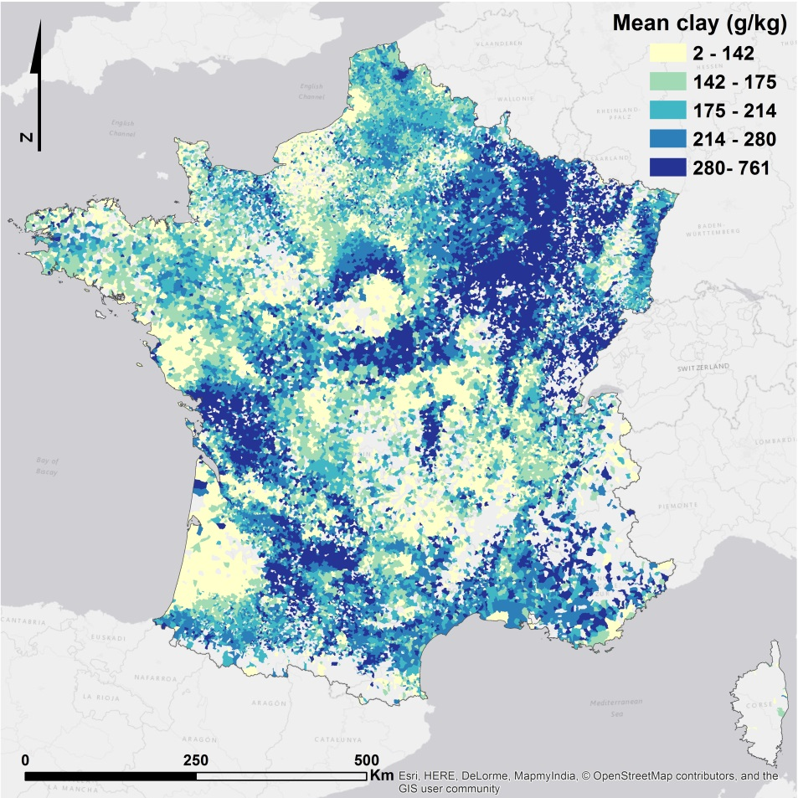
The French Soil Test Database
Base de Données d’Analyse des Terres (BDAT)
The BDAT collects the results of soil analyses requested by farmers to improve management
Physico-chemical properties of agricultural topsoils (~ 0 - 25 cm)
Location of farms is not available due to data confidentiality, best georeference is the municipality
> 2,000,000 samples since 1990
Important source of information, but how can we use it?
Aggregated clay content (1990 – 2009)
M. Roman Dobarco/ Soil texture in Region Centre combining regression and area-to-point kriging
10/ 08/ 2015
Notes:
The French soil-test database (BDAT), is populated with analytical results of agricultural topsoil samples collected across France since 1990
Farmers and landowners interested in the fertility status and physico-chemical properties of their soils request these analyses from commercial laboratories certified by the French Ministry of Agriculture, usually to determine the application of fertilizer
The sampling depth is usually of 0 - 25 cm for crops and the 5 – 15 cm for pasture
The location of the farms is unknown to protect their anonymity, hence the best spatial approximation is at the level of municipality.
The simplest way to analyze this type of data is by calculating summary statistics for administrative units and mapping the aggregated data. This approach ignores the variability of soil properties within the units due to changes in soil forming factors and inherent spatial variability.
Soil-test databases of aggregated data still provide valuable information for digital soil mapping and soil monitoring.

Slide 3
Change of support of areal data
Geostatistical approaches for change of support:
Prediction at point support from areal data with an estimate of prediction uncertainty → Area-to-Point kriging (AtoP) (Kyriakidis, 2004)
Iterative deconvolution taking into account irregular polygon shapes (Goovaerts,2008)
Summary statistics approach(mean, variance, number of observations by unit) (Orton et al., 2012a, 2012b)
scorpan model + AtoP = AtoP regression kriging (Kerry et al., 2012)
Kyriakidis. 2004 Geogr. Anal., 36(3):259-289
Goovaerts. 2008. Math. Geol., 40(1):101-128
Orton et al. 2012a. Environmetrics, 23(2):129-147
Orton et al. 2012b. Environmetrics, 23(2):148-161
Kerry et al. 2012. Geoderma, 170:347-358
M. Roman Dobarco/ Soil texture in Region Centre combining regression and area-to-point kriging
10/ 08/ 2015
Notes:
The use of data summarized by areal units for spatial prediction effectively entails a change of support. Sophisticated geostatistical methods for change of spatial support developed during the last decade enable the prediction of point values from areal data and also provide an estimate of the prediction uncertainty (Kyriakidis, 2004).
Goovaerts developed a method to estimate the point support variogram (deconvolution) based on the method of moments through an iterative process.
Orton and others developed a related area-to-point kriging (and cokriging) approach for use when data are in the form of summary statistics (mean, variance and number of observations) for areal units. Covariance and cross-covariance parameters are estimated by restricted maximum likelihood method (REML).
Regression kriging (RK) for areal-support data. Kerry et al. (2012) used a function of relief and parent material to give the trend and applied AToP to the residuals (i.e. AToP RK) for mapping soil organic carbon concentration in Northern Ireland, obtaining more accurate results than with just AToP kriging.
Furthermore, the within-unit variance data helps to get a better estimate of short-range variation (Orton et al., 2015), which can be useful for estimating prediction uncertainty.
Most RK studies with areal data do not take account of the within-unit variability of the trend. An extension of the method — based on the kriging with location error approach of Cressie and Kornak (2003), and presented in Orton et al. (2015) — uses the within-unit variability of the trend in parameter fitting and prediction.

Slide 4
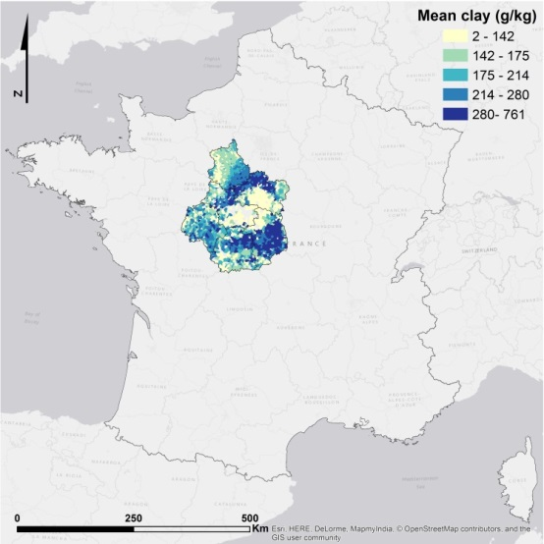
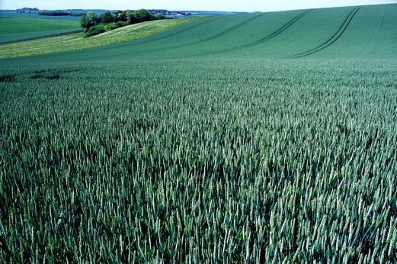
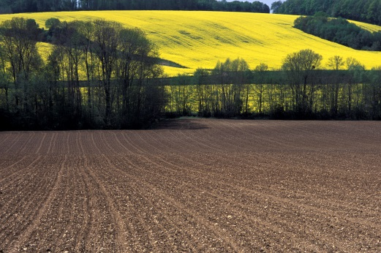
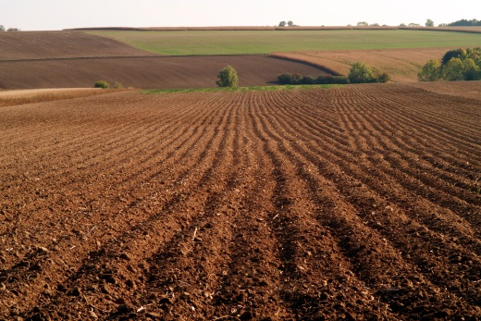
Objectives
Compare 4 approaches for mapping soil texture in Region Centre using BDAT data:
Average BDAT data aggregated by municipality (BDAT reference)
scorpan model
AtoP cokriging
AtoP regression cokriging
Photos: Jean Weber © INRA
M. Roman Dobarco/ Soil texture in Region Centre combining regression and area-to-point kriging
10/ 08/ 2015
Notes:
Most RK studies with areal data do not take account of the within-unit variability of the trend. An extension of the method — based on the kriging with location error approach of Cressie and Kornak (2003), and presented in Orton et al. (2015) — uses the within-unit variability of the trend in parameter fitting and prediction.

Slide 5
Methods
scorpan model:
Additive log-ratio transformation (>25,500 observations)
${clay}_{alr}=ln\frac{clay}{silt}$ ${sand}_{alr}=ln\frac{sand}{silt}$
25 environmental covariates : average (continuous variables) / dominant class (categorical) by municipality
Boosted regression trees (BRT) models fitted for sand_{alr} and clay_{alr}
Relief derivates
Gamma-ray, geology, soil
% crop types
M. Roman Dobarco/ Soil texture in Region Centre combining regression and area-to-point kriging
10/ 08/ 2015

Slide 6
Methods
AtoP cokriging approach with summary statistics data (AtoP CK)
AtoP regression cokriging (AtoP RCK)
BRT predictions = auxiliary variable (fixed effect of LMM)
Variance of predicted variables - but we assume the covariates do not vary within municipalities
M. Roman Dobarco/ Soil texture in Region Centre combining regression and area-to-point kriging
10/ 08/ 2015
Notes:
The summary statistics (SS) approach: a likelihood function is rewritten in terms of the areal summary statistics data, which comprise the mean, variance and number of observations from each areal unit. Since it is written in terms of a linear mixed model (LMM; e.g Lark et al., 2006), fixed effects can be included to explain some part of the variation. An extended LMM can be used in conjunction with a linear model of coregionalization (LMCR) to model the joint distribution of ${clay}_{alr}=\ln{\frac{clay}{silt}}$ and ${sand}_{alr}=\ln{\frac{sand}{silt}}$
For AToP RCK, we assume that linear functions of the BRT predictions of ${clay}_{alr}$ and ${sand}_{alr}$ give the expectations. That is:
$$E\left[{clay}_{alr}\left(x\right)\right]=β_{0}+β_{1}{clay}_{alr.BRT}\left(x\right)$$
$$E\left[{sand}_{alr}\left(x\right)\right]=β_{2}+β_{3}{sand}_{alr.BRT}\left(x\right)$$
When parameters are fitted using the approach presented in Orton et al. (2015), the within-unit variability of the covariates (i.e. ${clay}_{alr.BRT}\left(x\right)$ and ${sand}_{alr.BRT}\left(x\right)$) is accounted for.

Slide 7
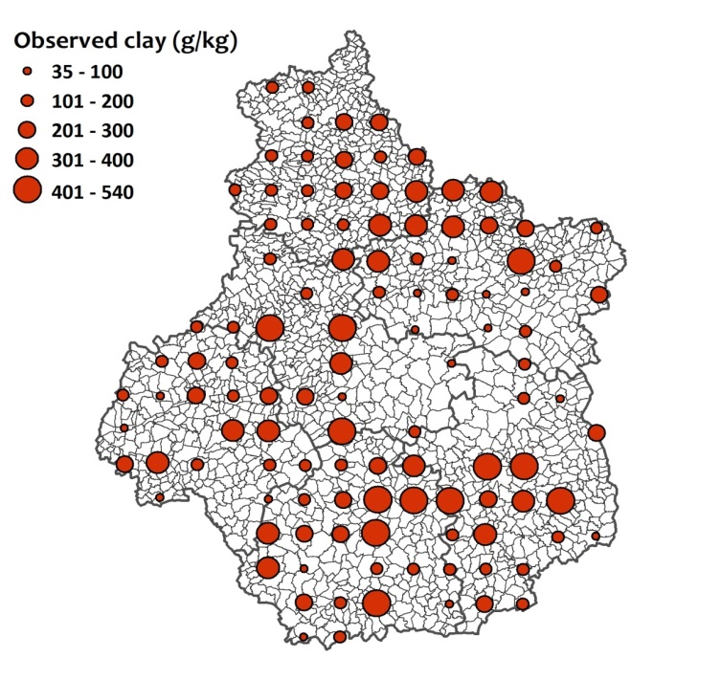
Methods
Independent validation
100 sites from the French National Soil Monitoring Network (RMQS)
16-km systematic random grid
RMSE, R², MPE
Uncertainty assessment:
$$θ(s_{i})= \frac{ {\left\{ z\left(s_{ i}\right)− \hat{z}\left(s_{i}\right)\right\}}^{2}}{σ_{i}^{2}}$$
BDAT reference → BDAT variance by municipality
M. Roman Dobarco/ Soil texture in Region Centre combining regression and area-to-point kriging
10/ 08/ 2015
Notes:
We selected 100 sites from the RMQS located in agricultural land (cropland, pastures, vineyards and orchards) as independent probability sample.
We calculated the mean prediction error (MPE), the root mean square error (RMSE), and the coefficient of determination (R²) to compare the prediction accuracy for the four models. In addition, we calculated the standardized prediction errors, or Ɵ statistic.
For the BDAT Reference, Ɵ statistics will inform whether the BDAT measurements are biased relative to the systematic random grid of the RMQS.

Slide 8
Results
Prediction accuracy – Independent validation
Particle size fraction | Model | RMSE | R² | MPE
Clay | BDAT reference | 96.9 | 0.32 | -8.6
Clay | BRT | 81.6 | 0.50 | -20.0
Clay | AToP CK | 86.7 | 0.44 | -5.9
Clay | AToP RCK | 85.2 | 0.46 | -1.8
Sand | BDAT reference | 153.7 | 0.59 | -2.7
Sand | BRT | 125.2 | 0.73 | -4.7
Sand | AToP CK | 130.5 | 0.71 | 2.3
Sand | AToP RCK | 120.8 | 0.75 | -4.5
Silt | BDAT reference | 123.0 | 0.64 | 10.5
Silt | BRT | 100.0 | 0.77 | 24.7
Silt | AToP CK | 111.7 | 0.71 | 3.6
Silt | AToP RCK | 97.9 | 0.78 | 6.3
M. Roman Dobarco/ Soil texture in Region Centre combining regression and area-to-point kriging
10/ 08/ 2015
Notes:
Geology and agricultural land use were the most relevant variables for clay-alr and sand-alr models respectively

Slide 9
Results
Uncertainty assessment – Independent validation
Model | Variable | $$\overline{θ}$$ | $$\tilde{θ}$$
BDAT reference | Clay_{alr} | 8.05 | 0.77
BDAT reference | Sand_{alr} | 8.27 | 0.75
AToP CK | Clay_{alr} | 1.06 | 0.38
AToP CK | Sand_{alr} | 0.80 | 0.35
AToP RCK | Clay_{alr} | 0.94 | 0.44
AToP RCK | Sand_{alr} | 0.72 | 0.29
M. Roman Dobarco/ Soil texture in Region Centre combining regression and area-to-point kriging
10/ 08/ 2015
Notes:
The Ɵ statistics showed some extreme differences between RMQS observations and the reference BDAT average values. One possible explanation for this is the different sample supports of individual observations in the two databases. The RMQS is based on a defined sampling design, each sample being a composite sample of twenty-five cores taken from locations across a 20 m x 20 m plot. In the case of the BDAT, the sampling strategy is uncontrolled; some samples will be individual soil cores, whilst others will be composite samples. Furthermore, the composite samples were most probably formed with aliquots from locations dispersed over a larger area (e.g. a few locations across a field) than the 20 m x 20 m plots of RMQS. The larger extent of the sample supports of observations in the BDAT database will lead to more short-scale variance being averaged out of the data, which could provide one explanation of the larger-than-expected $\overline{θ}$ values (uncertainty being under-estimated) for the reference method. I think this is what I meant to say.

Slide 10
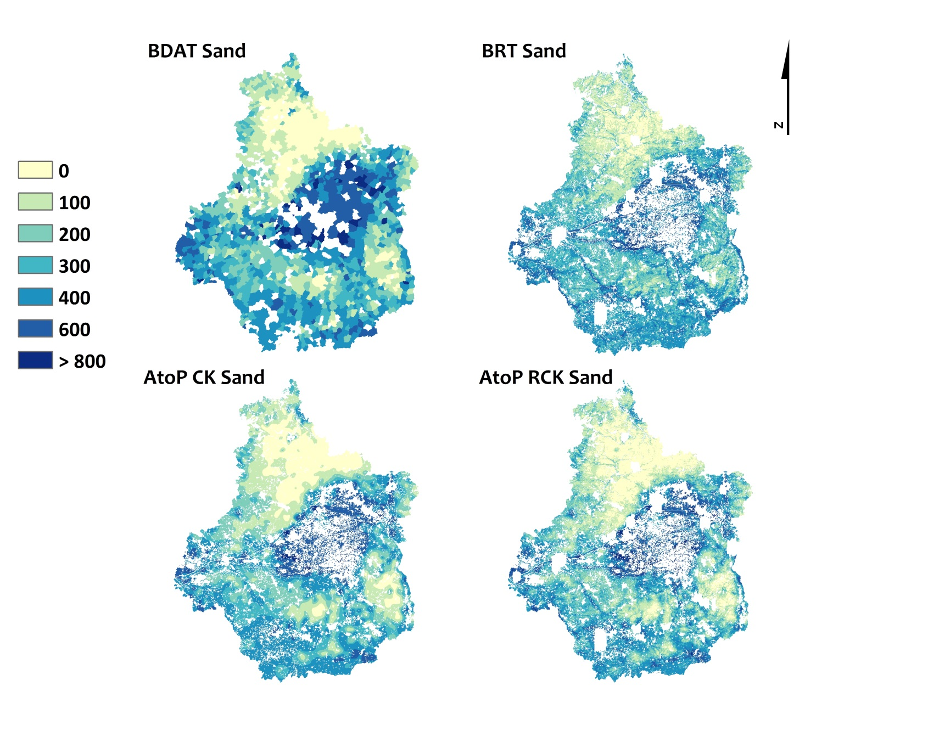
Results
M. Roman Dobarco/ Soil texture in Region Centre combining regression and area-to-point kriging
10/ 08/ 2015

Slide 11
Discussion and conclusions
Aggregated BDAT data provided a good first idea of the spatial distribution of soil texture
BRT model had similar performance to BRT models calibrated with a point-support dataset (Ciampalini et al., 2014)
Prediction accuracy: AtoP RCK > AToP CK
Uncertainty assessment: AtoP CK > AToP RCK
Ciampalini et al. 2014. GlobalSoilMap, pp 121-126
M. Roman Dobarco/ Soil texture in Region Centre combining regression and area-to-point kriging
10/ 08/ 2015
Notes:
These results are consistent to those obtained for the Region Centre by Ciampalini et al. (2014) for soil texture in the 0-30 cm depth with cross-validation: clay R² ~ 0.40, sand R² ~ 0.63, silt R² ~ 0.66.
The comparison of model performance indicates that despite the limitations linked to the soil-test database (e.g., municipal average values of data and environmental covariates used to fit models, absence of sampling design), our models provided acceptable predictions when compared to models developed with observations on point support.

Slide 12
Discussion and conclusions
AToP CK and AToP RCK are powerful methods for disaggregating and mapping areal data
Improving scorpan model predictions with other covariates? e.g.,LANDSAT indices
Further applications of disaggregated maps of BDAT data
Model ensemble
French scale products
Always difficult to estimate the bias of the BDAT
Probability
Sand_{alr}
M. Roman Dobarco/ Soil texture in Region Centre combining regression and area-to-point kriging
10/ 08/ 2015

Slide 13
Acknowledgements
M. Roman Dobarco/ Soil texture in Region Centre combining regression and area-to-point kriging
10/ 08/ 2015

