Slide 1
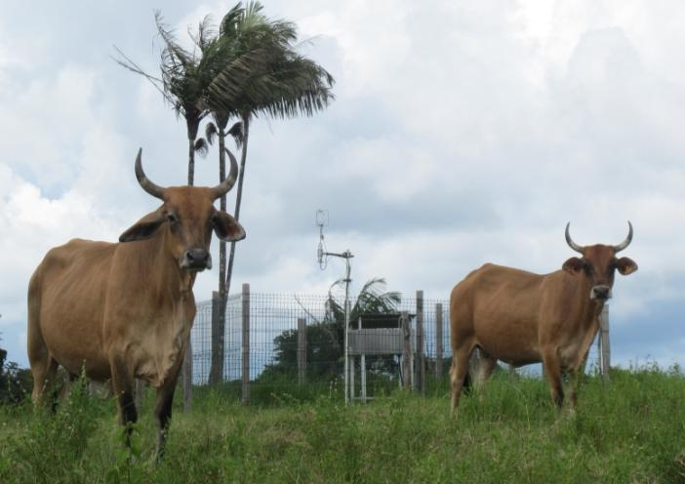
Effect of agricultural practics and climate on carbon storage potential of two contrasted permanent tropical Pastures – case study French Guiana
Katja Klumpp¹, Clément Stahl^{1-2 *}, Robert Falcimagne¹, Olivier Darsonville ¹, Benoit Burban², Vincent Blanfort^{1-3 ,}Lecomte Philippe³
(1) INRA, UR 874, Research Unit on permanent grasslands, 63100 Clermont Ferrand, France (2) CIRAD, UMR Selmet, Campus Agronomique, BP 709, 97387 Kourou Cedex French Guiana (3) CIRAD, UMR Selmet, Campus international de Baillarguet - TA C-112/ A 34398 Montpellier Cedex 5 * clement.stahl@ecofog.gf
More than 15% of Amazon forest has been converted to pastures in last decades. Forests contain more C than a pasture, however, only little information is available on the potential C sequestration of those pastures in the long term and with respect to climatic variability. A better insight on how climatic variability and agricultural management affects net carbon exchange (i.e. NEE) of cattle pastures are, thus, important to increase C storage and to prevent from increasing greenhouse gas emission.
AIMS
MATERIELS & METHODS
This study was conducted in two farms in French Guiana, South America (5°16’54”N, 52°54’44”W). Mean annual rainfall is 3041 mm and mean air temperature is around 25.7 °C. The study focused on a hilltop zone with clayey soils, classiﬁed as Ferralsols or Acrisols.
Investigate the drought effect on the carbon storage in two contrasted agricultural management.
Evaluate the specific consequences of the climatic variability (i.e dry and wet season) on the GPP and Reco.
The pastures were established in 1978 (old) and 2008 (young) after deforestation of native rainforest and were grazed rotationally by livestock at low and high stocking density. The vegetation in the pastures was dominated by Brachiaria humidicola.
Young pasture “ETVM”, were grazed at high stocking density 4.4 LSU ha⁻¹ yr⁻¹ (intensive).
Old pasture “Bio-Savane”, were grazed at low stocking density 1.4 LSU ha⁻¹ yr⁻¹ (extensive).
RESULTS
Since 2010, we measured C sink potential by eddy covariance technique of the two pastures. Eddy covariance flux measurements followed European flux guidelines, and gaps and poor quality data were reconstructed using the gap-filling strategy of Reichstein et al. (2005).
intensive
C source
Precipitation-ET (mm)
Soil water content (m³ m⁻³)
extensive
Cum NEE (g C/m²)
C sink
2011
2012
2013
Seasonal variation of water conditions indicate that during the 3 years, 2012 was the driest years, with 260 days of P-ETP<0 compared to 215 days in 2013, which was the wettest year.
The two pastures show a intra-annual variation of net carbon storage (NEE) as an effect of soil water conditions modulated by the management. Extensive management allows a better net C storage for dry years (2012), while during the wet years intensive grazing seems to be an advantage (2013).
g C/m2 | Reco |  | GPP
year | extensive | intensive | extensive | intensive
2011 | 1950 | 1909 | 2123 | 1930
2012 | 1026 | 1545 | 1105 | 1536
2013 | 1735 | 1921 | 1807 | 2112
t C ha⁻¹ an⁻¹ | 2011 | 2012 | 2013 | mean
intensive | +0.7 | +0.3 | -1.7 | -0.4
extensive | -1.7 | -0.8 | -0.7 | -1.1
Annual Net Ecosystem Exchange (NEE) in the two pastures
2012
In the year with a long period of consecutive dry days (e.g. 2012 - 128days), GPP and Reco are higher for the intensive compared to extensive grazing.
2011
2013
CONCLUSION
2012
Intensity of dry season is different between dry and wet years (e.g. 2012 and 2013) leading to a high inter- and intra-annual C storage variability in relation to water condition.
The old extensive pasture shows a higher net C storage but is more affected to intermediate water conditions, between wet and dry season, allowing the higher C storage in dry years.
The GPP-Reco-relation is sensitive to SWC (and P-ETP), changing fraction their pattern in dry and wet years.
The part of GPP respired (Reco) is similar for both treatments for the wet year (2013), while a higher fraction of GPP is respired in dry years by the intensive grazing, which may explain the lower NEE (less negative) during these years.
We thank the farmers, who permit to samples their pastures. We thank also the great technician assistance of Cirad Guyane and Inra Clermont during this experimentation.

