Slide 1






MEASURING AND MODELING SOIL INTRA-DAY VARIABILITY OF THE ¹³CO₂ & ¹²CO₂ PRODUCTION AND TRANSPORT IN A SCOTS PINE FOREST
Goffin Stéphanie, Parent F., Plain C., Epron D., Wylock C., Haut B., Maier M., Schack-Kirchner H., Aubinet M., Longdoz Bernard

Slide 2
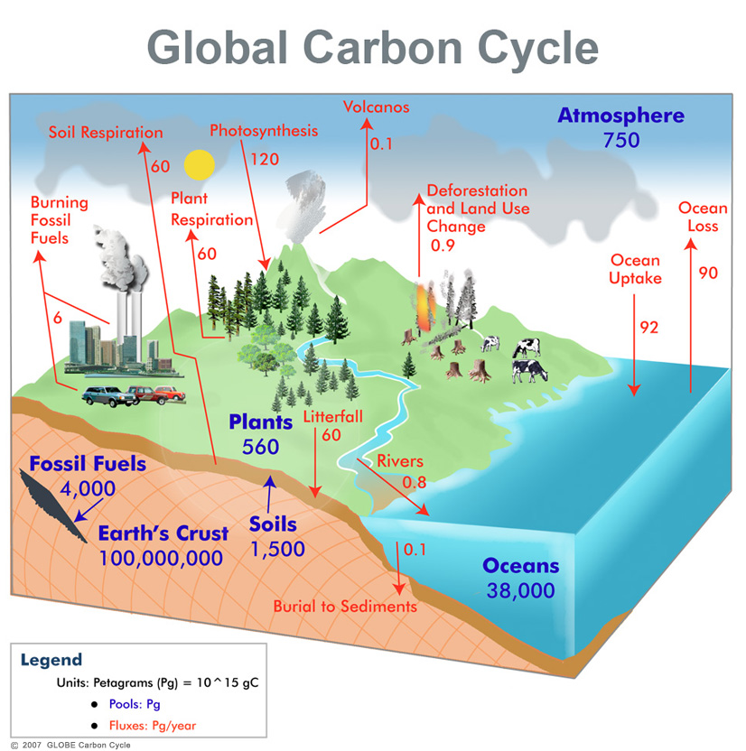
Background & Objectives
Soil CO₂ efflux (Fs)
Fs: One of the largest component of C cycle
≅ 10 times greater than fossil fuel emissions
Soil: large C pool
⇒ Fs changes may rival the loading of atmosphere by fossil fuel
⇒ Uncertainties >>>
  ? Climate Change Impact?
  ? Positive feedback to the GHG effect?
Past
today
Future
Empirical description
Mechanistic understanding

Slide 3
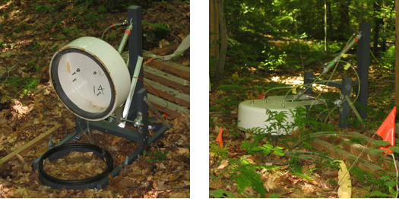
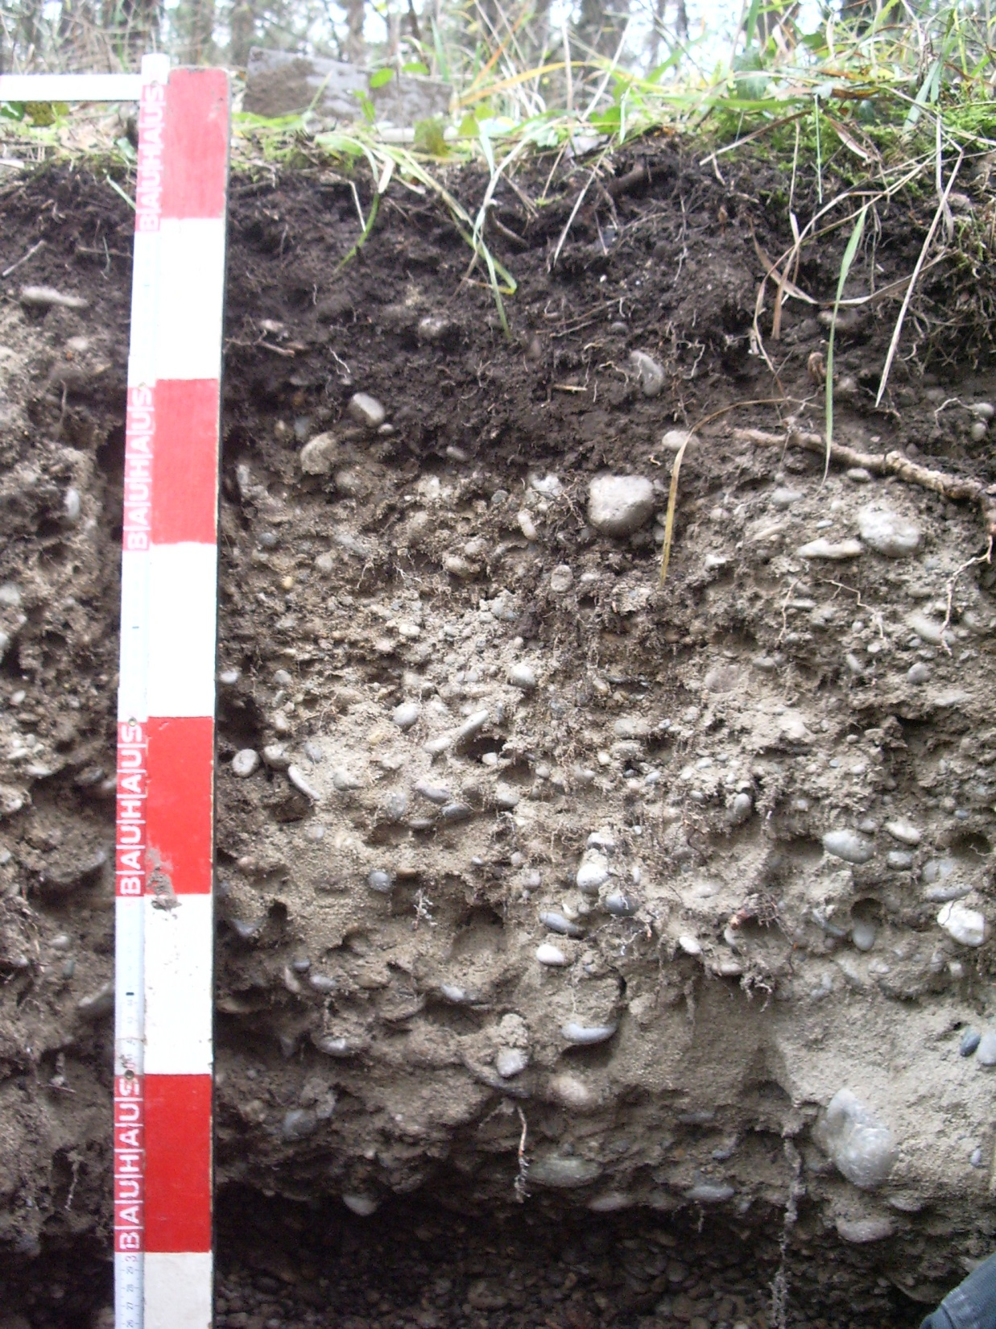
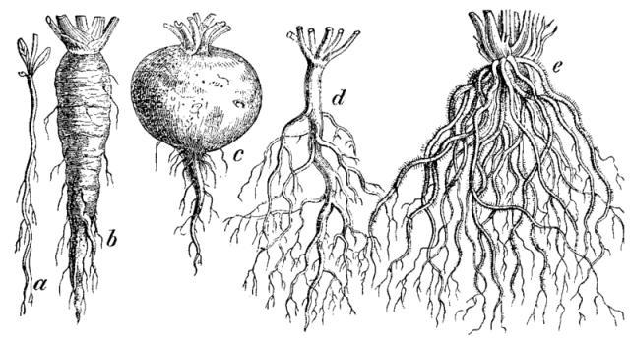

Background & Objectives
Fs
Low
Transport
Production
CO₂
Diffusion
Autotrophic
Depth
[CO₂]
CO₂
CO₂
Avection + Dispersion
Heterotrophic
High
Liquid phase
Abiotic

Slide 4
Background & Objectives
Fs
Transport
Production Ps
f(porosity, humidity…)
CO₂
Heterotrophic
Autotrophic
Porosity
CO₂
f(Temperature, humidity, substrate)
High
CO₂
Fine and Coarse Roots
Corg
Low
⇒ Multilayer Approach needed

Slide 5
Background & Objectives
δ¹³CO₂=-8‰
Discrimination during CO₂ assimilation
Discrimination changes with climatic conditions
δ¹³CO₂=-27‰
⇒ During drought, discrimination decrease ⇒ photoassimilats more enriched in ¹³CO₂ ( ex: -25‰)
⇒ Temporal variation of δ¹³CO₂ may give informations about transfert time of photoassimilates
Fs
δ¹³CO₂ = -27‰
δ¹³CO₂ may differs between CO₂ sources
⇒ δ¹³CO₂ may helps for partitionning Fs between sources
Sources
⇒ Understanding of δ¹³CO₂ fluctuations (space & time) needed
Notes:
So, for example, the isotopic signature of CO2 in the atmosphere is -8 per mil…and the isotopic signature of plant material is -27 per mil. It means that there is a strong discrimination againt C13 during assimilation. Vegetation assimilate preferentially the 12CO2 than the 13CO2 so that the plant material is depleted in 13CO2 in comparison with the atmosphere. That discrimination against 13C may change with climatic conditions. For example, during drought events, that discrimination decrease…it means that the photoassimilats become more enriched is C13. As a portion of photoassimilates are then used as substrate for soil respiration, the temporal variation of the isotopic composition of soil respiration may give information about the transfert time of photoassimilats. Another interesting point is that the isotopic composition between autotrophic and heterotrophic sources may also differ…if it is the case, the isotopic composition of soil respiration may give additionnal information about the sources involved.

Slide 6

Background & Objectives
Improving mechanistic understanding of F_{s}
Multilayer Approach
Isotopic Signal Analysis
Sources & δ¹³C
Determine the CO₂ production rate Ps and its isotopic signature δ¹³Ps for the different soil horizons.
Find factors affecting Ps & δ¹³Ps intra & inter day fluctuations
Evaluate by modeling which processes (production or transport) drive Fs temporal variability
Sources & δ¹³C
Sources & δ¹³C
Sources & δ¹³C
Sources & δ¹³C
Sources et δ¹³C

Slide 7
Determine Ps and δ¹³Ps for ≠ layers
¹²CO₂ & ¹³CO₂ balances for each i layer
Fs
for ¹²CO₂ & ¹³CO₂
Diffusive Flux-Gradient approach
for ¹²CO₂ & ¹³CO₂
z
F_{up}
up
Ps_{i}
ΔC_{i}
⇒
i
F_{down}
down
Vertical profile of their dependence on SWC measured on samples at
¹²CO₂ & ¹³CO₂ vertical profile measured by
➨ Ps and δPs for each layer

Slide 8
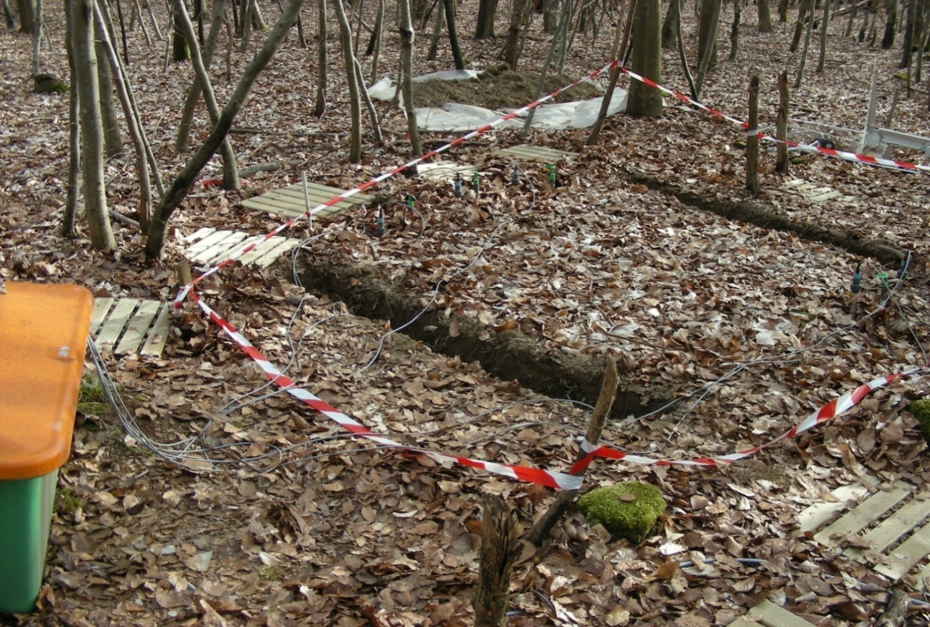
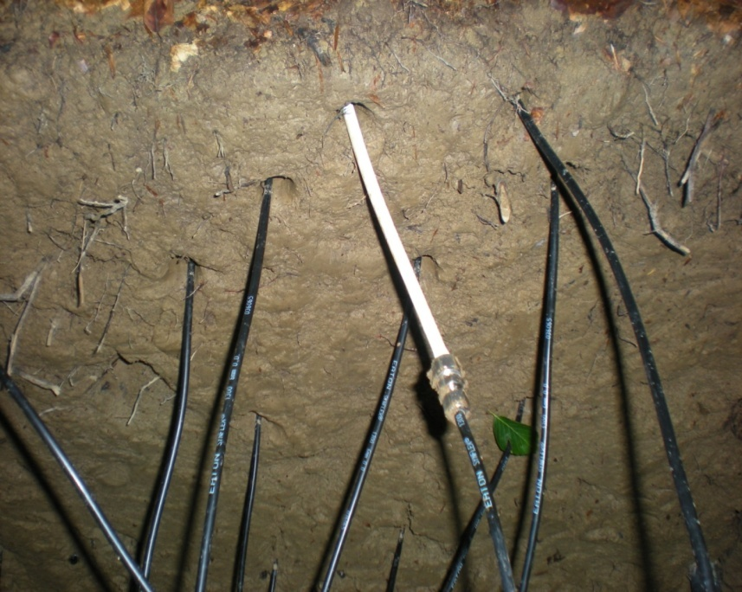
Determine Ps and δ¹³Ps for ≠ layers
(Parent et al. 2013)
Field Measurements
Membrane porous tube
Soil depth
0 cm
5 cm
10 cm
20 cm
40 cm
80 cm
Notes:
Here is our experimental device, we inserted at several depths in the soil a series of sensors: CO2 probes to measure the vertical profile of CO2 concentration, Temperature and Soil water content probe to measure respectively temperature and soil water content profile and also a series of porous tubes connected to a specific gaz analyseur that differentiates the 13CO2 and 12CO2 so that we have a measurement of the vertical profile of isotopic signature of CO2 profile. In addition to that soil measurements, we measure the surface CO2 fluxes and its isotopic signature.

Slide 9
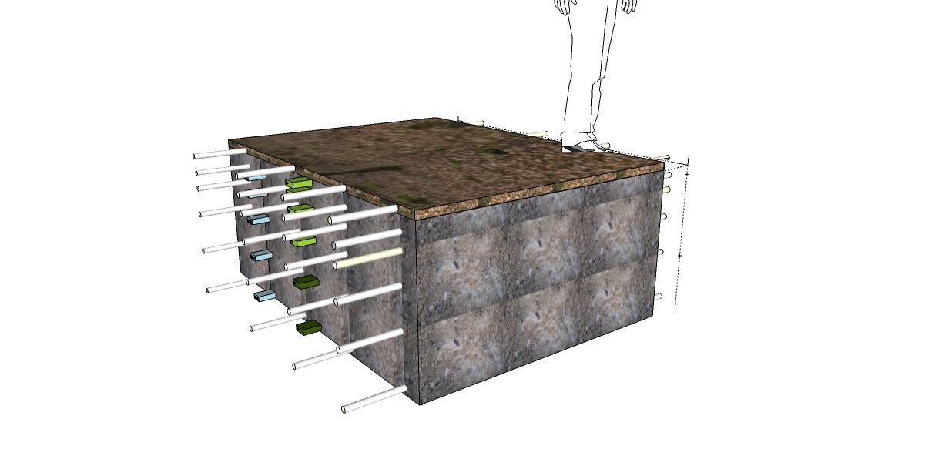
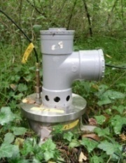
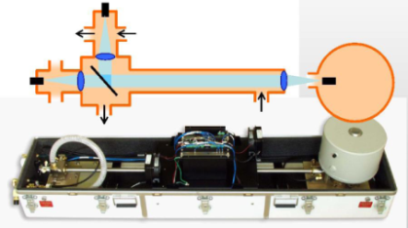
Determine Ps and δ¹³Ps for ≠ layers
(Parent et al. 2013)
Field Measurements
Half-hourly In situ measurements during
21 days
Soil Chamber
TDLS:
¹²[CO₂] & ¹³[CO₂]
membrane tube ≡ [CO₂] & δ¹³CO₂ in soil layers
from chamber ≡ EFs & δ¹³EFs
2 m
SWC sensors
T° sensors
Notes:
Here is our experimental device, we inserted at several depths in the soil a series of sensors: CO2 probes to measure the vertical profile of CO2 concentration, Temperature and Soil water content probe to measure respectively temperature and soil water content profile and also a series of porous tubes connected to a specific gaz analyseur that differentiates the 13CO2 and 12CO2 so that we have a measurement of the vertical profile of isotopic signature of CO2 profile. In addition to that soil measurements, we measure the surface CO2 fluxes and its isotopic signature.

Slide 10
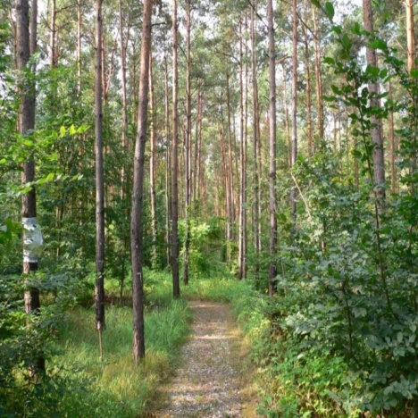
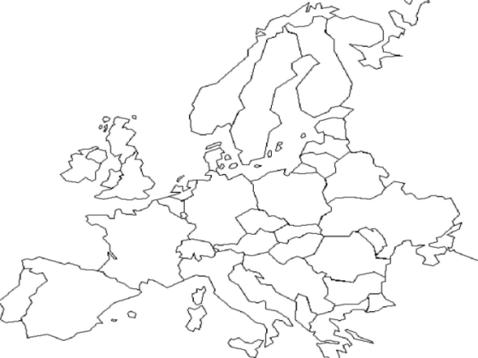
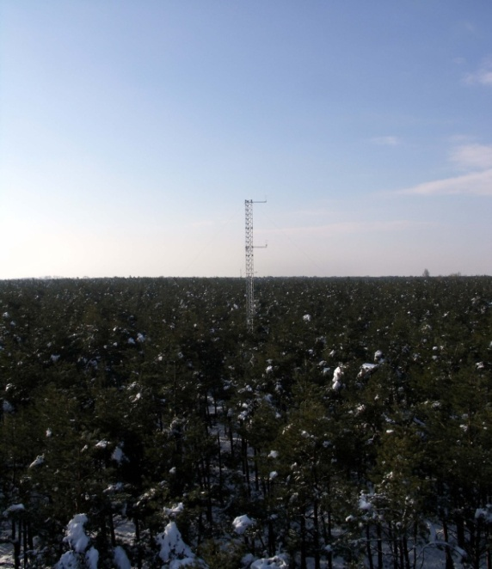
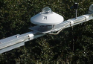
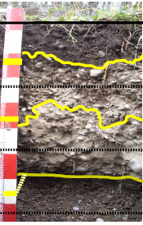
Determine Ps and δ¹³Ps for ≠ layers
Site Description
Hartheim experimental site
(47°56’N-7°36’E)
Slow growing 46 year old Scots Pine Forest (Pinus sylvestris L.)
Mean annual air Temp:10.3°C
Mean annual precip: 642 mm
Ah
AhC
Haplic Regosol (calcaric, humic) (FAO, 2006)
Eddy Covariance tower
Meteorological station
C
Humus type is mull (1-3 cm thick)

Slide 11

Determine Ps and δ¹³Ps for ≠ layers
Vertical Profile of Ps
2.5cm
Ol
0 cm
Ah
-20 cm
AhC
-40 cm
C
-80 cm

Slide 12
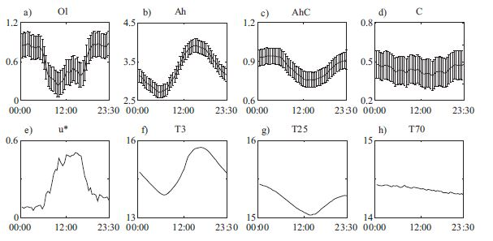
Factors affecting Ps and δ¹³Ps
(Goffin et al. 2014)
Intra-day Ps variability
Mean diel variation
Mean diel varation explained by LOCAL T° in Ah & AhC
No significant diel variation in C
In the litter relationship with u* because of advection not taken into account

Slide 13
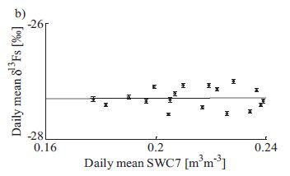
Factors affecting Ps and δ¹³Ps
(Goffin et al. 2014)
Inter-day δ¹³Ps variability
Significant day to day variations of δ¹³Ps (> 2.5‰) in Ah
(SWC)
Best explained by soil moisture
Soil drought impact = enrichment
Same impact as for photosynthesis discrimination !!!
Not observed with chamber efflux measurements
Mixing of ≠ layers contributions
Perturbation of local soil climate by chamber ?

Slide 14
Who (transport or production) is responsible for Ps and δ¹³Ps temporal variability ?
(Goffin et al. undre review)
3 model versions simulating CO₂ production and transport
Comparison of their outputs with [CO₂] and Fs measurements
Reference model (RM):
each layer produce CO₂ following Q10 relationship with the local t° & diffusion is the only transport process
Transport Version (TV):
Advection and dispersion are ss
Production Version :
Production is also driven by Photosynthesis Pressure Concentration Wave (PPCW) by adding a dependence on VPD

Slide 15
Who (transport or production) is responsible for Ps and δ¹³Ps temporal variability ?
(Goffin et al. undre review)
RM: Relatively good reproduction of inter-day variability but intra-day variability too low and not in phase
No significant improvement with TV
PPCW : Not perfect but diurnal fluctuations are better reproduced and difference in phase is reduced
➨ Working on production description instead on transport one is a better option to improve soil CO₂ model

Slide 16
Key points
Set up of an experimental in-situ device to obtain vertical profile of Ps and δPs
Identify a dependence of one layer to local temperature
Indentify enrichment of Ps with soil drought in Ah horizon
Soil CO₂ model should develop production description more than transport one to simulate hourly/daily variability

Slide 17
Thank you for your attention
Meet me on poster #21

Slide 18
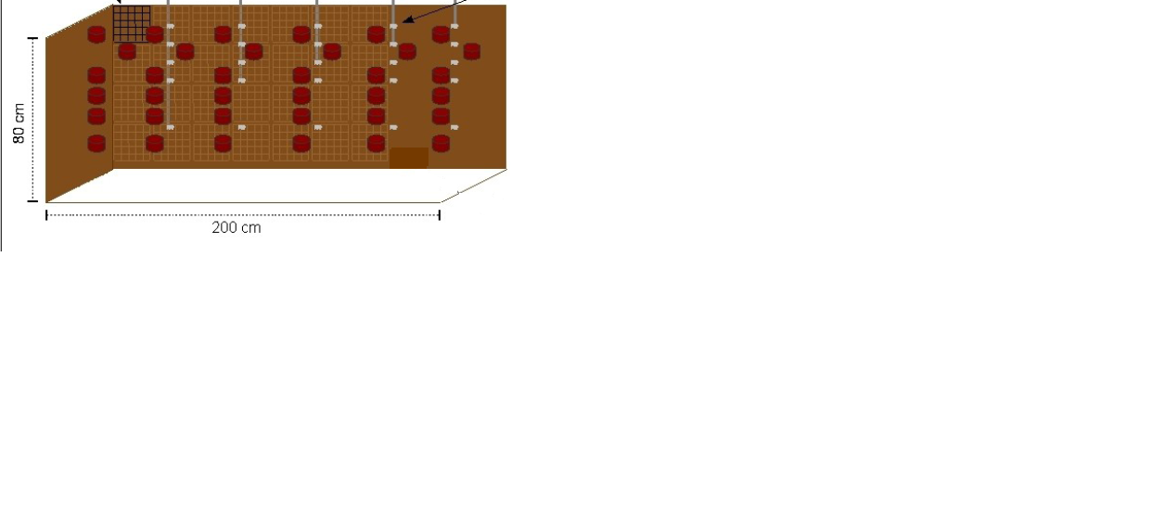
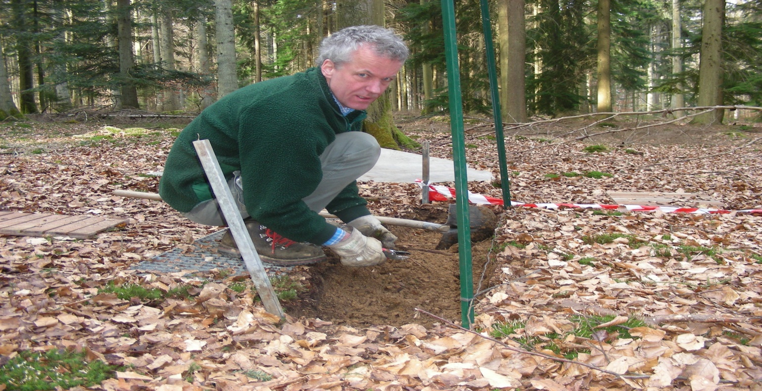
Materials & Method
Laboratory Measurements
Undisturbed soil cores of 200 cm³ collected in each horizon
Soil horizon specific physical parameters :
  Porosity, pF curves
  Relationships between Ds(SWC)
Notes:
And in addition to that in situ measurement, we collected several sample in each soil horizons to determine in laboratory soil horizon specific characteristics. More specifically soil horizon specific relationships between the diffusion coefficient and soil water content.

Slide 19
Material & Method
Laboratory measurements – Ds determination
Laboratory measurements
Ds [m²s⁻¹]
Ds(SWC)_{Ah1}
Ds(SWC)_{Ah2}
Ds(SWC)_{AhC}
Ds(SWC)_{C}
In Situ measurements

Slide 20
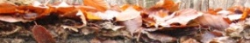
Materials & Method
Background & Objectives
Materials & Method
Results & Discussion
Conclusions
Laboratory Measurements– Parametization
Litter
Level 0
Pingintha et al, 2009

Slide 21
Determine Ps and δ¹³Ps for ≠ layers
Day to day variation
Vertical Profile of CO₂ sources
Ah Production terms
Litter Production terms
Soil production shows clear diel and daily fluctuations in Ah
  Unlike other horizons, Ol production was best explained by surface soil water content (SWC) (R²=0.46)
The diel and daily fluctuations are best explained by the T measured in the topsoil
  → temperature is the most important driver of soil CO₂ production

