Slide 1





YASSO-07
French case study
Laurent SAINT-ANDRE, Delphine DERRIEN, Manuel NICOLAS, Mathieu JONARD

Slide 2
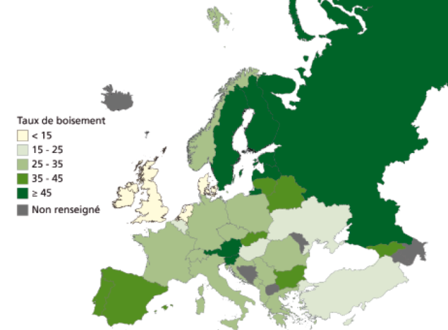
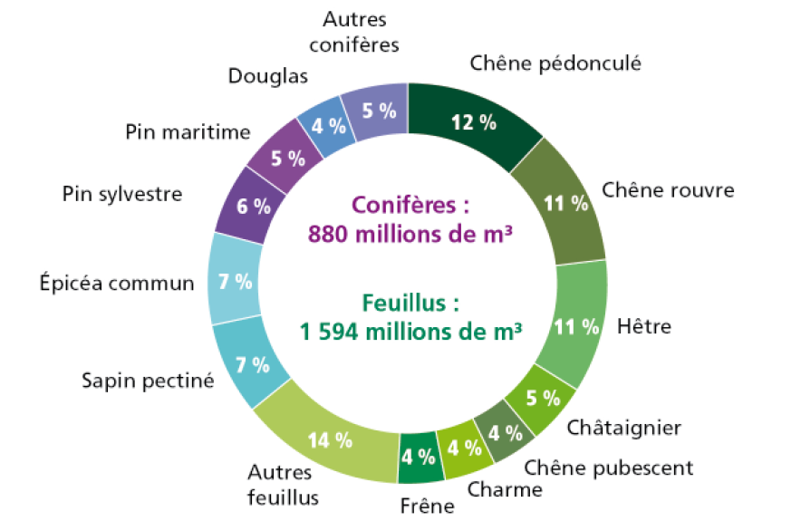
Introduction
Soil Organic Matter Processes…….. Opening the blackbox !
Panorama of the
French Forest
Land cover area : 29.7% is Forests (Europe average, including Russia 32.2%)
Forest owners: 75% private, 25% public
Total Volume (m3): 2.5 billion = 4th European country after Russia, Germany, Sweden.
Forest land (% of land cover, source European State of Forests, 2011)
Other
Coniferous
Forest Composition : Broadleaves species (67%), Coniferous species (22%), Mixed stands (11%)
Pseudotsuga menziesii
Quercus robur
Pinus pinaster
Pinus Sylvestris
Quercus petraea
Coniferous
880 millions of m³
12 tree species contribute to 80% of the total volume of French Forests
Picea abies
Broadleaf
1594 millions of m³
Fagus Silvatica
Abies Alba
Castanea sativa
Other
Broadleaves
Quercus pubescens
Fraxinus
Excelsior
Carpinus Betulus
© IGN 2012

Slide 3
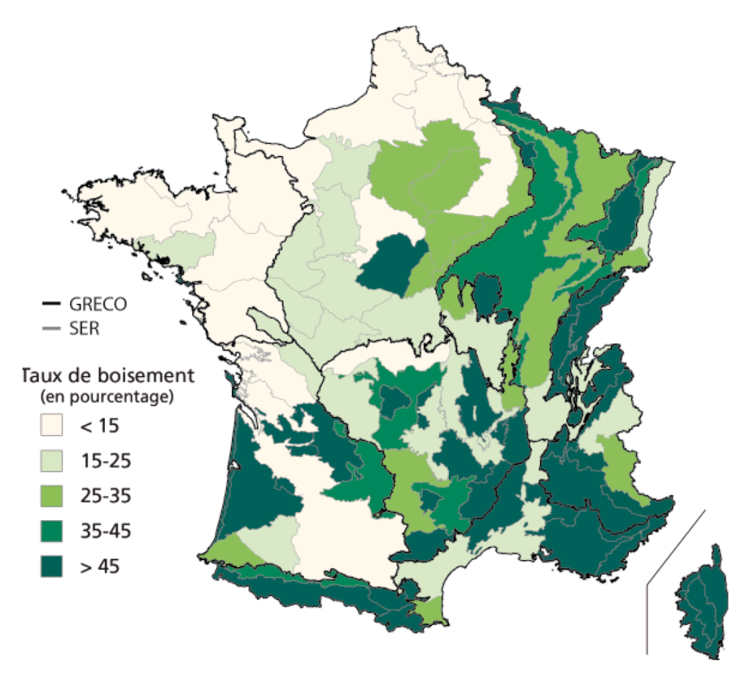
Introduction
Soil Organic Matter Processes…….. Opening the blackbox !
Panorama of the
French Forest
National Forest Inventory: The Institute (IFN) in charge of the national inventory has been embedded into the National Geographic Institute in 2012
Yearly assessment of forest inventory (it was every ten years before 2008)
Results provided by administrative departments and by SylvoEcological Regions : 91 SER and 12 GRECO
Forest land (% of land cover) by SylvoEcoRegions
SER = SylvoEcologicalRegion (determinants of forest growth conditions and habitats)
GRECO = Ecological regions (one GRECO regrouping several SER)

Slide 4
Soil Organic Matter Processes…….. Opening the blackbox !
SOERE
F-ORE-T
GIS-Coop,
Liming network,
MOS network,
PlantaComp,…
15N labelled litter network
Douglas network
Monitoring networks
Eg. level II- 16x16
RENECOFOR
GUYAFOR
National Forest Inventories
Instrumentation in situ
Intensive study sites
Range of ecological situations
Experimentation
Take advantage of the high (but structured) diversity
of monitoring and experimental networks in forest ecosystems
Let’s open the black box !!

Slide 5
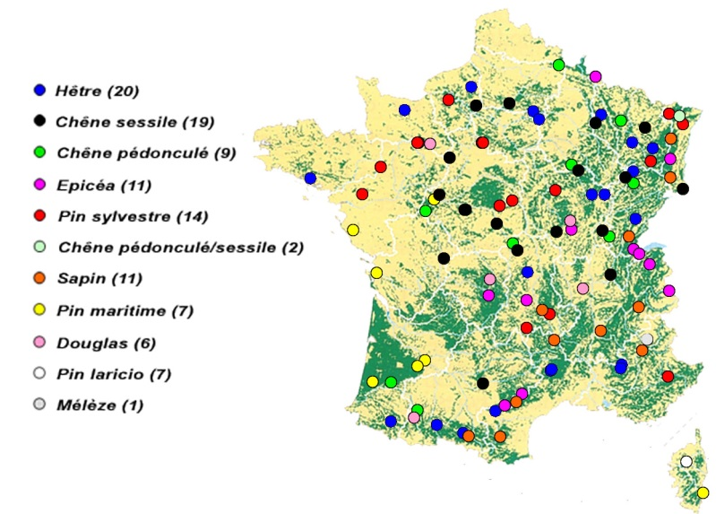
Soil Organic Matter Processes…….. Integration at ecosystem scale
An unique dataset in forest ecosystems
Cover the main tree species in France
Aboveground litterfalls measured between1994-2008 (leaves, branches, fruits et miscellaneous).
Regular forest inventories combined with biomass models (above- and below-ground biomass) allowed to estimate the inputs after each thinning and each storm
Soil carbon stocks have been measured in 93-95 and in 07-12.
Climatic datasets are coming from RENECOFOR own recording and Meteo France.
102 plot of the RENECOFOR Network

Slide 6
Soil Organic Matter Processes…….. Integration at ecosystem scale
Good results in average
1999 storm, plot HET 54b
Spinup procedure with average climate and litter inputs
Thinning
 | Observed (tC/ha) | Yasso07-6rdRun (tC/ha)
Mean | 80.9 | 81.6
SD | 29.9 | 22.8
CV | 37% | 28%
 | Observed (tC/ha/period) | Yasso07-6rdRun (tC/ha/period)
Mean | 5.6 | 6.1
SD | 9.5 | 7.2
CV | 170% | 118%
Actual climate and litter inputs (evaluation of the stock changes)

Slide 7
Soil Organic Matter Processes…….. Integration at ecosystem scale
BUT, not at the stand / species level…….
Taking species specific biochemistry of the litters
Without considering species biochemistry of the litters
Same results for both stocks and stock changes……..

Slide 8
Soil Organic Matter Processes…….. Integration at ecosystem scale
Error tracking…….
Error well correlated to the initial stock
Past history ? But also wrong estimate of the partitionning of SOM into the biochemical components
Species effect (on the intercept and interaction with the stand productivity)
  Biogeochemistry of the litter not well taken into account
  Too much emphisize on the amount of the litter
Fertility effect (slight)
The litter inputs do eliminate most of the impact of soil fertility on
SOC dynamics, but not all. It remains a slight effect of soil properties

Slide 9
Soil Organic Matter Processes…….. Integration at ecosystem scale
Conclusion on the Yasso model
The architecture of Yasso based on a biochemical partitioning of SOC is particularly relevant to tackle the challenge of assessing assess fluxes at decades to centuries time scale
But it need to be reparametrized for French application with more contrasted values for the Acid, Ethanol and Non soluble pools (like in Tuomi et al., 2011a Ecological Modelling; 2011b, Environmental Modeling and Software)
And also may be an improvement to take, at least, humus type into consideration (cf work of J. Salleles)

