Slide 1
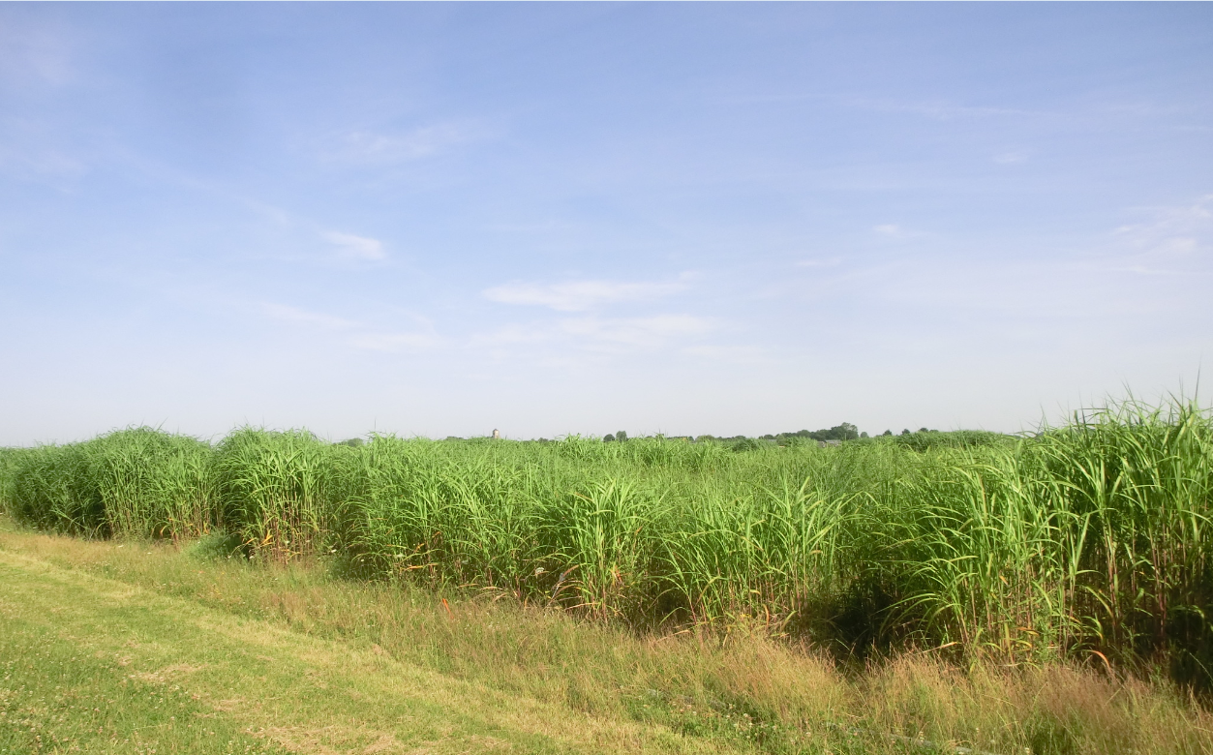
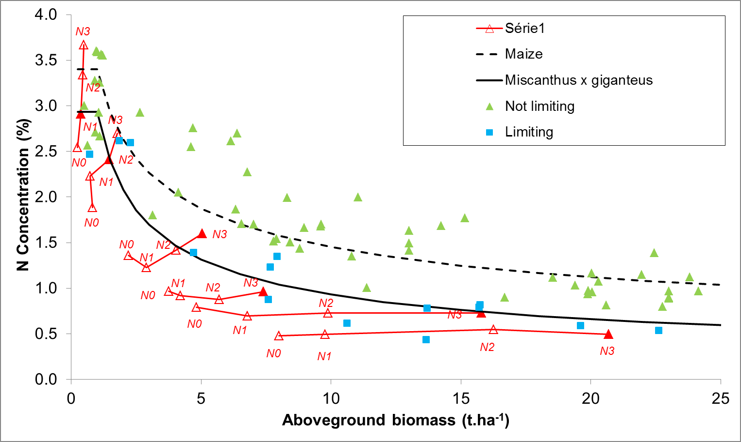
Determining a critical nitrogen dilution curve
in Miscanthus x giganteus
Zapater M¹, Ollier M¹, Mary B¹, Catterou M², Ferchaud F¹, Giauffret C¹, Strullu L¹, Arnoult S³, Dubois F², Brancourt-Hulmel M¹
¹ INRA UR AgroImpact, ² EDYSAN-AEB Université de Picardie Jules Verne, ³ INRA UE GCIE Picardie
Introduction
The critical curve was constructed as follows: for each sampling date 1) we determined the points presenting the highest biomass among the four N treatments and 2) among those presenting non statistical differences in biomass, we selected the points having the lowest N concentration as being ‘critical’ points.
The validity of the critical curve was tested by gathering data from different studies (Table 1). Data were classified into two groups depending on N status: ‘limiting’ (limited growth due to lack of N) and non-limiting. This classification was based on statistical comparisons of aboveground biomass production between the assumed non limiting condition for each study (highest rate of N fertilizer condition) and the other rates of N fertilizer conditions.
The power function was then fitted to these critical points to establish the critical curve:
Nc = 2.94 W^{-0.50} if W > 1 t ha⁻¹
Nc = 2.94 if W ≤ 1 t ha⁻¹
The literature datasets were in good agreement with the critical N dilution curve: all non limiting data (64 points) were above the critical curve and most of the limiting data (9 points out of 14) fell on or below the critical curve.
Miscanthus x giganteus is a promising bioenergy crop, combining high biomass production and low nutrients requirements, thanks to an efficient nutrient recycling (Strullu et al, 2011; Cadoux et al, 2013).
The important fluxes of nitrogen (N) recycling from the rhizome makes the evaluation of the crop N status difficult. Reliable indicators of crop N status are needed to improve detection of N deficiency and define N fertilization strategies for sustainable crop production. Among the available indicators, the critical N dilution curve is a fruitful concept (Lemaire and Gastal, 1997). Critical N is defined as the minimum concentration of N required in shoots at a given time to maximize the aboveground biomass.
The aim of this work was to determine the critical N dilution curve for Miscanthus x giganteus in a dedicated experiment and validate it using published data.
The a coefficient (2.94%) represents the critical N concentration when shoot biomass is lower than 1 t ha⁻¹. It is linked to plant metabolism, C4 plants presenting lower values than C3 (Greenwood et al, 1990).
The b coefficient (0.50) is species dependent and represents the N dilution rate due to the increasing fraction of shaded leaves and structural organs throughout time.
The critical curve of Miscanthus appears to be much lower than that of maize (Plénet and Cruz, 1997), another C4 plant. This confirms the very low N needs of Miscanthus, as indicated by Cadoux et al (2012) and Strullu et al (2014).
Location | crop age (years) | Nitrogen rate (kg N/ha/an) | Reference
North France | 2, 3, 4 | 0 and 120 | Strullu et al, 2011
Northwest France | 3, 4 | 0, 50, 100, 150 | CRA Bretagne database
West France | 5, 6 | 0, 200 | INRA UE Ferlus database
Southwest France | 3, 4 | 200 | Arvalis Baziège database
West Germany | 4 | 90 | Himken et al, 1997
Sicily | 3 | 0 and 120 | Cosentino et al, 2007
Methods
The dedicated field experiment was located at INRA research station of Estrées-Mons in northern France (49.87 N, 3.01 E).
Miscanthus x giganteus ADAS clone was established in 2007 in 3 blocks, and early harvested from 2010 to 2013. In 2014, each main plot was divided into 4 subplots receiving various rates of N fertilizer: 0 (N0), 80 (N1), 160 (N2) and 240 kg N/ha (N3).
Five plant samplings were performed during the vegetative phase, from May to end July 2014 and a last sampling was performed at flowering time (October).
The biomass and N content of aboveground organs were measured at each date and in each N treatment.
The critical curve was determined according to the power function: Nc = a W ^{–b}, where Nc is the critical nitrogen concentration (%) and W is the biomass (t.ha⁻¹) of aboveground crop, a and b are plant specific parameters (Lemaire and Gastal, 1997).
Table 1: Datasets used to validate the critical curve.
Conclusion
Results
This study is a first attempt to establish a critical N dilution curve in Miscanthus species. The critical curve allows the diagnosis of the crop N status: a point (W, N%) above the critical curve indicates that a luxury N consumption occurred whereas a point below the curve shows that N deficiency limited biomass growth.
The crop N status can be calculated at any time during crop growth using the nitrogen nutrition index (NNI), defined as the ratio of actual to critical N concentration. NNI can be used to optimize crop management strategies through simulation models such as STICS (Brisson et al., 2003) that includes this concept.
Further investigations are undergoing to compare Miscanthus x giganteus to M. sinensis, another cultivated species of Miscanthus, in order to provide relevant guidelines for its crop management.
As expected, the four N treatments resulted in a crop response both in biomass and N concentration in aboveground plant parts (red symbols, Fig 1).
Fig.1: N dilution curves of Miscanthus x giganteus: experimental data points (red open triangles), critical data points (full red triangles), critical curve (black solid curve), data points from literature either non limiting (green symbols) or limiting (blue points). The critical curve of maize (dotted curve) is given for comparison.
References
For most dates of measurement, biomass continued to increase with N supply, which showed that treatments N0, N1 and N2 had surely been N limited. In this case, we assumed that N3 treatment was not limiting and had the lowest N concentration.
Brisson N. et al 2003. Eur. J. Agron. 18, 309–332.
Cadoux S. et al 2013. GCB Bioenergy. doi:10.1111/gcbb.12065
Cadoux S. et al 2012. Biomass Bioenergy 38, 14–22.
Cosentino S.L. et al 2007. Ind. Crops Prod. 25, 75–88.
Himken M. et al 1997. Plant Soil 189, 117–126.
Lemaire G., Gastal F., 1997. In: Diagnosis of the Nitrogen Status in Crops. Berlin, Heidelberg, pp. 3–44.
Plénet D., Cruz P. 1997. In: Diagnosis of the Nitrogen Status in Crops. Berlin, Heidelberg, pp. 93-106
Strullu L. et al 2011. Field Crops Res. 121, 381–391.
Strullu L. et al 2014. Bioenergy Res. doi: 10.1007/s12155-014-9462-4.
We are gratefull to Arvalis Bazièges, INRA UE Ferlus, CRA Bretagne, MiscPic and MiscAzote Project.
‘PIVERT’
‘Picardie Innovations Végétales, Enseignements et Recherches Technologiques’
This work was performed in partnership with the SAS PIVERT, within the frame of French Institute for the Energy Transition (Institut pour la Transition Energétique (ITE) PIVERT., selected as an investment for the Future (“Investissement d’Avenir”). This work was supported, as part of investments for the Future, by French government under the reference ANR-001-01.
www.institut-pivert.com

