Slide 1
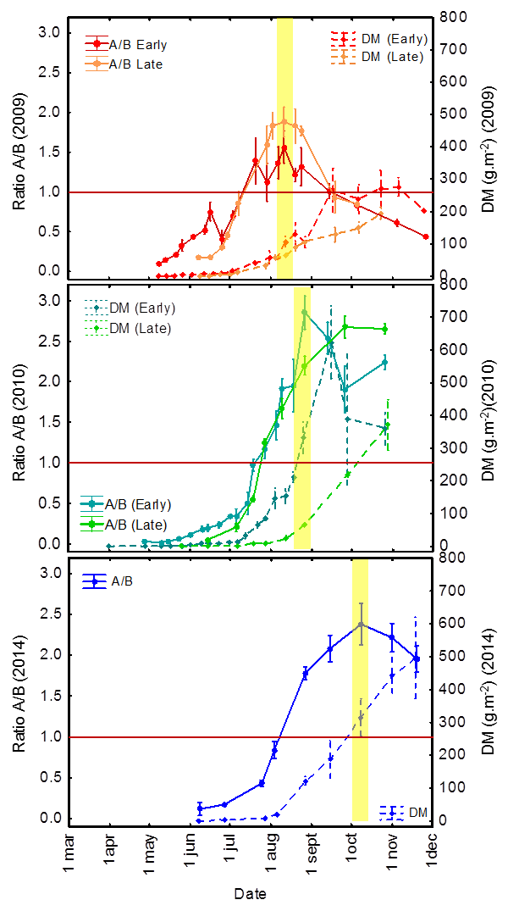
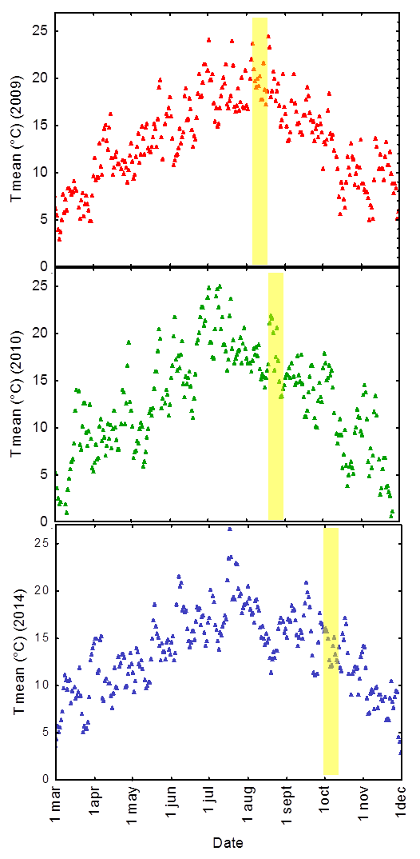
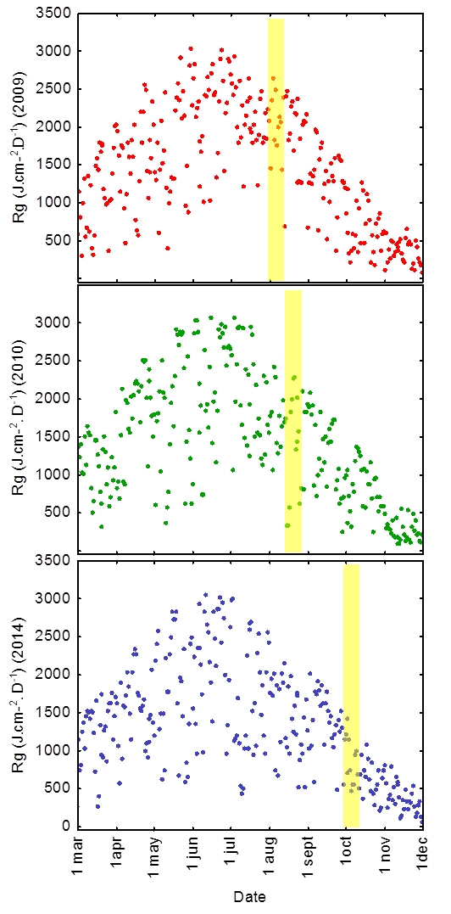
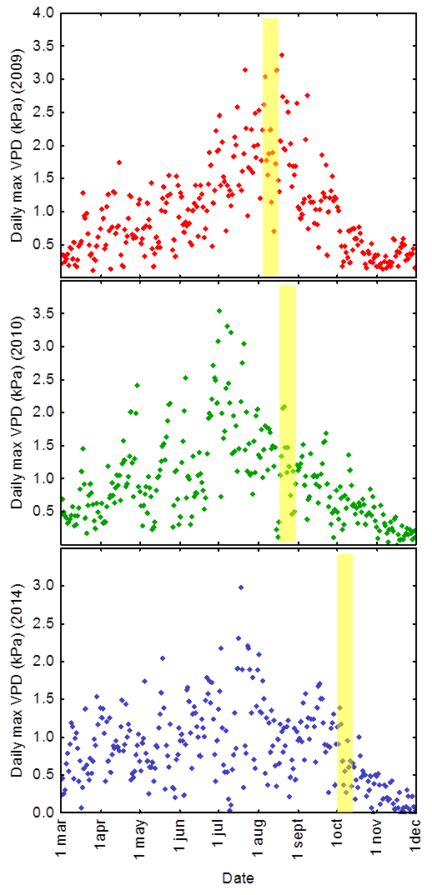
Rhizome filling seems to be triggered by climatic events in Miscanthus x giganteus
Zapater M ¹, Postaire O¹ , Bethancourt L¹ , Hervieu S¹ , Fingar L¹, Mansard MC², Arnoult S², Ferchaud F¹, Brancourt-Hulmel M ¹, Giauffret C¹
¹ INRA UR AgroImpact , ² INRA UE GCIE Picardie
Introduction
Methods
Miscanthus x giganteus (Mxg) is a good candidate for biomass production. It produces high biomass with low environmental impacts, due to an efficient rhizome filling in autumn and nitrogen recycling in spring (Cadoux et al, 2013). However, the triggers of rhizome filling remain unknown. Here, the aim of the study is to gain knowledge on such putative triggers. We present some preliminary results on Mxg crops during the first year of cultivation.
Mxg crops (clone from ADAS, UK) were studied in 2009, 2010 and 2014 at INRA station of Estrées-Mons in northern France (50°N,3°E). The plots were irrigated.
In 2009 and 2010, two dates of establishment were compared:
early (19/03/09 and 30/03/10)
late (15/05/09 and 25/05/10)
In 2014, there was only a single date of establishment on 08/04/14.
Above and belowground biomass were weekly sampled in 2009 and 2010 and every 3 weeks in 2014.
We studied the dynamic of biomass allocation all along the growing season through the ratio of aboveground on belowground biomass (A/B ratio).
Day mean temperature T°C, global radiation Rg, and maximum vapor pressure deficit (VPD) were calculated from hourly recorded data.
Results
(a) Above/belowground DM ratio
(b) Mean Temperature
(c) Daily Rg
(d) Maximum VPD
2009
2010
2014
Fig 1: Seasonal dynamic of (a) dry matter (DM) and above- on below-ground (A/B) ratio; and seasonal course of daily T°C (b), daily summed Rg (c) and daily maximum VPD (d) in 2009, 2010 and 2014. In 2009 and 2010, 2 dates of establishment were compared. Yellow areas represent the period during which shift in preferential allocation from aboveground to belowground parts seemed to occur.
In early season, plants were characterized by higher below- than above-ground biomass: A/B ratio from 0 to 1 (red horizontal line).
Seasonal evolution of the A/B ratio varied between years. Yellow areas represent the switch in preferential biomass allocation: above ground part continued to develop, but even more assimilates were allocated to rhizome.
This switch occurred around August 11 in 2009 (early and late establishment), August 25 in 2010 early establishment only) and October 8 in 2014. This suggests that the switch was not induced by photoperiod.
This switch was not systematically observed during the growing season (late establishment in 2010).
The switch was synchronous for the two dates of establishment in 2009 suggesting that it was not linked to phenological stage but may be triggered by climatic events.
2009 and 2010 were characterized by high mean T°and VPD during the summer, while 2014 was cooler and wetter.
In 2009 but not in 2010, the highest VPD values coincided with the switch on biomass preferential allocation. This suggests that a stronger stress may have occurred in 2009 (soil water deficit despite irrigation ?).
In 2010, the switch was observed for early establishment only. This suggests that a sufficient “carbohydrate status” should be reached prior to preferential allocation to the rhizome.
Conclusion
We hypothesized that the switch on biomass preferential allocation to belowground parts may be mediated by a “carbohydrates status” linked to assimilate accumulation.
The switch might occurred earlier depending on numerous and interacting climatic events (as observed for photosynthesis or stem elongation). These climatic events could trigger signaling cascades, one of those perhaps being the “carbohydrates status”.
Future prospects
References
The A/B ratio showed trend in biomass allocation but was probably not the best indicator to study triggers of rhizome filling (due to its large variability and to its integrated nature).
The hypotheses proposed have to be deeper investigated particularly through
The study of photosynthesis and carbohydrates metabolism in the different organs during the growing season, in relation with climatic events;
The study of nitrogen fluxes and nitrogen-metabolism in the plant.
Cadoux, S., Ferchaud, F., Demay, C., Boizard, H., Machet, J.-M., Fourdinier, E., Preudhomme, M., Chabbert, B., Gosse, G., Mary, B., 2013. I. GCB Bioenergy . doi:10.1111/gcbb.12065
‘ArchiC4’ is a regional research project funded by Conseil Régional de Picardie www.cr-picardie.fr
and ‘Biomass For the Future’ (BFF) is a national research project funded by ANR under the grant agreement ANR-11-BTRBR-0006 www.biomassforthefuture.org

