Slide 1


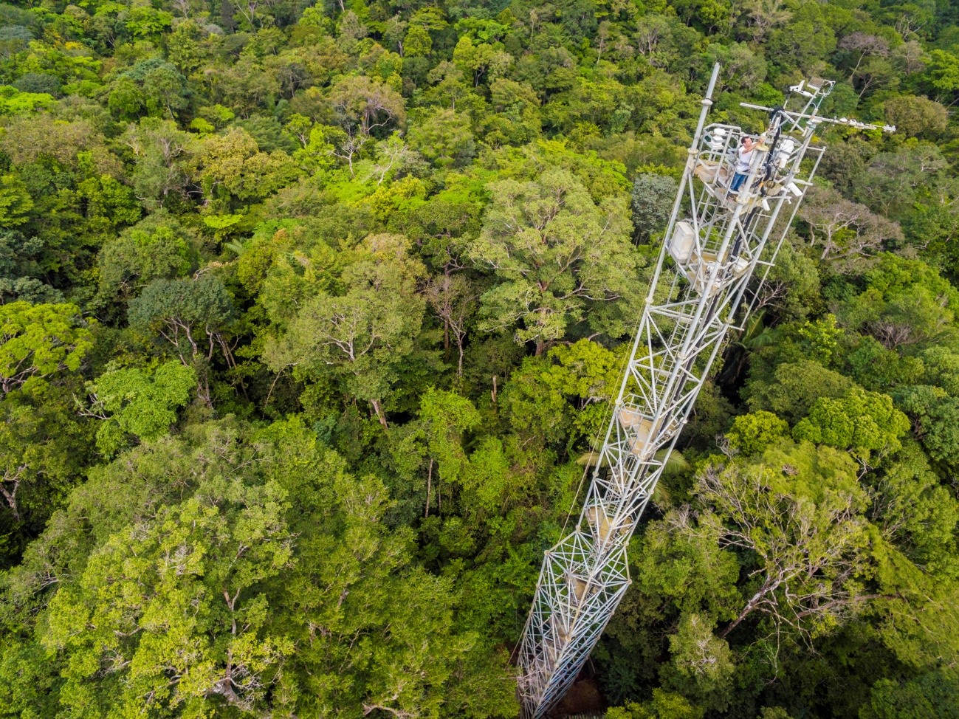
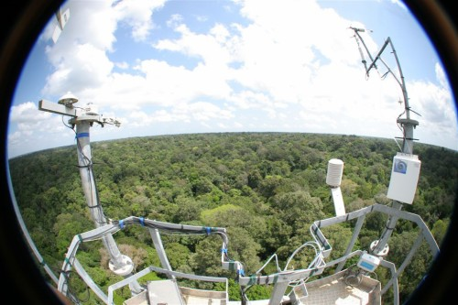
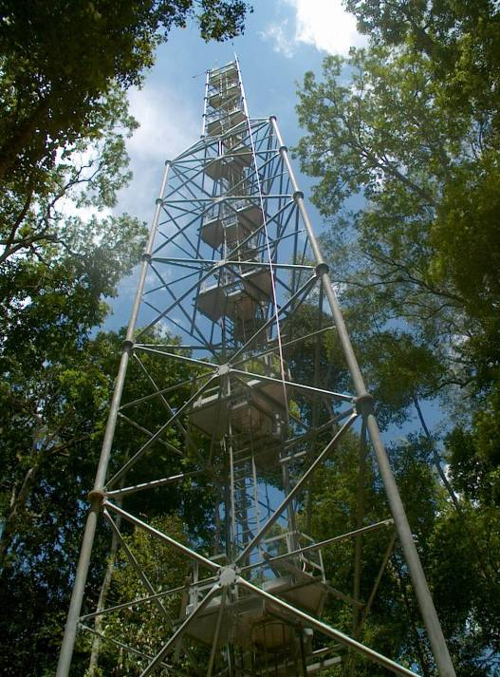
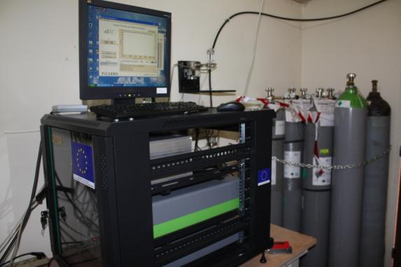
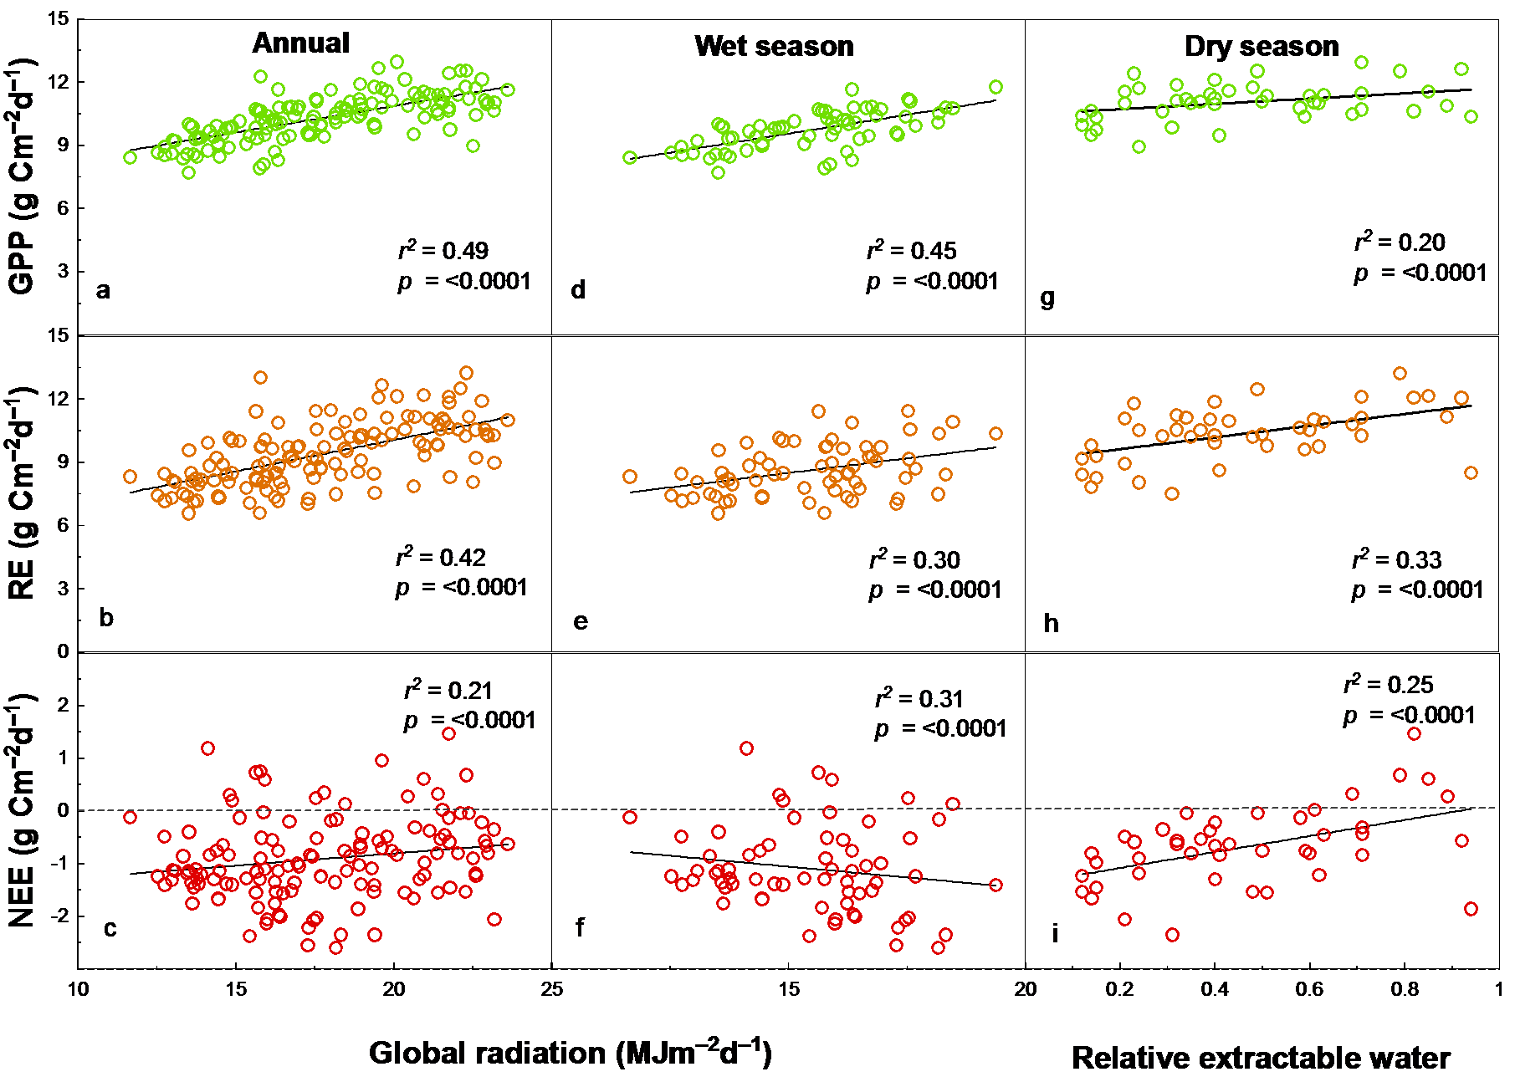
What drives the interannual variations in C fluxes
and balance in a tropical rainforest of French Guiana?
Maricar AGUILOS¹, Benoit BURBAN^{1 ,} Damien BONAL²
¹INRA, UMR Ecologie des Forêts de Guyane, BP 316 Avenue de France Kourou Cedex, French Guiana, and ²INRA, UMR EEF 1137, Champenoux, France
I. Introduction
The Amazon basin occupies a central position in our ability to understand the major role it plays in the global carbon cycles.
It suffered exceptional droughts in 2005 and 2010, yet 2010 dry spell was more critical shifting the unburned forests from a net carbon sink during a wet year to a carbon neutral status during the extreme drought year.
Using an 11-year (2004 – 2014) data from French Guiana’s GuyaFlux tower, how drought affect the carbon dynamics in this tropical ecosystem was examined and the climatic drivers influencing the interannual variation in carbon fluxes was determined.
II. Methods
Study site
French Guiana, South America – a tropical wet forest
10 – 40 m above sea level
Ave. rainfall is 3041 mm; ave. air temperature is 25.7°C
Guyaflux experimental unit covers >400 ha of undisturbed forest
620 tree ha⁻¹ tree density (DBH >0.1 m)
Tree species richness is 140 species ha⁻¹
Mean tree height is 35 m; emergent
trees >40m
The CO₂ flux monitoring tower
55 m high
20 m higher than overall canopy height
Flux and meteorological measurements
CO₂ and H₂O concentrations
Air temperature and humidity
Rainfall
Wind direction and speed
Global and infrared incident and reflected radiations
Incident and reflected photosynthetic photon flux density
Atmospheric pressure
Soil temperature
Volumetric soil water content
Relationship between GPP, RE and NEE and global radiation
(a – f) annually and during wet season and with relative extractable water (g – i) during dry periods
III. Results
emission
Interannual variation in GPP, RE and NEE
absorption
IV. Conclusion
Fluctuations in total annual GPP vary from 3394.9 g C m⁻² yr ⁻¹ to 4054.5 g C m⁻² yr ⁻¹. RE is more varied than GPP (3057.4 g C m⁻² yr ⁻¹ to 3425.9 g C m⁻² yr ⁻¹). Yet, annual GPP is always higher than annual RE, and the forest has remained carbon sink in an annual basis although NEE has huge interannual variability, from -68.2 g C m⁻² yr ⁻¹ to -596.2 g C m⁻² yr ⁻¹.
Distinct seasonal patterns in RE and GPP partly explained this variability.
The pattern of annual NEE appears to be driven by a higher rate of increase in respiration during the dry season, with less comparable rise in photosynthetic activity.
Solar radiation mostly explain the GPP, NEE and RE annually and during wet season, soil water limits them during dry season.
Therefore, process models dealing with tropical ecosystems must consider site-specific responses to drought to reduce uncertainties and to generate a more accurate projections on forest response to climate change.
Acknowledgments:
SOERE-FORET, GIP-ECOFOR, INRA, CIRAD, Labex CEBA, Jena platform, Observatoire du Carbone, 12ème CPER-Guyane

