Slide 1



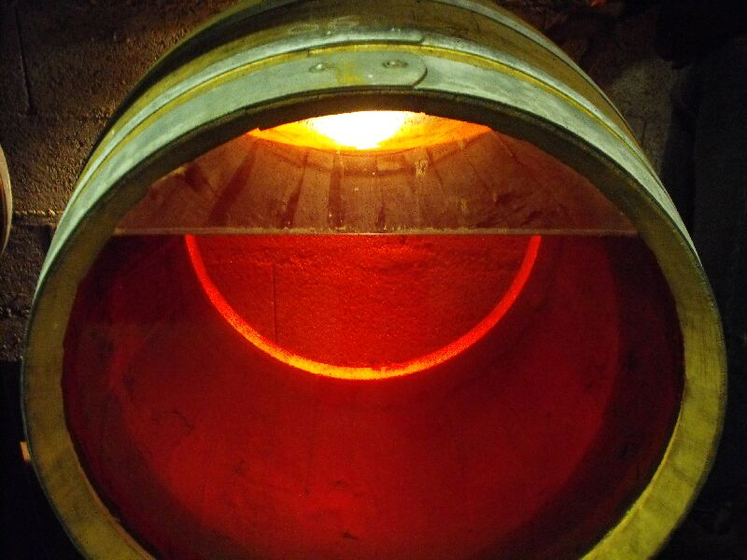
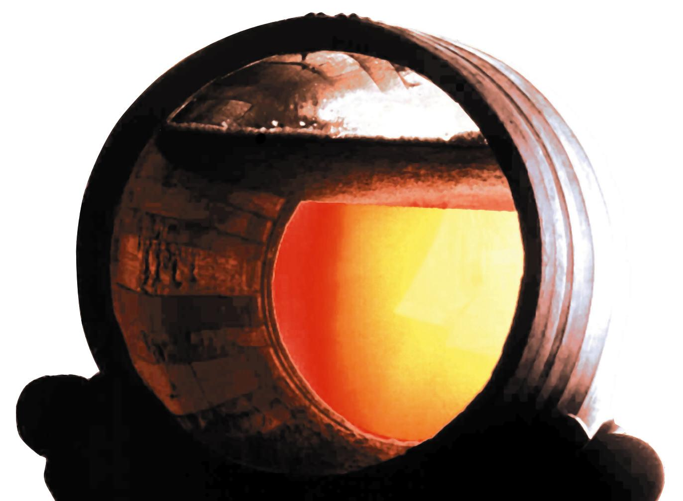
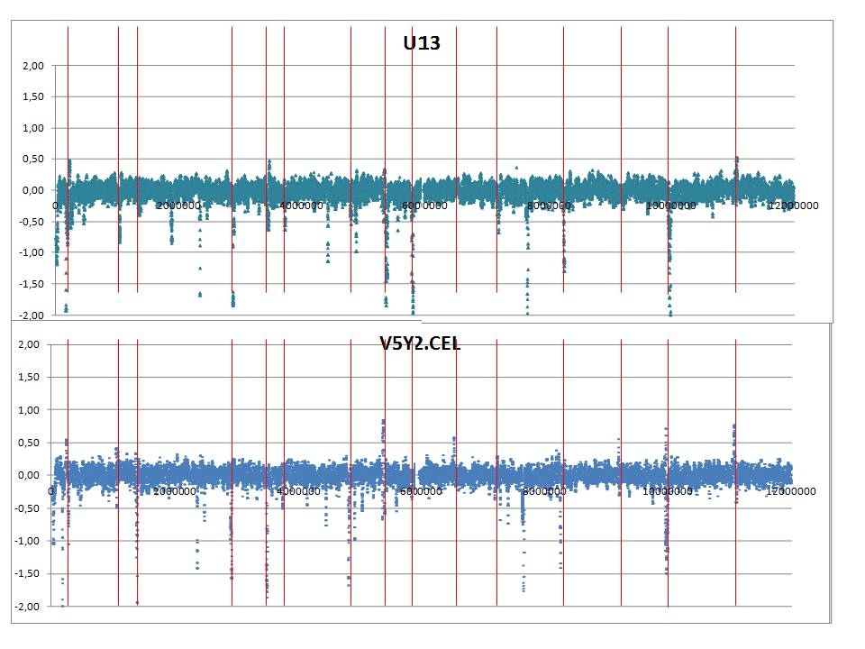
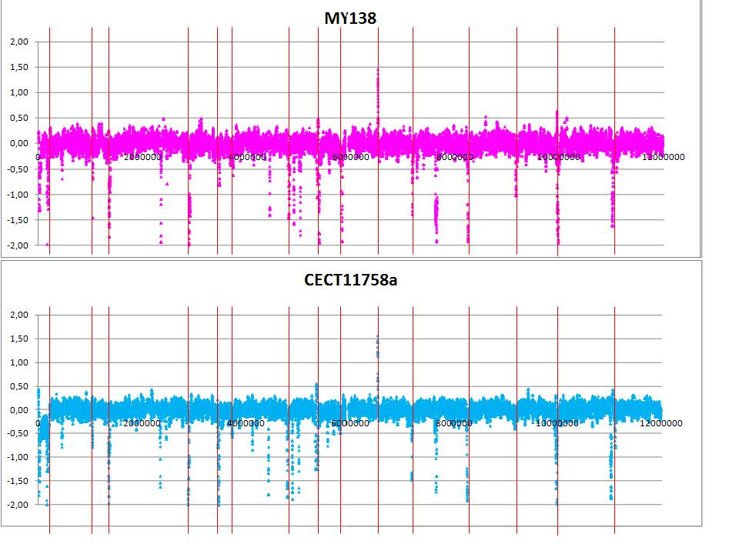
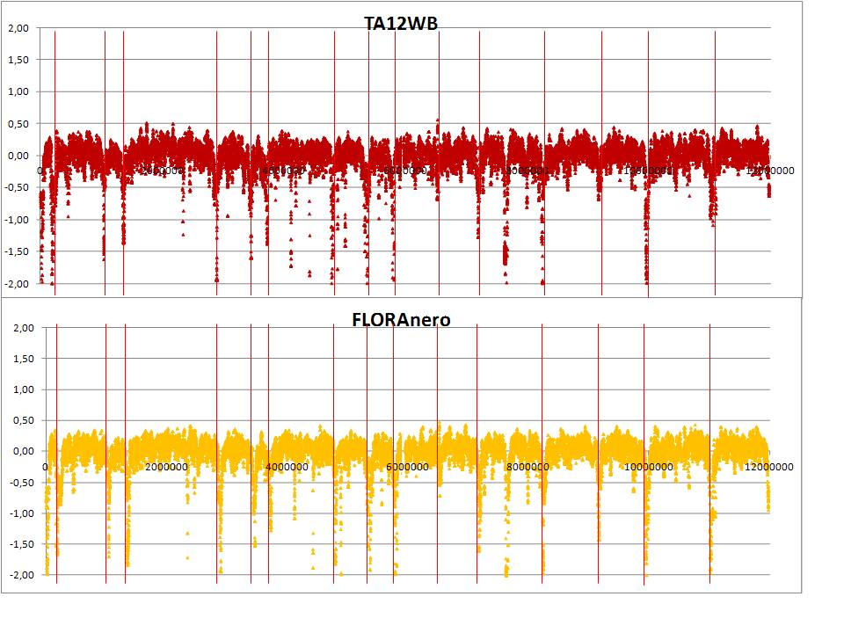
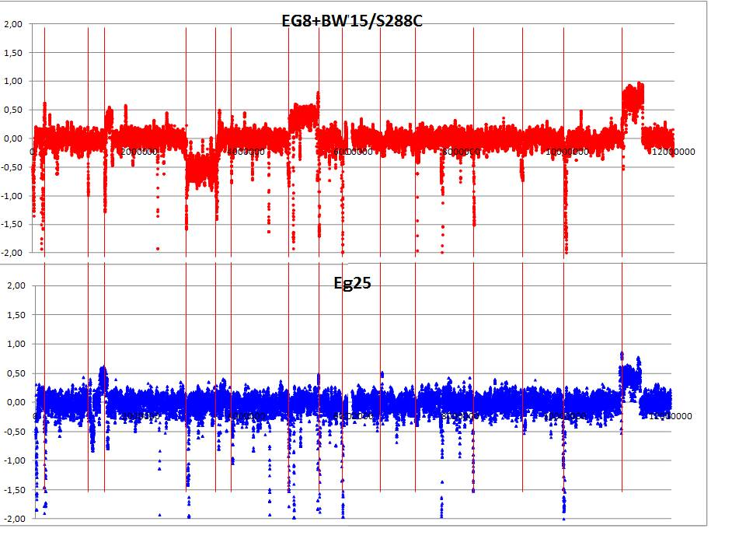
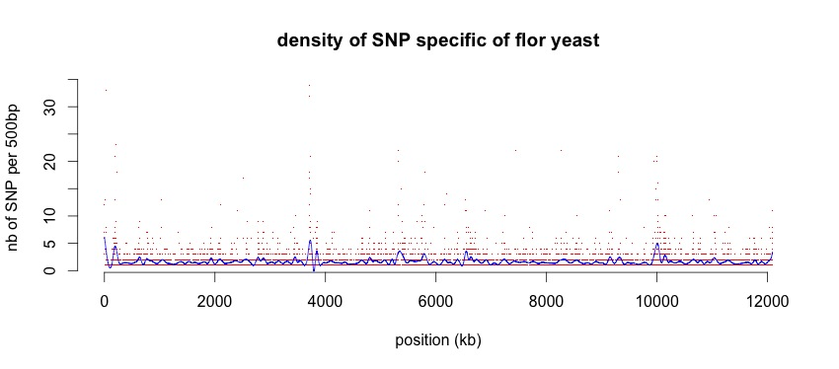
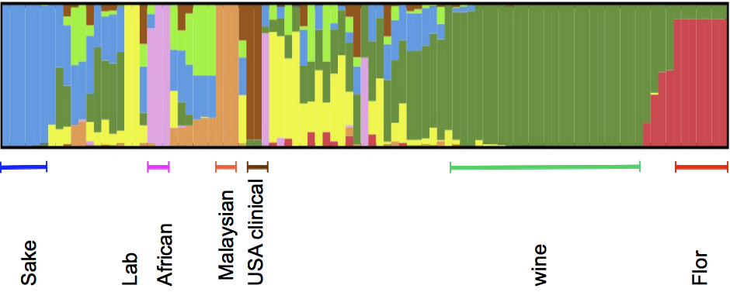
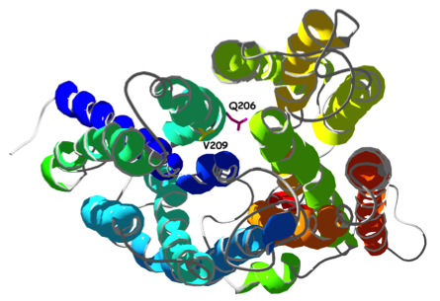
Diversity and adaptation of flor yeast : new data for an old question
Jean-Luc Legras*, Fréderic Bigey, Anna Lisa Coi, Virginie Galeote, Claudine Charpentier et Sylvie Dequin
¹INRA, UMR1083, Sciences pour l’œnologie – Montpellier, France ²University of Sassari, Italy
Context and Goals
Saccharomyces cerevisiae, our favorite model organism has been used for millennia for the production of all sort of fermented beverages as well as for bread rising. In contrast with these fermentation lifestyles, during flor wine aging Saccharomyces cerevisiae strains are growing aerobically at the surface of wine as a biofilm. As a significant part of the nutriment has been depleted from wine during alcoholic fermentation, and glucose has been replaced by ethanol, flor yeast must have overcome the different stress imposed by this niche.
This work aims at characterizing Flor strains in order to unravel the basis of flor yeast adaptation to sherry like biological aging.
Experimental Approaches
- Diversity of Flor strain from different countries was evaluated with 12 microsatellite markers according to Legras et al 2007 . 119 flor strains (64 from Jura, 30 from Sardinia, 43 from Spain) were genotyped and compared to 500 strains already characterized .
- aCGH on Yeast2 Affymetrix arrays was performed for 6 flor strains from: France (Jura 2), Hungary (Tokay 1), Italy (Sardinia 1), Spain (Jerez 2) in comparison to three wine strains (one classical wine U13, one hybrid Eg8 and one Eg25 flor type wine strains).
- Genome sequencing (Hiseq2000, 100bp pair ends reads, 250 x average coverage) of 8 wine strains and 8 flor strains (France (Jura 2), Hungary (Tokay 2), Italy (Sardinia 1), Spain (Jerez 2, Cordoba 1) ). Assemblies were obtained with SOAP and SNP scored with GATK.
Diversity of flor strains evaluated
with microsatellites markers
MY138
FLO11 core size
Genomic specificities of flor strains evaluated with aCGH
CECT1882-
VI
3.7+0.7
481-S4
MY91
CECT11756
CECT11757
10.13
Infante et al 2003 described large aneuploidies when comparing two flor strains that they associated to velum growth adaptation
CNV were detected with DNAcopy Venkatraman et al., 2007 Bioinformatics)
Large aneuploidies can be detected for Eg8 hybrid strain or Eg25 given here as a control, but only for flor strain CECT11758 (Chromosome I)
For each flor strain 31 to 55 genes present a lower hybridization
Only two genes YKL222C and YKL221w were amplified in 4 out of 6 flor strains
CECT11762
II
45.1
CECT12765
Jerez 1
16.29
F25- c ord
I
II
III
IV
V
VI
VII
VIII
IX
X
XI
XII
XIII
XIV
XV
XVI
7.7
11.2
8.21
11.3
9.12
III
17.29
UCD580
X
XVIII
VIII
TS12CUB
CAW22
CAW22B
CAW24
Jura 1
CAX22
CAH54
BAD52
3.7+0.4
BAE52
Flor strains from Hungary, Italy, Spain, and France belong to one main origin and few Spanish strains are clustered in a second group
Related strains can be encountered in several vineyards (Romania, Lebanon and France (Alsace)).
FLO11 core size varies according to the clusters. Some clusters do not carry the deletion deletion in the promoting region described by Fidalgo et al. 2006
Flor strains present a variable ability to sporulate and produce viable spores . Interestingly strains from (Jura3) sporulate nicely whereas Spanish flor strains did not produce viable spores
PII31
PIA64
CAM43
PII33
XRG22
XRG24
XRG25
LR
PIN34
PIE31
V75
PIO32
V9
V69
V63
V66
Sarde2D
2.7+0.5
Sardinia
A41
A33
Sard-M25
1043
V5
V16
M23
M49
M12
M3
XRA22
XRA23
T19CUB
T8CUB
V23
V3
FloNero
XRC21
V56
V59
M39
M38
M4
M8
MAH53
3.6+0.2
MAC51
Jura 2
MAD51
MA51jura
Flor strains
MAE54
MAF54
SAC53
MAF53
MAI53
SAC56
4.2mjxx
Lebanon
Flor strains
MJ104
M14mjxx
MJ34
D2mjxx
MJ100
480-S4
MJ170
GUF55
GUF54
GUF51
TR05CUB
TA12CUB
GUE51
GUG55A
SAA55
CBA13
SAA52P
GUG55B
SAA52G
CBE54
28640
ARC43
ARC41
ARC44
ARC42
ARC46
CAX21
4.8+0.9
CAV23
CBB52
CBB01
P5
P3
2Val.Cal
Eg25
Jura 3
10402
CBD55
CBC01
CBE51
CBD05
CBA14
MTF1097
CBD04
CBE05
CBB04
CAV21
cheFFA
10418
3.0+0.6
Hungarian
10419
3238-32
A51
TP32CUB
6038
P7
M66
Eg8 hybrid cluster
6bPenciu
10423
VS290
UHA14
COG24
KL21
EC1118
KL1
MJ73
UCD535
322134S
Fa9623Bdx
DBVPG1853
1.28.2
1.28.3
VPDN
ET7
Jerez 2
V
IV
3.7+0.7
I
CECT11760
11.76.3
CECT11763
CECT11758
CECT11759
2.7+0.7
Wine
COG27
CogFA5
MCN5C
TA02
MJ54
Rum strains 1
Flor 2
F12-cord
Bread strains
315
397
KR645
Bread strains 2
3Val.Cal
Rum strains 2
Beer strains
Fermented milk strains
Sake and rice wine strains
lab strains
Flor yeast Genomics preliminary results – HGT introgressions
YPS1000
UW87-2421
CBS7957
CBS7958
USA Oak strains
UW05-227.2
UW05-217.3
African strains 1
YJM326
YJM320
YJM451
DBVPG6040
YJM269
UW83-787.3
NC02-1764
YPS1009
African strains 2
0.1
111bp deletion in FLO11 promoter
Three HGT caused introgressions (region A BC and) have been characterized in EC1118 that we tried to detect in the genome of Flor strains:
Wild type promoter of FLO11
Strain | Region A | Region B | Region C
F25 7.7 | - - | - | -
P3 Guf54 | - - | -
TA12 TS12 | - - | - - | -
Sarde2D | - | -
F12 | -
EC1118 | +
Region A was not detected in sequenced flor strains (but in some other flor genotypes)
Region B is detected in half of flor strains
Region C is detected in most flor strain (FOT1-2 and FSY1 genes)
Other genes: Ty5-6 of S. paradoxus also found in QA23
V
Global phylogeny of Flor yeast obtained from Genome sequencing
Fig : Phylogenetic Network obtained with SPLITREE from the matrix of number of SNP per kb estimated from the pairwise genome sequence alignment of 95 strains with MUMmer 3.0
Yeast genomes from Liti et al. 2009, Fay et al. http://www.genetics.wustl.edu/jflab/data4.html
Novo et al 2009, Borneman et al 2011, Argueso et al 2009, Akao et al 2011.
0.001
Lab.
African palm wine
Density of SNP specific to flor yeast reveals divergent regions
Wine
Japan sake
(BWA alignment of reads on S288C genome sequence, SNP call made with genotypes were called with the Genome Analysis Toolkit) 7 flor strains were compared to 8 wine strains
Flor
FZF1
Telomere Chr12
FLO9
HXT3
PAU11
USA oaks
FLO1
FLO5
TY1
HPF1
Detection of different divergent genes (ie PAU11, FZF1, FLO5 -9, HXT3 ….)
Other events: translocations, chimeric genes
Structure output obtained form a subset of 5000 non ambiguous positions obtained from genomes alignments .
Optimum K =8 evaluated with 10 runs per K according to Evanno’s method (2005)
EC1118
/QA23
Flor HXT3 allele, has been described from strain Fermichamp: 1 mutation (625 A → G : Ile209 → Val) gives Hxt3p a higher affinity to fructose (Guillaume et al., 2007 AEM, Blondin et al unpublished data)
Figure : 3D structure of HXT3 : V209 is facing Q206 in the hexose channel
K = 8
(10 runs combined
with CLUMP)
.
EC1118 and QA23 are the result of a cross between a wine and a flor strain.
Conclusions:
Flor strains are found mainly in one group of S. cerevisiae strains, and represent a specific lineage
CNV is very likely not the main mechanism involved in adaptation to velum growth, but polymorphism (translocation, mutations, …) with specific alleles.
Flor strains are more fructophilic than classical wine strains as they carry an improved low affinity transporter for fructose allele of HXT3 and the high
affinity fructose transporter FSY1 of region C of EC1118 (Galeote et al. 2010).
References:
Legras et al. 2007. Mol Ecol 16, 2091–2102 Fidalgo 2006 PNAS 103, 11228-11233. Infante 2003, Genetics Evanno 2005, MolEcol
Journées des microbiologistes de l’INRA, Avignon, 13-15 Novembre 2012

