Slide 1
How conciliate services provided by grasslands in order to ensure the sustainability of farming systems at local and regional levels.
Carrère P.¹, Farruggia A.², and Hulin S.³
¹INRA, UR874 Ecosystème Prairial, Site de Crouël, 5 chemin de Beaulieu F-63039 Clermont-Ferrand
²INRA, UR1213 Herbivores, F-63122 Saint-Genès-Champanelle
³Pôle fromager Massif central, 20 Côte de Reyne, F-15000 Aurillac
E-mail: pascal.carrere@clermont.inra.fr

Slide 2
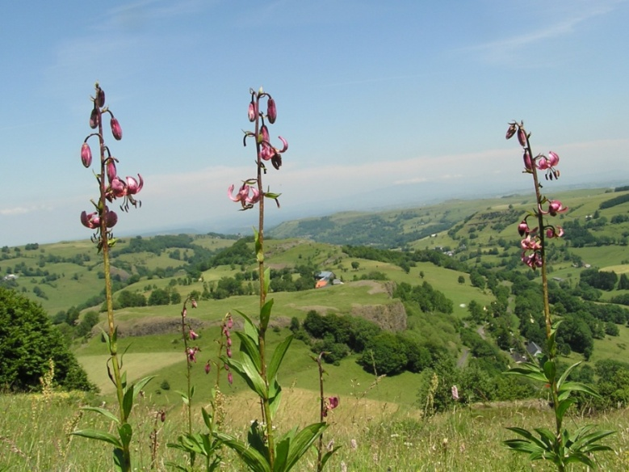
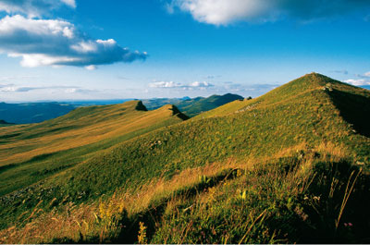


Consequently, grasslands are at the heart of the debates on multi-functionality (Carrère et al., 2012^{[1]}).
17th Meeting of the FAO-CIHEAM
Mountain Pastures Network
Introduction
Grasslands and rangelands cover 50% of the arable lands in Europe (Eurostat 2009).
 They provide most of the energy and protein required for agricultural outputs
 They are major elements of most European landscapes, contributing to the regional identity.
 They host a tremendous diversity of plants, animals and microorganisms of functional and/or patrimonial interest
Grasslands are at the heart of the debates on multi-functionality (Carrère et al., 2012)
http://www.prairies-aoc.net

Slide 3
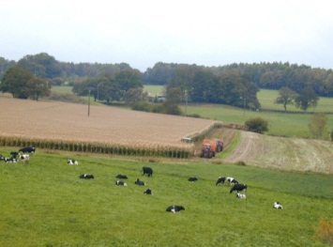
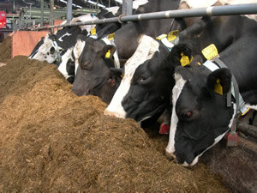
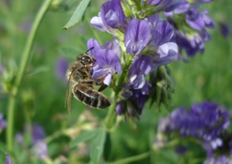
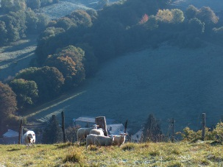
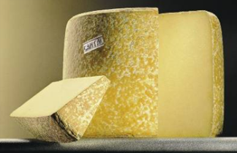
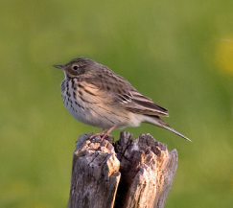
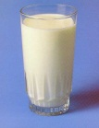
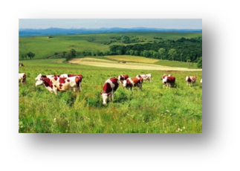
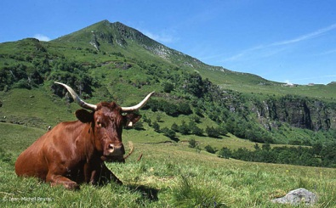
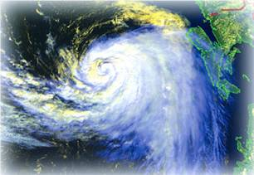
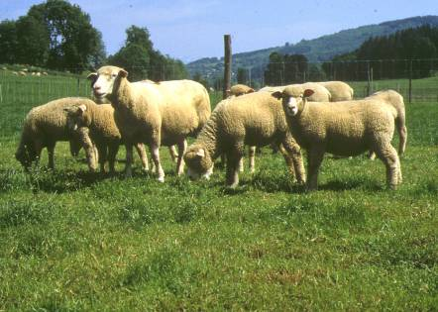
17th Meeting of the FAO-CIHEAM
Mountain Pastures Network
The emergence of new societal expectations, combined with challenges linked to global change, requires a new approach to livestock farming systems :
 production of save and genuine products,
 biodiversity conservation,
 environmentally friendly,
 support to agricultural systems (pollination, fertilisation)
 landscape production
Adopting this approach :
 makes it possible to conciliate environmental benefits and production services.
 highlights the importance of complex vegetation covers and the benefits of heterogeneous vegetation
But it necessitate to have :
 a better evaluation of grasslands potentialities (typology tool)
 multi criteria tool to assess the system coherence (diagnosis tool).

Slide 4
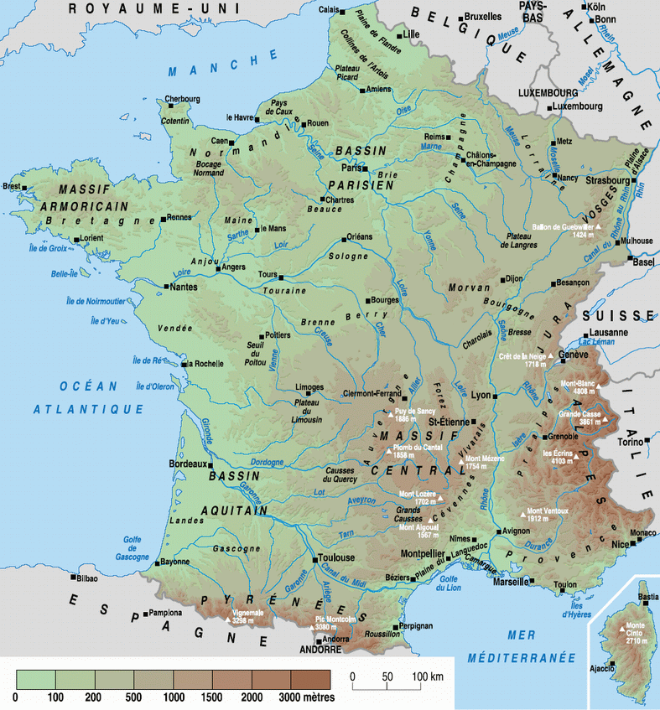
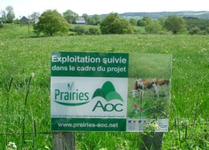
17th Meeting of the FAO-CIHEAM
Mountain Pastures Network
The program “grassland and PDO” is a project involving 14 research, extension and education partners.
Area and Process of the study
   Massif Central – (upland area)
 A network of 75 plots from 15 farms covering the range of environmental and management conditions of PDO areas in the Massif central
   Survey identifying farmers’ practises (cutting, grazing, fertilization)
   Botanic composition to assess the vegetation diversity of the plots (phytosociology).
 Agronomic measurements (production and nutritive values) at four times during grazing season

Slide 5
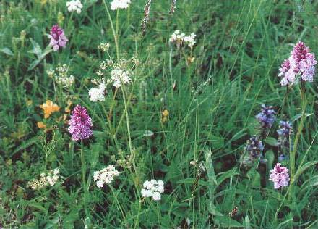
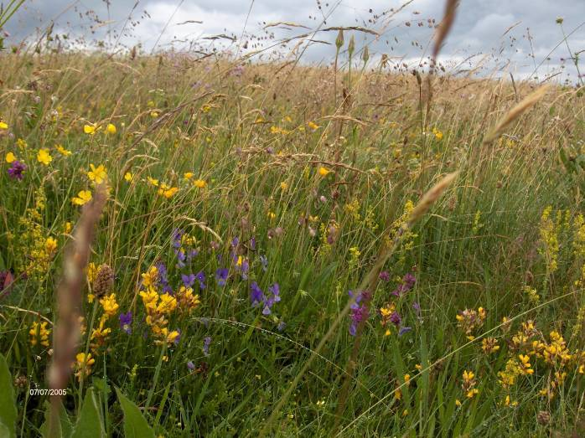
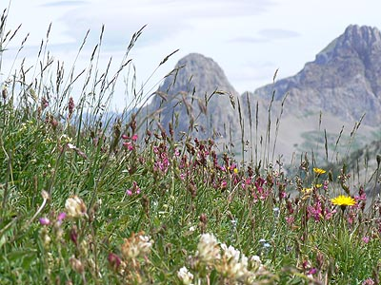
17th Meeting of the FAO-CIHEAM
Mountain Pastures Network
1) How to deal with the great diversity of grasslands in uplands dairy farms?
2) How to characterize grasslands, especially concerning the agronomic, environmental potentials and quality of cheeses?
A typology to characterize grasslands in uplands dairy farms
environment
management conditions
vegetation composition
+
dynamics of herbage biomass and quality during the season
agricultural potentials
environmental potentials
quality of cheeses

Slide 6
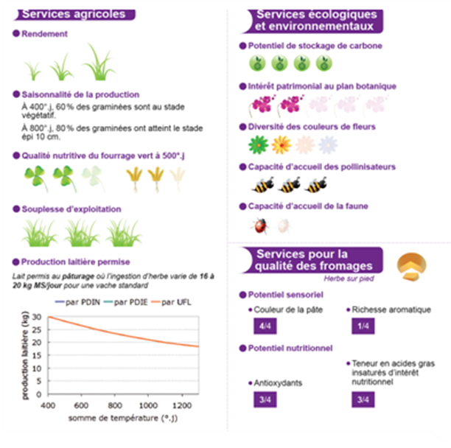
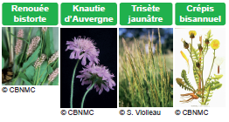
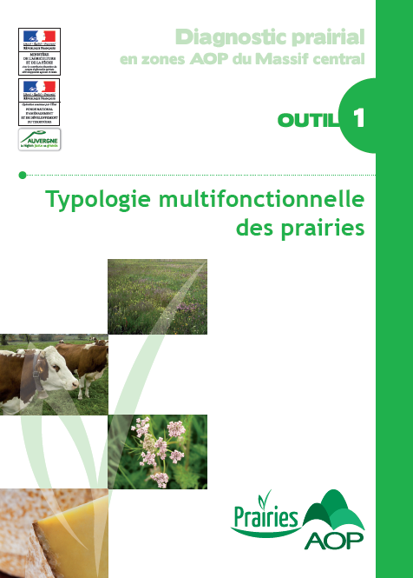
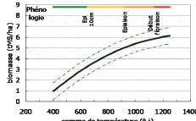
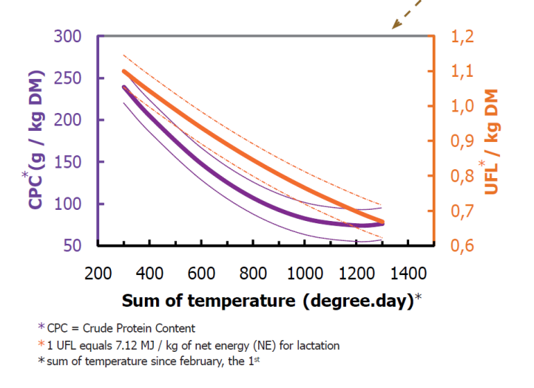
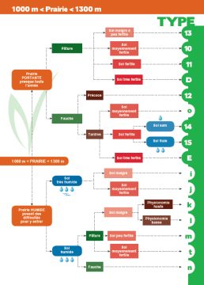
17th Meeting of the FAO-CIHEAM
Mountain Pastures Network
Agricultural services
Ecological & Environmental services
❖ Yield
❖ Carbon storage
23 vegetation types (VT) were organized by hierarchical approach considering altitude, practice, soil moisture and fertility.
Botanical composition
❖ Patrimonial interest (botany)
❖ Production seasonnality
At 400 °C 60% of grass are vegetative
At 800 °C 80% of grass culms above 10 cm soil level
❖ Color diversity
❖ Forage nutritive value at 500°C
❖ Pollinisation impact
Agronomic Potential (quantity and quality)
Each index card of a VT describes
Dominant species
❖ Management flexibilty
❖ Fauna interest
Indicator species practice or environment.
Cheese quality services
Allowed milk production
(milk production allowed at grazing, with a diet intake from 16-20 Kg MS/day for a standard dairy cow)
❖ Organoleptic potential
Color Flavor
Milk production (Kg)
❖ Nutritional potential
Biodiversity Potentials
Antioxydes
insaturated fatty acides
Richness
thermal time (degree day, C)
Rarity index

Slide 7
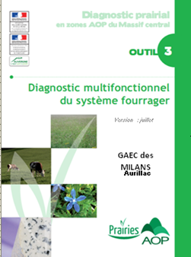
17th Meeting of the FAO-CIHEAM
Mountain Pastures Network
The multifunctional diagnosis - DIAM
A tool
- Designed for farmers and agricultural advisors
- To decline compromise between production, environment and quality of cheese in the forage systems.
System description
Farm Plots
Diversity of vegetation types ; practice ; stock.
Herd
Animal needs ; milk production; calving ; concentrate.
Analysis / Diagnosis
(4 modules)
Forage system
Ressource (forage) valorization (PDO rules)
Environmental services
Quality of dairy product (cheese)

Slide 8
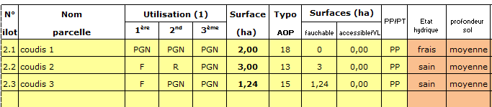
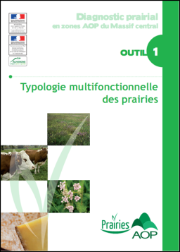
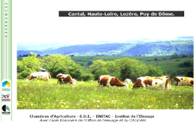
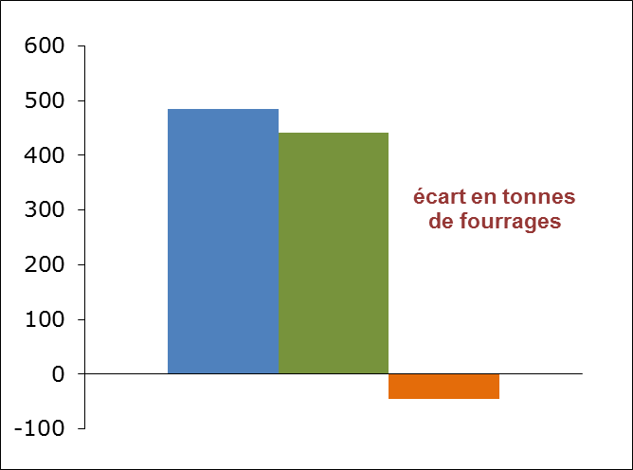
17th Meeting of the FAO-CIHEAM
Mountain Pastures Network
Farm Plots description
Forage system * stocking rate * Vegetation type
Regional references
Analysis of system consistency
Forage needed
Production planned
Consistancy index | Farm | Réf.
Forage production (t MS/UGB) | 2.9 | 3.0
Area grazed in spring/UGB | 45 | 36
% first cut / grassland area | 54 | 55
N mineral | 28 | 54
… | … | …
kg concentrate/dairy cow | 2642 | High
Forage feed balance (t)
Farm stocking rate (ie 0.92 UGB/ha)

Slide 9
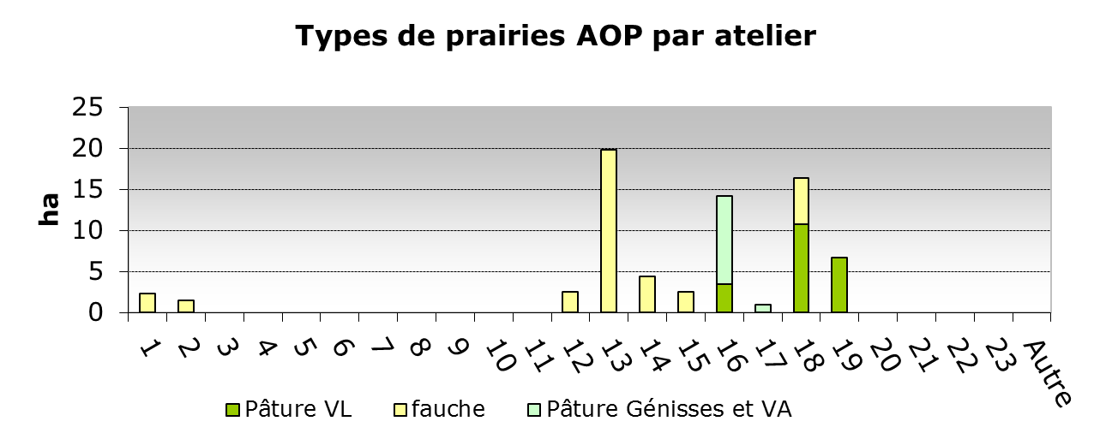
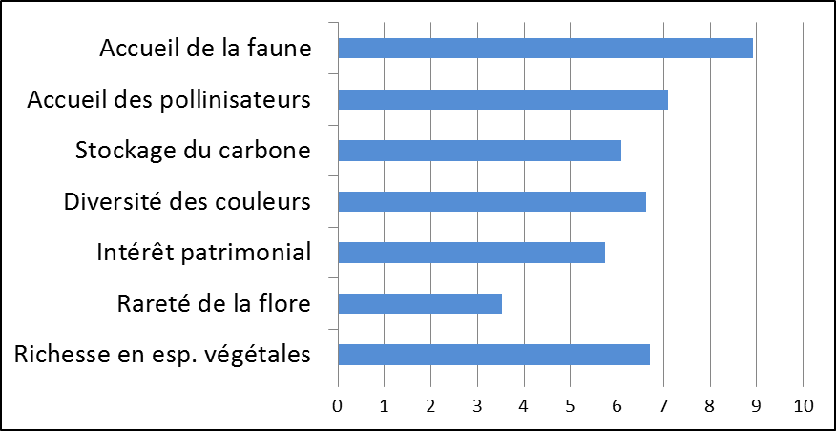

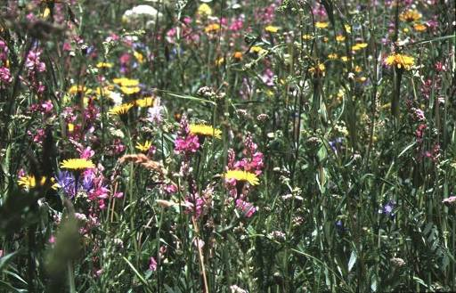
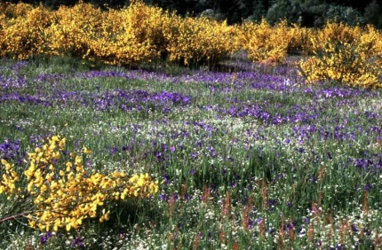
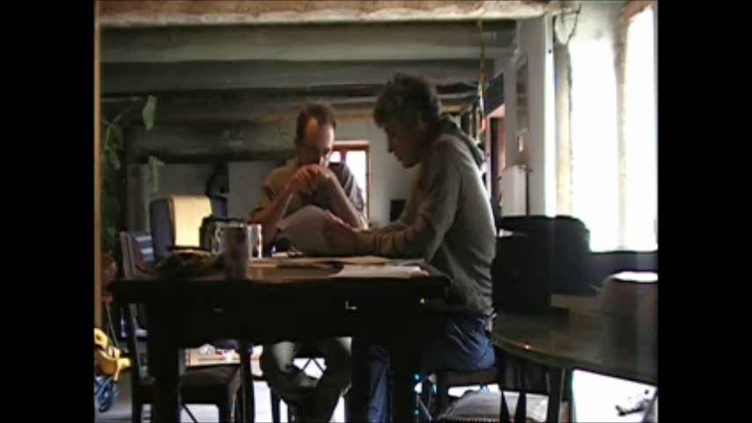
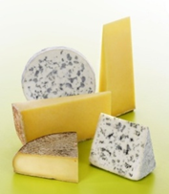
17th Meeting of the FAO-CIHEAM
Mountain Pastures Network
Evaluation of ecosystem services
Distribution of vegetation type
Fauna
Pollination
Carbon storage
Color diversity
Patrimonial (interst)
Rare species (botany)
Species richness (botany)
Evaluation of products quality
Fatty acids balance
Flavor potential
Anti-oxydant potential
Color
Analysis of ressource valorization according to PDO rules.

Slide 10
17th Meeting of the FAO-CIHEAM
Mountain Pastures Network
DIAM allows to compare farming systems
Farm type | Surface Ha | Stocking rate (average dairy cow/ha) | Milk / dairy cow | % temporary grassland | Kg N/ha | Number of VT in the farm
PROD-A | 57 | 0.92 | 6300 | 0% | 20 | 6
PROD+-nA | 71 | 1.02 | 9000 | 0% | 28 | 10
EFF-A | 59 | 0.77 | 7500 | 40% | 30 | 10
PROD-A => A moderately productive farm for the area in term of Kg milk/cow but autonomous for its forage ;
PROD+-nA => a very productive – non autonomous farm ;
EFF-A => an efficient farm (productive, autonomous, farm with a low stocking rate).

Slide 11
17th Meeting of the FAO-CIHEAM
Mountain Pastures Network
PROD-A => moderately productive autonomous farm
Index value (/ 10) | 0-2,5 | 2,5-5 | 5-7,5 | 7,5-10
System balance
Forage services
Environmental services
Cheese quality
Ressource valorization
System very balanced on all components studied & a very good valorization of natural farm resources.
PROD +/- NA => very productive – non autonomous farm
Index value (/ 10) | 0-2,5 | 2,5-5 | 5-7,5 | 7,5-10
System balance
Forage services
Environmental services
Cheese quality
Ressource valorization
Inconsistencies in the forage system due to a low utilization of herbage resource and large concentrate inputs, despite a good potential of its grasslands (large number of VT / high flexibility).
EFF-A => an efficient farm
Index value (/ 10) | 0-2,5 | 2,5-5 | 5-7,5 | 7,5-10
System balance
Forage services
Environmental services
Cheese quality
Ressource valorization
a very consistent feeding system with a very good valorization of its resources, but a quite low contribution from environmental point of view
Farruggia et al. 2012

Slide 12
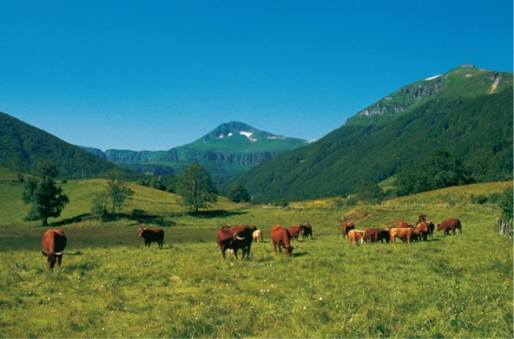
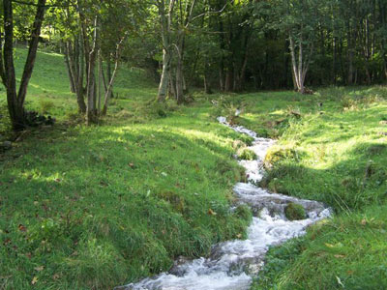
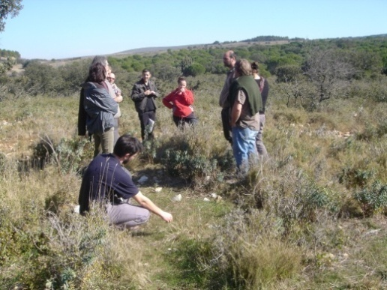
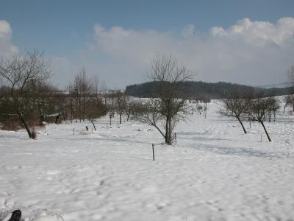
17th Meeting of the FAO-CIHEAM
Mountain Pastures Network
Conclusions
➢ DIAM is a multifunctional approach of the farm feeding system.
➢ DIAM brings to the farmer thoughts on the balance between the production, environment and the product quality
DIAM could discriminate forage systems.
DIAM is well suited for the diagnosis of specialized dairy systems but is a little trickier to apply to mixed systems.
➢ DIAM question the balances and tradeoffs within a farm and between farms within a territory. (ie PDO cheese areas).

Slide 13
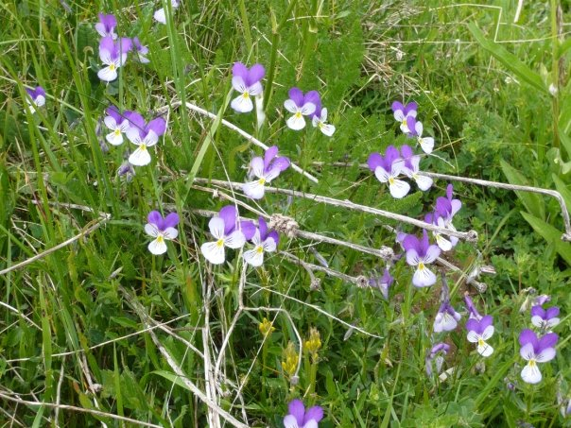
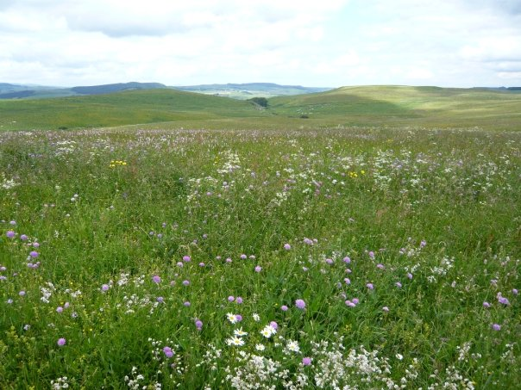
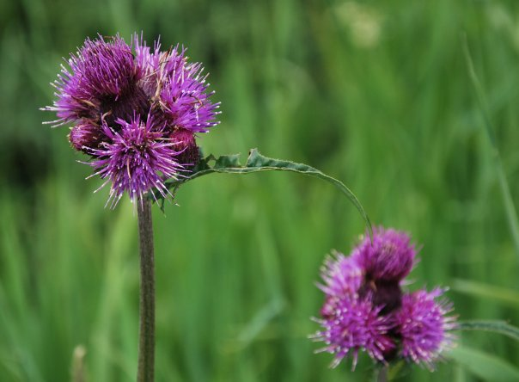

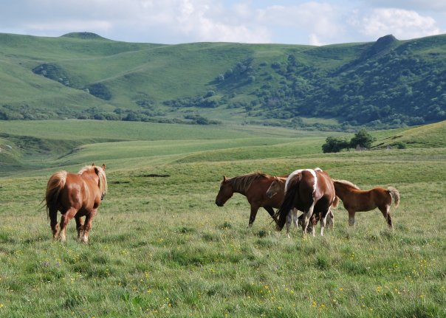
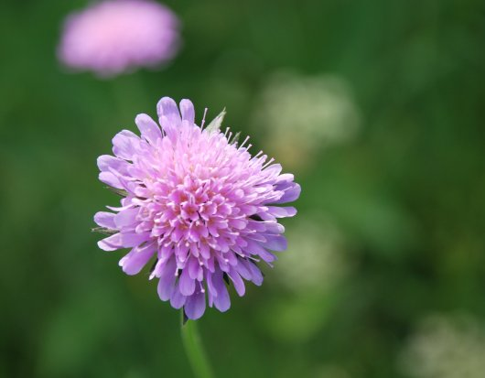
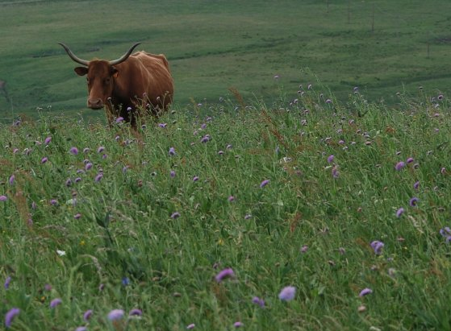
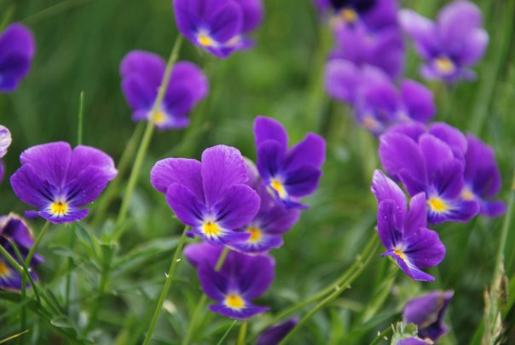
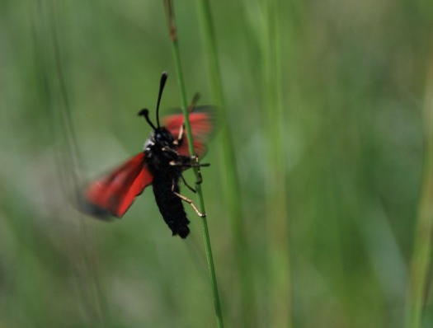
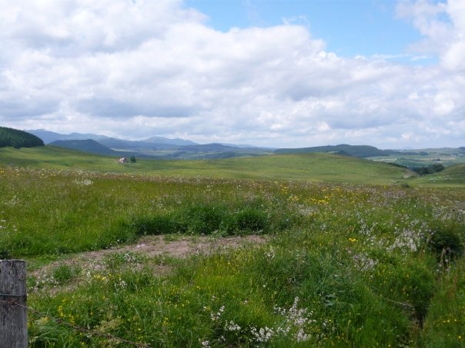
17th Meeting of the FAO-CIHEAM
Mountain Pastures Network
Thank you for your attention
http://www.prairies-aoc.net

