Slide 1
Biogeochemical cycles in Forest Ecosystems
Carbon, water, nutrients and their interactions
Saint-Andre L, Granier A., Loustau D., Legout A., Augusto L.
01/ 07/ 2013

Slide 2
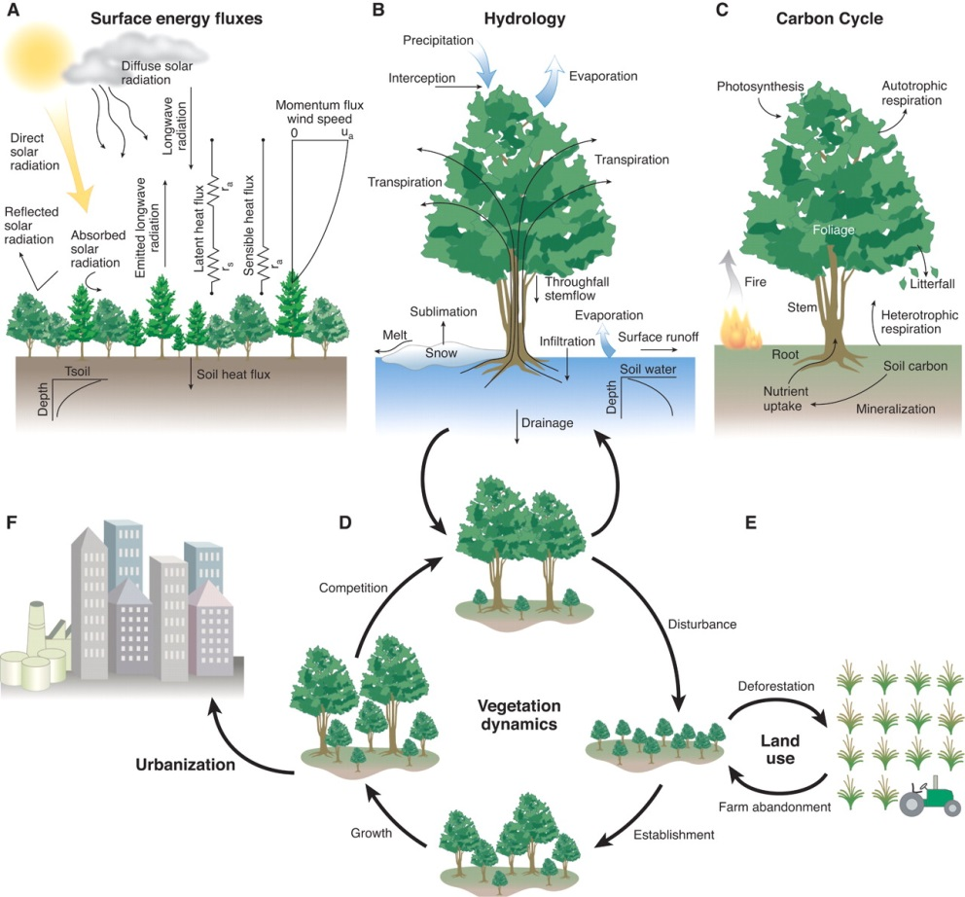
INTRODUCTION
Atmospheric deposits
Carbon and nutrient cycles
Forest Ecosystems, owing to their nature, are complex (temporally, spatially, …)
Allocation and translocation
Fertilisation N fixation
Soil Organic matter
High expectation and pressure from the society (wood production, carbon sequestration, biodiversity, provision of drinkable water,..)
Soil solution
Weathering
Drainage
Impacted by global changes but also regulates biogeochemical cycles (climate change mitigation, interactions with the atmosphere, species impact on the biological cycles)
Vegetation dynamics (D) and Forest management (G)
(adapted from Gordon B Bonan et al 2008, Science 320, 1444, DOI:10.1126/science.1155121)
SAINT-ANDRE et al. / BIOGEOCHEMICAL CYCLES IN FOREST ECOSYSTEMS
01 / 07 / 2013

Slide 3
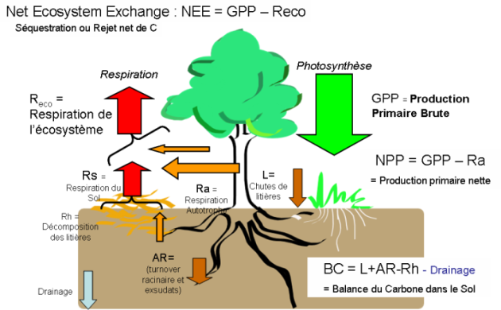


Two Key Programs of Challenge 1 (Develop the sustainable provisionning service of ecological systems) and Challenge 2 (Characterize and optimize ecosystem services)
Carbon, water and balances in temperate
and tropical forests.
Nutrient cycling in forests
Atmosphere
Atmospheric deposits
Vegetation
Fertilization
Fixation of atmospheric N
Harvest
Litter fall, recretion
Biomass, Nutrient immobilization and translocation
Litter decomposition
Soil Gazes
Soil
Soil Organic Matter
Root turn-over and decomposition
Micro-organisms
Mineralization
Soil solution
Nutrient uptake, Impact on tree and stand growth
Weathering
Soil Minerals
Bedrock
Drainage
SAINT-ANDRE et al. / BIOGEOCHEMICAL CYCLES IN FOREST ECOSYSTEMS
01 / 07 / 2013

Slide 4
For which we have a method
Context, socio economic issues
Technological
Innovation
Comprehensive sites – Highly instrumented
Hypotheses on ecosystem functioning
Extrapolation
Service-related Indicators
Identify bottle-necks and important processes
Knowledge on the processes
Interpret, understand
Permanent plots, experimental networks
Input/output budgets
Put things into perspective
Conceptualization of forest ecosystems functioning
New hypotheses and research questions
Soil-plant models; recommendations to forest managers
SAINT-ANDRE et al. / BIOGEOCHEMICAL CYCLES IN FOREST ECOSYSTEMS
01 / 07 / 2013

Slide 5
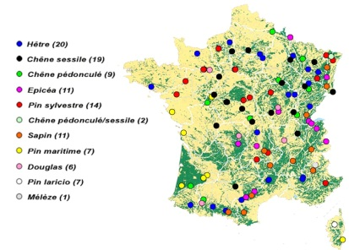
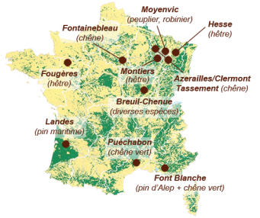
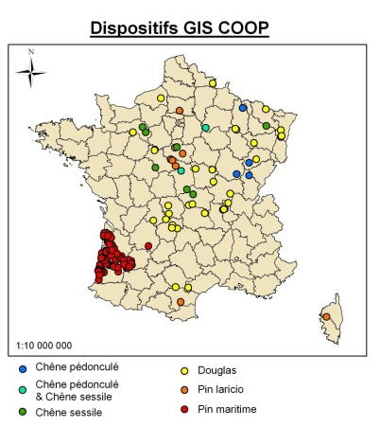
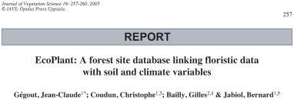
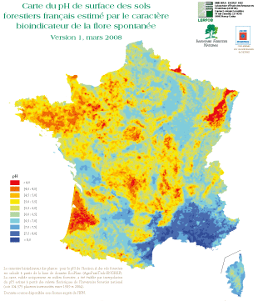
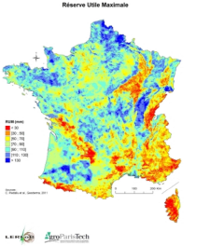
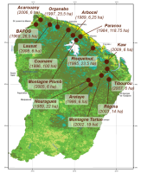
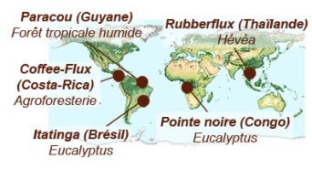

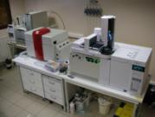
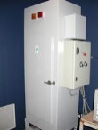

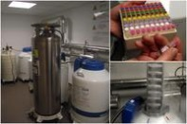
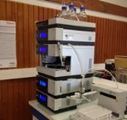

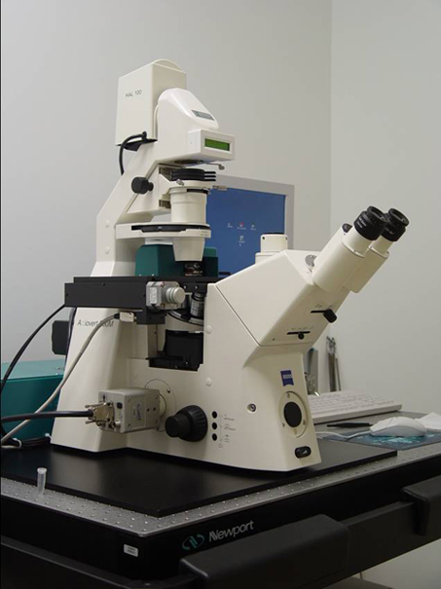
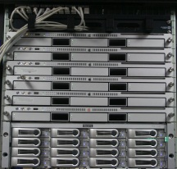
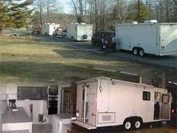

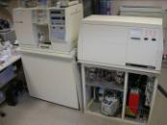

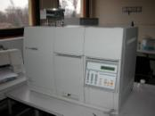
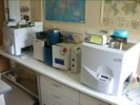
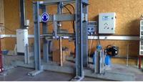
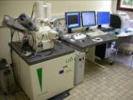
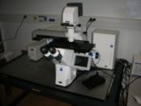
….in-situ and in lab consistent tools
Comprehensive sites
SOERE F-ORE-T
National experimental networks
GIS-COOP/PLANTACOMP
Large database
ECOPLANT/ Digitalis
Platform for FUNCTIONAL ECOLOGY
ECOGENOMIC
M-POETE
(ANAEE-S)
XYLOFOREST
Végétaux (bois, feuilles, sève, racines…)
Sols (litière, horizons organiques/minéraux)
Gaz (sols, atmosphères)
Eaux (eaux de surface, solutions sols, pluie)
Molécules (sucres, sucres aminés…)
Micro-dissection
ICP-MS
IC/GC-IRMS
Genomic
Bioinformatic
ICP-OES
ANALYSE CHIMIQUE
PTEF
ISOTOPIE
EA/GA-IRMS
C, N, majeurs, traces
δ¹³C, δ¹⁵N, δ¹⁸O, δD
EA
MICROSCOPIE ELECTRONIQUE MICROANALYSES
Pyr-IRMS
anatomie, dendrochimie, bio-marqueurs minéraux
HT-DNA sequencing & RNA-Seq
Microdissection
Laser
Microdissection-laser station
Bioinfo Xserve Cluster
MEB-WDS-
EDS-CRYO
SAINT-ANDRE et al. / BIOGEOCHEMICAL CYCLES IN FOREST ECOSYSTEMS
01 / 07 / 2013

Slide 6
….models at different scales
Several decades
Phenomenological models
Biogeochemical models
Several years
Seasonal
Process-based models
Daily
Hourly
Infra-hour
Wood Production
C and nutrients
Budgets/fluxes
Water Quantity
Water Quality
SAINT-ANDRE et al. / BIOGEOCHEMICAL CYCLES IN FOREST ECOSYSTEMS
01 / 07 / 2013

Slide 7
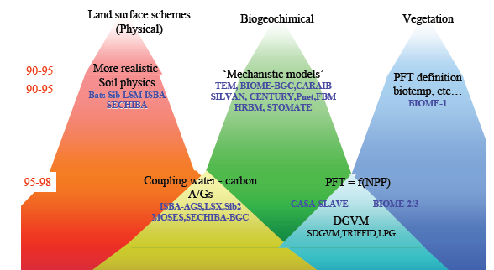
….models at different scales
Data for calibration, validation and forcing
Continent
Remote sensing
Country
Global models
National networks of permanent plots
National Forest Inventories (NFI)
Region
Forest
Spatialized models
3PG
CO2Fix
ForNBM
PnET; Lignum, GreenLab, G’Day, ForSafe, Castanea, GO+
Fagacée
PP3, E-Dendro
Stand
Comprehensive
sites
Tree and stand models
Tree
Empirical
Process-based
SAINT-ANDRE et al. / BIOGEOCHEMICAL CYCLES IN FOREST ECOSYSTEMS
01 / 07 / 2013

Slide 8


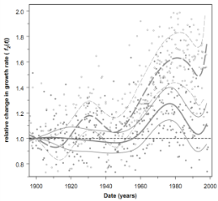
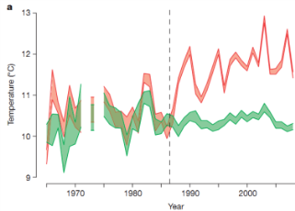
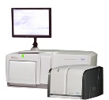
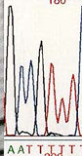
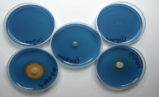
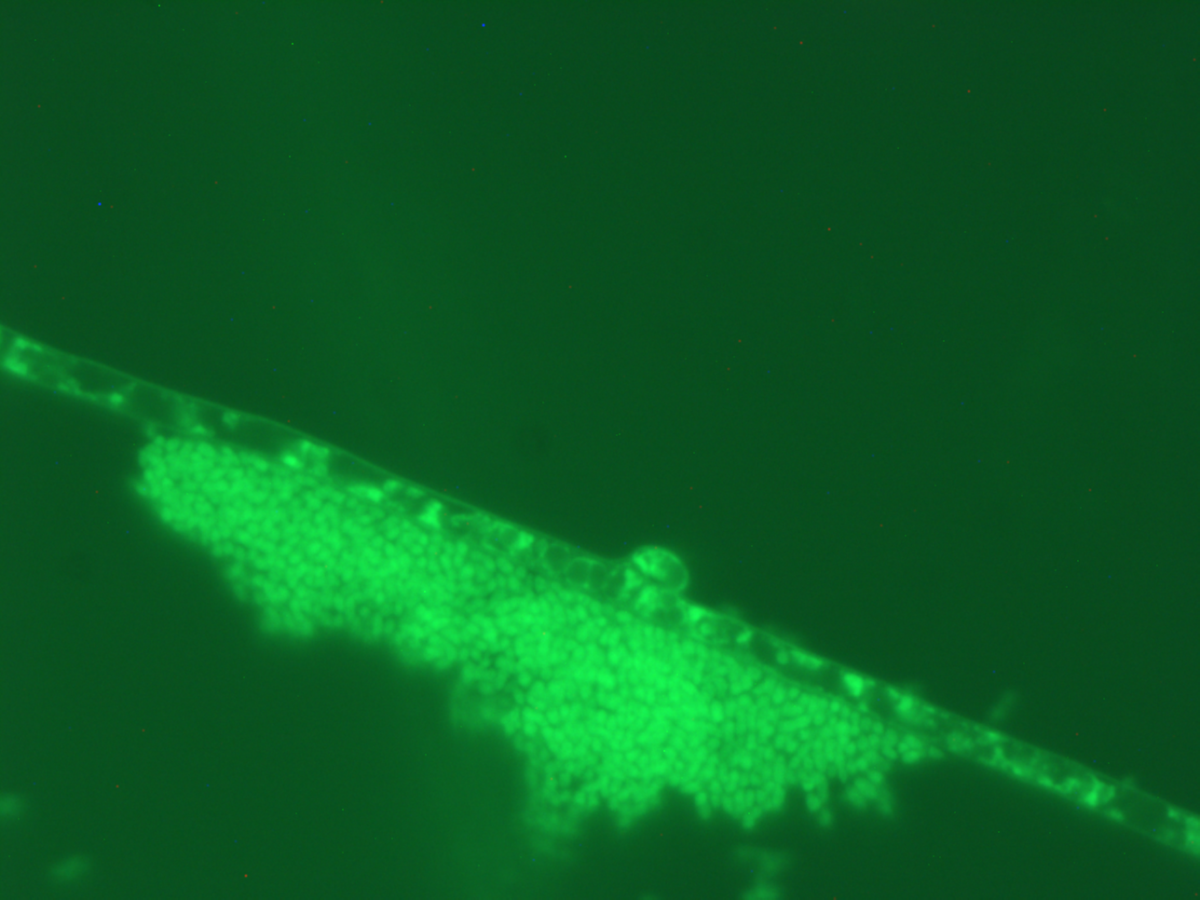
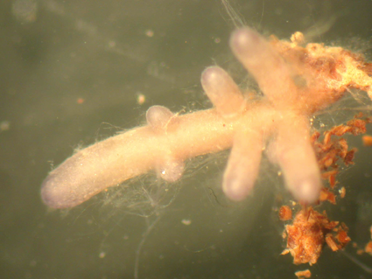
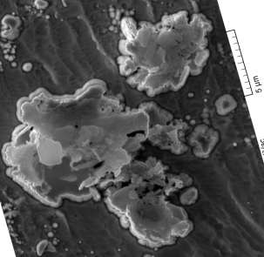
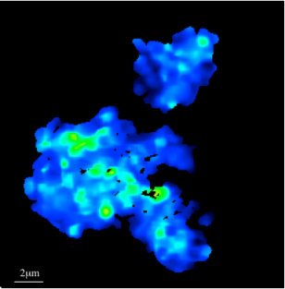
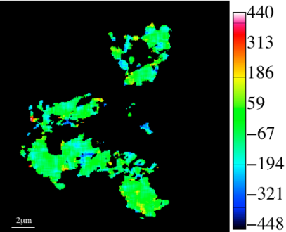
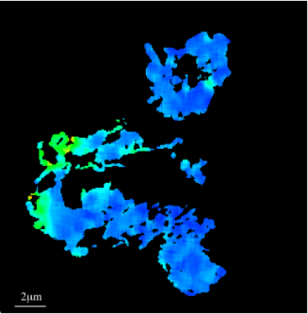
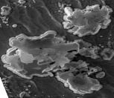
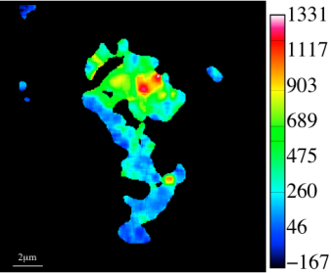


…. a strong disciplinary and inter-disciplinary settlement
Eco-physiology
Ecology of tree and stand growth
Niche en T°
EC : correlation
turbulente
Bio :
biométrie
Growth Index
Microbiology
Biogeochemical cycles, Soil science
SE images
C/N
δ¹³C (‰)
δ¹⁵N (‰)
9.9±0.1
36
130
638±20‰
800
27
90
600
18
50
400
10.9±0.1
9
10
200
2 µm
11.3±0.1
0
513±18‰
0
SAINT-ANDRE et al. / BIOGEOCHEMICAL CYCLES IN FOREST ECOSYSTEMS
01 / 07 / 2013

Slide 9



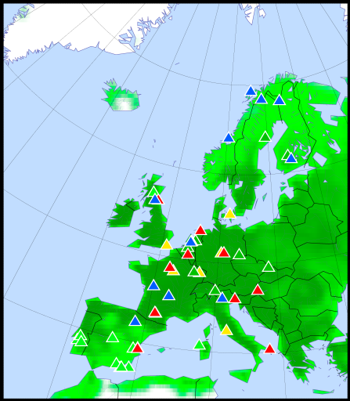
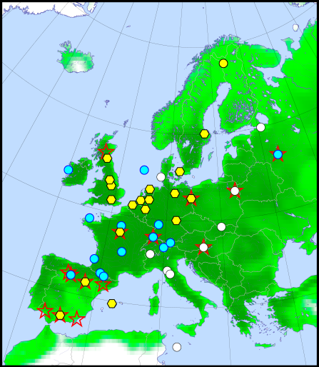
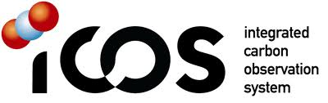


…. and collaborations through international networks
e.g. ICOS (Integrated Carbon Observation System)
Data and tools
Data and tools
Data and services
Ecosystem Thematic Center
Meta-information
Data for synthesis
Ecosystems (50 stations)
Atmosphere(30 stations)
SAINT-ANDRE et al. / BIOGEOCHEMICAL CYCLES IN FOREST ECOSYSTEMS
01 / 07 / 2013

Slide 10
_01
Snapshots on Carbon, water and balances in temperate and tropical forests
SAINT-ANDRE et al. / BIOGEOCHEMICAL CYCLES IN FOREST ECOSYSTEMS
01 / 07 / 2013

Slide 11
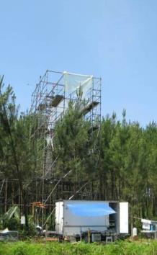
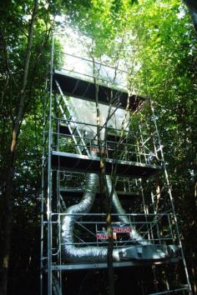
Carbon Allocation in Trees and Soil ANR-07-BLAN-0109
C.A.T.S. (Fontainebleau, Hesse, Landes), 13C Leaf Labeling
Beech, Sept 2008
Microbial
biomass
3 days
Time lag in soil
Beech: 12 ~ 32 h
Oak: 14 ~ 26 h
Pine: 39 ~ 110 h
Peak time in soil
Beech: 41 ~ 89 h
Oak: 38 ~ 89 h
Pine: 89 ~ 278 h
Epron et al. 2012,TREE PHYSIOLOGY 32(6): 776-798
Epron et al.2011 BIOGEOSCIENCES 8(5):1153-1168
SAINT-ANDRE et al. / BIOGEOCHEMICAL CYCLES IN FOREST ECOSYSTEMS
01 / 07 / 2013

Slide 12
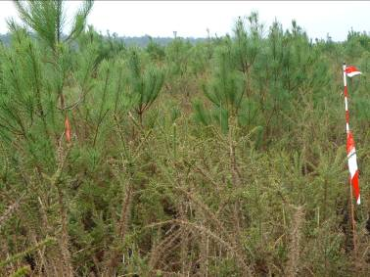
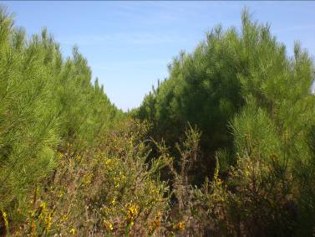
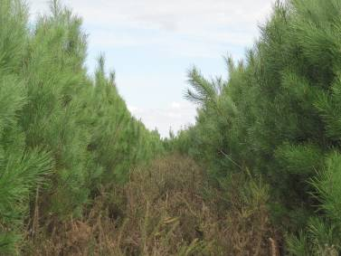
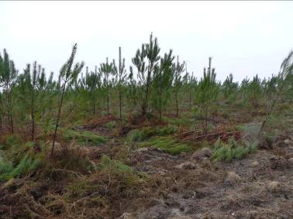
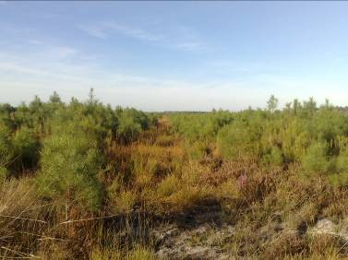
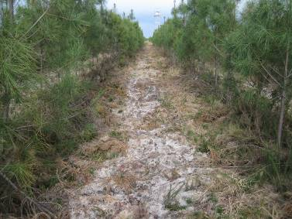
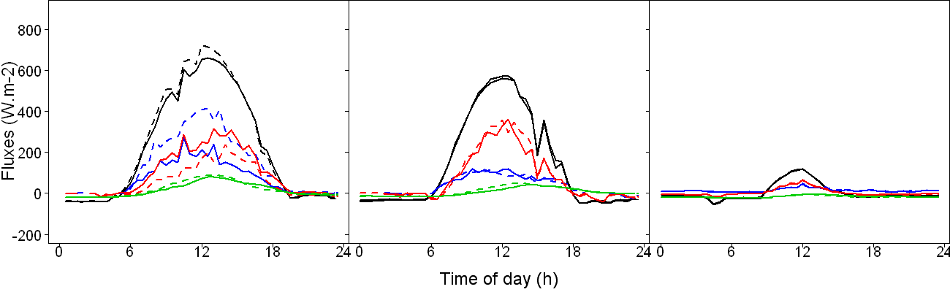
Impact of weeding and thinning on forest energy balance
Control
Moreaux et al. 2012
Tree Physiology
Weeded
Coll. Inra, U Grenade, U McQuarie Sydney
βw = 1.58
βc = 0.50
βw = 2.18
βc = 2.23
Rn
βw = 0.86
βc = 0.92
LE
H
G
SAINT-ANDRE et al. / BIOGEOCHEMICAL CYCLES IN FOREST ECOSYSTEMS
01 / 07 / 2013

Slide 13
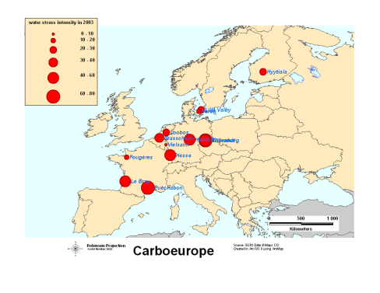


Carbon balance in different ecosystems, long term trends, and drought effects
Inter-annual variations of net C balance (Hesse site)
Average NEE: -3.9 ± 1.7 t_{C} ha⁻¹ an⁻¹
30% of GPP (or 60% of NPP) used for tree growth
High inter-annual variability (7 to 8 years are required to have a good idea of mean Reco; 5 years for GPP and 6 years for NEE
Increasing water deficit
Yearly variations of net C balance
Instrinsic water use efficiency at canopy scale
SAINT-ANDRE et al. / BIOGEOCHEMICAL CYCLES IN FOREST ECOSYSTEMS
01 / 07 / 2013

Slide 14


Evapotranspiration at continental scale - ICOS Ecosystem
Global average: 550 mm/yr
~ 60 Eg/yr (±10-15%)
(1Eg = 10¹⁸g ~ 1000 km³)
Map of mean Evapotranspiration from 1982-2008
Predicted vs. Observed ET at FLUXNET sites (10-fold cross-validation from MTE training)
Corroboration against river catchment water balances
Comparison against GSWP-2 land surface model ensemble (16 models) stratified according to bioclimatic zones
Evapotranspiration leveling off due to water limitation
Jung et al. 2010, Nature
SAINT-ANDRE et al. / BIOGEOCHEMICAL CYCLES IN FOREST ECOSYSTEMS
01 / 07 / 2013

Slide 15
_02
Snapshots on Nutrient cycling in forests
SAINT-ANDRE et al. / BIOGEOCHEMICAL CYCLES IN FOREST ECOSYSTEMS
01 / 07 / 2013

Slide 16



NanoSIMS Study of Organic Matter Associated with Soil Aggregates (Combination with STXM)
¹⁵N labelling of the litter
12 years after application:
NanoSims = localisation of 12C, 14N and 15N in the aggregates
STXM = chemical composition close to microbial componds
Coll. Inra, Mnhn, Cnrs
LBNL Berkeley, USA
Oregon State University, USA
Remusat et al. 2012
ENVIRONMENTAL SCIENCE & TECHNOLOGY
SAINT-ANDRE et al. / BIOGEOCHEMICAL CYCLES IN FOREST ECOSYSTEMS
01 / 07 / 2013

Slide 17
Interaction between N and Ca/P cycles
Rainfall
Douglas Fir (control)
30 years old
Douglas Fir (fertilized)
( Ca + P in 1979 and1983)
31
590
755
65
172
44
175
Ecosystem satured by N
Non-saturated Ecosystem
276
298
732
410
75
176
244
45
Role of microbes ?
4663
4239
331
126
kg.ha⁻¹.an⁻¹
353
107
NO3 µmol.L⁻¹
Norg
kg.ha⁻¹
363
55
Site F-ORE-T Breuil Morvan : m.e.p. M Bonneau et Coll. 1976
SAINT-ANDRE et al. / BIOGEOCHEMICAL CYCLES IN FOREST ECOSYSTEMS
01 / 07 / 2013

Slide 18



Measuring 44Ca/40Ca and 26Mg/24Mg in environmental samples from a tracer experiment using ICP-MS and TIMS
Monitoring in situ and measurement of isotopic ratios ²⁶Mg/²⁴Mg et ⁴⁴Ca/⁴⁰Ca (ICP-MS)
¹⁵N
⁴⁴Ca
²⁶Mg
²H
Humus, sol, biomasse microbienne
Pluie incidente, écoulement de tronc, pluviolessivats, solutions de sol
Racines fines, feuilles….
⁴⁴Ca Two years after application
Coll. INRA, MNHN, CNRS
University of Nevada, USA
Lund University, Sweden
James Hutton Institute, UK
Van der Heijden G., et al. 2013, Forest Ecology and Management
Van der Heijden G., et al. 2013, Geoderma
Van der Heijden G., et al. 2013, International Journal of Mass Spectrometry
Van der Heijden G., et al. 2013, Plant and soil
SAINT-ANDRE et al. / BIOGEOCHEMICAL CYCLES IN FOREST ECOSYSTEMS
01 / 07 / 2013

Slide 19




Measuring and modeling 15N, 42Ca and 26Mg movement in tree xylem from a tracer experiment using ICP-MS and TIMS
Concentration
g L⁻¹
_{4.3}
_{1.4}
_{2.1}
Isotopic enrichment
%
_{99.0}
_{79.0}
_{98.8}
Monitoring in situ (2 years) and measurement of isotopic ratios: δ15N, ²⁶Mg/²⁴Mg and ⁴²Ca/⁴⁰Ca (ICP-MS)
¹⁵N
⁴²Ca
²⁶Mg
_{Nitrate}
_{Calcium}
_{Magnesium}
Modeling of Ca transport in tree xylem (homothetic upsaling approach):
¹⁵N quickly transported
to foliage
by sap convection
⁴²Ca slowly transported successive cation exchanges along the xylem vessels
Coll. Inra,
Macaulay Institute, UK
US Forest Service, USA
Augusto L. et al. 2011, Annals of Forest Science.
EFPA funding
2 years
results confirmed by the model
SAINT-ANDRE et al. / BIOGEOCHEMICAL CYCLES IN FOREST ECOSYSTEMS
01 / 07 / 2013

Slide 20






Using radiotracers 32P and 33P to assess phosphorus nutritive status in forest soils
Batch experiments
(soil-solution suspensions with *P)
Incubation experiments
Greenhouse experiments
Modeling and Meta-analysis
Coll. Inra,
Tomsk Univ., Russia
Novosibirsk Univ., Russia
complete assessment of P nutritive status
Achat D.L. et al. 2009ab, 2010abc, 2011, 2012ab, 2013ab. Jonard et al. 2009, 2010. Trichet et al. 2009. Ann. For. Sci., Biogeochemistry, Biogeosciences, Ecol. Model., For. Sci., Geoderma, JSS, Soil Biol. Biochem., SSSAJ.
ACCAF Meta-Program
soil inorganic P
microbial P
water P
soil organic P
SAINT-ANDRE et al. / BIOGEOCHEMICAL CYCLES IN FOREST ECOSYSTEMS
01 / 07 / 2013

Slide 21

CONCLUSION
Large advances have been made
Next challenges –
Interaction between cycles,
Data model integration,
Robust service-related indicators,
Mapping of forest ecosystem services
But we are already on the road……. –
ESFRI road maps (ICOS, EXPEER)
LABEX (ARBRE, COTE, CEBA)
EQUIPEX (XYLOFOREST)
Infrastructure (ANAEE-S)
SAINT-ANDRE et al. / BIOGEOCHEMICAL CYCLES IN FOREST ECOSYSTEMS
01 / 07 / 2013

