Slide 1
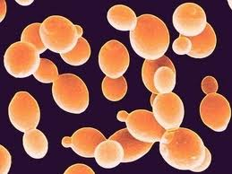
Phenotypic ANALYSIS and transcriptome PROFILING of Saccharomyces RESPONSE to medium chain fatty acidS
JL Legras , C Erny, C LeJeune, M Lollier, Y Adolphe, C Demuyter, P Delobel, B Blondin, F Karst
INRA UMR SVQV, Colmar,
INRA UMR SPO Montpellier,
UHA LVBE, Colmar

Slide 2
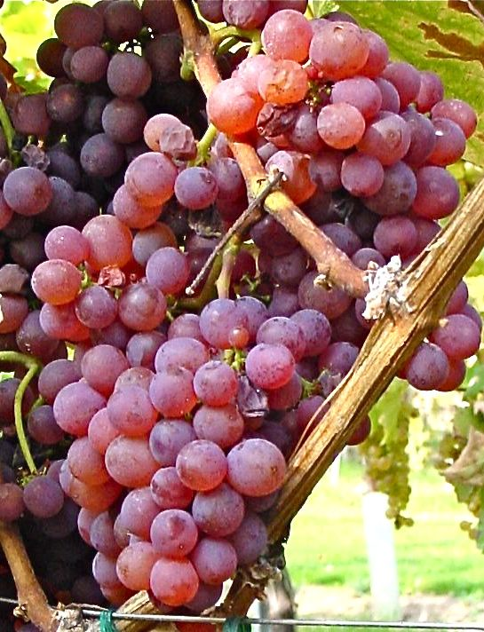
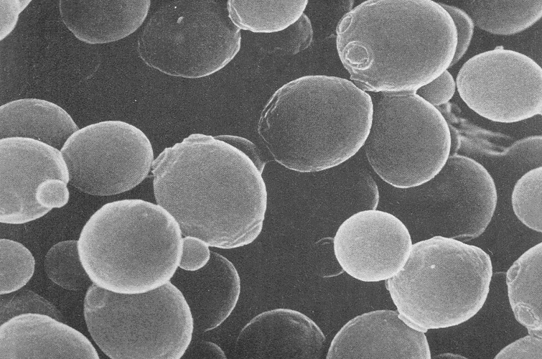
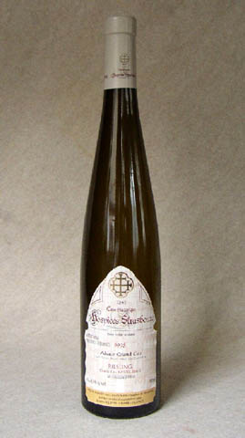
Fermentation
nn metabolites (esters …)
toxic compounds :
Medium chain fatty acids …

Slide 3
MCFA (medium chain fatty acids)
C8 : octanoïc acid
CH₃–(CH₂)₆-COOH
C10 : decanoïc acid
CH₃–(CH₂)₈-COOH
- Toxics for S. cerevisiae: fermentation inhibitors
R-COO⁻
H⁺
R-COOH
S. cerevisiae can adapt to MCFA
PDR12 induced by C8 (Hatzixanthis et al., Yeast 2003) but not involved in resistance (Holyoak et al., j Bact. 1999)
=> no clear mechanism of cell resistance

Slide 4
Wine yeast Resistance polymorphism to MCFA
C10 Resistance
80 wine strains tested on YPD containing AGCM
C8 Resistance
=> 2 partially overlapping mechanisms

Slide 5
Identification of S. cerevisiae genes involved in MCFA resistance
(Legras et al 2010 AEM)

Slide 6
Search of genes involved in resistance
Transcriptome
Analysis of all mRNA in cell at a specific time in a specific condition.
Step1 : synthesis of fluorescent labelled cDNA from each type of cell

Slide 7
genes involved in MCFA resistance
Transcriptome
Step2 : DNA microarray production
Microarray slide:
commercial array spotted with oligonucleotides (Eurogentec)

Slide 8
genes involved in MCFA resistance
Transcriptome
Step 3 : Hybridization
CCCGATC
GGGCTAG
CCCGATC
GGGCTAG
CCCGATC
GGGCTAG
GAATTCA
CTTAAGT
GAATTCA
CTTAAGT
GAATTCA
CTTAAGT
GGGAAAT
cDNA from the two conditions compete for hybridization on the probes

Slide 9
Genes involved in MCFA resistance
Transcriptome
Step 3 : Hybridization
orf 1
orf 2
orf 3
1
1
2
2
3
3
4
5
6
6
1000 spots per cm²
7
8
8
9
7
8
Condition 1
Condition 2
mRNA
mRNA

Slide 10
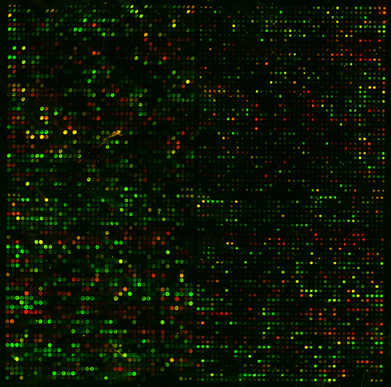
Genes involved in MCFA resistance
Transcriptome
Step 3 : microarray scan
fluorescence measurement for each fluoro phosphorescent compound (excitation at 2 different λ)
2 images one forCy5 the other for Cy3

Slide 11
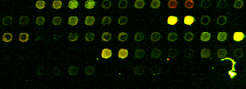
Genes involved in MCFA resistance
Transcriptome
Step 4 : data analysis
connect image data and genes iD (grid)
check for problems (artifacts dust, spot without signal, or saturated spots)
transformation of scanned image into numerical data

Slide 12
Transcriptome re-modeling after exposure to MCFA
wine strain U13 resistant to C8 andC10
4 independent cultures in three conditions
YPD + 0.05 mM C8 + 0.05 mM C10
Control C8 C10
RNA extraction after 20 min
comparison by pairs
- analysis : LIMA GUI package (R soft)
T
C8
C10

Slide 13
Transcriptome re-modeling after exposure to MCFA
81 genes activated by C8
620 genes by C10
71 genes by C10 to C8
(P-value 0.05 corrected FDR)
Responses with different intensities
log ratio : different threshold for each compound
0.3 pour C8
0.5 pour C10 to C8

Slide 14
Transcriptome re-modeling after exposure to MCFA
210 are activated in at least one condition
C8 / Control
C10 / Control
22
8 +
14 -
39 28 +
11 -
81 : 28 +
53 -
14
11+
3
0
33 : 19+
14-
22 : 13+
9-
C10 / C8

Slide 15
Functional categories of genes modulated MCFA (funspec website)
C8 and C10 activate genes shared by the same categories and C10 response involve more genes involved in RNA processing.

Slide 16
Comparison with other stress
Stress | Percentage of genes shared between the different responses
number of genes involved | 75 | 165 | 137 | 548 | 342 | 621 | 463 | 132 | 69 | 172 | 267 | 936
in each response
C8 acid | 100
C10 acid | 71 | 100
Sorbic acid | 29 | 19 | 100
POELE 1mM | 43 | 31 | 43 | 100
DCP 3mM | 19 | 22 | 20 | 28 | 100
Octanol 1% | 0 | 23 | 18 | 14 | 19 | 100
SDS 1% | 45 | 39 | 26 | 21 | 20 | 21 | 100
Fluphenazin | 12 | 17 | 12 | 26 | 27 | 17 | 37 | 100
Benomyl 7mM | 12 | 14 | 12 | 17 | 25 | 16 | 23 | 13 | 100
2,4 Dichlorophenoxyacetic acid 3mM | 16 | 14 | 17 | 20 | 13 | 15 | 21 | 11 | 6 | 100
Oleic acid | 7 | 6 | 8 | 8 | 10 | 6 | 17 | 16 | 12 | 5 | 100
H₂0₂ 3mM | 52 | 47 | 42 | 27 | 35 | 23 | 40 | 38 | 41 | 30 | 22 | 100
Both responses share many genes with oxidative stress response, and with sorbic acid and SDS stress.

Slide 17
Genes involved in each response
PDR12 transporter has the highest induction level for C8 (* 3,5)
The transporter TPO4 is highly activated (* 3,2). Others transporters are induced : TPO1 , PDR12.
Activation of ethyl ester synthesis EEB1, FAA1 , ELO1

Slide 18
Phenotypic evaluation of candidate genes
YPD Control
YPD
0.6mM C8
YPD
0.25mM C10
YPD Control
YPD
0.6mM C8
YPD
0.25mM C10
By4741
Δtpo3
Δsnq2
Δtpo2
Δyor1
Δtpo1
Δnft1
Δpdr12
Δpxa2
Δpdr12
Δtpo1
Δtpo4

Slide 19
Conclusions
PDR12 and TPO1 are responsible for cell resistance to C8 and C10 respectively
Other transporters can increase C10 resistance but in a lower extent
Ethyl ester synthesis is activated and contributes to MCFA resistance

Slide 20
Transcription factors involved in MCFA adaptation and resistance

Slide 21
Transcription factors involved in MCFA response
http://www.yeastract.com/index.php

Slide 22
Transcription factors involved in MCFA response
From Yeastract

Slide 23
Phenotypic evaluation of TF regulating the responses
YPD témoin
YPD
0.6 mM C8
YPD
0.25 mM C10
Involvement of WAR1 PDR3 (confirmed) and PDR16 for C8
Involvement of PDR1 and at a lower level MSN2 and YAP1 for C10
By
Δpdr1
Δpdr3
Δpdr1/
Δpdr3
Δwar1
Δyap1
Δyap2
Δpdr16
Δmsn2
Δmsn4
Δmsn2/
Δmsn4

Slide 24
Conclusion: global view of MCFA response
HXT7
HXT6
Sugar
metabolism
Amino acids
metabolism
C14-CoA
C8
ELO1
EEB1
C10
Respiration
C12-CoA
Nucleus
ELO1
Éthyl-C14
C10
C10-CoA
EEB1
SNQ2
C10
FAA1
EEB1
Éthyl-C12
C10
TPO4
Éthyl-C10
C10
C8
C8
TPO1
PDR12

Slide 25
Acknowledgement
Colmar
INRA University of Strasbourg UMR SVQV Oenologie
A. Alais
F. Karst
J.L. Legras
University de Haute Alsace LVBE
C. Erny
C. Le Jeune
M. Lollier
C. Demuyter
Montpellier
INRA SupAgro UMR SPO
B. Blondin
P. Delobel
Deletion strains
F. Devaux
C. Rodrigues - Pousada
Multumesc !!!

